Slide 1
Climate and socioeconomic drivers of land-cover and land-use change in tropical Andean alpine wetlands Final Report: July 2015 – July 2019 Supplemental Figures

Slide 2
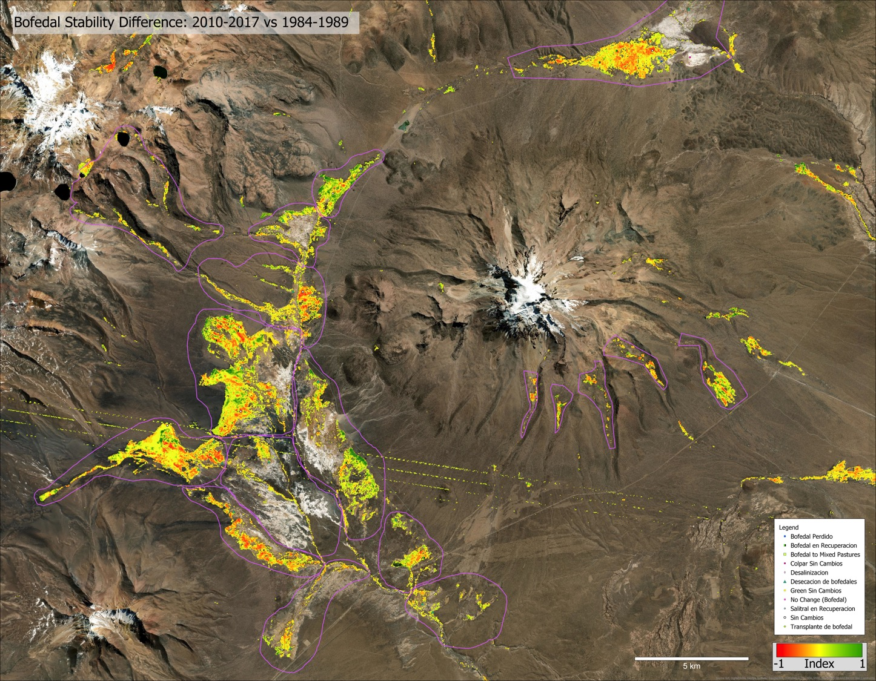

Slide 3
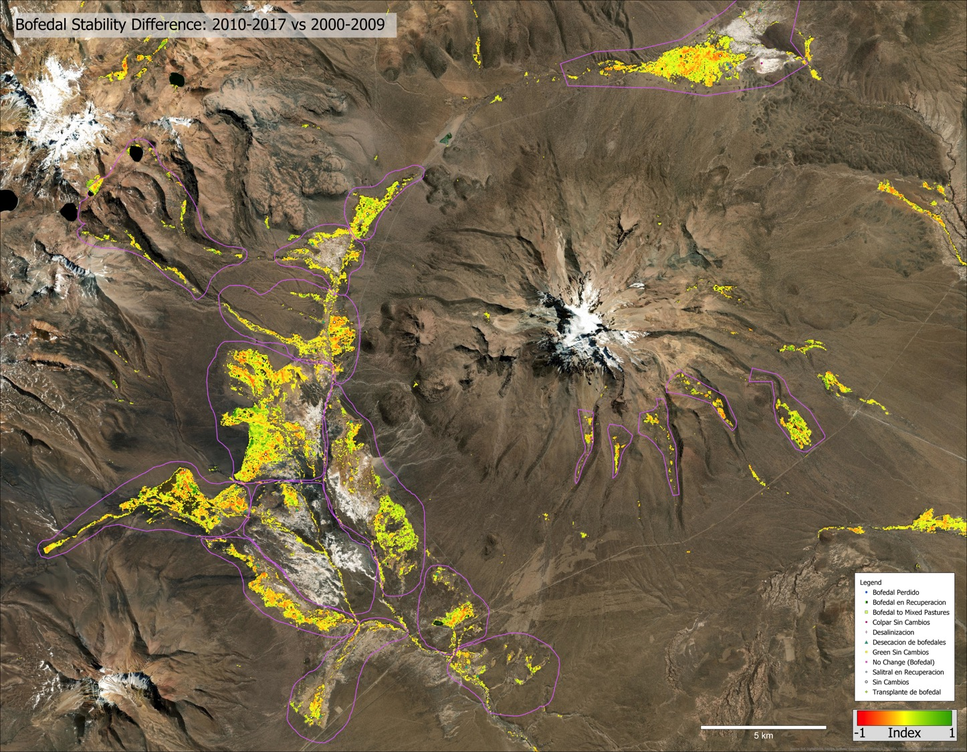

Slide 4
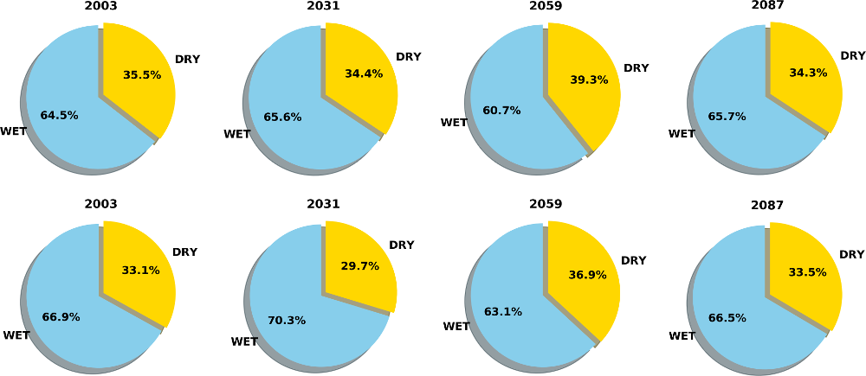
Annual Precipitation wet vs dry season
Composite (4-member average) contribution to annual precipitation over entire region
Sajama more dependent upon wet season for annual precipitation (up to 4.6%) than Altiplano
Future precipitation contributions show no consistent bias towards either the wet or dry season.
Changes in precipitation amounts however do achieve significance (next slide)
P & B Altiplano
Sajama
Notes:
2003 data are derived only using model simulations ingesting global climate model (GCM) historical scenario data. This does NOT include any actual observations.
P + B Altiplano = Peruvian + Bolivian Altiplano
Sajama = Entirety of Sajama National Park
Annual period starts in October of year shown. For example, 2003 covers the period Oct. 1, 2003 – Oct. 1, 2004
Wet season: Nov 1 – Mar. 31
Dry Season: Apr. 1 – Oct. 1
Model simulation information:
Model name: Coupled Ocean Atmosphere Wave Sedimentation Transport modelling system (COAWST) – Ocean-Atmosphere model coupling (Atm: WRF, Ocean: ROMS)
Model resolution: 9-km grid spacing. Good enough to explicitly capture convective systems, not capable of capturing individual thunderstorms
Model members: Four separate COAWST simulations, where each uses a difference global climate model (GCM) as input
Global climate models: CCSM4, GFDL-ESM2M, IPSL-CM5A. MIROC5. GCM selection was based upon capturing the widest possible spectra of model simualtions in light of limited computational resources
Climate scenario: Regional Climate Pathway (RCP) 6.0. 6.0 denotes change in top of atmosphere longwave ration flux by the year 2100. I also tested RCP 4.5 and 8.5 using MIROC5 for 2003. There results did not compare as favorably to the Tropical Rainfall Measuring Mission (TRMM) precipitation product as RCP 6.0

Slide 5
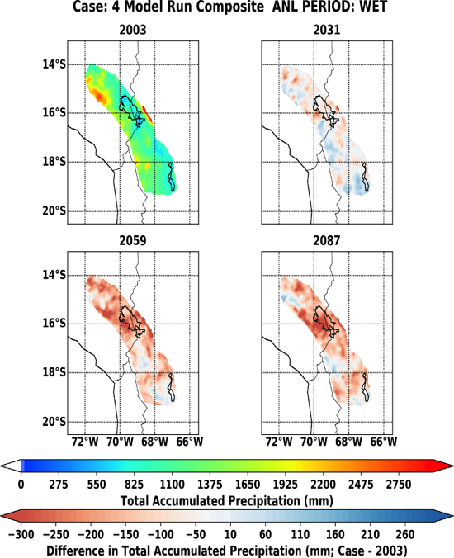
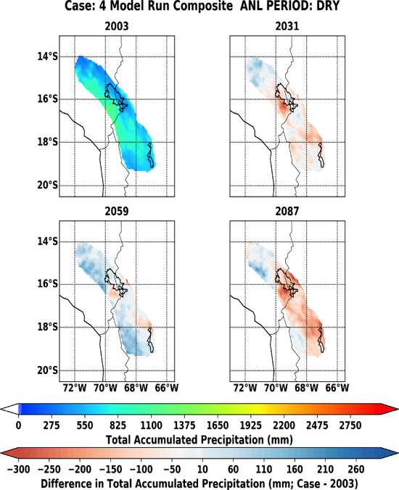
Annual Precipitation wet vs dry season
4-simulation composite average of wet (left) and dry (right) season precipitation and their difference relative to 2003.
Altiplano: Precipitation differences are significant (p-value < 0.05) in all but the 2031 wet season
Sajama: No local statistical significance. Like due to only 8 grid points within the park
General decrease in precipitation amounts (up to 300 mm) for most regions of the Altiplano (including Sajama)
Average precipitation rates however are predicted to increase (up to 0.5 mm/hr), but with fewer total precipitating events
Notes:
T-test numbers based upon Welch’s t-test, which does not assume equal population variance
Shown region is entire Peruvian + Bolivian Altiplano
Wet season: Nov 1 – Mar. 31
Dry Season: Apr. 1 – Oct. 1
Model simulation information:
Model name: Coupled Ocean Atmosphere Wave Sedimentation Transport modelling system (COAWST)
Model resolution: 9-km grid spacing
Model members: Four separate COAWST simulations, where each uses a difference global climate model (GCM) as input
Global climate models: CCSM4, GFDL-ESM2M, IPSL-CM5A. MIROC5

Slide 6
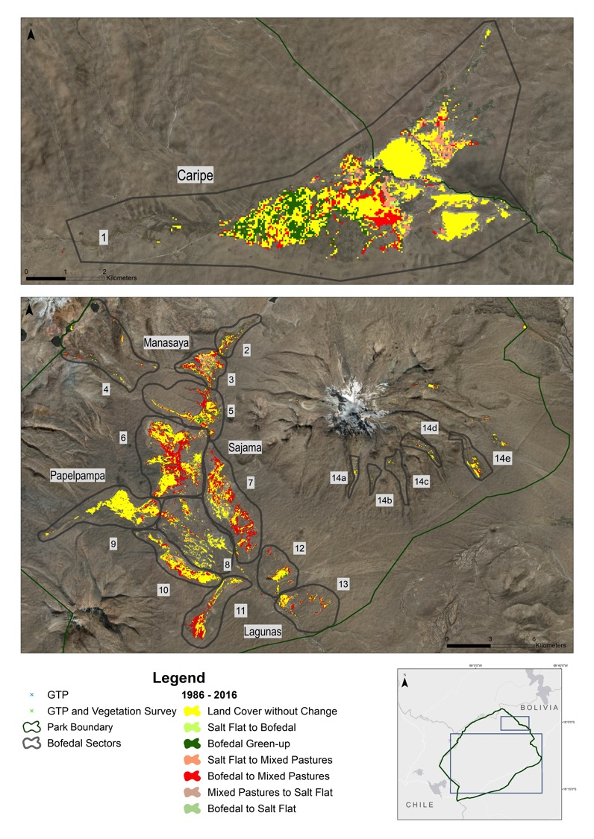
Land cover change map 1986 to 2016 and location of vegetation field survey and groundtruth points.
Numbered zones of land cover change in bofedal sectors are listed in Table 1 in report.

Slide 7
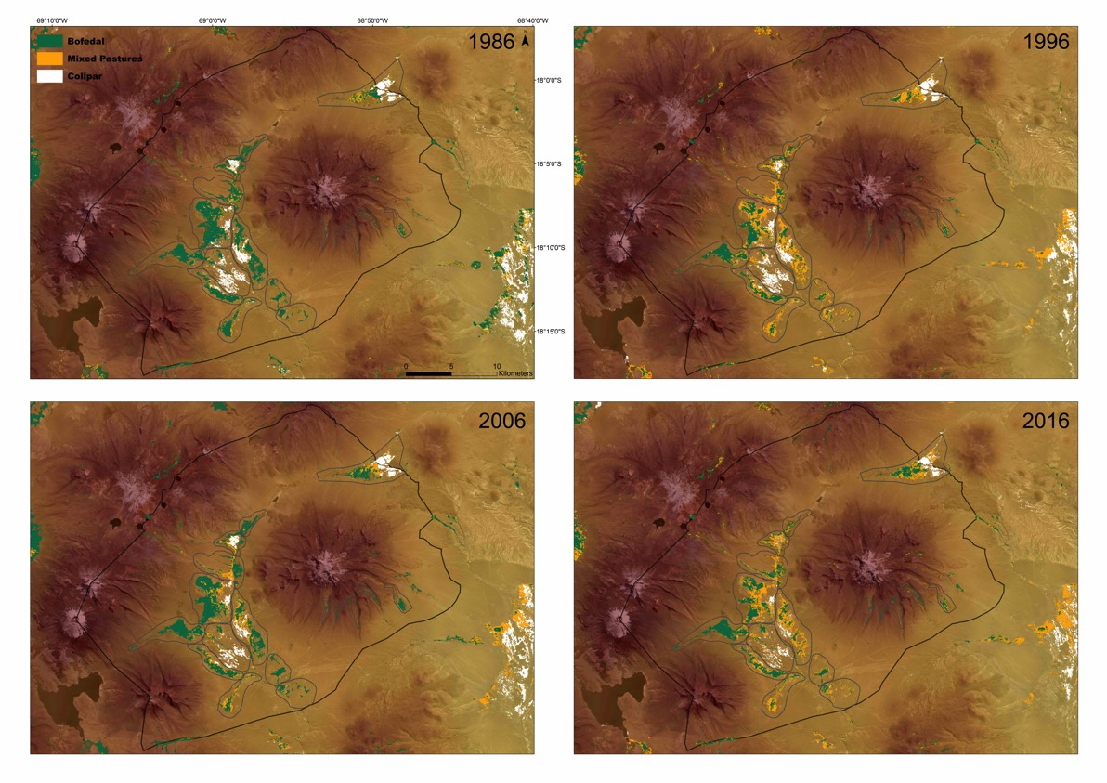
Land cover maps of three pasture classes (healthy bofedales, dry bofedales/mixed pastures, and collpares) in 1986, 1996, 2006 and 2016 in Sajama National Park.

Slide 8
Livelihoods, Life Cycle, Capitals and Access to Water Variables in the Cluster Analysis (stats, n=83)
Household Survey Analysis
Variable | Min | Max | Mean | SD
Income/Earnings (bolivianos/ $1=6.85Bs) | 2,725 | 193,020 | 39,205 | 35,703
Age Head of Household (years) | 23 | 80 | 53.47 | 13.86
Education Head of Household (years) | 0 | 18 | 6.80 | 4.42
Adult Equivalents (labor available at HH) | 0 | 5.47 | 1.61 | 1.13
Number of families sharing the sayaña | 1 | 4 | 1.86 | 0.73
Number of alpacas (head) | 0 | 400 | 90.53 | 74.39
Number of llamas (head) | 0 | 300 | 61.72 | 65.13
Sources of Water Index (3 is worse) | 1 | 3 | 1.57 | 0.72
Irrigation Index (higher worse) | 1 | 3 | 1.31 | 0.66
Water Access Difficulties Index (higher worse) | 1 | 3 | 2.64 | 0.65

Slide 9
Socio-economic data: Four clusters represent different livelihood strategies impacting peatland management
 | CL1 | CL2 | CL3 | CL4 | p-value
Income/Earnings (bolivianos/ $1=6.85Bs) | 39,434 | 26,690 | 49,594 | 37,161 | 0.7251
Age Head of Household (years) | 64.69 | 61.42 | **36.68 | *50.85 | 0.0000
Education Head of Household (years) | 4.5 | 4 | 7.95 | **9.54 | 0.0000
Adult Equivalents (weighted) (labor available at HH) | 1.5 | 1.9 | 1.25 | 1.84 | 0.2896
Number of families sharing the sayaña | 1.96 | 1.5 | **2.58 | *1.38 | 0.0000
Number of alpacas (head) | 99.62 | 70.83 | 71.42 | 104.5 | 0.1072
Number of llamas (head) | **102.19 | 20.42 | 60.32 | 41.35 | 0.0001
Sources of Water Index | 1.58 | 1.25 | 1.68 | 1.62 | 0.4194
Irrigation Index | 1.15 | 1.08 | 1 | **1.81 | 0.0003
Water Access Difficulties Index | 2.96 | *1.5 | **2.42 | 3 | 0.0000
Number of households in cluster | 26 | 12 | 19 | 26

Slide 10
Distribution of socio-economic clusters in Sajama National Park by community

