Slide 1





The South/Southeast Asia Research Initiative (SARI)
Update
Krishna Prasad Vadrevu
NASA MSFC

Slide 2
Presentation topics
Background to the SARI initiative
Regional science issues from the SARI meetings (2015-2016)
SARI next steps

Slide 3
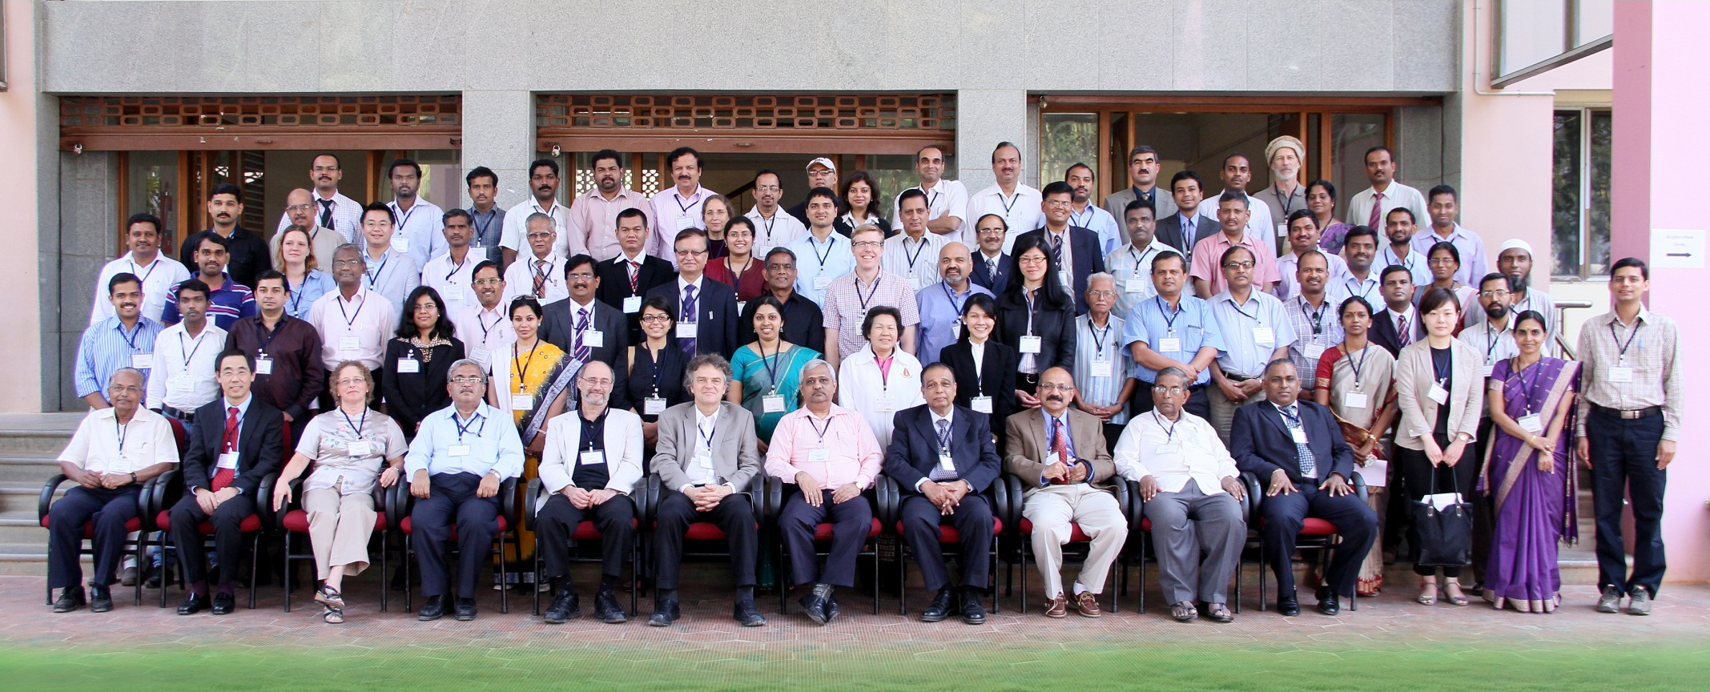
How it started - strong interest in a SARI from local scientists
Jan-10-13th, 2013-Regional Science Meeting, Coimbatore
Total participants =120
US – 18 researchers
Nepal-3; Srilanka-2; Myanmar-1; Afghanistan, Myanmar, Bangladesh-1 each
Pakistan, China invited but could not attend – Visa issues
India – University Researchers, Government, Non-Government, NGO’s

Slide 4
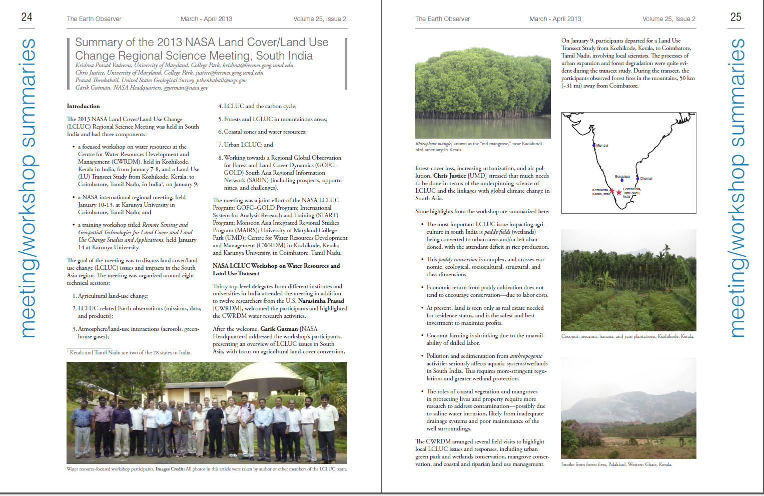
Meeting Summary-The Earth Observer
March/April 2013
http://eospso.gsfc.nasa.gov/eos_homepage/for_scientists/earth_observer.php

Slide 5
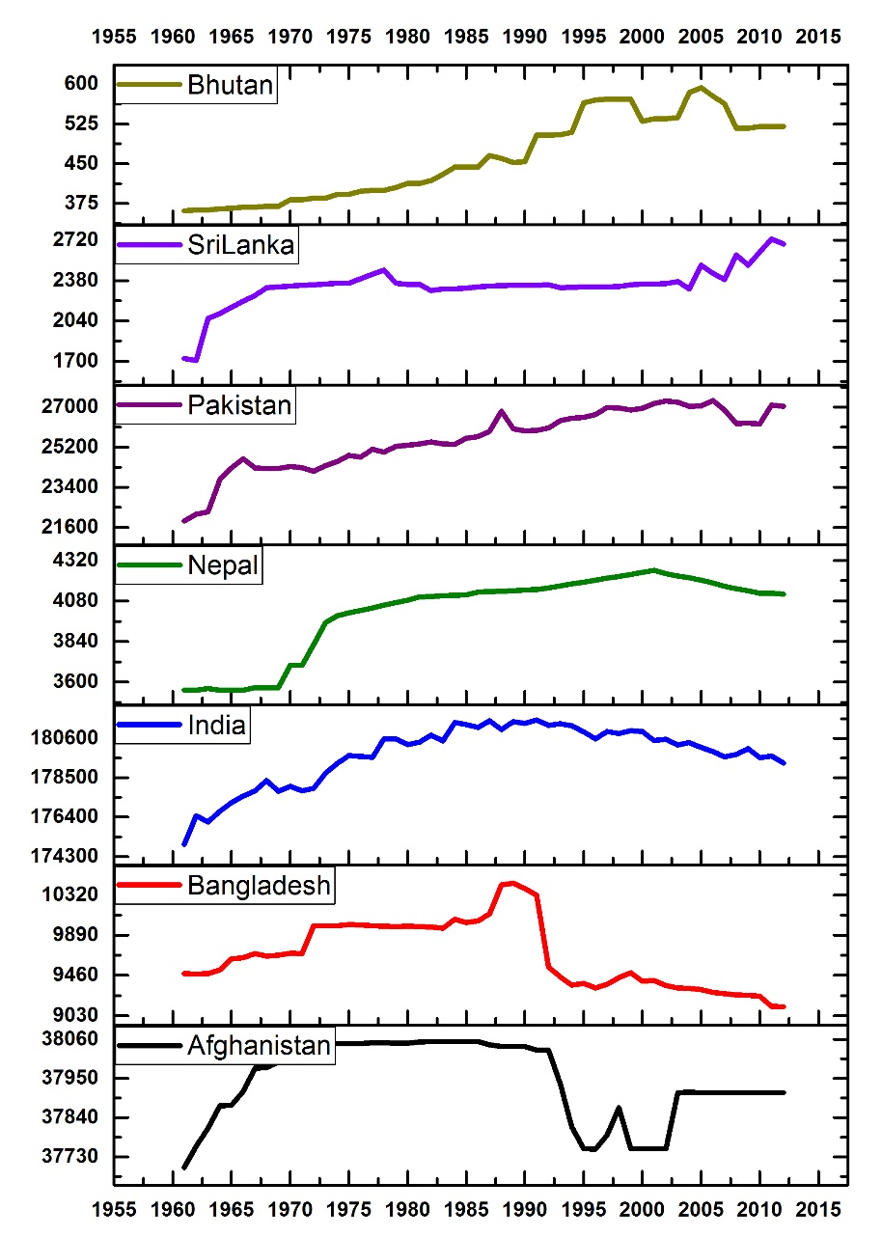
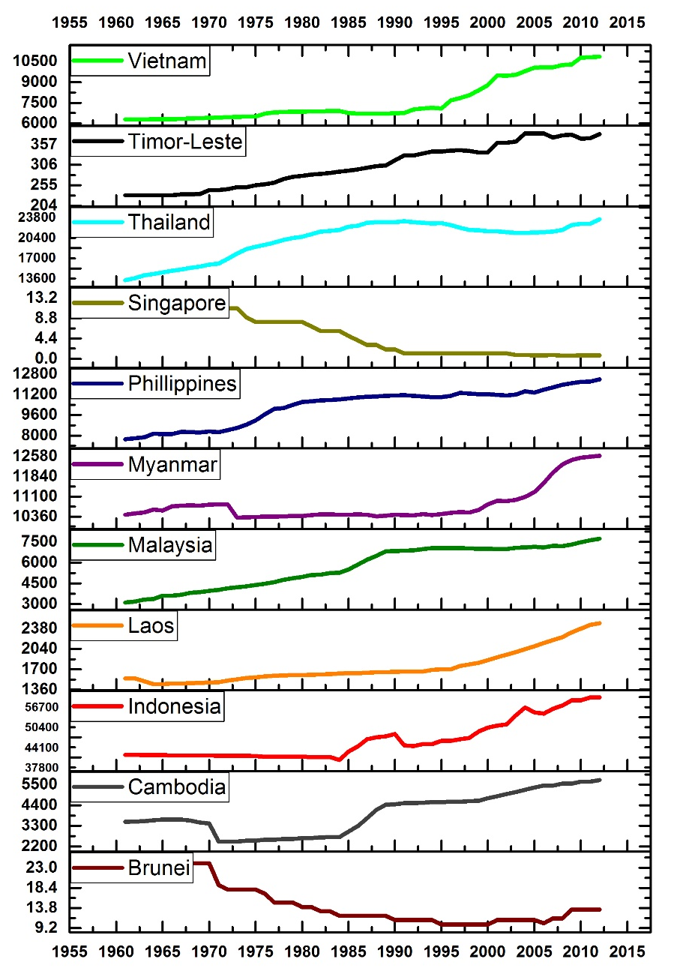
Agricultural land use in South/SE Asia
Significant increase in Agricultural Land Area (x 1000ha) in Several South and Southeast Asian Countries
Vadrevu et al., 2017, ERL (in press)
Data Source: FAO, 2015

Slide 6
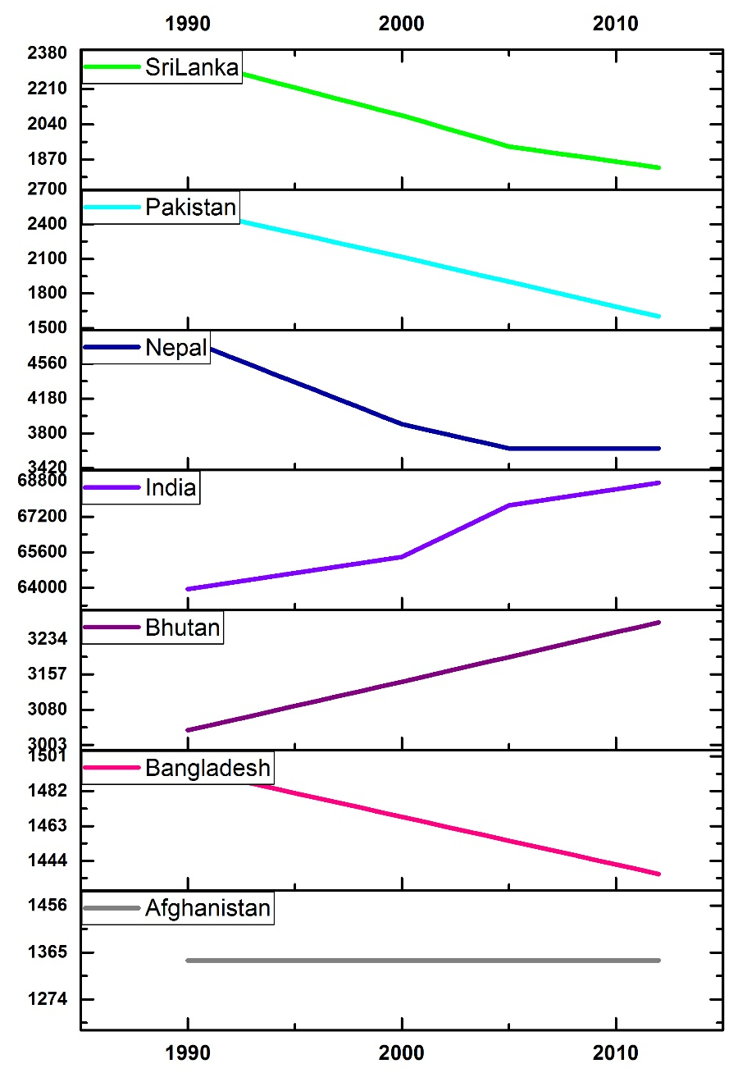
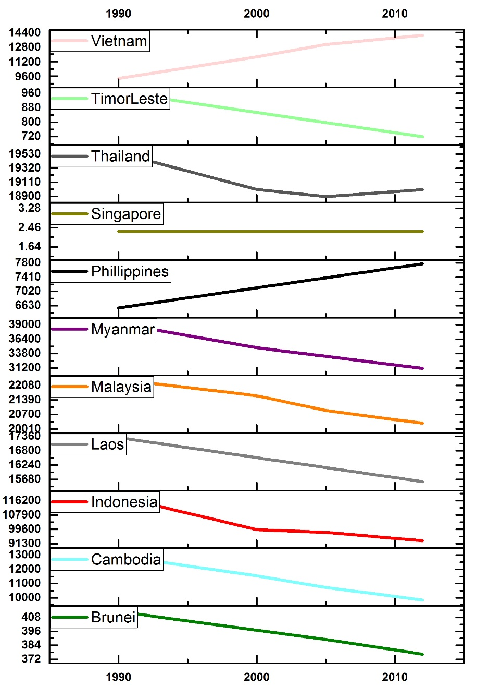
Forest Area in South/SE Asia
Significant decrease in Forest Area (x 1000ha) in Several South and Southeast Asian Countries
Vadrevu et al., 2015, ERL (in Press)
Data Source: FAO, 2015

Slide 7
SARI - Goal
To develop an innovative research, education, and capacity building program involving state-of-the-art remote sensing, natural sciences, engineering and social sciences to enrich LCLUC science in South/Southeast Asia.

Slide 8
Regional Science Issues – Inputs from SARI Workshops

Slide 9
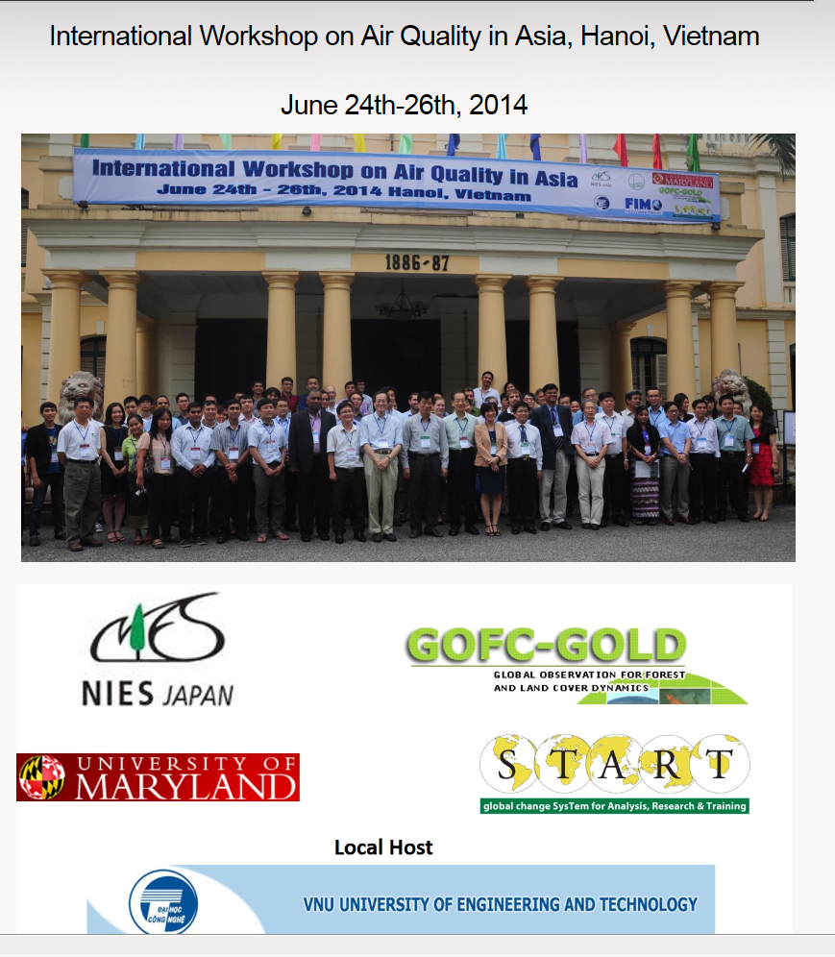
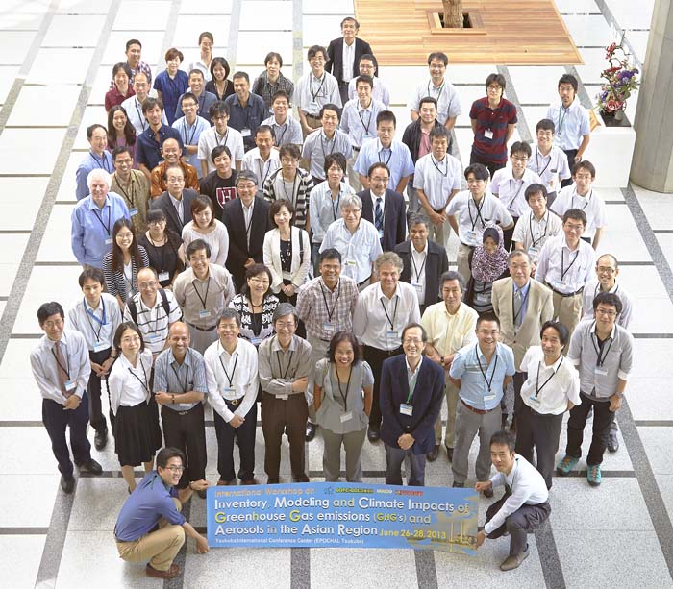
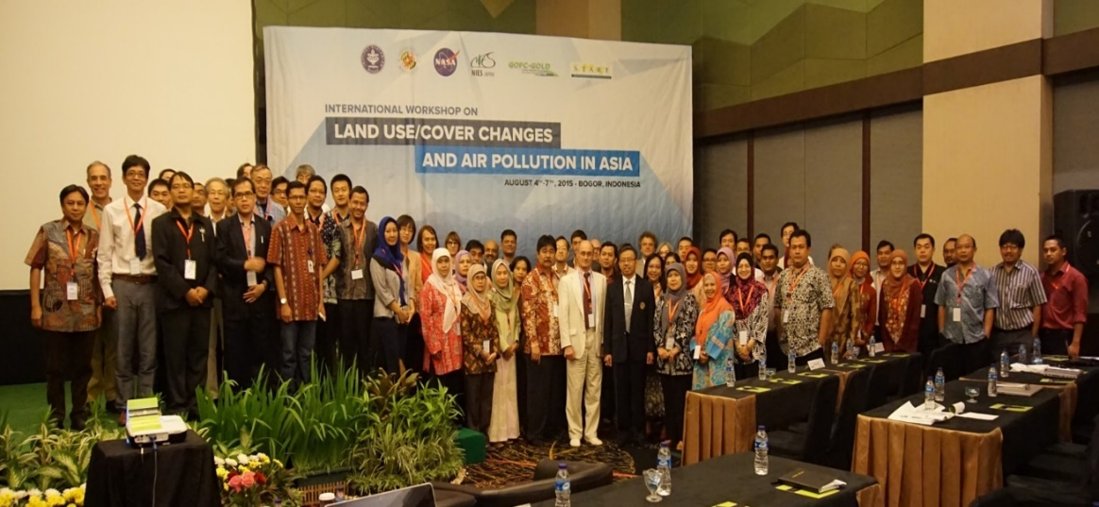
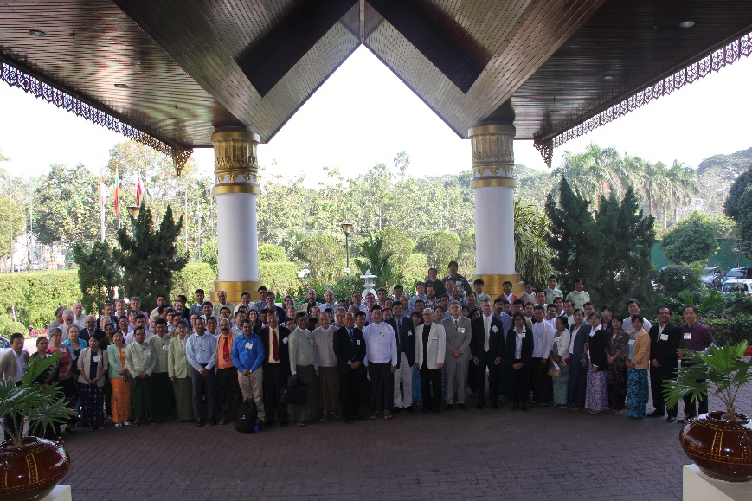
SARI meetings - funded by NIES, Japan and several other international, regional and local partners

Slide 10
2015-2016 LCLUC South Asia Projects
Forests
Spatiotemporal Drivers of Fine-Scale Forest Plantation Establishment in Village-Based Economies of Andhra Pradesh
Consequences of Changing Mangrove Forests in South Asia on the Provision of Global Ecosystem Goods and Services
Complex Forest Landscapes and Sociopolitical Drivers of Deforestation - The Interplay of Land-use Policies, Armed Conflict, and Human Displacement in Myanmar
Impacts of Afforestation on Sustainable Livelihoods in Rural Communities in India
Tropical Deciduous Forests of South Asia: Monitoring Degradation and Assessing Impacts of Urbanization

Slide 11
2015-2016 LCLUC South Asia Projects
Agriculture and Food security
Landscapes In Flux: The Influence of Demographic Change and Institutional Mechanisms on Land Cover Change, Climate Adaptability and Food Security in Rural India
The Future of Food Security in India: Can Farmers Adapt to Environmental Change?
Understanding Changes in Agricultural Land Use and Land Cover in the Breadbasket Area of the Ganges Basin 2000-2015: A Socioeconomic-Ecological Analysis
Urban
Urban Growth, Land-Use Change, and Growing Vulnerability in the Greater Himalaya Mountain Range Across India, Nepal, and Bhutan
Human Health
Understanding the Role of Land Cover/Land Use Nexus in Malaria Transmission Under Changing Socio-Economic Climate in Myanmar

Slide 12
Agriculture
Long- term Food Security is a major concern for the region;
Agricultural production and land use is changing
  Crop water requirements;
  Extreme events (flooding and drought (almost every year!)
  Adaptation options needs to be explored to address food security questions
RS data needed to monitor agriculture (within season) and forecast crop production (integrating Landsat+ Sentinel + other high resolution data);
Transitioning from research to operational research
  3-year research projects (eg: 6-different teams working on Rice mapping in Mekong; coordination required and transitioning from research to operations;
    Crop type and area statistics
    Production estimates
    Yield forecasting
      GEOGLAM working on some of the above activities.

Slide 13
Water Resources
Water management policies and systems need to be enhanced to accommodate the current and future trends (extreme events, limited flow, ground water management)
Shortage of freshwater because of urbanization, agriculture and aquaculture; Nutrient and pesticide residue issues need attention;
Inconsistent data at national and regional data on water resources; Upstream countries need to share data more effectively;
Data on water quantity and water quality including sediment transport; subsidence, change of water bodies (RS for mapping/monitoring); Need for more detailed at temporal scale on water resource datasets;
Science results need to be communicated to decision makers.

Slide 14
Urban Environments
Rapid Urban Change in this region including mega cities - some planning
  But largely uncontrolled development and industrial infrastructure– displacing rural communities
Traffic and pollution unprecedented – with human health impacts;
How infrastructure can cope up with the sewage/drainage/flooding related issues); Urban development tied to health/diseases – thus need attention;
Need for timely monitoring and transparency (satellite based approaches still not robust!)
Need for land zoning to update land records;
Comprehensive urban planning is a challenge but very much needed.

Slide 15
Emissions Inventories and GHG’s
Policy mandate – national contribution (Intended Naturally Determined Contributions (INDC’s) – MRV;
Underlying data sets still in development especially w.r.t AFOLU – forestry and agriculture (inventory) (eg: Cambodia almost no GHG data); Vietnam no standardized methodologies;)
Need for enhanced national GHG monitoring systems
  Using Instrumentation and integrating satellite remote sensing data;
  Robust methodologies to develop spatially explicit GHG inventories;
  Emissions data linking with public health.
Need a closer partnership with policy formulation community to inform the policy development;
Training on GHG inventory expertise is needed for the country; Need for capacity building and training in air pollution inventory methodologies.

Slide 16
Data and Analysis
Many Data Management Challenges (many countries yet to develop Spatial Data Infrastructure (SDI)
  Need for adequate funding and Efficiencies can be made at the national level (data stewardship)
  Cloud computing and Private Clouds offer an opportunity – IT/Science partnerships
Priority for high resolution datasets; time series analysis at large spatial scales in LCLUC;
Metadata is poor (data quality is always questionable);
Need authentic data (to be approved by Govt; otherwise, it becomes to difficult to convince the results);
Data transfer/sharing mechanisms;.
Transitioning the data to users in a useful manner is very important (eg: SERVIR application projects; GEOGLAM crop monitor;)

Slide 17
SARI Priority
Involving National Researchers and Practitioners – Universities, Institutes and Operational Agencies;
Strong emphasis on Applied Research with regional / national societal applications and benefits.
Facilitate strengthening regional/national projects through co-design and collaborations;

Slide 18






























Collaborations are the Key !

Slide 19
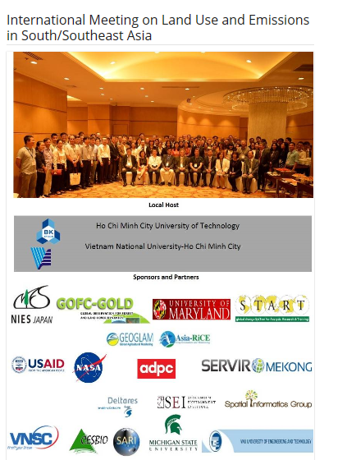
October, 2017
Total Meeting Participants =140
Training Participants = 90
3-Day Meeting
3-Day Training
including tea/coffee breaks + lunches

Slide 20






22-different institution contribution
Ho Chi Minh City University of Technology
Vietnam National University-Ho Chi Minh City
22 different institutions/programs – Collaborations are the key to success !

Slide 21
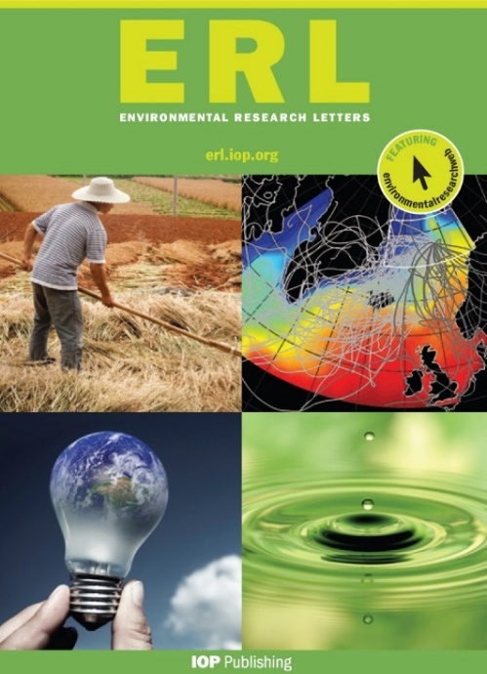
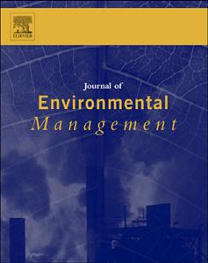
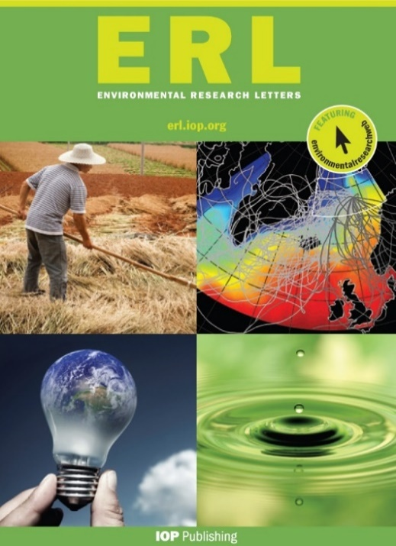
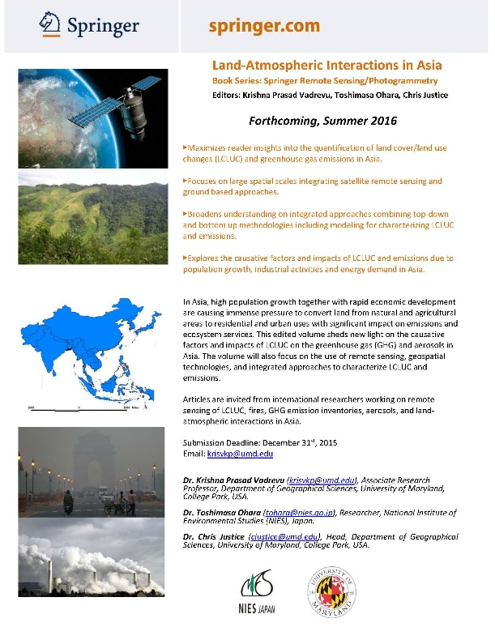
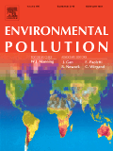
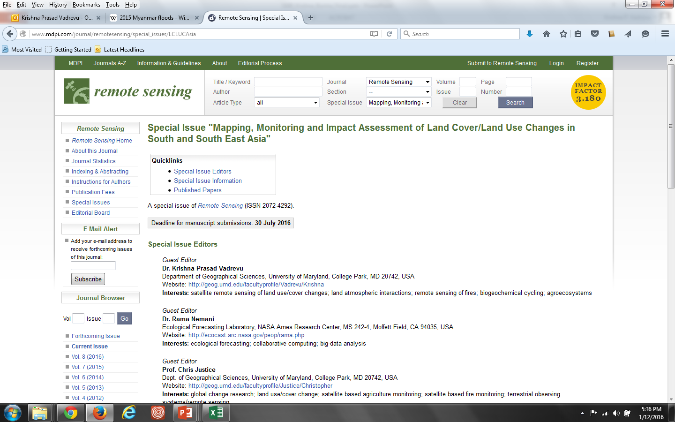
SARI - Peer Reviewed Publications
Volume-I
Volume-II

Slide 22
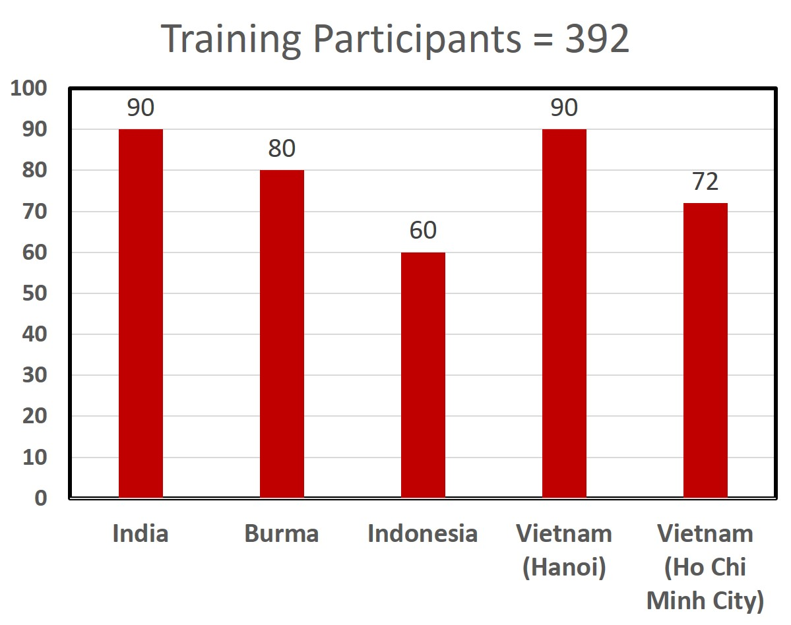
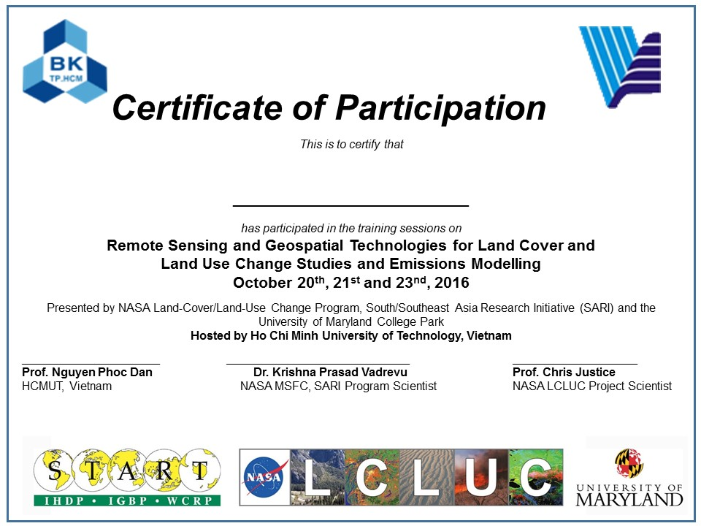
SARI Outputs-2015-2016-2017 (in just 2.5 years)
SARI Peer Reviewed Publications: 102
NASA LCLUC South Asia projects just started (March-1, 20177)

Slide 23
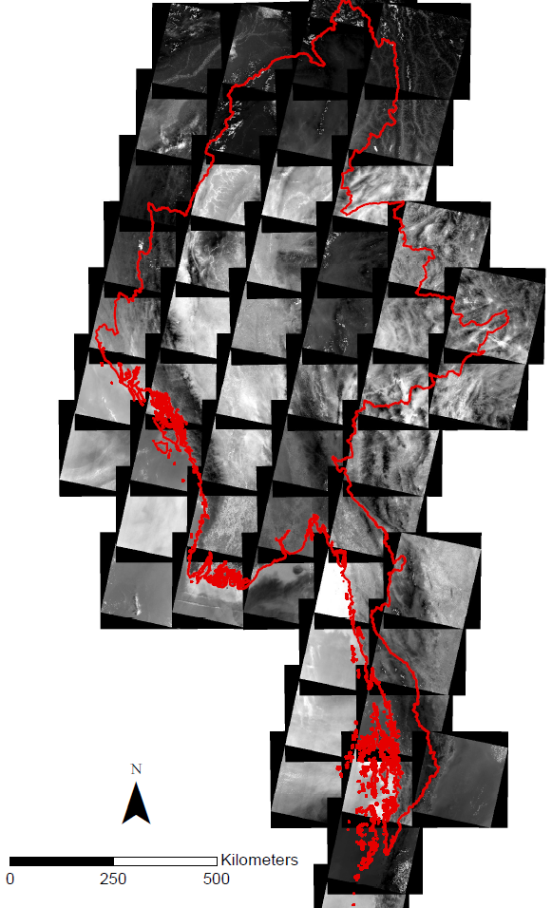



FREE LANDSAT-8 DATA
Landsat images for the whole country of Myanmar Images from Landsat 8 for the period of January-March, 2015.
LANDSAT-8 – 2015 – CLOUD FREE IMAGES

Slide 24
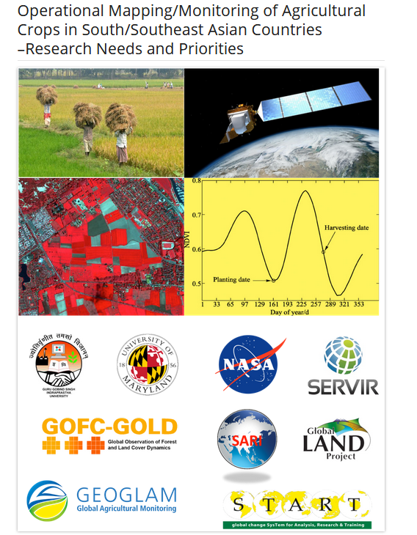
Dates: May 2-4 2017
Venue: GGIndraprastha University, New Delhi
Total participants: 80
Topics
Remote sensing of agriculture i.e., crop identification and crop phenology/growth mapping/monitoring, yield estimation/prediction, key biophysical, biochemical and environmental parameters governing crop production, crop damage/disaster monitoring, precision farming, crop residue management, etc.

Slide 25
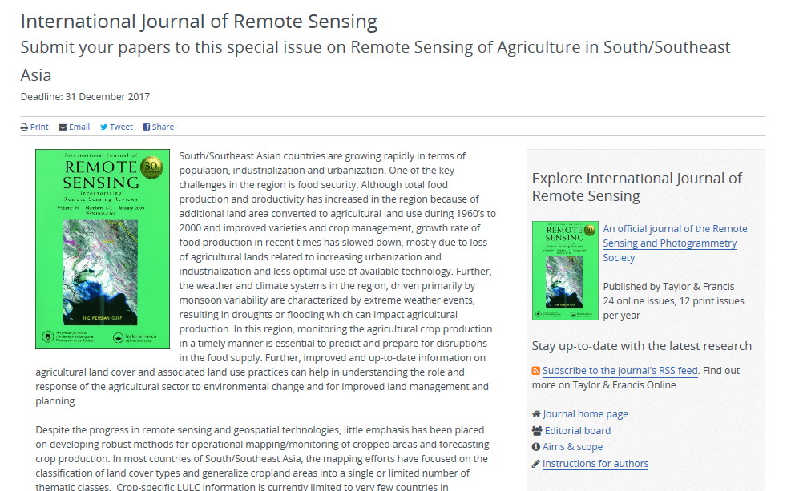
http://explore.tandfonline.com/cfp/est/tres-remote-sensing-in-asia-cfp
Eds: Krishna Vadrevu, Vinay Dadhwal, Garik Gutman and Chris Justice
Deadline: December 31st, 2017

Slide 26
SARI forthcoming meetings (2017-2018)
2017 – Operational Mapping/Monitoring of Agricultural crops in
South/Southeast Asia
  Meeting Focus: Agriculture
  Dates: May 2-4th, 2017
2017 - SARI LCLUC regional meeting in Thailand
  Meeting: July 17-18-19
  Training: July 20-21-22
2018 - LCLUC and Emissions Meeting in Laos
  Dates: TBD
  Training
2018 - LCLUC in Mountain Environments, Bhutan
  Dates: TBD
  Training

Slide 27
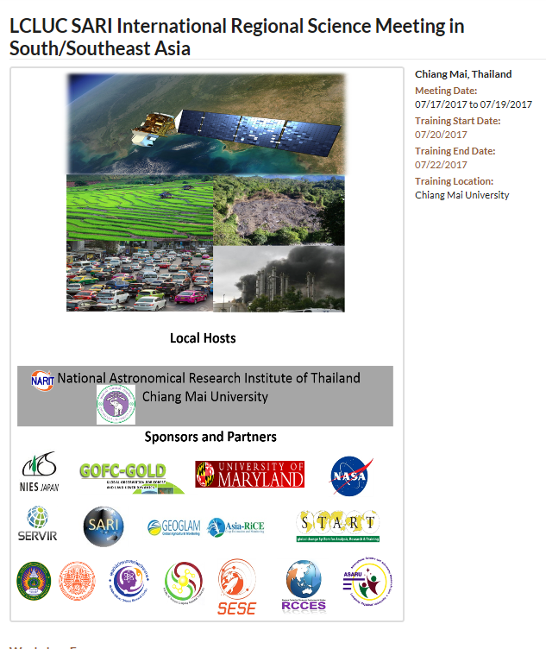
Dates: July 17-19th, 2017
Venue: Chiang Mai, Thailand.
Training: 20-22nd, 2017
Themes: LCLUC relating to (1) agriculture and water resources, 2) biomass burning, including land-atmosphere interactions, 3) urbanization, and 4) land use in coastal zones and estuaries, and 5) land use in forests and mountain regions
www.lcluc.umd.edu

Slide 28
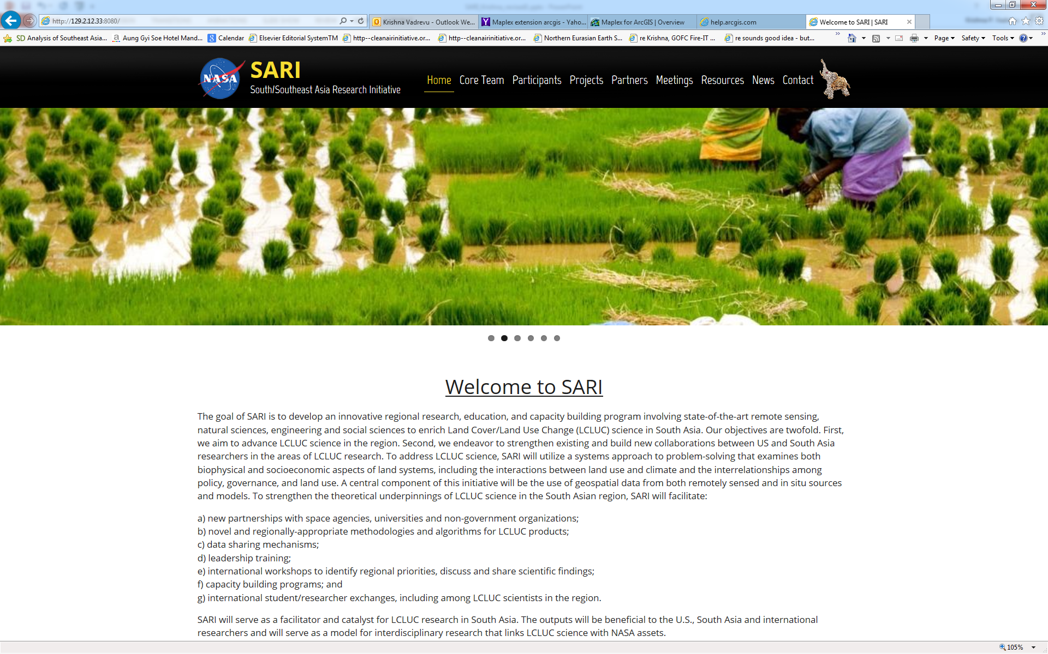
SARI website
www.sari.umd.edu

