Slide 1
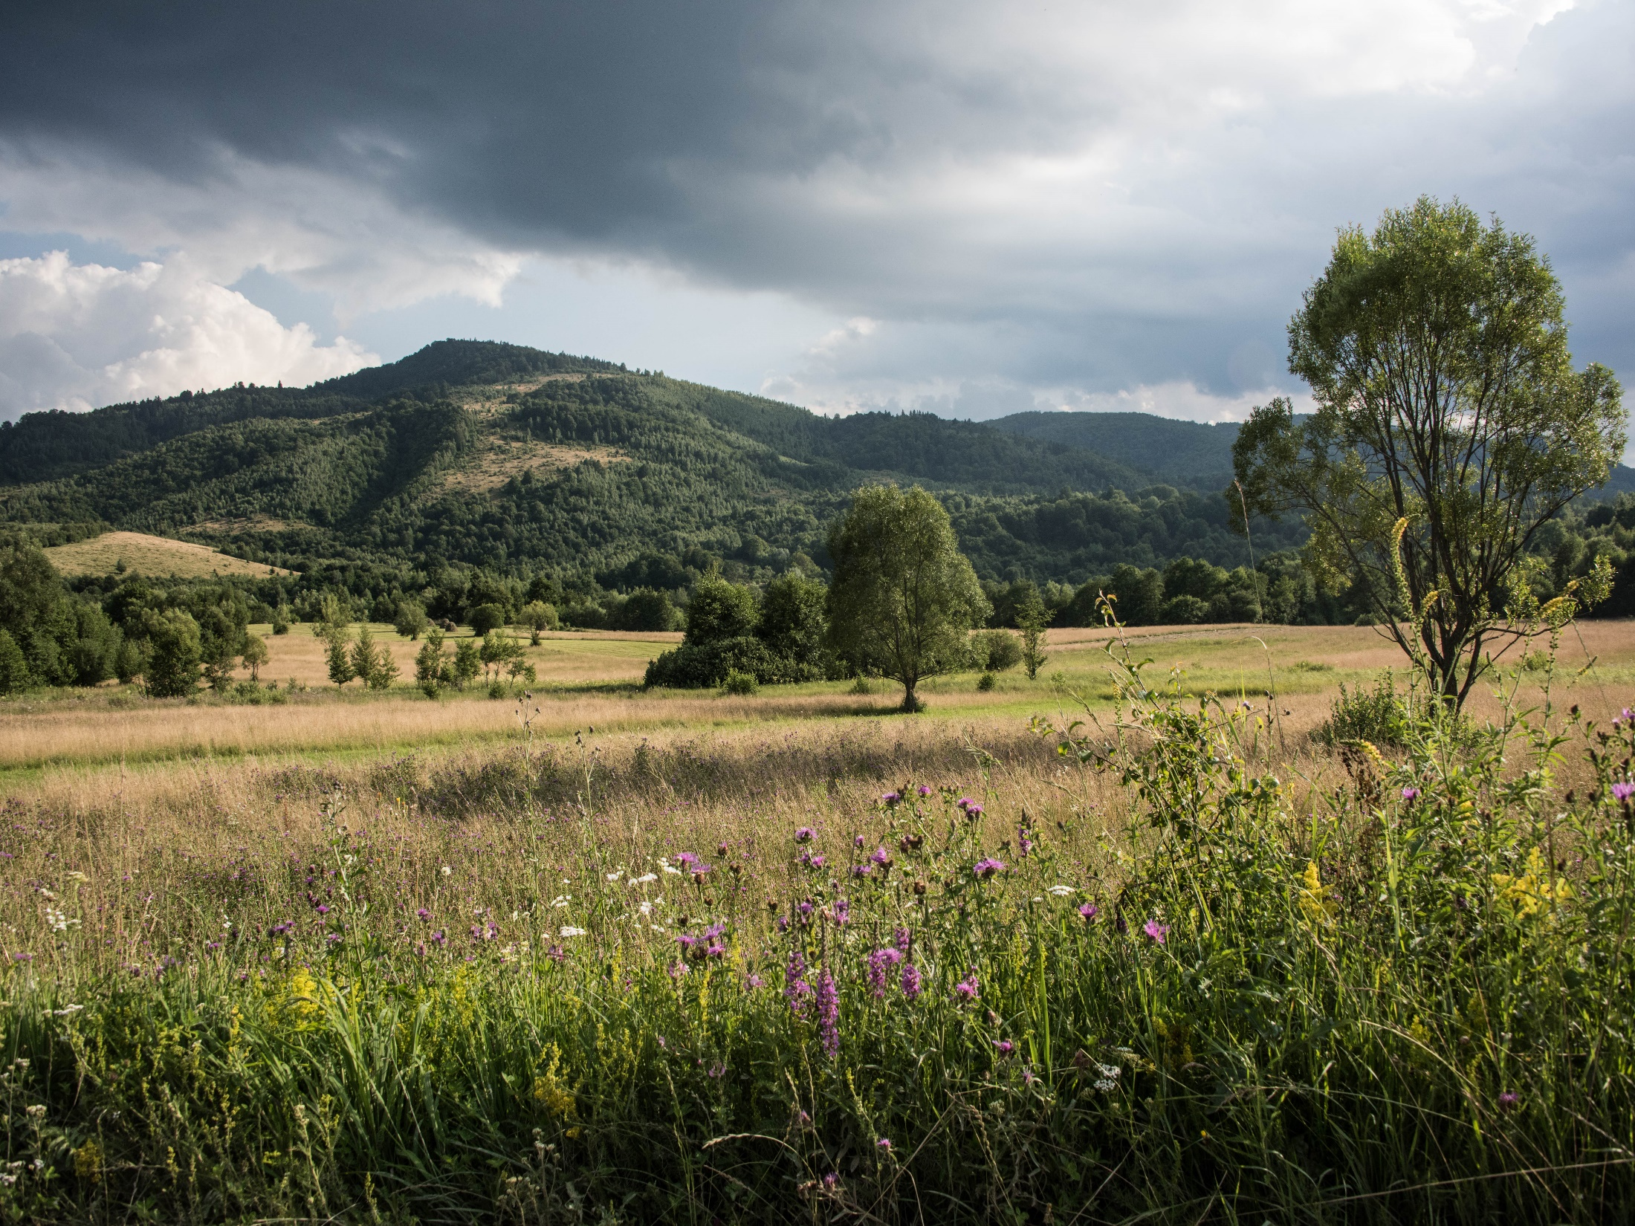
Structural transformation, increasing returns to scale
and land use change –
or a proposal for a unified land use theory
Volker C. Radeloff, and Van Butsic
NASA LCLUC Science Team Meeting 4/13/2017

Slide 3
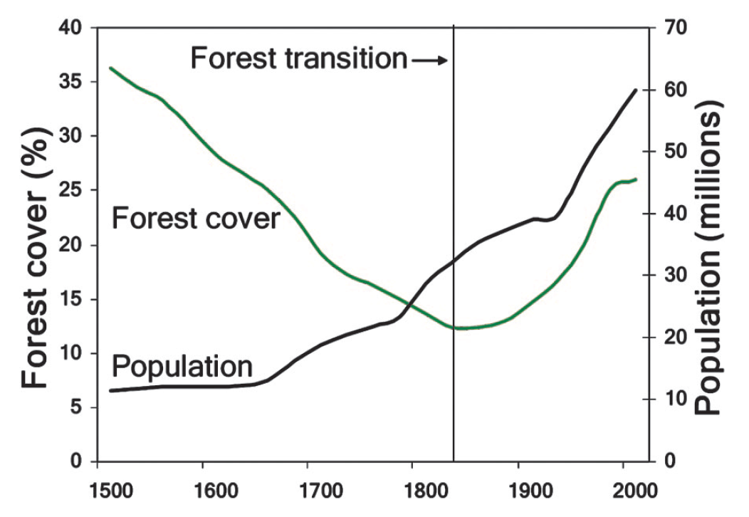
Introduction
Kauppi et al, 2006, PNAS

Slide 4
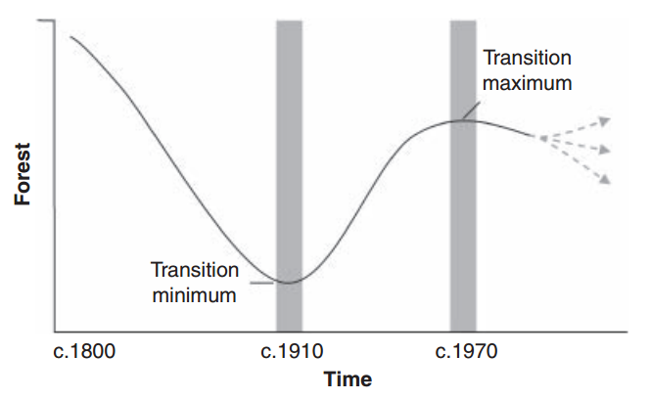
Introduction
Drummond and Loveland, 2010, BioScience

Slide 5
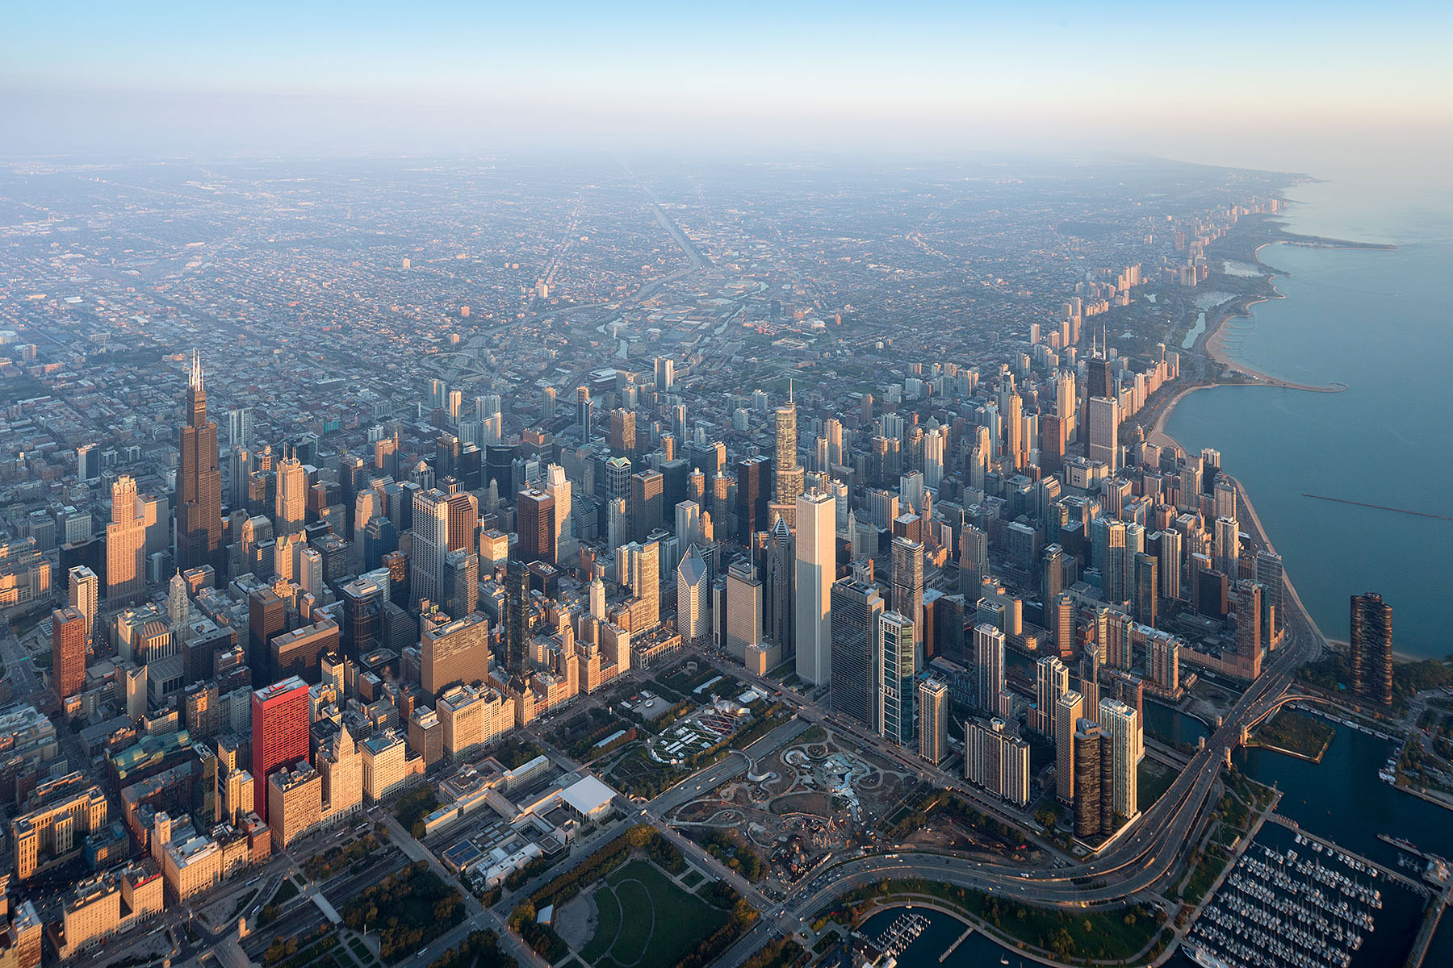
Introduction

Slide 6
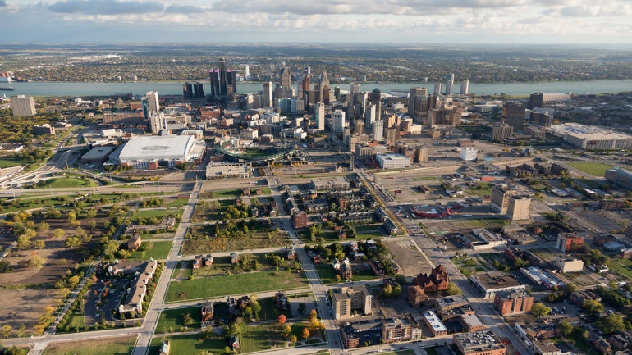
Introduction

Slide 7
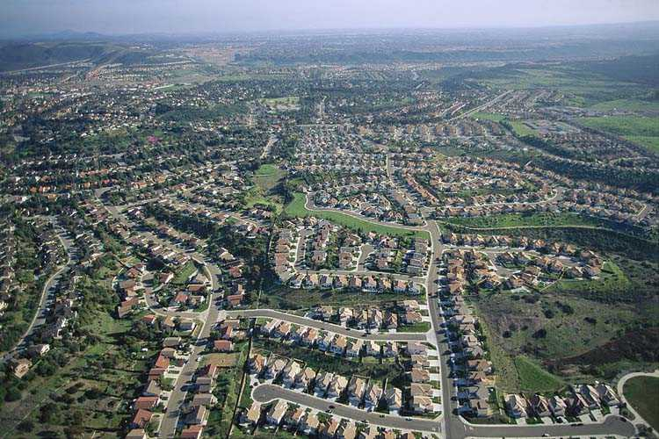
Introduction

Slide 8
Introduction
Land use change requires to unify three economic theories:
      Land rent theory
      New growth theory
      New trade theory

Slide 9
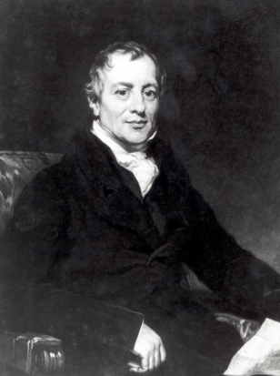
Introduction
Land rent theory
David Ricardo, 1809
  Comparative advantage results in specialization and trade
  The reason to grow the most valuable crops on the most fertile soil

Slide 10
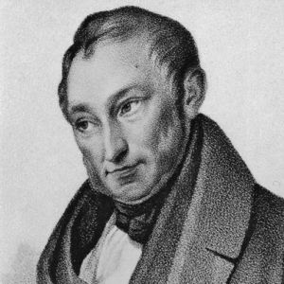
Introduction
Land rent theory
Johann Heinrich von Thünen, 1826
  Transportation costs affect land rent

Slide 11
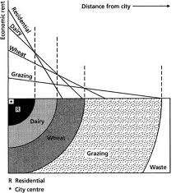
Introduction
Land rent theory
Johann Heinrich von Thünen, 1826
  Transportation costs affect land rent
  Land use forms rings around cities

Slide 12
Introduction
The problem with land rent theory
Land rent theory is great (!), but was developed for agrarian economies
By itself, land rent theory does not explain
current land use patterns

Slide 13
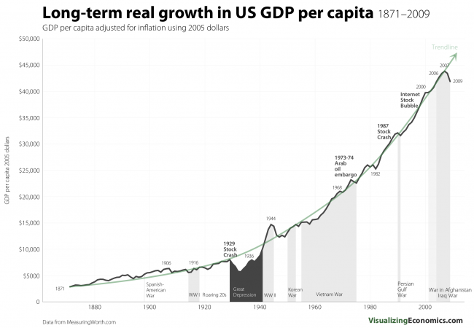
Introduction

Slide 14
Introduction
Returns to scale
In agriculture, returns to scale are initially constant, and ultimately decreasing
“Diminishing returns”
Outputs
Inputs

Slide 15
Introduction
Returns to scale
However, increasing returns to scale are typical for manufacturing
“Economies of scale”
Hard(er) to model
Outputs
Inputs

Slide 16

Introduction
New growth theory
Paul Romer, 1990
  Explained economic growth with increasing returns to scale
  Knowledge accumulates and begets new technology
  New technology drives economic growth

Slide 17
Introduction
Structural transformation

Slide 18

Introduction
New trade theory
Paul Krugman, 1991
  Increasing returns to scale cause agglomeration
  Core and periphery
  Trade

Slide 19
Introduction
New trade theory
Trade
Cities
Ideas
Agglomeration
Growth

Slide 20
Introduction
New trade theory
Resources
Workers
Periphery
Core
Goods

Slide 21
Introduction
The problems with new growth and new trade theory
New growth theory
  is agnostic to space
  does not address land use
New trade theory
  focuses on cities and goods, not on the peripheries and land use
  ignores environmental endowment

Slide 22
Introduction
The contributions of each theory
Land rent theory
  Comparative advantage leads to specialization and trade
  Transportation costs matter
New growth theory
  Increasing returns to scale in manufacturing
  Ideas are the engine of growth
  Growth results in the structural transformation of economies
New trade theory
  Increasing returns to scale lead to cores and peripheries
  Trade connects the two
  Legacies matter

Slide 23
Goal
To explain land use change by unifying:
      Land rent theory
      New growth theory, and
      New trade theory

Slide 24
Conceptual model
LU = S, E, T, L
LU : Land use
S : Structure of the economy
E : Environmental endowment
T : Transportation costs
L : Land use legacies

Slide 25
Conceptual model
Land rent theory | New growth theory | New trade theory
Structure of the economy | Environmental endowment | Transportation costs | Land use legacies
Land use change

Slide 26
Conceptual model
S : Structure of the economy
  Employment, GDP, and trade in agriculture, manufacturing, and service sectors
  Ag: Decreasing or constant returns to scale
  Mf: Increasing returns to scale
  Sv: Constant returns to scale (largely)
  New growth and new trade theory:
  S determines growth, agglomeration, and trade
  S can change rapidly as an economy grows

Slide 27
Conceptual model
E : Environmental endowment
  Ag: Climate, soil quality, and topography
  Mf: Energy, and minerals
  Sv: Climate, scenic view, and natural amenities
  Ricardo: land use with the highest net returns will occur where E is highest
  E can change over time due to new technology (e.g., drought resistant seeds), improvements (e.g., irrigation), or degradation from overuse

Slide 28
Conceptual model
T : Transportation costs
  Distance to roads and markets
  Transportation technology and investments
  Customs, tariffs, and trade agreements
  von Thünen: T results in rings around city
  New trade theory: non-linear relationship
    High T: no trade nor agglomeration
    Medium T: Specialization, agglomeration, trade
    Low T: Less agglomeration, cheaper labor in periphery

Slide 29
Conceptual model
L : Land use legacies
  Legacies of prior land use
  For urban areas: castles, transportation nodes, concentrated resources
  New trade theory: Initially small differences in size of cities will exacerbate over time

Slide 30
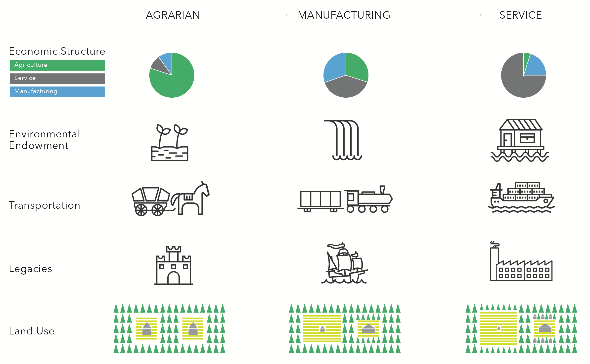
Conceptual model

Slide 31
Conceptual model
Agrarian economy
  Constant or decreasing returns prevent agglomeration
  High transport costs cause land use rings
  Forest loss near cities
Manufacturing economy
  Increasing returns foster strong agglomeration
  Cores and peripheries; trade and lower transport costs
  Core forests recover; new agriculture in peripheries
Service economy
  Constant returns cause de-agglomeration
  Cities sprawl
  Forest loss due to exurban development

Slide 32
Conceptual model

Slide 33
Conceptual model

Slide 34
Conceptual model

Slide 35
Empirical model
Notes:
Showing data for Forests only, but agricultural gains are the other side of the coin of forest losses until 1920s, and lately forest losses are dominated by urban growth, so our results pertain to these three major land use classes

Slide 36
Empirical model

Slide 37
Empirical model

Slide 38
Empirical model

Slide 39
Empirical model
Forest transition in the US
39 States lost > 25% forest
  Of these, 20 regained > 10 percentage points
  Of these, 8 lost > 5 percentage points in a
  2nd wave of deforestation
  These 8 lost on average half of the initial gain
Forest trends highly variable among US states!

Slide 40
Introduction
Structural transformation in the US

Slide 41
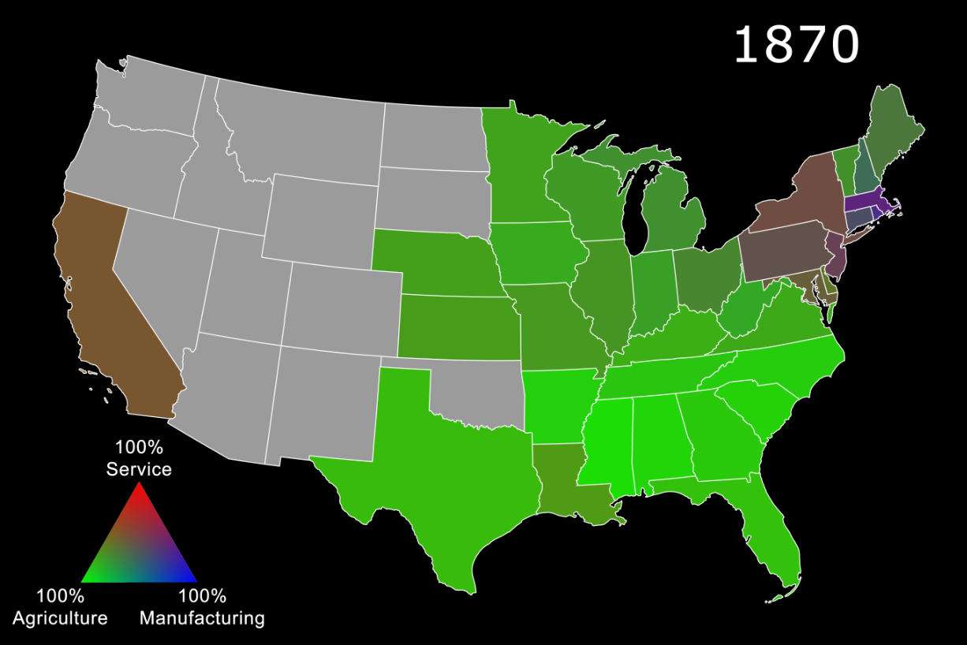
Empirical model

Slide 42
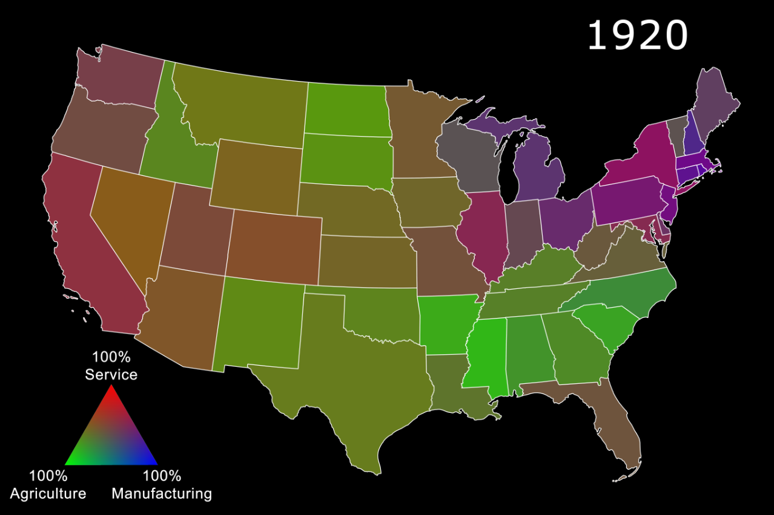
Empirical model

Slide 43
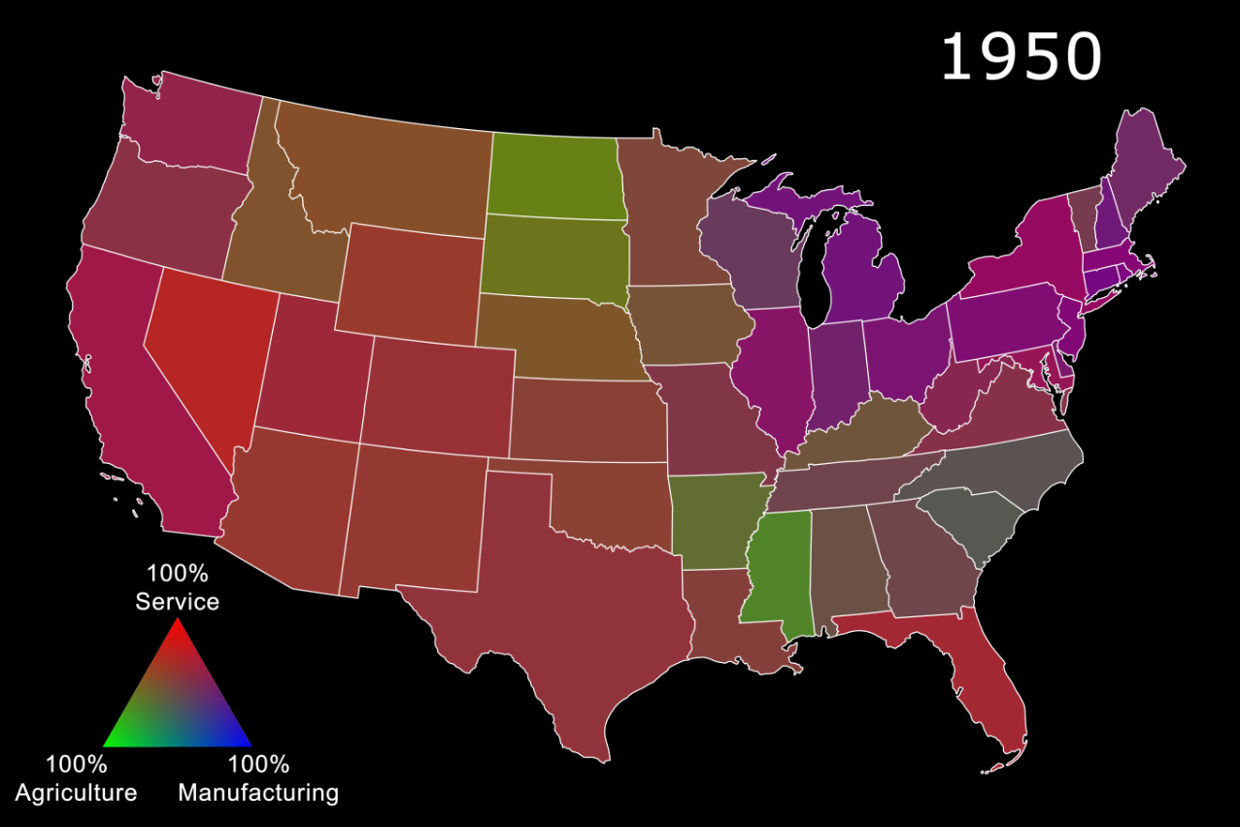
Empirical model

Slide 44
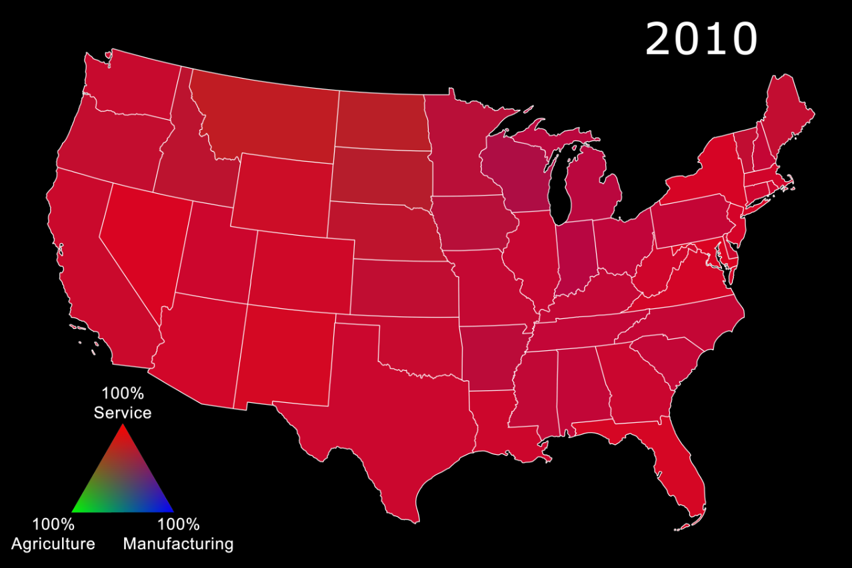
Empirical model

Slide 45
Empirical model
Forest change pattern | Year peak manufacturing | Peak manu-facturing | Loss in manu-facturing
Loss, recovery and 2nd wave of deforestation | 1920 | 52% | -30 p.p.
Loss and recovery | 1950 | 35% | -11 p.p.
Loss and no recovery | 1970 | 29% | -7 p.p.
Notes:
Connecticut , Georgia, Maryland, Massachusetts, New Hampshire, New Jersey

Slide 46
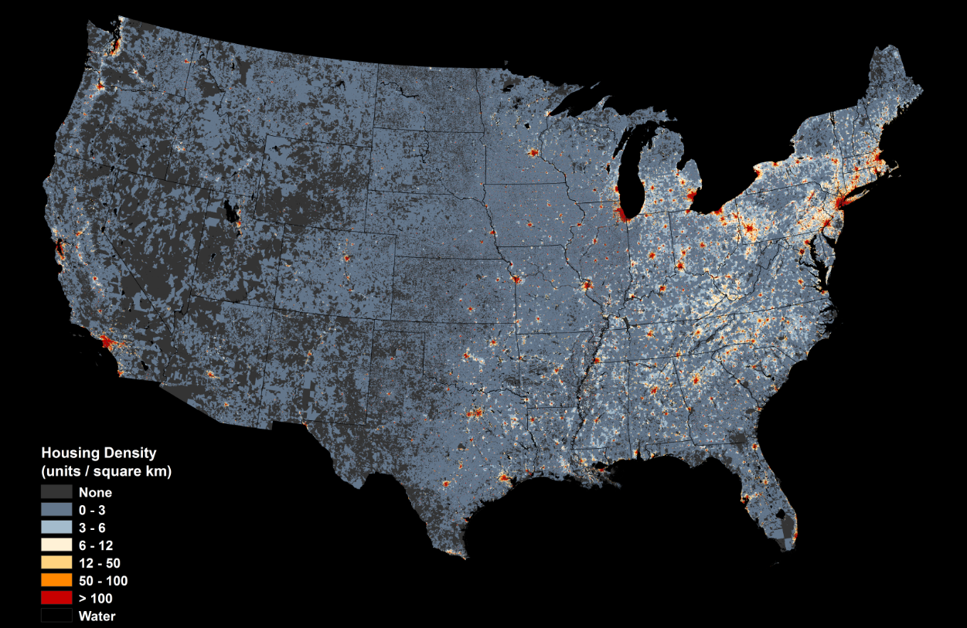
Empirical model
1940

Slide 47
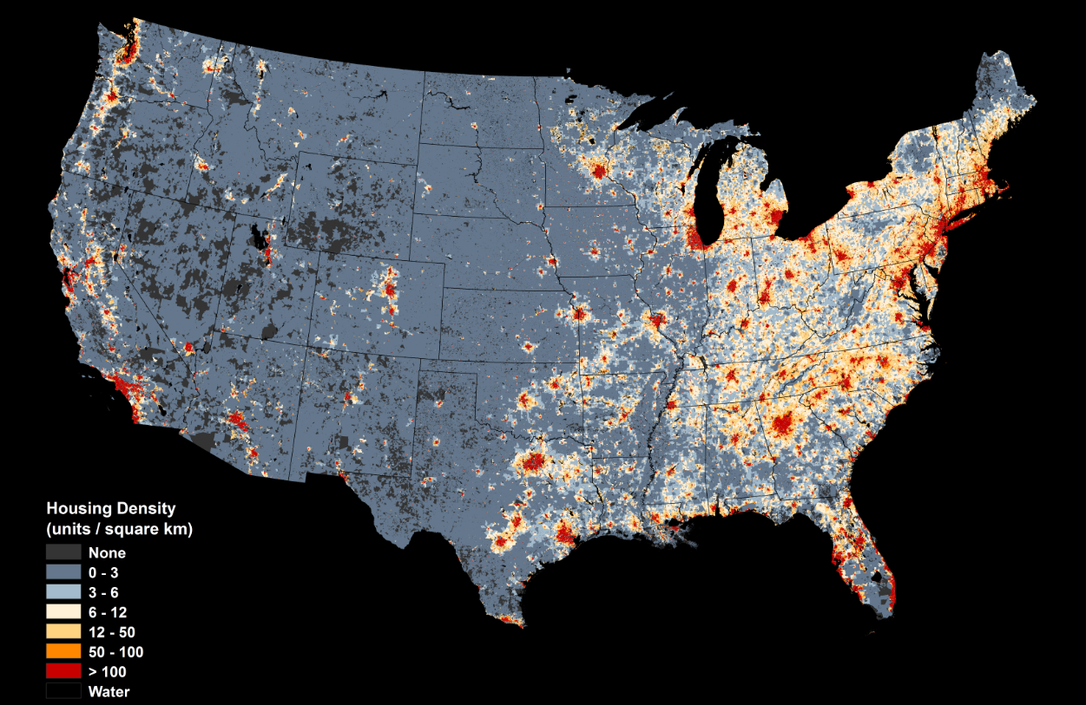
Empirical model
2010

Slide 48
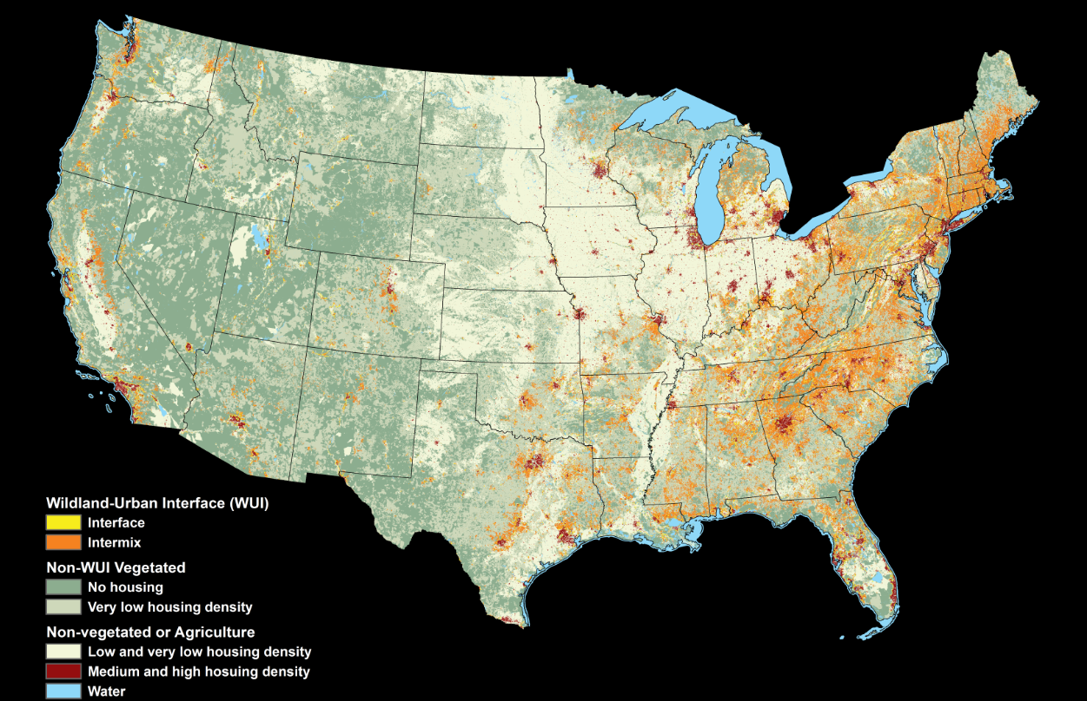
Empirical model
2010

Slide 49

Empirical model
$$Forest cover={ B}_{1}+B_{2−14}∗year+B_{15}∗total employment+B_{16}∗manufacture+B_{17}∗service \\ + B_{18}∗manufacture∗aftermax \\ + B_{19}∗service∗aftermax \\ + aftermax+u_{s}+e_{it}$$

Slide 50
Empirical model
 | (1) | (2) | (3) | (4)
 | % Max. Forest | % Max. Forest | Forest Area | Forest Area
Manufacture | -0.57*** | -0.59*** | -9,925*** | -11,813***
Aftermax * Manufacture | 0.42*** | 0.36*** | 3,847 | 5,169*
Service | -0.16** | -0.14* | -4,167*** | -3,211*
Aftermax * Service | -0.25* | -0.24* | -3,572 | -4,052
Year effect | *** | *** | *** | ***
R-squared | 0.44 | 0.46 | 0.47 | 0.49
Observations | 729 | 665 | 729 | 665
>10,000 km² forest | No | Yes | No | Yes

Slide 51
Empirical model
 | (1) | (2) | (3) | (4)
 | % Max. Forest | % Max. Forest | Forest Area | Forest Area
Manufacture | -0.57*** | -0.59*** | -9,925*** | -11,813***
Aftermax * Manufacture | 0.42*** | 0.36*** | 3,847 | 5,169*
Service | -0.16** | -0.14* | -4,167*** | -3,211*
Aftermax * Service | -0.25* | -0.24* | -3,572 | -4,052
Year effect | *** | *** | *** | ***
R-squared | 0.44 | 0.46 | 0.47 | 0.49
Observations | 729 | 665 | 729 | 665
>10,000 km² forest | No | Yes | No | Yes

Slide 52
Discussion
Goal
To explain land use change by unifying:
      Land rent theory
      New growth theory, and
      New trade theory

Slide 53
Discussion
The structural transformation of economies is key for land use change
  The transition from agricultural to industrial economies leads to cores and peripheries,
  urban centers, abandonment, and forest transition
  The transition from manufacturing to service economy reduces agglomeration and hence causes sprawl and 2nd wave of deforestation

Slide 54
Discussion
LU = S, E, T, L
LU : Land use
S : Structure of the economy
E : Environmental endowment
T : Transportation costs
L : Land use legacies

Slide 55
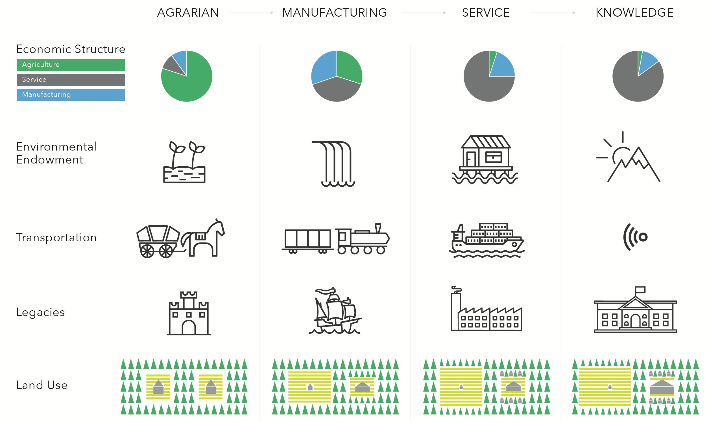
Discussion

Slide 56
Discussion

Slide 57
Discussion
But!!!! What about?
  Policies
  Trade
  Technological change
  Institutions
  Shocks
  …

Slide 58
Discussion
 | Economic structure | Environ-mental endowment | Trans-portation cost | Land use legacies
Policies | X | X | X | X
Trade | X |  | X
Technology | X | X | X
Institutions | X |  | X | X
Shocks | X | X | X | X

Slide 59
Discussion
Where does this theory apply?
  Observed land use trends fit theory
    Urban teleconnections
    Forest transition
    Urban sprawl in maturing economies
  It now applies globally, because trade links cores with peripheries across continents

Slide 60
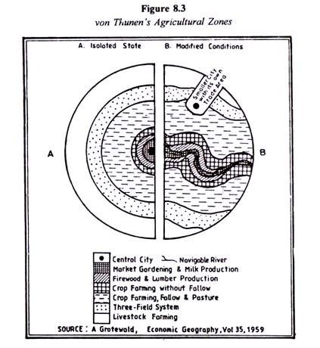
Discussion

Slide 61
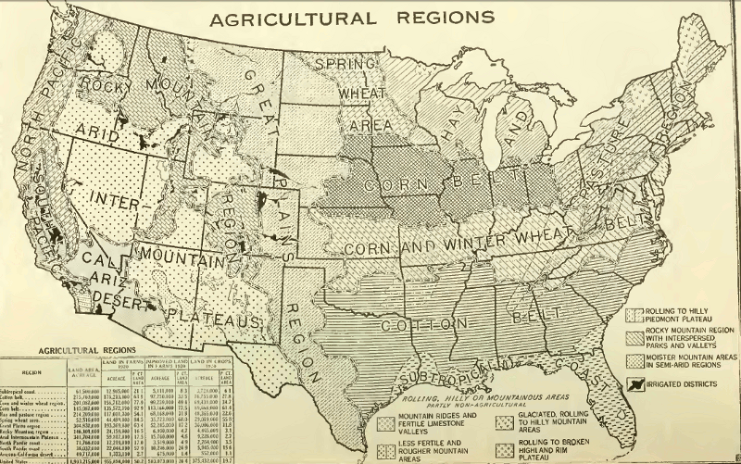
Discussion
Baker et al., 1922

Slide 62
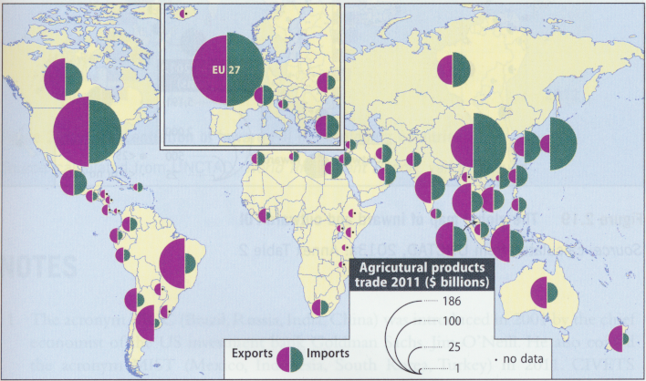
Discussion
Dicken 2015

Slide 63
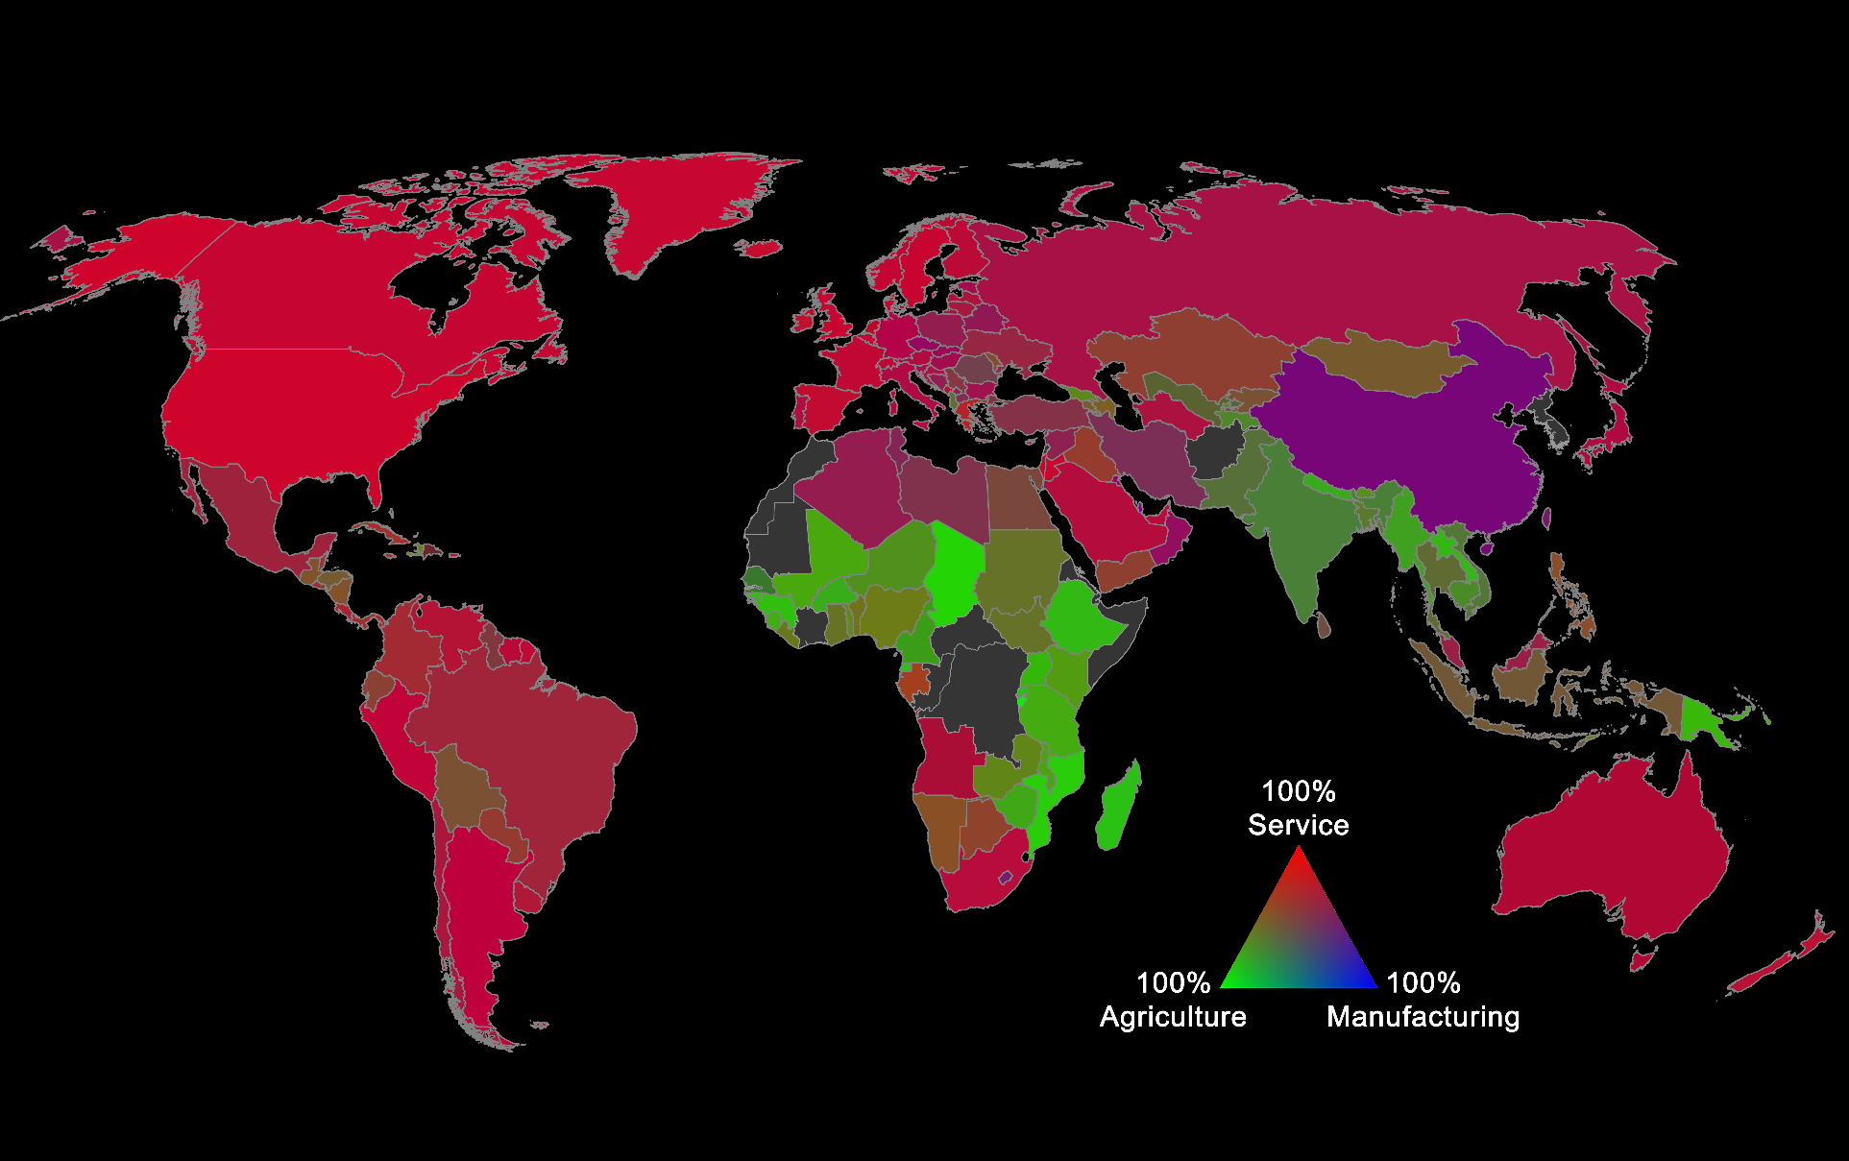
Discussion

Slide 64
Discussion
Future of developed countries
  Knowledge economy is highly agglomerated
  Amenities and knowledge centers determine future cores
  These cores will be centers of demand for global trade

Slide 65
Discussion
Future of under-developed countries
  Not all peripheries can become cores
  Few potential new peripheries left
    Africa? Oceans?
  Without new peripheries, forest transition in current agricultural peripheries unlikely
  Agricultural economies may transition directly to service economies
  Plus, agriculture is industrializing, thereby agglomerating crop types

Slide 66
Discussion
Future of under-developed countries
  Not all peripheries can become cores
  Few potential new peripheries left
    Africa? Oceans?
  Without new peripheries, forest transition in current agricultural peripheries unlikely
  Agricultural economies may transition directly to service economies
  Plus, agriculture is industrializing, and agglomerating crop types

Slide 67
Discussion
Conservation
  Necessary to tailor conservation policies to the structure of the economy
  The role of natural resources has diminished
    Valuing ecosystem services is insufficient to justify conservation
  Conserving natural amenities that attract knowledge industries is key

Slide 68
Conclusion
What is novel?
  Explaining land use based on “new” macroeconomic theory
  Linking changes in the returns to scale, and hence the structural transformation of economies, directly to land use change
  Accounting for the root causes for economic growth and trade

Slide 69
Conclusion
Land rent theory | New growth theory | New trade theory
Structure of the economy | Environmental endowment | Transportation costs | Land use legacies
Land use change

Slide 70
Conclusion
LU = S, E, T, L
LU : Land use
S : Structure of the economy
E : Environmental endowment
T : Transportation costs
L : Land use legacies

Slide 71
Conclusion
What is novel?
  Unifying land rent, new growth, and new trade theory provides explanations for many of the major land use trends
    Forest transition, and 2nd wave of deforestation
    Agricultural expansion and abandonment
    Urbanization and urban sprawl
    Tele-connections
  It offers a theory of land use change as a whole

Slide 72
References
Krugman P (1991) Increasing returns and economic geography. Journal of Political Economy 99(3):483-499.
Ricardo D (1817) On the Principles of Political Economy and Taxation (John Murray, London) p 604.
Romer PM (1990) Endogenous technological change. Journal of Political Economy 98(5):S71-S102.
von Thünen JH (1826) Der isolirte Staat in Beziehung auf Landwirtschaft und Nationalökonomie, oder Untersuchungen über den Einfluß, den die Getreidepreise, der Reichthum des Bodens und die Abgaben auf den Ackerbau ausüben (Friedrich Perthes, Hamburg) p 313.

Slide 73

Conclusion

