Slide 1
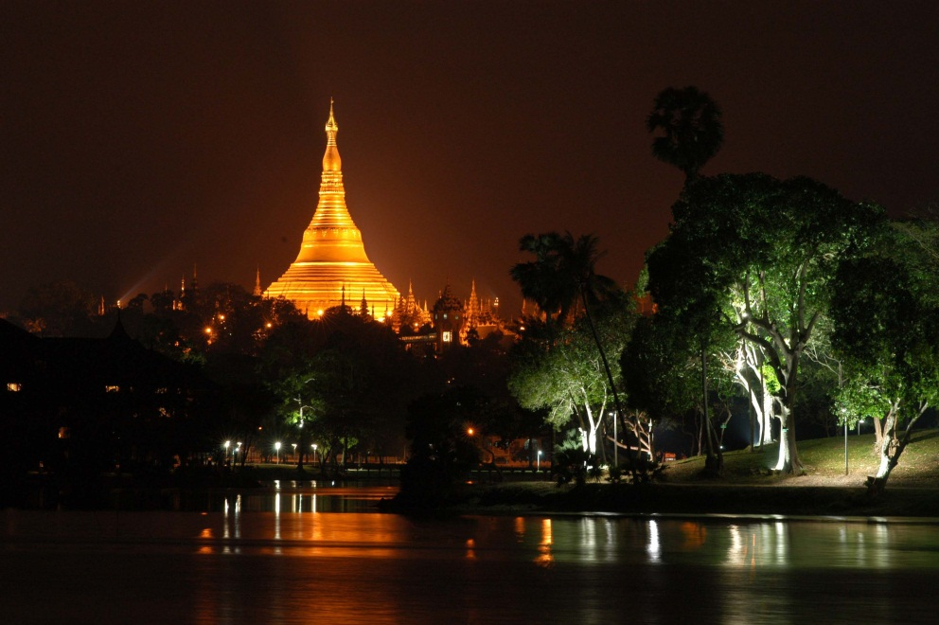
Urbanization and sustainability under global change and transitional economies: Synthesis from Southeast, East, and North Asia (SENA)
senacgc.org
Peilei Fan, Michigan State University
April 12, 2017, NASA LCLUC Science Meeting, Rockville, MD
Principal Investigators: Peilei Fan (PI) and Jiquan Chen (Co-I)
Postdoctor associate: Zutao Ouyang (MSU)
Collaborators:
Amarjargal Amartuvshin (Univ of Humanities, UB, Mongolia),
Nguyen Dinh Duong, Nguyen Lam-Dao (Vietnam Academy of Sci. and Tech.),
Neang Thy (Ministry of Environment, Cambodia),
Tep Markathy (Cambodia Institute for Urban Studies)
Outhailak Souphanthalop (Lao PDR)
Zaw Naing (Mandalay Technology, Myanmar), Zin Nwe Myint (Yangon Univ)
Steve Leisz (Colorado State Univ), Mingliang Liu (Washington State Univ.),
Tatiana Loboda (Univ. of Maryland, College Park), Soe Myint (Arizona State U.),
Annemarie Schneider (Univ. of Wisconsin-Madison)

Slide 2




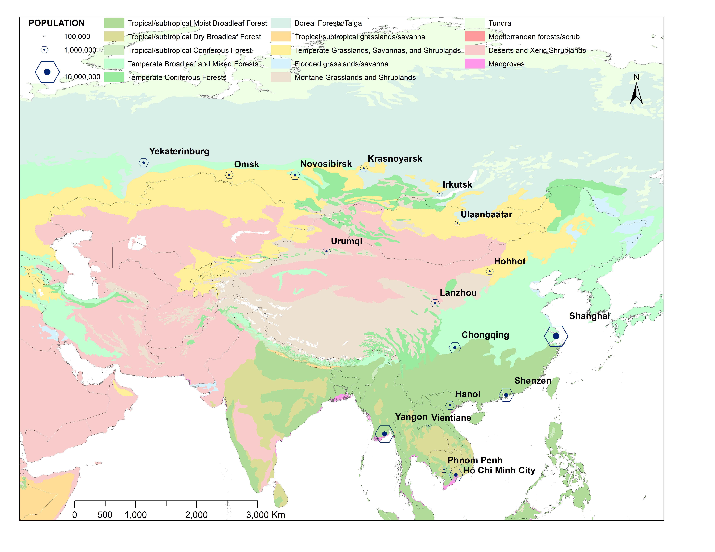
Urbanization and sustainability under global change and transitional economies: Synthesis from Southeast, East, and North Asia (SENA)
Grant #: NNX15AD51G
web: senacgc.org
Study Context:
SENA countries constitute a region that is significant in both natural and socioeconomic dimensions:
  a land area of 25.4 million km² population of 1.54 billion in 2010
experienced liberalization, macroeconomic stabilization, restructuring and privatization, and legal and institutional reforms over the past three decades
urbanization at various but mostly tenacious speeds, exert tremendous pressure on social, economic, and environmental sustainability, especially under the increasingly visible climate change.
17 urban systems overlaid on the Ecoregion coverage (8 biomes in 7 countries)
Research Questions:
What are the spatiotemporal changes of urban expansion within transitional economies?
What are the key socioeconomic and biophysical drivers of urbanization and urban sustainability? More specifically, which institutional mechanism is unique and crucial? How well do our models and data explain these changes through the interactions and feedback mechanisms of human and natural systems?
How well can we predict the changes in urban LCLUCs and functions based on the derived structure and functions of LCLUC, human systems, and natural systems?
What socioeconomic and institutional adaptations have been implemented and how effective have they been? What policy recommendations can be offered to enhance urban sustainability in the near future?
Notes:
SENA project

Slide 3
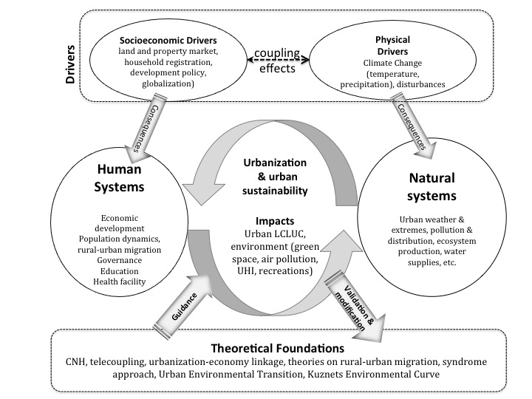
Conceptual framework
for understanding drivers, process, and impacts of urbanization and sustainability

Slide 4
Tasks:
Data Integration:
Database of LCLUC, socioeconomics, and environmental variables at multiple spatial and temporal scales (multiple sources)
Knowledge Synthesis:
construct quantitative indices for spatial, human, and natural systems of 17 cities
perform statistical and modeling analyses to quantify the interactions and feedbacks
Forecast Synthesis:
model and predict the changes of the urban LCLUC, human, and natural systems beyond 2016 with sound scenarios of climate and land cover changes, populations, economic growth, and possible planning and policies.
Two workshops in the region: gathering expert opinions from policymakers and local collaborators on plausible scenarios

Slide 5
Major synthesis working-in-progress and Findings:
Urban LCLUC: Patterns and characteristics, methods
  Southeast Asia, Siberia, Mongolia Plateau, Bayesian Sequential learning for global urban map, historic mapping, informal settlement mapping
Drivers and spatial determinants
  Economic development (post-industrialization, globalization), institutional role,
  Spatial determinants: 2. green space => PM 2.5? 2. Suburban residential land development
  Revision of capital accumulation theory by David Harvey
Impacts
  Social equity: public urban green accessibility, walkability
  CNH: Urbanization on hydrology
Forecast synthesis: Future scenarios
  2 workshops focus on SENA cities scenarios (Yangon and HCMC)
On-going and future
  Workshop in UB , SIs (Landscape and Urban Planning, Ecological Indicators)
Notes:
2.
Economic development & Institutions (2 SENA cities): Hohhot and UB
(2) Post-industrialization and globalization (SENA vs non-SENA city): Shanghai vs. Barcelona
(3) Urban green space affect PM2.5?
(4) Suburban residential land development – Spatial determinant: Case of Hangzhou
(5) Suburbanization and capital accumulation
3.
(1) Urbanization & social equity: public urban green accessibility
(2) Urbanization on walkability
(3) Urbanization on hydrology

Slide 6
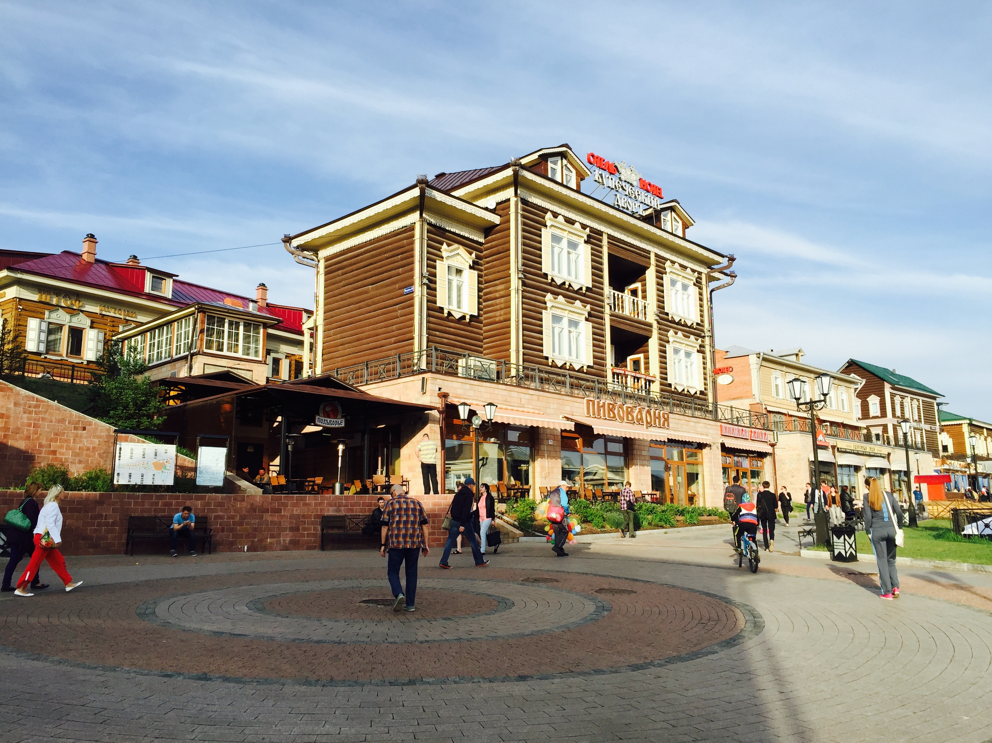
(1) SENA Urban LCLUC:
Patterns and characteristics, Methods
Urbanization and sustainability under global change and transitional economies: Synthesis from Southeast, East, and North Asia (SENA)
Southeast Asia (hybrid mapping)
Mongolia Plateau
Siberian cities
Mapping uncertainty of global urban land with Bayesian sequential learning
Mapping the evolution of oasis for long historic period (2000 years)
Informal settelment

Slide 7
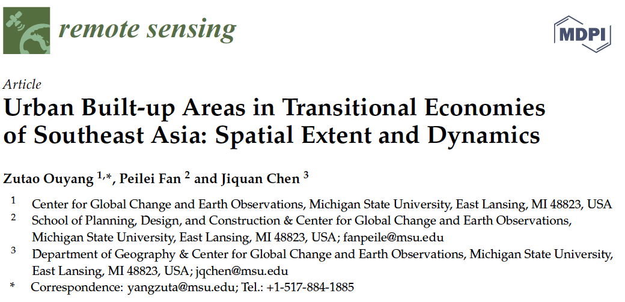
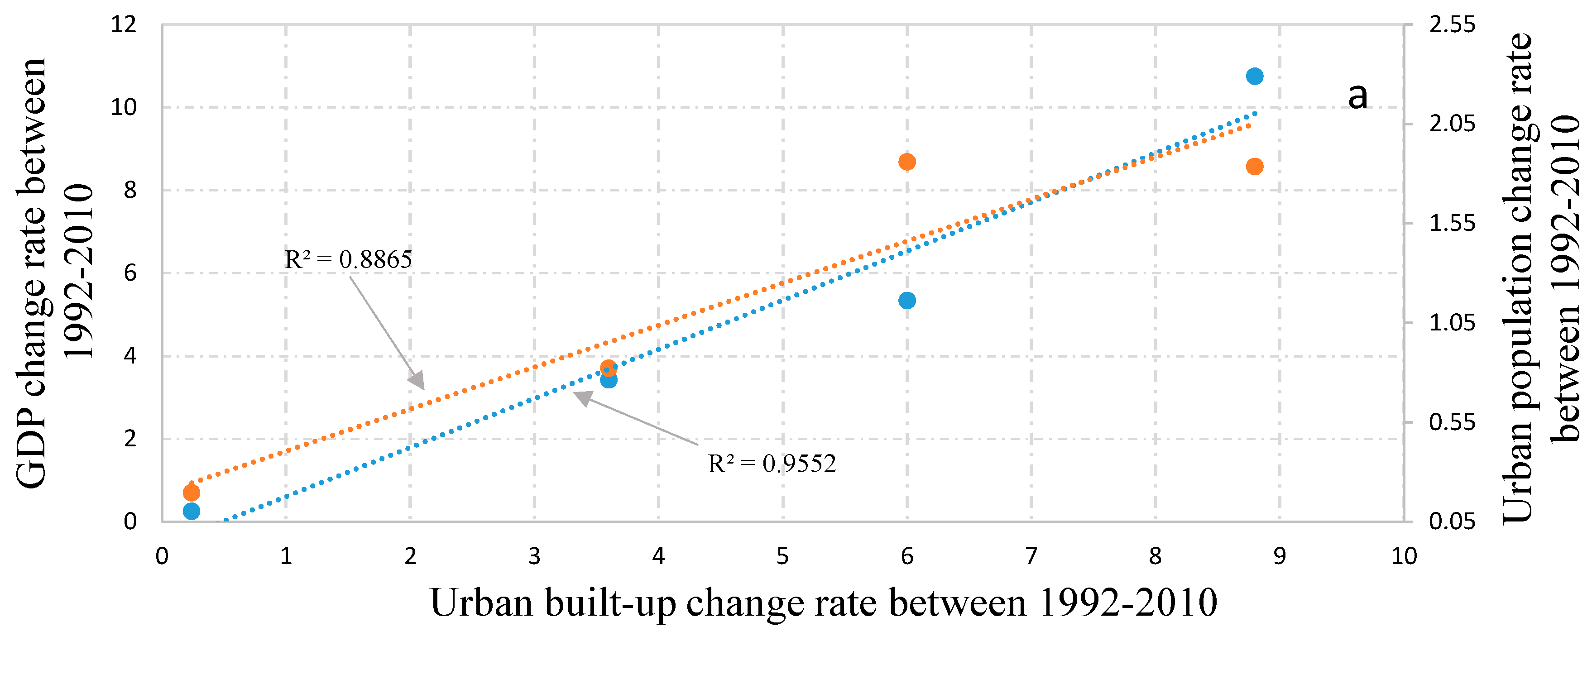
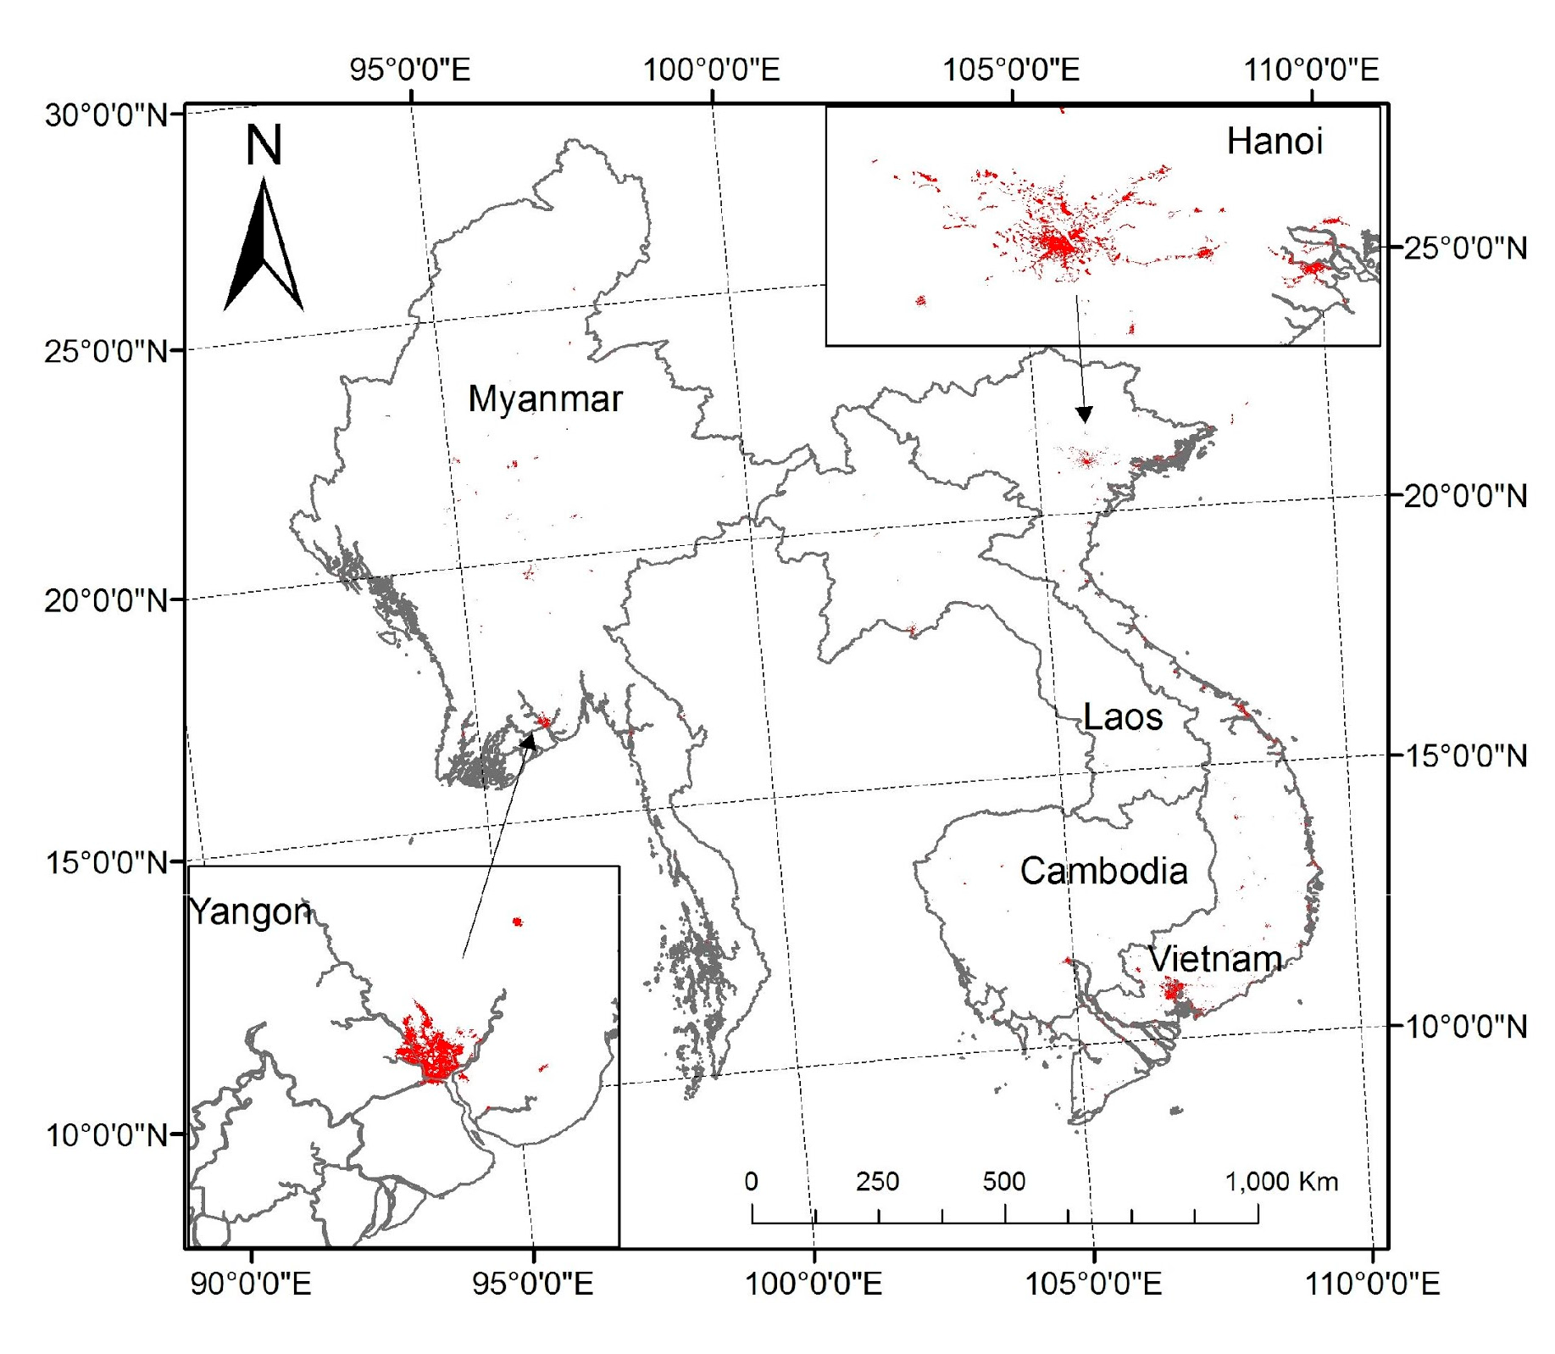
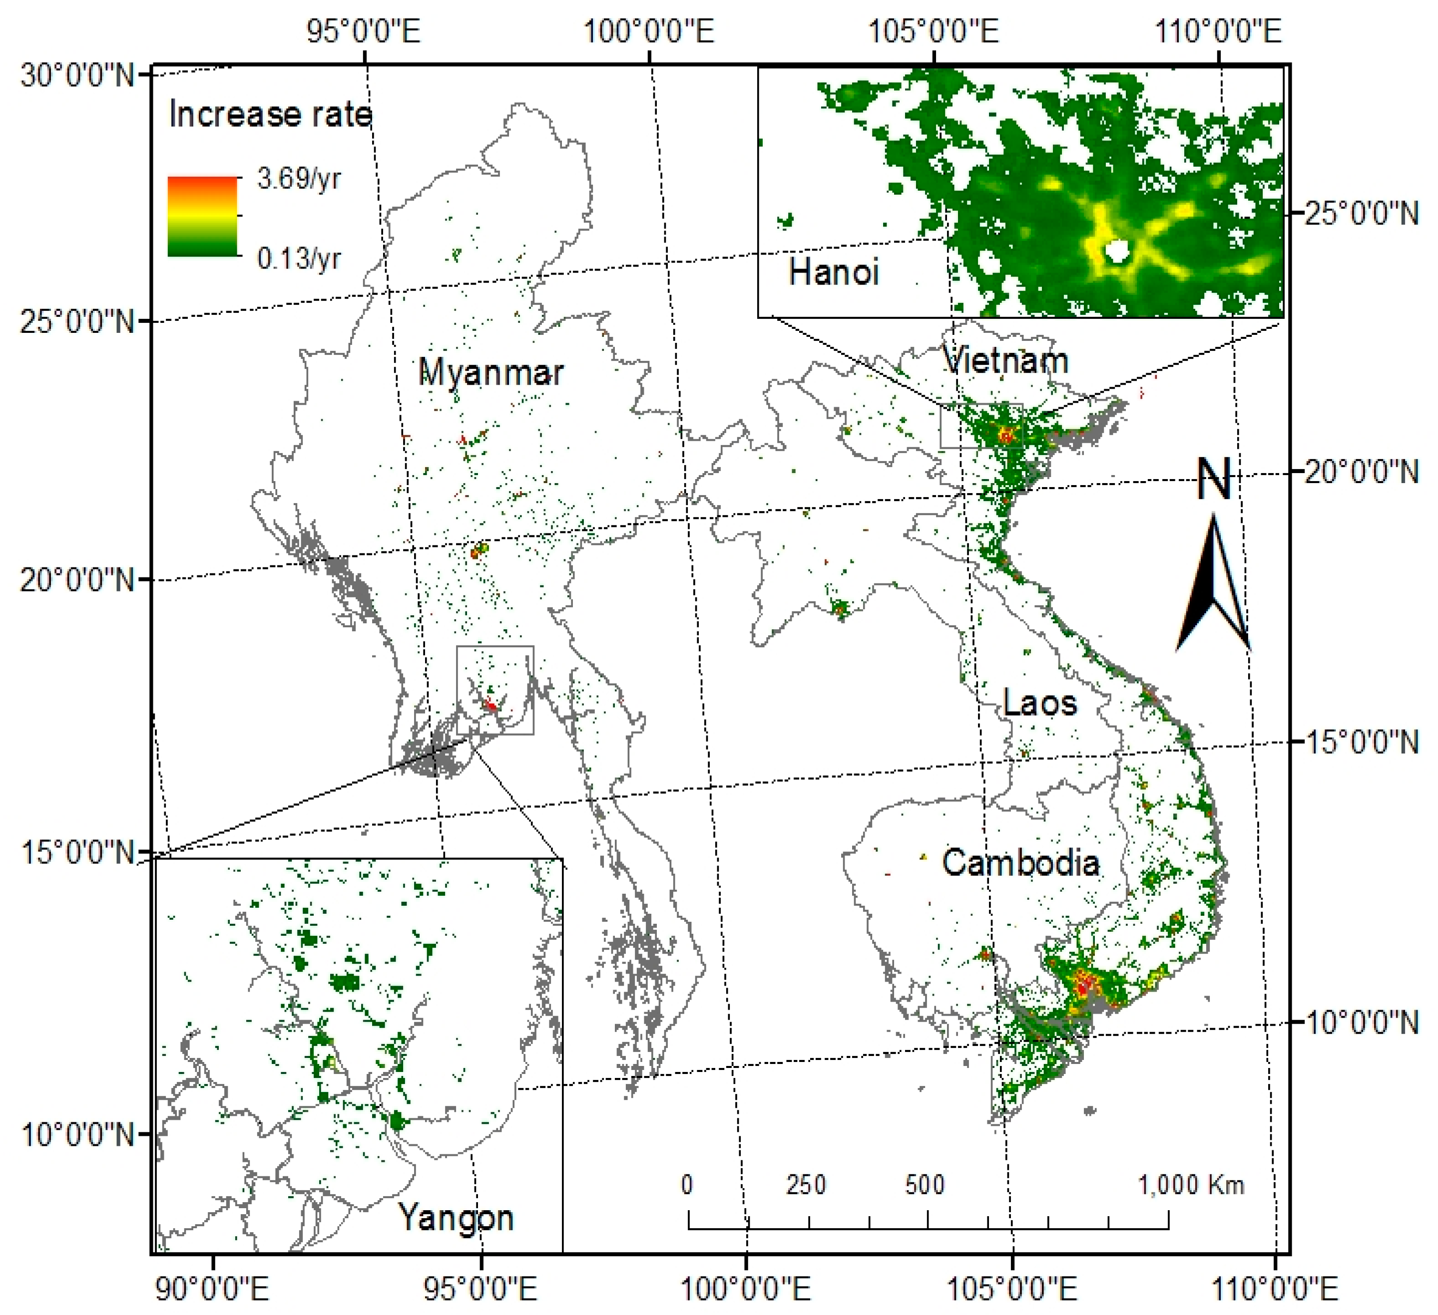
1. Patterns and characteristics, method (1) SE Asia & hybrid mapping
Relationship between GDP/ urban population increasing rates and urban built-up increasing rate
Urban built-up land in Vietnam, Cambodia, Laos, and Myanmar in 2010 with a spatial resolution of 30 m. The area around cities of Hanoi and Yangon were are shown as examples.
The increasing trends of DMSP/OLS NTL brightness in 1992 to 2010
Urbanization in SE Asia (Method and Findings)
We combined multiple remote sensing data, including Landsat, DMSP/OLS night time light, MODIS NDVI data, and other ancillary spatial data, to develop a 30-m resolution urban built-up map of 2010 for transitional economies in Southeast Asia.
Vietnam had the highest proportion of urban built-up area (0.91%), followed by Myanmar (0.15%), Cambodia (0.12%) and Laos (0.09%). Vietnam was also the fastest in new built-up development (increased ~8.8-times during the 18-year study period), followed by Laos, Cambodia and Myanmar, which increased at 6.0-, 3.6-, and 0.24-times, respectively.
The increasing rate of built-up area is closely correlated with the increasing of urban population and GDP.

Slide 8
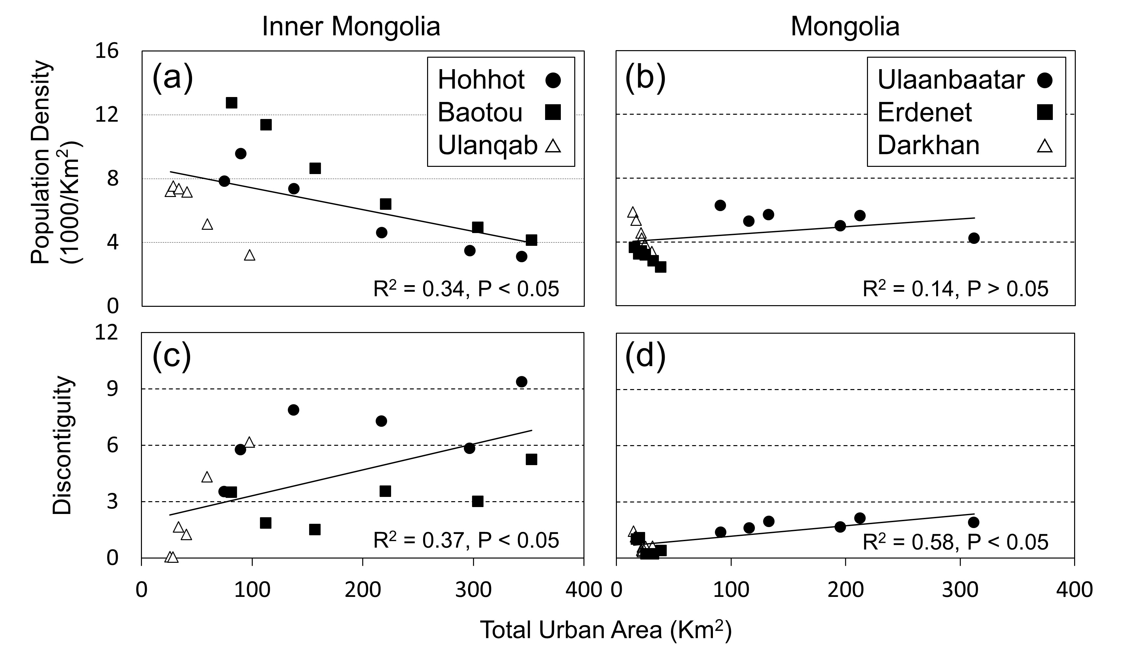
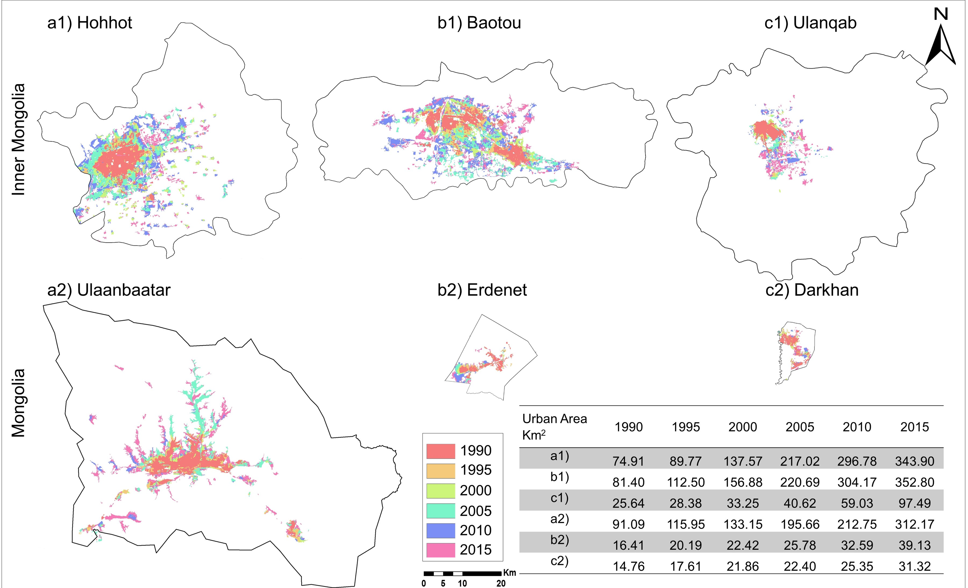
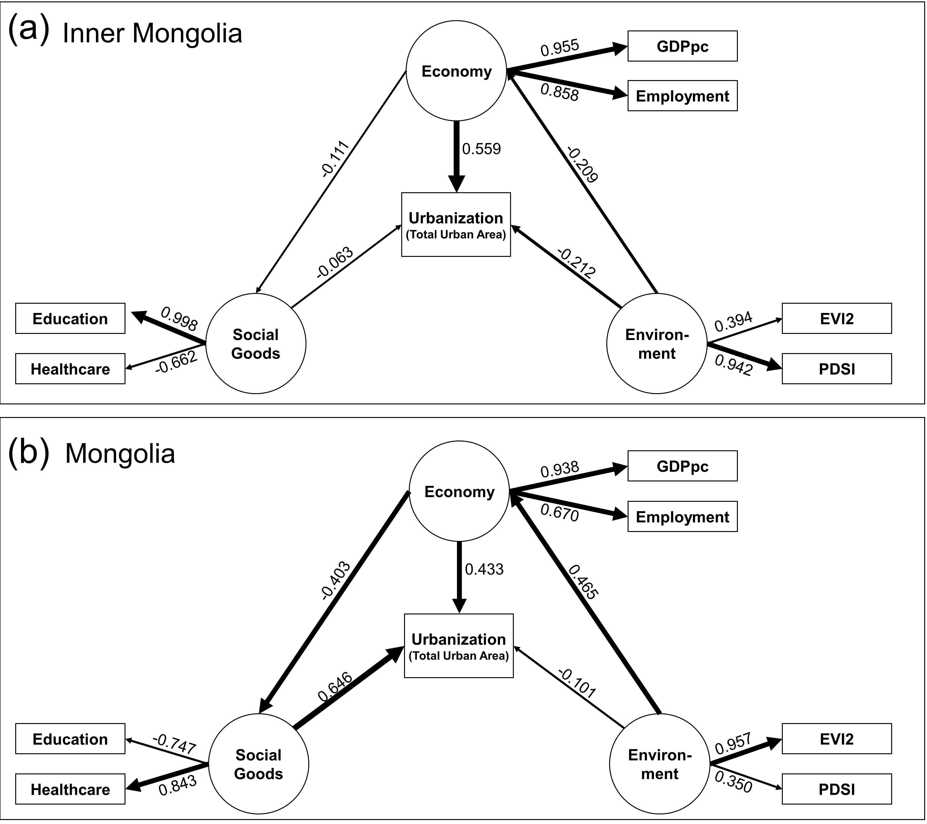
Patterns and characteristics, method (2) Mongolia Plateau
Urbanization on the Mongolian Plateau after economic reform: changes and causes (submitted to Applied Geography)
Hogeun Park, Peilei Fan, Ranjeet John , and Jiquan Chen
Urbanization in the six cities from 1990 through 2015. By using Geographic Object-Based Image Analysis (GEOBIA), we extracted the urban built-up (impervious) areas over the last three decades in the six cities. Different colored shapes in the maps describe their diverse trend of urban extension and growths. The table also notes the different rate of urbanization.
Partial Least Squared Structural Equation Modeling (PLS-SEM) of socioeconomic and biophysical drivers on urbanization in both Inner Mongolia (IM) and Mongolia (MG).
Main highlights//findings:
The Mongolian Plateau, including Inner Mongolia and Mongolia, has experienced rapid urban growth during its transitional period.
Spatial patterns of urbanization vary; cities in Inner Mongolia became less-dense and sprawled, while cities in Mongolia have shown a linear aggregated form.
Economic development is a major driver of urbanization in Inner Mongolia, whereas social goods and economic development are influential on urbanization in Mongolia.
Different institutional and national contexts contributed to differences in urbanization processes of Inner Mongolia and Mongolia.

Slide 9
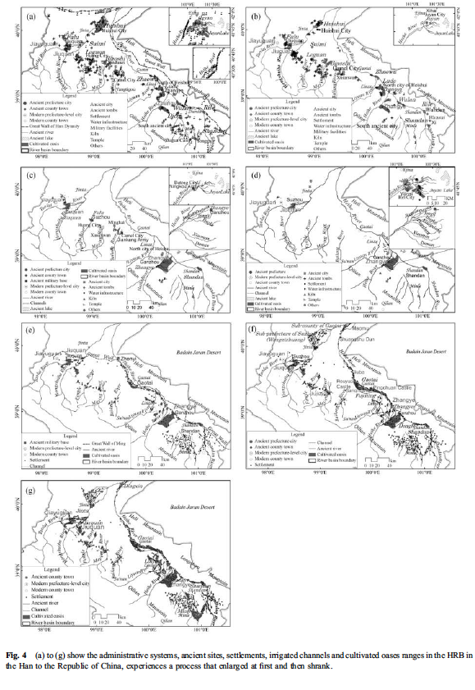
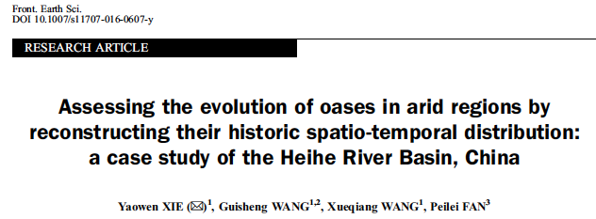
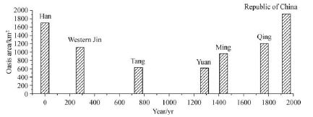
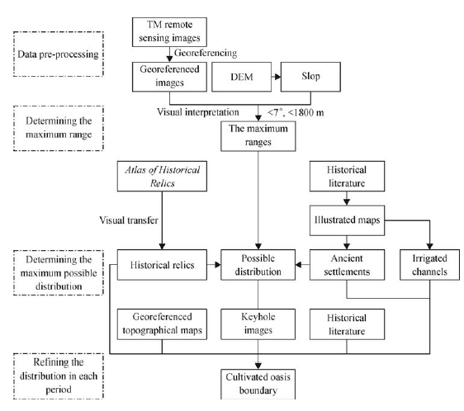
Patterns and Characteristics, methods (5) – Mapping the evolution of oases in arid regions for long historical period (121BC-1949)
Main highlights//findings:
historical spatio-temporal evolution (over 2000 years) of the cultivated oases in the Heihe River Basin was assessed
Multidisciplinary methods: historical literature analysis, archaeology, map analysis, visual interpretation of remote sensing (RS) images, and geographic information system (GIS)-based spatial analysis.
The spatial distribution: a continuous sprawl process, with the center of the oases moving gradually from the downstream region to the middle and even upstream regions.
Natural factors: pleasant climate
Main socioeconomic drivers: political and societal stability, national defense, agricultural policy, population, and technological progress
Notes:
cultivated oasis evolution in the HRB has been driven by both natural and socio-economic factors.
The oases were prosperous during warm periods, although their prosperity was not directly correlated with the availability of water resources. The oasis evolution was also consistent with conditions of political stability and national defense, closely linked with the customs of the inhabitants of different nationalities and the state of technological progress.

Slide 10
(2) drivers and spatial determinants
Urbanization and sustainability under global change and transitional economies: Synthesis from Southeast, East, and North Asia (SENA)
Economic development & Institutions (2 SENA cities): Hohhot and UB
Post-industrialization and globalization (SENA vs non-SENA city): Shanghai vs. Barcelona
Urban green space affect PM2.5?
Suburban residential land development – Spatial determinant: Case of Hangzhou
Suburbanization and capital accumulation

Slide 11
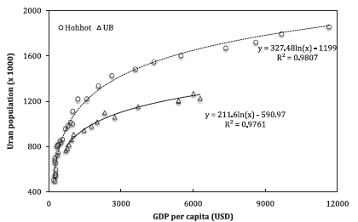
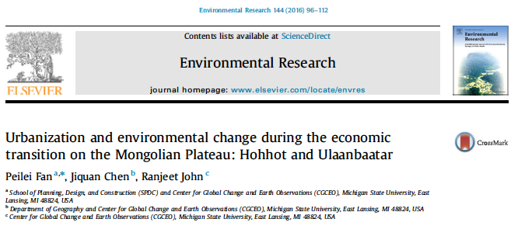
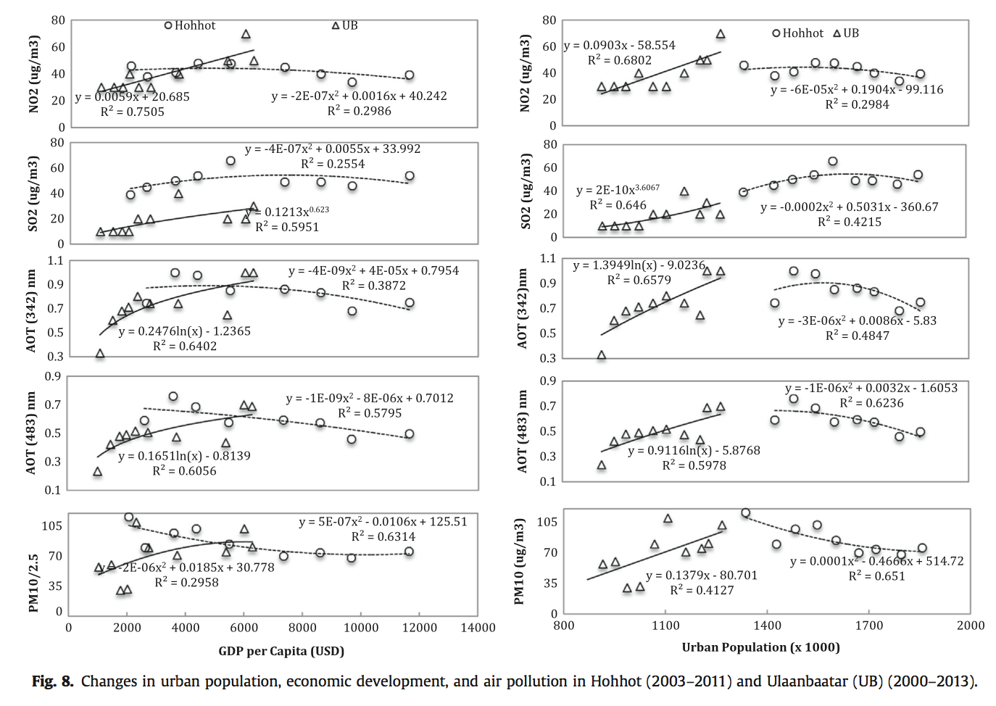
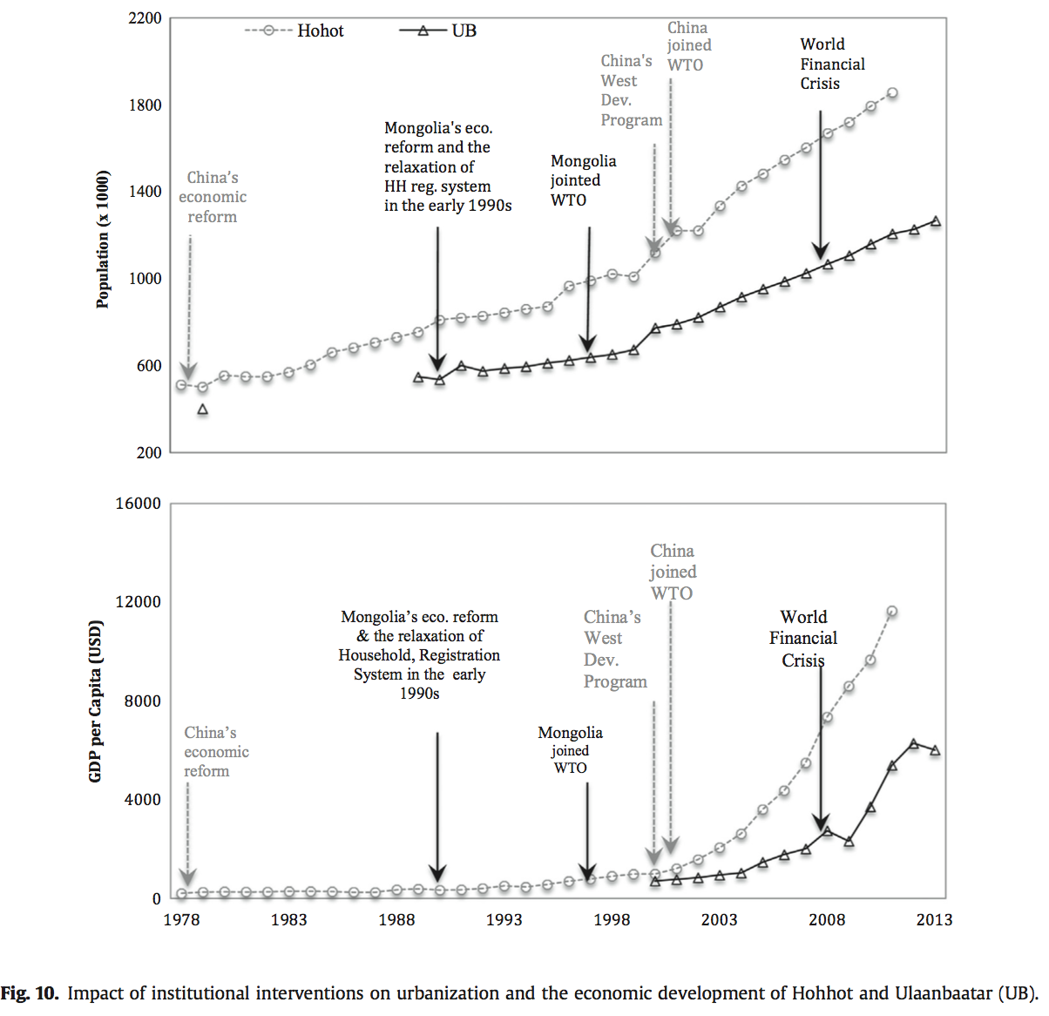
2. Drivers and determinants of urban LCLUC and urban environment
(1) Economic development & Institutions (2 SENA cities):
Hohhot and UB
Relationship between economic development and urban population growth
Air pollution and its relationship with economic development and urban population growth
Impact of institutional intervention on urban growth and economic development
Main research findings
(1) the co-evolution of urbanization, economic development, and environmental change;
while economic development serves as an essential driver for urban growth, its impact on urbanization seems to decrease over time
E.g., concentrations of air pollutants initially increased and then decreased as GDPpc increased, can be partly explained by the Environmental Kuznets Curve concept (air pollution first gets worse but then gets better when GDPpc increases)
(2) the urbanization of transitional economies has been driven by the change of the economic structure, i.e., the development by both manufacturing and tertiary sectors and the change in the primary sector. This is different from either developed countries whose urbanization was mainly pulled by industrialization or from low-income, developing countries whose urbanization was pushed by poverty in rural areas.
(3) the increasing integration with the global economy in the recent decade and the institutional force, despite the transition from central planning to the market paradigm, have stood out remarkably as key determinants for urbanization

Slide 12
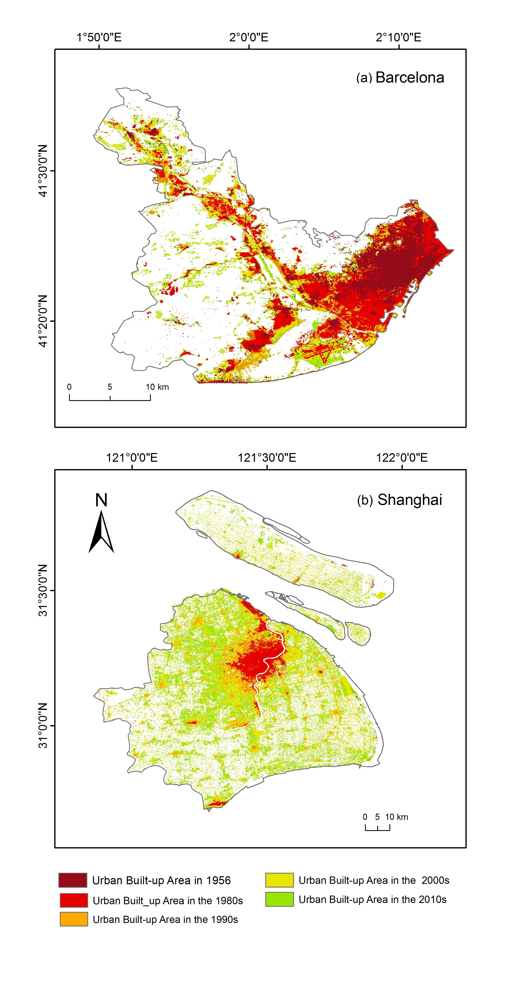
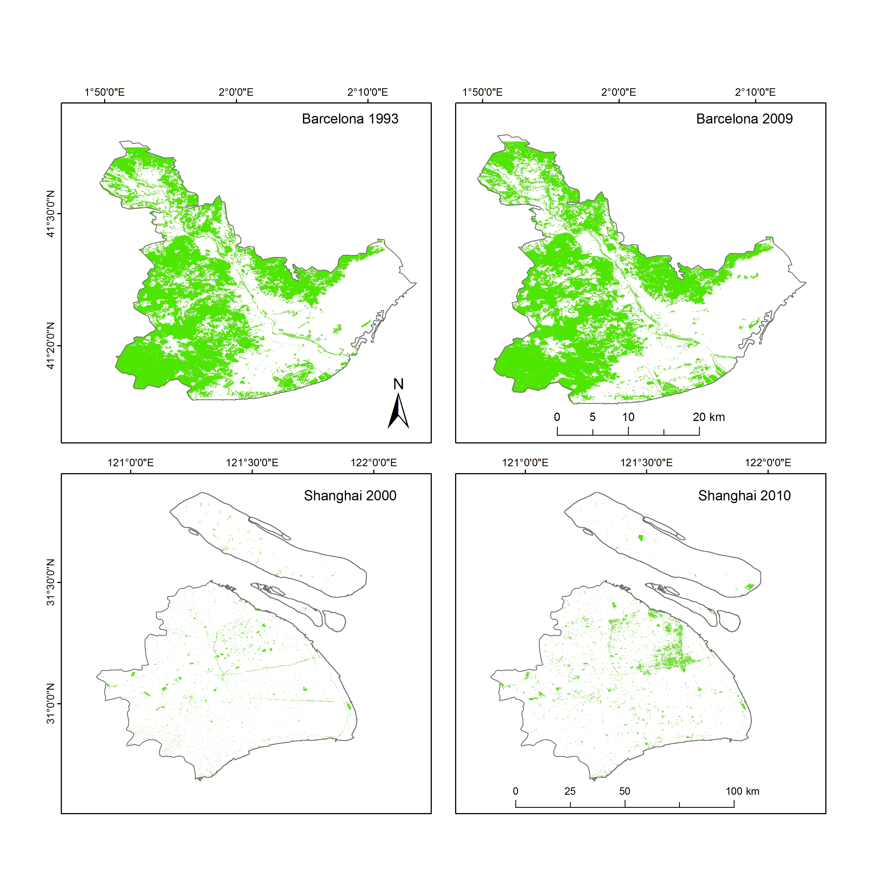
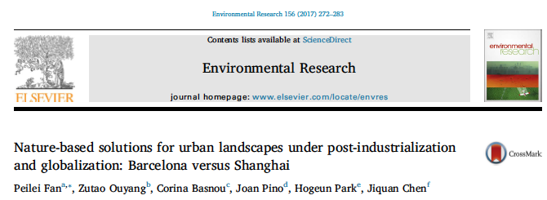
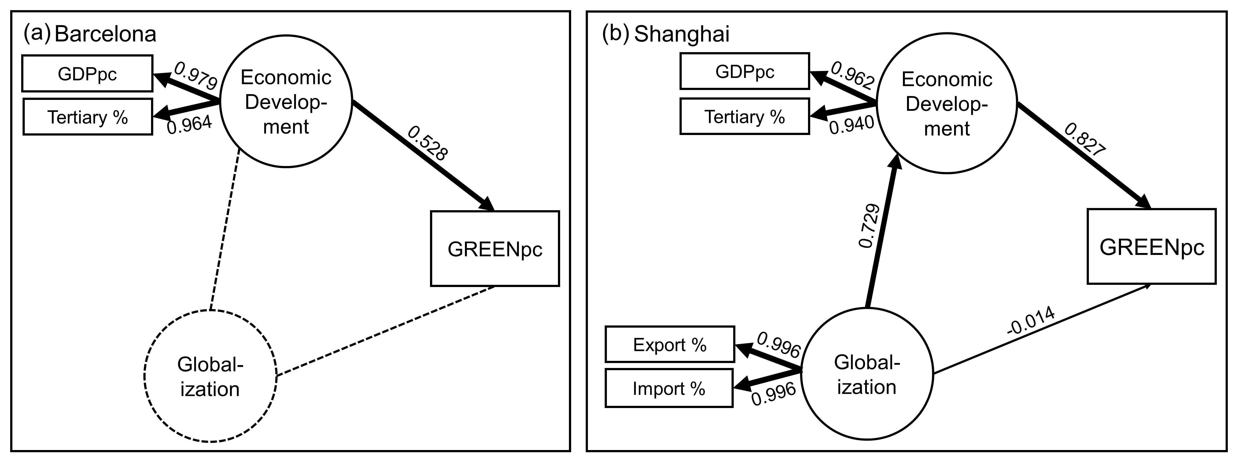
2. Drivers and determinants of urban LCLUC and urban environment
(2) Post-industrialization and globalization (SENA vs non-SENA cities)
Shanghai vs. Barcelona
Total green space (GREEN) in Barcelona (1993 & 2009) and Shanghai (2000 & 2010)
relationships between economic development, globalization, and environmental quality (PLS-SEM modeling results)
research questions:
What are the spatiotemporal changes in urban built-up land and green space in Barcelona and Shanghai?
(2) What are the relationships between economic development, exemplified by post-industrialization, globalization, and urban green space?
Findings
urban expansion in Barcelona beginning in the 1960s–1970s and in Shanghai in the last decade.
Barcelona’s urban green space and green space per capita began declining between the 1950s and 1990s, they increased slightly over the past two decades. Shanghai, has consistently and significantly improved urban green space and green space per capita over the past six decades, especially since the economic reform in 1978.
Economic development: a direct and significant influence on urban green space for both cities and post-industrialization had served as the main driving force
aspiration to become a global or globalizing city ( higher status in the global city hierarchy) institutional shifts, such as land property rights in a market economy vs. a transitional economy,
Notes:
Using Barcelona and Shanghai as case studies, we examined the nature-based solutions (NBS) in urban settings—specifically within cities experiencing post-industrialization and globalization.
Our specific research questions are:
What are the spatiotemporal changes in urban built-up land and green space in Barcelona and Shanghai?
(2) What are the relationships between economic development, exemplified by post-industrialization, globalization, and urban green space?
Urban land use and green space change were evaluated using data derived from a variety of sources, including satellite images, landscape matrix indicators, and a land conversion matrix. The relationships between economic development, globalization, and environmental quality were analyzed through partial least squares structural equation modeling (PLS-SME) based on secondary statistical data.
Findings
Both Barcelona and Shanghai have undergone rapid urbanization, with urban expansion in Barcelona beginning in the 1960s–1970s and in Shanghai in the last decade.
While Barcelona’s urban green space and green space per capita began declining between the 1950s and 1990s, they increased slightly over the past two decades. Shanghai, however, has consistently and significantly improved urban green space and green space per capita over the past six decades, especially since the economic reform in 1978.
Economic development has a direct and significant influence on urban green space for both cities and post-industrialization had served as the main driving force for urban landscape change in Barcelona and Shanghai.
Based on secondary statistical and qualitative data from on-site observations and interviews with local experts, we highlighted the institution’s role in NBS planning. Furthermore, aspiration to become a global or globalizing city motivated both cities to use NBS planning as a place-making tool to attract global investment, which is reflected in various governing policies and regulations. The cities’ effort to achieve a higher status in the global city hierarchy may have contributed to the increase in total green space and urban green per capita. In addition, various institutional shifts, such as land property rights in a market economy vs. a transitional economy, may also have contributed to the differences in efficiency when expanding urban green space in Barcelona and Shanghai.

Slide 13
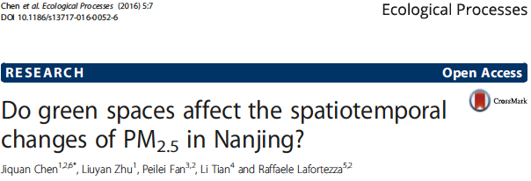
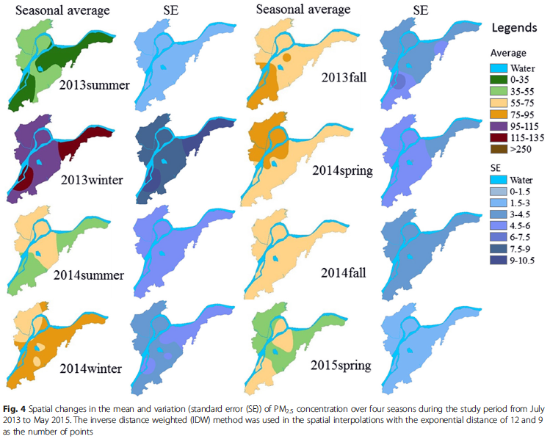
2. Drivers and spatial determinants of urban LCLUC and urban environment
(3) Urban green space affect PM2.5?
Objective: to understand the impact of green space on PM2.5’s spatio-temporal distributions in urban landscape (figure below) by using a case city of Nanjing (Chen et al, 2016).
Hypothesis: green vegetation had the potential to reduce PM2.5 concentration was accepted at specific seasons and scales.
Findings:
The PM2.5 concentration appeared very highly correlated (R2 > 0.85) with green cover in spring at 1– 2 km scales, highly correlated (R2 > 0.6) in autumn and winter at 4 km scale, and moderately correlated in summer (R2 > 0.4) at 2-, 5-, and 6-km scales.
However, a non-significant correlation between green cover and PM2.5 concentration was found when its level was >75 μg/m³.
Across the Nanjing urban landscape, the east and southwest parts had high pollution levels.
Notes:
Objective: to understand the impact of green space on PM2.5’s spatio-temporal distributions in urban landscape (figure below) by using a case city of Nanjing (Chen et al, 2016).
Hypothesis: green vegetation had the potential to reduce PM2.5 concentration was accepted at specific seasons and scales.
Findings: The PM2.5 concentration appeared very highly correlated (R2 > 0.85) with green cover in spring at 1– 2 km scales, highly correlated (R2 > 0.6) in autumn and winter at 4 km scale, and moderately correlated in summer (R2 > 0.4) at 2-, 5-, and 6-km scales. However, a non-significant correlation between green cover and PM2.5 concentration was found when its level was >75 μg/m³. Across the Nanjing urban landscape, the east and southwest parts had high pollution levels.

Slide 14
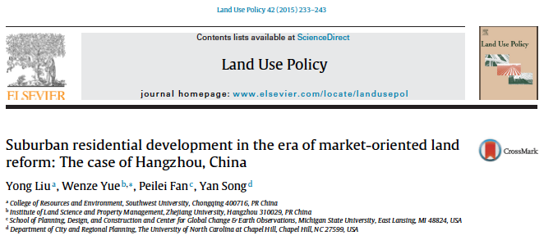
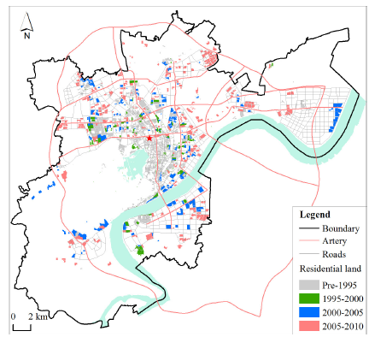
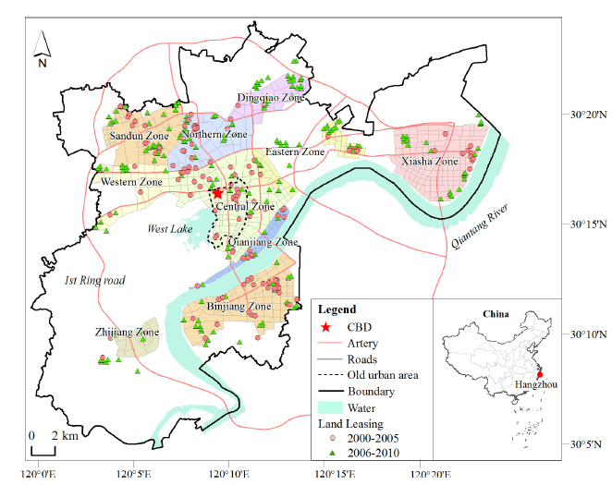
2. Drivers and spatial determinants of urban LCLUC and urban environment
(4) Suburban residential land development – Spatial determinant: Case of Hangzhou
Residential land development in Hangzhou.
Residential land leased and division of residential market zones between 2000 and 2010.
Data: based on parcel-level land use data and site-specific land leasing data
Method: The major spatial determinants of residential land development were identified through Logit models on the scales of timing, density, and intensity.
Findings:
Hangzhou has formed a fragmented and dispersed pattern in the suburbs, characterized by large-scale development and a relatively low floor area ratio.
Major spatial determinants: travel time to the central business district, distance to urban arteries, distance to schools and colleges, distance to Qiantang River (the new urban development center), percentage of industrial land and residential land, and surrounding land
The residential development was encouraged in suburbs despite the lack of adequate public facilities.
Notes:
Method: The major spatial determinants of residential land development were identified through Logit models on the scales of timing, density, and intensity.
Data: based on parcel-level land use data and site-specific land leasing data
Findings:
Hangzhou has formed a fragmented and dispersed pattern in the suburbs, characterized by large-scale development and a relatively low floor area ratio.
Major spatial determinants: travel time to the central business district, distance to urban arteries, distance to schools and colleges, distance to Qiantang River (the new urban development center), percentage of industrial land and residential land, and surrounding land
The residential development was encouraged in suburbs despite the lack of adequate public facilities.

Slide 15
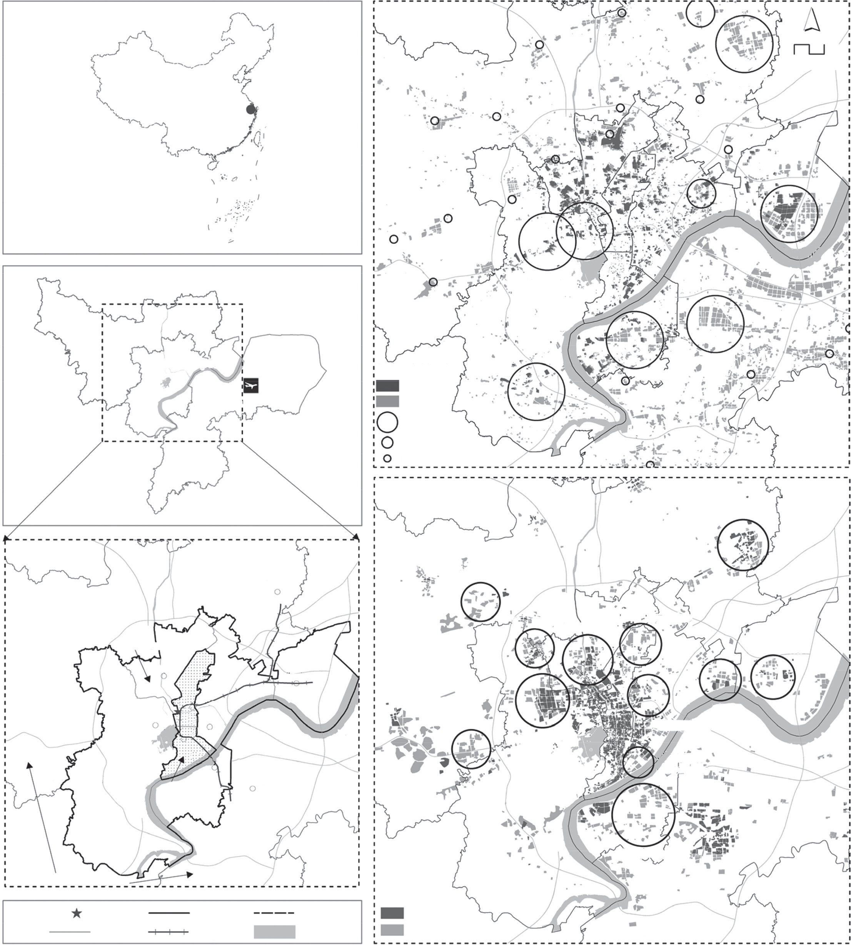
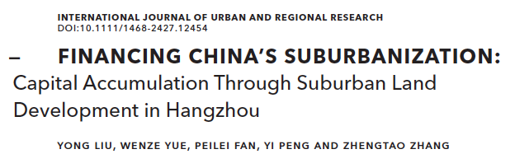
2. Drivers and spatial determinants of urban LCLUC and urban environment
(5) Suburbanization and capital accumulation
Figure =>
(a) Location of Hangzhou
(b) Conversion of industrial land from 2000 to 2010
(c) Conversion of residential land from 2000 to 2010
Objective: how land-based capital is used to finance massive investment in suburbanization by China’s local governments during the 2000s.
Findings:
local governments have attempted to simultaneously strengthen housing development and industrial growth.
China’s suburbanization was not necessarily the result of diversion of excess capital from over-accumulated investments in the manufacturing industry, but facilitated by local government
Local governments and their affiliated land-reserve centers and local investment platforms have acted as entrepreneurs by using profits from suburban property development to subsidize industrial investments and fund the infrastructure-supported expansion of outer suburbs.
Policy Implications: potential risks of land-centered accumulation and provide important reflections upon the theory of David Harvey in the context of urban China.
Notes:
Objective: how land-based capital is used to finance massive investment in suburbanization by China’s local governments during the 2000s.
Findings:
local governments have attempted to simultaneously strengthen housing development and industrial growth.
In contrast to experiences of suburbanization in Western countries, a real estate boom during the early days of suburbanization was not necessarily the result of diversion of excess capital from over-accumulated investments in the manufacturing industry. Rather, it was a consequence of capital accumulation facilitated by land-reserve systems and land-based financing of infrastructure orchestrated by local government.
Local governments and their affiliated land-reserve centers and local investment platforms have acted as entrepreneurs by using profits from suburban property development to subsidize industrial investments and fund the infrastructure-supported expansion of outer suburbs.
Policy Implications: potential risks of land-centered accumulation and provide important reflections upon the theory of David Harvey in the context of urban China.
Location of Hangzhou (a) and conversion of industrial land (b) and
residential land (c) in Hangzhou from 2000 to 2010

Slide 16
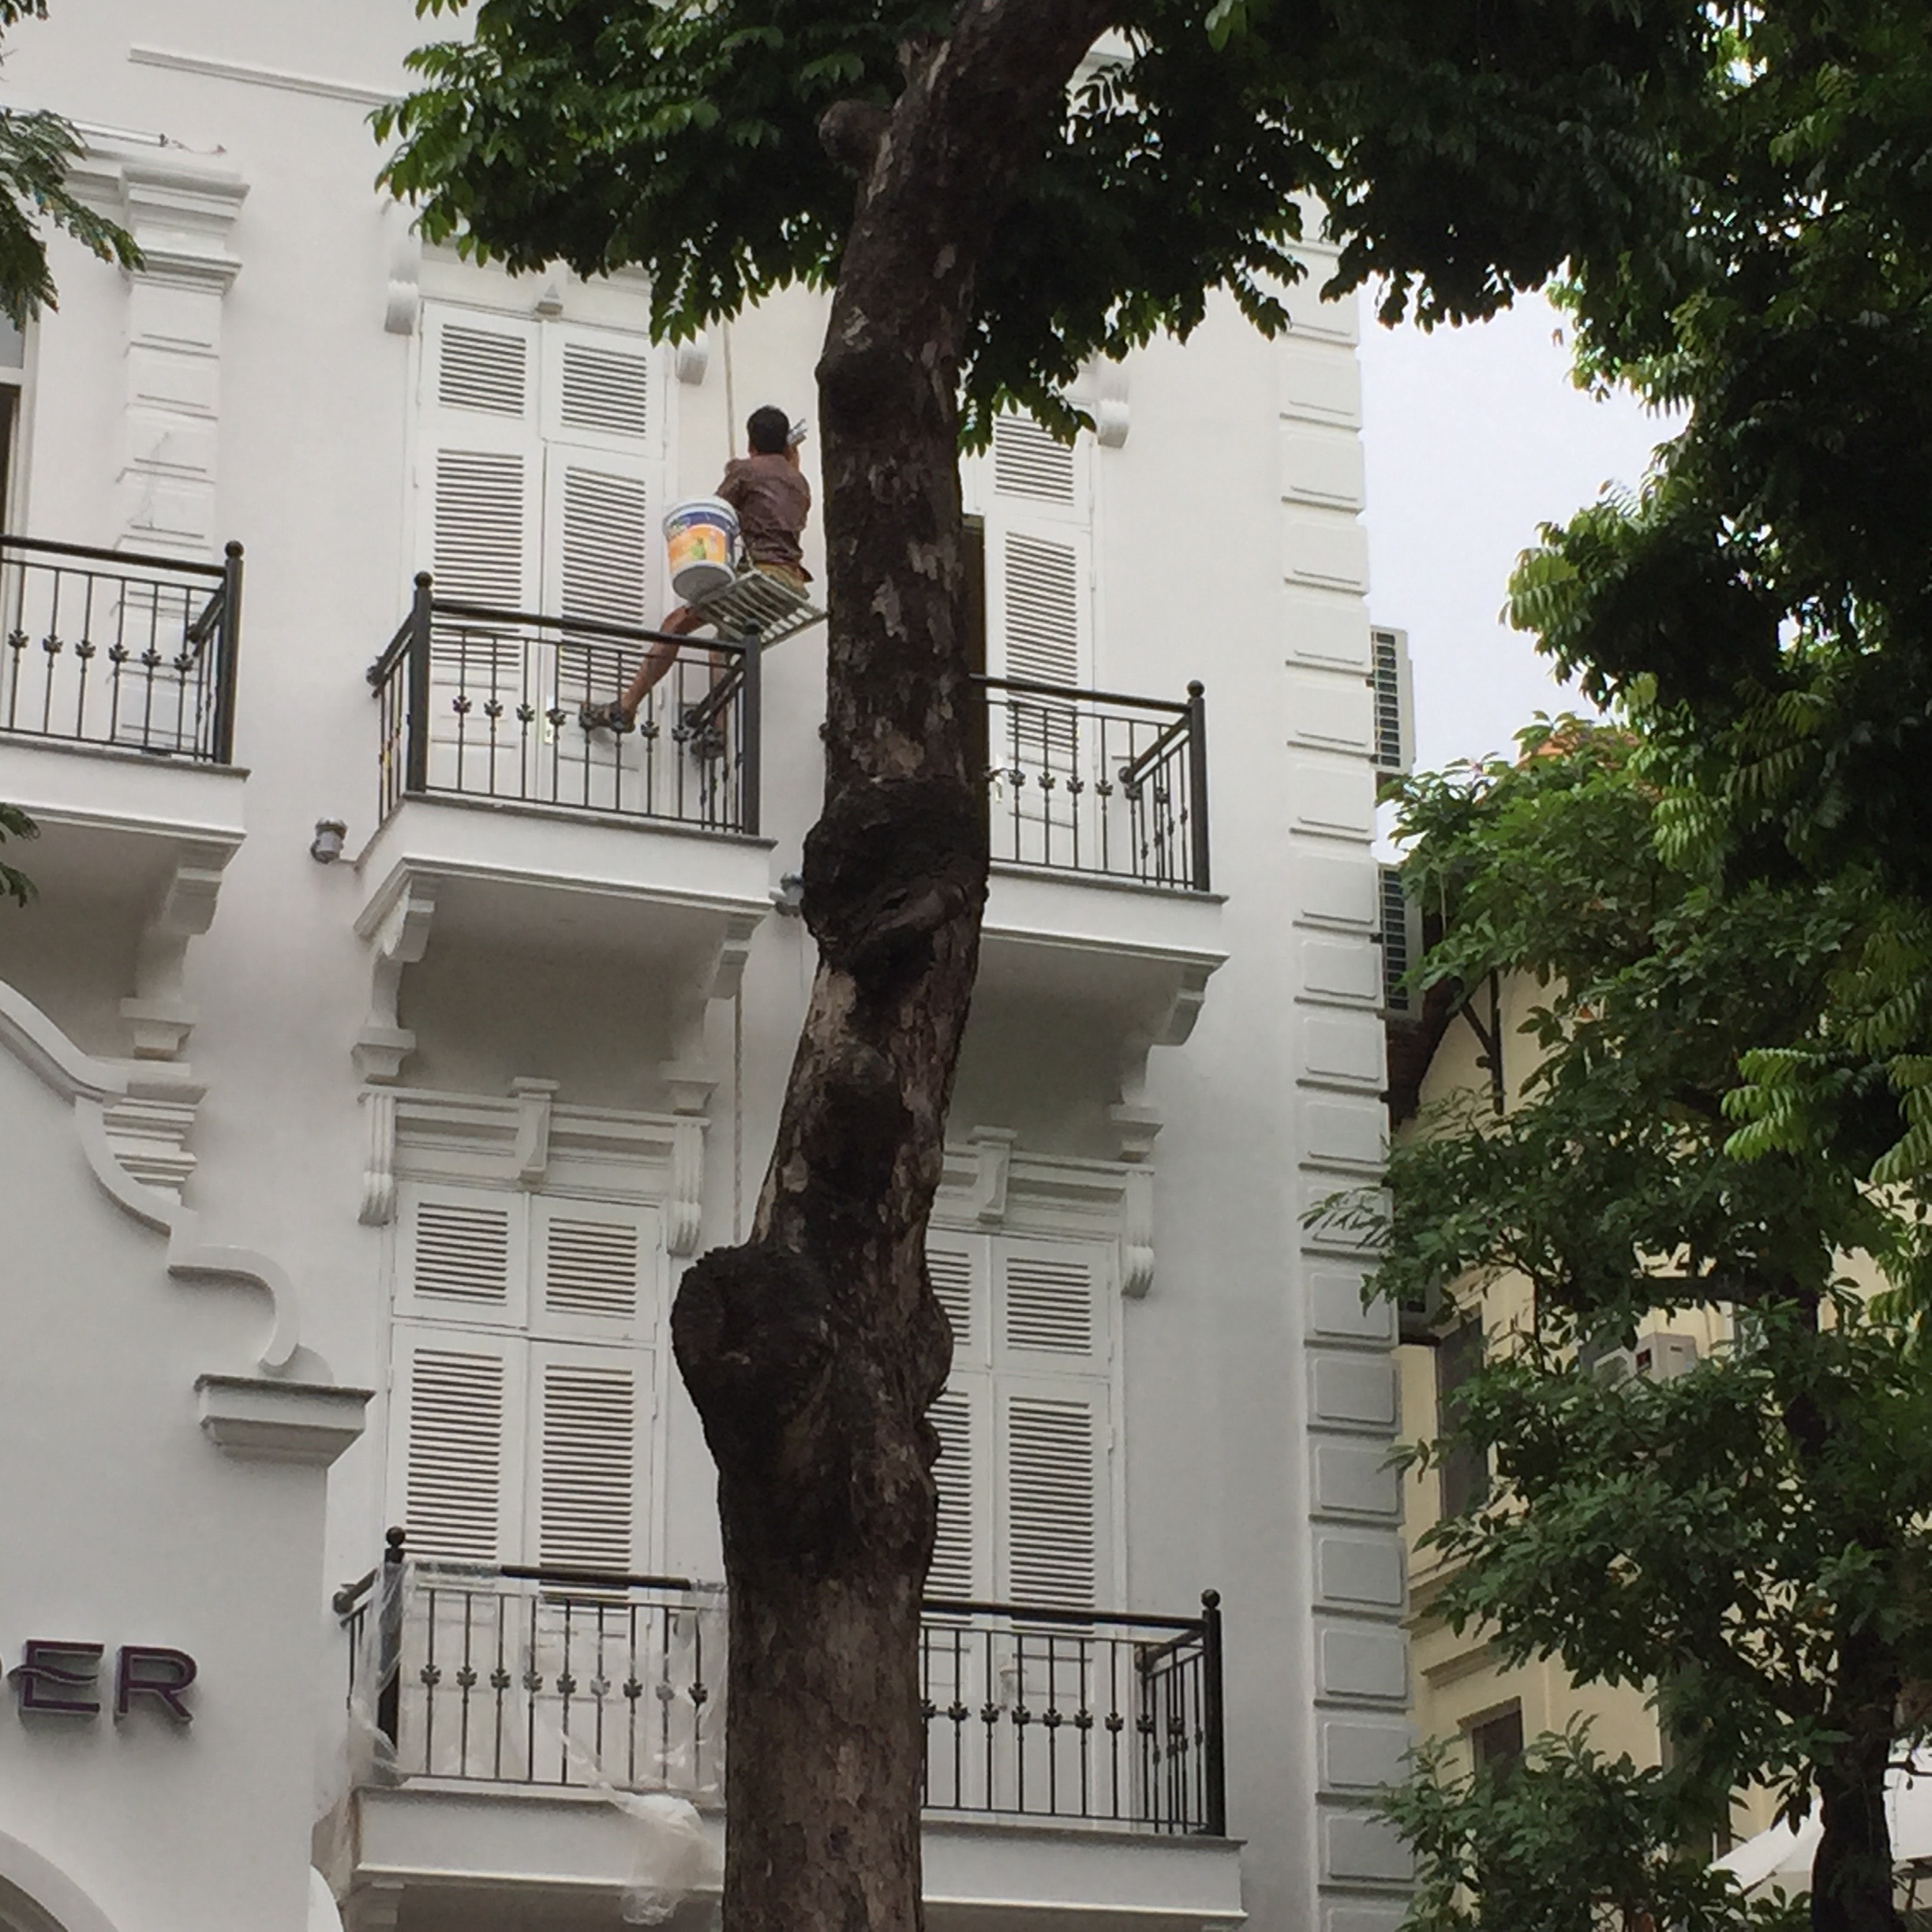
(3) Impacts
Urbanization and sustainability under global change and transitional economies: Synthesis from Southeast, East, and North Asia (SENA)
Urbanization & social equity:
public urban green accessibility
(2) Urbanization on walkability
(3) Urbanization on hydrology

Slide 17
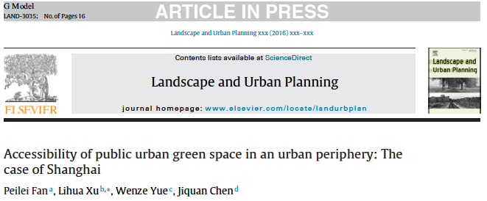
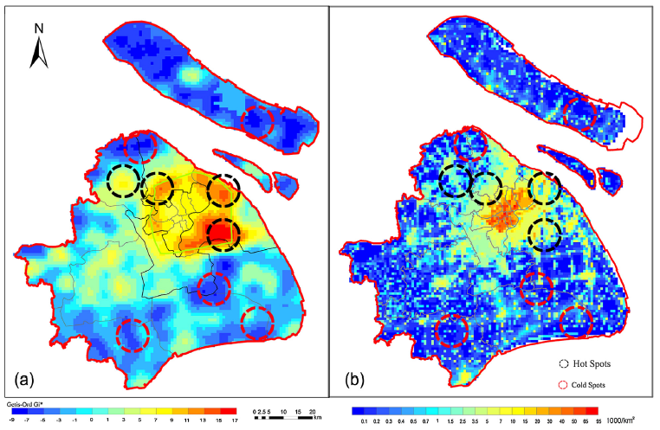
3. Impacts (1)
Urbanization & social equity: public urban green accessibility
Spatial distribution of hot and cold spots of green accessibility index (GAI) in Shanghai overlaid with , 2010 GAI (L), 2010 population density (R)
Method and Findings
We constructed a composite index named the “green accessibility index” (GAI), which measures how well residents are treated in terms of access to different types of public urban green spaces.
Shanghai and its districts have improved their green accessibility index from 2000 to 2010. However, the GAI in the urban periphery fell behind the city average.
While the inner suburbs, especially Pudong and Baoshan, had fared quite well in green accessibility improvement, outer suburbs made moderate progress in comparison to the city average.
We identified hot/cold spots and spatial clustering that had a high/low green accessibility index in the urban periphery. The cold spots are in urgent need of substantial improvements to green space accessibility.
Notes:
http://dx.doi.org/10.1016/j.landurbplan.2016.11.007
By using Shanghai, China as a case study, we illustrated how to evaluate the access to public green spaces of an urban periphery and how planning processes can influence the improvement of such access.
We constructed a composite index named the “green accessibility index” (GAI), which measures how well residents are treated in terms of access to different types of public urban green spaces.
Shanghai and its districts have improved their green accessibility index from 2000 to 2010. However, the GAI in the urban periphery fell behind the city average.
Furthermore, while the inner suburbs, especially Pudong and Baoshan, had fared quite well in green accessibility improvement, outer suburbs made moderate progress in comparison to the city average.
We identified hot/cold spots and spatial clustering that had a high/low green accessibility index in the urban periphery. The cold spots are in urgent need of substantial improvements to green space accessibility.

Slide 18
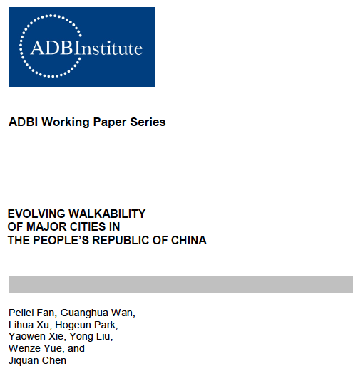
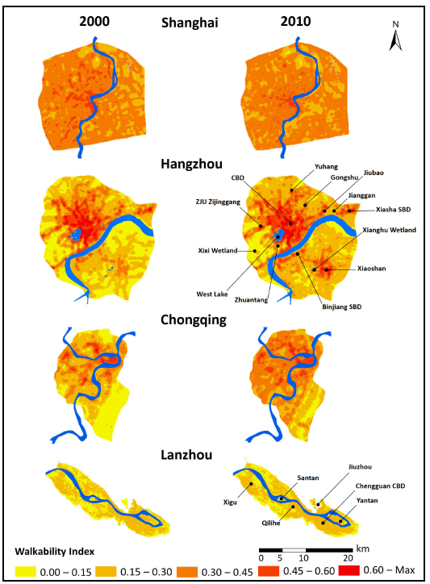
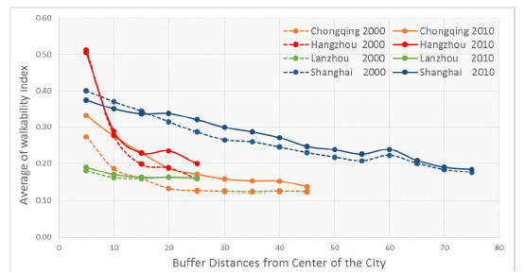
3. Impacts (2)
urbanization on walkability
Method and contribution:
A comprehensive walkability index is developed to integrate five aspects of the urban built environment: dwelling density, street connectivity, land-use mix, access to public transit, and elevation variation.
The walkability index method developed in this paper can be widely adopted due to its comprehensiveness, simplicity, and flexibility.
Findings:
Great variations exist among the four cities in terms of speed, scale, and locations of changes of walkability.
In 2000­–2010, the inner cities of Hangzhou, Chongqing, and Lanzhou and the entire cities of Shanghai and Chongqing increased their walkability index, whereas the inner city of Shanghai had decreased walkability.
For inner cities, Shanghai had the highest average walkability index, whereas Lanzhou held the lowest in 2010.
Walkability declines as distance to the center increased but it exhibited different patterns for different cities.
Notes:
Method and contribution:
A comprehensive walkability index is developed to integrate five aspects of the urban built environment: dwelling density, street connectivity, land-use mix, access to public transit, and elevation variation.
The walkability index method developed in this paper can be widely adopted due to its comprehensiveness, simplicity, and flexibility.
Findings:
Great variations exist among the four cities in terms of speed, scale, and locations of changes of walkability.
In 2000­–2010, the inner cities of Hangzhou, Chongqing, and Lanzhou and the entire cities of Shanghai and Chongqing increased their walkability index, whereas the inner city of Shanghai had decreased walkability.
For inner cities, Shanghai had the highest average walkability index, whereas Lanzhou held the lowest in 2010.
Walkability declines as distance to the center increased but it exhibited different patterns for different cities.

Slide 19
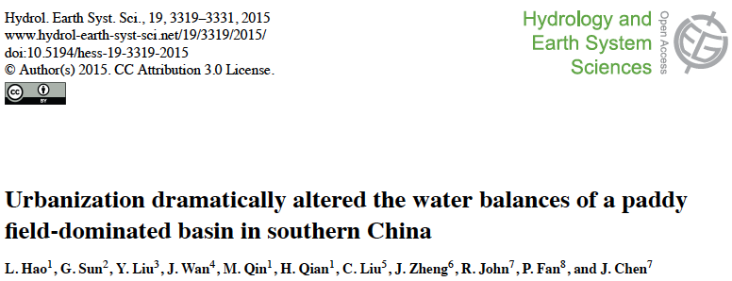
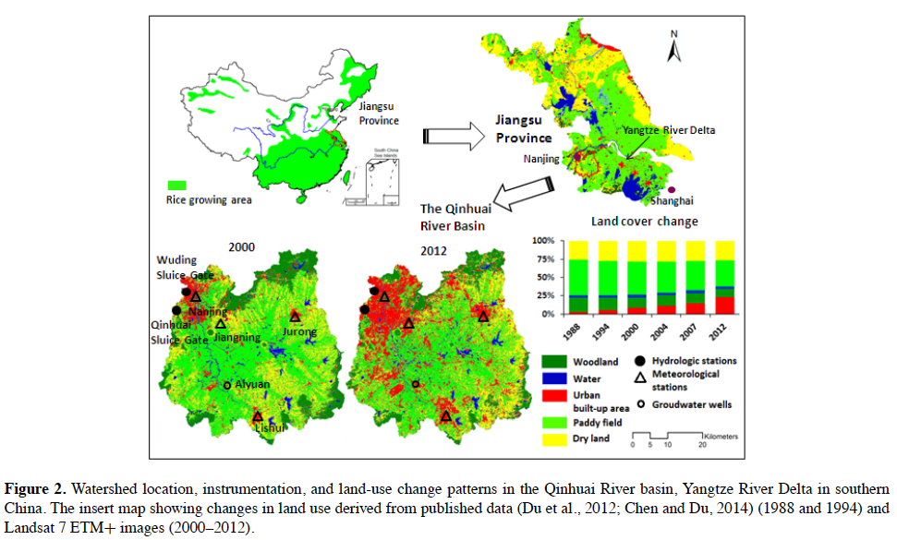
3. Impacts (3) Urbanization on hydrology
Findings
We found that stream flow increased by 58% and evapotranspiration (ET) decreased by 23% during 1986–2013 as a result of a threefold increase in urban areas and a reduction of rice paddy fields by 27 %.
Attribution analysis, based on two empirical models, indicated that land-use/land-cover change contributed about 82–108% of the observed increase in stream flow from 353 +/- 287mmyr-1 during 1986–2002 to 556+/-145 during 2003–2013.
The effects of land-use change overwhelmed the effects of regional climate warming and climate variability.
The ongoing large-scale urbanization of the rice paddy-dominated regions, in humid southern China and East Asia, will likely elevate storm-flow volume, aggravate flood risks, and intensify urban heat island effects.
Notes:
Major findings:
We found that stream flow increased by 58% and evapotranspiration (ET) decreased by 23% during 1986–2013 as a result of a threefold
increase in urban areas and a reduction of rice paddy fields by 27 %.
Both high flows and low flows increased significantly by about 28% from 2002 to 2013. The increases in stream flow were consistent with the decreases in ET
and leaf area index monitored by independent remote sensing MODIS (Moderate Resolution Imaging Spectroradiometer)
data.
Attribution analysis, based on two empirical models, indicated that land-use/land-cover change contributed about 82–108% of the observed increase in stream flow from 353 +/- 287mmyr-1 during 1986–2002 to 556+/-145 during 2003–2013.
We concluded that the reduction in ET was largely attributed to the conversion of cropland to urban use.
The effects of land-use change overwhelmed the effects of regional climate warming and climate variability.
Converting traditional rice paddy fields to urban use dramatically altered land surface conditions from an artificial wetland dominated landscape to an urban land-use- dominated one, and thus was considered an extreme type of contemporary hydrologic disturbance.
The ongoing large-scale urbanization of the rice paddy-dominated regions, in humid southern China and East Asia, will likely elevate storm-flow volume,
aggravate flood risks, and intensify urban heat island effects.
Understanding the connection between land-use/land-cover change and changes in hydrological processes is essential for better management of urbanizing watersheds in the rice paddy-dominated landscape.

Slide 20
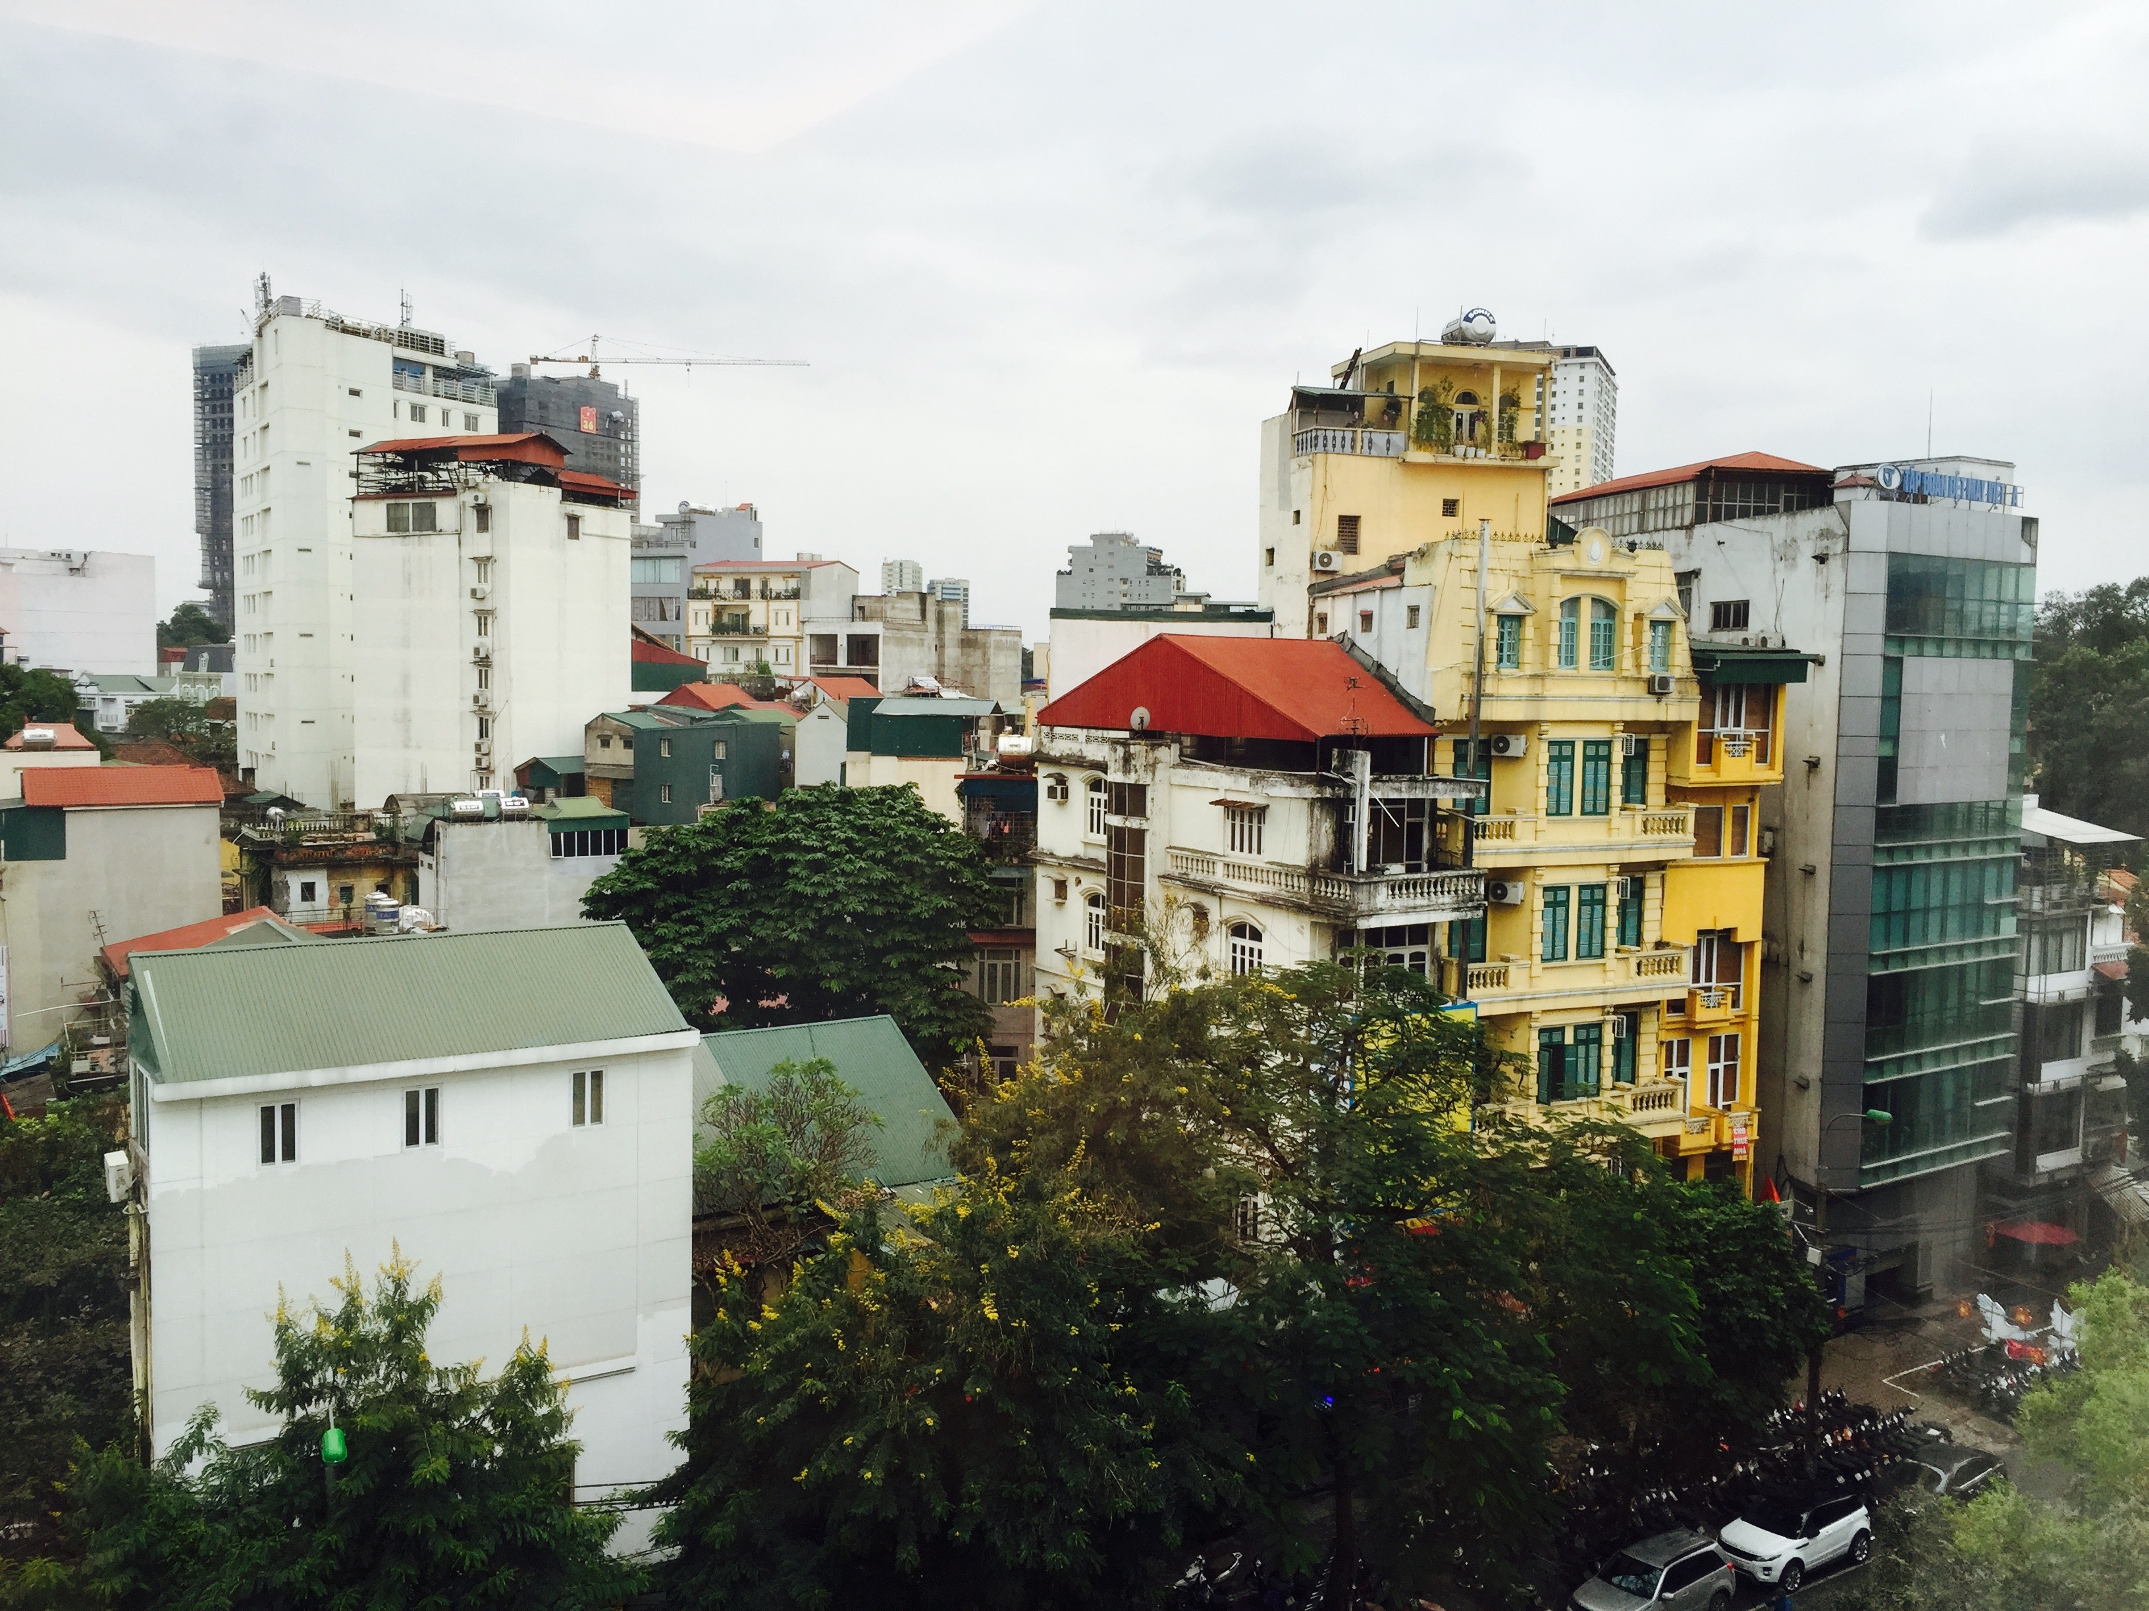
(4) Forecast synthesis:
Future Scenarios
Urbanization and sustainability under global change and transitional economies: Synthesis from Southeast, East, and North Asia (SENA)
2 workshops focus on SENA cities scenarios (Yangon and HCMC)

Slide 21
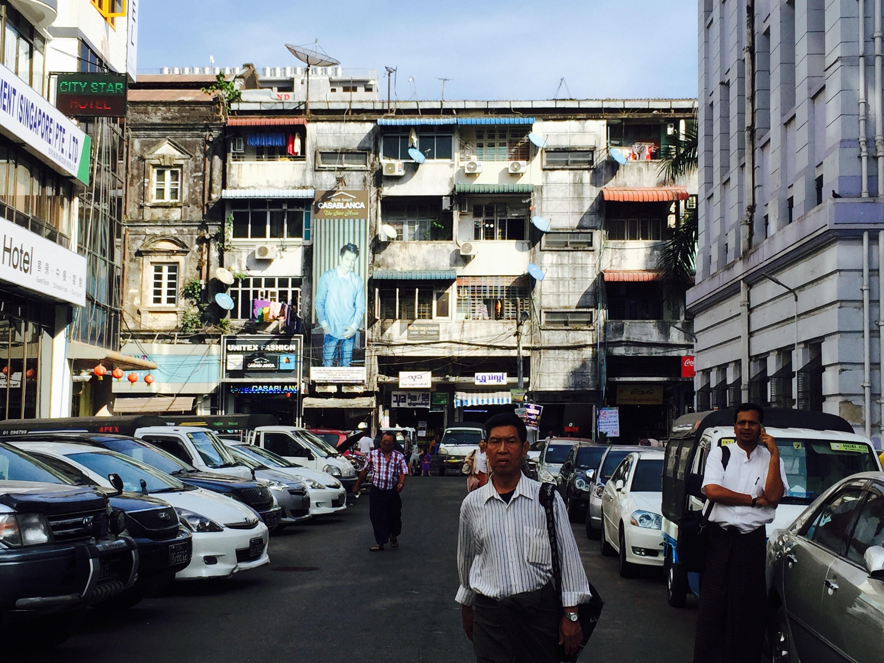
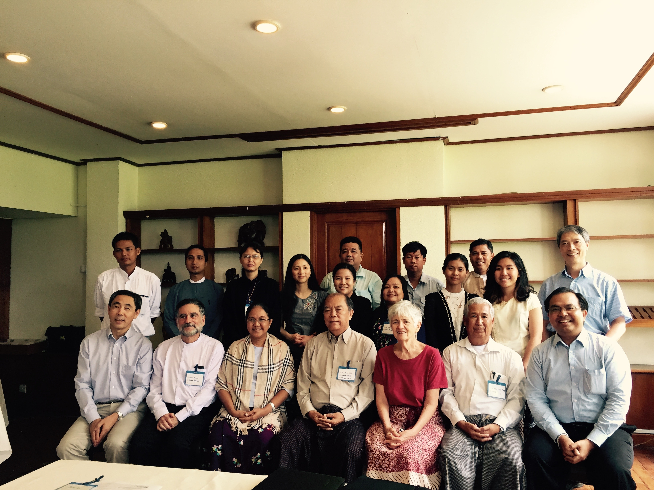
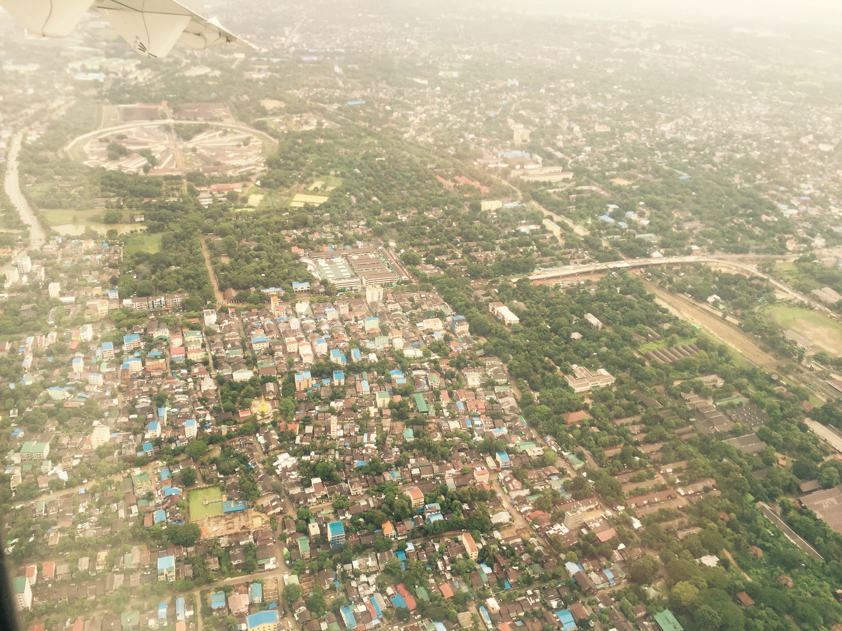
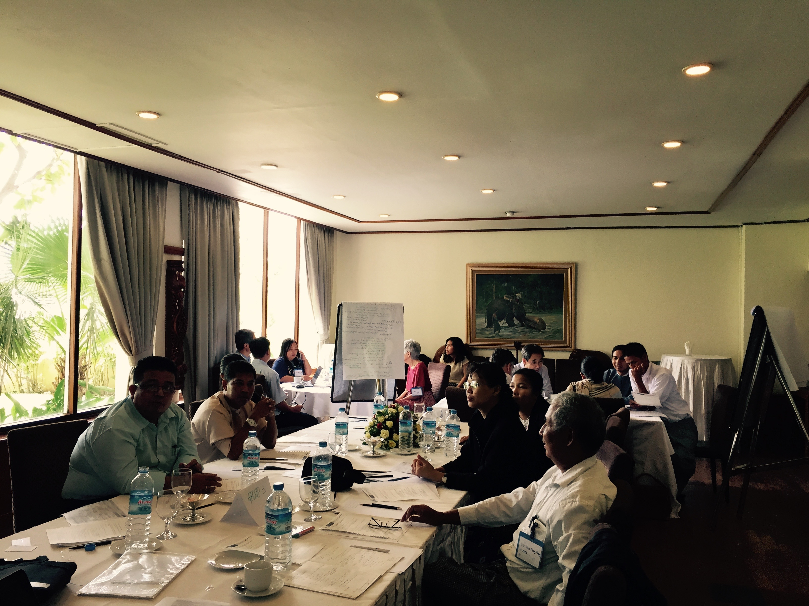
4. Scenarios
Workshop (1)
Yangon
June 20, 2015
Yangon Workshop on Urbanization and Sustainability in SENA
Objectives
Building Yangon Urbanization and Sustainability Research Network for future collaboration
Major causes of urban development of Yangon
Future development trends of Yangon
Unique characteristics of Yangon from other cities in Myanmar
Identify data & knowledge gaps and create data inventory for sustainable urban development for Yangon
Co-hosted by Mandalay Technology and CGCEO, MSU. (20 participants, with 17 from Myanmar, from academics, government ministries, local government, and companies)
Outcomes
Shared and exchanged ideas, data, and knowledge on urban development of Yangon (patterns, causes, impacts, future scenarios)
Discussed existing and future geo-spatial data products (land, climate, population & socioeconomic can be generated from the project
An established network for future collaboration for grants, projects, publications, and exchange of scholars
Notes:
Yangon Workshop

Slide 22
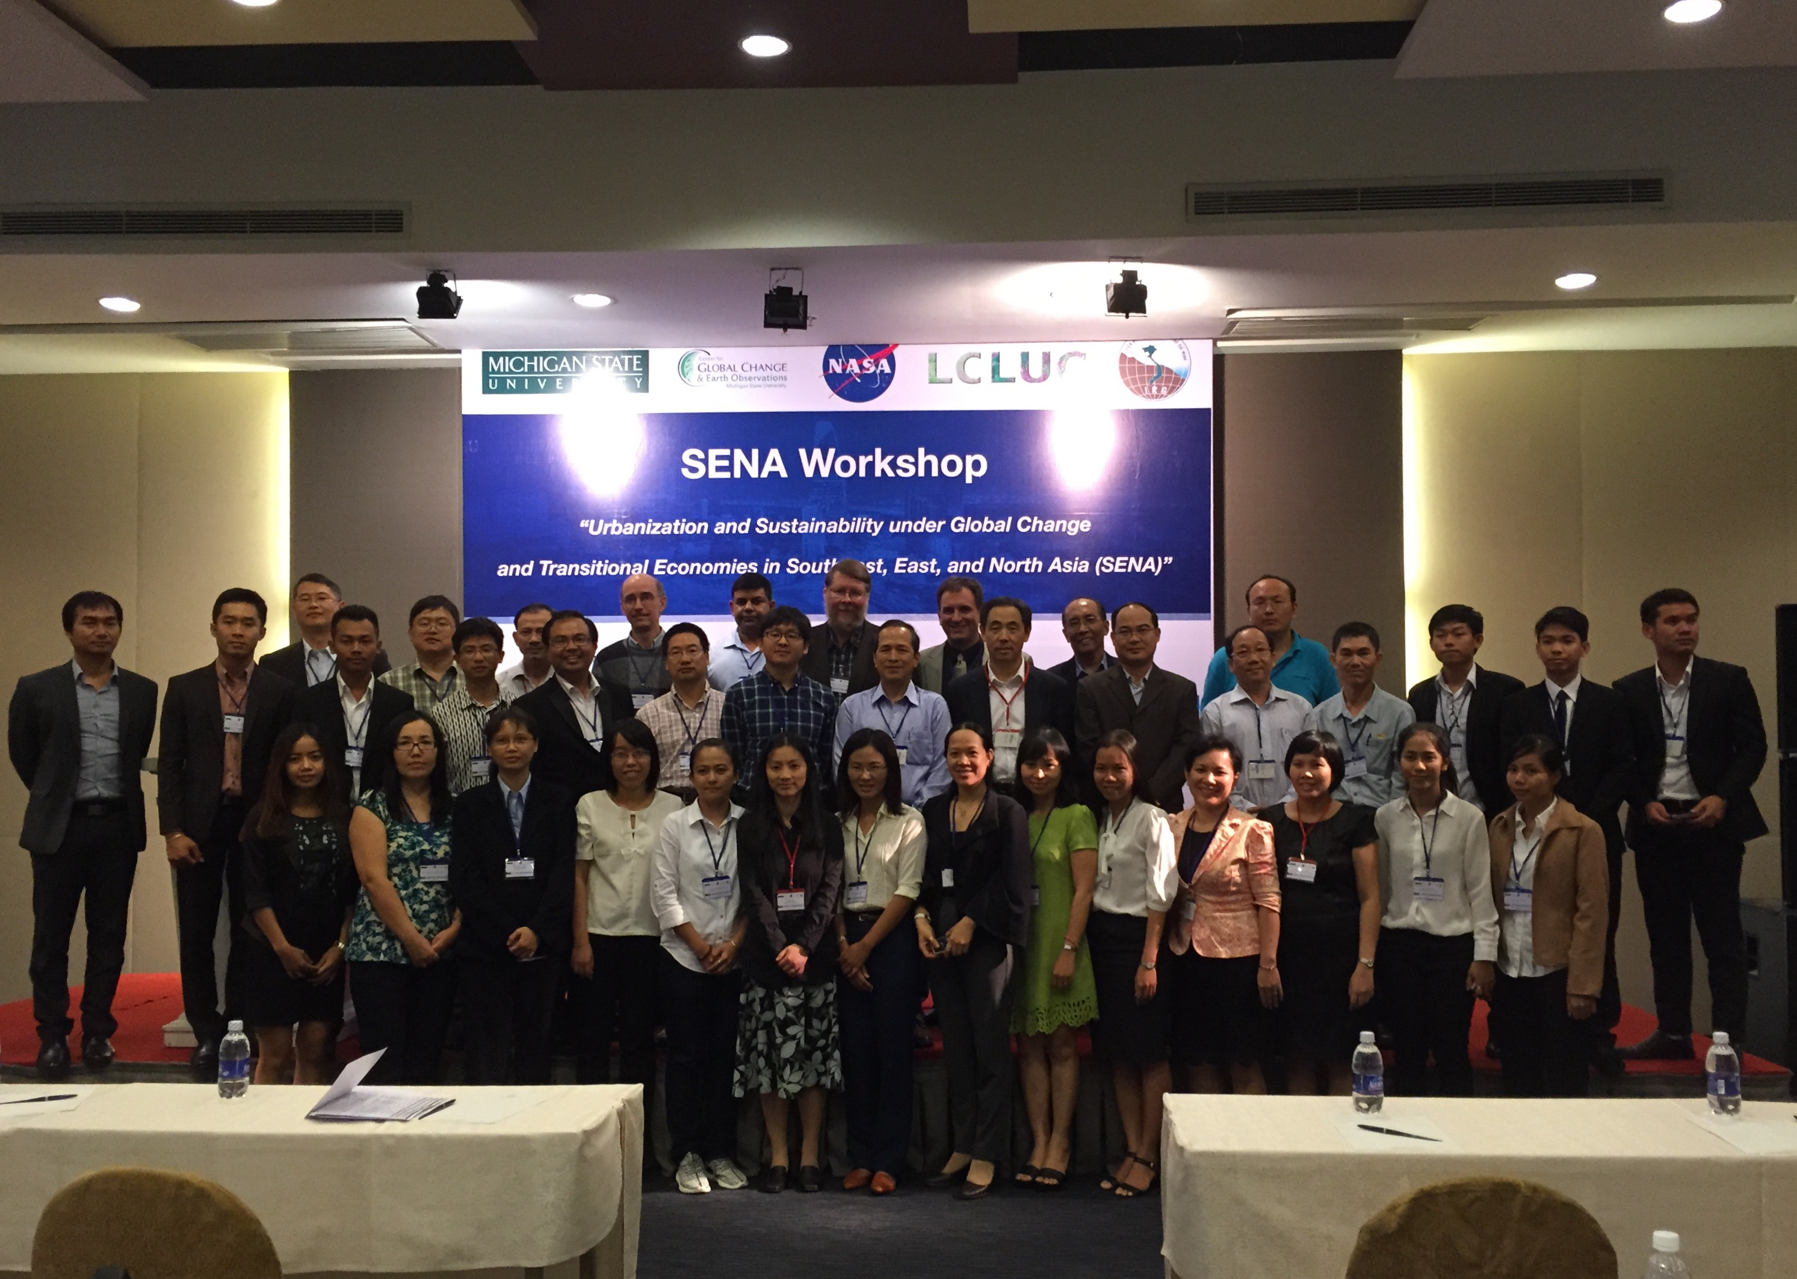
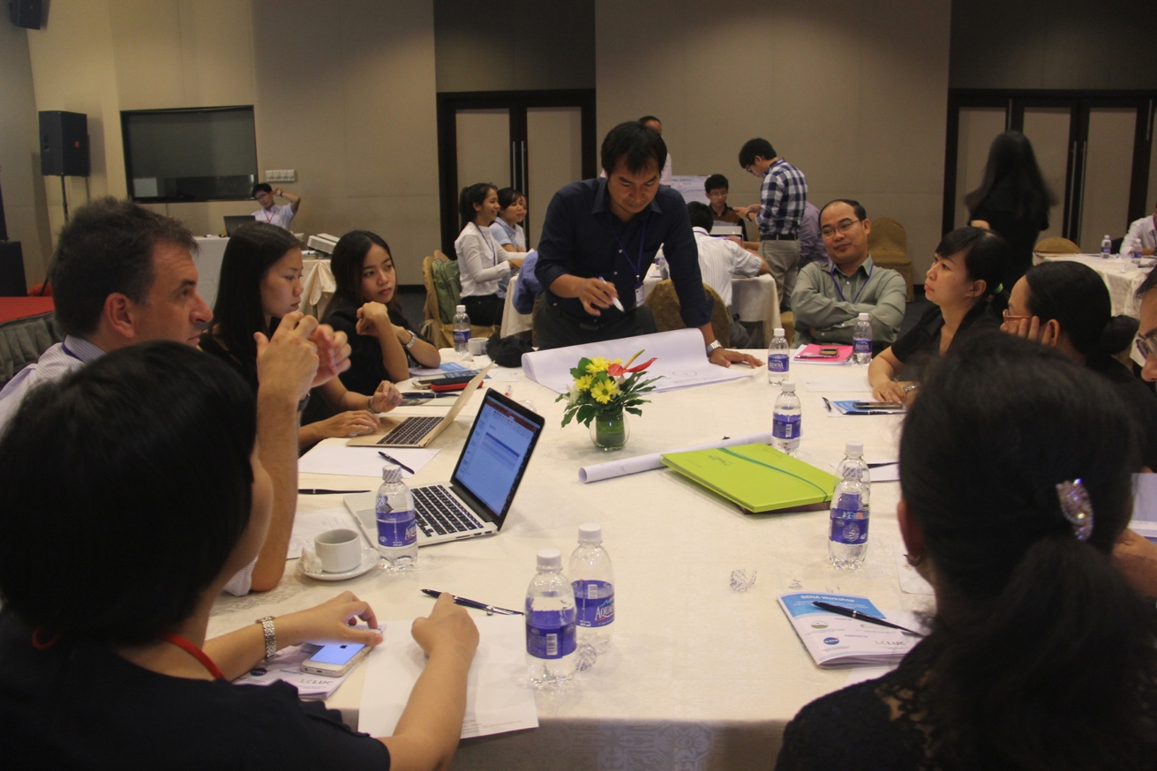
4. Scenarios
Workshop (2)
Ho Chi Minh City Nov. 4-6, 2015
Objectives
Discuss the major causes of urban expansion, the main impacts and consequences of urbanization, and the possible future development scenarios for cities
Phnom Penh, Ho Chi Minh City, Hanoi, Vientiane, and Yangon of Southeast Asia; Shanghai, Shenzhen, Chongqing, Lanzhou, Hohhot, and Urumqi of China;
Siberian cities (Irkutsk, Novosibirsk, Omsk, Yekaterinburg, and Khabarovsk )and Ulaanbaatar.
Co-hosted Ho Chi Minh City Institute of Resources Geography, Vietnam Academy of Science and Technology (HCMIRG of VAST) and Center for Global Change and Earth Observations (CGCEO), Michigan State University (MSU)
Outcomes
Shared and exchanged opinions and knowledge on major causes of urban expansion in the past thirty years.
Discussed the impact and consequences of urbanization in China, Vietnam, Laos, Mongolia, and Myanmar.
Proposed possible development scenarios in future
Notes:
HCMC

Slide 23
On-going and next step
Urbanization and sustainability under global change and transitional economies: Synthesis from Southeast, East, and North Asia (SENA)
Workshop in UB
SIs (Landscape and Urban Planning, Ecological Indicators)
More regional level analysis (e.g., North Asia synthesis, development scenarios simulations for SENA cities, suburbanization in SENA cities, SENA in the global urban context)

Slide 24
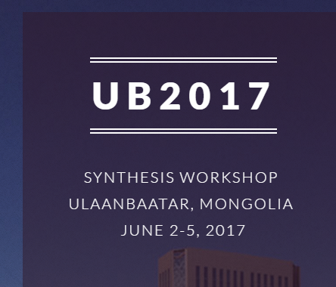
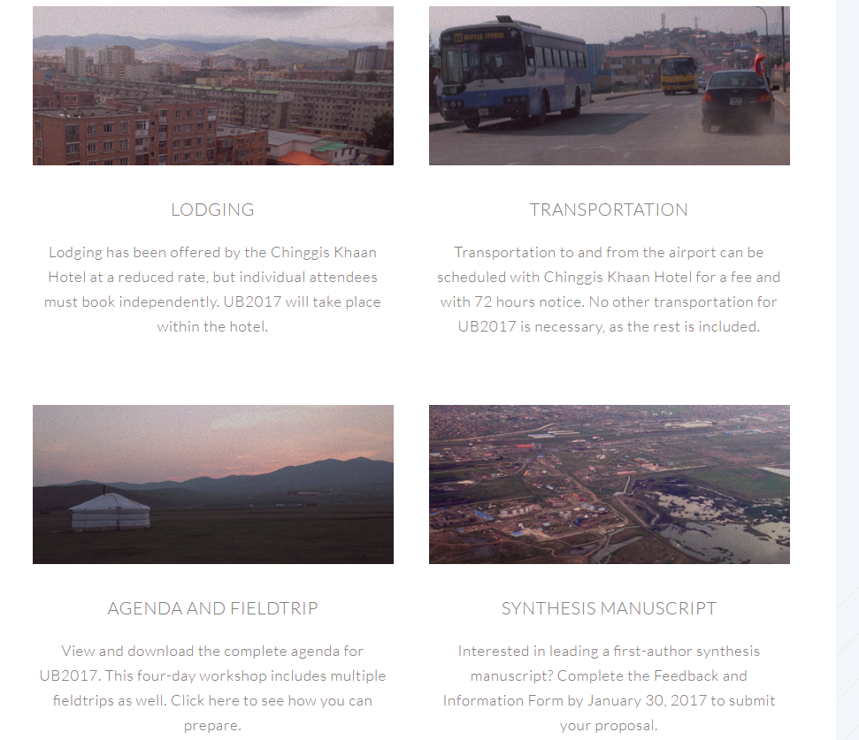

5. On-going and future (1): Workshop (3) in UB, Mongolia
http://lees.geo.msu.edu/research/UB2017/
Ulaanbaatar workshop SENA and CNH
Objectives
To synthesize our collective data, resources, and talents
To discuss selected synthesis manuscripts which will be targeted for publications
To discuss efficient ways of sharing data and resources.
Co-hosted by Institute of Geography-Geoecology, Mongolia Academy of Science (IGG, MAS), Saruul Khuduu Environmental Research & Consulting (SKERC),
And Center for Global Change and Earth Observations (CGCEO), Michigan State University (MSU)

Slide 25
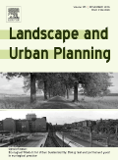



Call for Papers: Special Issue on “Evolving Landscapes under Institutional Change, Globalization, and Cultural Influence in Contrasting Urban Systems”
5. On-going and future (2):
SI with Landscape and Urban planning
Guest Editors:
Peilei Fan (Michigan State University, USA)
Jiquan Chen (Michigan State University, USA)
Jingle Wu (Arizona State University, USA)
01/01/2017: Abstract deadline (title, abstracts, key words, bios)
06/01/2017: Submission of manuscripts
03/01/2018: Recommendations to the facilitating Co-Editors-in-Chief of LAND
http://www.journals.elsevier.com/landscape-and-urban-planning/news/call-for-papers-special-issue-on-evolving-landscapes

Slide 26


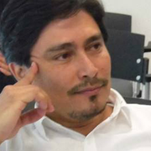
Call for Papers: Special Issue on “From urban sprawl to compact green cities – indicators for multi-scale and multi-dimensional analysis”
5. On-going and future (3):
SI with Ecological Indicators
Guest Editors:
Marina Artmann (Leibniz Inst. of Ecological Urban and Reg. Dev, Dresden, Germany)
Luis Inostroza (Technical University, Dresden, Germany)
Peilei Fan (Michigan State University, East Lansing, MI, USA)
11/30/2016: Submission of manuscripts
09/01/2017: Publication of the SI
http://www.journals.elsevier.com

Slide 27
Summary
Urbanization and sustainability under global change and transitional economies: Synthesis from Southeast, East, and North Asia (SENA)
Urban LCLUC: Patterns and characteristics, method
  Diverging patterns at different spatio-temporal scales
  Methodological advancement: Bayesian sequential learning for global urban land mapping, hybrid mapping,, informal settlement mapping, multidisciplinary methods for mapping historical land use changes
Drivers and spatial determinants
  Economic development: post-industrialization and globalization
  Institutions (for transitional economies)
    revision of Harvey’s theory due to the strong role of government
  More nuanced analysis of relationship between urban land use and urban environment quality
Impacts
  Methodological contribution: green accessibility index and walkability index
  social equity dimension need to be assessed => planning implication (broader impact of our research)
  Coupled Nature Human system: urbanization and hydrology
Notes:
2.
Economic development & Institutions (2 SENA cities): Hohhot and UB
(2) Post-industrialization and globalization (SENA vs non-SENA city): Shanghai vs. Barcelona
(3) Urban green space affect PM2.5?
(4) Suburban residential land development – Spatial determinant: Case of Hangzhou
(5) Suburbanization and capital accumulation
3.
(1) Urbanization & social equity: public urban green accessibility
(2) Urbanization on walkability
(3) Urbanization on hydrology

Slide 28

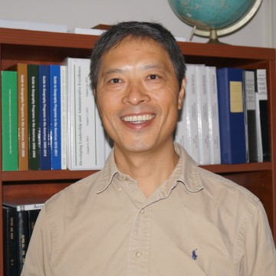
















Urbanization and sustainability under global change and transitional economies: Synthesis from Southeast, East, and North Asia (SENA)
Grant #: NNX15AD51G
web: senacgc.org
Tep Markathy
Peilei Fan
Jiquan Chen
Joseph Messina
Nathan Moore
Dengsheng Lu
Zutao Ouyang
Ranjeet John
Nguyen Dinh Duong
Amarjargal
Amartuvshin
Stephen Leisz
Minliang Liu
Tatiana Loboda
Outhailak
Souphanthalop
Soe Myint
Zin Nwe Myint
Zaw Naing
Nguyen Lam-Dao
Annemarie
Schneider
Principal Investigators: Peilei Fan (PI) and Jiquan Chen (Co-I)
Postdoctor associate: Zutao Ouyang (MSU)
Collaborators:
Amarjargal Amartuvshin (Univ of Humanities, UB, Mongolia),
Nguyen Dinh Duong, Nguyen Lam-Dao (Vietnam Academy of Sci. and Tech.),
Neang Thy (Ministry of Environment, Cambodia),
Tep Markathy (Cambodia Institute for Urban Studies)
Outhailak Souphanthalop (Lao PDR)
Zaw Naing (Mandalay Technology, Myanmar), Zin Nwe Myint (Yangon Univ)
Steve Leisz (Colorado State Univ), Mingliang Liu (Washington State Univ.),
Tatiana Loboda (Univ. of Maryland, College Park), Soe Myint (Arizona State U.),
Annemarie Schneider (Univ. of Wisconsin-Madison)
Notes:
Principal Investigators: Peilei Fan (PI) and Jiquan Chen (Co-I)
Postdoctor associate: Zutao Ouyang (MSU)
Collaborators:
Amarjargal Amartuvshin (Univ of Humanities, UB, Mongolia),
Nguyen Dinh Duong, Nguyen Lam-Dao (Vietnam Academy of Sci. and Tech.),
Neang Thy (Ministry of Environment, Cambodia), Tep Markathy (Cambodia Institute for Urban Studies)
Outhailak Souphanthalop (Lao PDR)
Zaw Naing (Mandalay Technology, Myanmar), Zin Nwe Myint (Yangon Univ)
Steve Leisz (Colorado State Univ), Mingliang Liu (Washington State Univ.),
Tatiana Loboda (Univ. of Maryland, College Park), Soe Myint (Arizona State U.),
Annemarie Schneider (Univ. of Wisconsin-Madison)

