Slide 1
Multisource Imaging of Seasonal Dynamics in Land Surface Phenology: A Fusion Approach Using Landsat and Sentinel-2
Mark Friedl¹, Eli Melaas¹, Jordan Graesser¹, & Josh Gray²
¹Boston University
²North Carolina State University
International Collaborators:
Lars Eklundh, Lund University,
Patrick Hostert & Patrick Griffiths, Humboldt University

Slide 2
Land Surface Phenology
Preprocessing
Clouds, snow, noise
Model Fitting
Functional models (e.g., double logistic) vs local fits (e.g. cubic splines); phenometrics
Applications
Biological indicator of climate change, terrestrial ecosystem modeling, land cover mapping….
image credit: Bill Hargrove (ForWarn)

Slide 3
Project Goals
Exploit temporal density of Landsat + Sentinel 2:
To quantify the timing and magnitude of land surface phenology events (“phenometrics”) at moderate spatial resolution, and
To generate gap-filled time series of spectral vegetation indices that characterize the entire seasonal cycle of land surface phenology at fixed time steps.
+Analysis of phenology of natural (forests) vs managed (croplands) ecosystems

Slide 4
Activities Over Last Year
International collaboration:
  Meeting in Berlin, Lund, Nov 7-11; Quarterly skype-conferences
  Planning next meeting for late August, 2017
Data set development:
  Sites in NA, SA, Europe; initially Landsat only, now relying on HLS
  Cal/val data compilation (including field work in Argentina, March 2017)
  Algorithm development and testing:
    Lund: working on more flexible functional models
    NCSU: Kalman filter fusion-phenology algorithm
    BU: Data cleaning, imputation, and model refinement based on HLS

Slide 5
Forest phenology with HLS
Broader questions
How is the phenology of global forests (and more generally, natural ecosystems) changing in response to climate?
How can information related to phenology by used to improve discrimination and characterization of forests?

Slide 6
Moderate Resolution Phenology
Melaas et al., RSE, 2013; Melaas et al., RSE, 2016

Slide 7
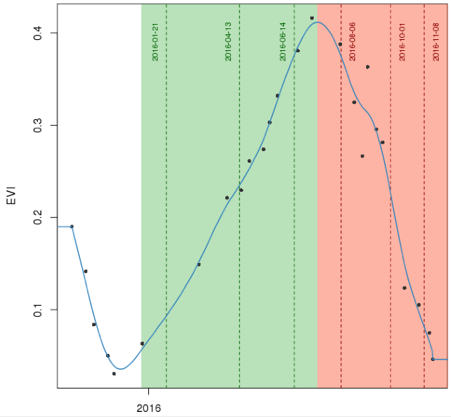
Estimating Phenometrics Using Local Fitting Methods
EOS
SOA
MOS
MOA
SOS
MOA
Jonsson et al, in prep, IEEE TGARS
Notes:
Here is an example of a high elevation pixel (note low EVI amplitude during growing season) with early SOS.
Note that early SOS is driven by snowmelt, which is captured because snow mask didn’t work.

Slide 8
Barlett Experimental Forest, NH
Notes:
UL: During green up segment (green portion of slide 4), average time interval between cloud-free observations
UR: During green up segment (green portion of slide 4), maximum time interval between cloud-free observations
LL: During green down segment (red portion of slide 4), average time interval between cloud-free observations
LR: During green down segment (redportion of slide 4), maximum time interval between cloud-free observations

Slide 9
Barlett Experimental Forest, NH
Notes:
5 x 5 km window of pixels centered on Bartlett, NH PhenoCam site
UL: 2006 NLCD Land Cover (black is non-forest)
UR: Total number of cloud/snow-free observations
LL: EVI Amplitude (note that high EVI amplitude corresponds well with DBF above)M
LR: Integrated EVI

Slide 10
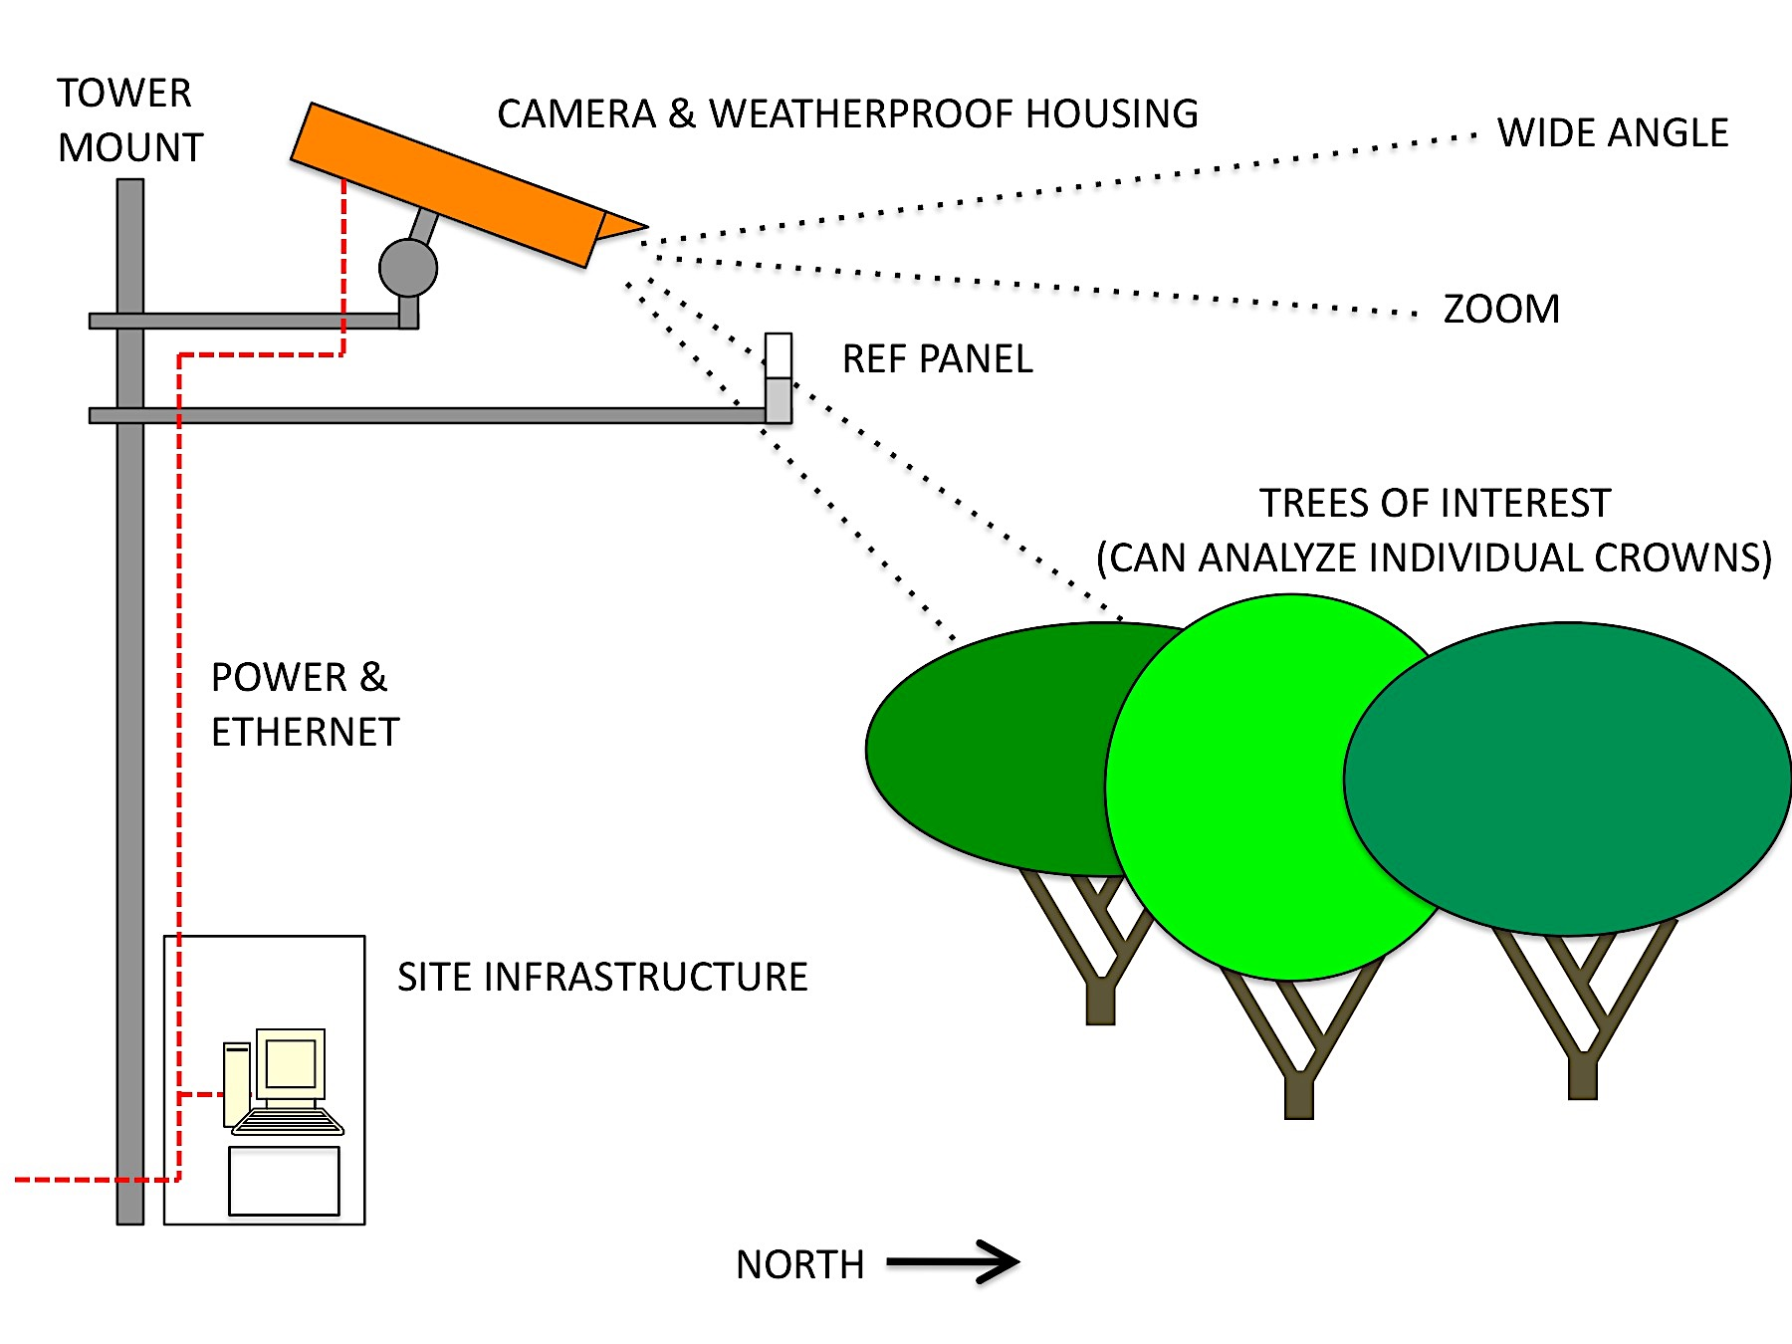
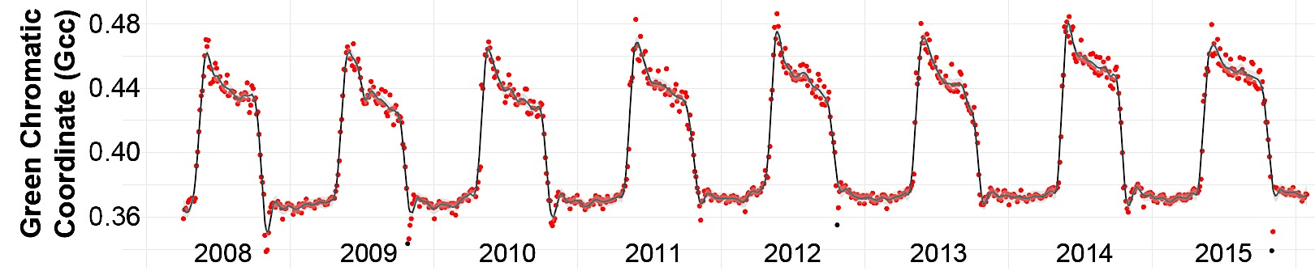
Barlett Experimental Forest, NH
Notes:
Bias between PhenoCam derived MOS date and the MOS date at each pixel.
Location of PhenoCam site is denoted by circle with X.
Note the low bias (less than 5 days) between pixels directly surrounding the camera, as well as the high bias with higher elevation pixels.

Slide 11
Agricultural phenology with HLS
Broader questions
How do production gaps between small-
and large-scale farmers vary across the planet?
What are the differences in crop management
practices at the field level?

Slide 12
High quality time series

Slide 13
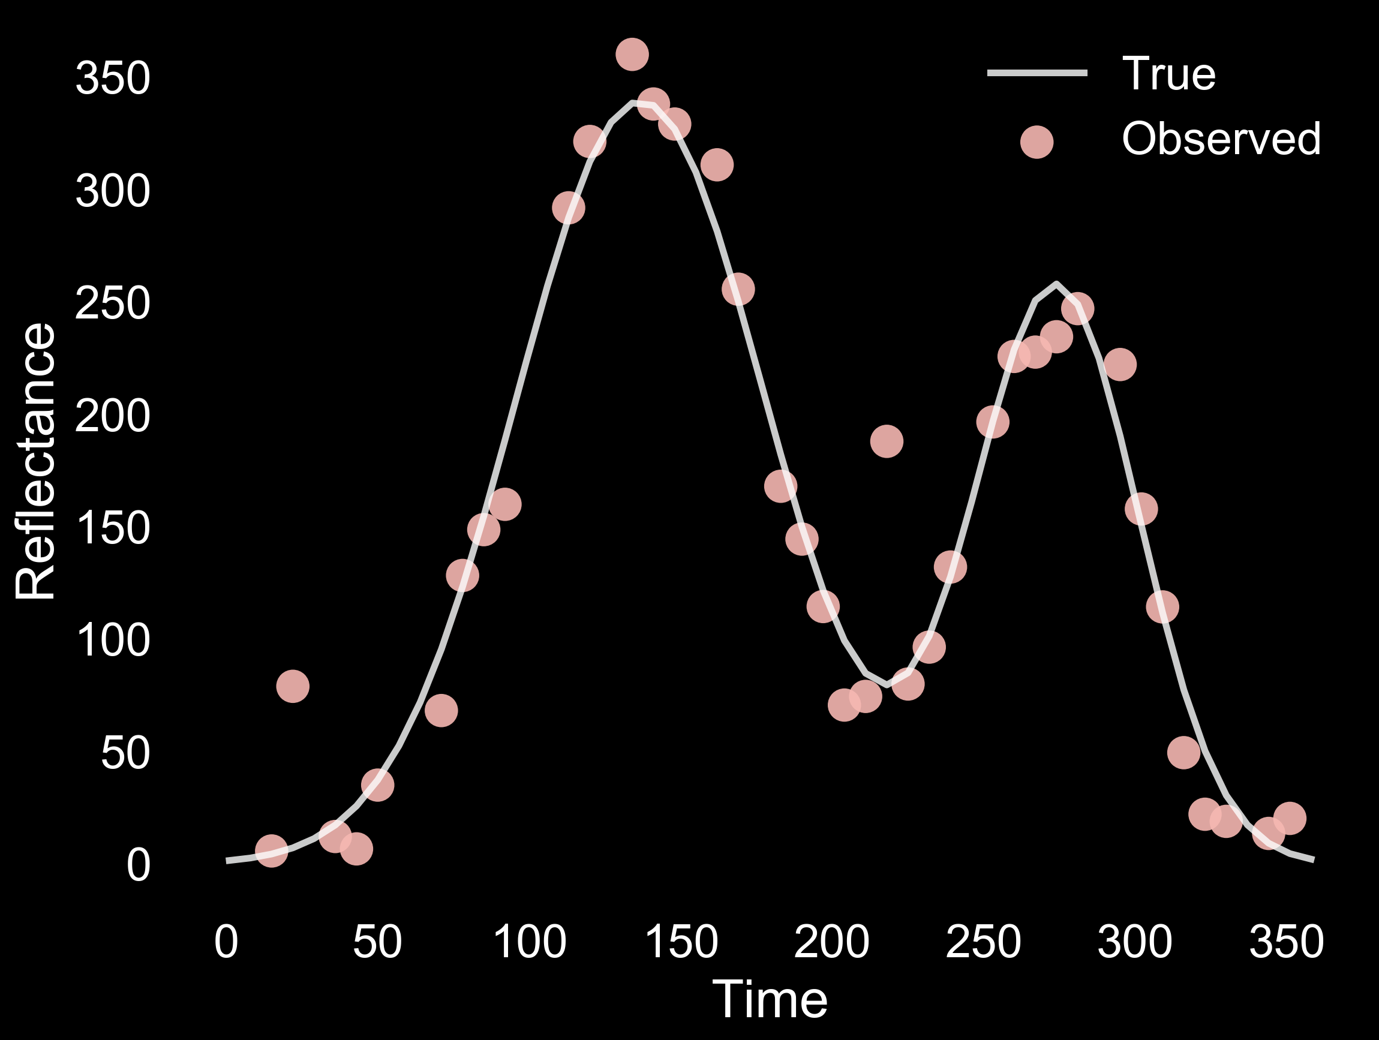

Slide 14
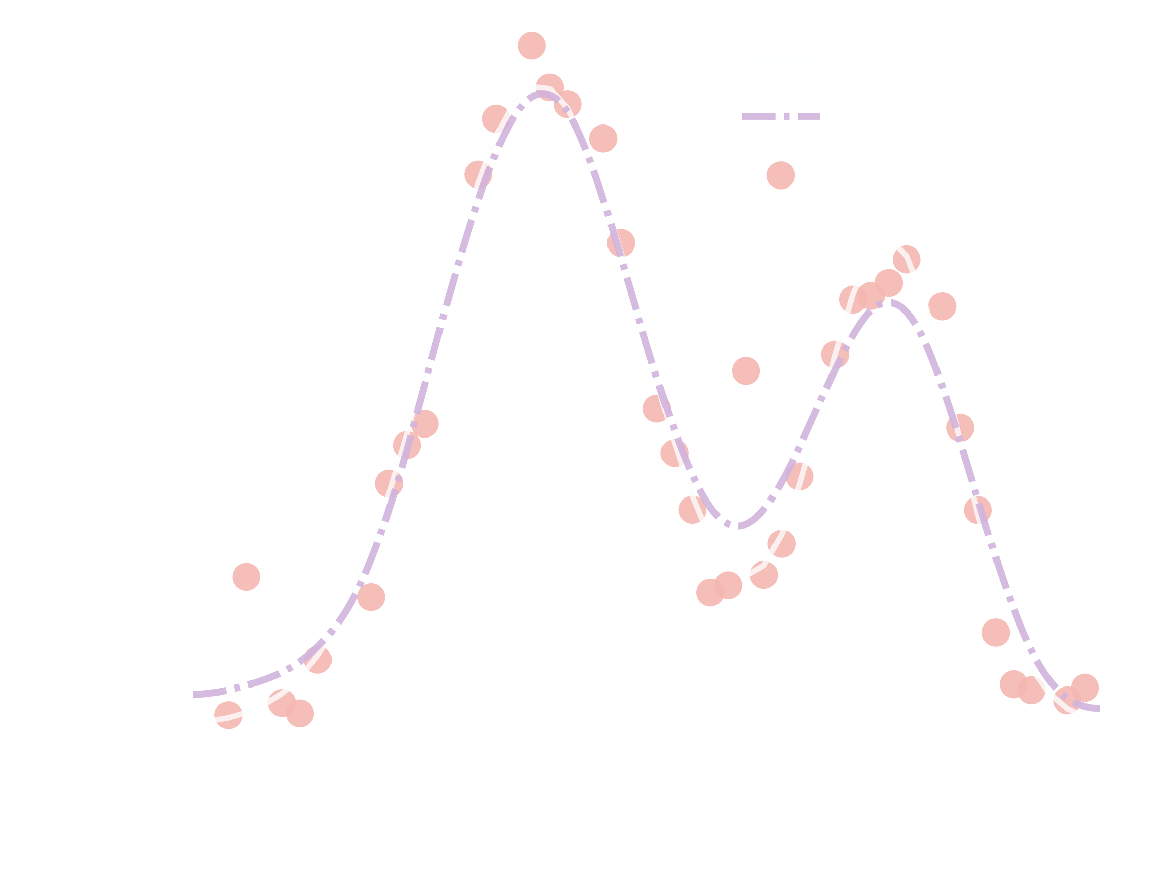

Slide 15
Gappy (& noisey) time series

Slide 16
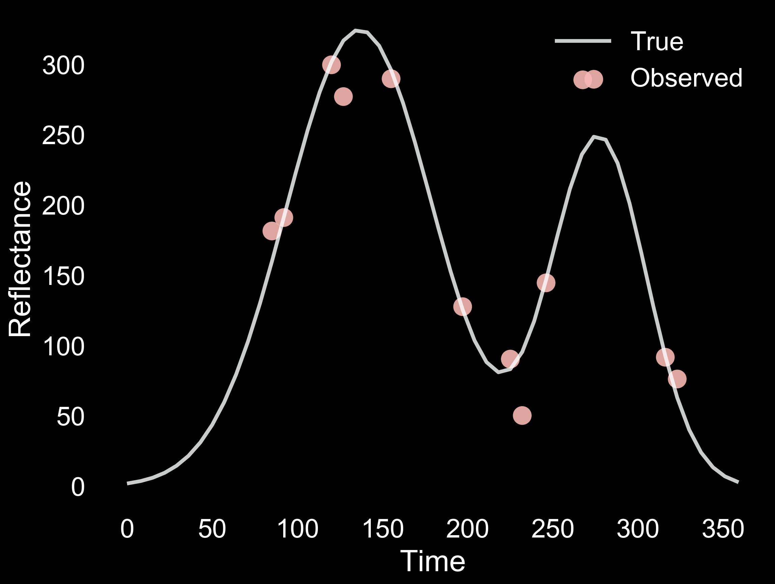

Slide 17
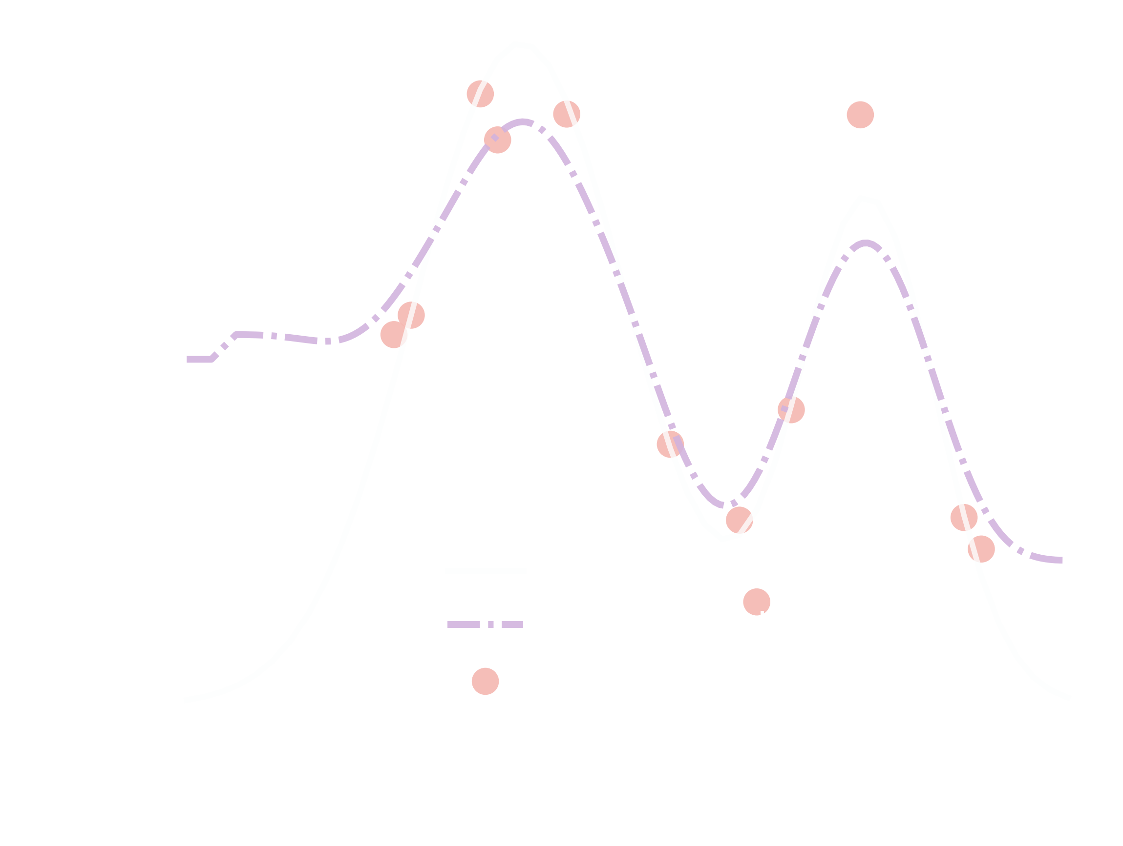

Slide 18
Multiple Imputation
Multivariate Imputation by Chained Equations (MICE)
Accounts for statistical uncertainty
Imputations are derived from observed values
Each missing day is predicted from observed values throughout the timeframe.

Slide 19
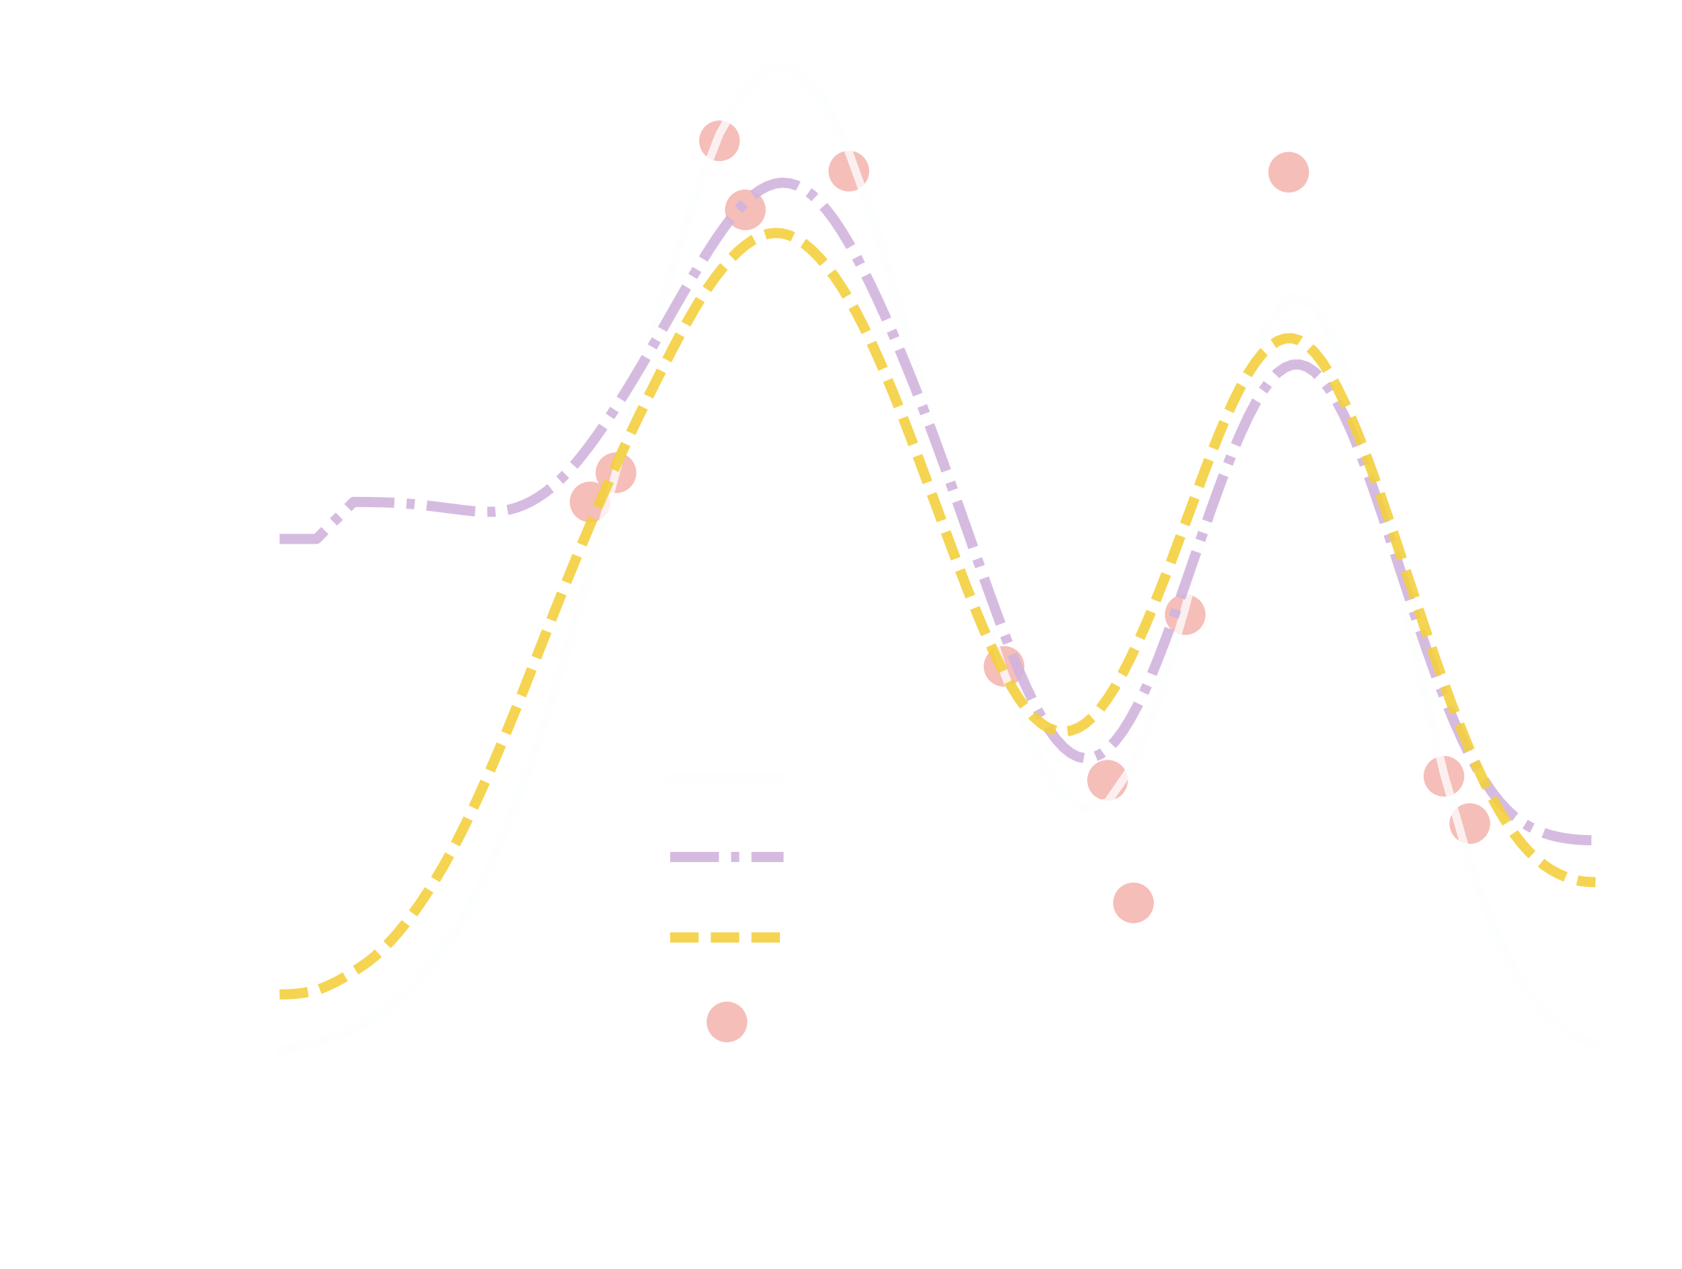

Slide 20
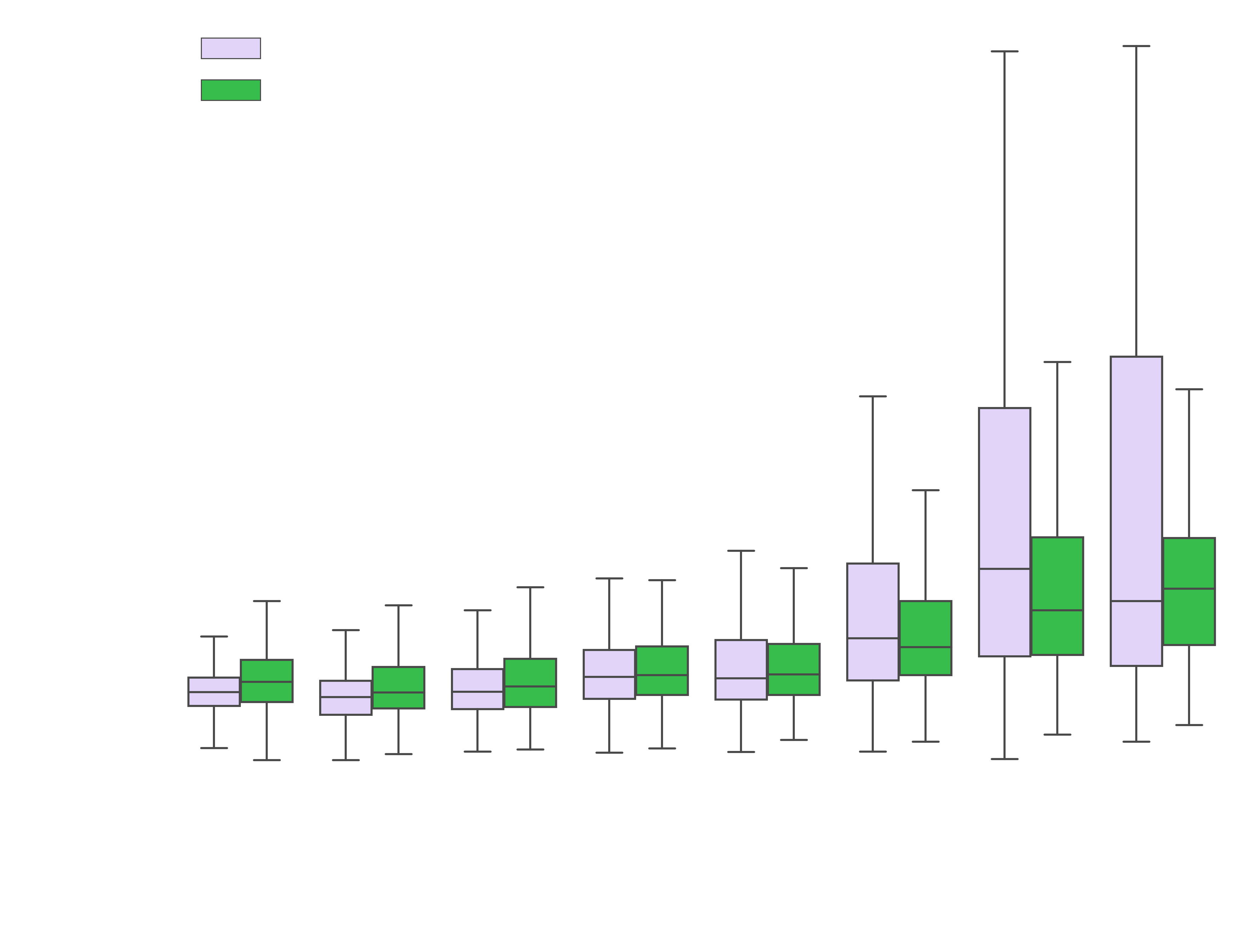
Next Step: Scale and implement operationally using HLS time series

Slide 21
HLS time series

Slide 22
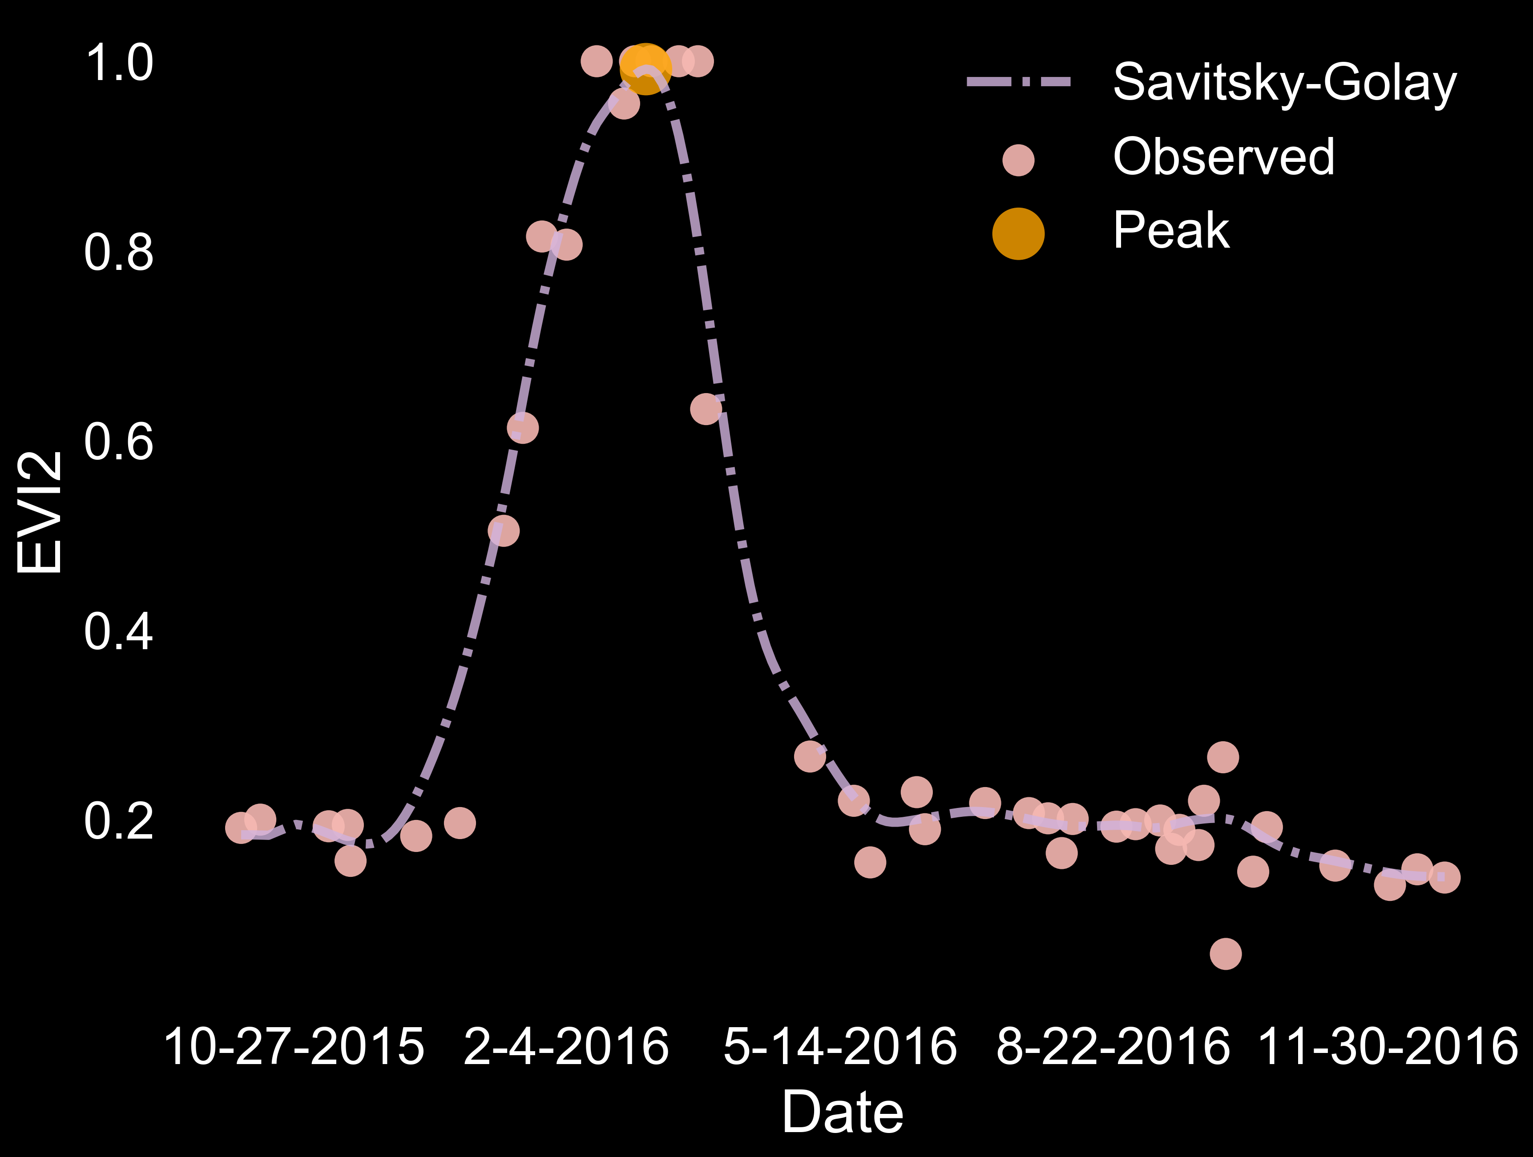
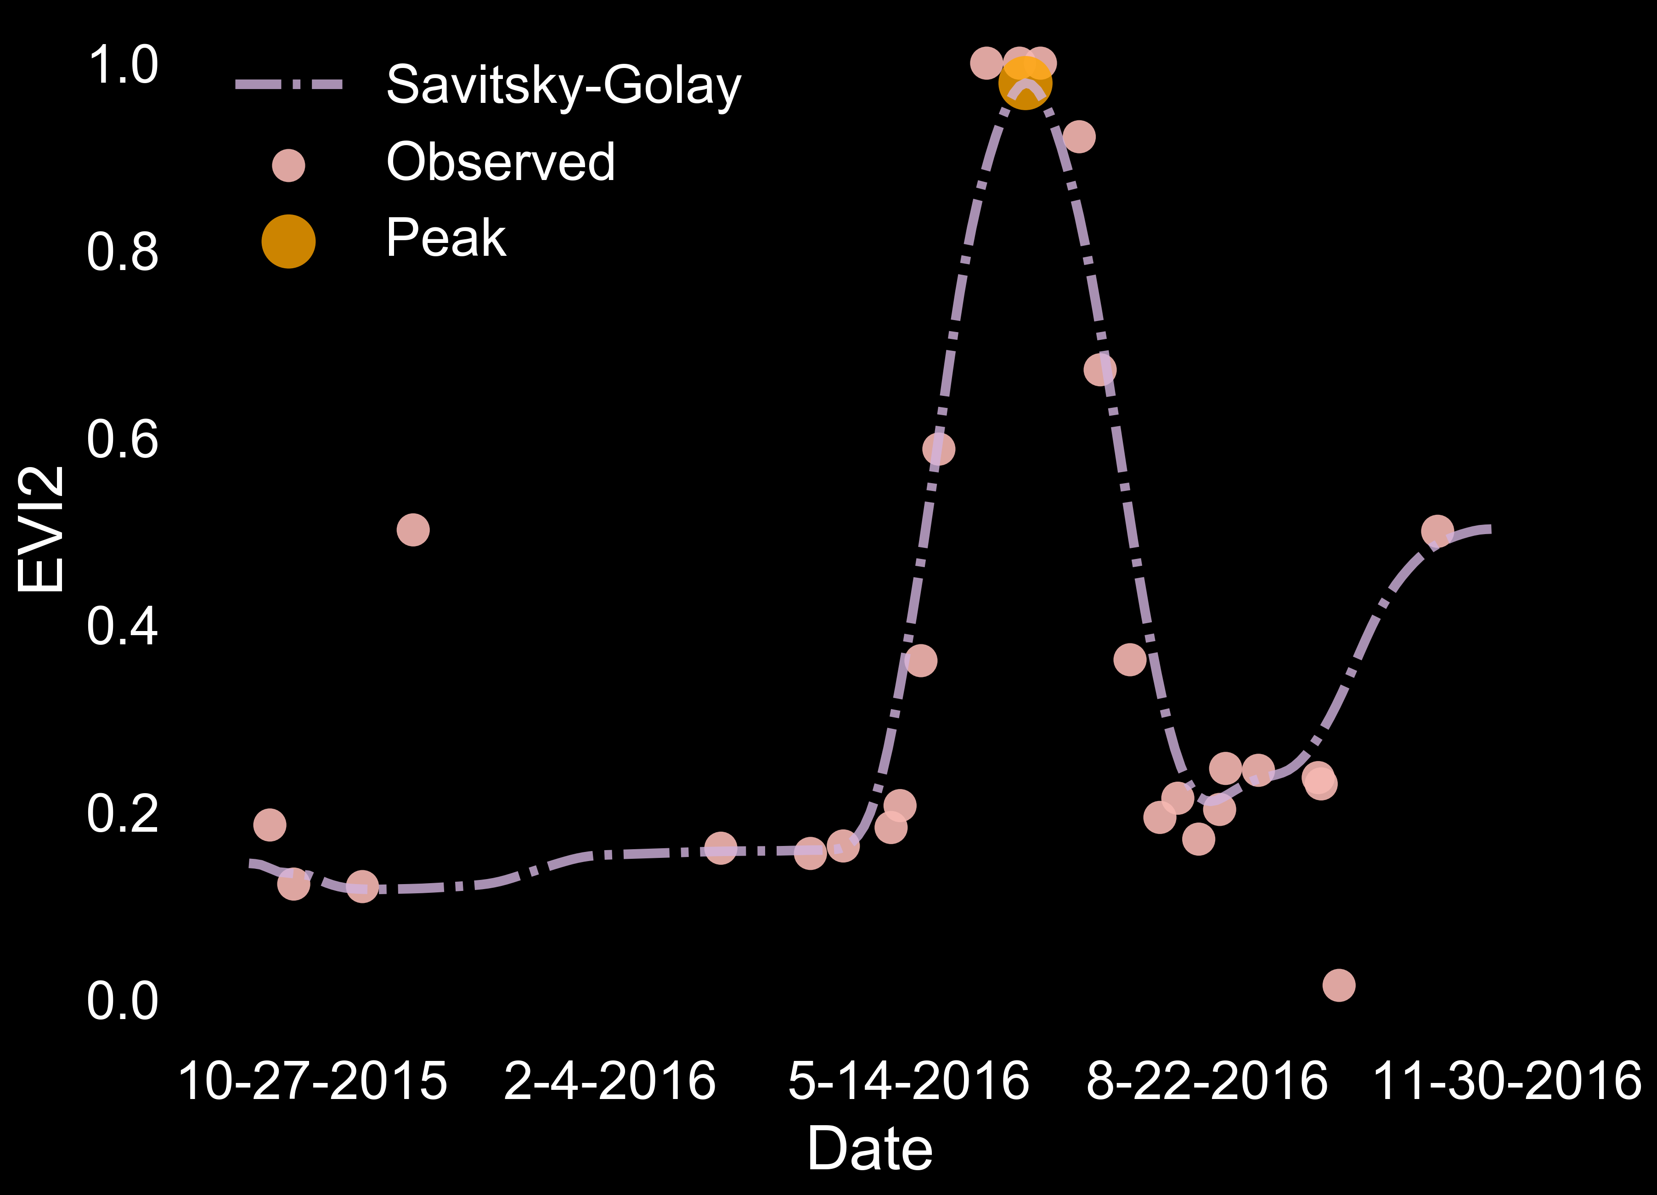
Córdoba,
Argentina
North
Dakota
Notes:
PAM

Slide 23
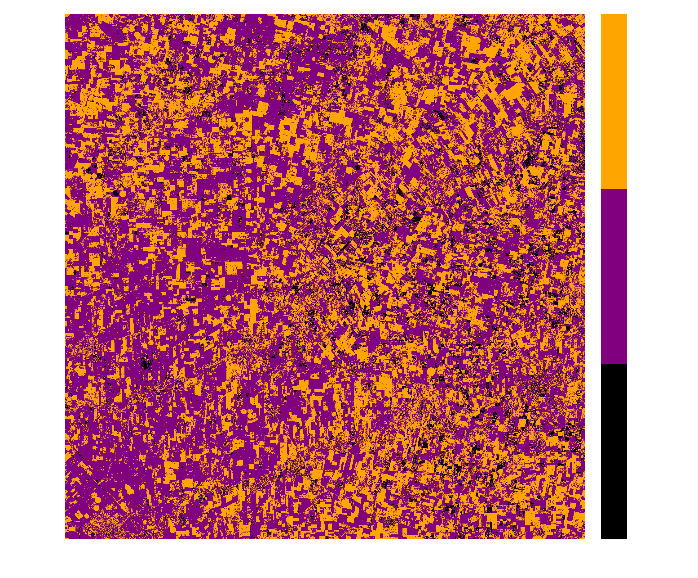
# of crop cycles
(pixel level)
HLS
Córdoba

Slide 24
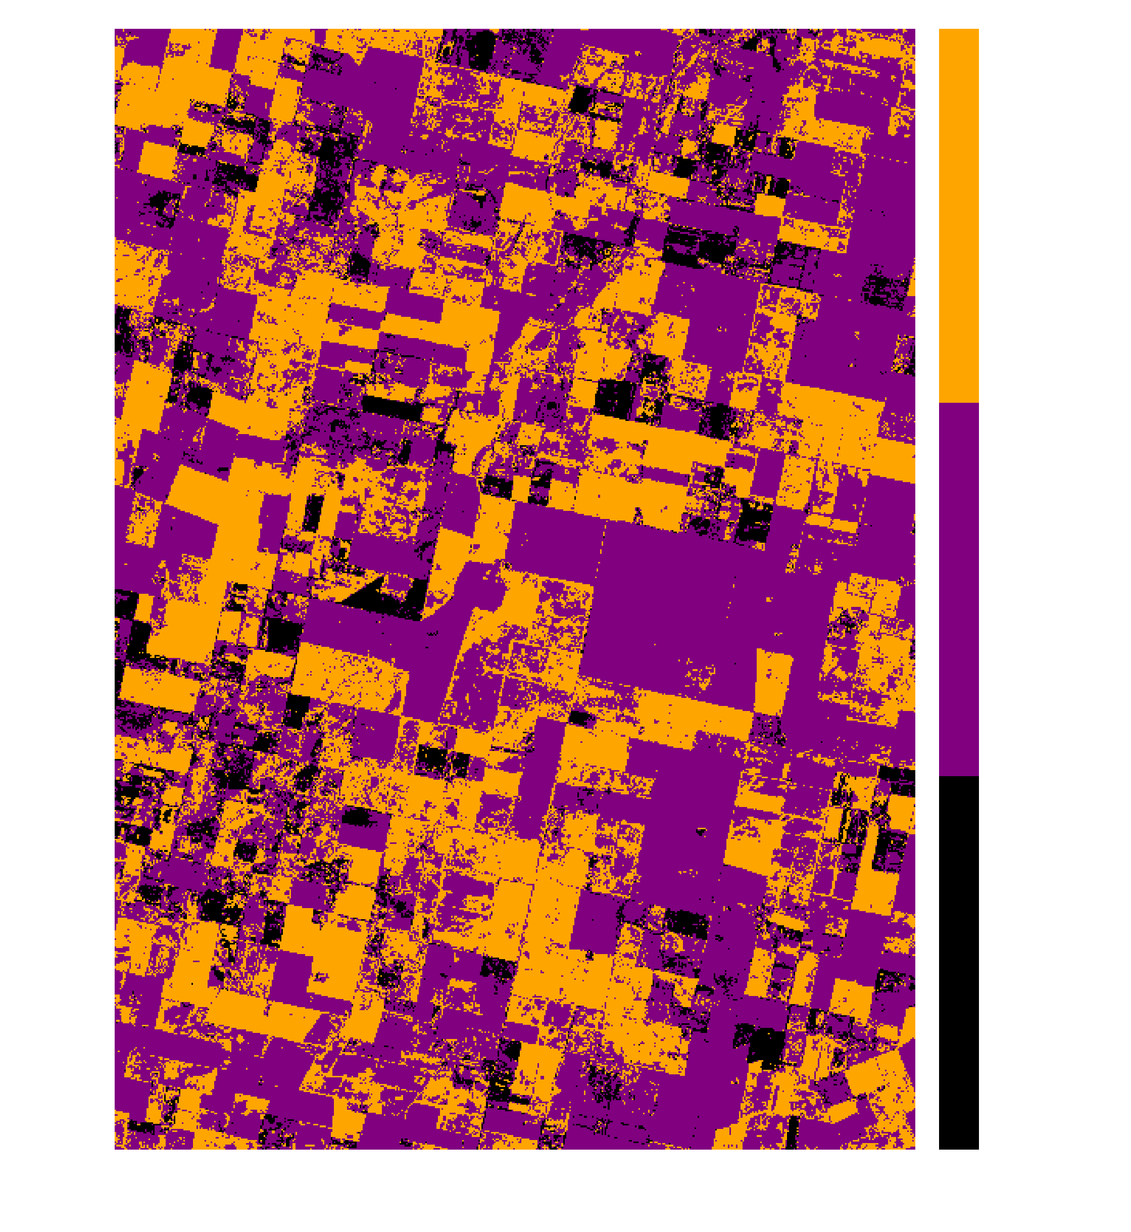
# of crop cycles
(pixel level)
HLS
Córdoba

Slide 25
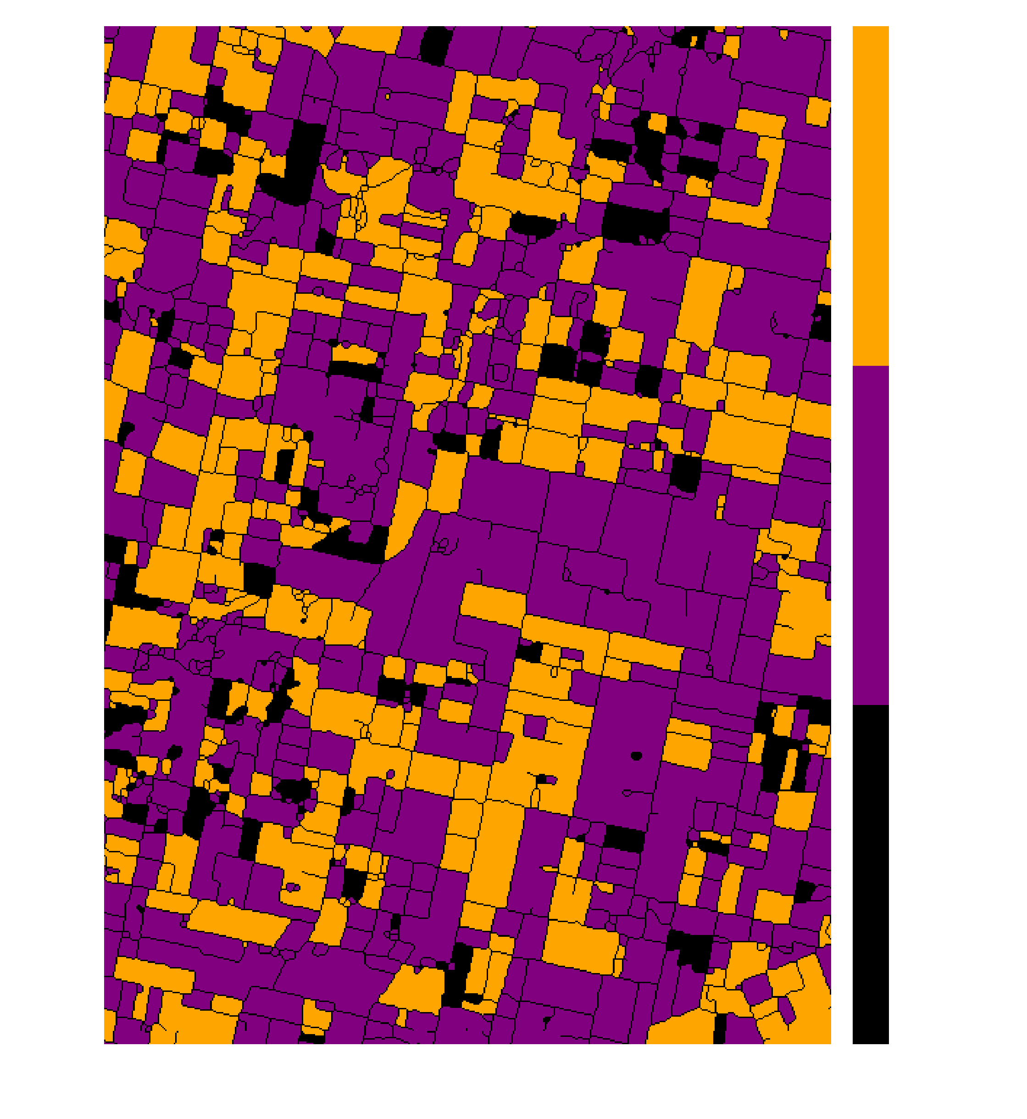
# of crop cycles
(parcel level)
HLS
Córdoba

Slide 26
Summary
Preprocessing
  MICE provides realistic and computationally efficient solution
Model fitting
  Local fitting provides more general and robust solution
Applications
  Natural systems: results sensitive to subtle landscape patterns
  Croplands: Presence, timing of multi-cropping; within vs between field variability in crop calendars

