Slide 1
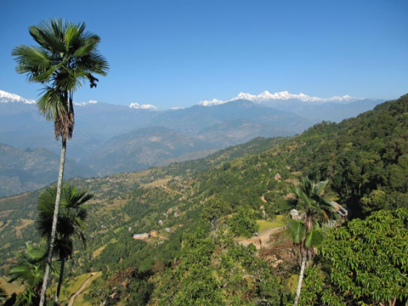
Twenty-five years of community forestry:
Mapping forest dynamics in the Middle Hills of Nepal
Jefferson Fox (PI) East-West Center
Sumeet Saksena (Co-I)
Kaspar Hurni (Co-I) and Universitat Bern
Jamon Van Den Hoek (Co-I) Oregon State University
Alex Smith (PhD student)
Ram Chhetri(Co-I) Resources Himalaya Foundation
Pitamber Sharma (Co-I)

Slide 2
Background
Nepal is a mountainous country composed of three distinct physiographic zones: the Himalayas, the Middle Hills (MH), and the Terai (lowland plains).
The MH lie between 700 and 4,000 masl.
The MH include 40% of the country’s land area; 45% of its population, 68% of its forests, and 75% of its Community Forests (CFs).

Slide 3
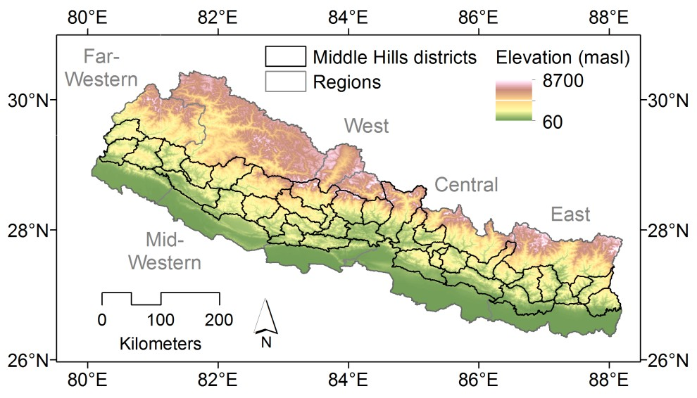
The Middle Hills
The 39 districts we are studying are outlined in black.

Slide 4
Background
Forests account for upwards of 40% of Nepal’s national land area (5.5 m ha).
In 1988 the Department of Forests (DoF) identified 61% of the nation’s forest that could be transferred to local communities for management.
Today, Community Forests occupy near 23% of Nepal’s total forest area and involve over 18,000 CF user groups

Slide 5
Background
In Nepal, out-migration from rural areas for improved economic opportunities is frequently cited as a driver of socioeconomic change.
Today there are about four million migrants – one-third of the working male population – and foreign remittances constitute a quarter of the income of all households.
In 2016, 32% of the GDP was drawn from remittances, a figure that does not include remittances from India and undocumented or informal sources.

Slide 6
Background
In February 1996, the Unified Community Party of Nepal (Maoist) started a bid to replace the parliamentary monarchy with a people's new democratic republic, through a Maoist revolutionary strategy.
In 2008, the monarchy was formally abolished; by 2012, fighting had ceased and Maoist military units were integrated into the Nepali army.
In the post-Maoist period there have been no elected local governments and the absence of elected local government means that Nepal’s VDCs rely heavily on their Government-appointed secretaries.

Slide 7
Problem Statement
The spatially-explicit impacts of this hypothesized forest transition have not been documented in part because of the difficulty of mapping forest cover in mountainous environments.
Topographic effects, e.g., shading, presence of clouds, snow, and ice, and inaccessibility for ground truth data collection.

Slide 8
Socioeconomic Hypotheses
Forest regeneration will be positively associated with area under CF
Forest regeneration will be positively associated with remittance income.
Forest regeneration will be negatively associated with Maoist conflict

Slide 9
Hypotheses
Forest regeneration will be associated with socioeconomic variables including income, source of income, number of people per household, education, gender, number of livestock, etc.
Forest regeneration will be associated with biophysical and spatial variables including aspect, slope, elevation, distance from markets, etc.

Slide 10
Project Objectives
At the Middle Hills scale, specific research objectives include:
Build comprehensive database of forest cover change in the Middle Hills since 1990, and produce maps of forest cover history (disturbance and recovery) at district and Village Development Committee (VDC) scales.
Integrate forest dynamics data with demographic and socioeconomic data from the Central Bureau of Statistics to identify physiographic and socioeconomic variables associated with forest dynamics at district and VDC scales.
Quantify how the geographic distribution of economic migration and remittances are correlated with spatially-explicit forest cover dynamics.

Slide 11
Project Objectives
At the local scale, specific research objectives include:
Identify a sample of sites mapped as showing forest regrowth or stagnation through this period for more intensive study.
Conduct focus group discussions and household interviews in these sample sites to examine how forest management practices, economic migration, and remittances have changed.

Slide 12
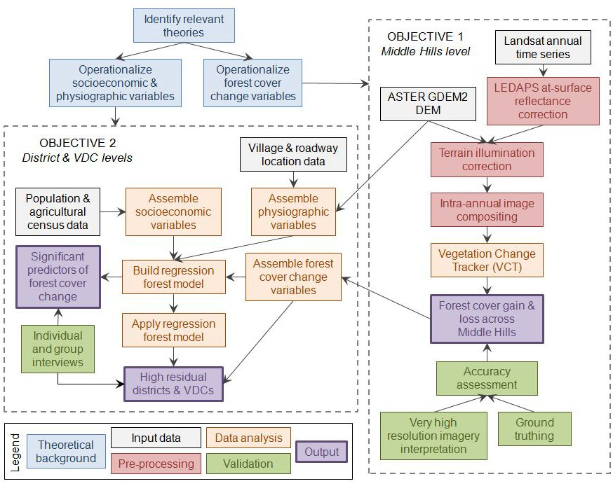
Methodological Work Flow

Slide 13
Analytical framework
performed in Google Earth Engine
Topographic correction (TC)
Review TC literature
Select 7 TC methods
LandTrendr annual change mapping
Input seasonal composites
Assess effect of TC and wavelength on classification accuracy
Output forest dynamics map based on best performing TC & wavelength
Assess spatio-temporal dynamics
Timesync
Perform expert visual interpretation at sample validation sites
Seasonal image composition
Minimize seasonality & maximize pixel count
Build seasonal composites
Field data collection
Link forest cover dynamics with village- and community forest-level interview data
Determine change drivers using independent spatial variables (census, forest user group data, etc.) within spatial modeling framework
TC evaluation
Evaluate each composite and TC
Determine best TC for each wavelength / band

Slide 14
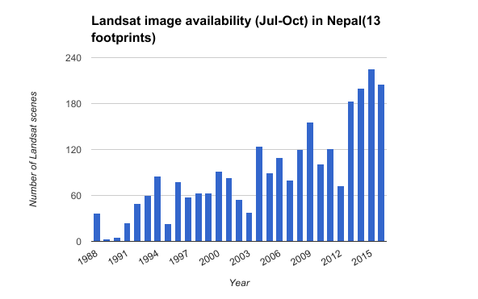
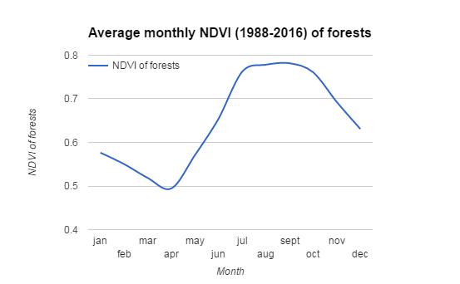
Landsat image availability
(13 footprints, Jul-Oct)
Average monthly forest NDVI
(1988-2016)
Growing season
Season peak
Mapping forest dynamics requires consistent seasonal observations
Clouds, cloud shadows, haze, and SLC-off data gaps limit the amount of valid pixels within individual images
Seasonal image composition to obtain as many valid pixels as possible
Notes:
Brief stats on average cloud cover

Slide 15
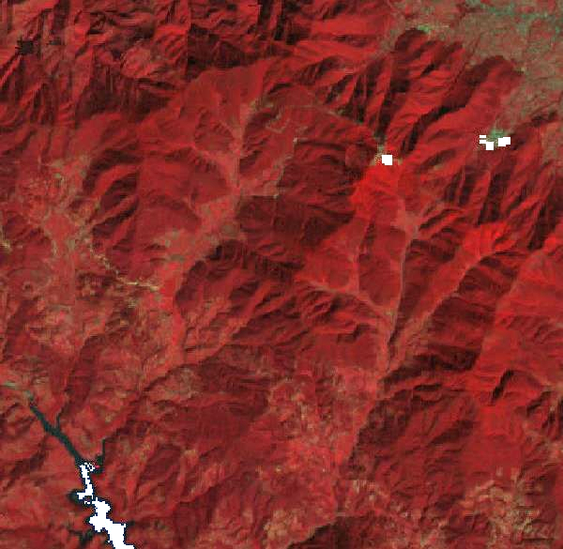
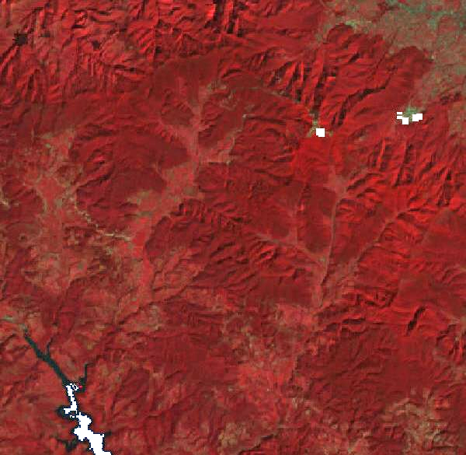
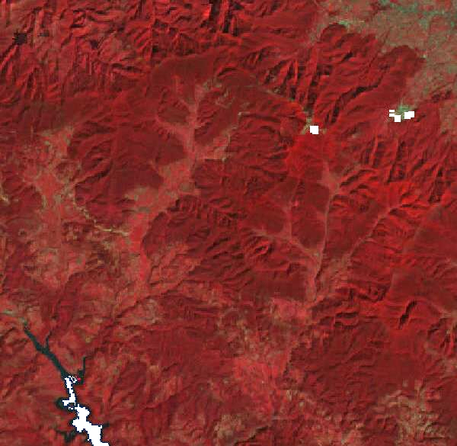
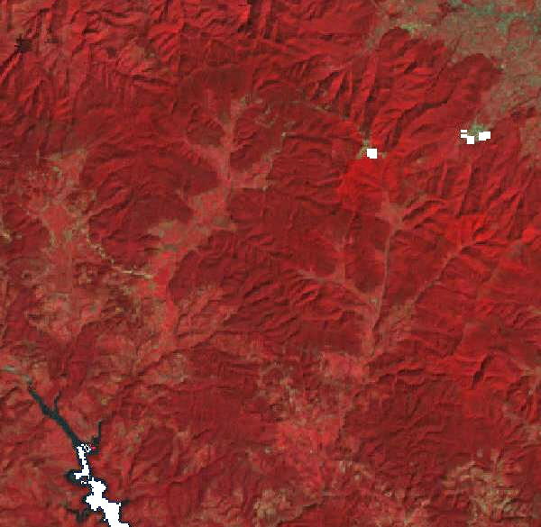
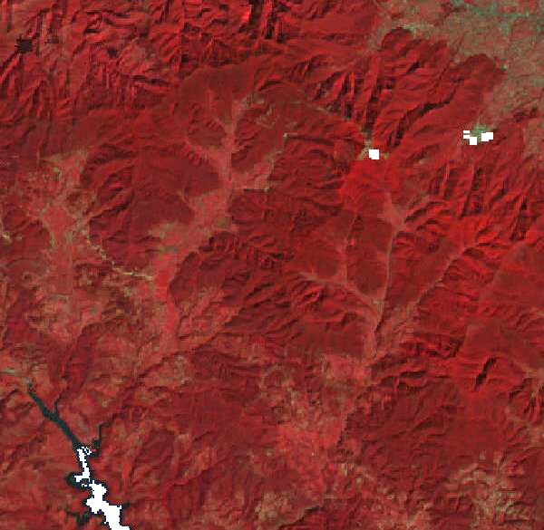
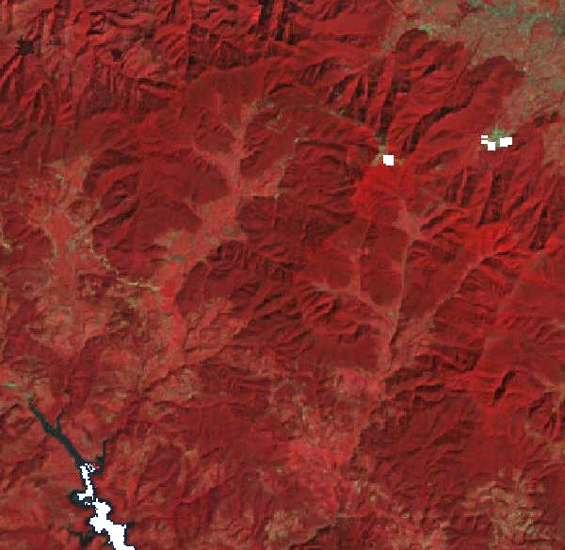
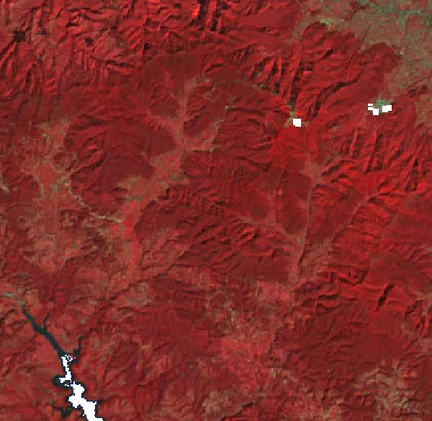
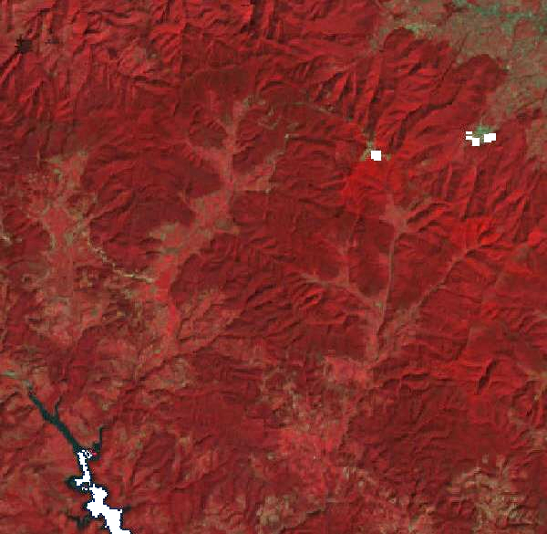
Uncorrected
C-correction
SCS+C
Bin Tan
Minnaert slope
PBM
VECA
Statistical-Empirical
Notes:
Composite of 2015, very subtle differences between the TC’s (almost only visible in steeper areas)

Slide 16
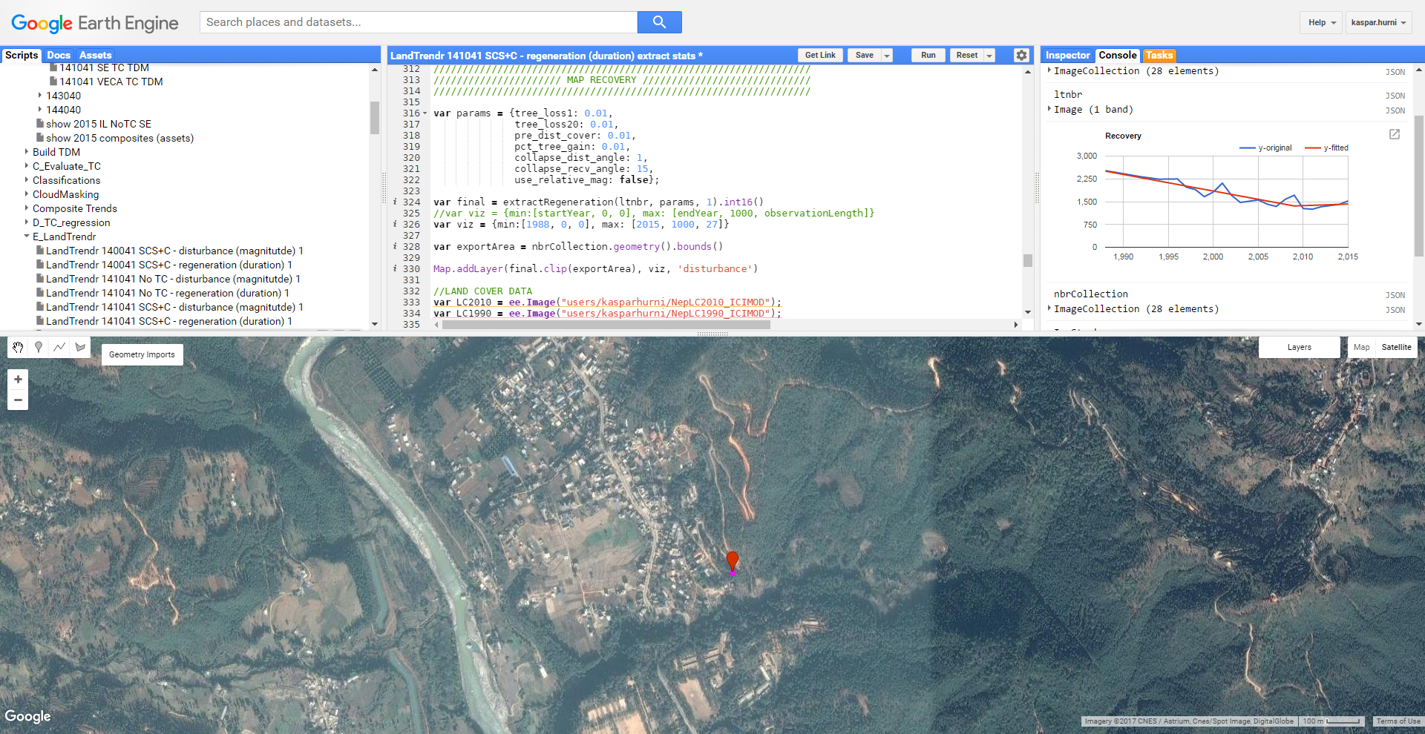

Slide 17
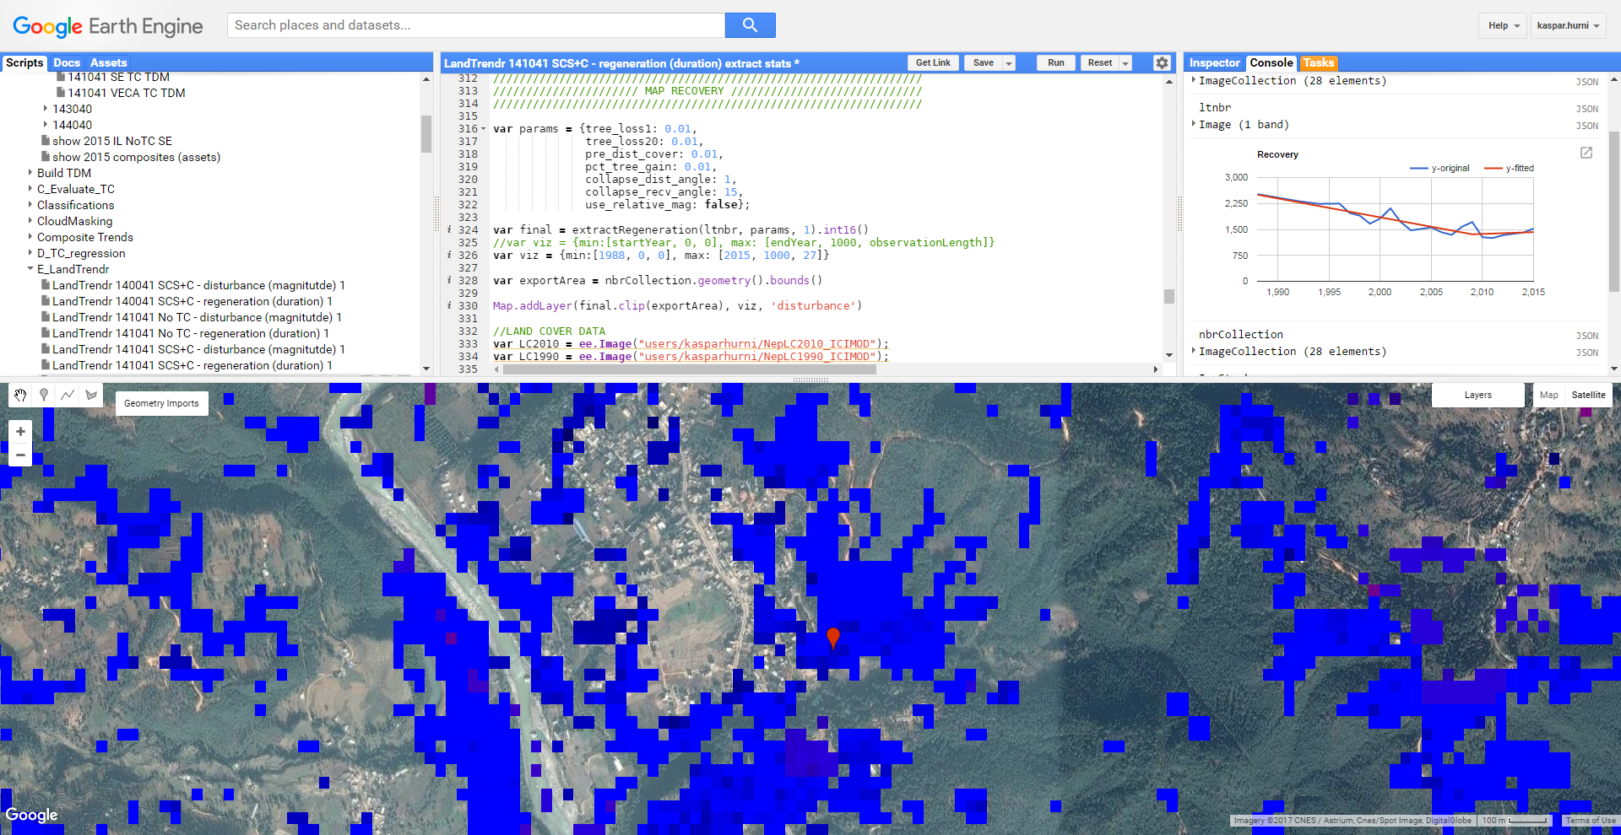

Slide 18
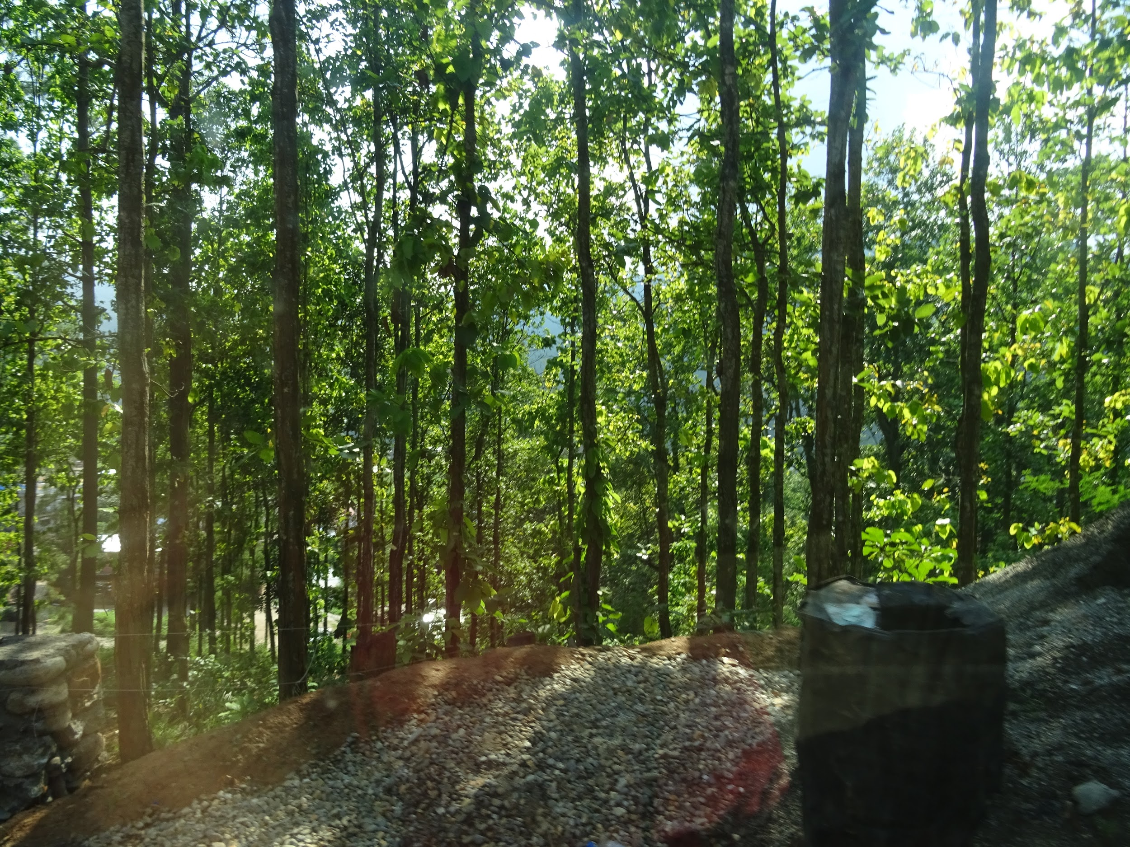
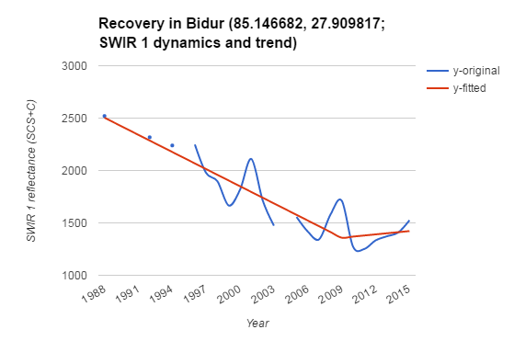
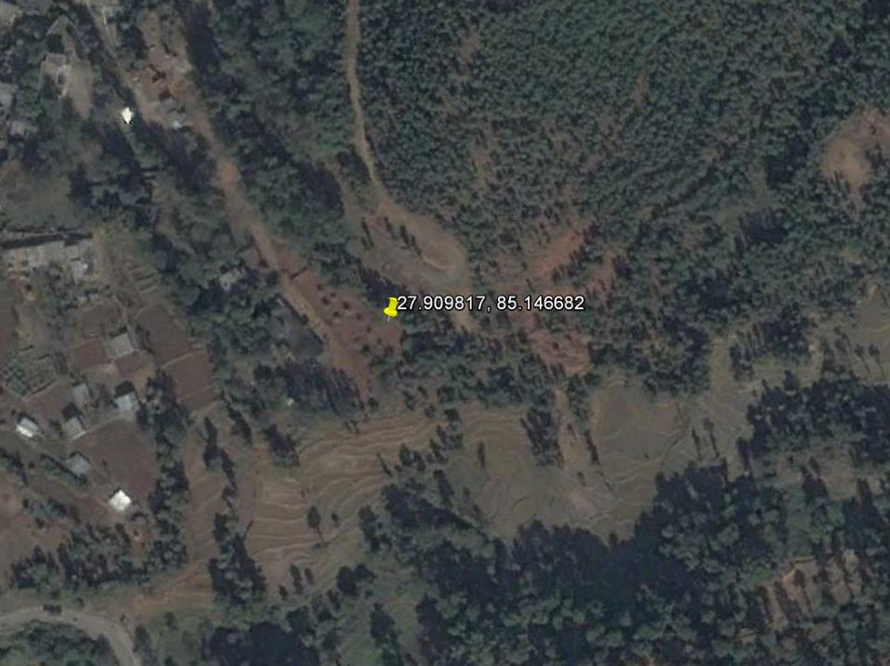
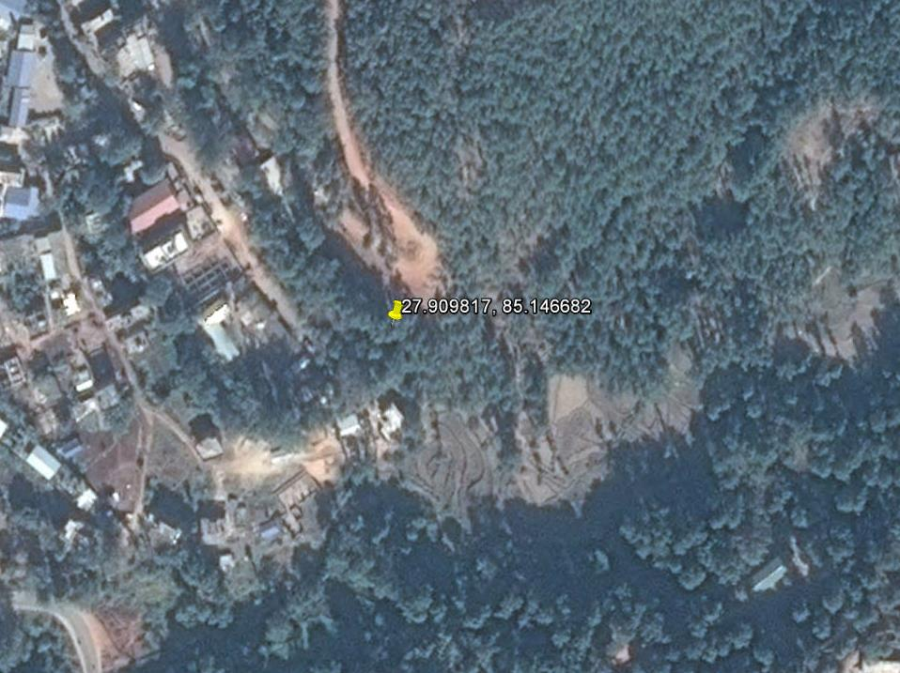
2015
2004
2016

Slide 19
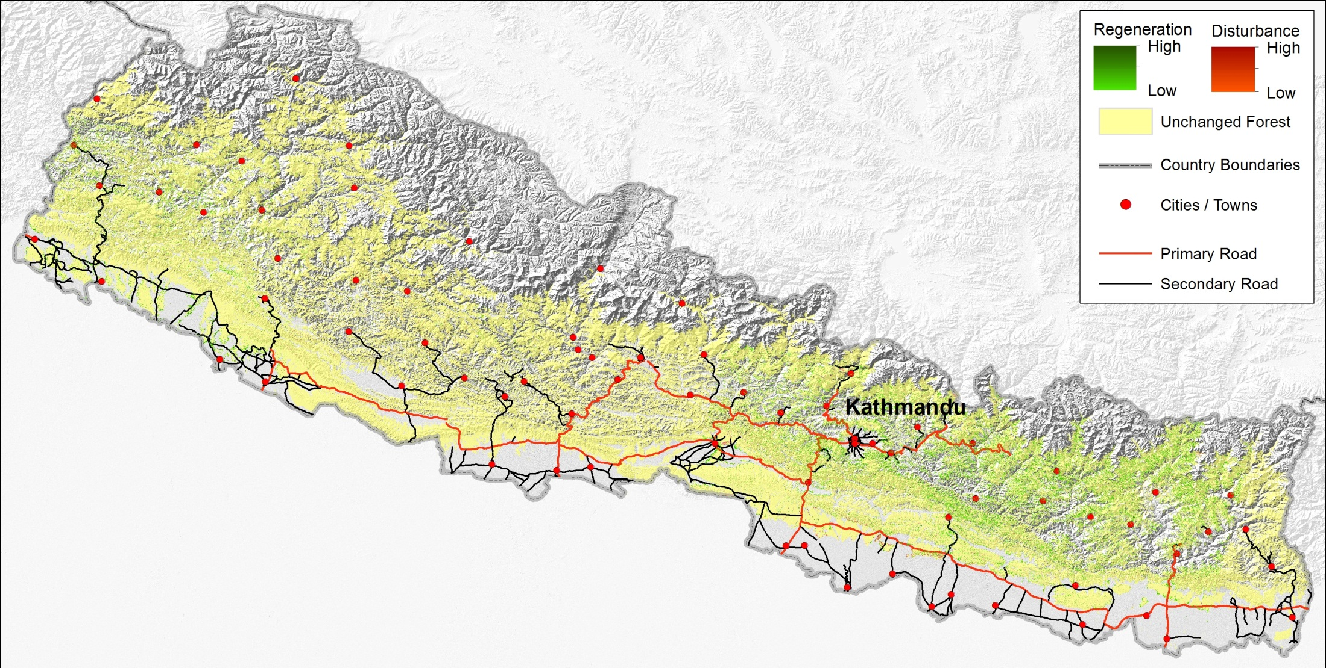
Forest regeneration and loss 1990-2015

Slide 20
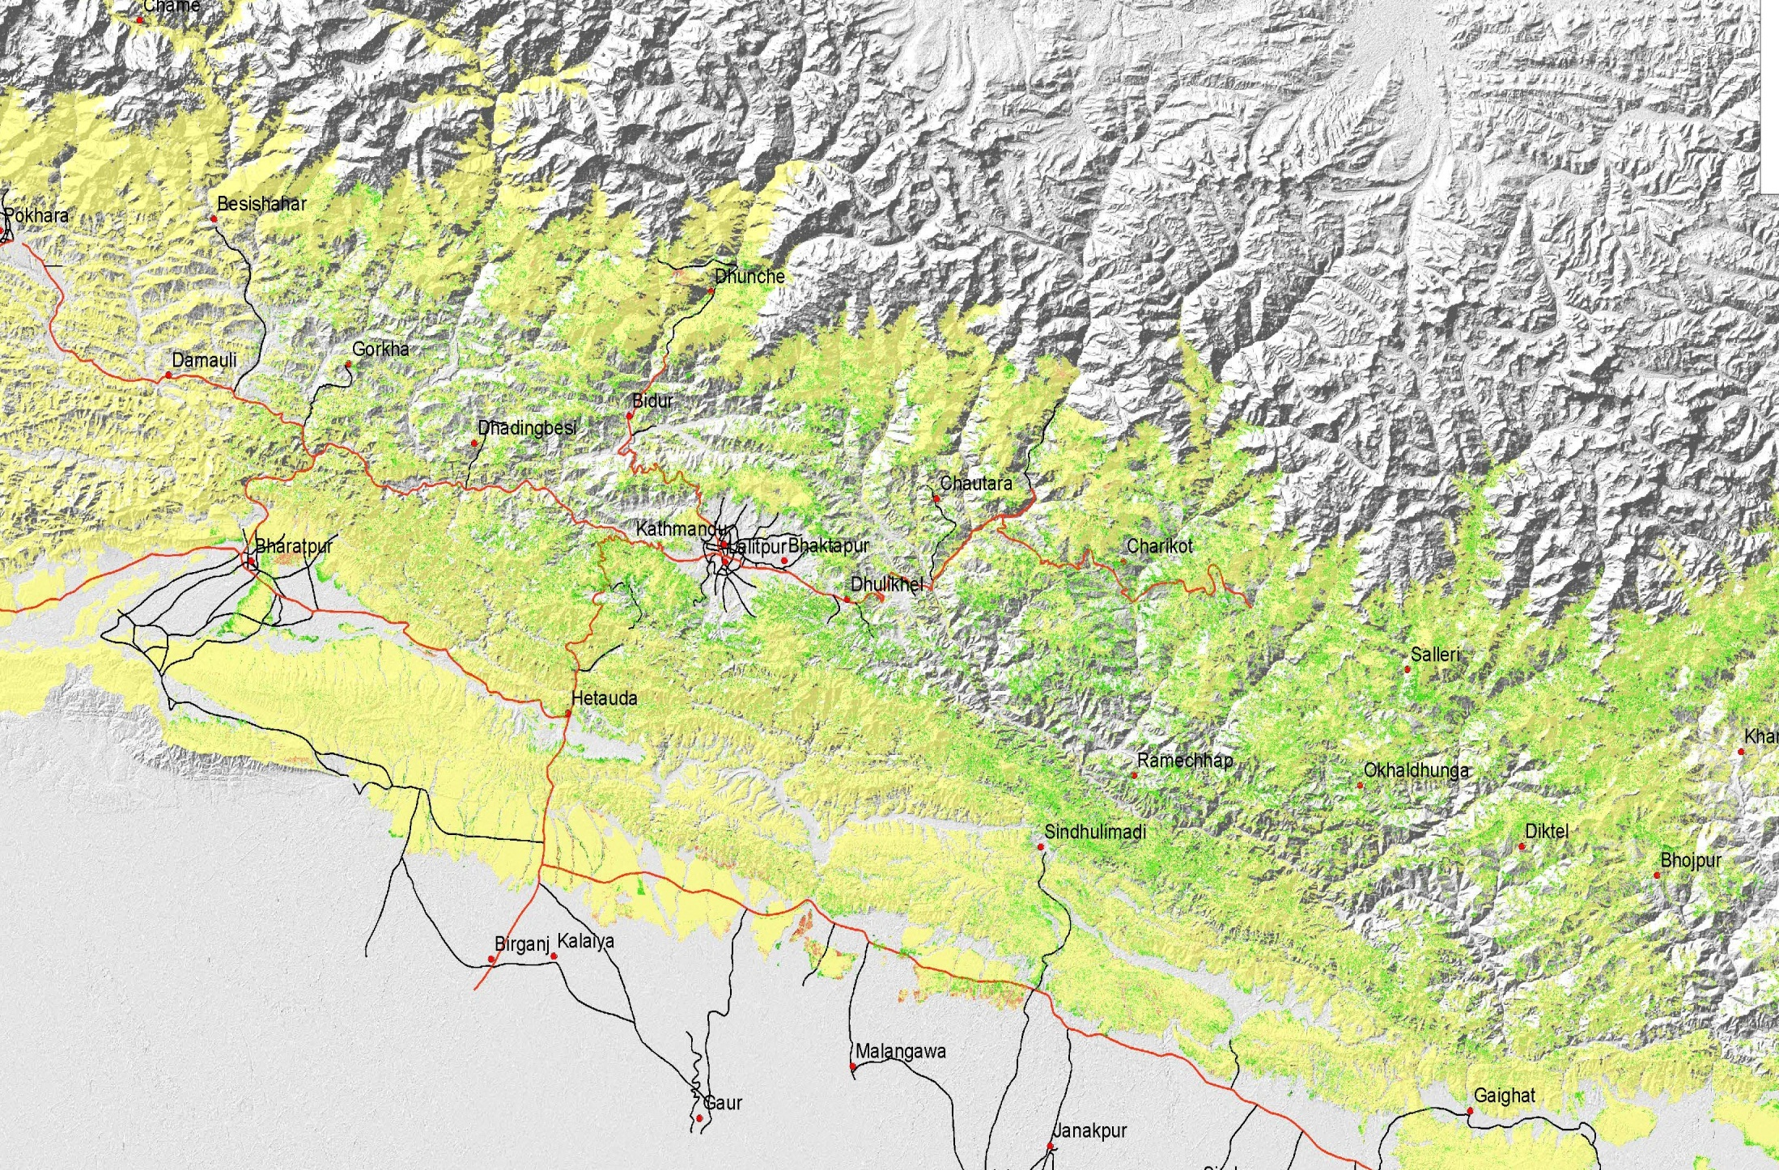
Forest regeneration and loss 1990-2015

Slide 21
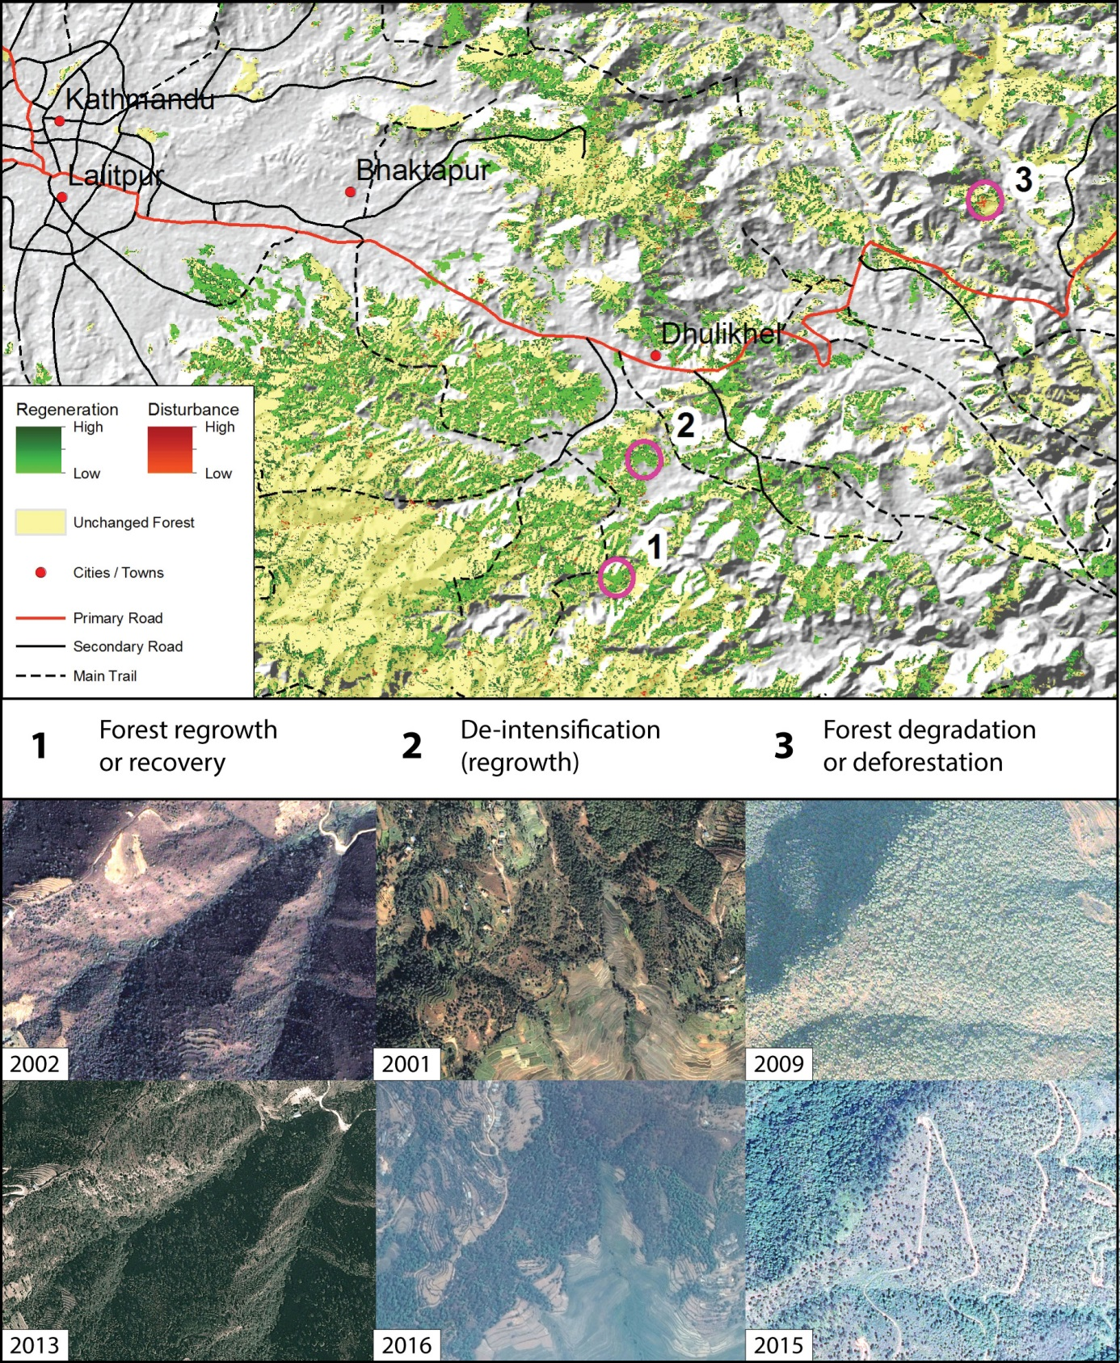
Forest regeneration
and loss 1990-2015

Slide 22
Methods and Data
Acquire national databases
Data source | Dates | Examples of available data | Scale | Survey method | Lowest level of aggregation
Population Censuses | 1981, 1991, 2001, 2011 | Age, population, income, residence abroad, education | National | Household interviews | District VDC
National Labor Force Survey | 1998, 2008 (800 PSUs) | Absentee members of households, migration, labor, remittances | Sample VDCs | Household interviews | VDC
National Living Standards Survey | 2004, 2011 (500 PSUs) | Population, housing, income, education, source of water and fuel | Sample VDCs | Household interviews | VDC
National Community Forest Census | 1986-2012 | Date formed, hectares, # households, # members, # women | National | Listing of CF with DoF | ward
Survey Department | 1986-1996 | Land use, land cover, hydrography, topography, roads | National | Various | Various

Slide 23
Preliminary description of 2011 census data
Descriptive Statistics
 | N | Minimum | Maximum | Mean | Std. Deviation | Variance
fraction house owners | 2074 | .26 | 1.00 | .9362 | .09181 | .008
fraction modern house foundation | 2030 | .00 | .93 | .0539 | .13956 | .019
fraction modern wall | 2074 | .00 | .93 | .0685 | .14853 | .022
fraction modern roof | 2074 | .00 | .90 | .0475 | .13628 | .019
fraction modern water | 2074 | .01 | 1.00 | .7556 | .20215 | .041
fraction modern cook fuels | 2074 | .00 | .96 | .0719 | .16431 | .027
fraction modern lighting | 2074 | .02 | .99 | .6811 | .24486 | .060
fraction modern toilet | 2074 | .00 | 1.00 | .3743 | .25969 | .067
fraction modern appliances | 2074 | .18 | .98 | .7768 | .13255 | .018
fraction absent males | 2074 | .01 | .70 | .2011 | .12944 | .017
fraction males in school | 2074 | .06 | .94 | .7769 | .07507 | .006
fraction females in school | 2074 | .18 | .87 | .6859 | .06991 | .005
fraction males in workforce | 2074 | .37 | .78 | .5335 | .06037 | .004
fraction females in workforce | 2074 | .48 | .74 | .6046 | .04755 | .002
Valid N (listwise) | 2030

Slide 24
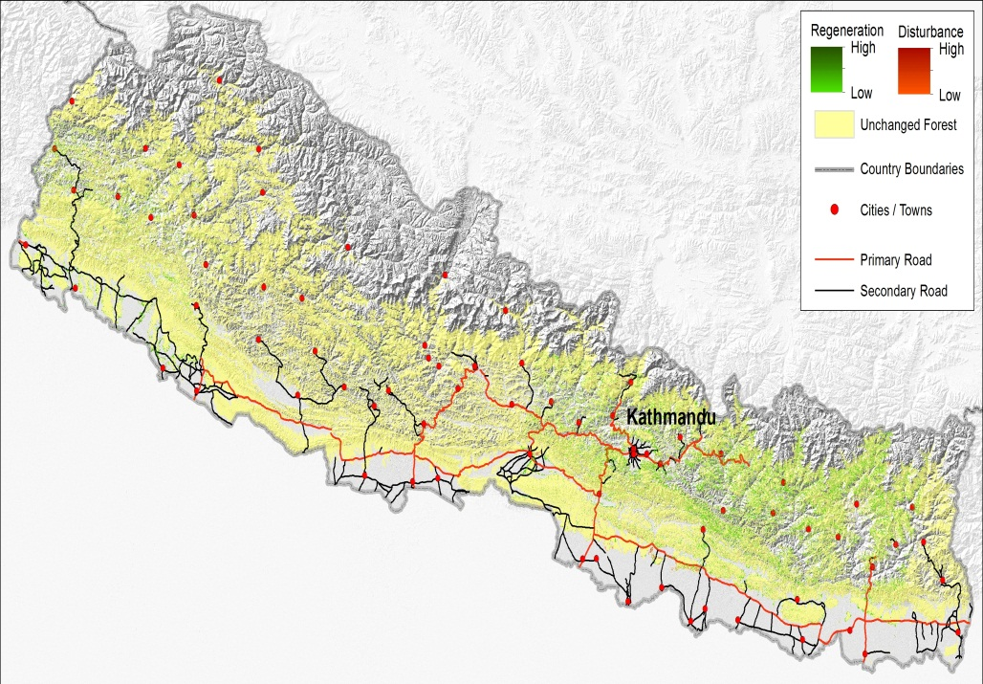
Middle Hills scale hypotheses:
Forest change and Toilets

Slide 25
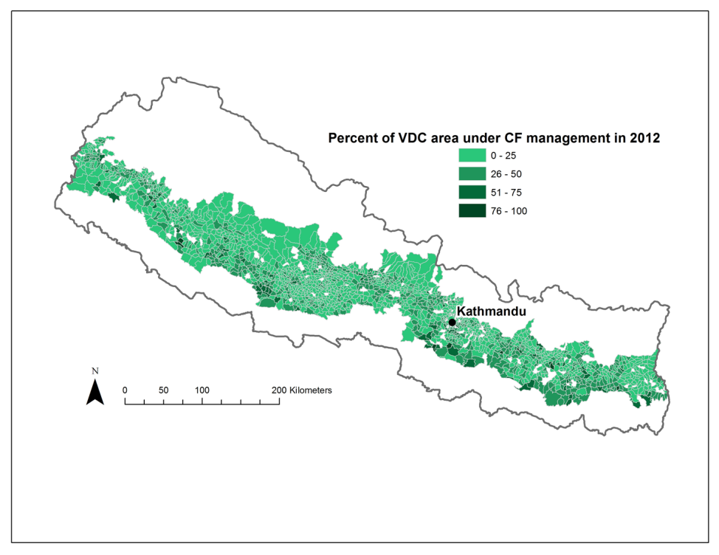
Middle Hills scale hypotheses:
Forest change and Community forestry

Slide 26
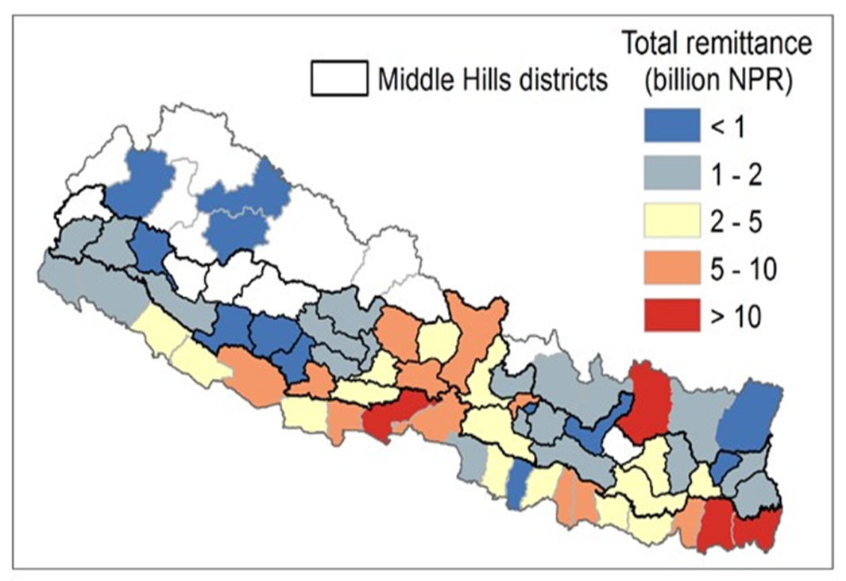
Middle Hills scale hypotheses:
Forest change and remittances

Slide 27
Migration patterns 2001-2010
Migration to India
Non India Migration
2001
2008
2010

Slide 28
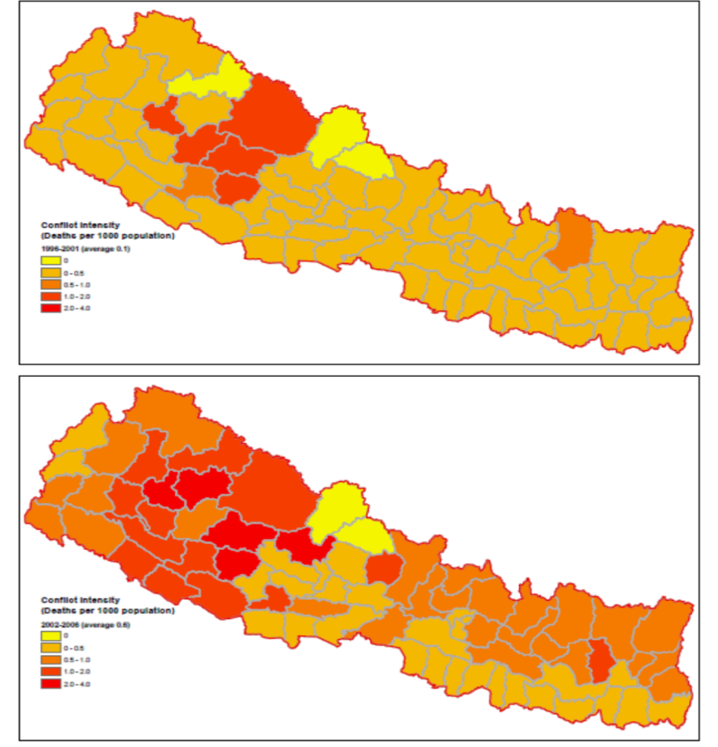
Middle Hills scale hypotheses:
Forest change and conflict
1996-2001
2002-2006
Conflict Intensity
(Deaths per 1000
population)
0
0-0.5
0.5-1.0
1.0-2.0
2.0-4.0

Slide 29
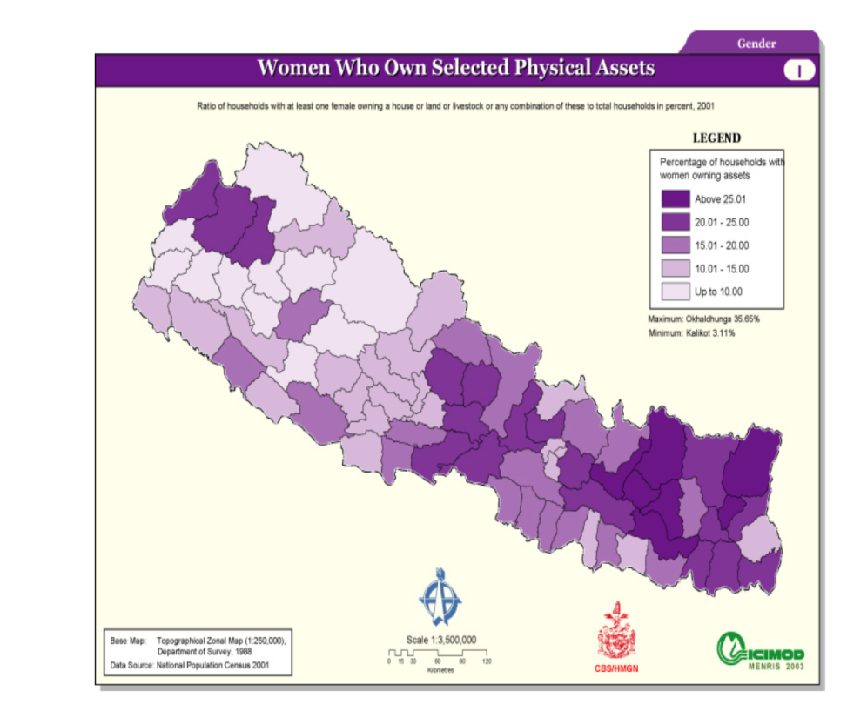
Middle Hills scale hypotheses:
Forest change and % women who own assets

Slide 30
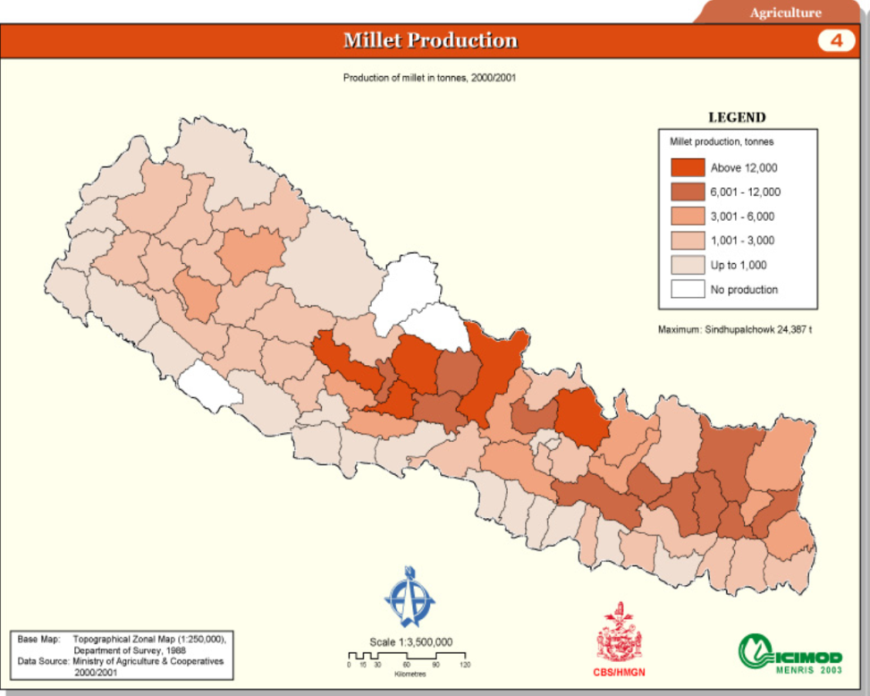
Middle Hills scale hypotheses:
Forest change and millet production

Slide 31
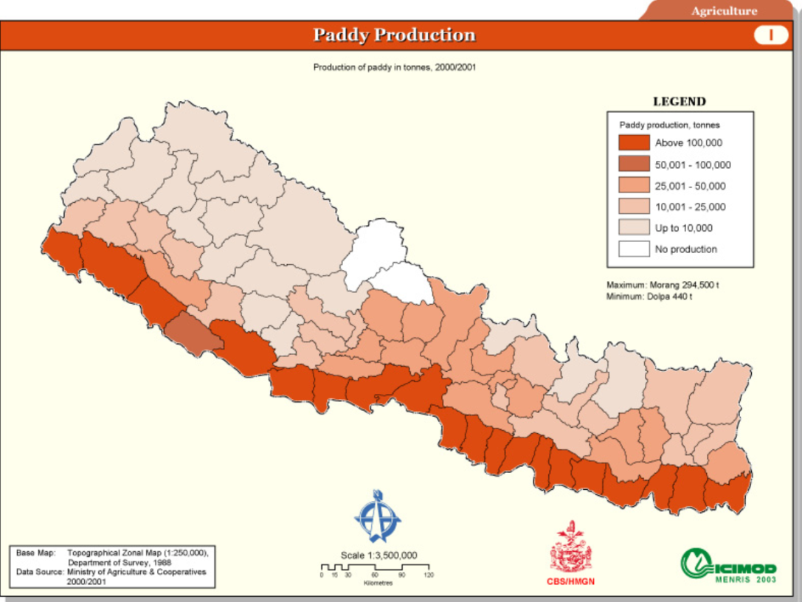
Middle Hills scale hypotheses:
Forest change and paddy production

Slide 32
Project Objectives
At the local scale, specific research objectives include:
Identify a sample of sites mapped as showing forest regrowth or stagnation through this period for more intensive study.
Conduct focus group discussions and household interviews in these sample sites to examine how forest management practices, economic migration, and remittances have changed.

Slide 33
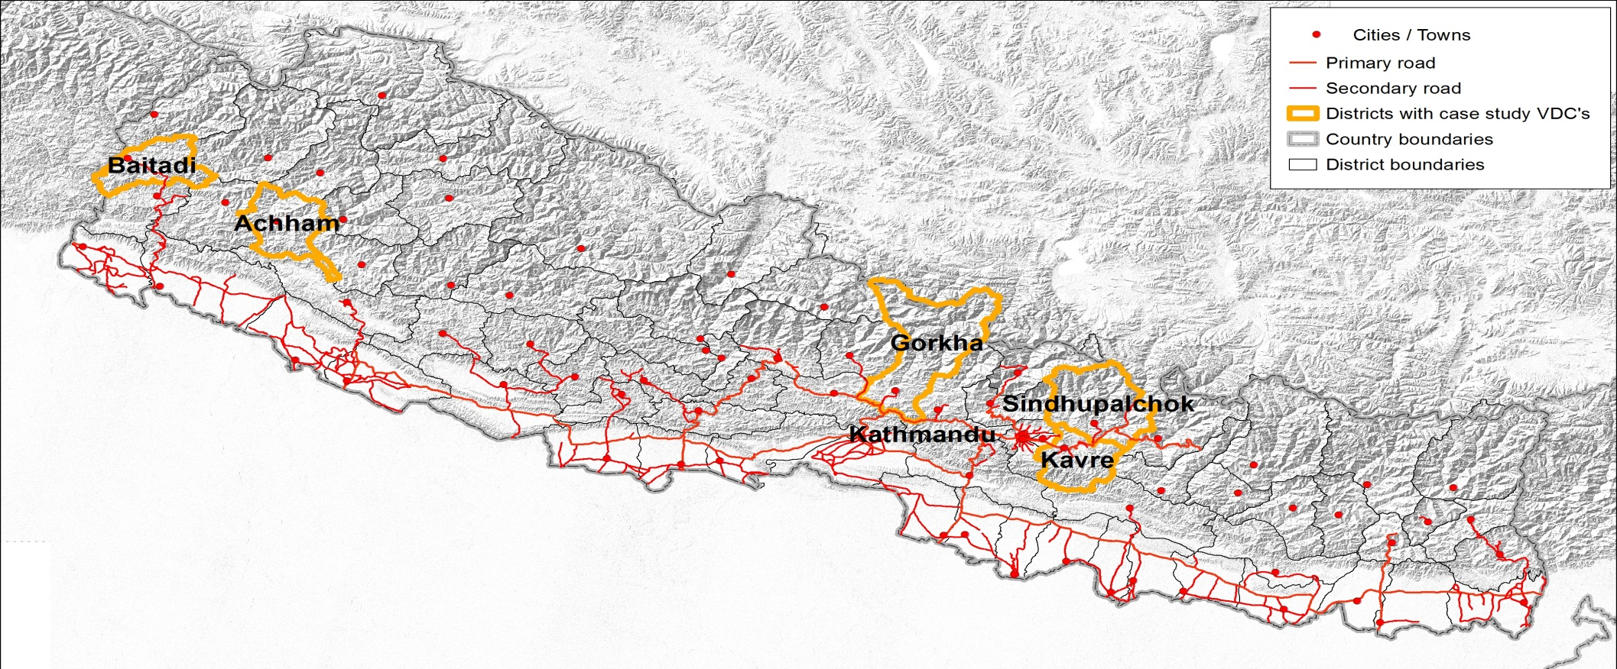
Local Scale Field Work
Mygadi
Chhetri, R. and T. Pandy. 1992. User Group Forestry in the Far-Western Region of
Nepal. Kathmandu: ICIMOD.
Chhetri, R., et al. 1996. Nepal Austral Forestry Project: Social Economic Impact
Study. Canberra: AusAid.
Fox, J. 2016. Community forestry, labor migration, and agrarian change in a Nepali
village: 1980 to 2010. The Journal of Peasant Studies.
Metz. J. 1994. Forest product use at an upper elevation village in Nepal.
Environmental Management 18:3: 371-390.

Slide 34
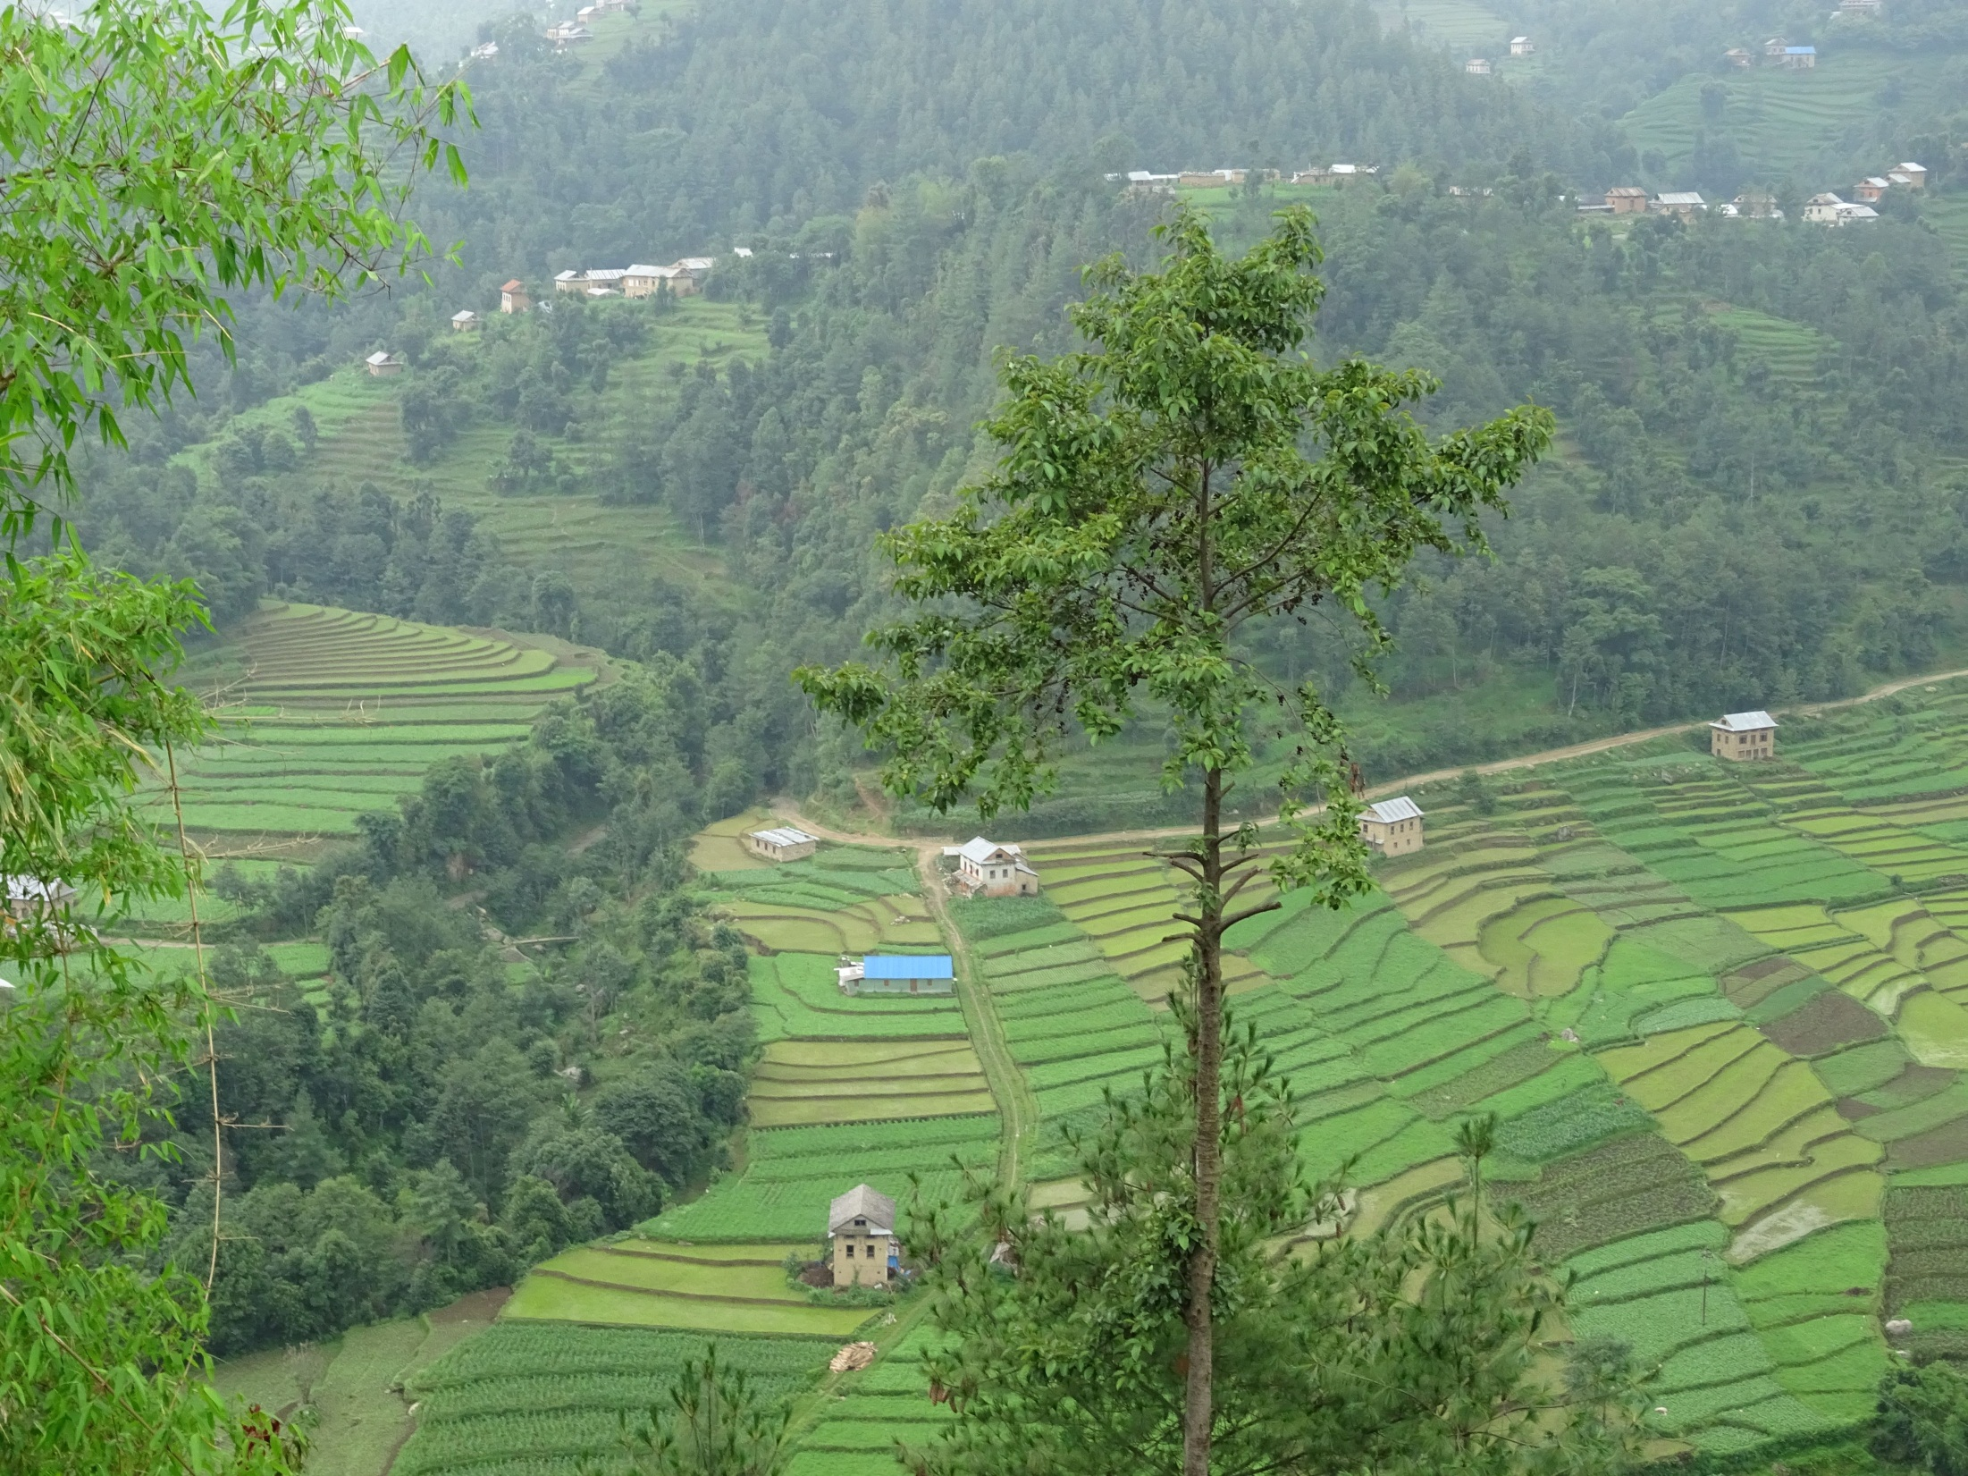
Next steps
Complete TimeSync-based validation of LandTrendr outputs
Finalize forest cover change maps
Conduct field interviews in Sindu Palchok and Kabhre Palanchok Districts April 7-21
Ground truthing field data collection in late summer 2017
Conduct field interviews in Baitadi and Accham Districts fall of 2017
Integrate socio-economic and remote sensing datasets and conduct socio-spatial modelling
Immediate
Near-term

Slide 35
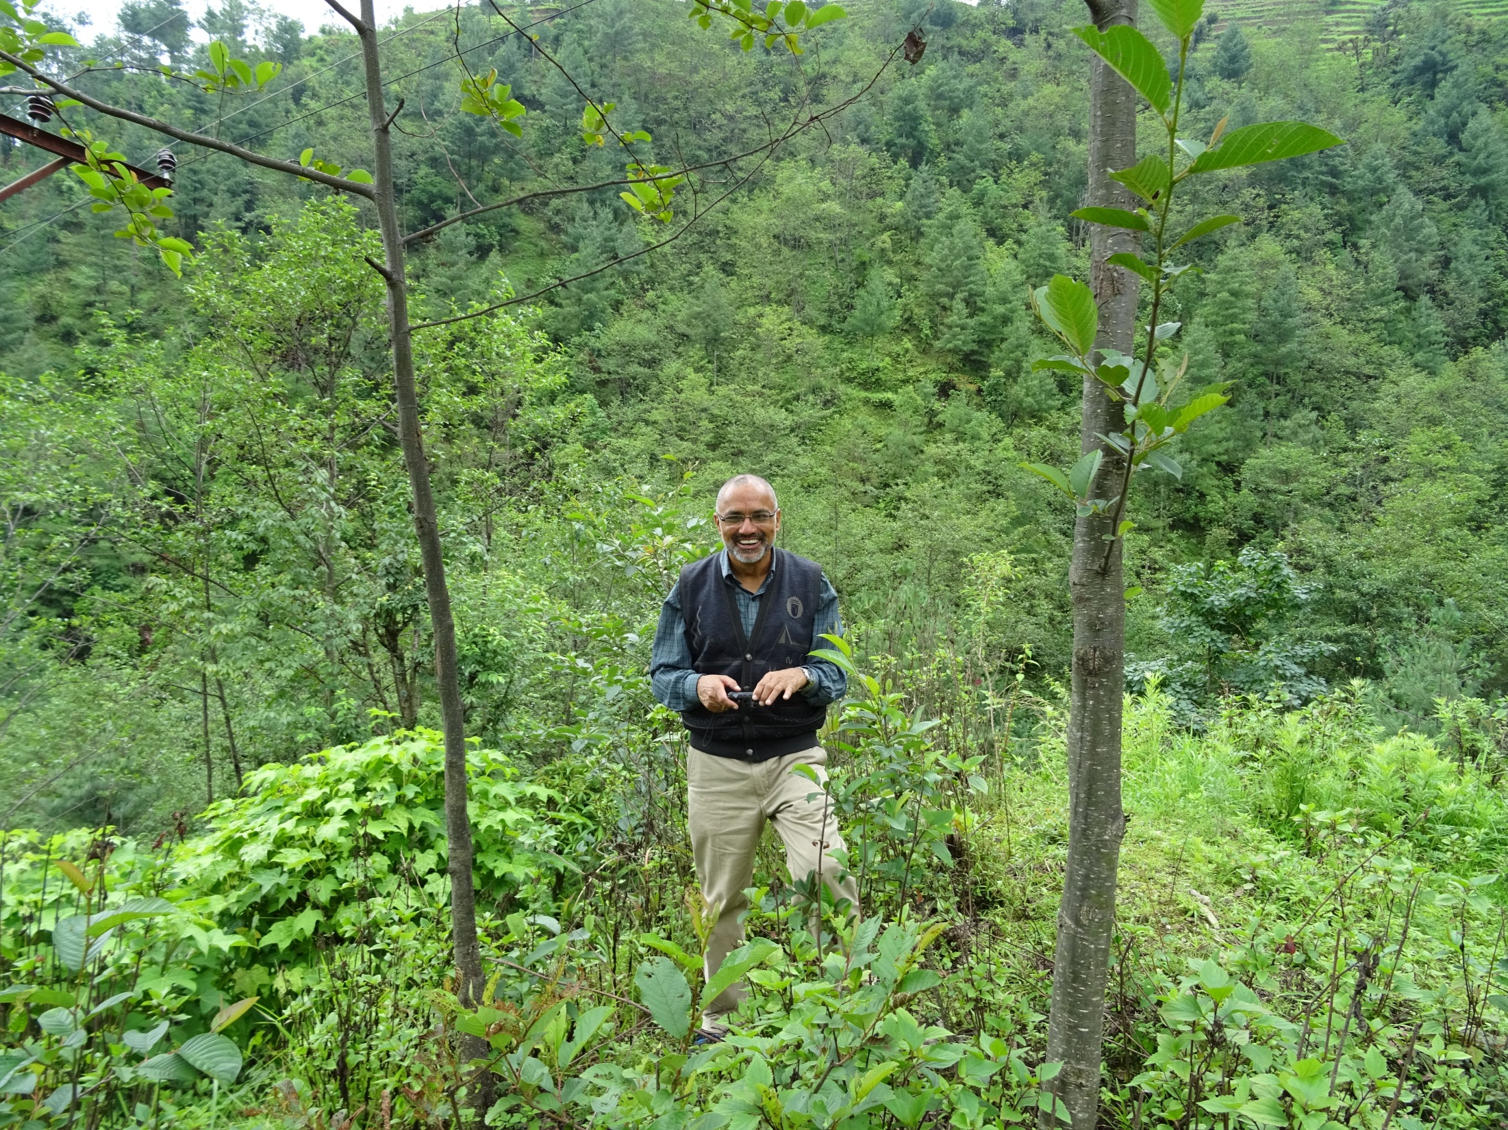
Thank You!
Dr. Ram Chhetri, Co-I
Resources Himalaya
foxj@eastwestcenter.org

