Slide 1
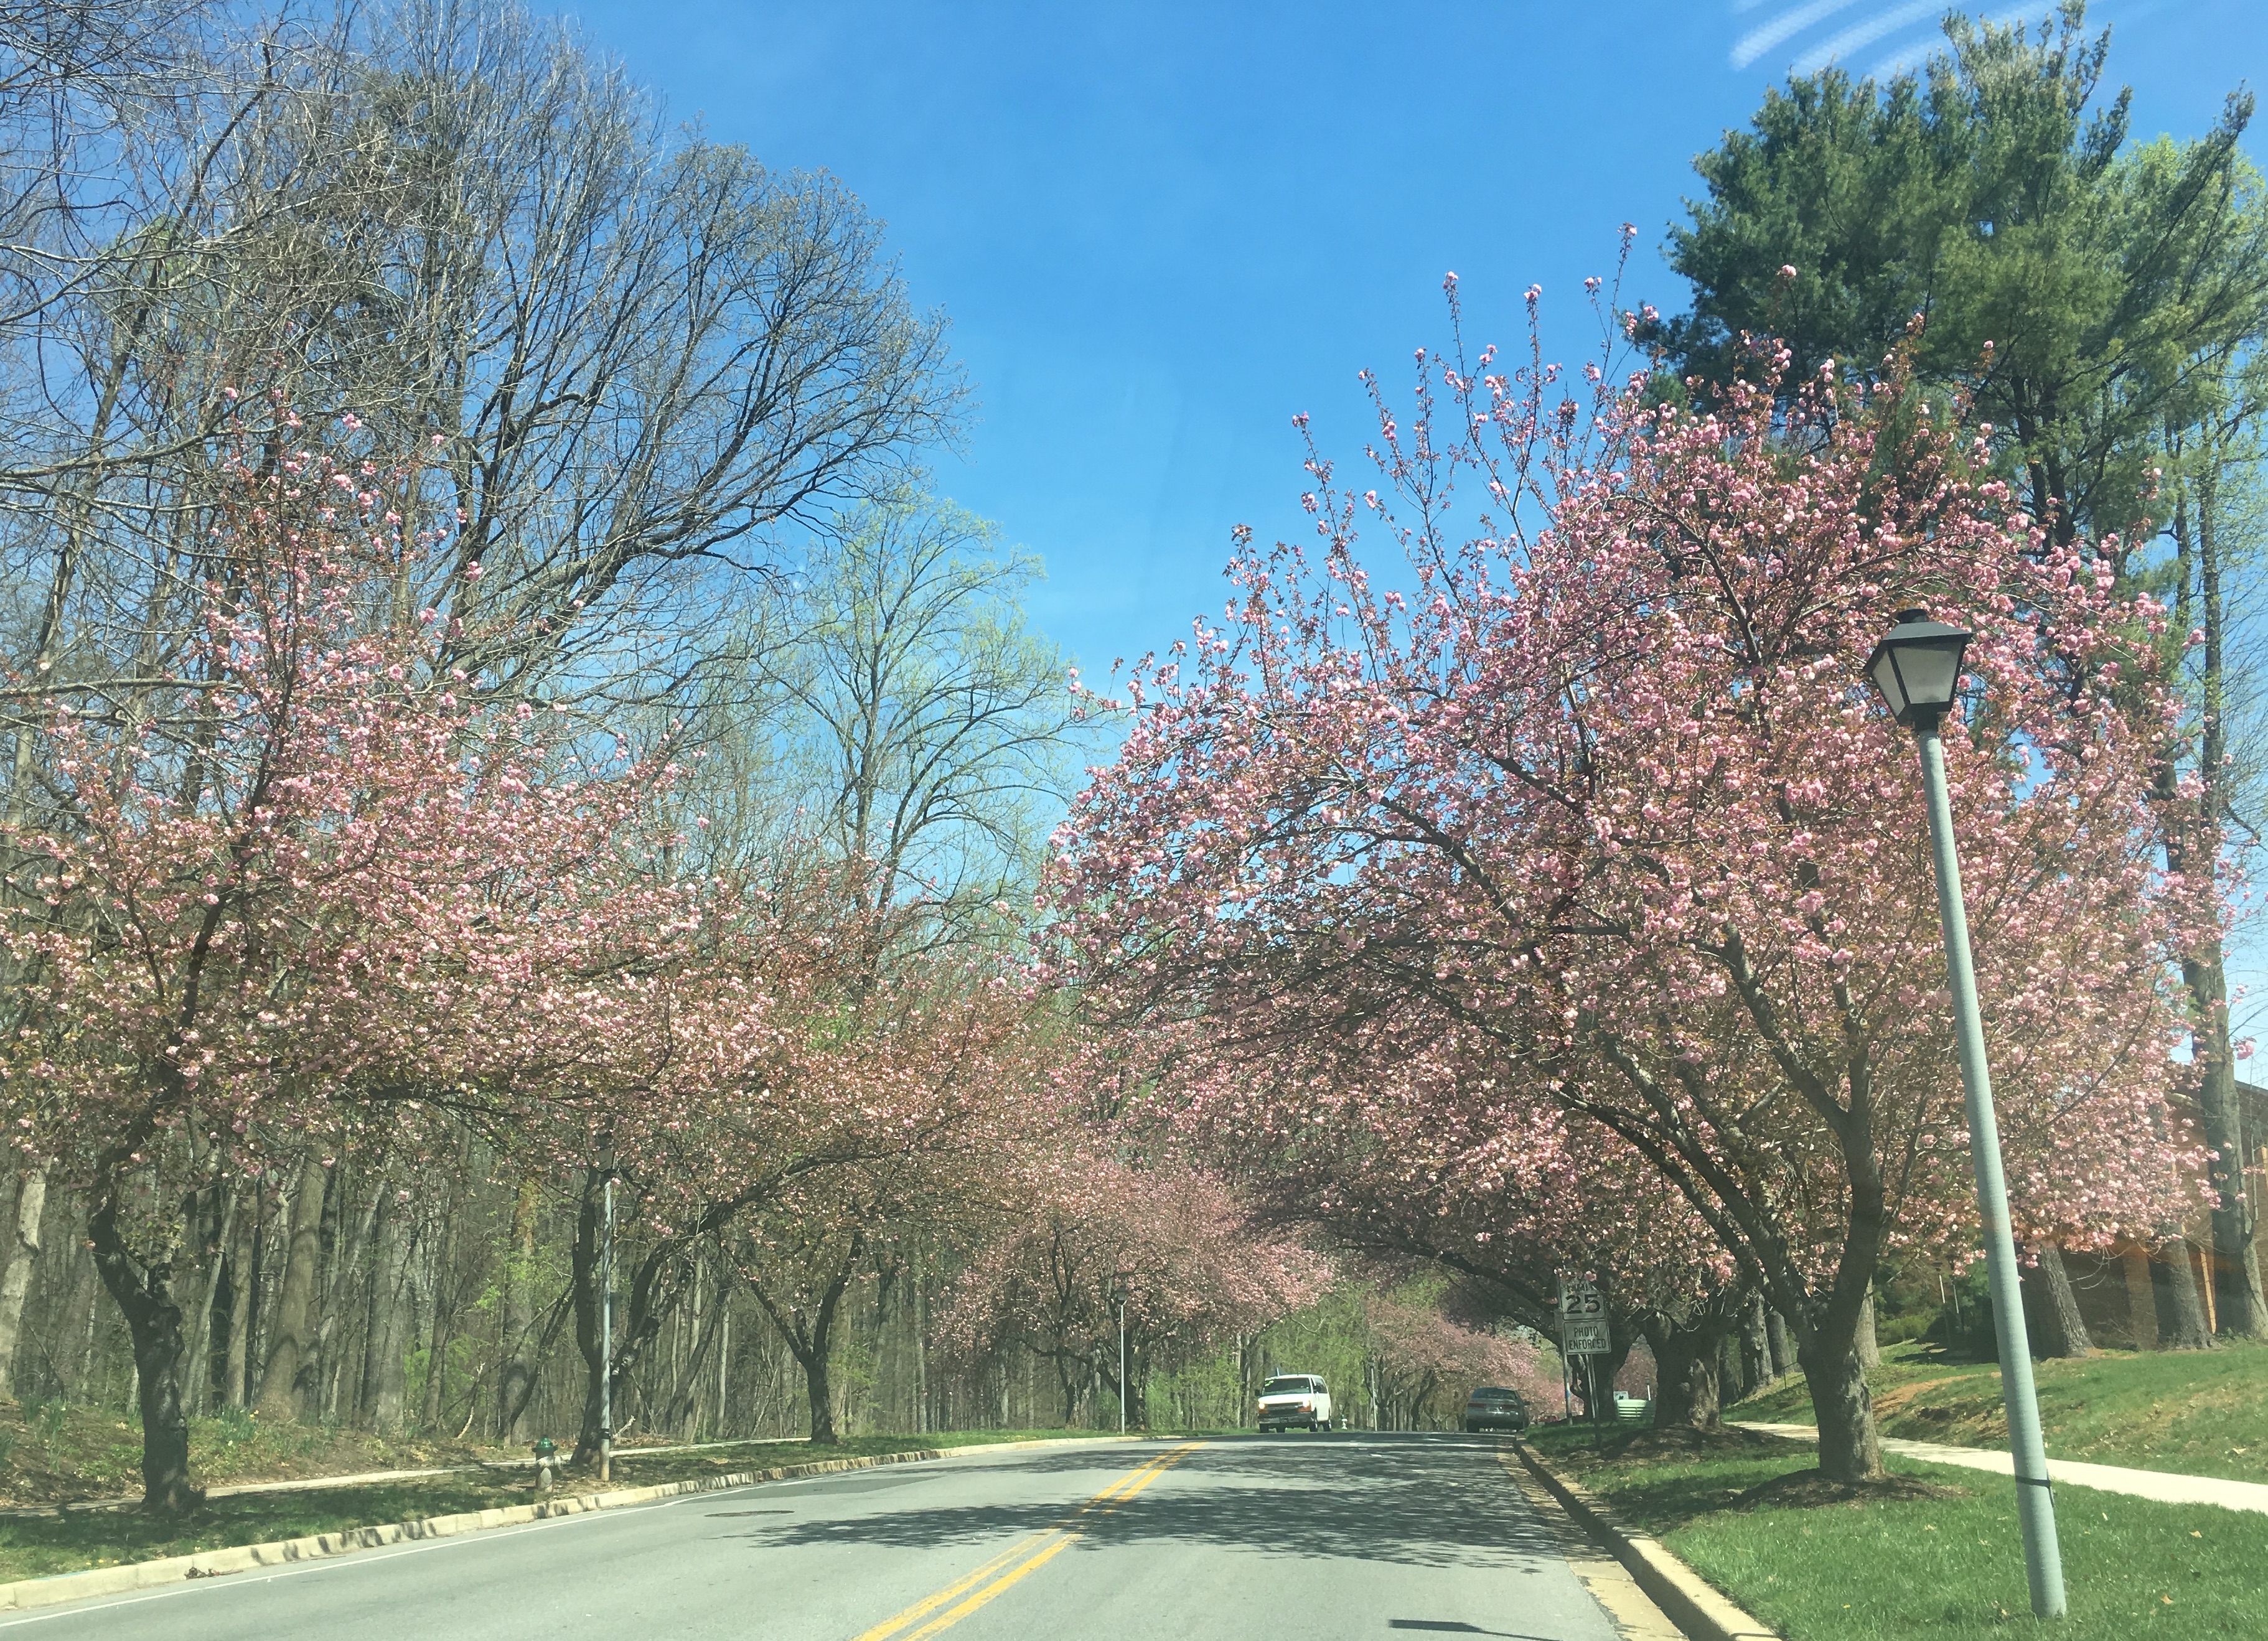
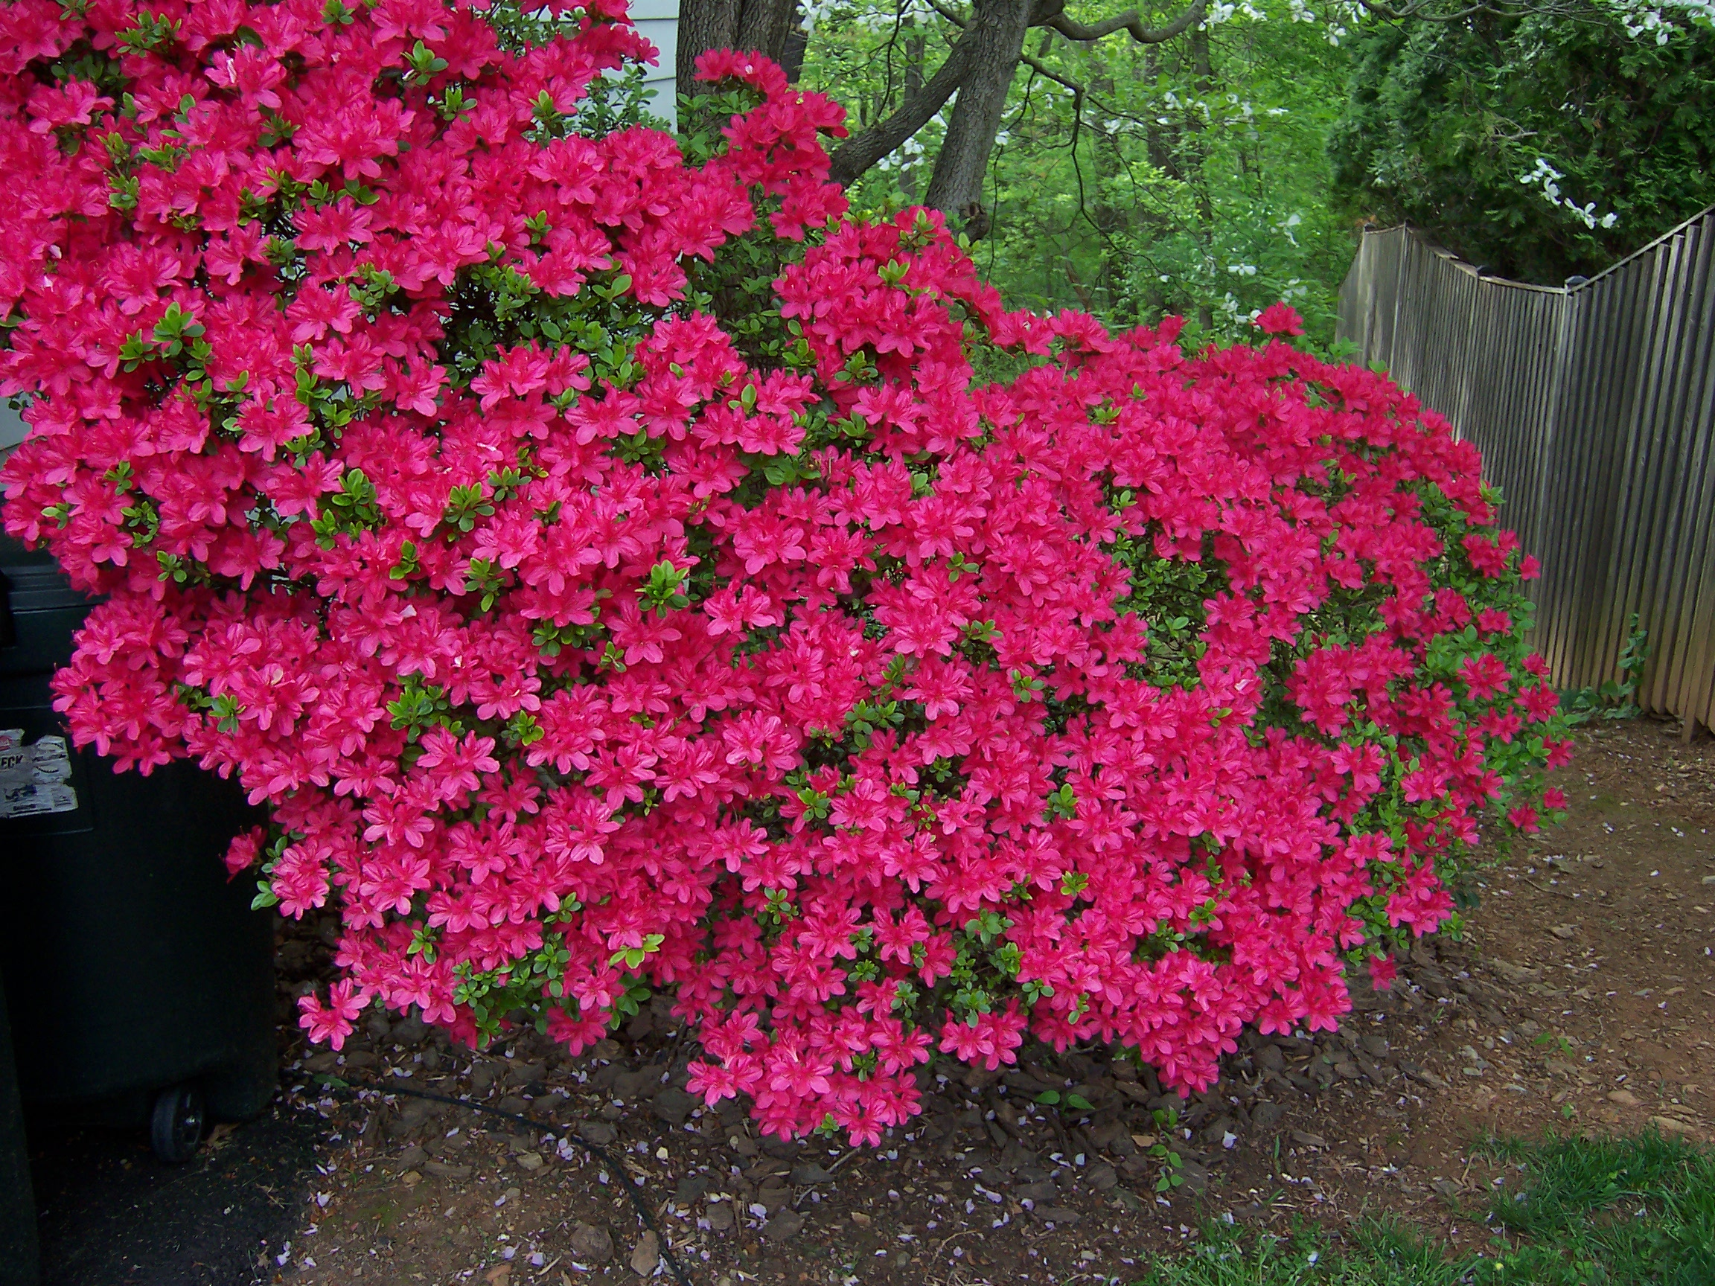
LCLUC Program: update
Garik Gutman,
NASA Headquarters
Manager, LCLUC Program
April 2017

Slide 2
Apr 12: International Day of Human Space Flight!
GISTDA Facility, Thailand

Slide 3
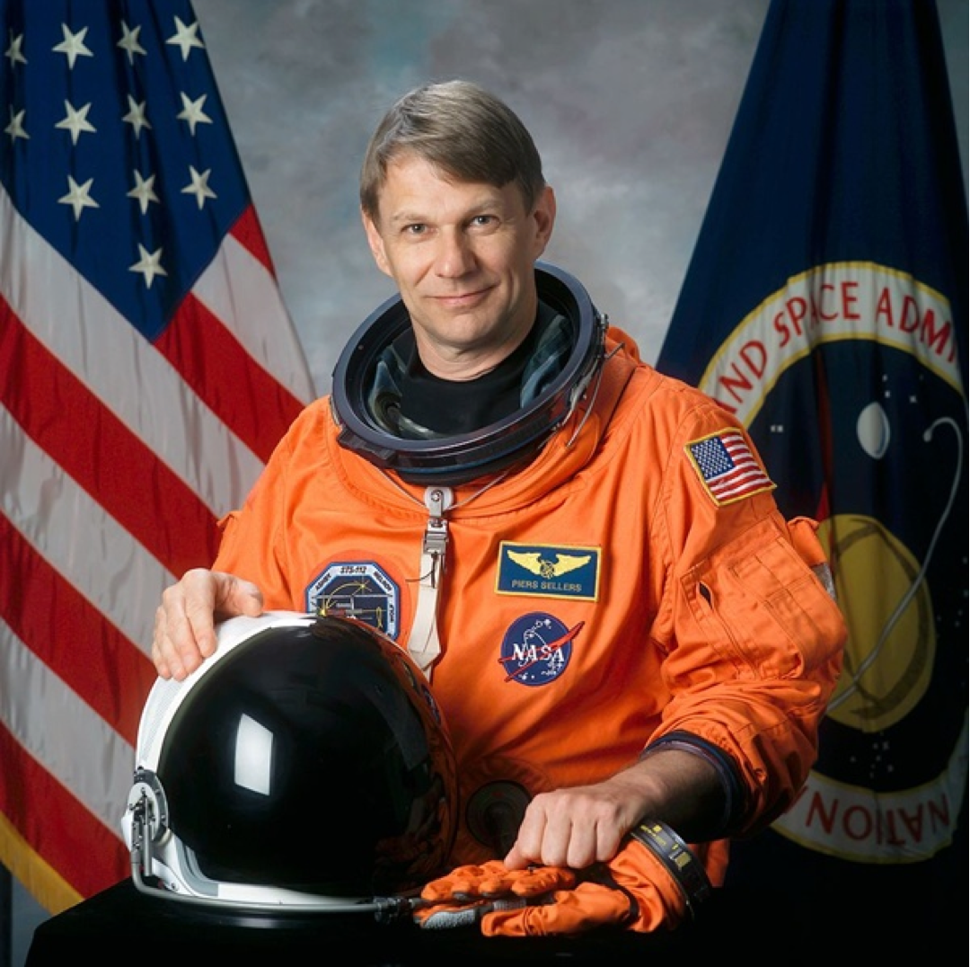
Earth Scientist, Astronaut Piers Sellers April 11, 1955-December 23, 2016

Slide 4
http://lcluc.hq.nasa.gov

Slide 5
LCLUC Science Program Structure
LCLUC Globally and Regionally
Socio-economic component as an integral part of projects
Remote sensing component
MuSLI (Multi-Source Land Imaging) component
Social science is not required
Multiple sensor 10-30m resolution data are to be used
Capacity Building/Education component

Slide 6
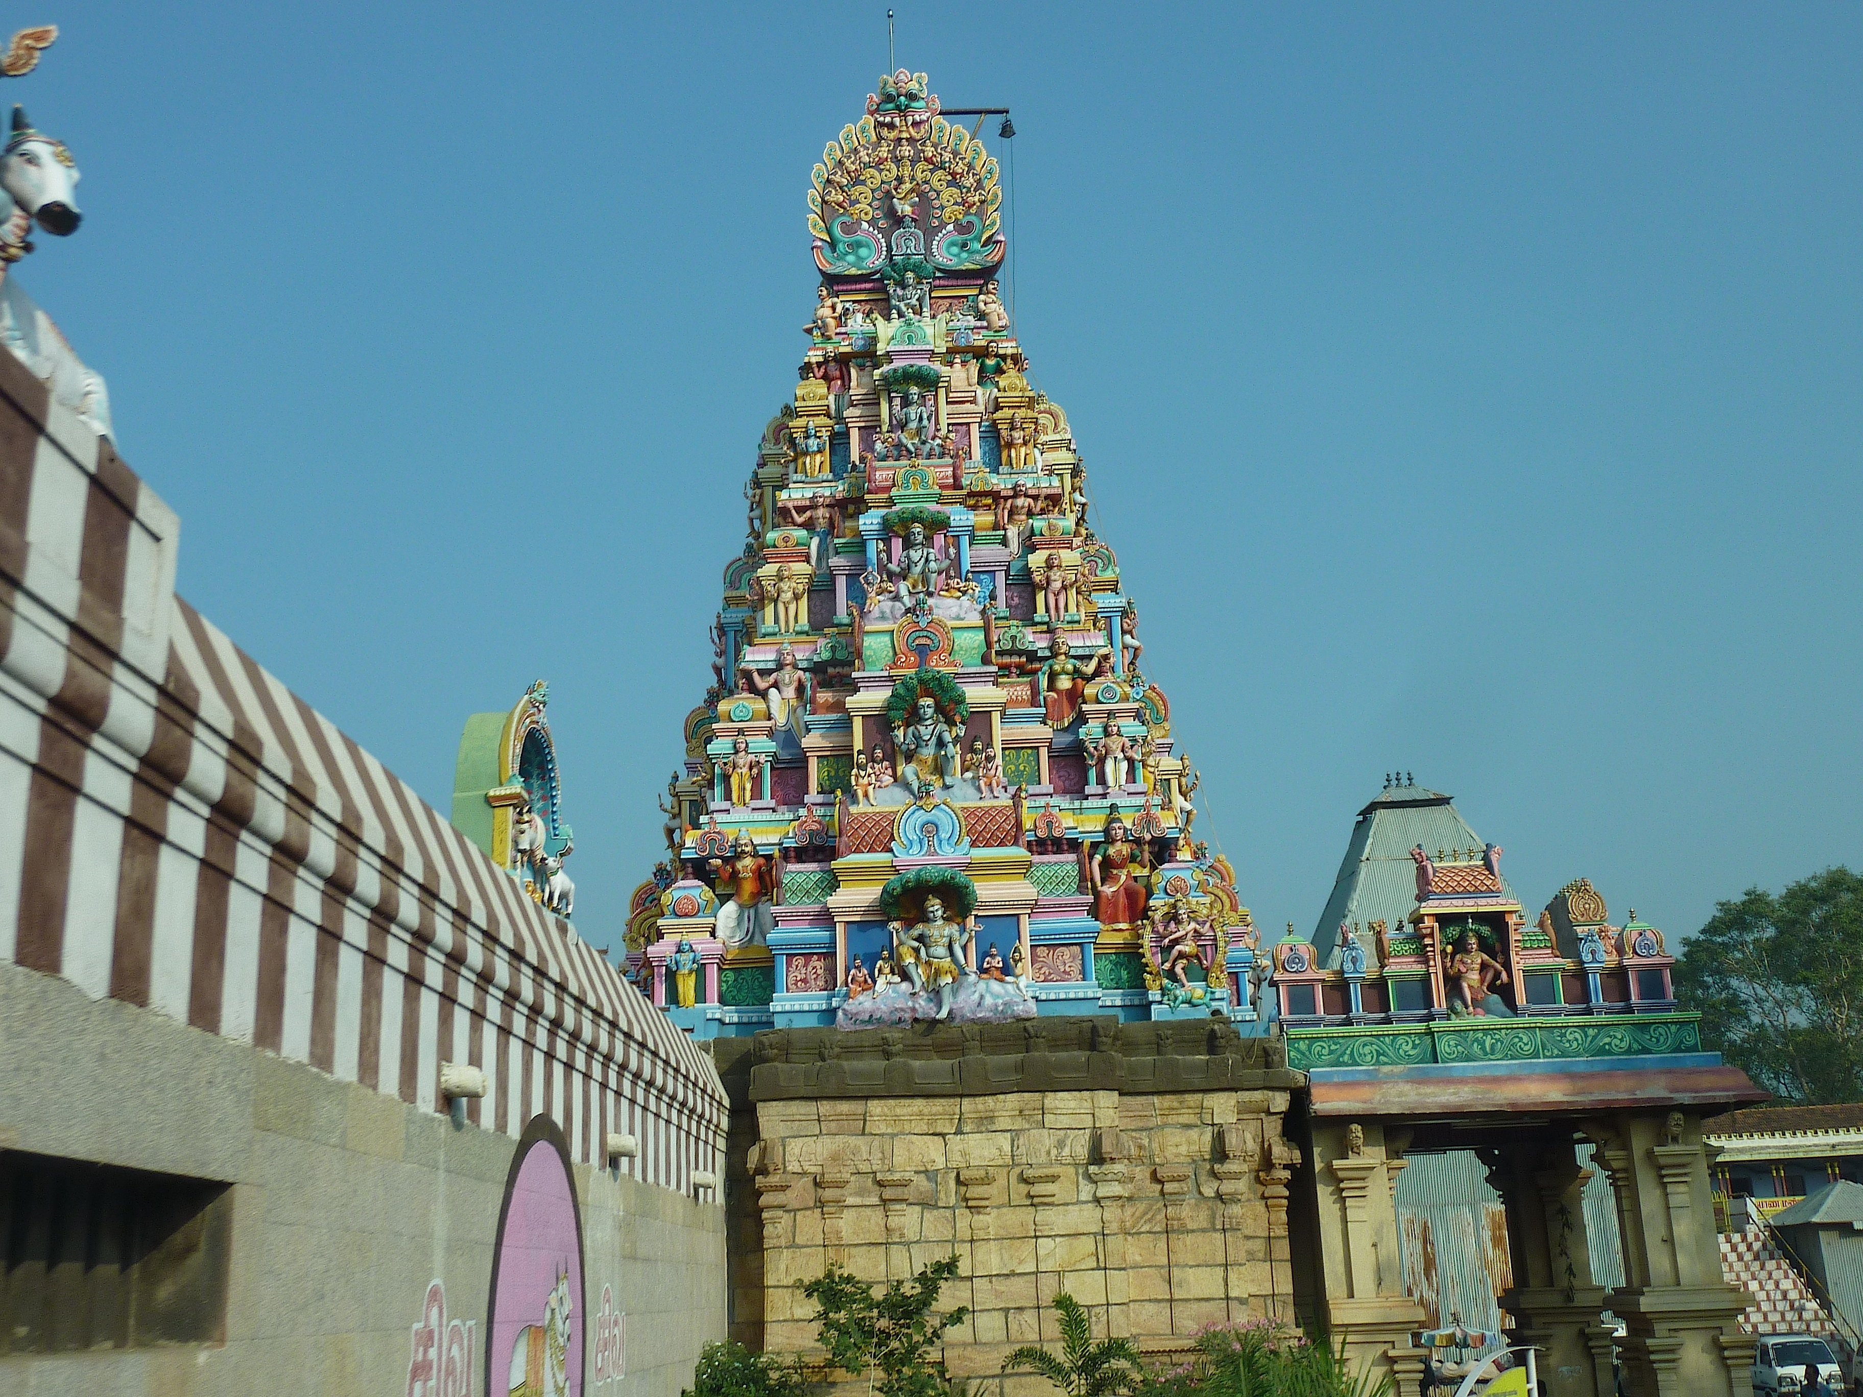
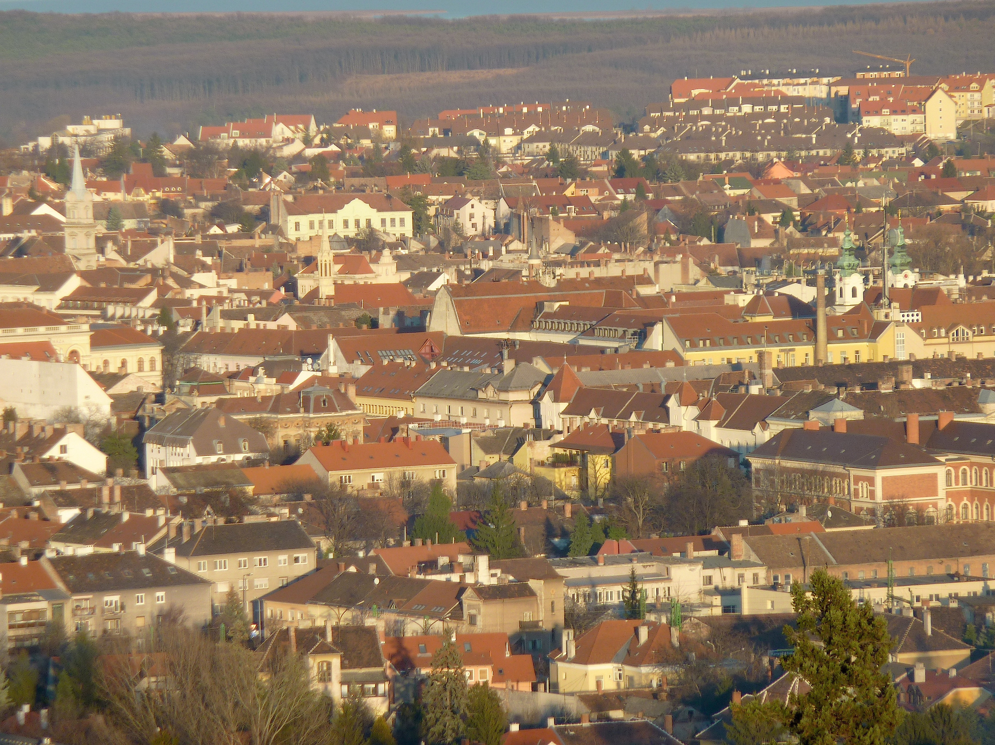
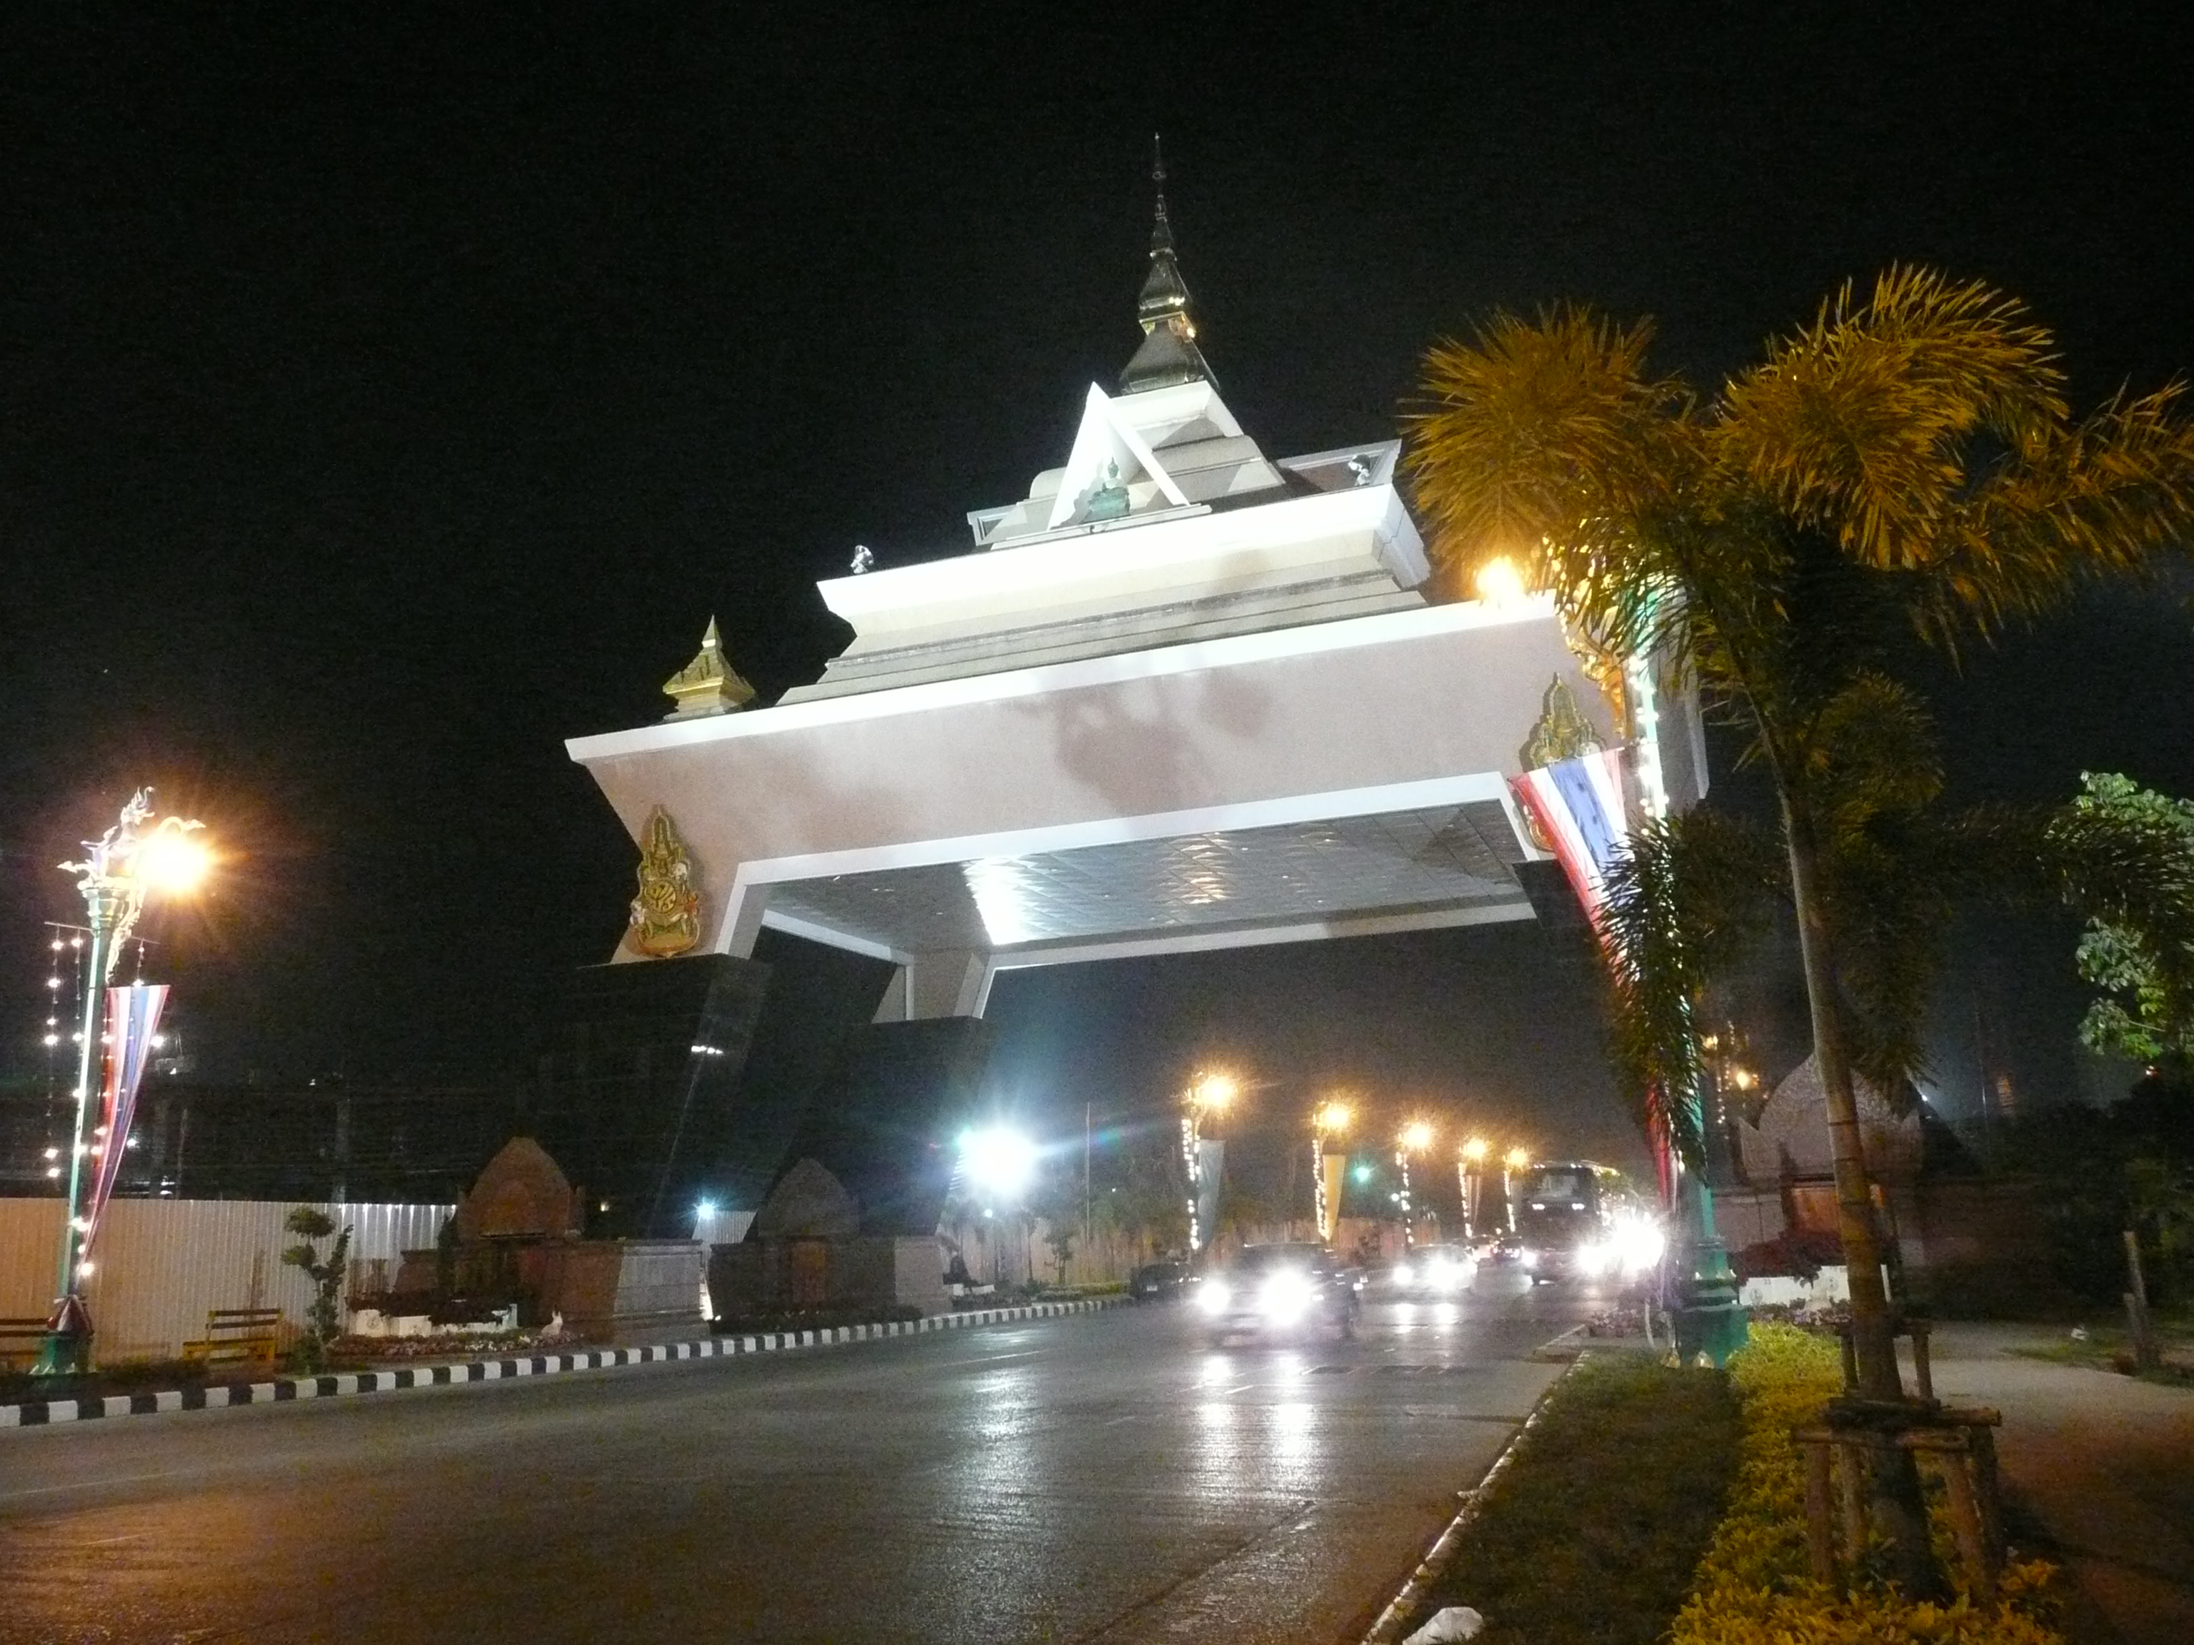
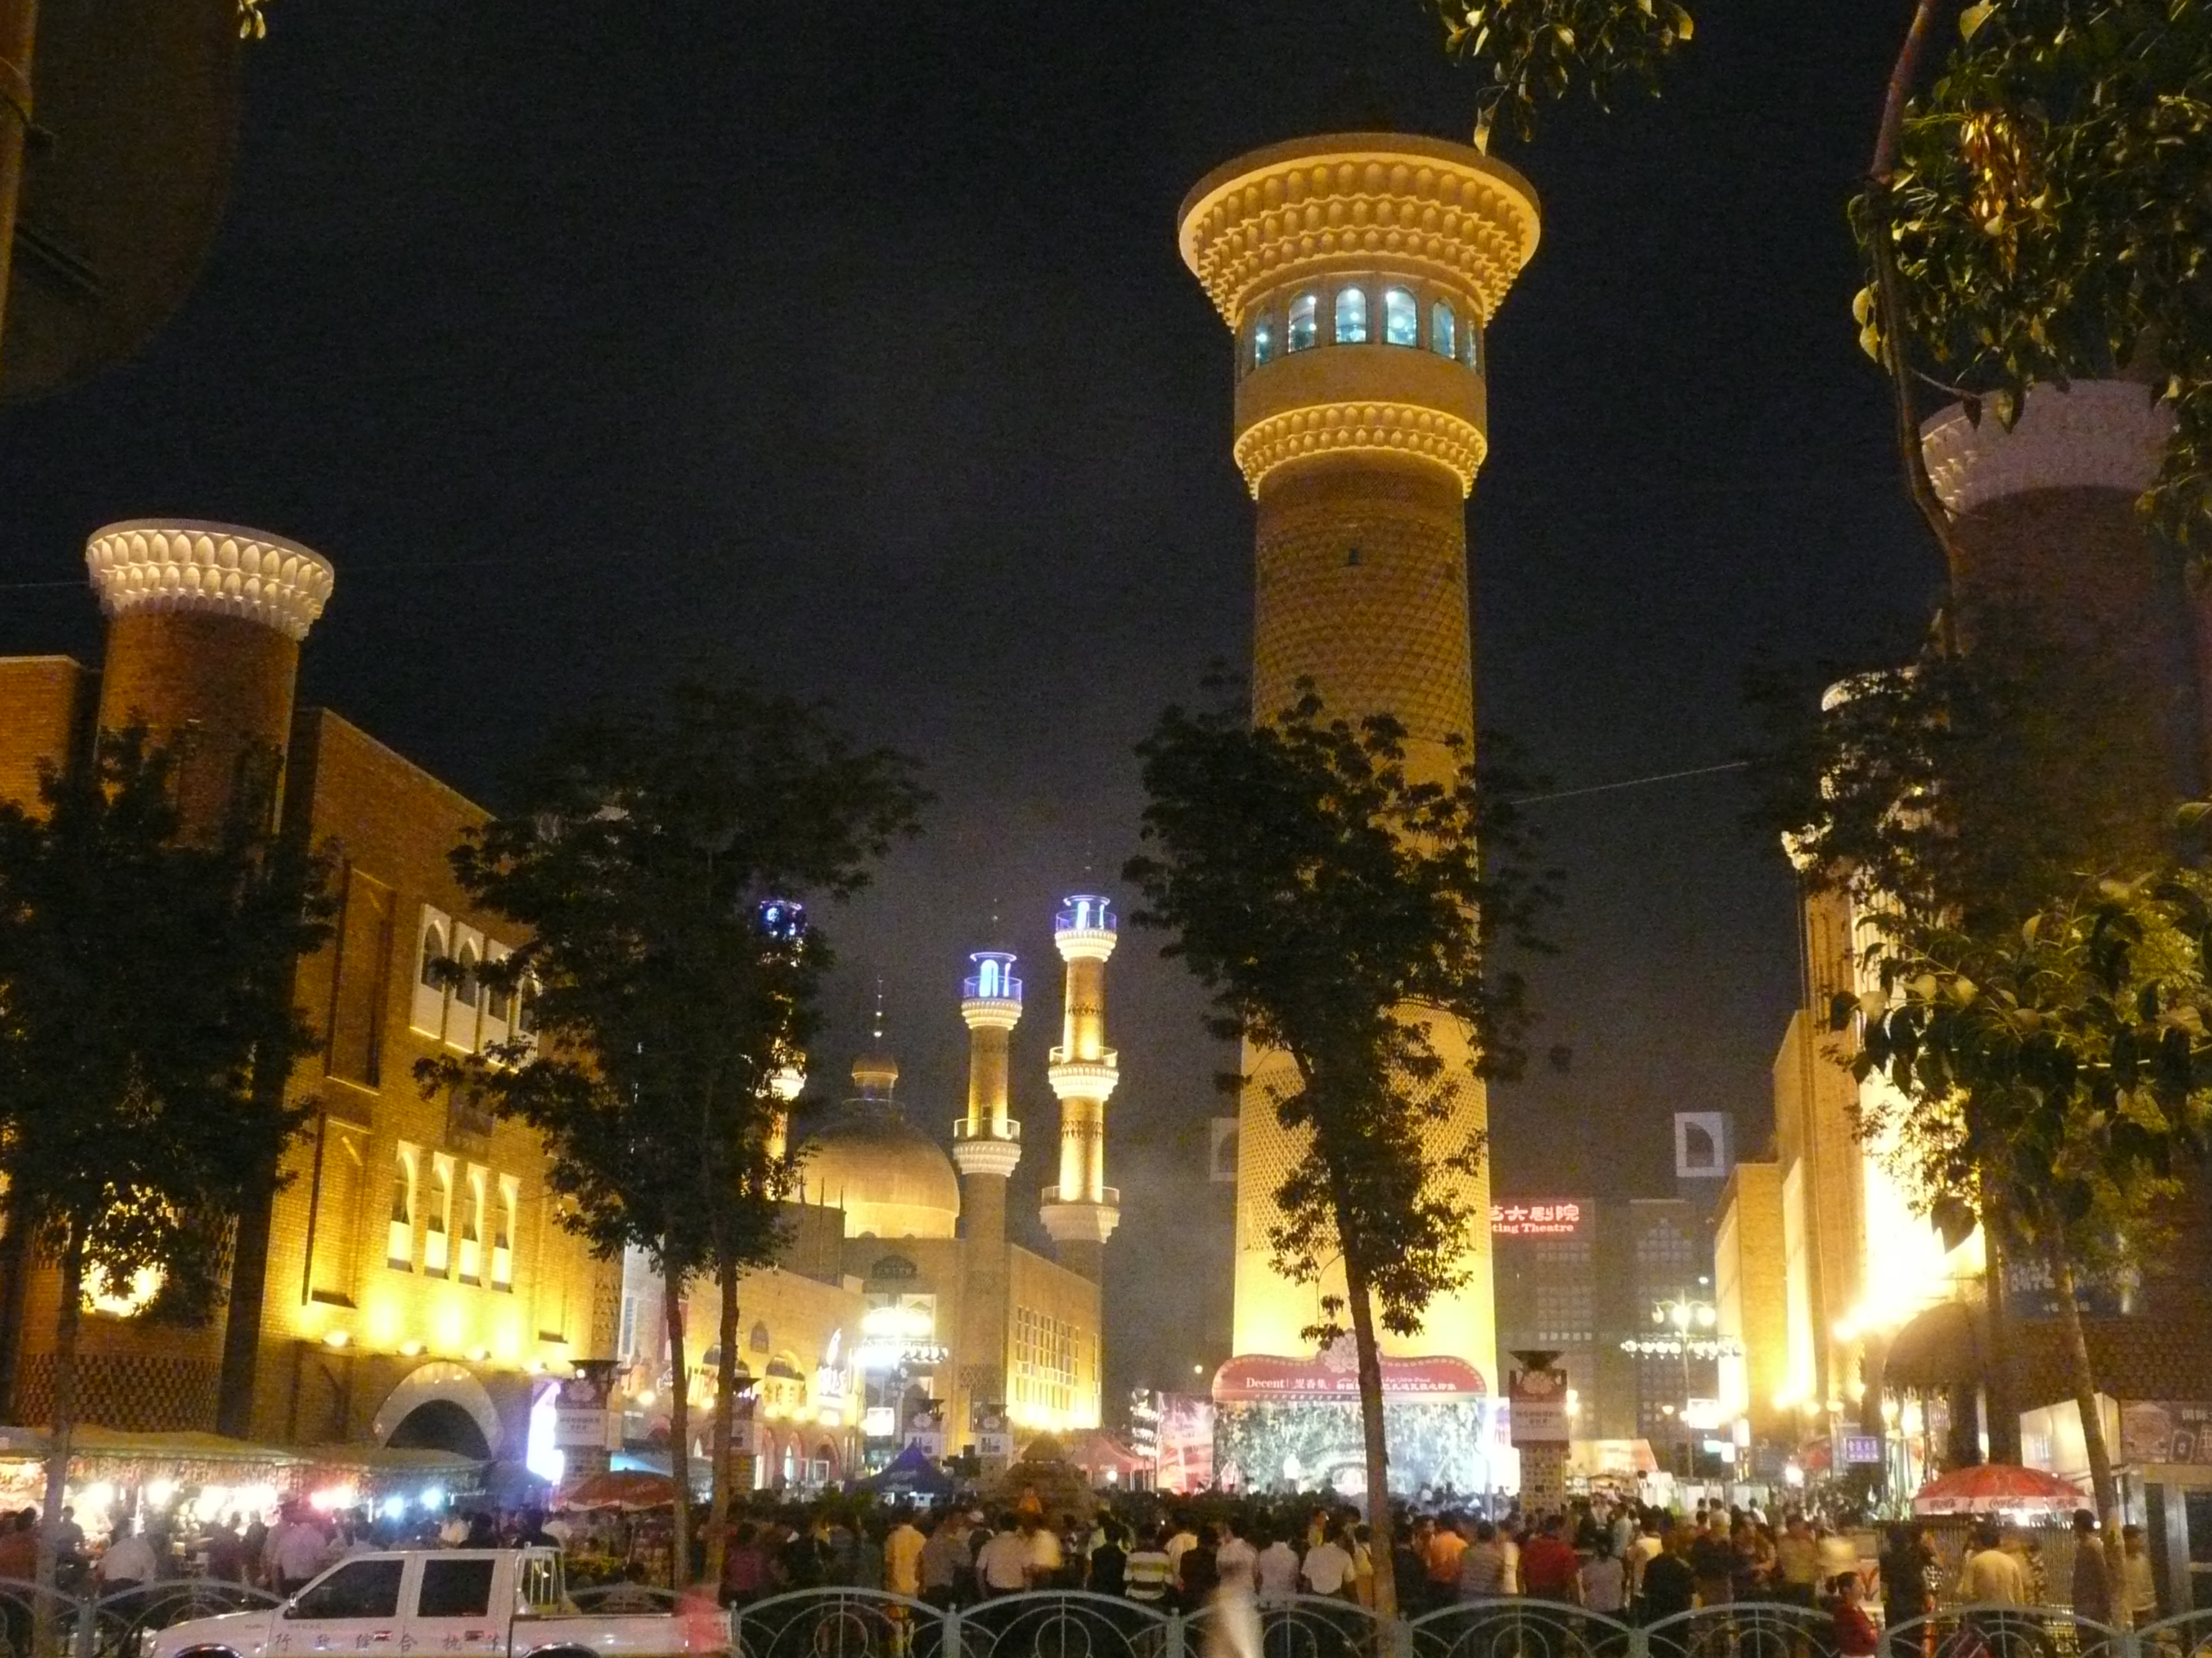
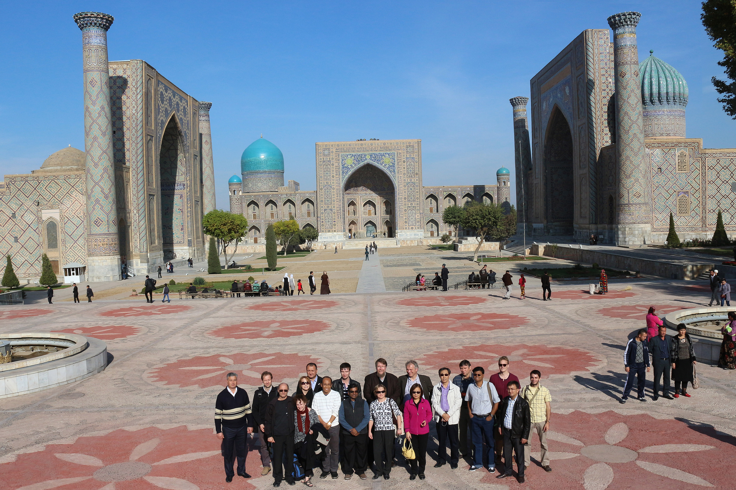
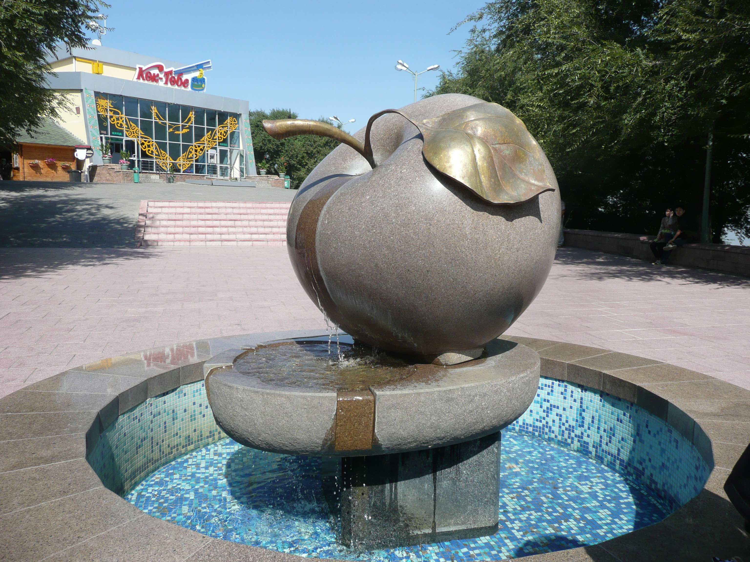
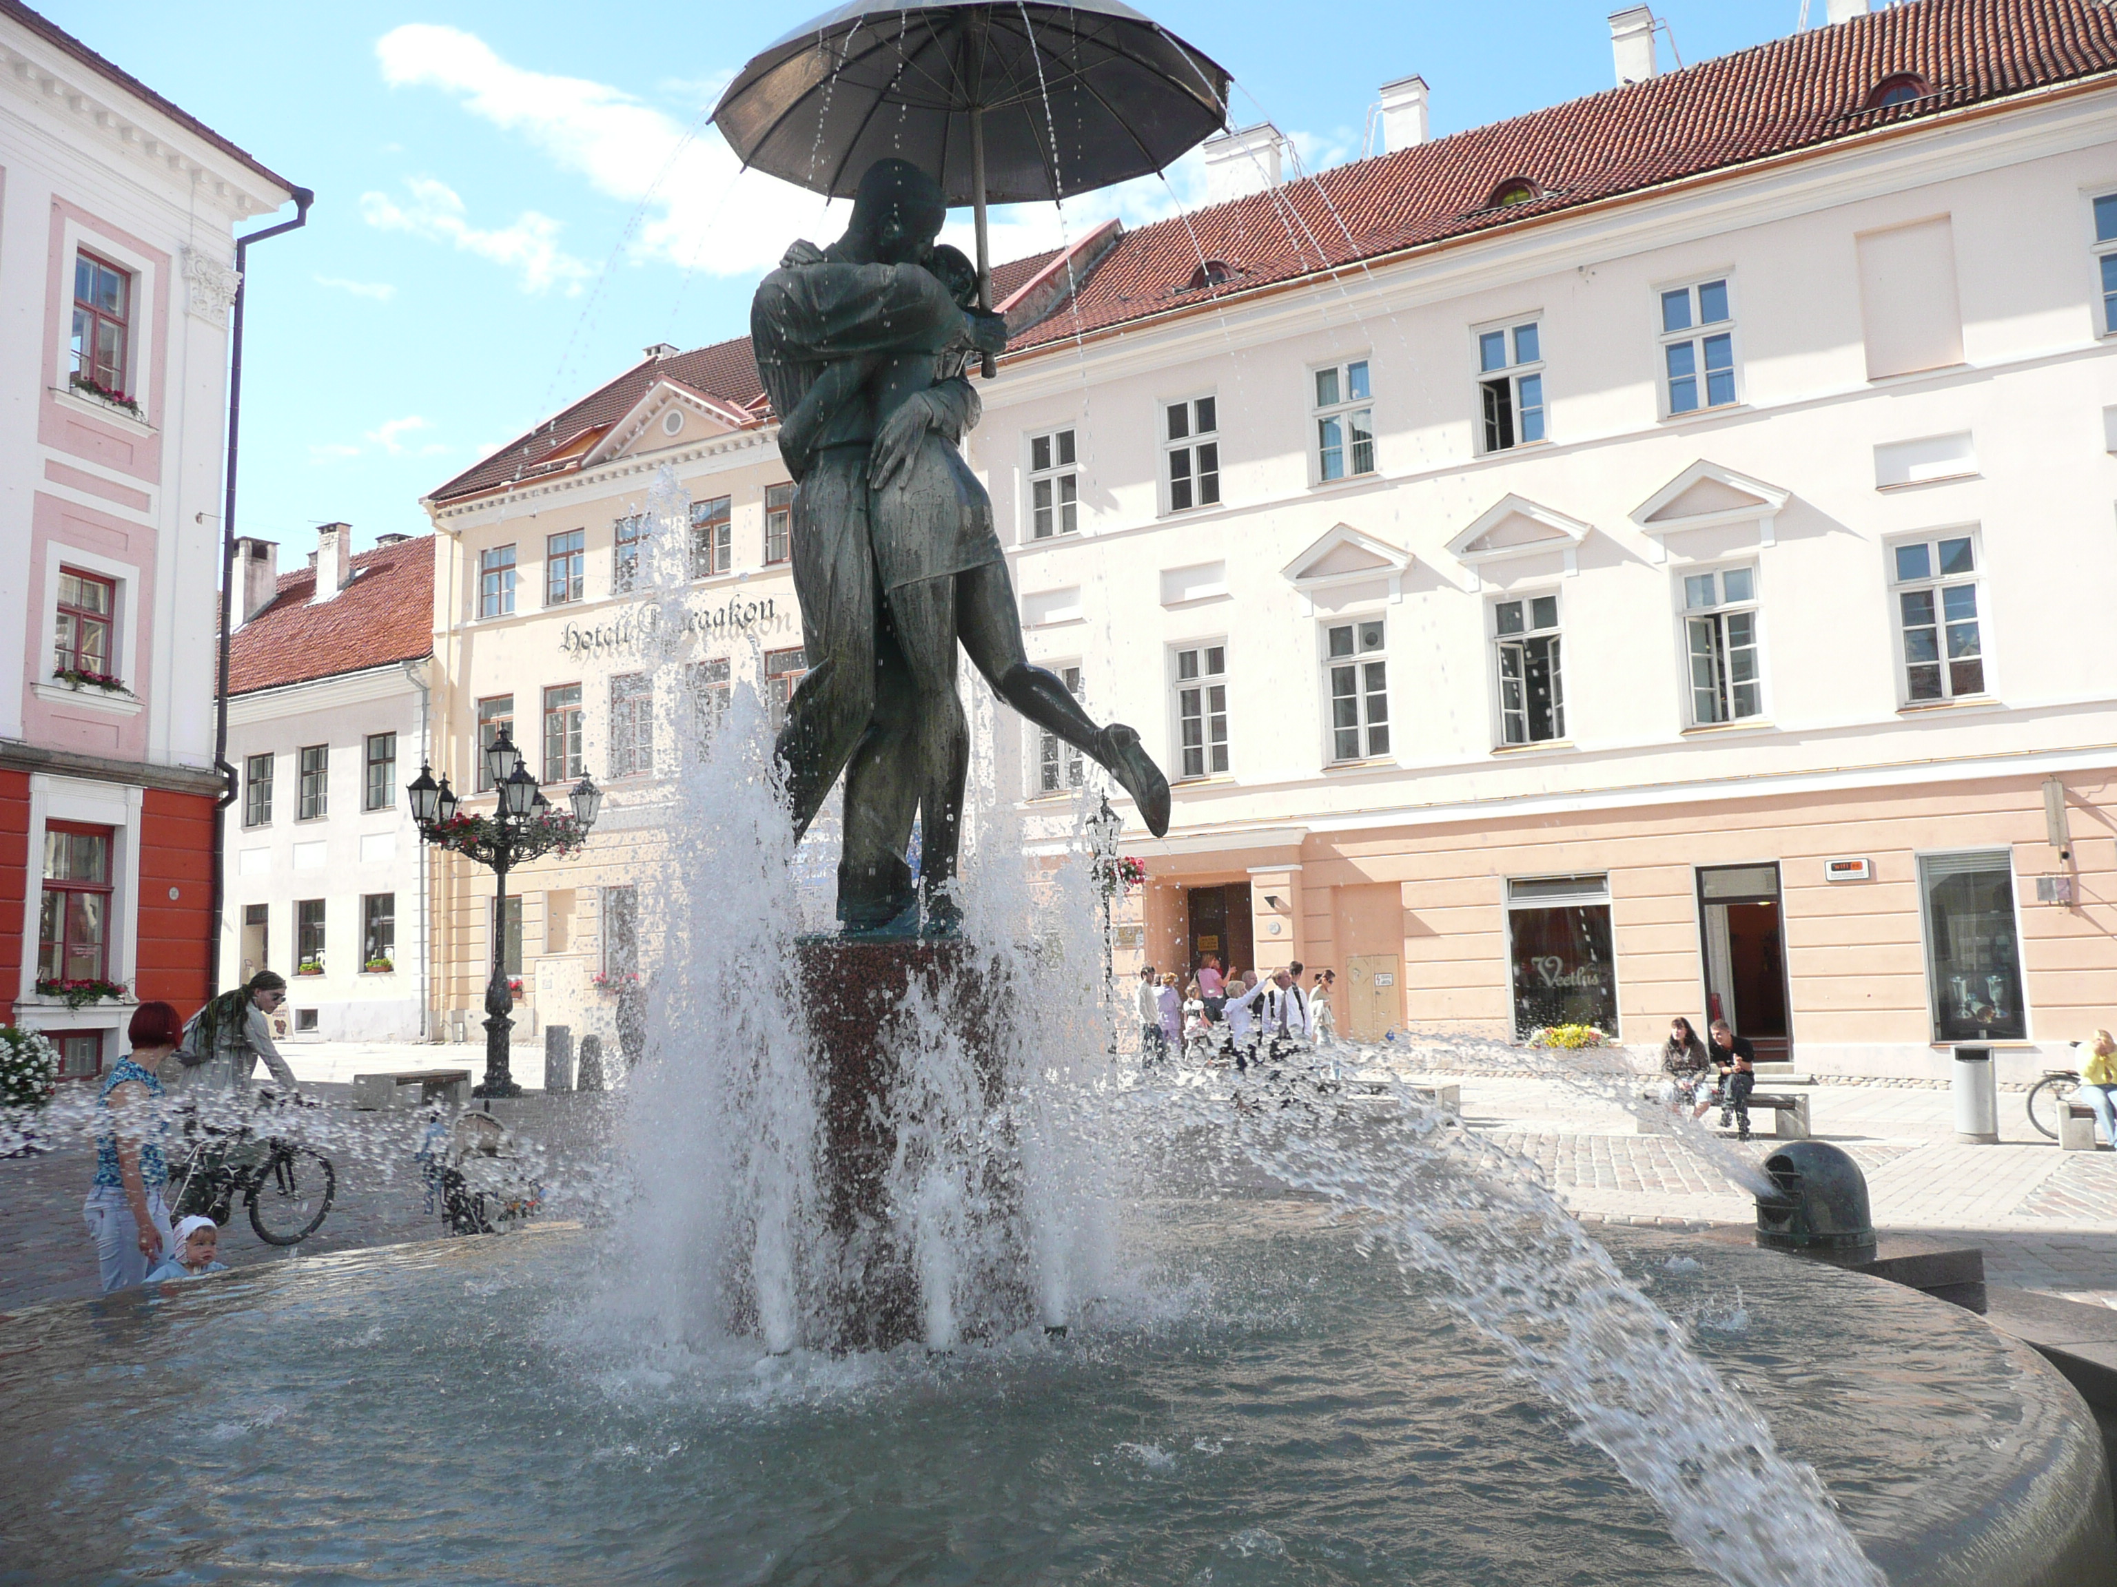
LCLUC Science Team Meetings
Washington: Spring Blossom
2007: Climate/Carbon
2008: Joint CC&E Focus Area meeting
2009: LCLUC impacts on climate
2010: GLS LCLUC products
2011: 15th Anniversary (review/update)
2011/9: Agriculture (Joint CC&E FA)
2012: Urban
2013: Wetlands
2014: Urban
2015: Early Career Scientists (Joint CC&E FA)
2016: 20th Anniversary/Industrial Forests
2017: Mountains
International Regional
2007/9: NEESPI/MAIRS Urumqi, China
2009/1: MAIRS Kohn Kaen,Thailand
2009/9:MAIRS/NEESPI Almaty, Kazakhstan
2010/8: NEESPI Tartu, Estonia
2011/11: MAIRS Hanoi, Vietnam
2013/1: MAIRS Coimbatore, India
2013/11: NEESPI/MAIRS Tashkent, Uzbekistan
2014/10: NEESPI: Sopron, Hungary
2016/1: SARI/MAIRS: Yangon, Burma/Myanmar
2017/7: SARI/MAIRS: Chiang Mai, Thailand

Slide 7
Carbon Cycle
and Ecosystems
Focus Research
Area
Internal Linkages
@ NASA
Terrestrial Ecosystems
Program
Ocean Biology
Program
Biodiversity
Program
Applications
Program
Carbon Management
Coastal Management
Water Management
Agri. Management
Land-Cover/Land-Use
Change Program
Atmospheric
Composition
Focus Area
Radiation
Science
Water and Energy Cycle
Focus Research Area
Terrestrial Hydrology

Slide 8
External Linkages: National
USGS
Merge of the next round Landsat & MuSLI Science Teams
USAID
SERVIR (acronym standing for Mesoamerican Regional Visualization and Monitoring System in Spanish)
PEER (Partnerships for Enhanced Engagement in Research)
USFS
Global Forest Observations Initiative (GFOI)

Slide 9
External Linkages: International
GOFC-GOLD
CEOS/GEO
Future Earth
SERVIR
EARSeL LULC Special Interest Group
ESA and EU institutions
Fire IT office at UMD
START Inc. activities
Regional Information Networks
CEOS on Cal/Val WG
CEOS LSI Constellation WG
GEO Tasks (SB-02 C1 ) on Global Landcover
GEO WG on Land Cover Africa
GFOI
GEOGLAM
Global Land Project (GLP)
NEFI
Future Asia
SARI (Himalaya and Mekong hubs)
Joint biennial workshop
Landsat-Sentinel products under MuSLI

Slide 10
The Role of Social Science in LCLUC Program
Humans play an important role in LCLUC
Social and economic science research includes
impacts of changes in human behavior on LCLUC
impacts of LCLUC on society
adaption to climate/environmental change of land-use systems
During the last 10 years, the Social/Economics Science component has been a mandatory part of all LCLUC proposals, unless otherwise stated in the solicitation

Slide 11
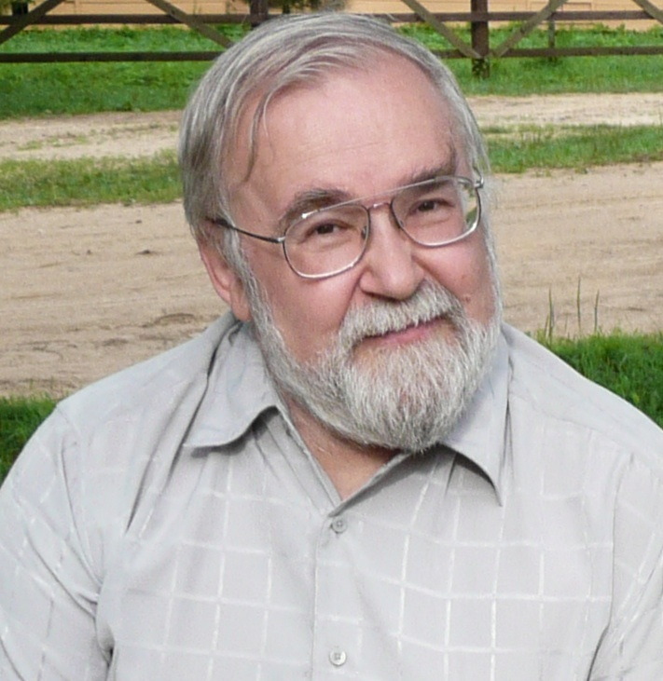
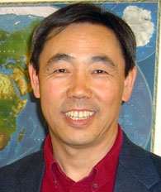
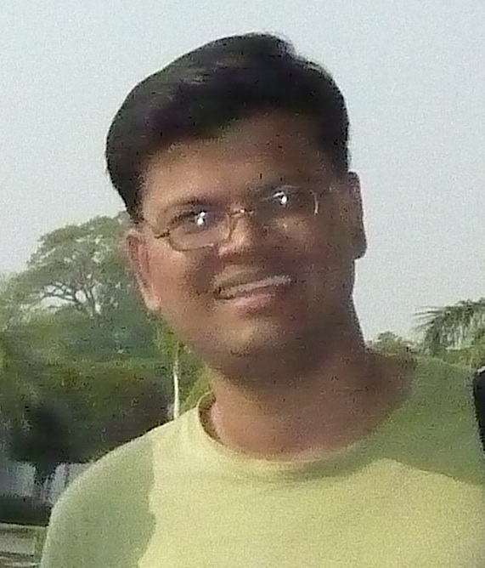
International Regional Initiatives
Northern Eurasia’s Future Initiative (NEFI)
LCLUC-2016: Caucasus element
Future Earth: Asia
Coordinated with SARI
South/Southeast Asia Research Initiative (SARI)
LCLUC-2015: South Asia
LCLUC-2016: Southeast Asia
Project Scientst
NEFI
Pasha Groisman, NOAA/UCAR
Project Scientist
MAIRS
Jiaguo Qi, MSU
Project Scientist
SARI
Krishna Vadrevu, NASA MSFC

Slide 12
NEESPI: 10 years of science
Number of Projects
>750 scientists
>200 institutions
>170 projects
30 countries
>80 Ph.D. students
~1500 papers
NEESPI → NEFI

Slide 13
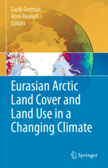
NEESPI-LCLUC Books
Springer 2013
Springer 2010
Springer 2012
Springer 2017
LCLUC in Central Asia to be published in 2018

Slide 14
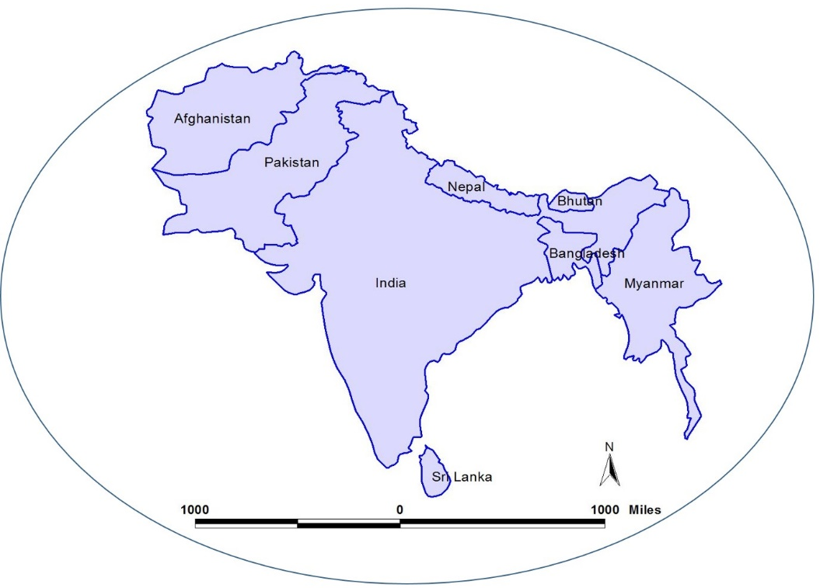
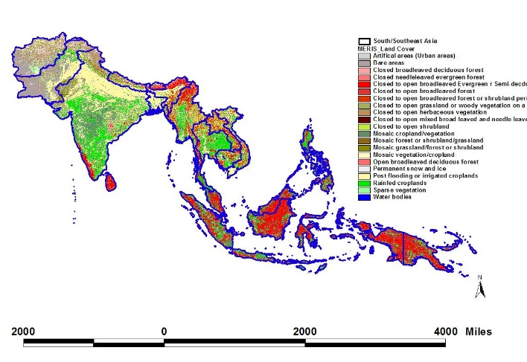
SARI
South/Southeast Asia
South Asia

Slide 15
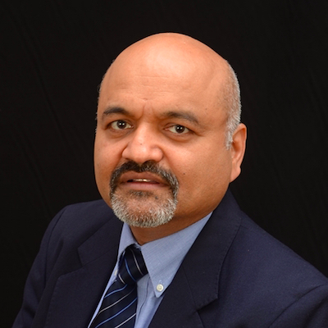
Pre-SARI Synthesis Projects
LCLUC-2012
LCLUC-2013
Atul Jain/U. of Illinois
Land Cover and Land Use Changes and Their Effects on Carbon Dynamics in South and South East Asia: A Synthesis Study
Jeff Fox, East-West Center, Hawaii
Forest, Agricultural, and Urban Transitions in Mainland Southeast Asia: Synthesizing Knowledge and Developing Theory
Peilei Fan, Michigan State U.
Urbanization and Sustainability Under Global Change and Transitional Economies: Synthesis from Southeast, East and North Asia
Seto, Karen , Yale U.
Synthesis of LCLUC studies on Urbanization: State of the Art, Gaps in Knowledge, and New Directions for Remote Sensing Science

Slide 16
What We Have Learned From Pre-sari Projects
Population growth => rapid urban expansion on rural and agricultural lands => further deforestation
Prevalent commodity crops (rubber and palm) prices increase => reduced food production and increased food costs
Large-scale land-cover conversion for agriculture => changes in carbon cycle and air quality degradation (biomass burning)
Economic development initiatives => regional landscape fragmentation

Slide 17
NASA-SARI Science
Will be based on the pre-SARI projects and new projects from
LCLUC-2015 selections for South Asia
LCLUC-2016 selections for Southeast Asia

Slide 18
LCLUC-2015: Selections for SARI
DeFries, Ruth Urban impact on forests (India) | Columbia U. |  | Tropical Deciduous Forests of South Asia: Monitoring Degradation and Assessing Impacts of Urbanization
Wynne, Randy Plantations (India) | Virginia Tech |  | Spatiotemporal Drivers of Fine-Scale Forest Plantation Establishment in Village-Based Economies of Andhra Pradesh
Fleischman, Forrest Afforestation (India) | U. Minnesota |  | Impacts of afforestation on sustainable livelihoods in rural communities in India.
Jain, Meha Agriculture (India) | U. Michigan |  | The Future of Food Security in India: Can Farmers Adapt to Environmental Change?
Townsend, Phil -> -> Aditya Singh Agricuture (India) | U. Wisconsin -> U. Florida |  | Landscapes in flux: The influence of demographic change and institutional mechanisms on land cover change, climate adaptability and food security in rural India
Di, Liping Agriculture (India) | George Mason U. |  | Understanding changes in agricultural land use and land cover in the breadbasket area of the Ganges Basin 2000-2015: A socioeconomic-ecological analysis
Loboda, Tatyana Malaria (Myanmar) | U. Maryland |  | Understanding the role of land cover / land use nexus in malaria transmission under changing socio-economic climate in Myanmar
Leimgruber, Peter Deforestation (Myanmar) | Smithsonian Institution |  | Complex Forest Landscapes and Sociopolitical Drivers of Deforestation - The Interplay of Land-use Policies, Armed Conflict, and Human Displacement in Myanmar

Slide 19
LCLUC-2015: Selections for SARI (cont.)
Seto, Karen Urban growth (South Asia) | Yale U. |  | Urban growth, land-use change, and growing vulnerability in the Greater Himalaya mountain range across India, Nepal, and Bhutan
Vincent, Jeff/Giri, Chandra Mangroves (South Asia) | Duke U./EPA |  | Consequences of changing mangrove forests in South Asia on the provision of global ecosystem goods and services

Slide 20
LCLUC-2015: Selections for Synthesis
Walsh, Steve Islands: Synthesis (global) | U. North Carolina Chapel Hill |  | Synthesis of Drivers, Patterns, and Trajectories of LCLUC in Island Ecosystems
Thomas, Valerie Regionally Specific Drivers of Land-Use Transitions and Future Scenario: Synthesis (US) | Virginia Tech |  | Regionally Specific Drivers of Land-Use Transitions and Future Scenarios: A Synthesis Considering the Land Management Influence in the Southeastern US
De Bremond, Ariane Land “grabbing” (global) | U. Maryland |  | The Global Land Rush: A Socio-Environmental Synthesis

Slide 21
Data Products
NASA promotes the free and open sharing of data
USGS - Landsat data for free distribution
LCLUC expects its PI’s to make their data and products available to the broader community
Data sharing is strongly encouraged
NASA-USGS Landsat Global Land Surveys: GLS-75, -90, 2000, 2005, 2010
WELD mosaics
Global Forest/Change
Global Mangroves/Change
Global Impervious Surfaces
Global Agriculture
Metadata page on the LCLUC web site – only 16 projects represented

Slide 22
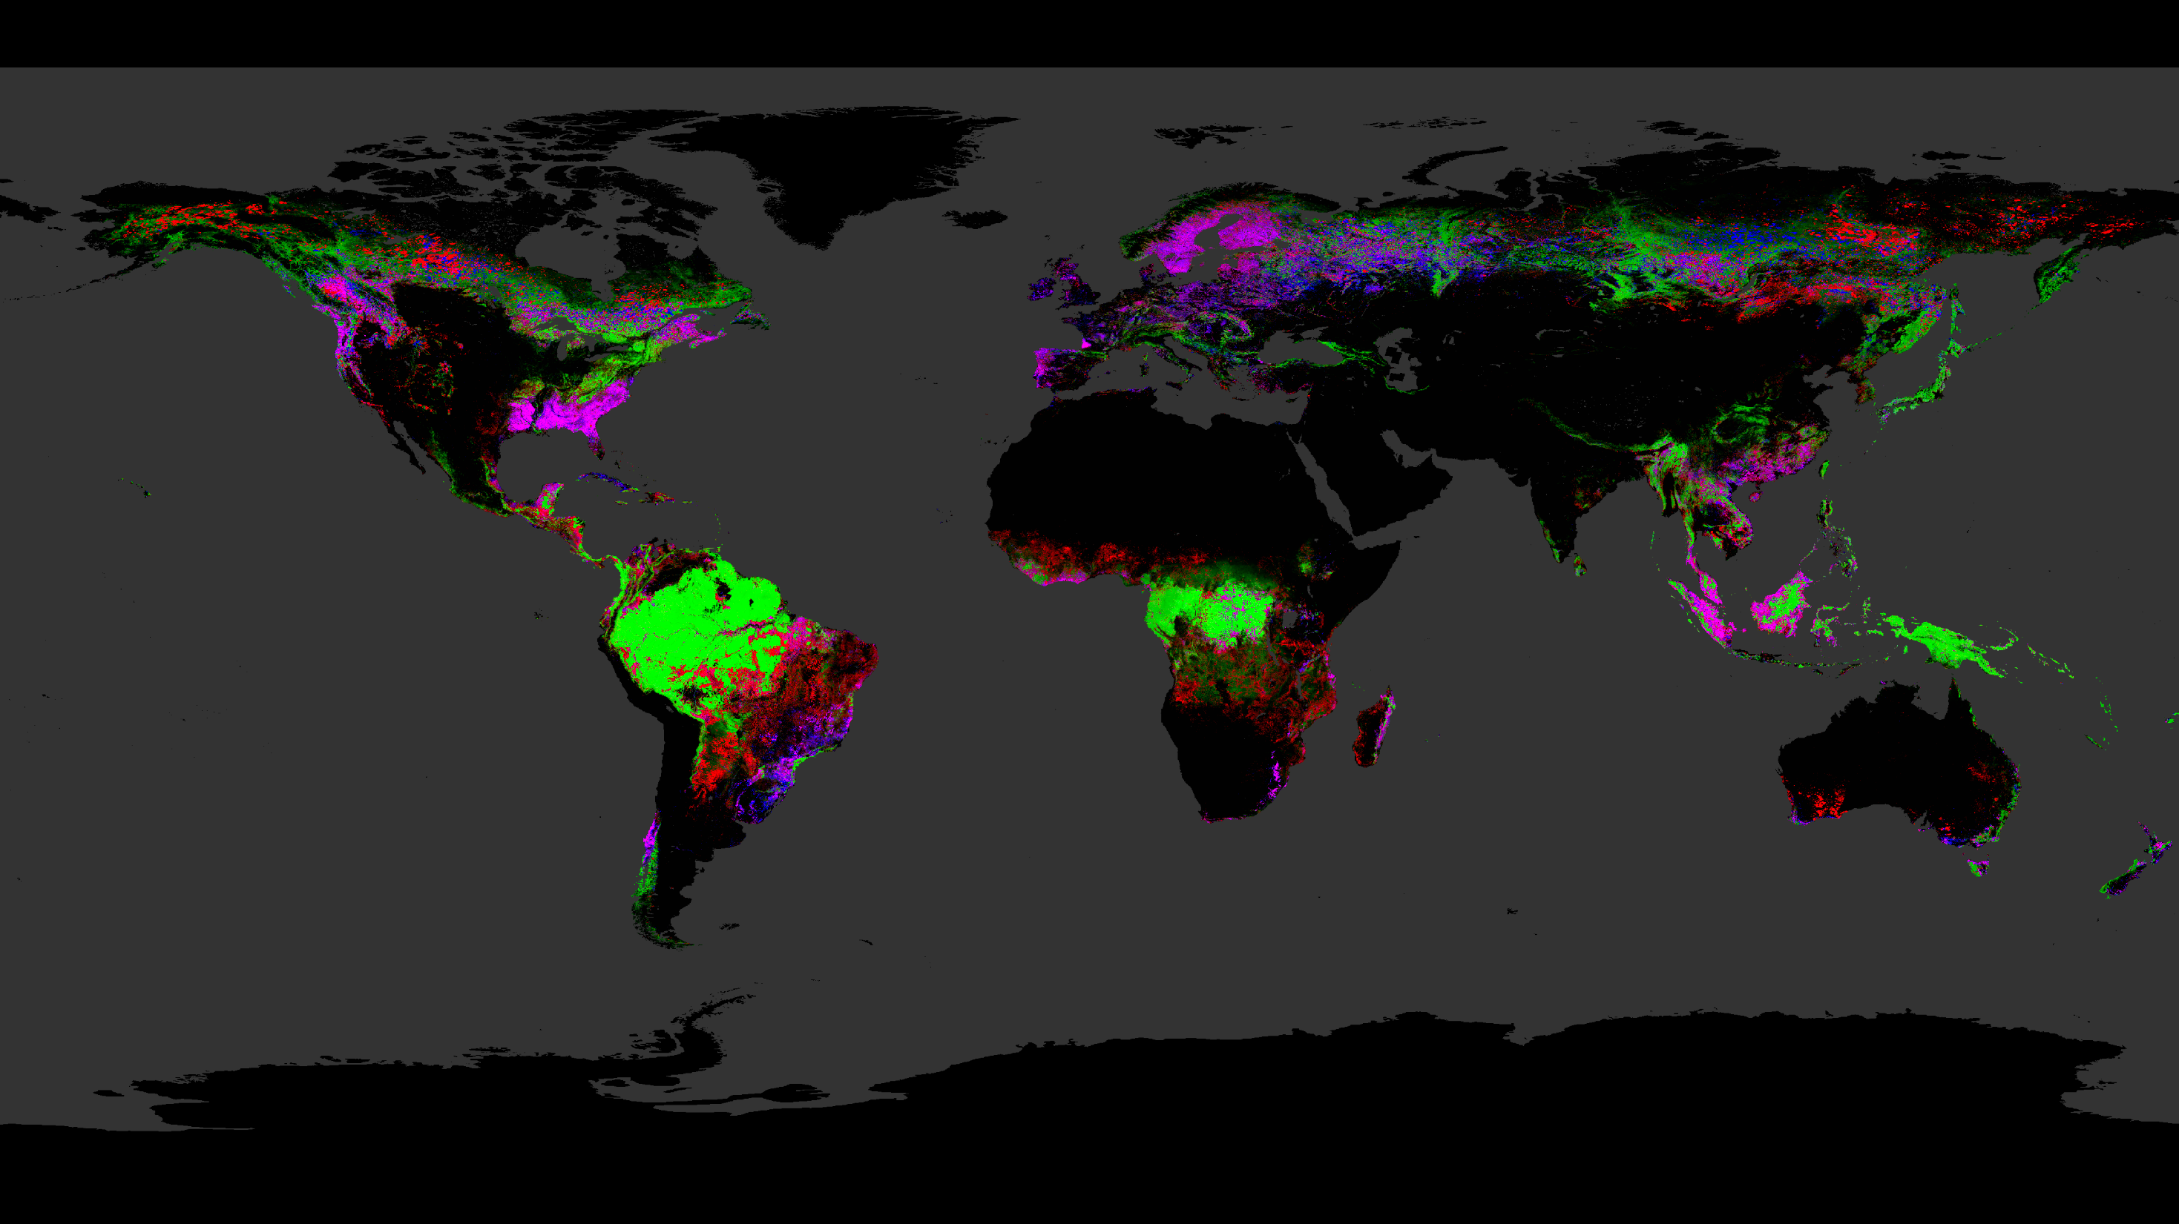
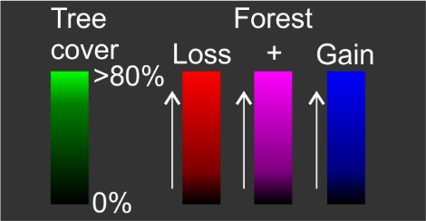
Tree Cover Extent and
Forest Loss and Gain: 2000-2014
Courtesy: Matt Hansen, U. Maryland

Slide 23
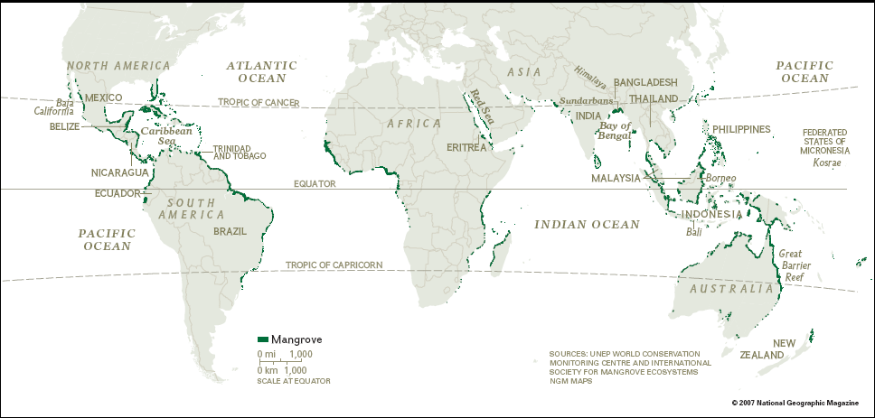
Mangrove forest cover change 1990-2005
Courtesy: Chandra Giri, EPA

Slide 24
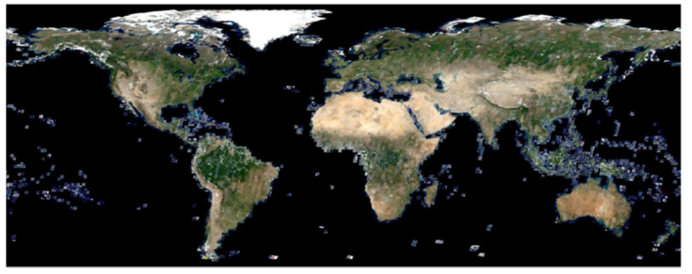
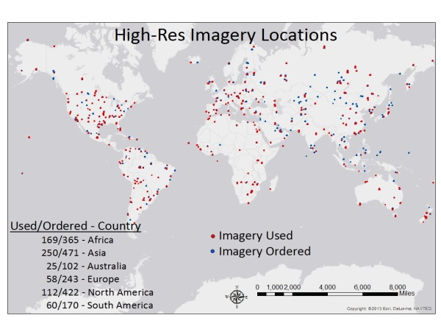
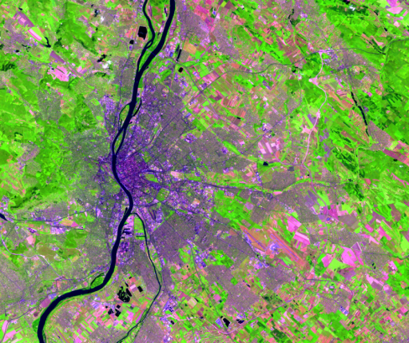
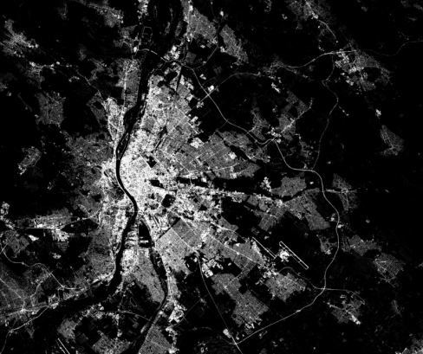
Global Impervious Cover From Landsat E. Brown de Colstoun¹, C. Huang² et al. 1 NASA Goddard Space Flight Center, Greenbelt, MD 2 Department of Geographical Sciences, University of Maryland, College Park, MD
Current estimates of urbanization are at scales of ~500-1000m but changes in the urban fabric occur at much finer scales (~15-30m).
Landsat resolution provides a good balance for global coverage, spatial details and repeatability.
The GLS-IMP project is producing the first Global 30 m impervious surface products using Global Land Survey (GLS) Data.
Subpixel estimation is essential since most urban pixels are highly mixed.
We have derived a very large global training data set from the NGAs non-classified commercial satellite image archive (e.g. Quickbird, Worldview). Access to these free data and global Landsat data are critical.
Approach is object-based, automated:
Surface reflectance provides consistent radiometry.
Regression tree algorithm is able to model complex nonlinear relationships and handle massive training set.
Image segmentation tools (Hseg) provide hierarchical image objects for training and for post-processing
Global Training Dataset
Landsat image
Percent Imperviousness
http://beta.www.ciesin.columbia.edu/mapping/impervious-surfaces/explore-view/

Slide 25
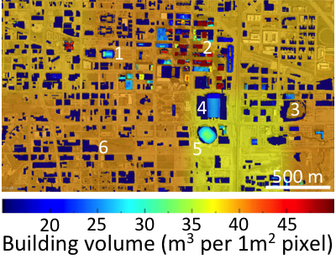
Mega Urban Change and Impacts in the Decade of the 2000s
PI: S. V. Nghiem/JPL ; Co-Is: Small/LDEO, Balk/CUNY, Jacobson/Stanford International collaborators: 28 institutions/agencies from 8 countries
Website https://urban.jpl.nasa.gov/
Goals: Investigate global megacities (>10 million inhabitants by 2012) change in the 2000s, and environmental, socioeconomic, and health impacts inside, around, and beyond megacities + others cities requested by the team.
Geographic area: All continents except Antarctica.
Data used: QuikSCAT, Landsat, other satellites, and socioeconomic/demographic/model data.
Advantage of multi-sensor methods: This is imperative to address interdisciplinary physical, environmental, and socioeconomic aspects.
Up-to-date progress: Completed all 29 megacities and other cities. Results published in peer-review papers, and in many meetings and conferences.
Significance: Provided results and inputs to US Department of State, US Department of Defense, and the Atlantic Council (to prepare Global Trends 2030, produced by the National Intelligence Council as a basis for long-range strategic policy assessment for the White House, 2012).
3D building volume derived from declassified Lidar data and from building footprint for Oklahoma City, which is well correlated with DSM city observation in 1-km grid shown in the background map. A key success of this research is the Dense Sampling Method (Patent US8401793, US20100280756, and WO2010127140A3) using decadal satellite scatterometer data to monitor global urban change in 3D for both lateral extension and vertical built-up.

Slide 26
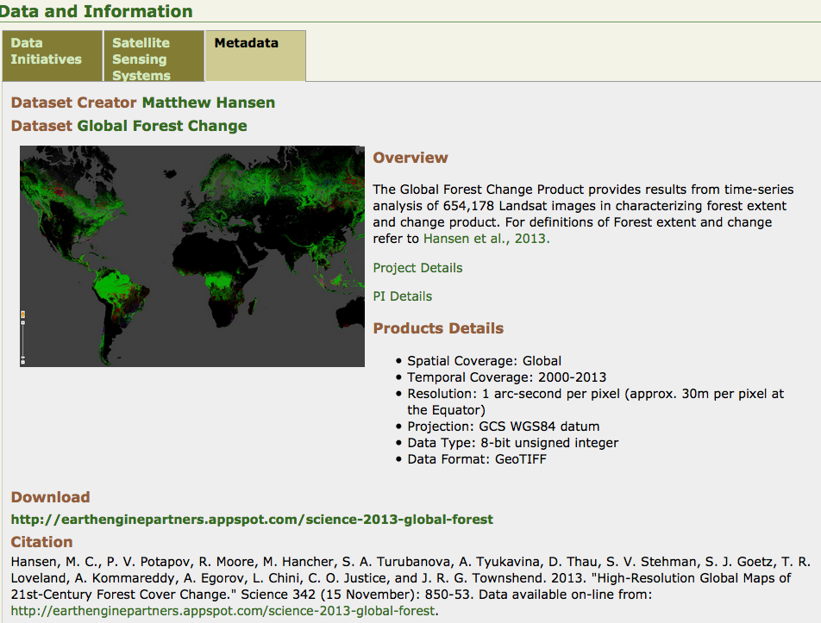
Metadata Page on LCLUC website

Slide 27
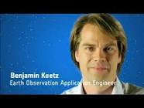
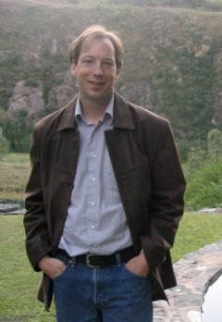
Multi-Source Land Imaging (MuSLI) Landsat-Sentinel Team under LCLUC
Sentinel-1a: launched Apr 2014
Sentinel-1b: launched Apr 2016
Sentinel-2a: launched Jun 2015
Sentinel-2b: launched Mar 2017
Landsat-7 & - 8 – nominal operations
MuSLI ESA Project Scientist
Benjamin Koetz, ESA
Earth Observations Engineer
MuSLI NASA Project Scientist
Jeff Masek, NASA
Landsat-9 Project Scientist
Prior efforts to synergistically use Sentinel data along with Landsat-8
Joint NASA-UMD-CNES/CESBIO project
Sentinel-2 NASA Data Use Preparation team
Cross-Calibration (GSFC)

Slide 28
MuSLI Science Team: 40+ members
PI and CO-Is
Int. Collaborators
Landcover Project Science Office
Salas , Applied Geosolutions Torbick, AG
Lang, U Maryland Jones, USGS Huang, UMD (new PI)
Small, Columbia U. Nghiem, JPL Greg Yetman, Columbia U.
Friedl, Boston U. Gray, BU Melaas, BU
Roy, South Dakota State U. Kovalskyy, SDSU Boschetti, U. Idaho
Hansen, U. Maryland Potapov, UMD
Townshend, U. Maryland Sexton, UMD Feng, UMD Channan, UMD
Hoekman, Wageningen U. Le Toan, CESBIO
Creed, Western U., Canada
Esch, DLR
Eklundh, Sweden
Chuvieco, Spain Tansey, UK
Defourny, Belgium
Schmullius, Germany
Koetz, ESA, Sentinel-2 Projects Coordinator
Dedieu & Hagolle, CESBIO
Masek, NASA, MSLI Project Scientist
Markham, NASA, calibration team Helder, SDSU Czapla-Myers (U. Az)
Schott, RIT DIRSIG model, LST
Vermote, NASA GSFC Atm. Corr. Team Claverie, U. MD
Woodcock, Boston U., clouds/cloud shadows
Dungan, NASA Ames, NEX Ganguly, NASA Ames, NEX

Slide 29
General Issues
Higher level products depend on preprocessing
Calibration
Cloud detection
Registration
Atmospheric correction
Errors in TOA reflectance due to cloud/cloud shadow contamination propagate to higher level products
Mis-registration is an obstacle in many applications which use pixel-to-pixel colocation

Slide 30
Current Prospects: Sentinel-2 - Landsat Fusion
Merging Sentinel-2 and Landsat data streams could provide < 5-day coverage required for Ag monitoring
Both sensors have 10-30m coverage in VNIR-SWIR
Satellite orbits complementary
Landsat-7 & -8 8 days out of phase
Sentinel-2a & 2b 5 days out of phase
Landsat and Sentinel sun synch orbits precess relative to each other
Landsat-7
Landsat-8
Sentinel-2a
Sentinel-2b
2013
2014
2015
2016
2017
Global ~5 day coverage
Global ~2-3 day

Slide 31
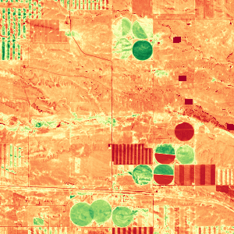
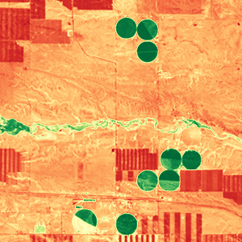
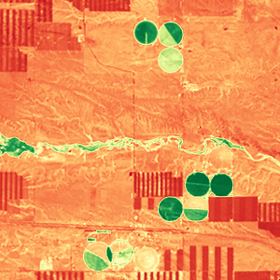
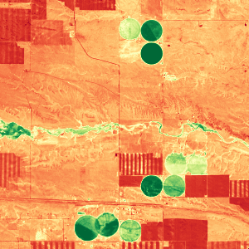
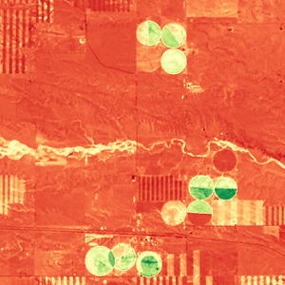
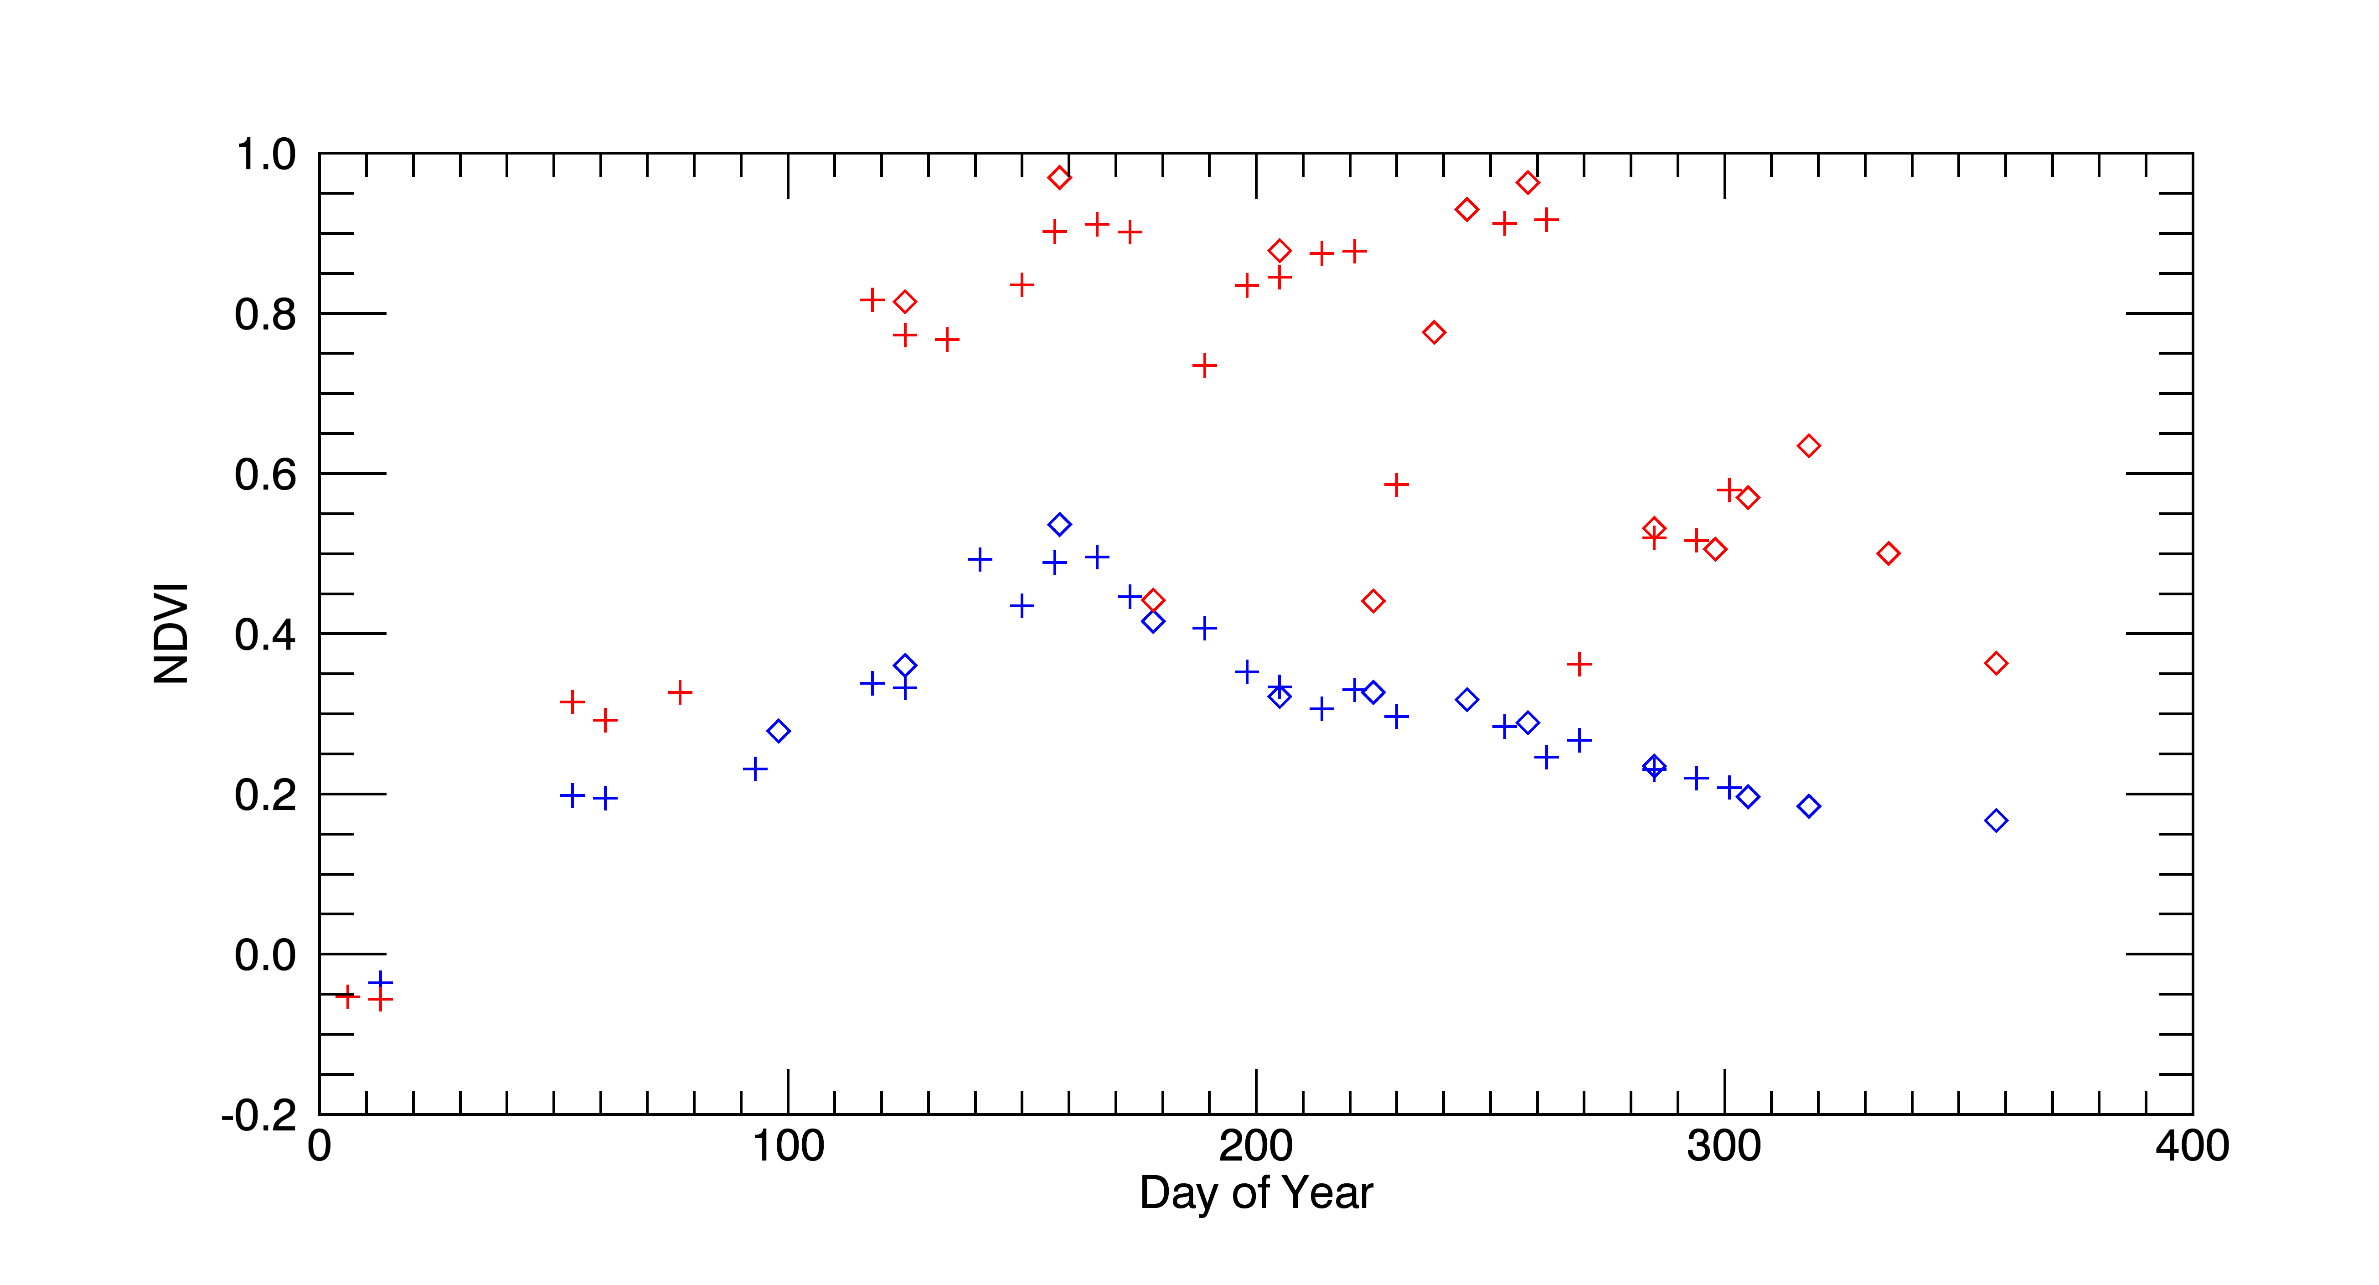
Harmonized Landsat / Sentinel-2 Products
Laramie County, WY
May 4, 2016
August 8
August 17
September 1
October 20
3km
0.1 NDVI 0.9
Seasonal phenology (greening) for natural grassland (blue line) and irrigated alfalfa fields (red line) near Cheyenne Wyoming observed from Harmonized Landsat/Sentinel-2 data products. The high temporal density of observations allows individual mowing events to be detected within alfalfa fields. HLS Products available from https://hls.gsfc.nasa.gov
+
Sentinel-2 Landsat-8
Alfalfa
NDVI
mowing
Grassland
Day of Year
Courtesy: Jeff Masek, NASA GSFC

Slide 32
In the spirit of Open Science ESA funds with the support of Elsevier the open access for up to 24 papers accepted within this Sentinel-2 special issue. Submissions are due by September 30th, 2017. Please see the below link for details on the call:
https://www.journals.elsevier.com/remote-sensing-of-environment/call-for-papers/science-and-applications-with-sentinel-2

Slide 33
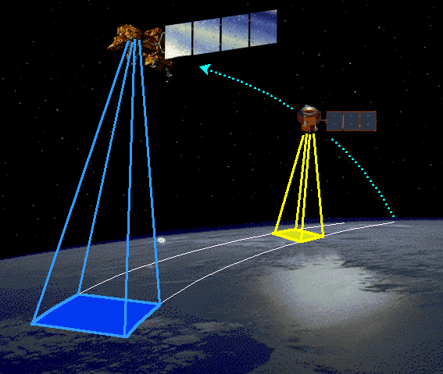
TRIBUTE TO EO-1
From: NASA Executive News Briefing:
The Journey of NASA's Smartest Satellite Finally Comes to an End
NASA's highly experimental Earth Observing-1 satellite mission was supposed to last just a year. It did that, and then survived 16 more-all the while testing NASA's riskiest, oddball ideas.
‘The Little Engine That Could’ (Betsy Middleton, NASA)

Slide 34
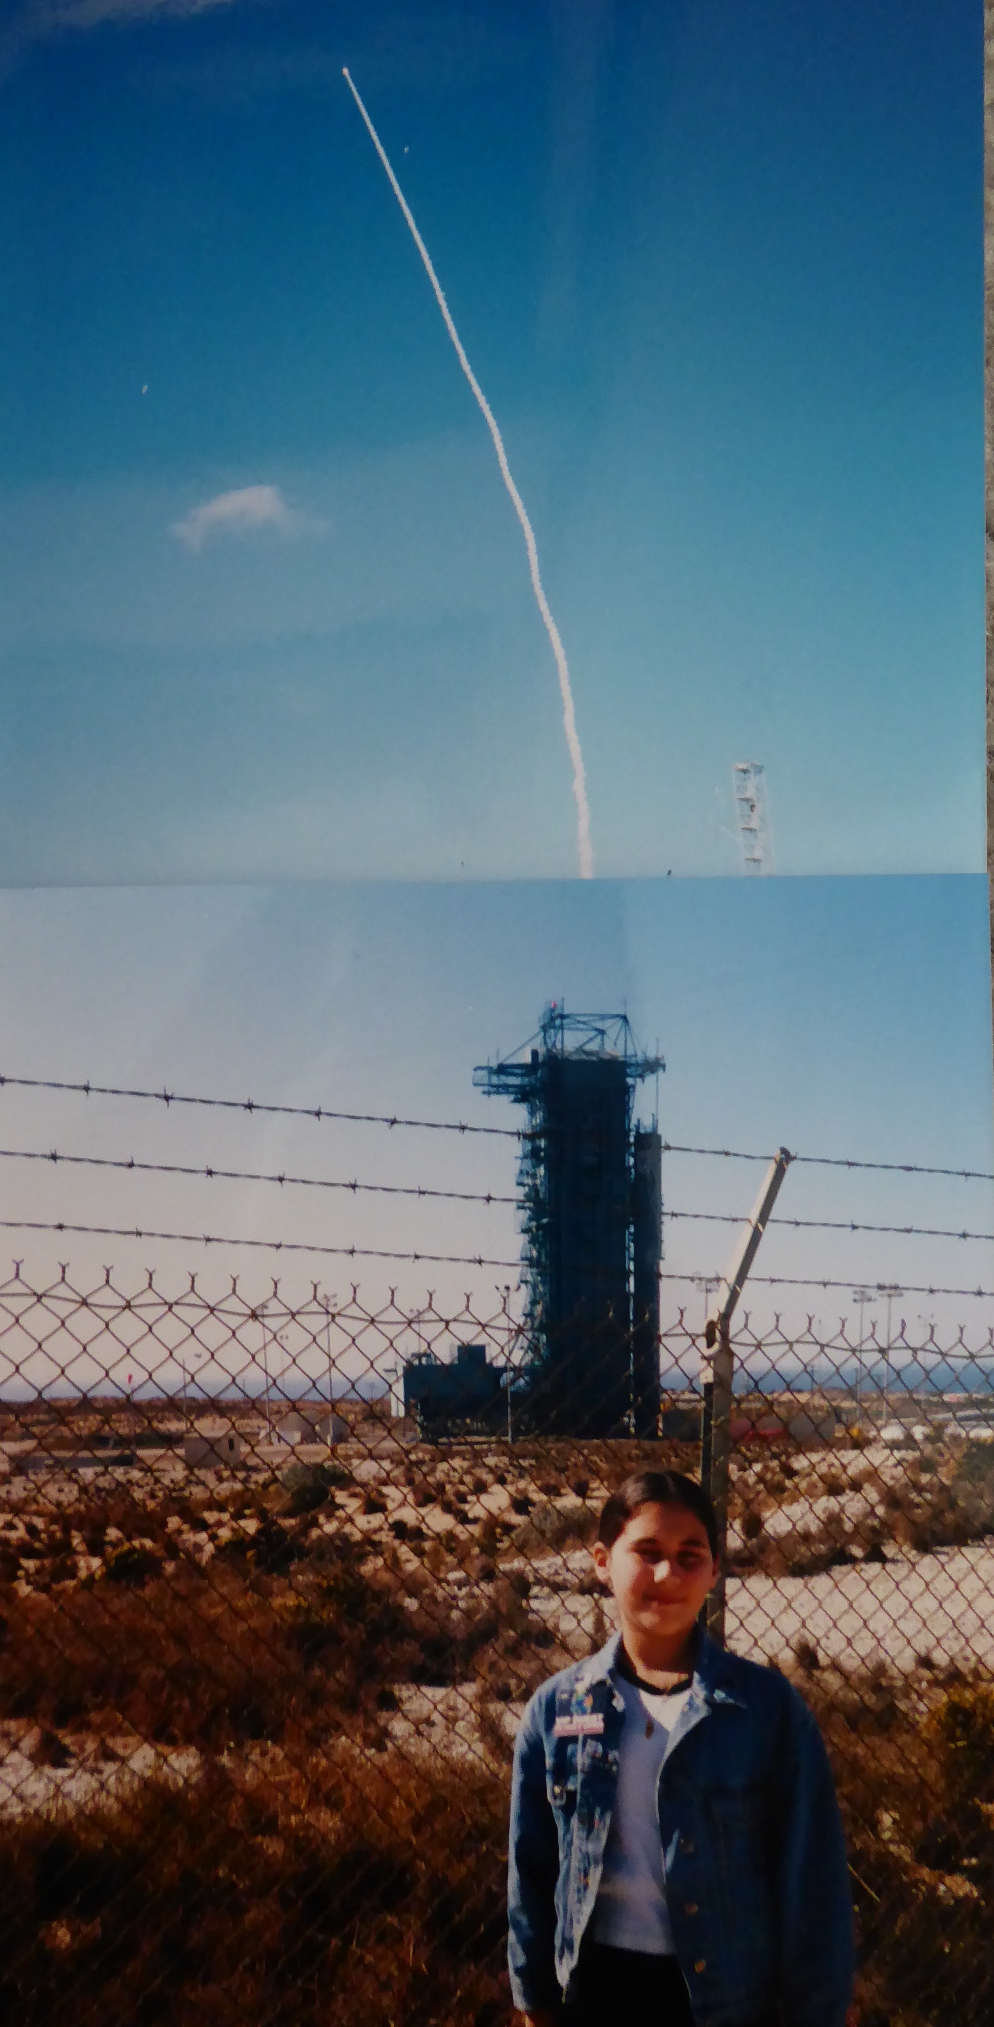
EO-1 Launch 11/21/2000

Slide 35
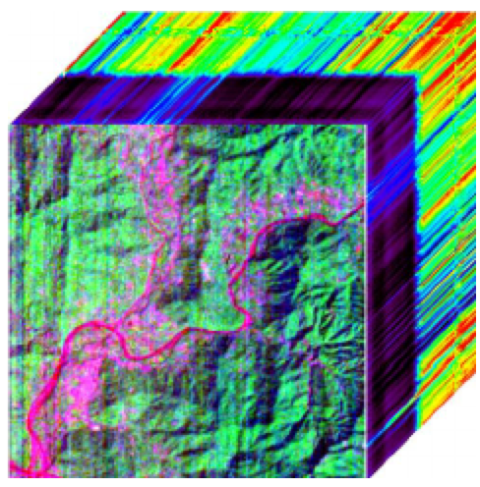
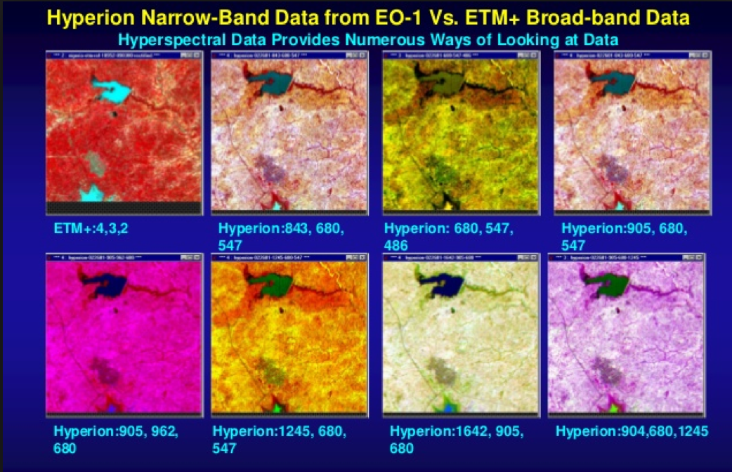
EO-1 Legacy
Demonstrating the pushbroom technology for land imaging– as predecessor for Landsat 8 and 9
Pointing ability – very useful feature for looking at the disaster event once it was identified
ability to increase collections (up to 5 in 16 days) for disaster support
led the disaster constellation, with automatic network connections to task among satellites
Discriminating among crops, C3 vs C4 plants, with the first hyperspectral instrument in space

Slide 36
Near-Term Plans
LCLUC-2017 solicitation
Type1: Deliver continental or global-scale land science products, derived from multiple, international sources of data over land surfaces including inland and coastal waters
Type2: Prototyping novel data products using multiple sensing systems

Slide 37
Education and Outreach
E-Newsletters
Webinars
One-pagers
Statistics: Information on students graduating in LCLUC is needed
LCLUC website and Facebook page
LCLUC Webinars series
Projects have been presented during 2014-16 (Urban, Urban-Ag transitions, Ag)

Slide 38
receiving the 'Outstanding Contributions in Remote Sensing Award' from the Remote Sensing Specialty Group of the Association of American Geographers
At the Annual AAG Meeting 2017, in Boston.

Slide 39
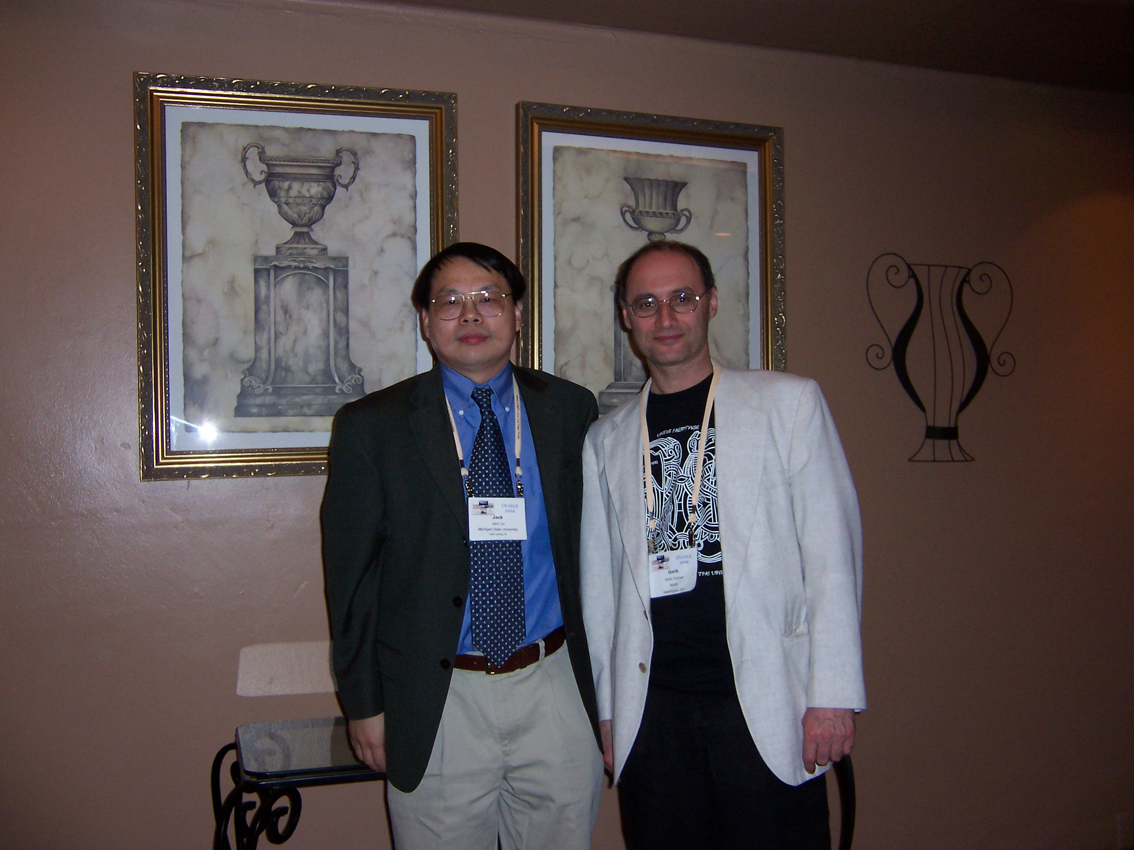
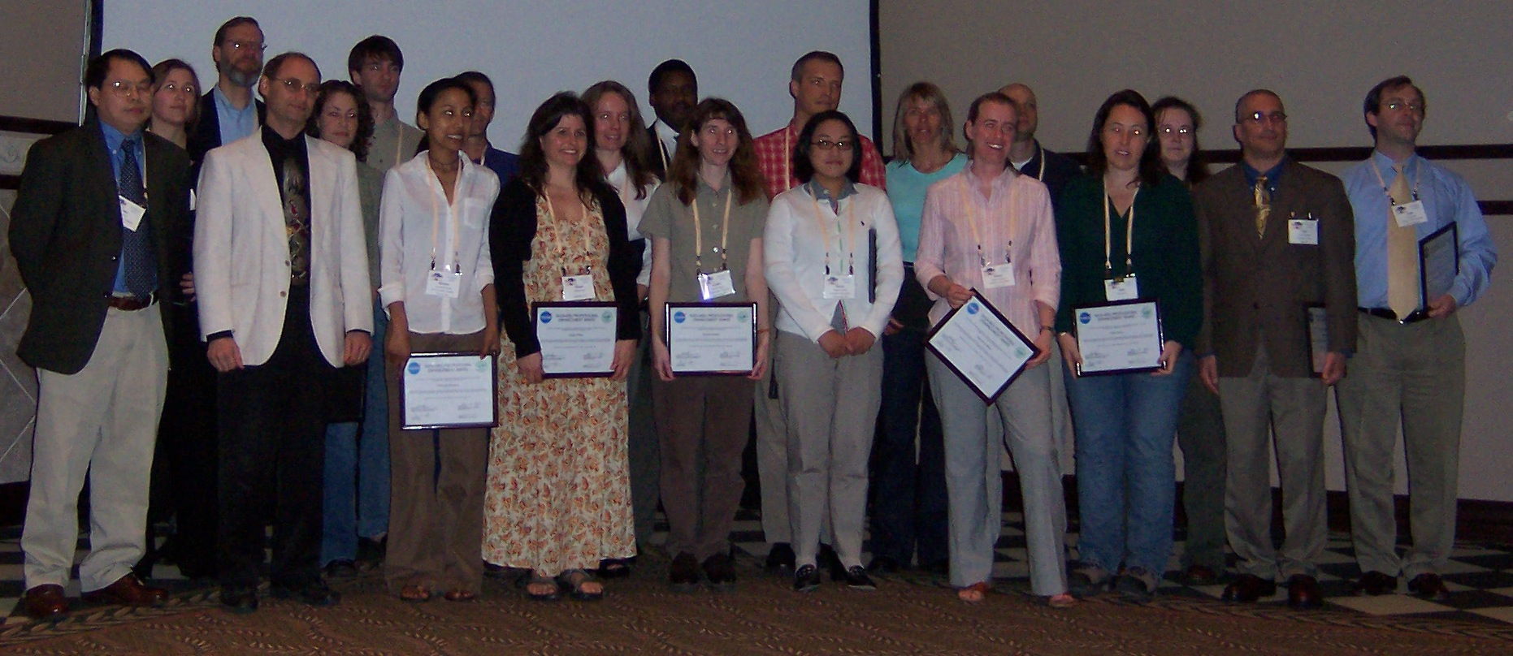
Educational Component: NASA-MSU IALE

Slide 40
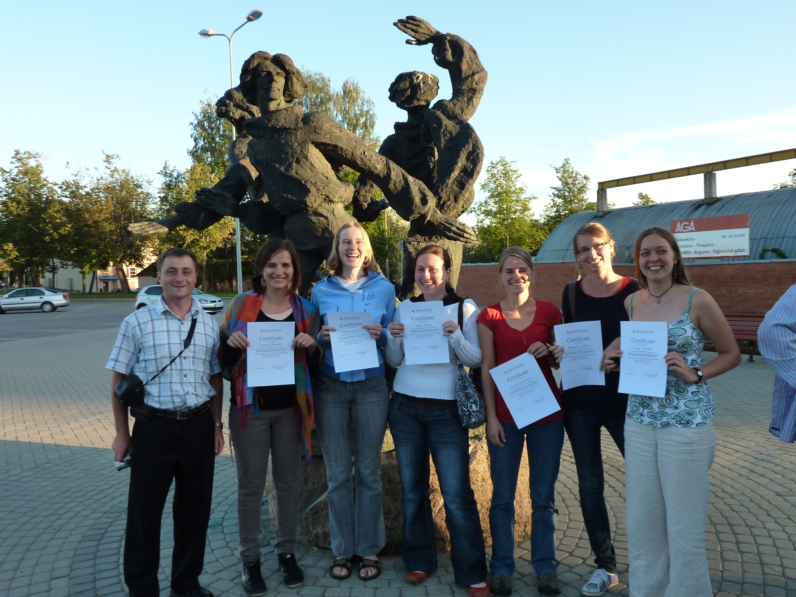
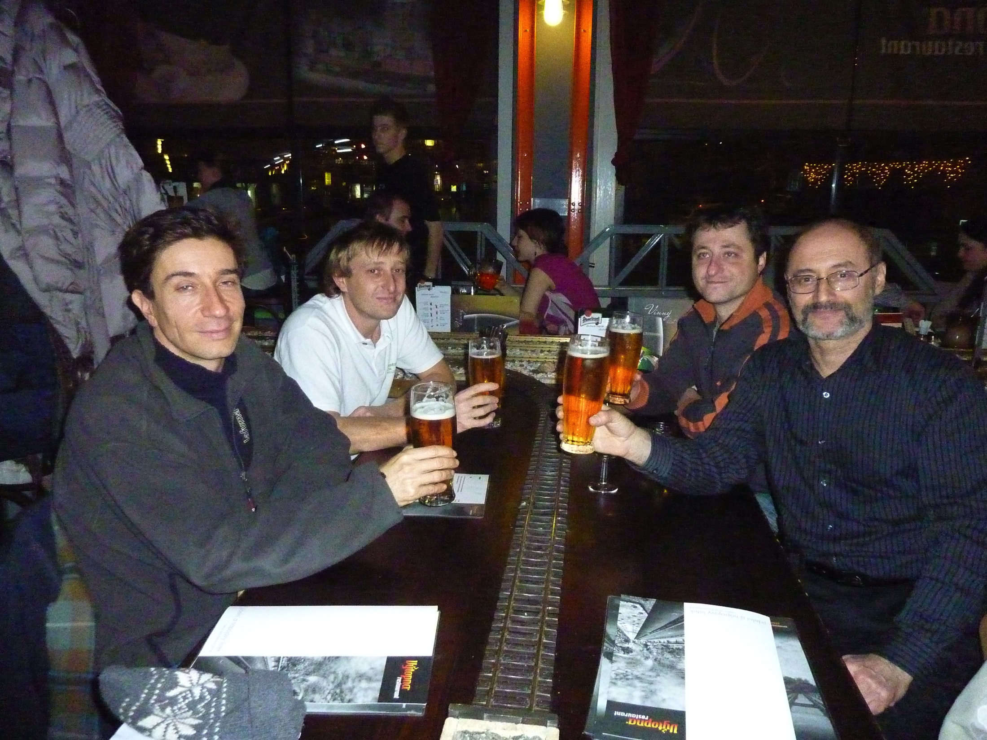
Educational Component:
Trans-Atlantic Training (TAT)
LCLUC Training in Latvia - 2010:
Czech trainees
Agreeing on the TAT: Prague, Dec 2011
NASA-ESA regular training sessions in Eastern Europe for students +3 years June 2013 in Prague, Czech Rep.
June 2014 in Krakow, Poland
April 2015 in Prague, Czech Rep.
July 2016 in Zvolen, Slovakia
June 2017 in Pecs, Hungary

Slide 41
Coordinated Efforts on Capacity Building Activities
LCLUC Theme
SERVIR
GOFC-GOLD
FAO
World Bank
START
GFOI
SilverCarbon
GEOGLAM

Slide 42
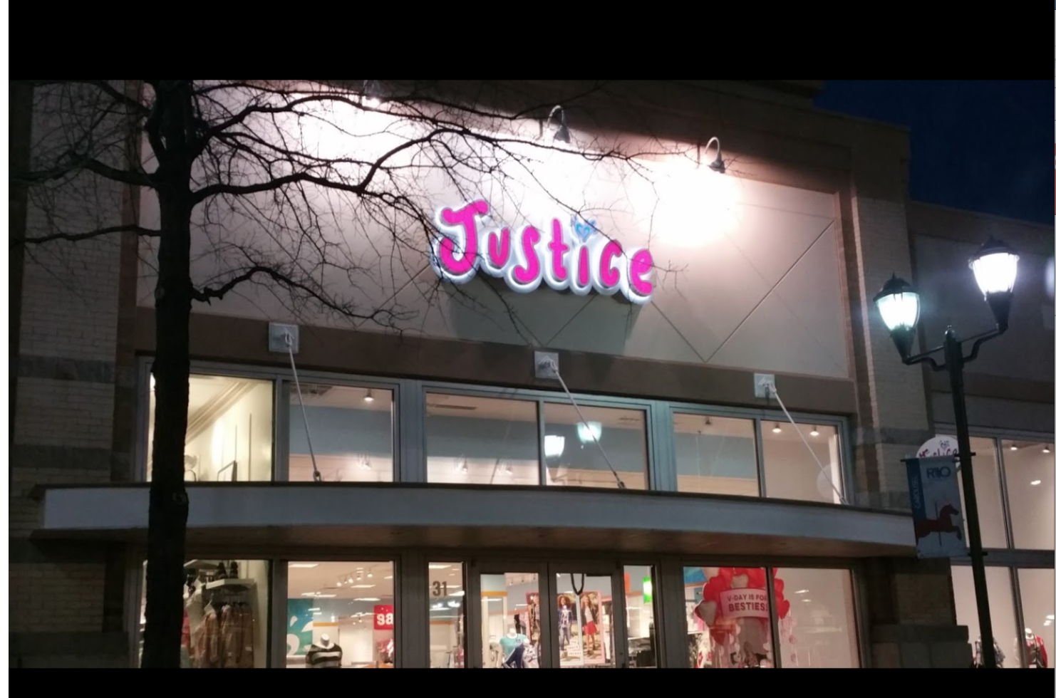
Thanks go to
Organizers: C. J. and Co.
Sponsors: SGT, Inc.

Slide 43
To All LCLUCers:
Enjoy
Spring Blossoms

