Slide 1
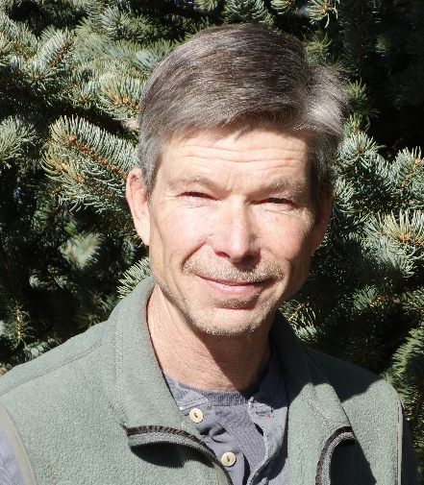






Downscaling IPCC Land Use Scenarios for Global Change Adaptation in Mountains
Andrew Hansen, Montana State University
Katrina Mullan, University of Montana
Scott Powell, Montana State University
Dave Theobald, Conservation Science Partners
NASA LCLUC Annual Meeting
April 2017

Slide 2
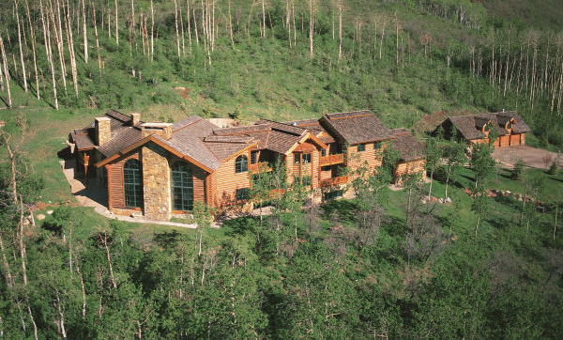
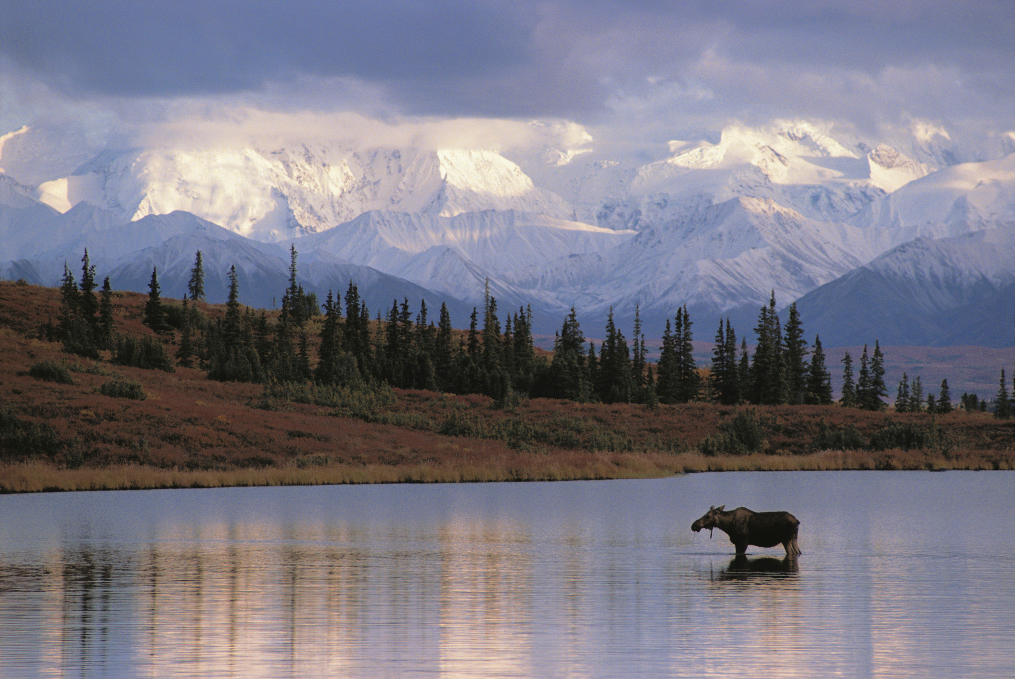
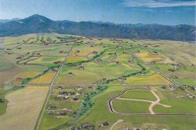
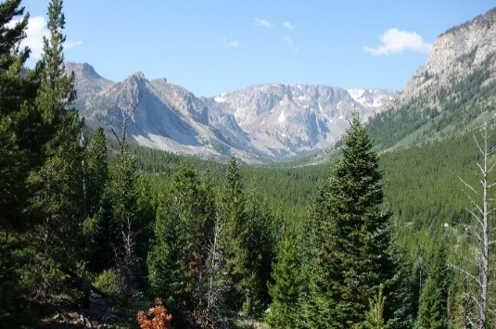
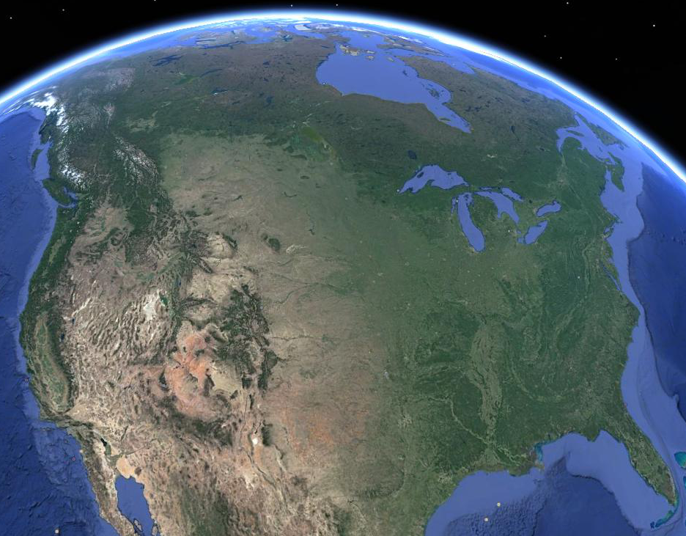

Introduction
Land Use in Mountains
Mountain landscapes:
High importance for conservation
Land use constrained by topography, soil, climate
Technology now allows pursuit of natural amenities
Now face rapid population growth
Conservation planning requires credible projections of future LCLUC

Slide 3
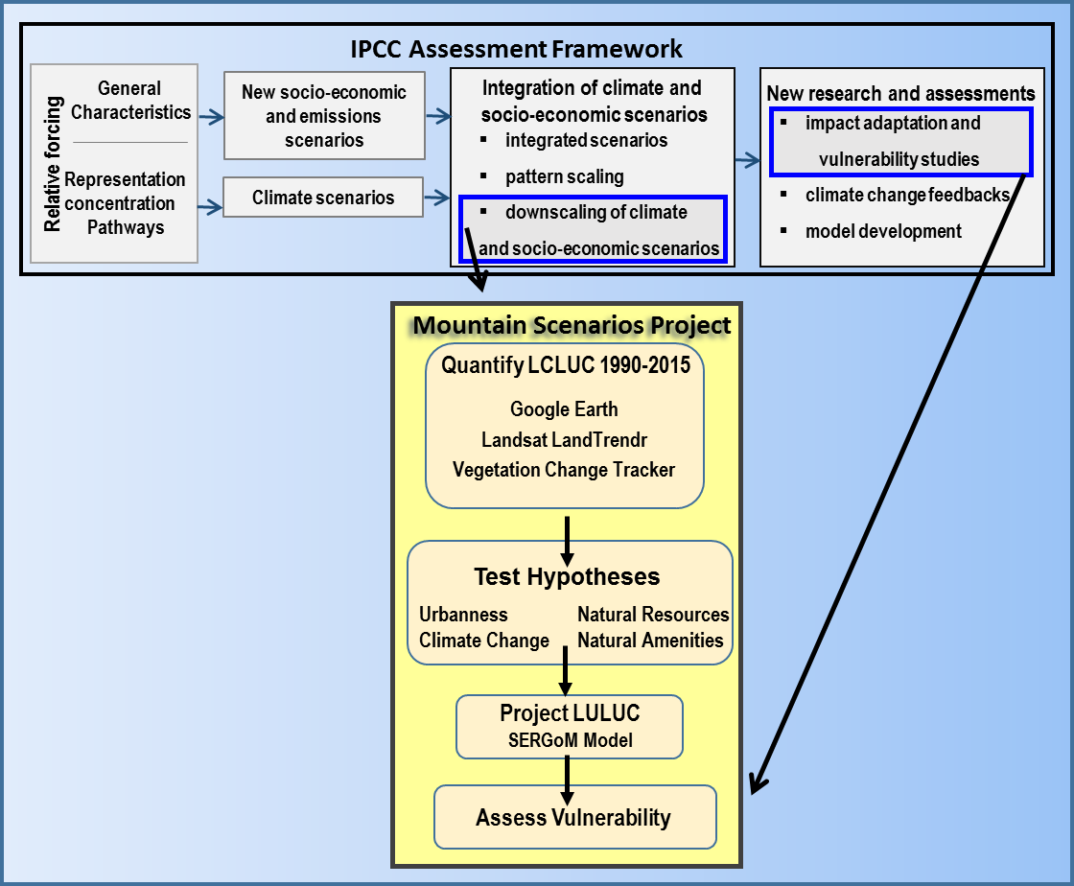
Introduction
Goal and Objectives
Project LCLUC under IPCC scenarios across western mountain landscapes to enhance vulnerability assessments of biodiversity.

Slide 4
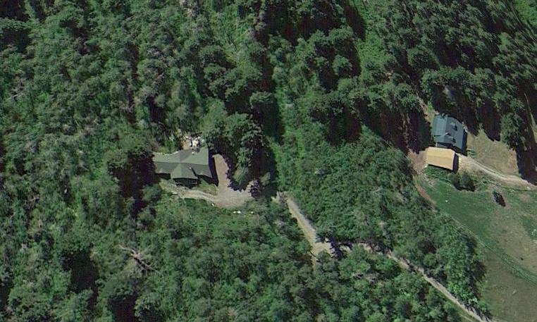
Introduction
Challenges
Mapping Fine-scale Land Uses
Land Use Classes of Interest | Traditional Data source | Source Added by this project
Urban | Landsat NLCD US Census
Suburban | Landsat NLCD US Census
RRD |  | Google Earth – sample based SERGoM – wall to wall Informed by US census block data
Agriculture: crops / pasture | Landsat NLCD Informed by NRI
Agriculture: grazing / other | Landsat NLCD
Natural Resource Extraction |  | Landsat LandTrendr Sample based
Wildland | Land Allocation | Human Modification Derived from multiple sources

Slide 5
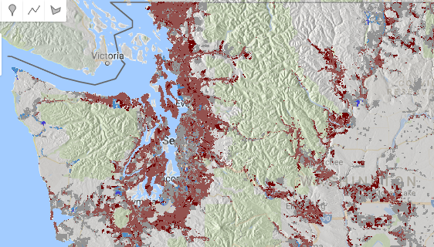
Introduction
Challenges
Modeling LCLUC at the fine spatial scales at which it occurs
Housing Density Change 1990-2010
Dark Red: >50% gain
Red: 5-50% gain
Grey: -5-5%
Blue: -5- -50% loss
Dark Blue: > -50% loss

Slide 6
Introduction
Challenge
Understanding drivers of LCLUC
Hypothesized Drivers of Land Use Change
  Natural Resources (Boserup et al. 1965, Huston 2005)
    Soils, minerals, forage, timber
  Urban proximity (Von Thünen 1826, Ricardo 1891)
    Markets, services, infrastructure
  Natural Amenities (Fuguitt & Beale 1996, McGranahan 1999)
    Scenery, wildlife, recreation, solitude
  Climate (Egan and Mullin 2016)
    Weather Preference Index
Context Dependency
The influence of a given driver is dependent on the condition of other drivers?
Hypotheses
1. Conditional on urban proximity and community type, NAs will increase the probability of exurban development.
2. Maintenance of private land in a wildland condition is likely in locations with low resource value that are remote from urban centers.
3. Less extreme climate will increase the probability of both agricultural and residential land conversion.

Slide 7
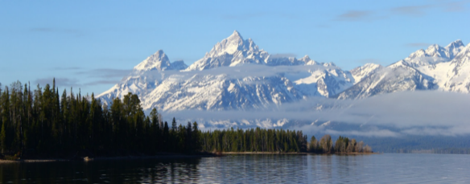
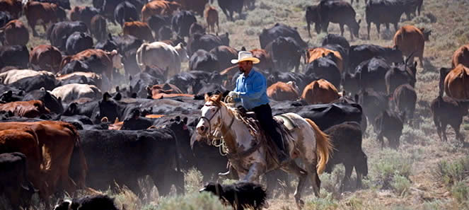
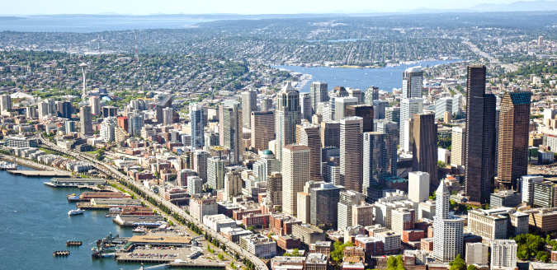

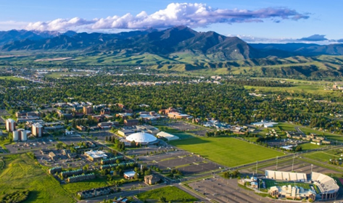
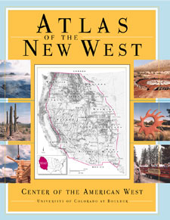
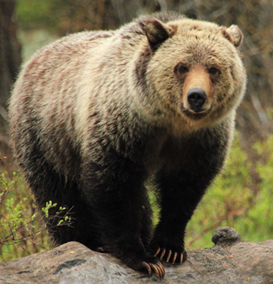
Study Area

Slide 8
Study Area
Population Change 2000-2010
Percent Change

Slide 9
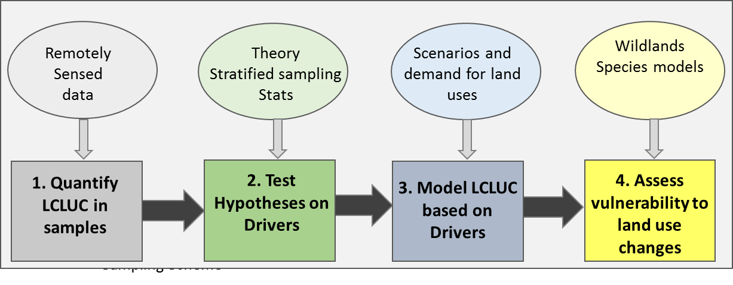
Topics

Slide 10
Study Design
Samples
Night light density | Natural amenities | Climate 1 |  |  |  | Climate 2 |  |  |  | Climate 3
 |  | New west |  | Old west |  | New west |  | Old west |  | New west |  | Old west
 |  | Urban | Rural | Urban | Rural | Urban | Rural | Urban | Rural | Urban | Rural | Urban | Rural
Urban | High
 | Low
Trans | High
 | Low
Rural <20 | High
 | Low
Rural >20 | High
 | Low
Total plots specified: 618 plots completed: 181
Stratified random sample
Selected sample plots

Slide 11
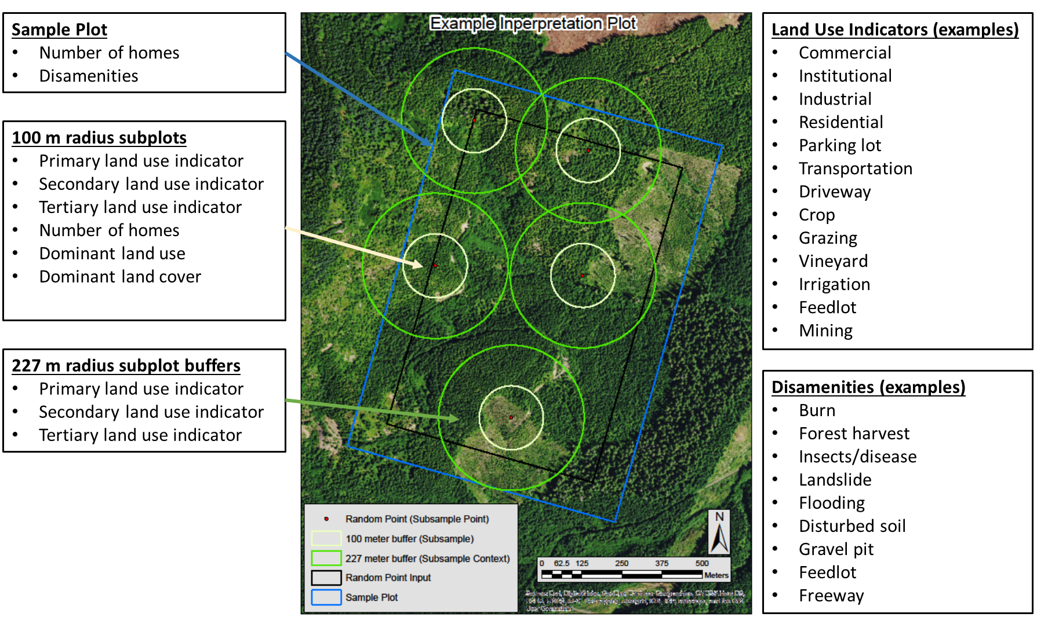
Study Design
Sampling Scheme
Google Earth Imagery:
1990, 2000, 2010, 2015

Slide 12
Study Design
Strata
Level | Criterion | Source
County | Rural/Urban | US Census
County | New West / Traditional | US Census
County | Weather Preference Index | Egan and Mullin 2016
Plot | Natural Amenity Index | This study
Plot | Night light density in 1992 | DMSP/OLS

Slide 13
Study Design
Strata – County Scale
Traditional / New West
Variable | Factor Score
Bachelor's degree or higher | 0.85
Housing over $200K | 0.88
Employment in extractive industry | -0.59
Employment in FIRE (e.g. finance) industry | 0.81
Employment in tourism industry | 0.66
Moved from a different state | 0.64
Living in a metro area | 0.29
Housing units in seasonal use | 0.33
Winkler et al. 2007
Strata

Slide 14
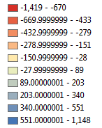
Study Design
Strata – 90-m Scale
Natural Amenities Index
Variable
Topographic Complexity
Forest/Nonforest Complexity
Public Land Proximity
Coast Proximity
Surface Water Proximity
Index based on the sum of the standardized values for each variable
Strata

Slide 15
Study Design
Predictors
Category | Variable
Existing development | Travel time to: urban, services, airport; Access to sewer; Homes/infrastructure in specified radius; Proportion of land use types (wildland, ag, NR) in radius
Policy | Urban growth boundary; State subdivision; County policies Conservation easement; CRP eligibility
Traditional natural resources | Soil type; lithology; Slope; landform; Irrigation access ;Distance to road; NPP ; Parcel size
 | Harvestable timber stocks; Presence of mineral or fuel resources; Access to transportation / transmission infrastructure
Old-west, new-west community character | In-migrants from out of state; In-migrants from met area; College educated; Extractive industry employment; Seasonal housing; FIRE industry employment; Tourism industry employment; Housing valued at $200,000 or more; Or factor analysis score that integrates them
Other economic and social | Land value; Net returns on use; Employment rates; Sectoral employment; Income, poverty, inequality; Population (total,rural/urban); Age profile
Natural Amenities | Viewshed (10 km radius) Topographic variation (Shannon diversity of landform classes); Forest/nonforest edge density; Water/land edge density; Open space (ag, rural, wildland classes) Commuting distance (100 km) Topographic variation (Shannon diversity of landform classes); Forest/nonforest edge density; Water/land edge density; Proportion of area in:Water, Open space, Forest, Public land by type Beyond commuting distance Travel time to: surface water,public land by type, recreational amenity (ski area, river, beach, scenic byway)
Dis-amenities | Property/neighborhood Fire risk,Flood risk’ Landslide risk, Soundscape quality Exurban development Viewshed Fire history, Air quality, Water quality Commuting distance Traffic levels and congestion
Climate | Reference period climate (1950-1980); 9 Weather Preference Index variables; 19 BIOCLIM variables; Change in Climate (1980-present)

Slide 16
Results
Census Tract: Change in Housing Density 1990-2010

Slide 17
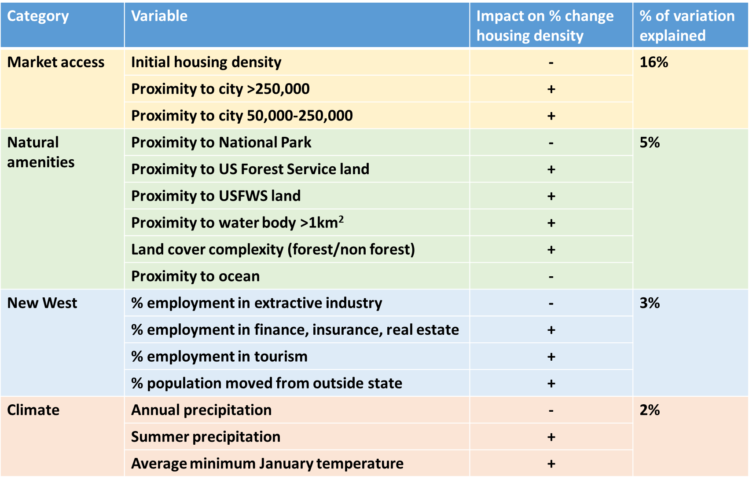
Results
Census Tract: Change in Housing Density 1990-2010

Slide 18
Results
Census Tract: Change in Housing Density 1990-2010

Slide 19
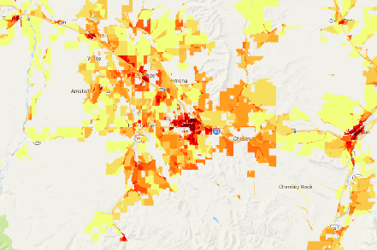
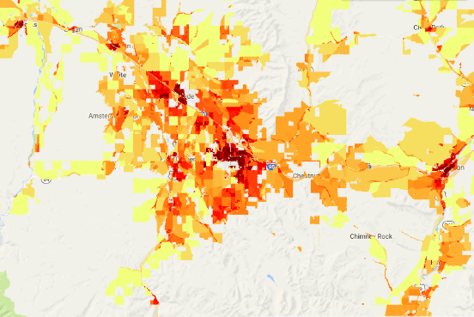
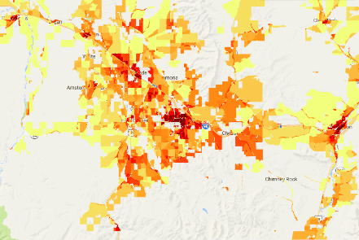
Modeling LCLUC
Forecasting land uses
Insight from econometric modeling
Land use classes
2040, 2080 for
SRES/SSPs scenarios
Spatially Explicit Regional Growth Model
Household size
Compact v. sprawled
Housing density (refined blocks)
2000 2010
Context Dependencies
Infrastructure
Transition
probabilities
Rate of growth
Population
projections
Vulnerability
assessment

Slide 20
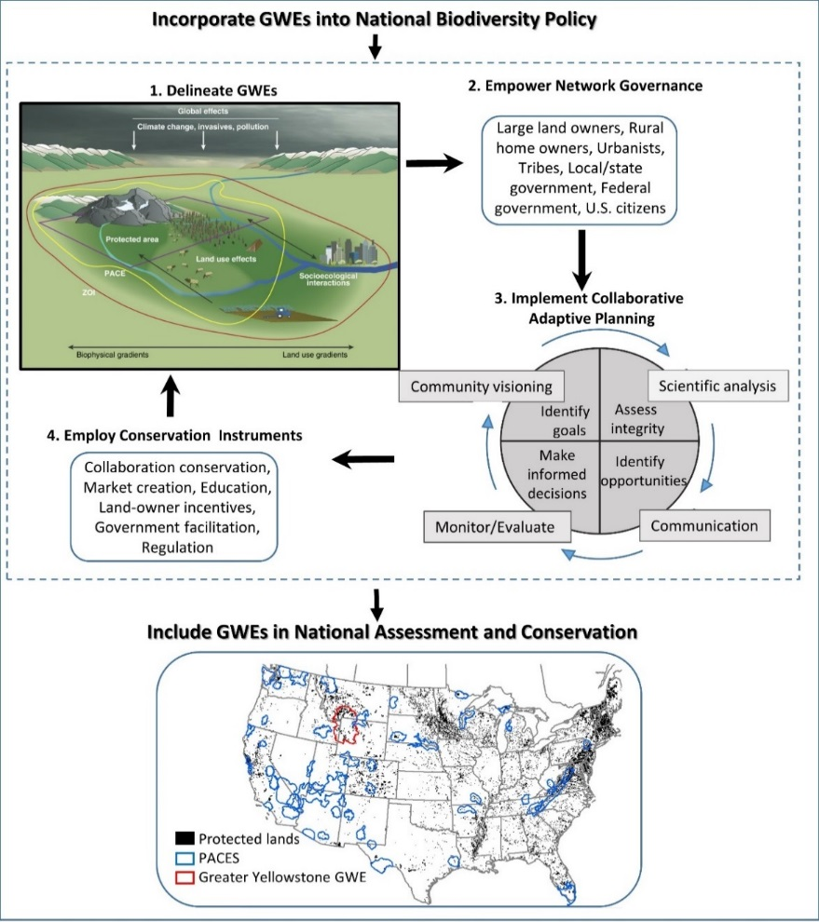
Conservation Vulnerability
A Framework for Sustaining Wildlands
Greater Wildland Ecosystems

Slide 21
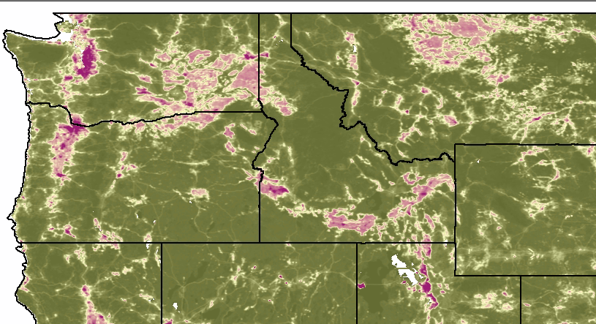
Conservation Vulnerability
Wildland Fragmentation and Connectivity
Theobald 2013
Based on land use type, intensity, and footprint for NLCD types, housing density, energy production, railways, roads, traffic, utility lines
Human Modification
Green - Low
Yellow - Moderate
Dark Red - High

Slide 22
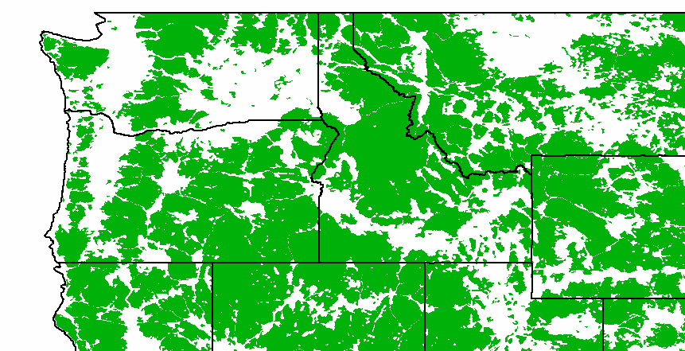
Conservation Vulnerability
Wildland Fragmentation and Connectivity
Theobald 2013
Based on land use type, intensity, and footprint for NLCD types, housing density, energy production, railways, roads, traffic, utility lines
Human Modification
Human modification < 0.1

Slide 23
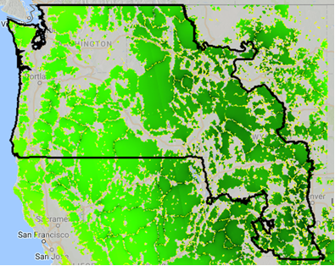
Conservation Vulnerability
Wildland Fragmentation and Connectivity
Connectivity among Wildlands
Darker green – more central in connectivity

Slide 24
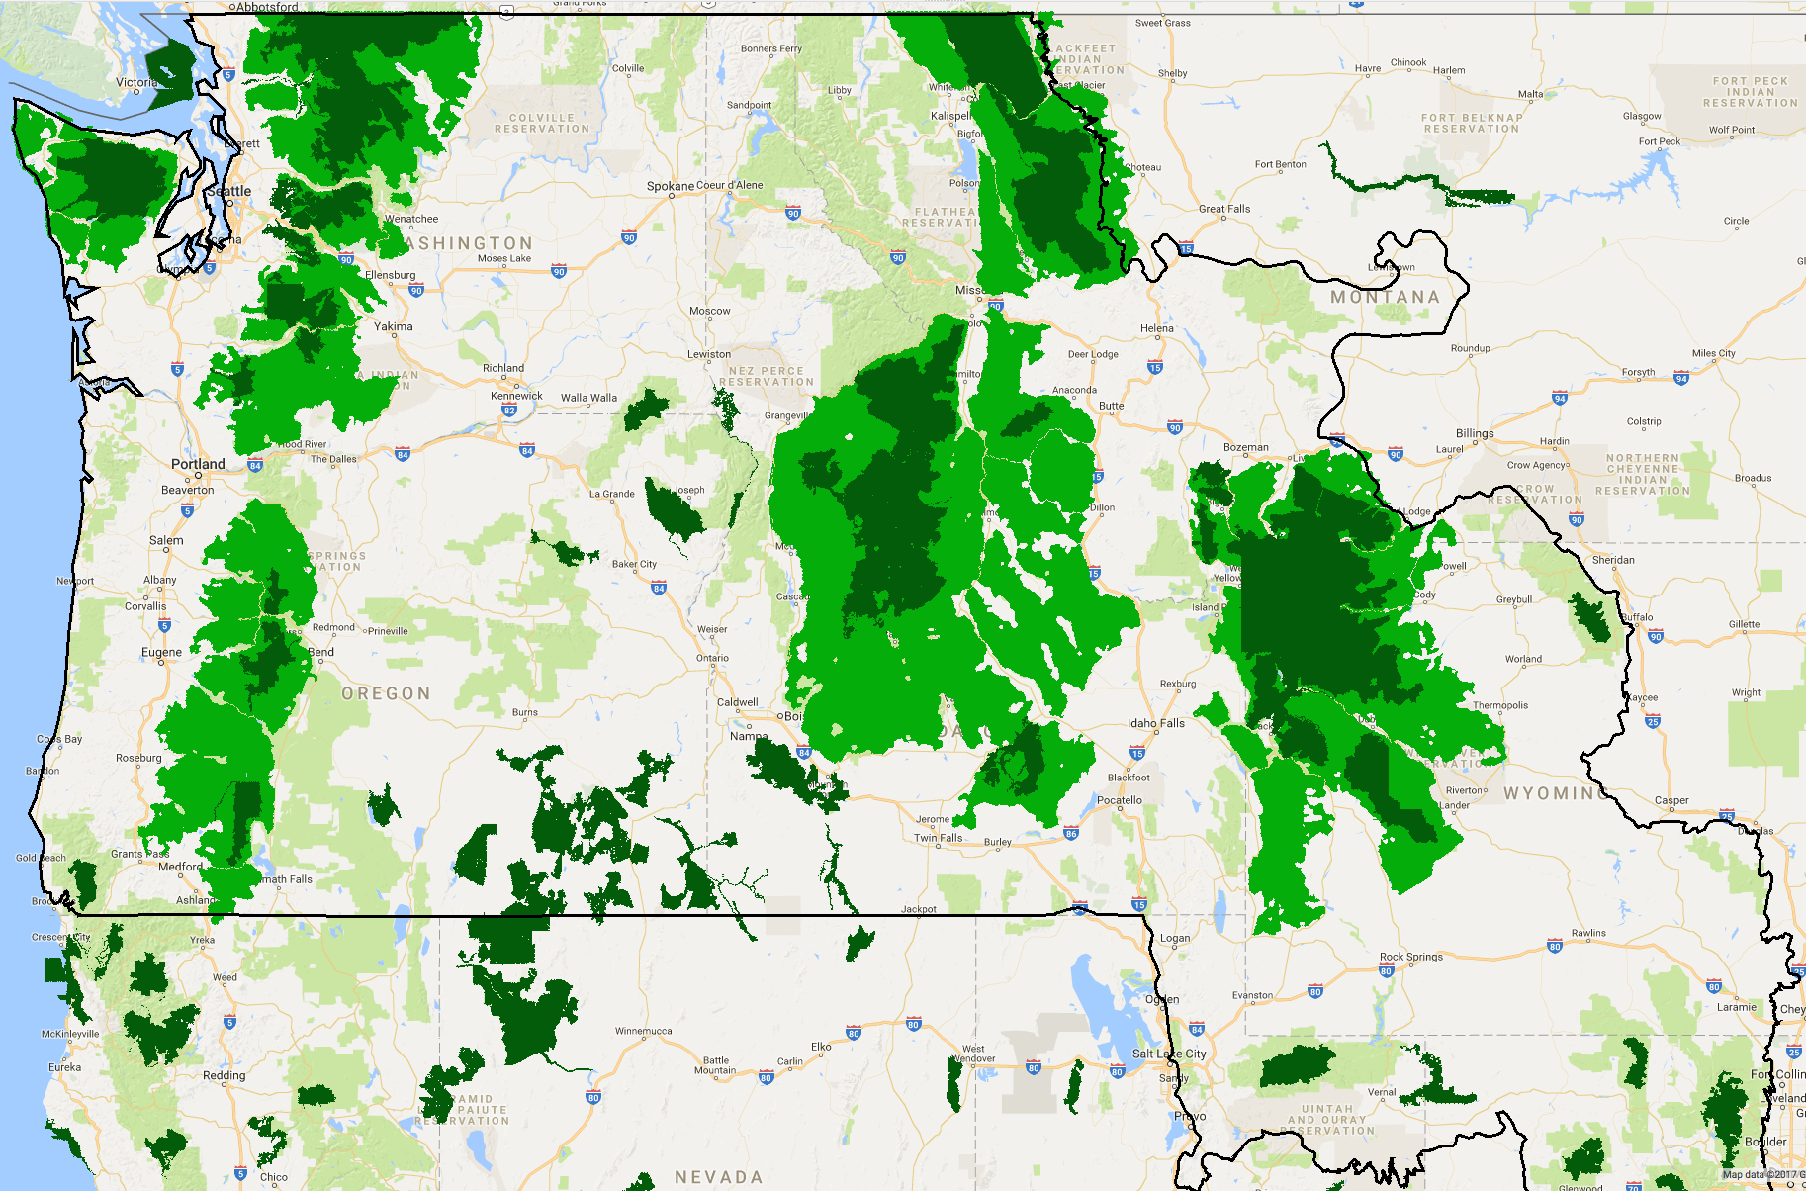
Conservation Vulnerability
Wildland Fragmentation and Connectivity
Greater Wildland Ecosystems
North Cascades
Crown
Olympic
Selway - Bitterroot
Oregon Cascades
Greater Yellowstone
Dark green – Protected areas
  (status 1 & 2, >100,000 acres)
Light green – Wildlands
  (low human modification)
Data from: USGS Protected Areas Database v1.4; Theobald 2013

Slide 25
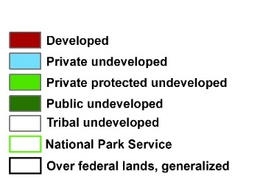

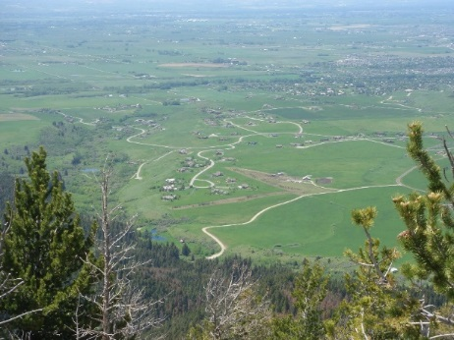
Conservation Vulnerability
Wildland Fragmentation and Connectivity
Fragmentation within GWEs
GYE Developed Area
Habitat Type | Proportion Overlaying Land Use Development
 | Private Lands | All Lands
Aspen | 56 | 27
Riparian habitat | 89 | 57
Sage/grassland | 68 | 39
Upland woody deciduous | 63 | 32
Douglas fir forest | 50 | 25
Subalpine coniferous forest | 50 | 10
Bird hot spots | 65 | 41
Irreplaceable areas
Pronghorn | 66 | 51
Moose | 64 | 44
Grizzly bear | 61 | 13
Elk winter | 56 | 30
Gallatin Valley 2010
Hansen and Phillips 2016

Slide 26

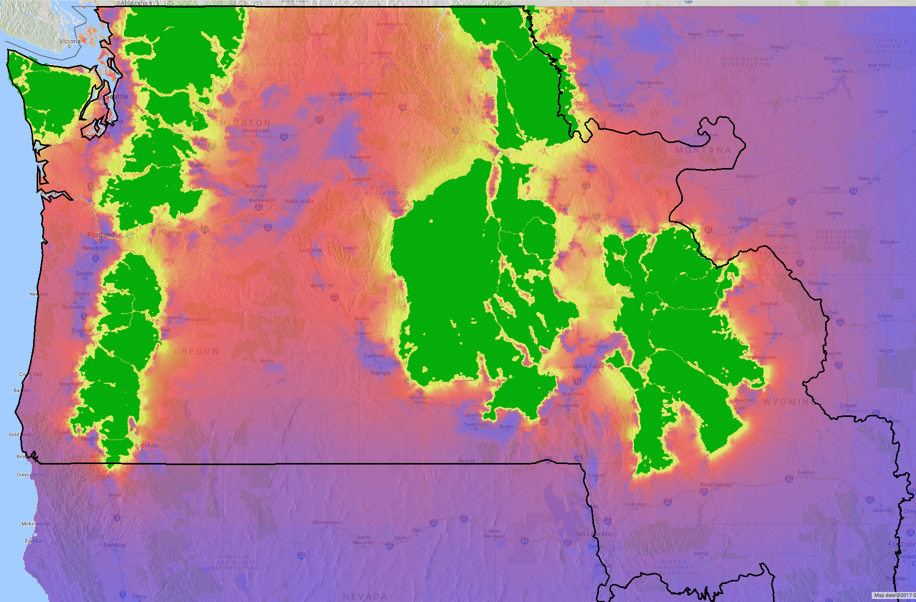
Conservation Vulnerability
Wildland Fragmentation and Connectivity
Connectivity among Greater Wildland Ecosystems
Yellow – high Orange - moderate
Red/Purple – low Blue – very low

Slide 27
Next Steps
Project LCLUC under IPCC scenarios across western mountain landscapes enhance vulnerability assessments of biodiversity to future global change.

Slide 28
Outcomes
Sustainable Mountain Landscapes
We hope the results help provide for sustainable mountain landscapes in the NW US and the approach be applied more broadly.

Slide 29
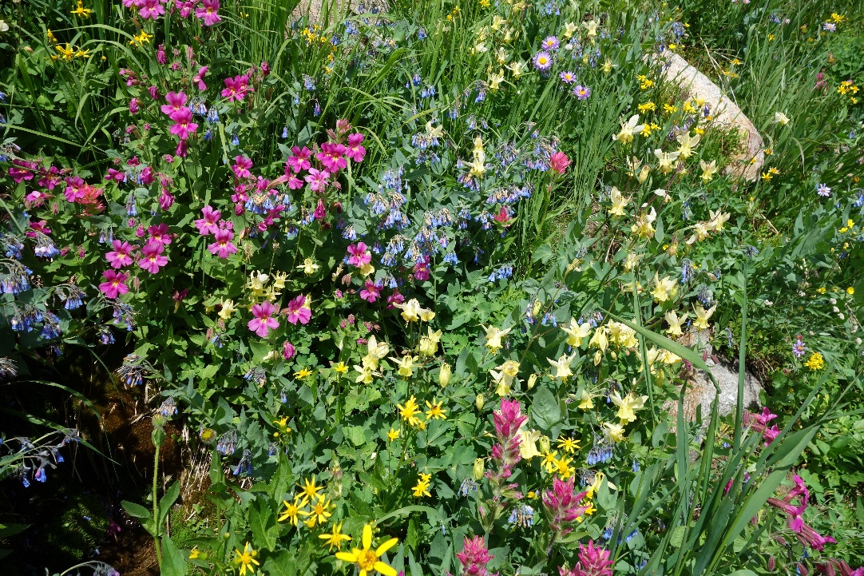
Acknowledgements
NASA Land Cover Land Use Change Program
NASA Applied Sciences Program
NSF EPSCoR Track-I
North Central Climate Sciences Center

Slide 30
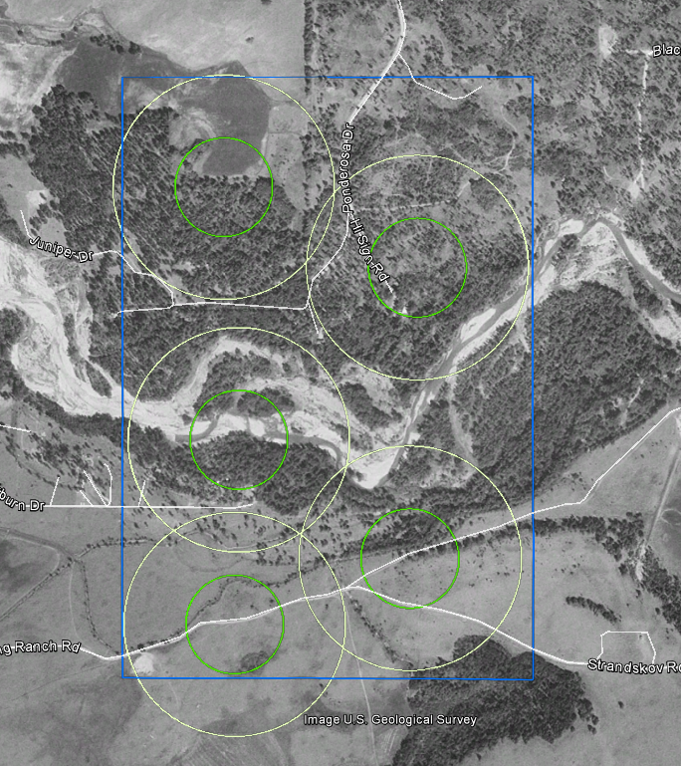
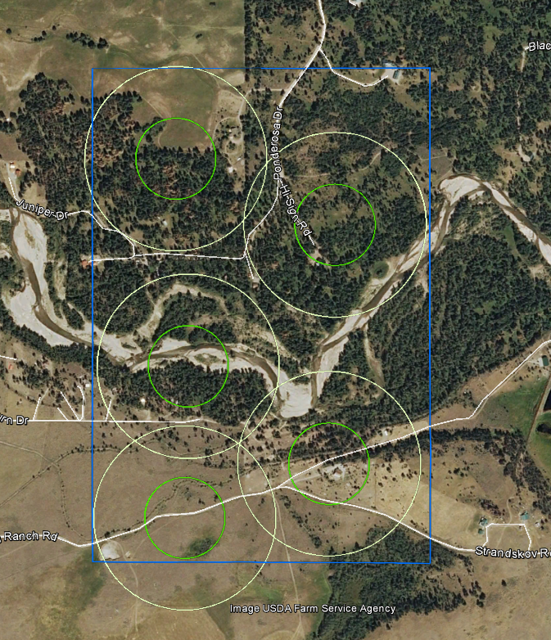
Study Design
Sampling Scheme
GRIDCODE 422288
STRAT 2302
1990
2010
Subplot Unique ID: | 2302062
1990 primary land use indicator | 9 = Local Road
1990 secondary land use indicator | 34 = No Indicator
1990 tertiary land use indicator | 34 = No Indicator
1990 homes per subplot | 0
1990 land use | 7 = Natural Cover
1990 land cover | 43 = Mixed Forest
1990 buffer primary land use indicator | 9 = Local Road
1990 buffer secondary land use indicator | 11 = Transportation – 4WD Road
1990 buffer tertiary land use indicator | 34 = No Indicator
Subplot Unique ID: | 2302062
2010 primary land use indicator | 4 = Residential
2010 secondary land use indicator | 9 = Local Road
2010 tertiary land use indicator | 14 = Driveway
2010 homes per subplot | 2
2010 land use | 3 = RRD
2010 land cover | 43 = Mixed Forest
2010 buffer primary land use indicator | 4 = Residential
2010 buffer secondary land use indicator | 9 = Local Road
2010 buffer tertiary land use indicator | 14 = Driveway

Slide 31
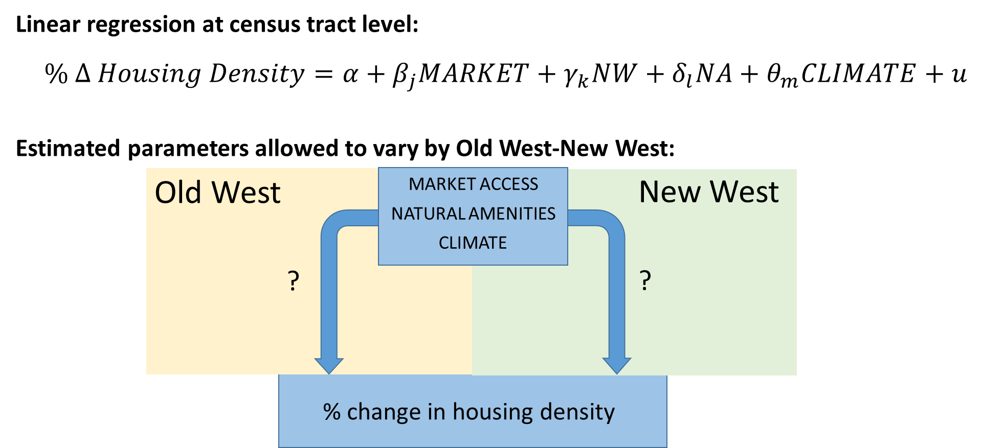
Study Design
Hypothesis Testing

