Slide 1
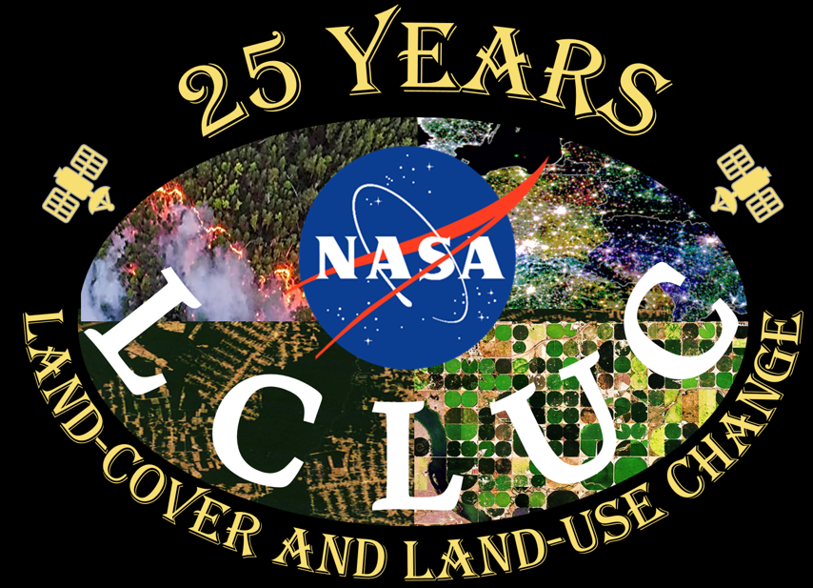
Peilei Fan
Challenges in Urban LCLUC Science
Urban as a focal point for human-environment interactions
Data
  Different types of data, mismatched resolutions
    Moderate -> High resolution: land use data
    low resolution: Socioeconomic (GDP), demographic (population density), health (disease)
    Creative ways to get data with ideal resolution
  satellite imageries + new data sources
    Google street image
    Field data (drone, citizen science-crowd sourcing)
    Fusion, validation, 2D=>3D
Integrated modeling
  Machine learning to identify important environment variable that may be use to predict behavior in city environment
  Input: urban built environment chars => output: health outcomes, crime, etc

Slide 2
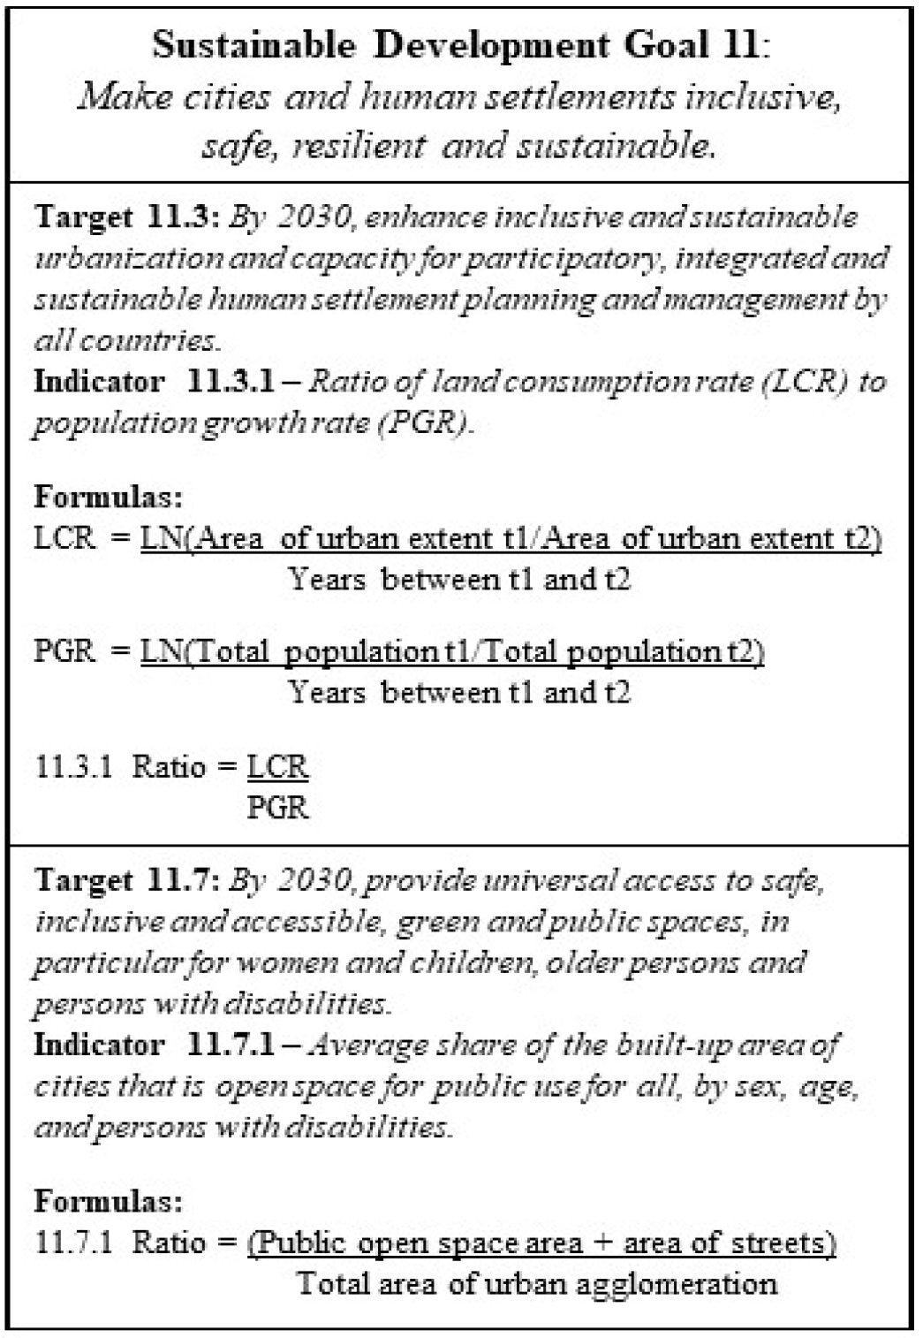
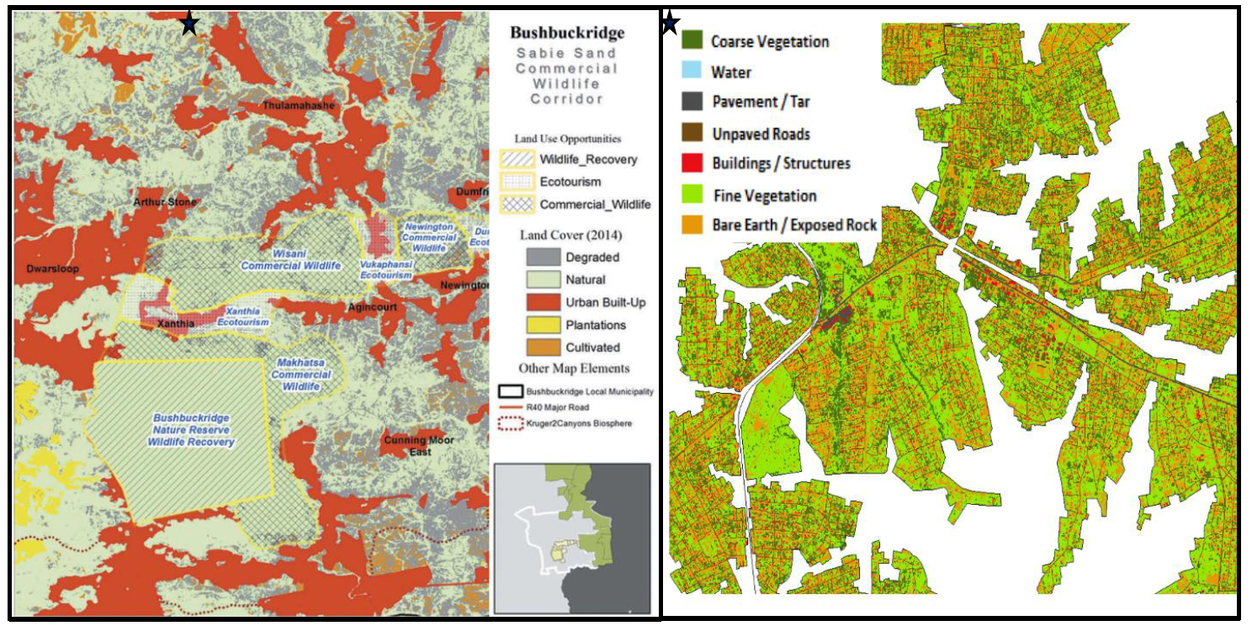
Jody Vogeler
Challenges in Urban LCLUC Science
Limitations and data gaps hindering the analyses of urban change dynamics necessary for guiding more sustainable land planning include:
SDG 11 – Examples of the conceptual challenges of mapping urban areas
Requires easily replicable frameworks for creation of spatial products in support of SDG indicators from remote sensing and widely available data sources.
Form vs Function: Remote sensing may be able to capture urban form, but locally informed ground-based information is needed to inform function.
A gap in geographic coverage of LMIC and the Global South;
Neglect of small-medium sized cities in favor of megacities (>5 million population);
Limited temporal resolution in urban change mapping;
A failure to capture urban heterogeneity in structure and form by oversimplifying urban landscapes into a single class;
Need for more explicit use of terminology and replicable frameworks across global monitoring indicators such as urban-related SDG Indicators
Difficulties in automated approaches for delineating urban extents
While we can monitor LCR with remote sensing (LU maps), we still need consistent population info, and additional measures of change and social/ecological services to go beyond spatial indicators and inform SDG targets and larger goals.
Here again, we can measure form (distribution of green spaces) with remote sensing (LC maps), but also need local information on function to fully monitor SDG target and goals.
Large Scale (regional, national, global), Lower Resolution (≥30m) urbanization patterns.
Small Scale (city, neighborhood), high resolution (~1m) studies of urban heterogeneity.
Highlights the value of higher resolution land cover information within cities to better capture the heterogeneity of urban environments (applicable for monitoring ecosystem services as well and multi-use lands)
Understanding urban growth, larger LCLUC resulting from urban expansions
Analyze landscape quality, human-environmental interactions, trade-offs in ecosystem services
Data limitations/gaps as well as need for locally informed reference data

Slide 3
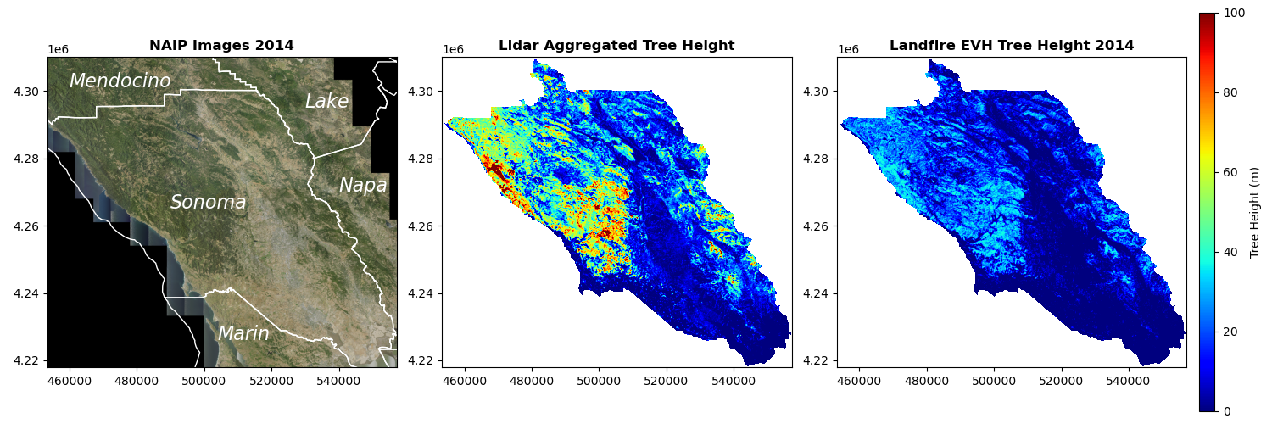
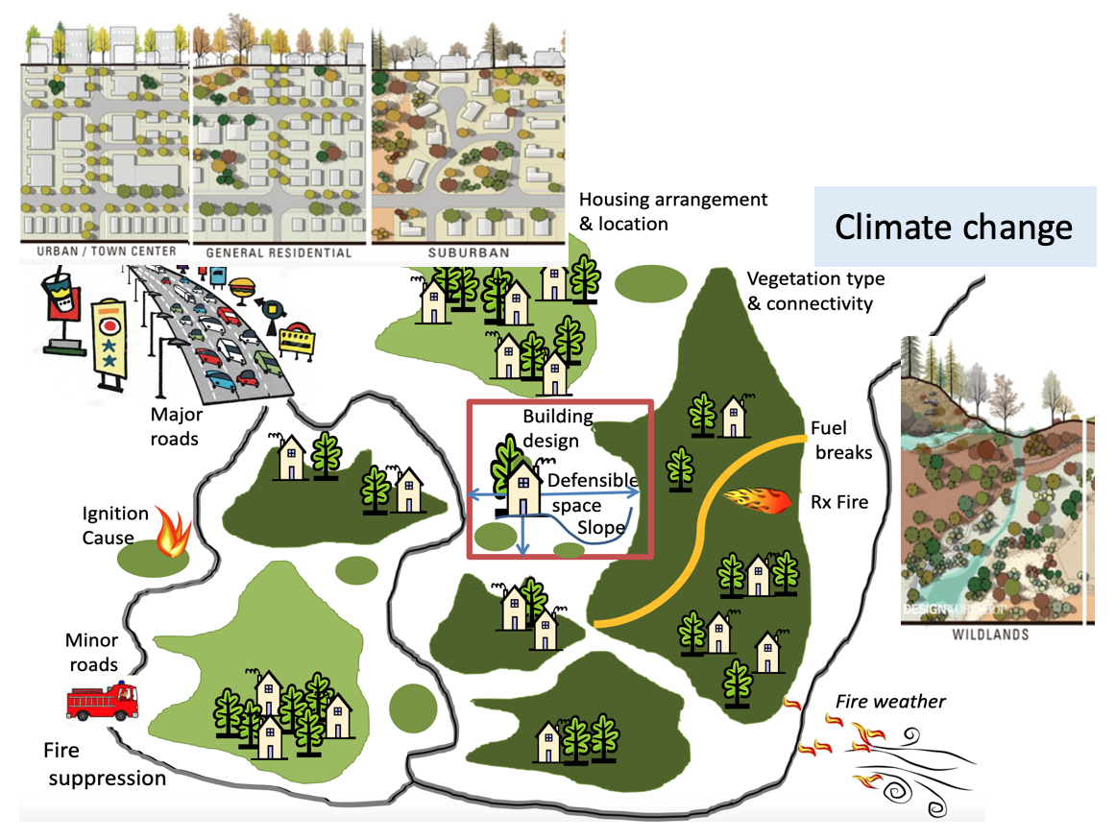
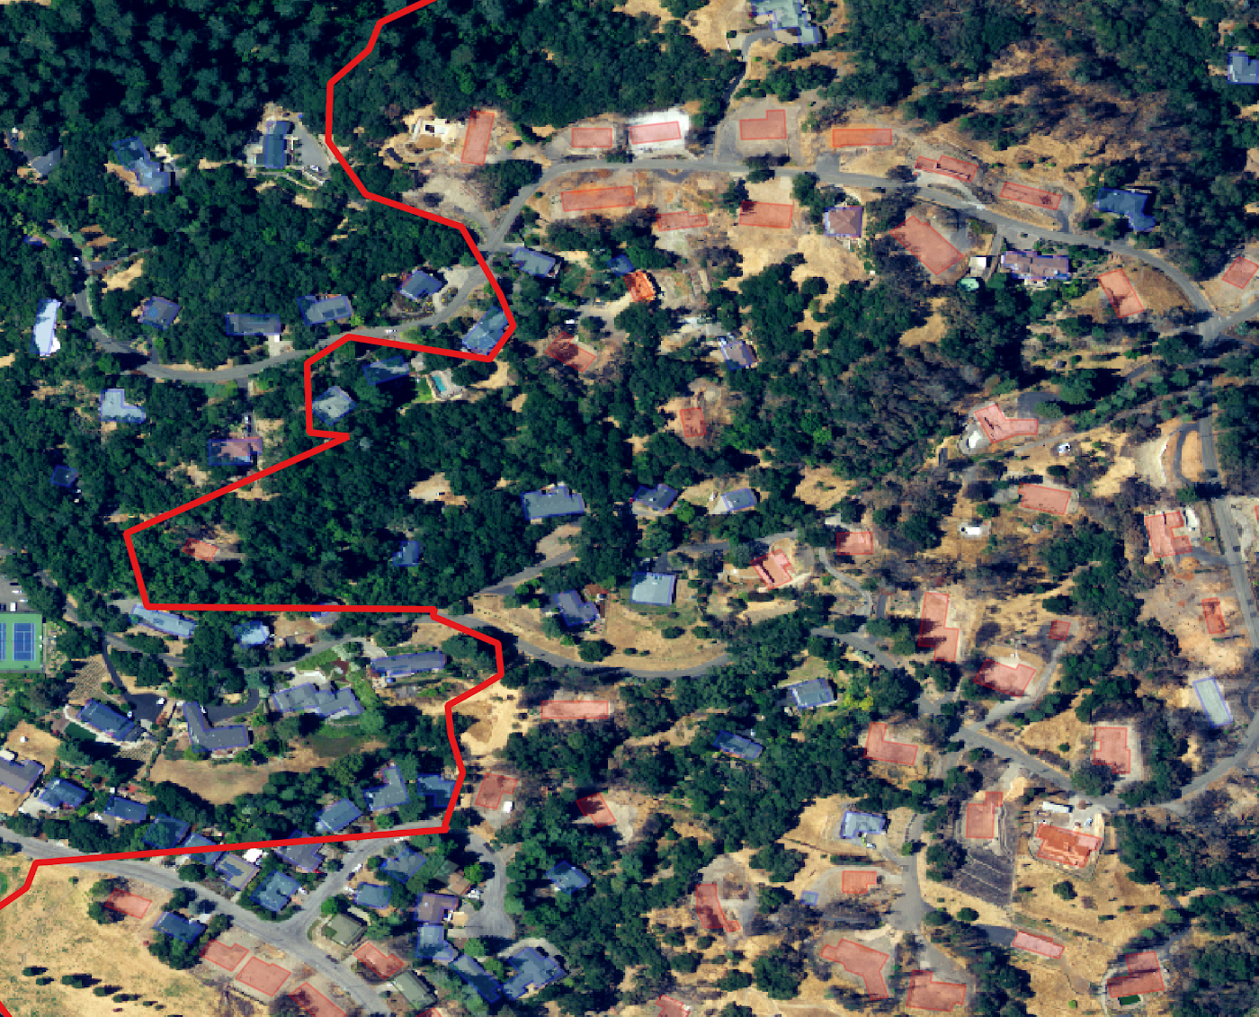


Yufang Jin
Challenges in Urban LCLUC Science
Rapid encroachment into wildland
Disruption to ecosystems and communities
Fragmented landscape
Increased wildfires, landslides …
Cascading effects: public health
Vulnerable to extreme events
Feedback loops
Science-based, data driven decision support across scales
Community
Adaptation & Resilience
NAIP
LiDAR tree height
Urban-wildland Continuum & coupling
Multi-source RS
Complexity in the coupled social-ecological system: dynamic, multi-level social actors ……
Data engine enhanced with AI/ML
Learning from past practices: limited social data, case studies
Textual social data
Challenges in fine scale monitoring, biophysical processes, risk assessment and prediction ……
AI/ML models and a coupled framework to link governance network, community response with LCLUC and community vulnerability
Challenges in balancing multiple ecosystem services, equity ……
Notes:
harnesses the long term record of big data from both biophysical components and social actors, coupled machine learning tools for processing and analyzing these data, to dramatically increase the scale and scope of social-environmental analysis (Governance: Incentive, Coordination, Capacity; Community response Zoning, growth, housing arrangement Building materials; denfensile space)
Learning from past: Existing studies of wildfire/environmental governance largely rely on surveys and other subjective measures.

Slide 4
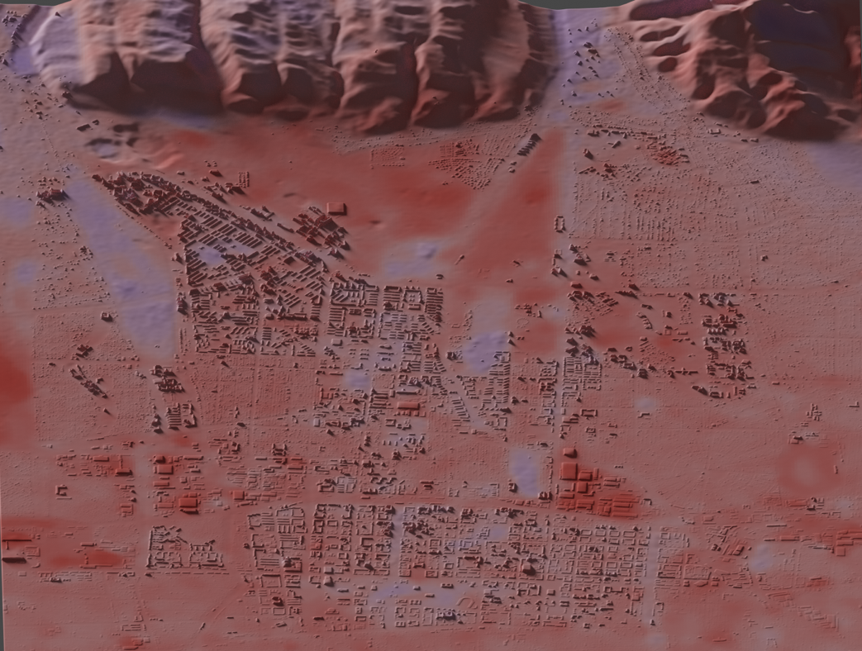
Kirsten de Beurs & Daniel Hicks
Challenges in Urban LCLUC Science
Questions and Opportunities
What is the impact of urbanization on human health? And how do we measure that?
Combine spatially explicit building data, with imagery at a variety of spatial resolutions.
Challenges
IRB permission was an in-depth process as surveys were reviewed in multiple languages, and specialized region experts were brought in to help assess the questionnaire.
IRB approval was obtained from the University of Oklahoma in summer 2021 and again from RAND in 2022.
We originally included a political economy module, which was cut during IRB Review, largely in response to the geopolitical situation in the region. The survey has been adapted to local contexts – with nuances in how neighborhoods are defined.

Slide 5
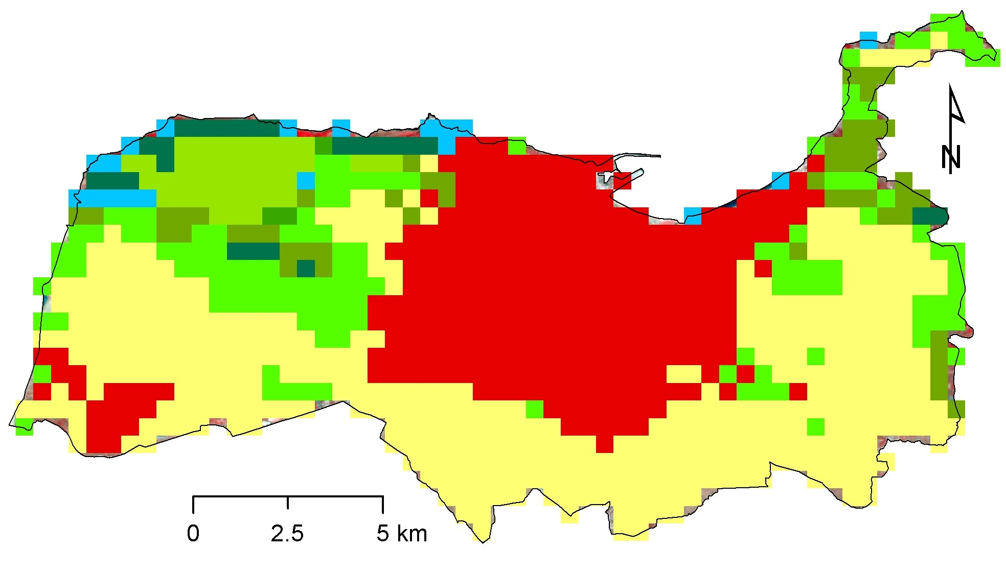
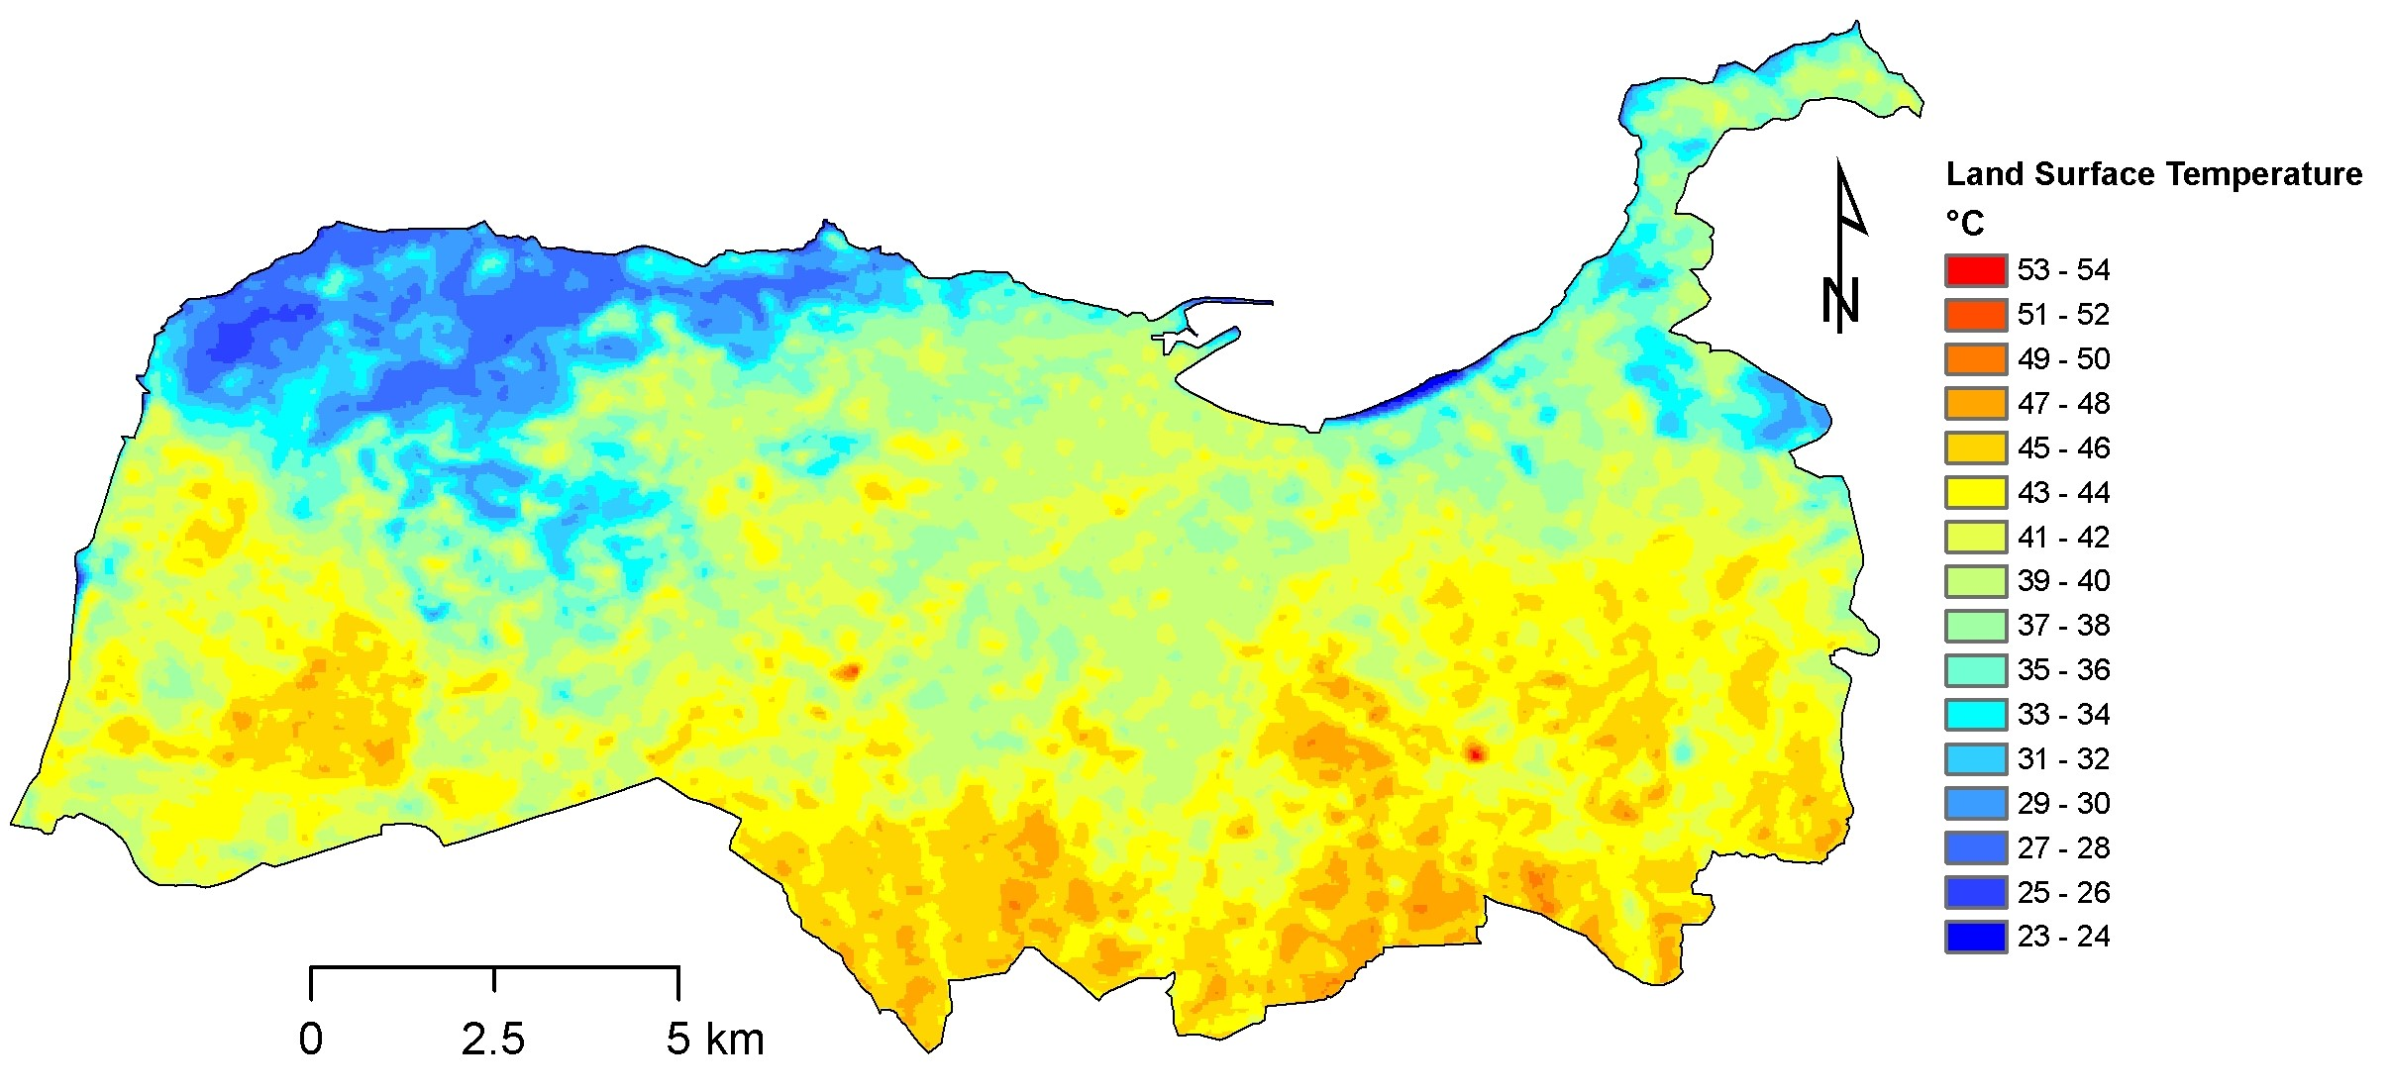
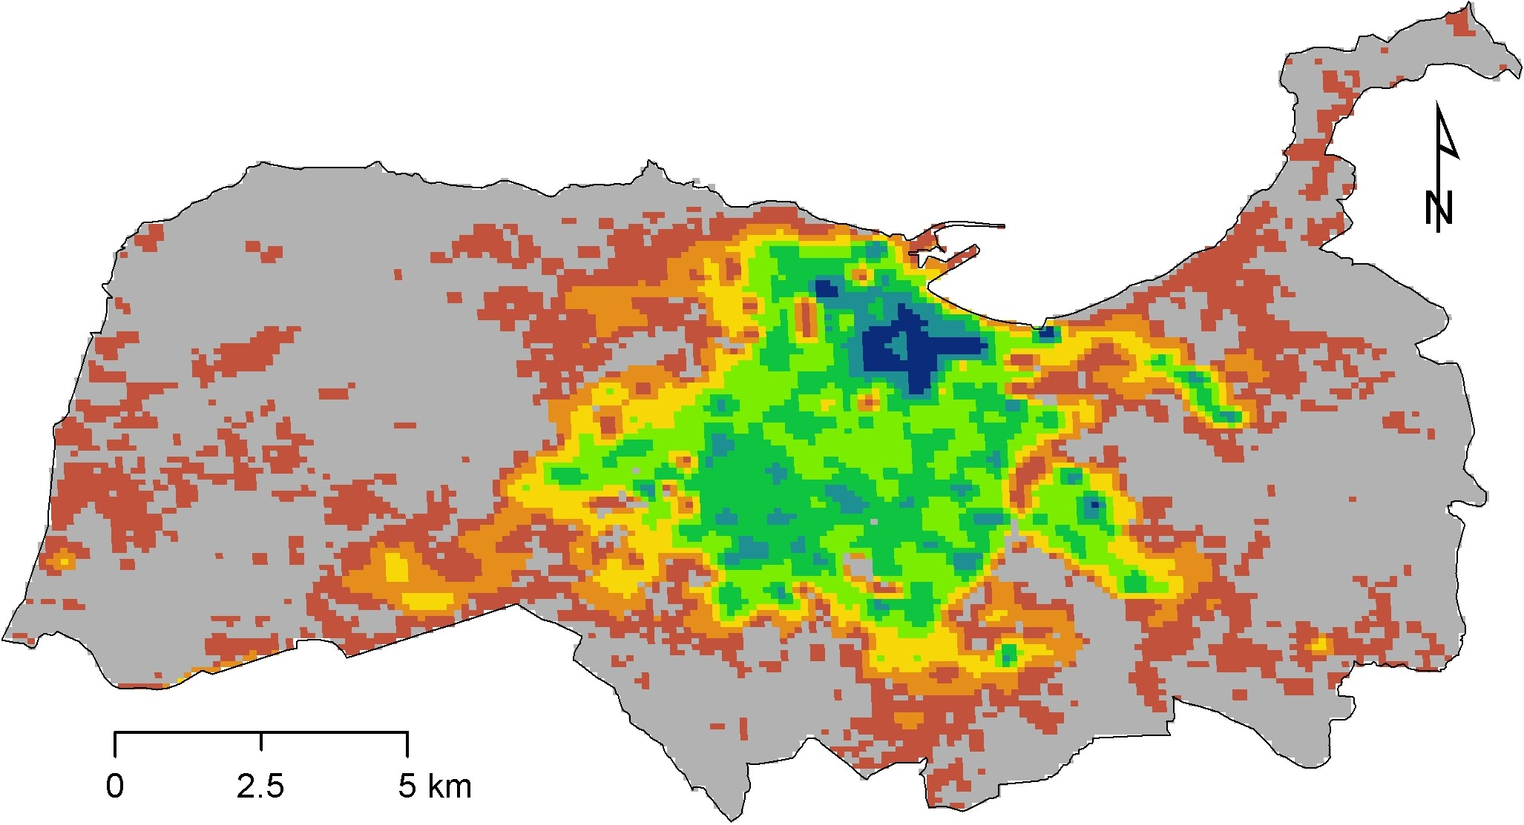

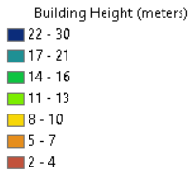
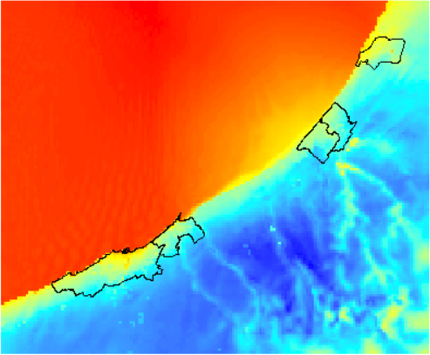
Alexey Shiklomanov
Challenges in Urban LCLUC Science
Our project: Assessing the impact of urban land conversion on local and regional surface climate and its socioeconomic consequences in Western North Africa
Our goals:
Map urbanization in 10 cities in Morocco
Quantify urban heat/cooling island effect
Understand the regional meteorological impacts of urbanization
Quantify economic consequences of urban heat/cooling effect in terms of building energy demand
500m Land Cover, Tangiers, Morocco (2014)
Landsat Collection 2 Surface Temperature Science Product – July 4, 2014
100m building height, Tangiers, Morocco (2018)
WRF-simulated 2m air temperature
Our team: Alexey Shiklomanov, Lahouari Bounoua, Joe Nigro [NASA GSFC]; Tao Zhang, Yuyu Zhou [Iowa State University]; Zarrar Khan [Pacific Northwest National Laboratory]; Hicham Bahi [Mohammed VI Polytechnic University]
°C
Rabat
Our perspectives on challenges to Urban LCLUC Science
Casablanca
“Urban” is a simplistic concept for land-cover classification. We need more granularity to really understand the physical, ecological, and socio-economic processes that happen in inhabited areas.
Cities, and their interactions with their surrounding environment, have complex 3D geometries. “Flat” and/or column-integrated measurements are insufficient, as are models that fail to capture vertical and lateral energy and mass fluxes.
Urbanization and its socio-economic consequences are a coupled human-natural systems problem that requires detailed socio-economic data and models.

