Slide 1

A Atmospheric Correction Update and ACIX Status
Eric Vermote et al.
NASA Goddard Space Flight Center Code 619
Eric.f.vermote@nasa.gov

Slide 2
Landsat8/OLI and Sentinel 2 Surface Reflectance is largely based on MODIS C6 (LaSRC)
Algorithm reference for L8: Vermote E., Justice C., Claverie M., Franch B., (2016) “Preliminary analysis of the performance of the Landsat 8/OLI land surface reflectance product", Remote Sensing of Environment, 185,46-56.
The MODIS Collection 6 AC algorithm relies on
the use of very accurate (better than 1%) vector radiative transfer modeling of the coupled atmosphere-surface system (6S)
the inversion of key atmospheric parameters
  Aerosols are processed from OLI/Sentinel 2 images
  Water vapor and ozone from daily MODIS product.
Home page: http://modis-sr.ltdri.org

Slide 3
Landsat8/OLI and Sentinel 2 Surface Reflectance is largely based on MODIS C6
Flowchart of the Landsat 8 (and Sentinel 2) atmospheric correction scheme
Ancillary (Ozone, Water Vapor, DEM)
OLI SR 7 Bands
OLI Atmospheric correction
OLI TOA 7 Bands
AOT Map
Vermote E.F., Justice C., Claverie M. and Franch B., “Preliminary analysis of the performance of the Landsat 8/OLI land surface reflectance product” Remote Sensing of Environment. In Press.

Slide 4
Landsat8/OLI and Sentinel 2 atmospheric correction
Reading Inputs, LUT and Ancillary data
ρ_{surf} determined (*) using ρ_{atm}, T_{atm} and S_{atm}
from LUT assuming AOT, Aerosol model and knowing pressure, altitude, water vapor, ozone…
Using the relationship between the blue surface reflectance (490 nm) and the red surface reflectance (665 nm) known from MODIS, we are able to retrieve the AOT.
We loop the AOT until (ρ_{surf} blue / ρ_{surf} red)_{MSI} = (ρ_{surf} blue / ρ_{surf} red)_{MODIS}
Aerosol
Opt. Thick.
and
Aerosol model
for each pixel
The retrieved AOT is used to compute
the surface reflectance at 443 and 2190 nm.
The aerosol model is then derived by minimizing the residual.
Surface reflectance
for each pixel
and
each band
Computation of surface reflectances
for all channels
ρ_{surf} determined (*) using ρ_{atm}, T_{atm} and S_{atm} from LUT knowing AOT, Aerosol model, pressure, altitude, water vapor, ozone…
with

Slide 5
CURRENT STATUS
Atmospheric correction algorithm
L8 surface reflectance product (V3) available and validated satisfactorily
Sentinel 2 atmospheric correction algorithm (V2) developed and implemented (preliminary validation through ACIX , cloud mask needs to be implemented)

Slide 6
Methodology for evaluating the performance of Landsat8/Sentinel2
Subsets of Level 1B data processed using the standard surface reflectance algorithm
comparison
Reference data set
Atmospherically corrected TOA reflectances derived from Level 1B subsets
AERONET measurements
(τ_{aer}, H₂O, particle distribution
Refractive indices,sphericity)
Vector 6S

Slide 7
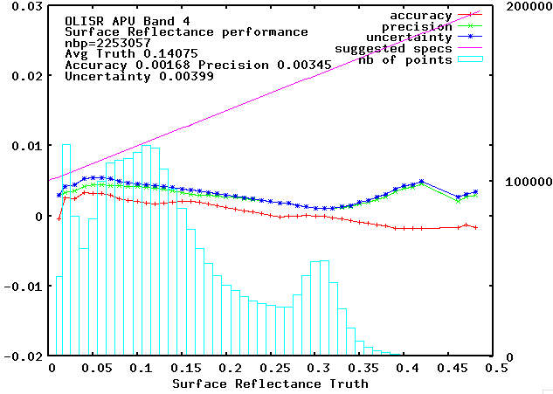
Evaluation of the performance of Landsat8
The “preliminary” analysis of OLI SR performance in the red band over AERONET is very similar to MODIS Collection 6

Slide 8
This is confirmed by comparison with MODIS

Slide 9
ACIX: CEOS-WGCV Atmospheric Correction Inter-comparison Exercise
(ESA/NASA/UMD)
The exercise aims to bring together available AC processors (actually 14 processors including SEN2COR, MACCS, L8-S2-6SAC, …) to generate the corresponding SR products.
The input data will be Landsat-8 and Sentinel-2 imagery of various test sites, i.e. coastal, agricultural, forest, snow/artic areas and deserts.
Objectives
To better understand uncertainties and issues on L8 and S2 AC products
To propose further improvements of the future AC schemes
* 1st Workshop in June 21st-22nd @ University of Maryland (by invitation): to elaborate concepts, protocols and guidelines for the inter-comparison and validation of SR products
2nd workshop in April 11-12 2017: to report and discuss intercomparison results
https://earth.esa.int/web/sppa/meetings-workshops/acix

Slide 10
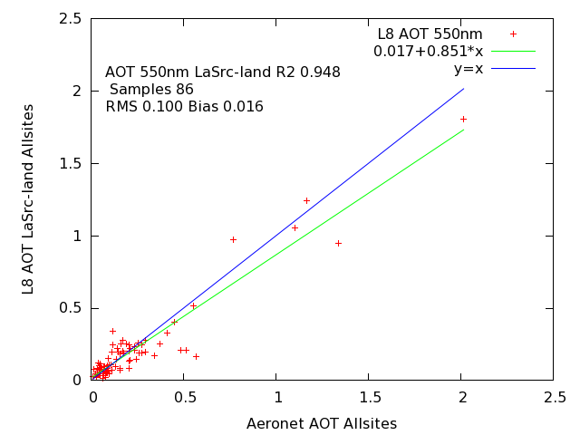
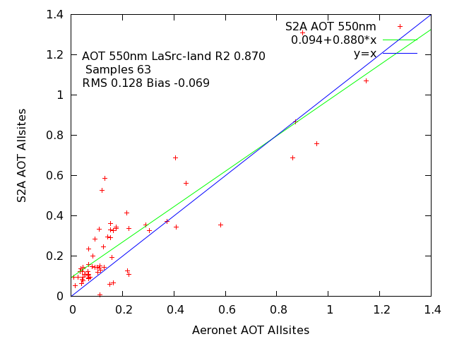
ACIX results for the LaSRC algorithm (L8/S2A) (Land sites only, no cloud)

Slide 11
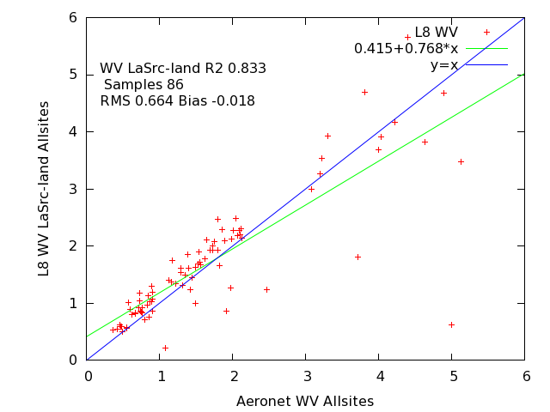
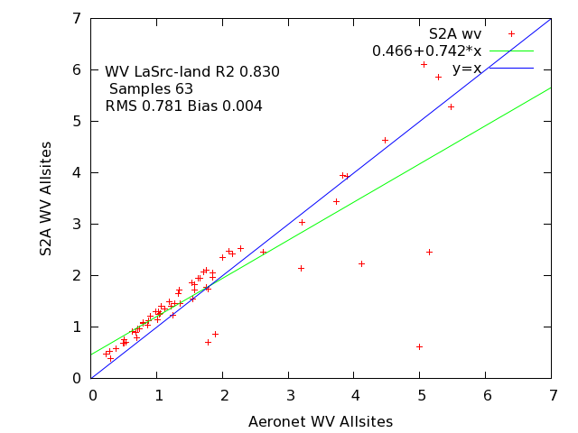
ACIX results for the MODIS SR algorithm (L8/S2A) (Land sites only, no cloud)

Slide 12
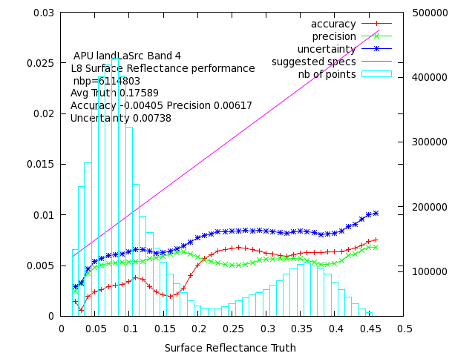
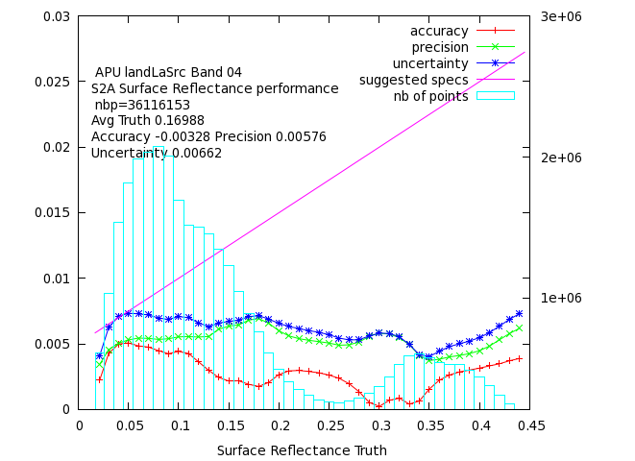
ACIX results for the MODIS SR algorithm (L8/S2A) (Land sites only, no cloud)

Slide 13
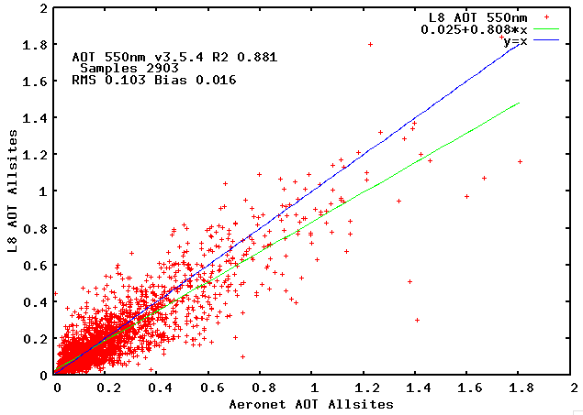
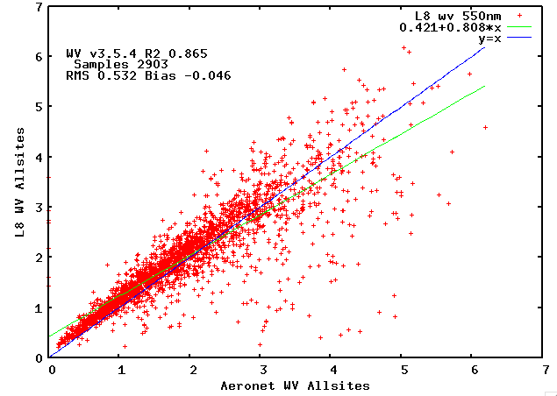
Validation is on-going moving into a systematic routine assesment

Slide 14
Conclusions
Surface reflectance code (LaSRC) is mature and pathway toward validation and automated QA is clearly identified.
Algorithm is generic and tied to documented validated radiative transfer code so the accuracy is traceable enabling error budget.
The use of BRDF correction enables easy cross-comparison of different sensors (MODIS,VIIRS,AVHRR, LDCM, Landsat, Sentinel 2 ,Sentinel 3…)
Preliminary Sentinel 2 surface reflectance validation shows good performance but needs a more extensive study

