Slide 1


Strategic Directions in
Urban Remote Sensing
Karen C. Seto
LCLUC 25th Anniversary Science Team Meeting
October 18-20, 2022
October 18-20th, 2022

Slide 2
From where have we come?

Slide 3


Modeling and Forecasting Effects of Land-Use Change in China Based on Socioeconomic Drivers
PI: Robert K. Kaufmann
Co-Investigators: Curtis E. Woodcock
Dennis G. Dye
Karen C. Seto
Chinese Collaborators: Lu Jinfa
Li Xiaowen
Wang Tongsan
LCLUC Science Team Meeting
Airlie House, Warrenton, VA
May 18-21, 1999

Slide 4
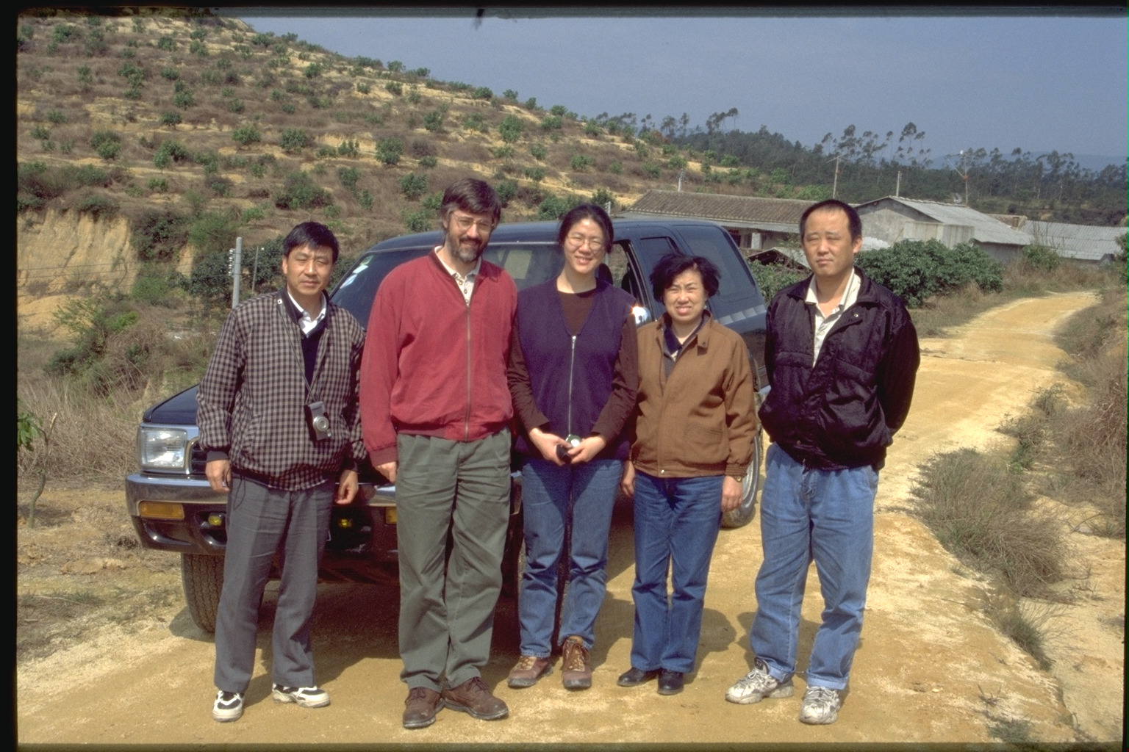

Slide 5
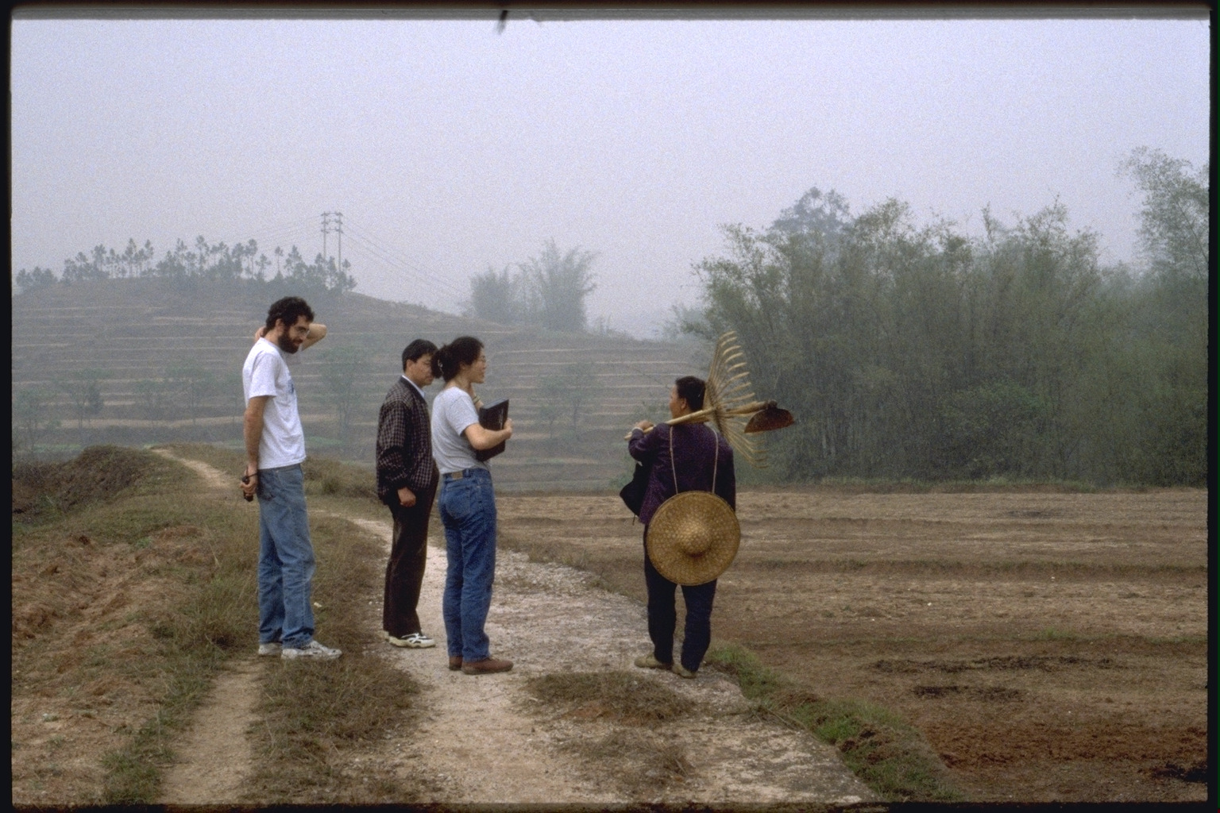

Slide 6
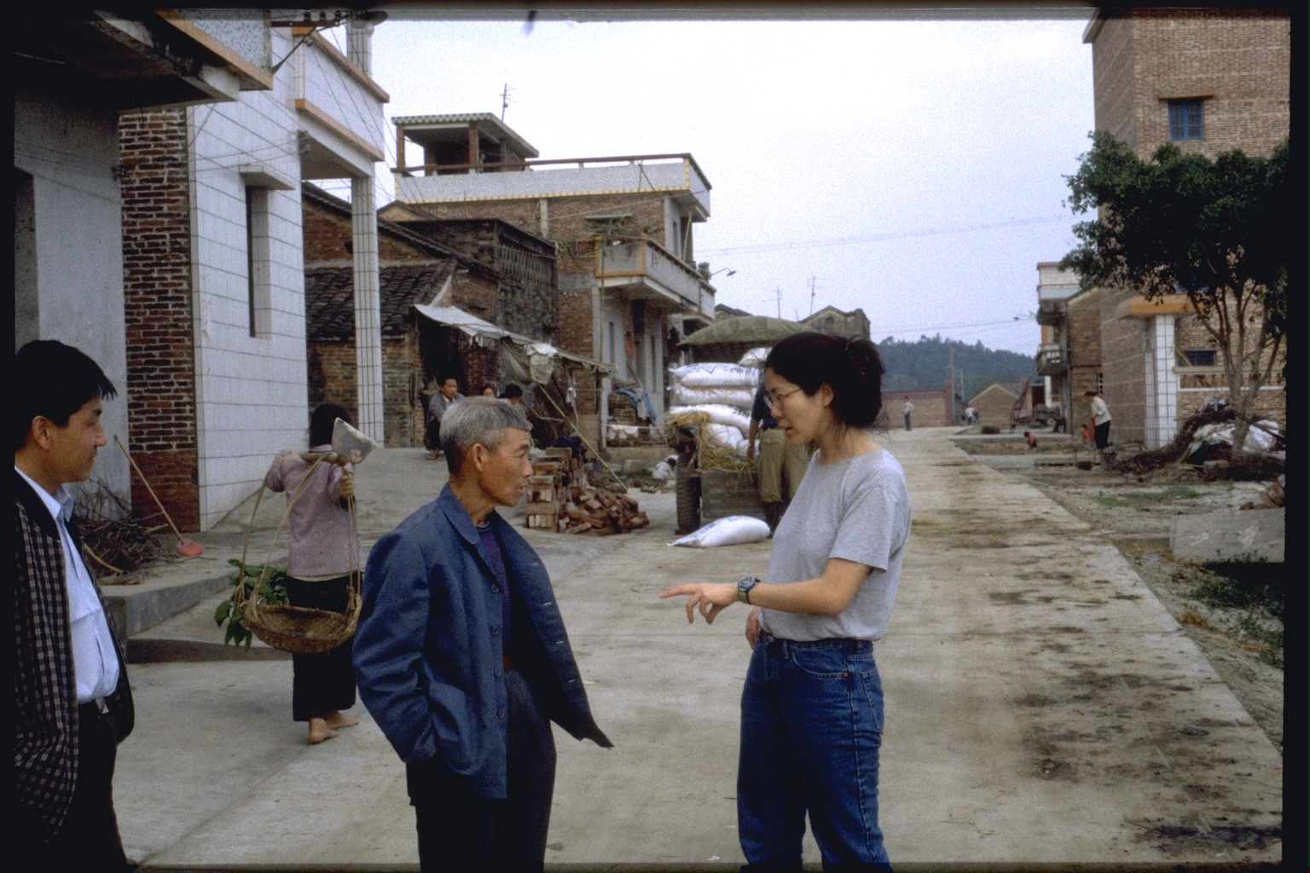

Slide 7
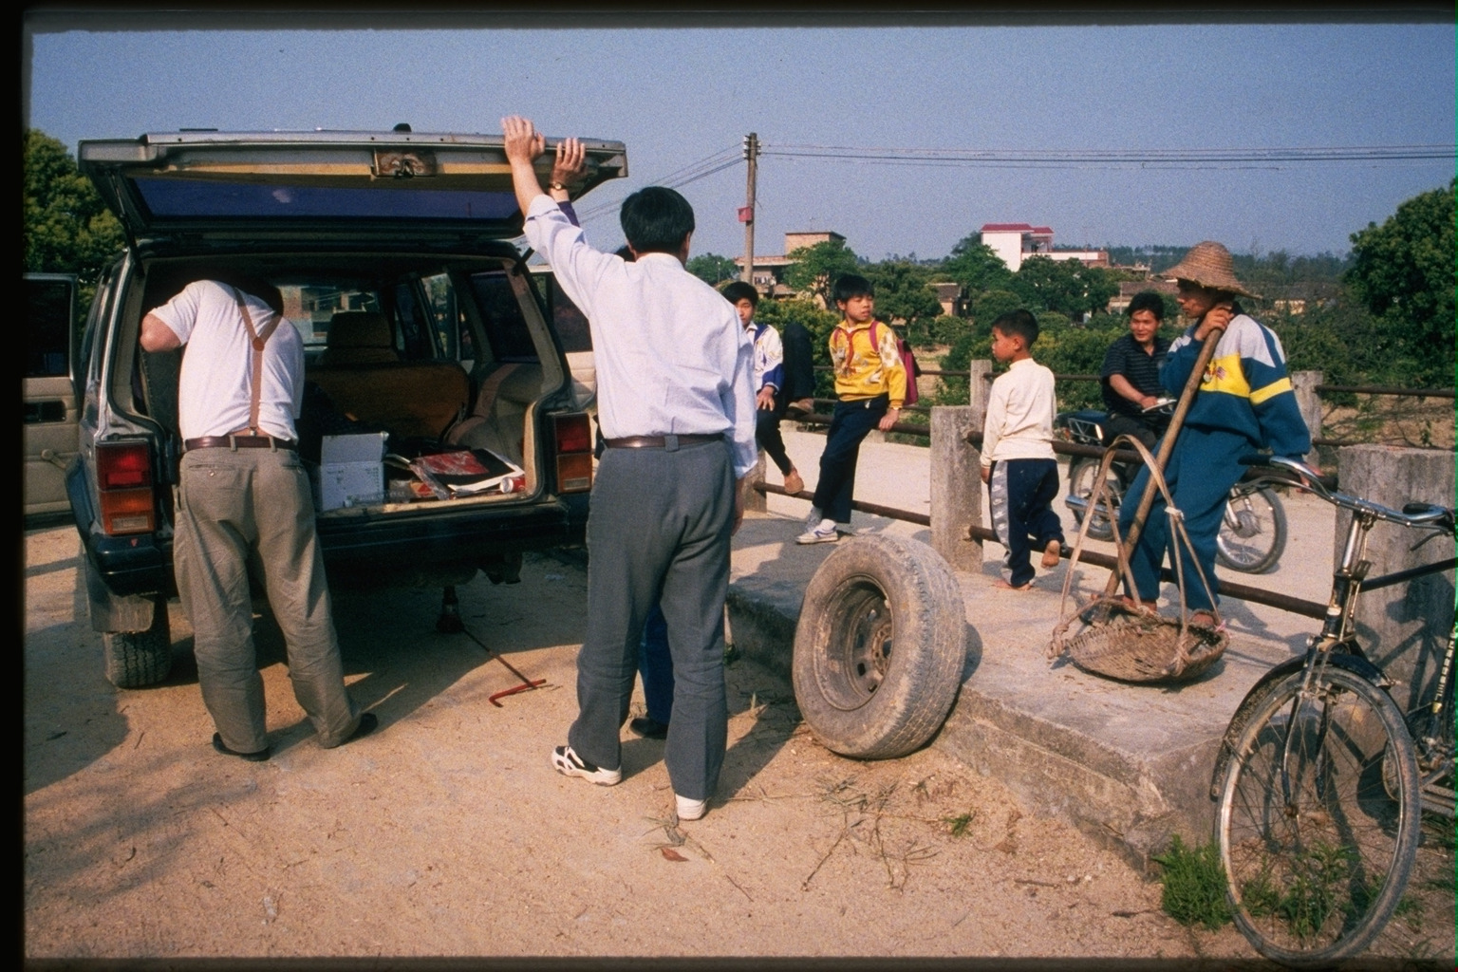

Slide 8
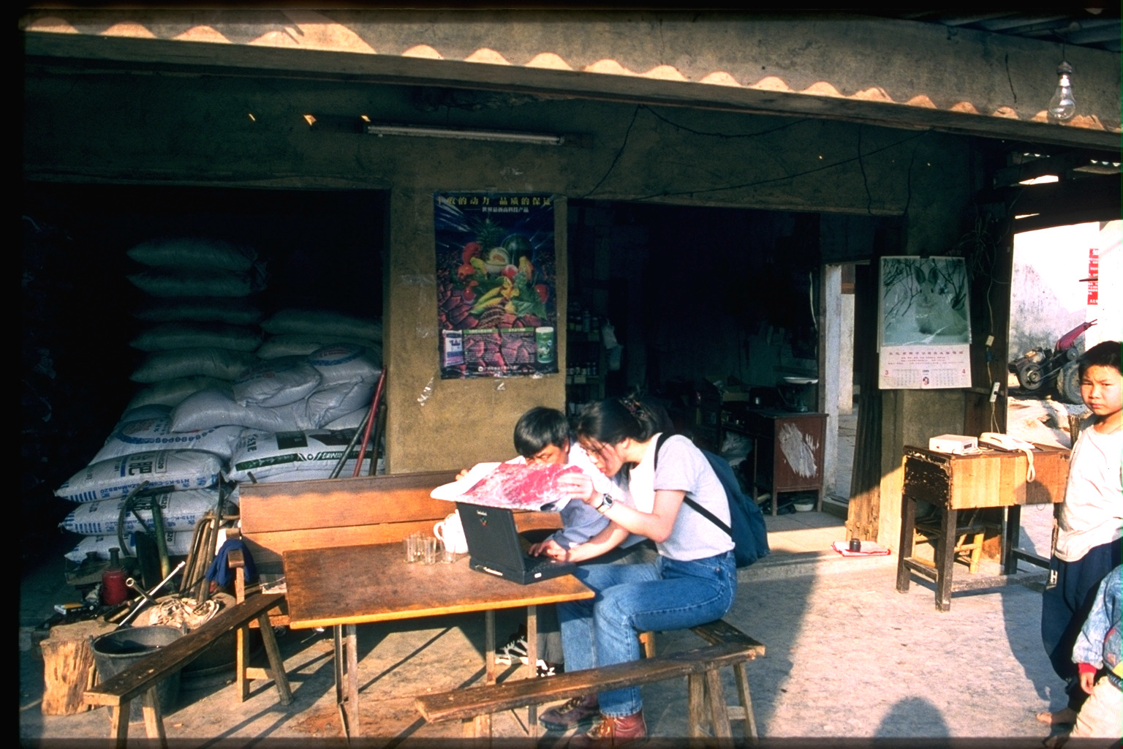

Slide 9
Seto et al., 2001. IJRS

Slide 10
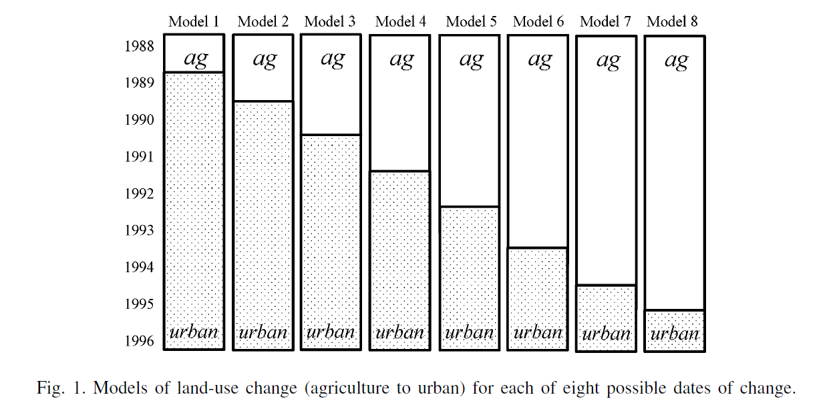
Time Series Analysis
Kaufmann and Seto, 2001. Agriculture, Ecosystems and Environment

Slide 11
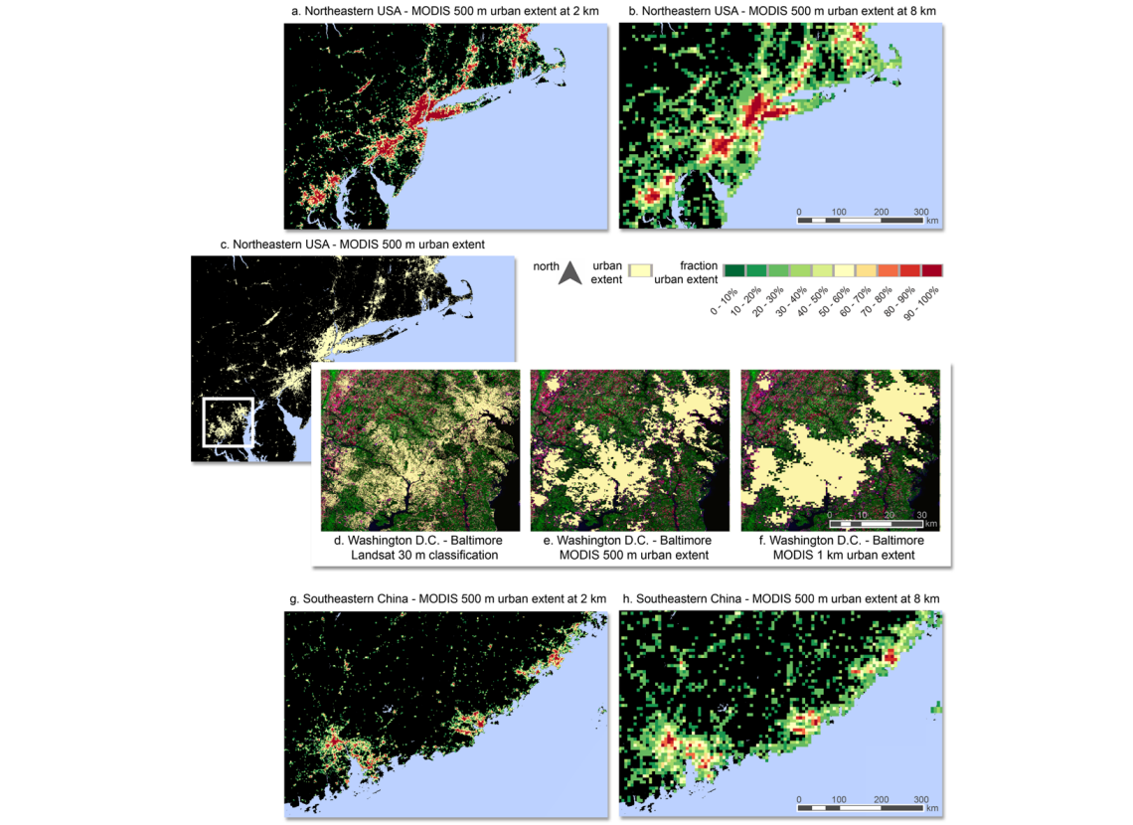
Global Urban Land Cover Maps
Schneider et al., 2009. ERL

Slide 12
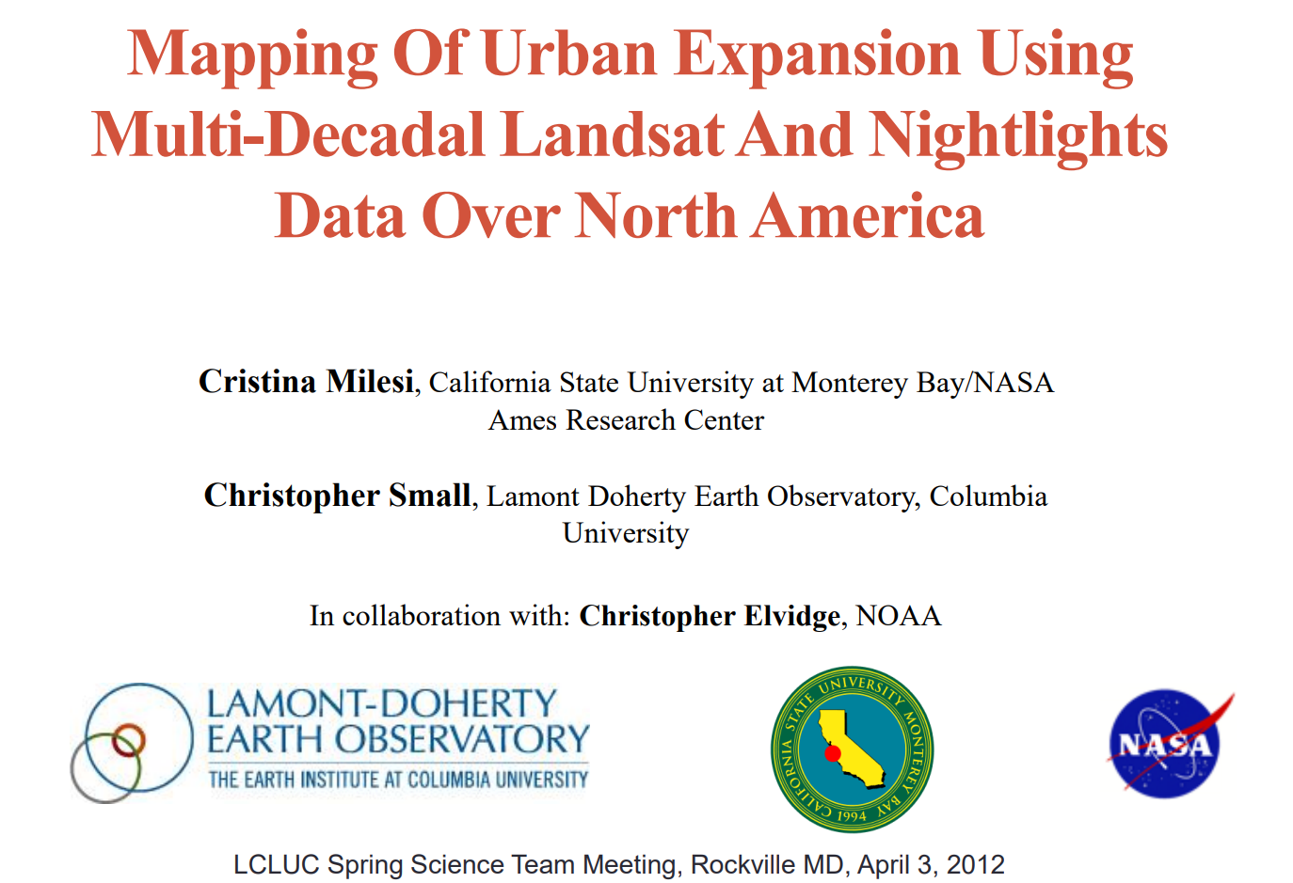

Slide 13
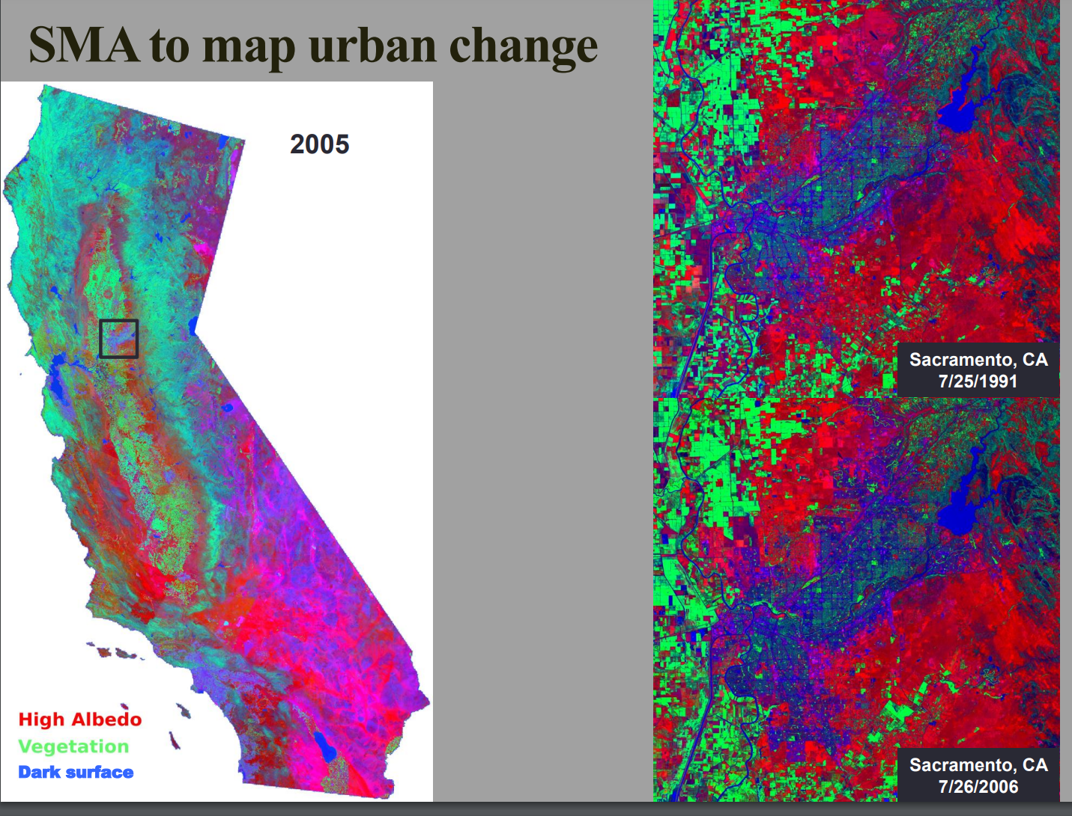
Milesi and Small, LCLUC Meeting 2012

Slide 14
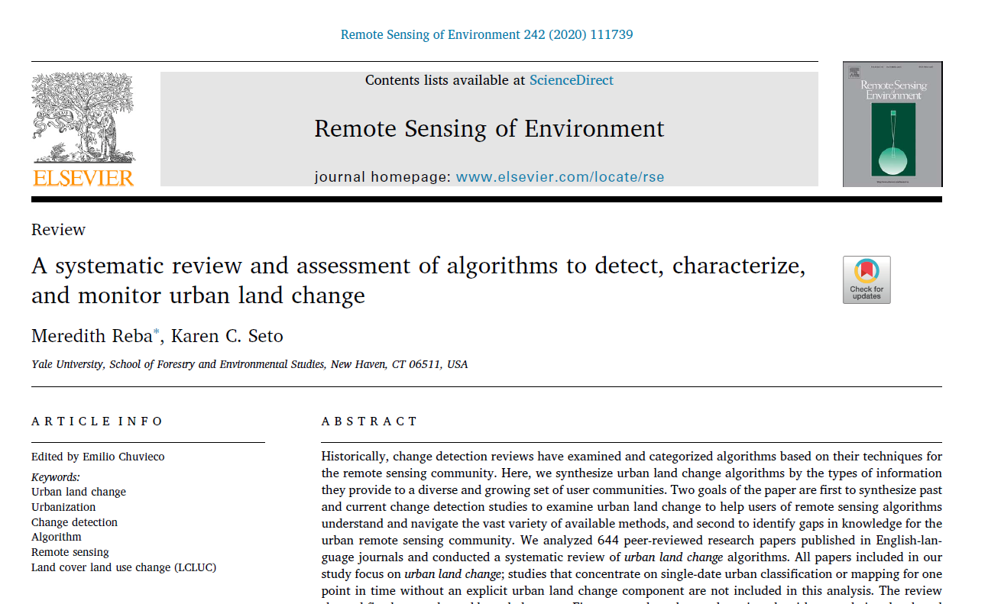

Slide 15
We disproportionately study large cities
41% algorithms: cities > 5+M
80% algorithms: cities > 1+M
Reba and Seto, 2020. RSE

Slide 16
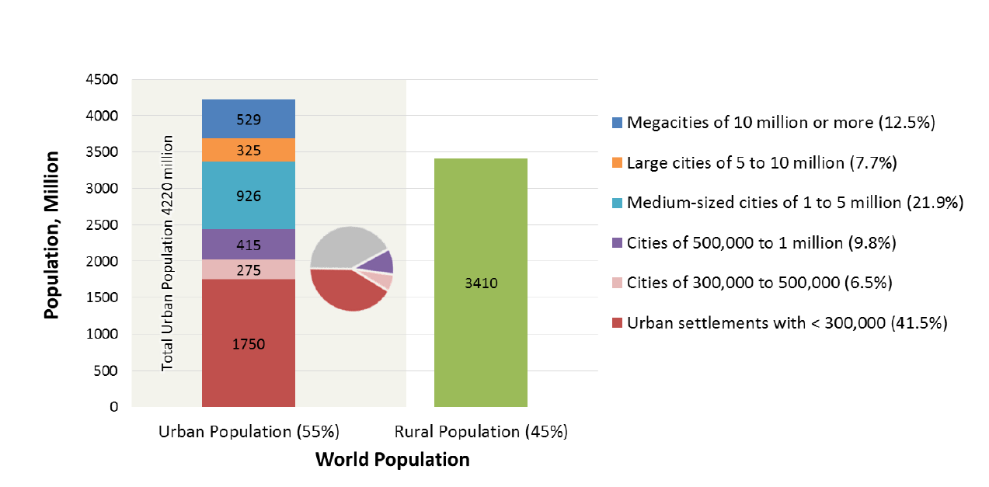
>50% of urban population <1M
IPCC AR6, 2022

Slide 17
What we’ve done so far
60% studies focus on China or the U.S.
75% studies focus on countries with high or upper-middle income levels
62% studies use 3 or fewer time points
63% papers focus on urban expansion
13% distinguish intra-urban change

Slide 18
Urban Remote Sensing 1.0
What’s changing?
How much, where, and why?
Distinguishing urban land use from land cover
Mapping urban extent
Mapping urban expansion

Slide 19
Where do we need to go?

Slide 20
Strategic Directions:
Urban Remote Sensing 2.0
Income levels and city sizes especially in the Global South

Slide 21
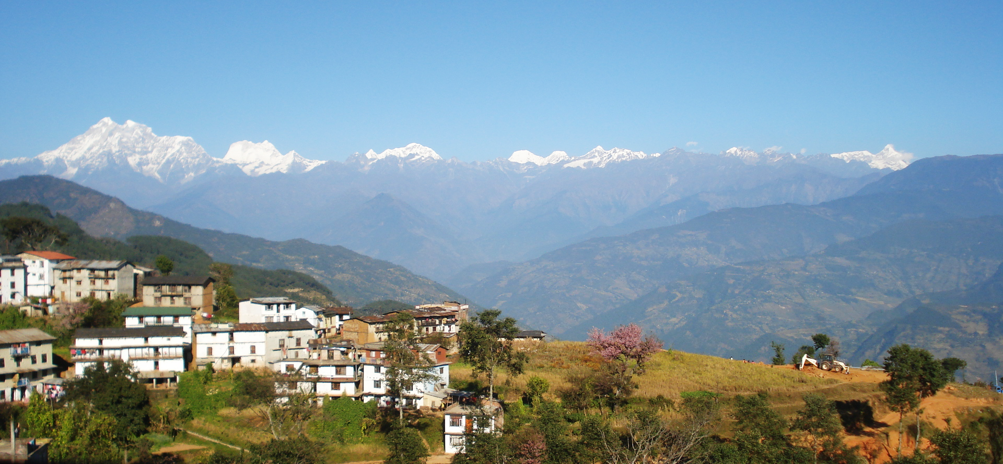
Charikot, Nepal
Photo: Raut Suresh
Notes:
Charikot 1990s

Slide 22
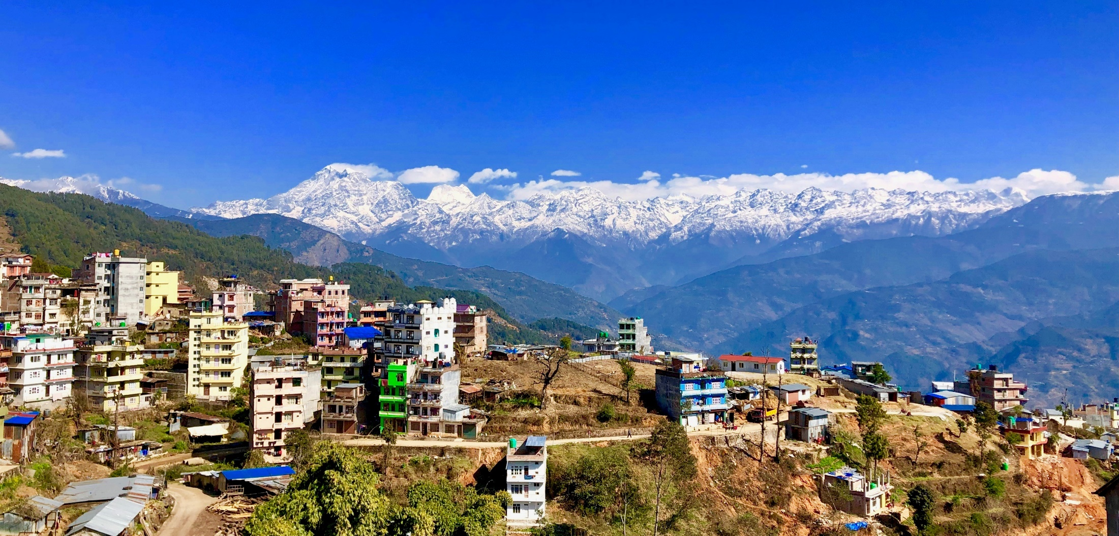
Charikot, Nepal
Photo: Raut Suresh
Notes:
Charikot 2010s

Slide 23
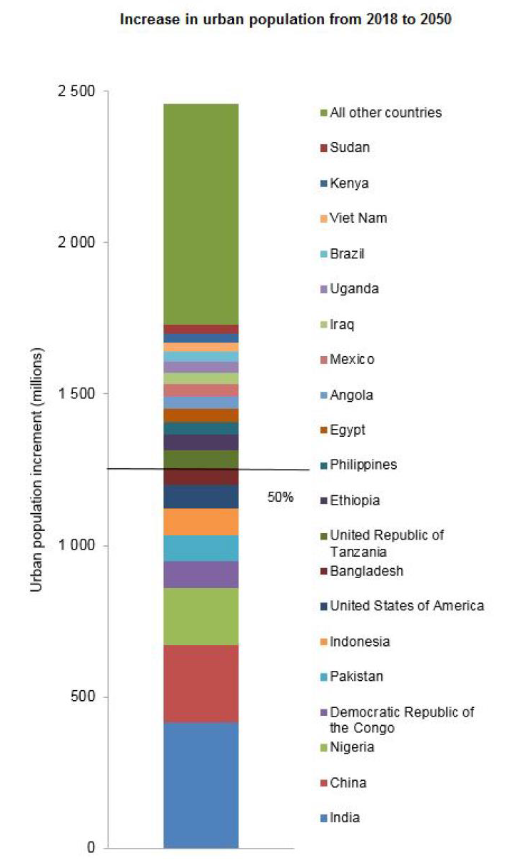
IPCC AR6, 2022

Slide 24
Strategic Directions:
Urban Remote Sensing 2.0
Income levels and city sizes especially in the Global South
Highly dynamic urban change

Slide 25
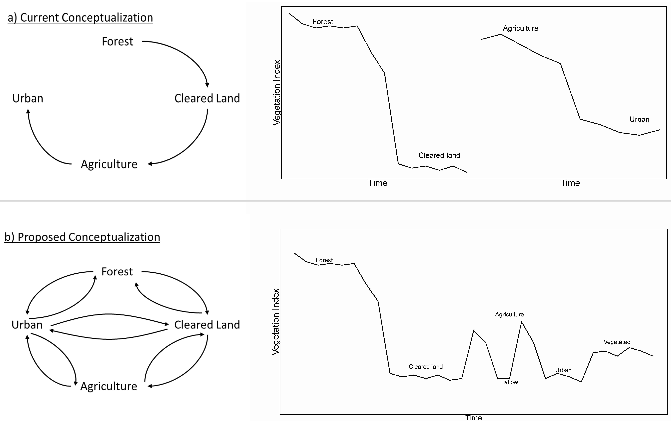
Pandey et al., 2018. J. Land Use Science

Slide 26
Pandey et al., 2018. J. Land Use Science

Slide 27
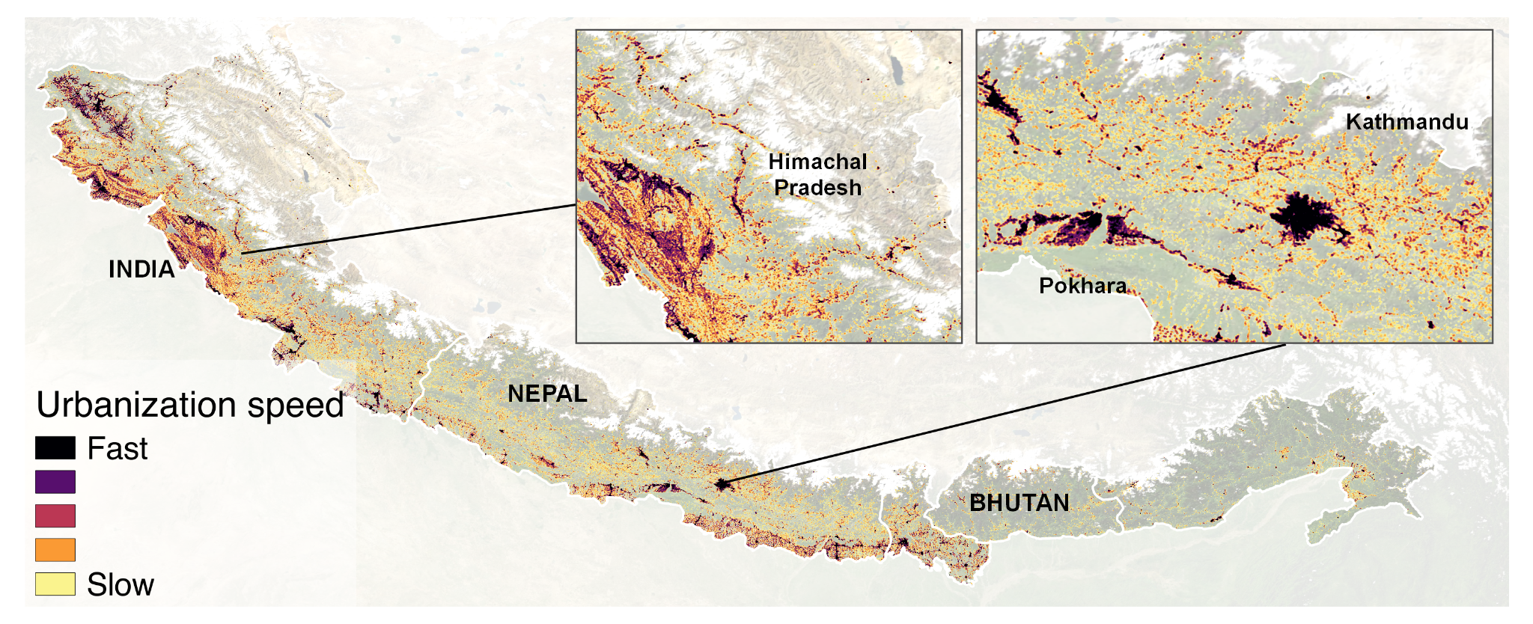
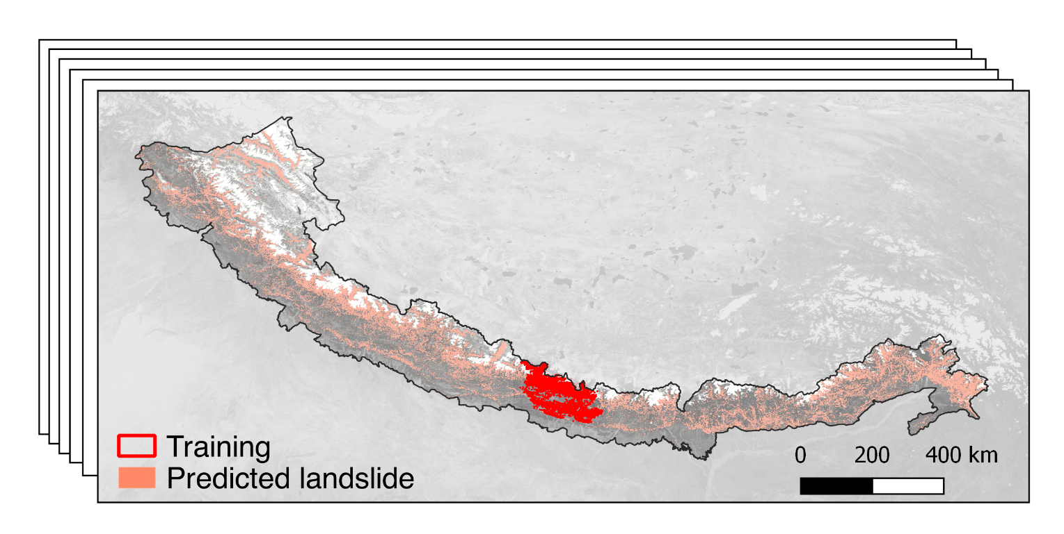
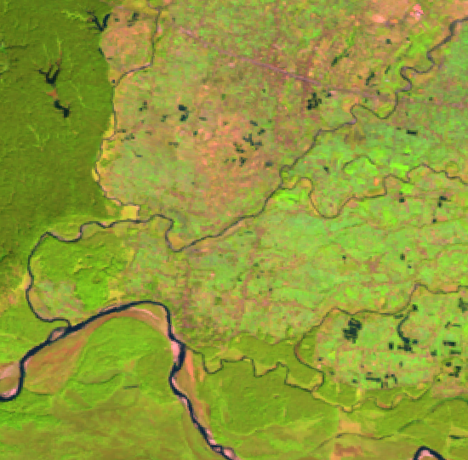
Dynamic urban change and landslide risk
Images 1992-2020
Time
Machine Learning
Time
Landslide inventories
1992-2020
Chen et al., In Progress

Slide 28
Strategic Directions:
Urban Remote Sensing 2.0
Income levels and city sizes especially in the Global South
Highly dynamic urban change
Intra- and inter-urban variability

Slide 29
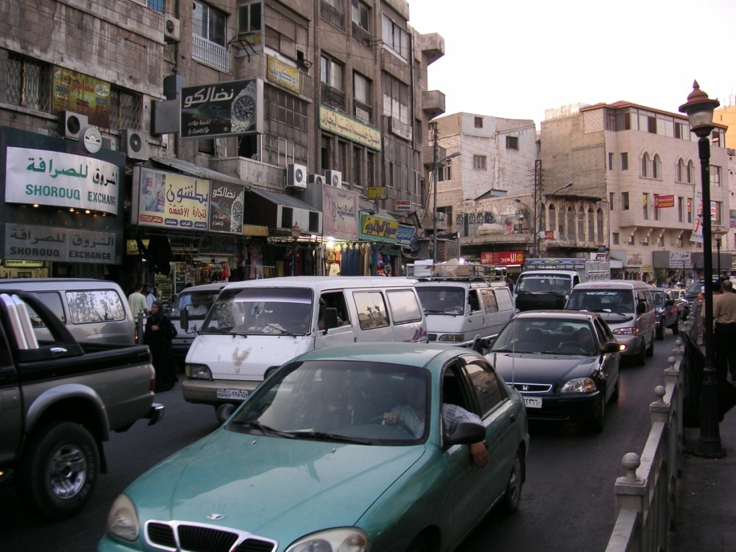
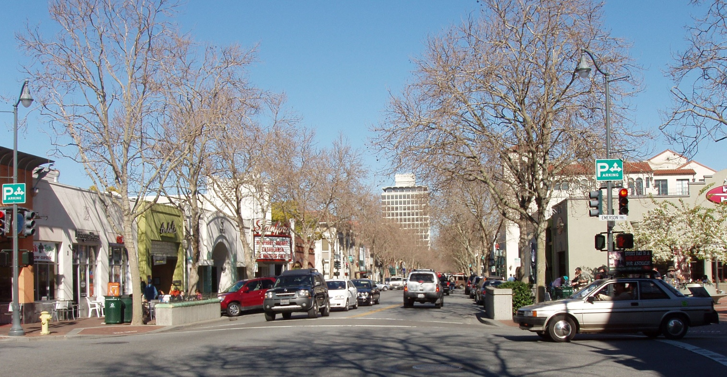
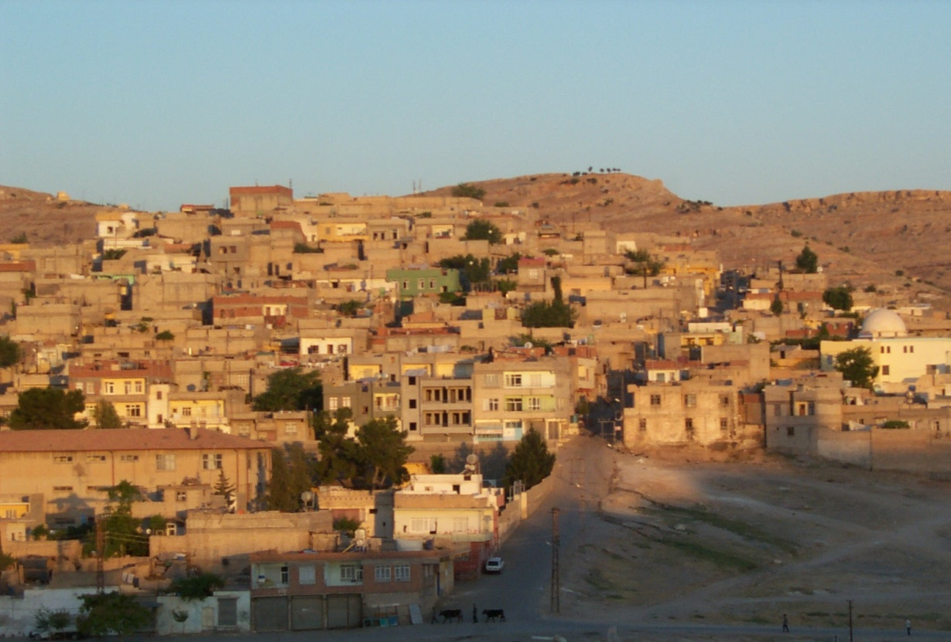
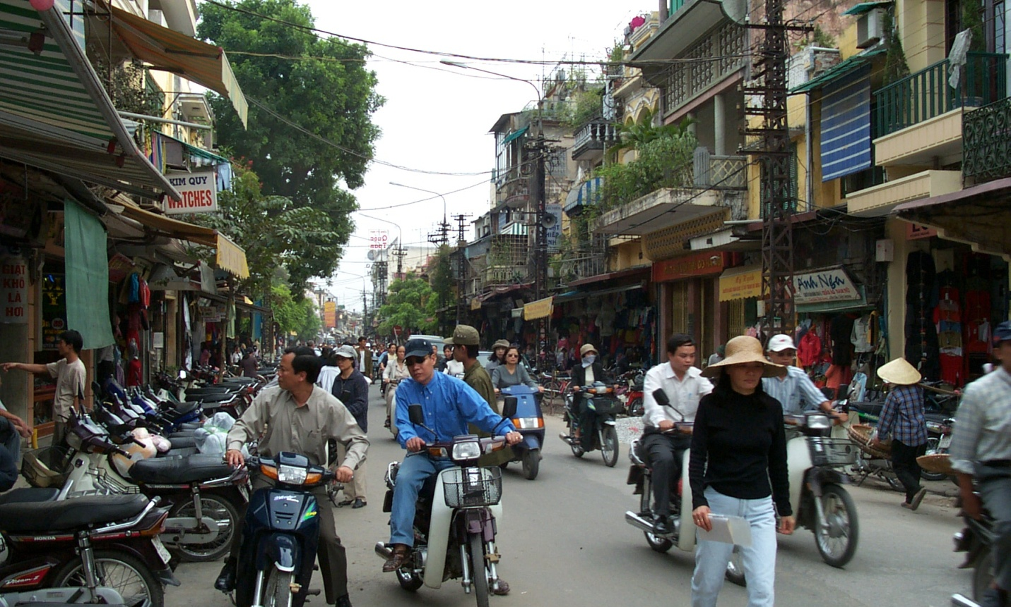

Slide 30
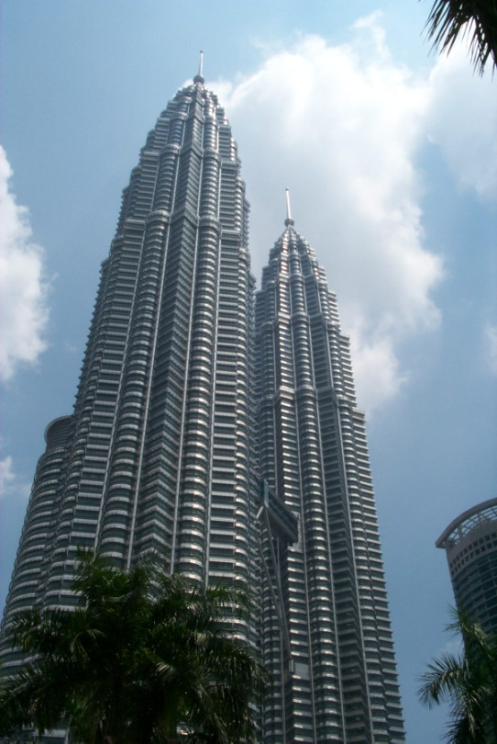
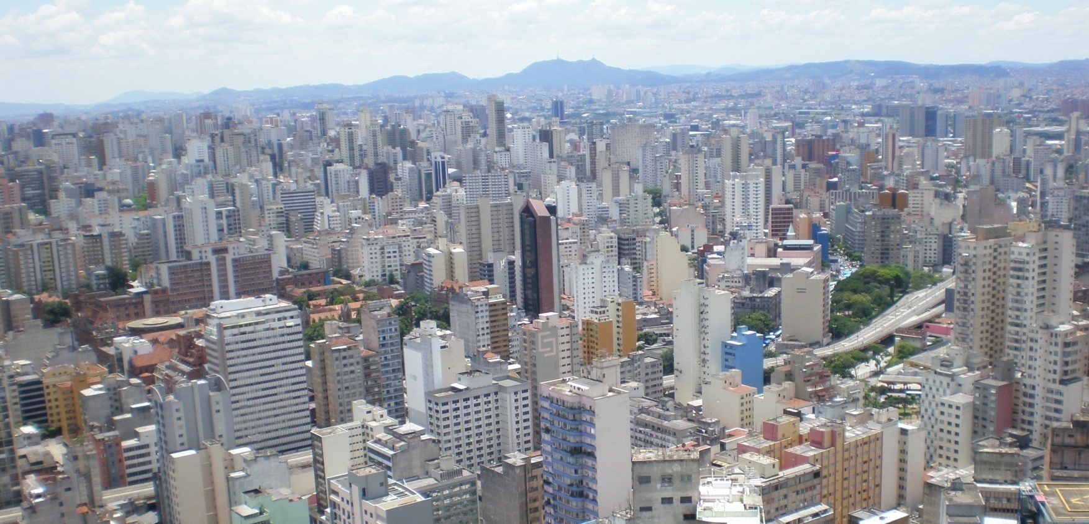
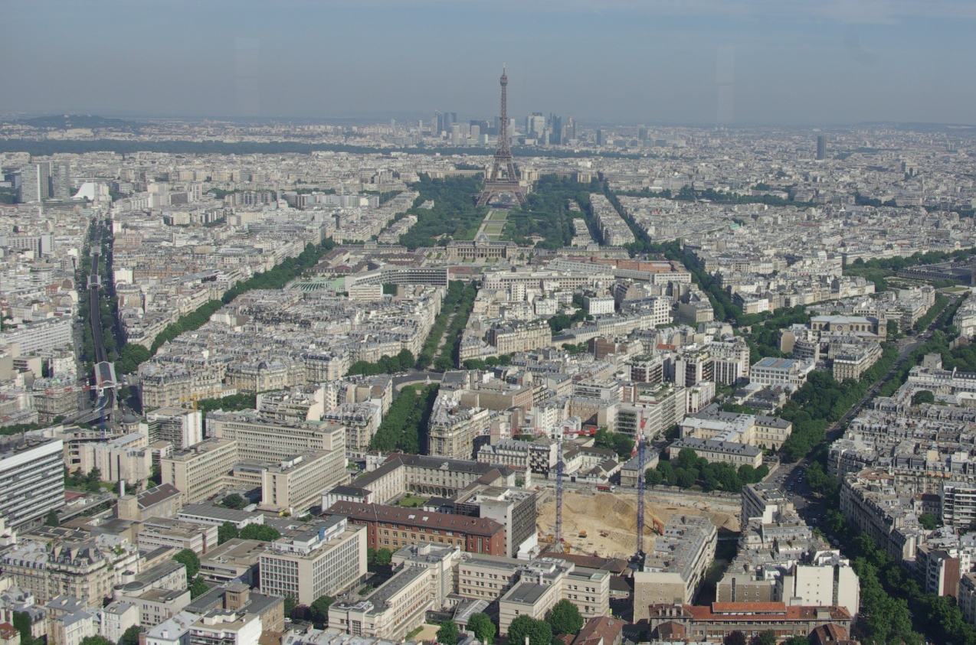
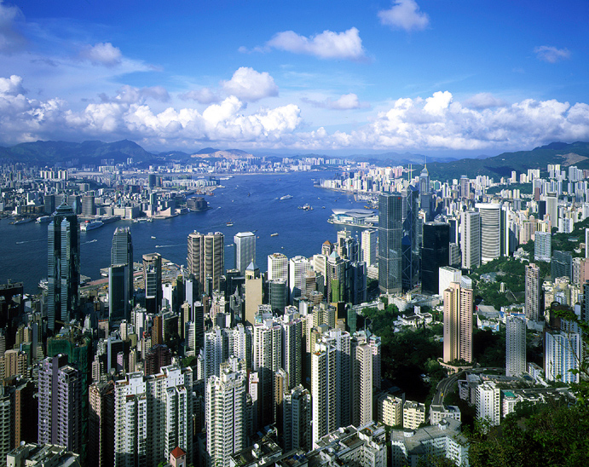

Slide 31
Strategic Directions:
Urban Remote Sensing 2.0
Income levels and city sizes especially in the Global South
Highly dynamic urban change
Intra- and inter-urban variability
Volumetric form

Slide 32
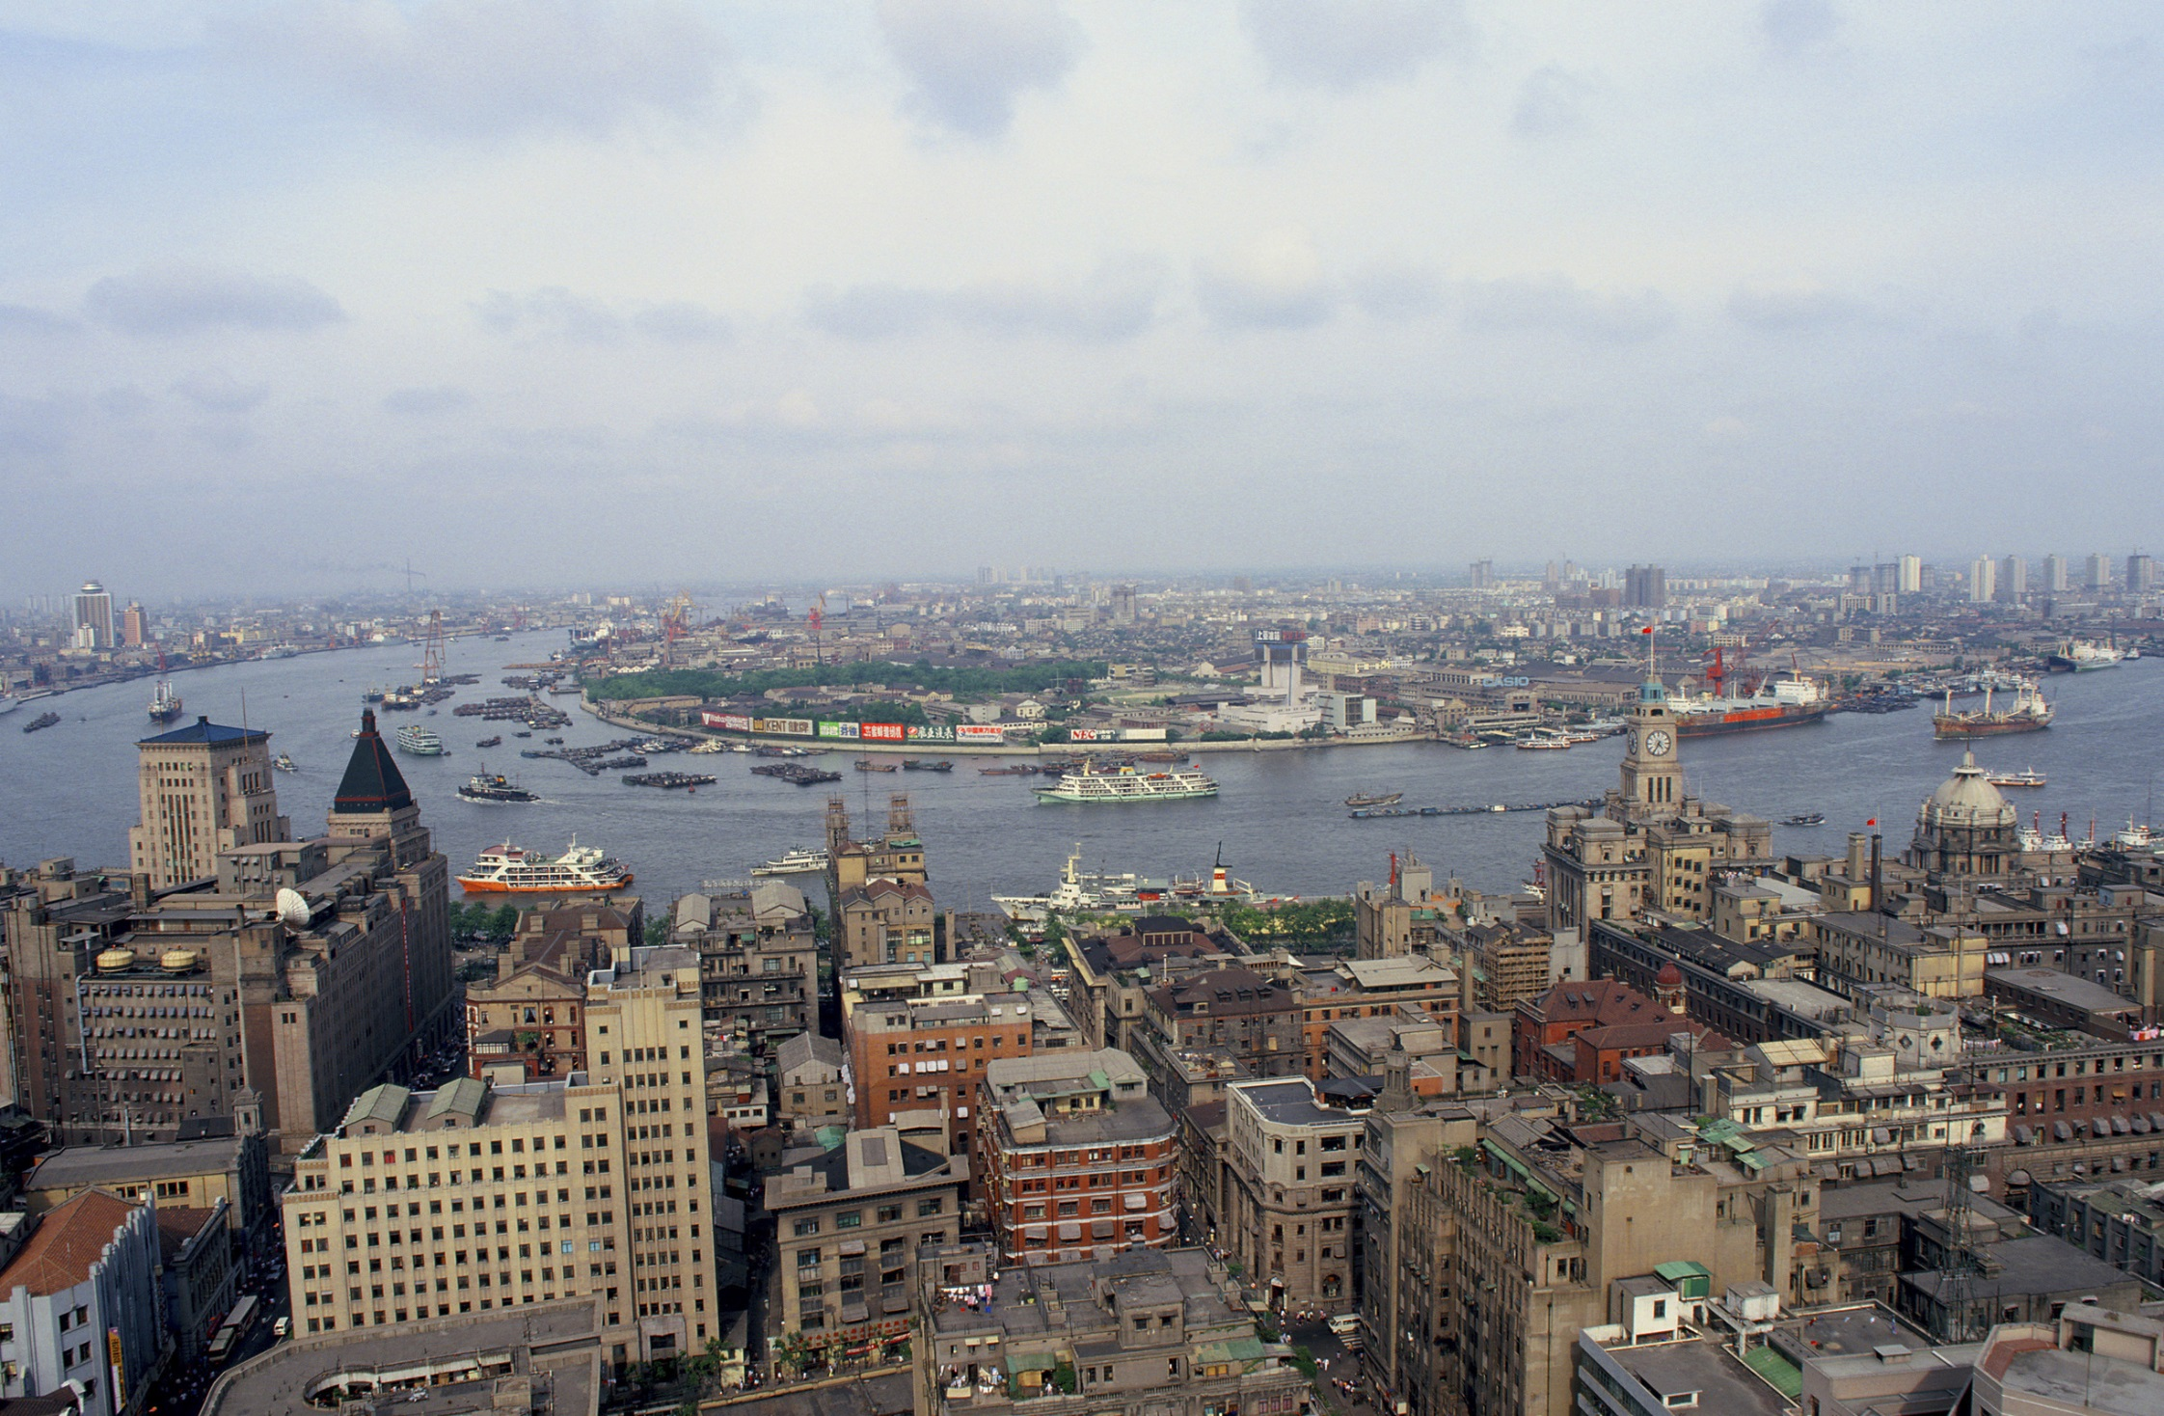

Slide 33
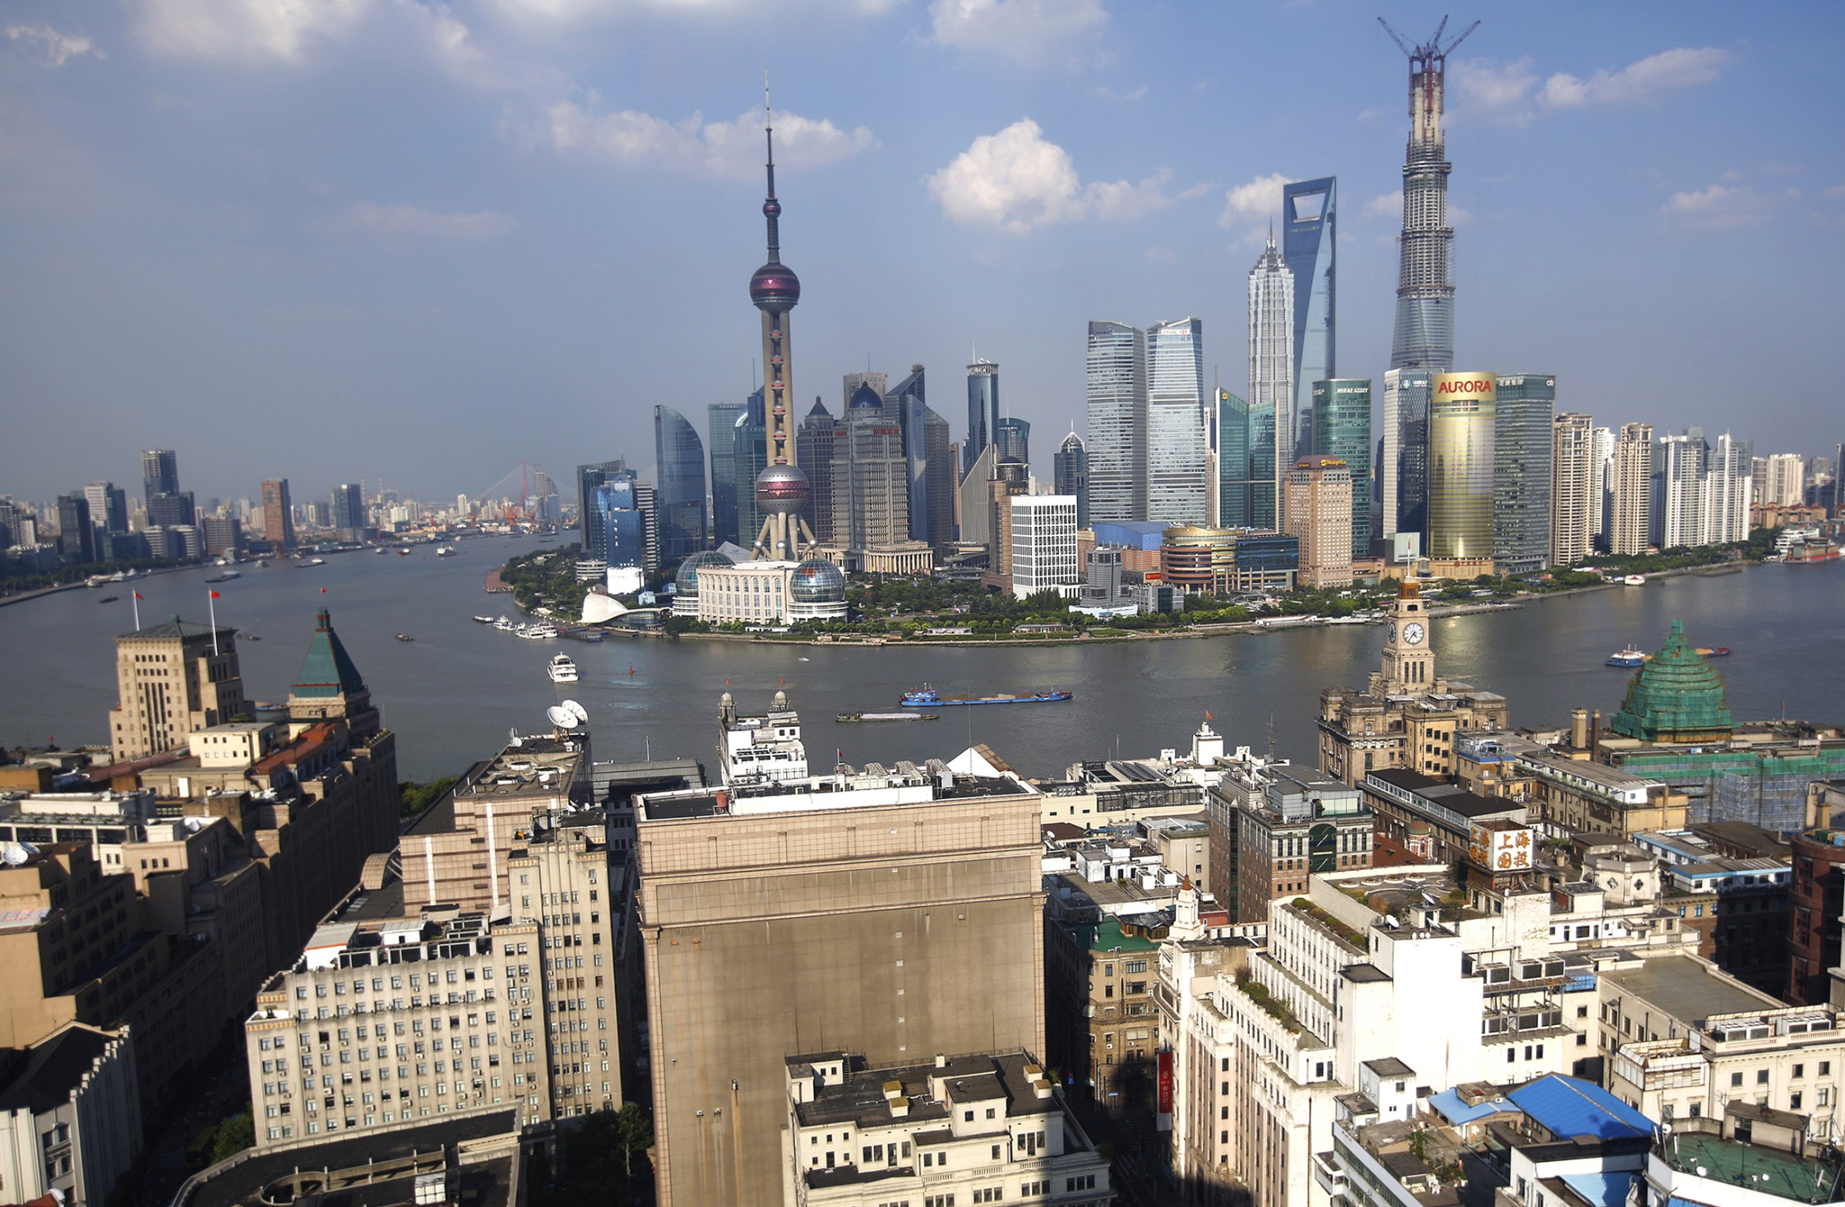

Slide 34
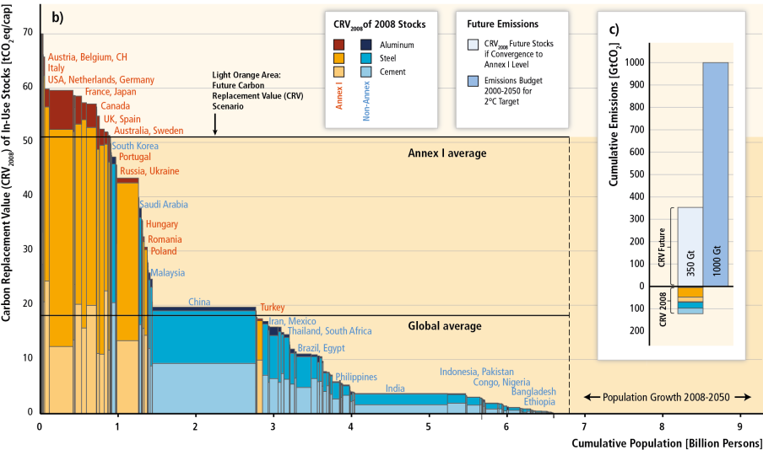
Why is urban volumetric change?
Total CO₂ emissions (per capita) needed to build up today’s infrastructure
Notes:
About CRV: Quoting Müller (2013):
In accounting, the value of an asset can be expressed, among others, as the historical cost (original monetary value) or as the replacement cost (cost of replacing an asset with current prices). Similarly, the carbon footprint of a stock can be defined as the historical emissions produced to build up the stock, or as the carbon emissions that would be generated if the existing stock was replaced using current technologies. As emissions per ton of material produced tend to decline, the replacement value expressed in carbon (here called “carbon replacement value, CRV”) is generally smaller than the historical value expressed in carbon (here called “CHV”). In this study, we determine the CRV of stocks, because this value is better suited when using the stocks in industrialized countries as a benchmark for stocks in developing countries.
The CRV_{P} was determined for the year 2008 using the three key materials steel, cement, and aluminum as a proxy. In 2008, these materials accounted for nearly half of industrial emissions (25% steel, 19% cement, and 3% aluminum) and 17% of total energy- and process-related CO₂ emissions.16 Emissions of other materials are either less significant for infrastructure stocks (e.g., plastic and paper, which together constitute about 3% energy- and process-related emissions) or contribute significantly smaller amounts of emissions (e.g., other metals, gravel).
Talking points:
Concerning emissions from building urban structures (building up stocks) it is important to understand the magnitude of future emissions awaiting us if the developing world would mimic the pathway western countries have taken.
The y-axis shows the amount of emissions (per person) needed to build the infrastructures (houses, transport (streets, railways, bridges), industry plants) existing in respective countries. You can see that developed countries (Annex I) have a far greater stock than Non-Annex I countries.

Slide 35
Building future urban infrastructure
may exceed remaining carbon budget
Future CO₂ emissions if developing countries catch up to average developed country level.
Notes:
Talking points:
The shaded area shows how much emissions would be needed to build in the rest of the world infrastructure of the level as existing today in developed countries. This rough estimate takes the expected increase of world population until 2050 into account (see x-axis). Compare the size of this area to the yellow-red coloured bars to see that these emissions would far outstrip the emissions needed to build up today’s infrastructure.

Slide 36
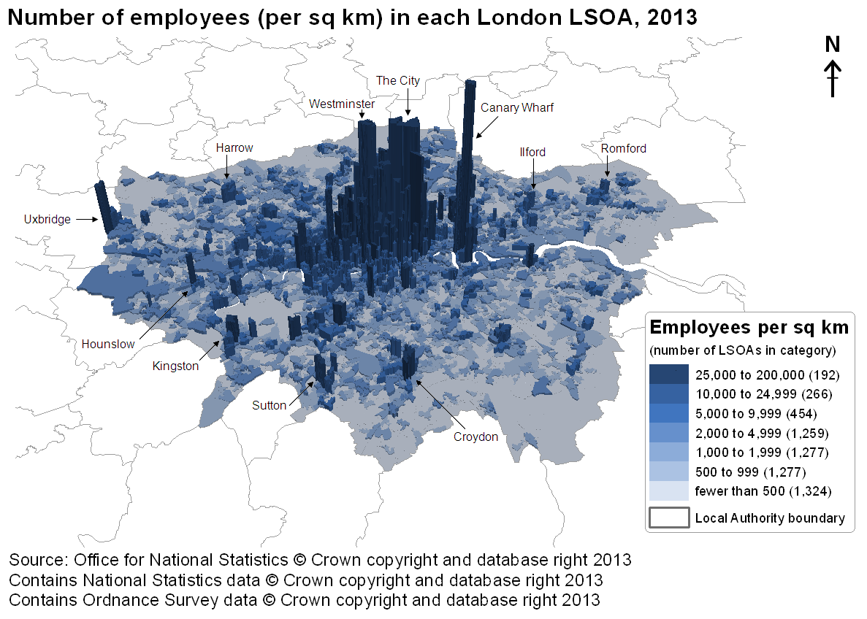
Urban volume proxies economic activities

Slide 37
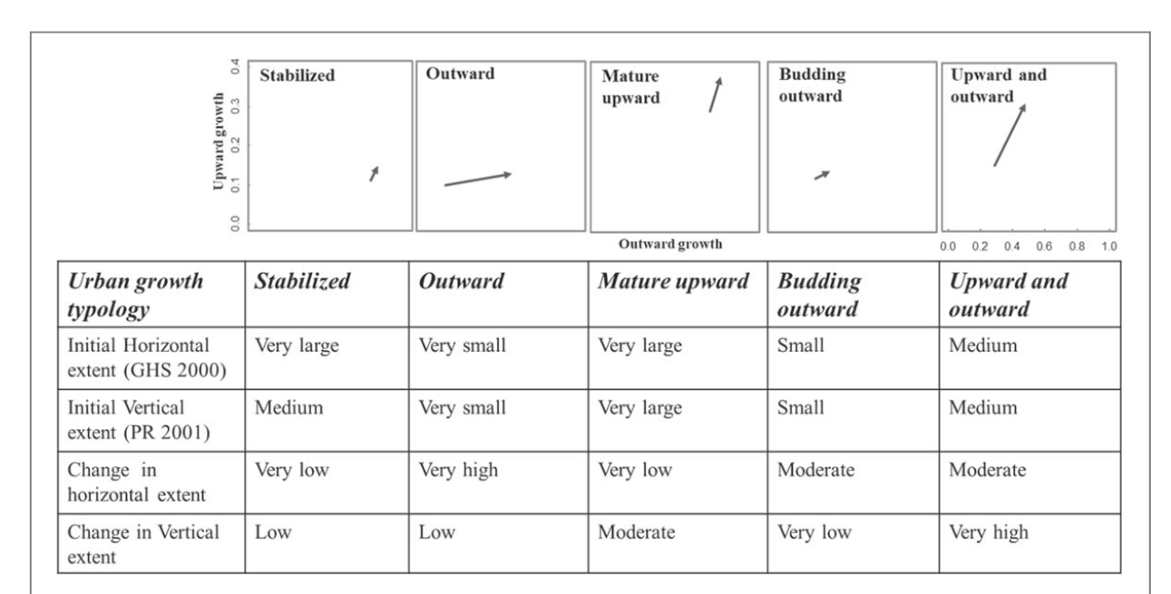
Urban volumetric change
Mahtta et al., 2020. ERL

Slide 38
Strategic Directions:
Urban Remote Sensing 2.0
Income levels and city sizes especially in the Global South
Highly dynamic urban change
Intra- and inter-urban variability
Volumetric form
Building urban science to inform policy

Slide 39
Two opportunities for urban LCLUC

Slide 40
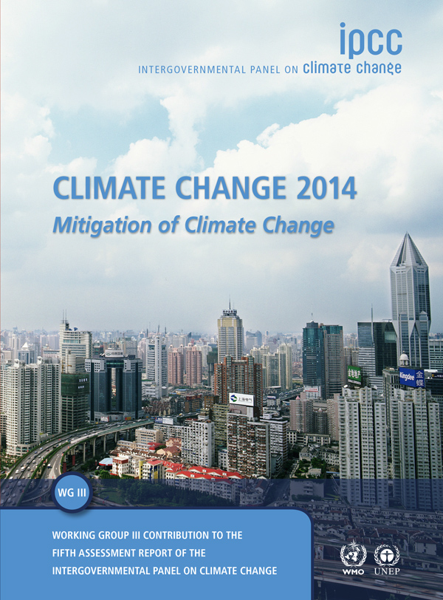
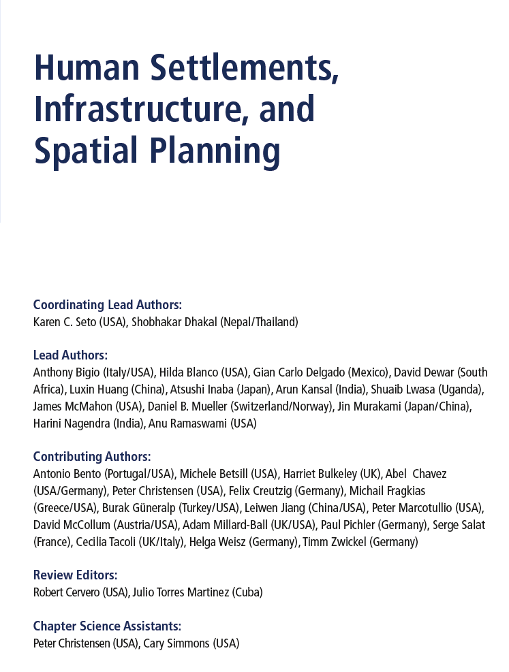

Slide 41
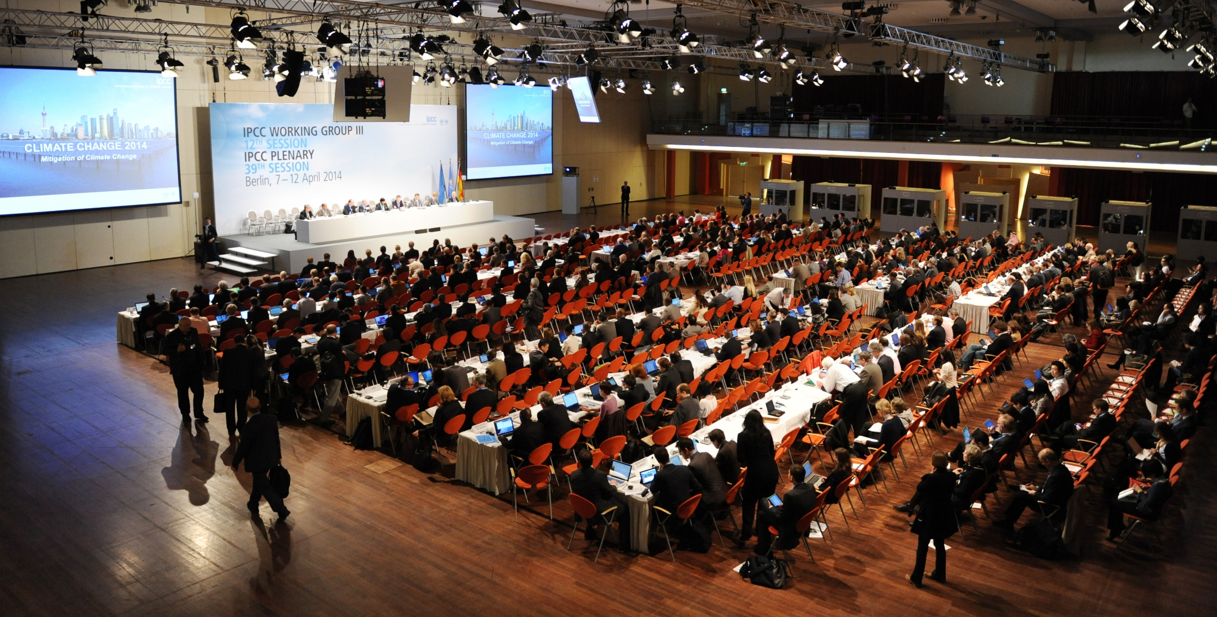
IPCC 5th Assessment Report Approval Plenary (2014)

Slide 42
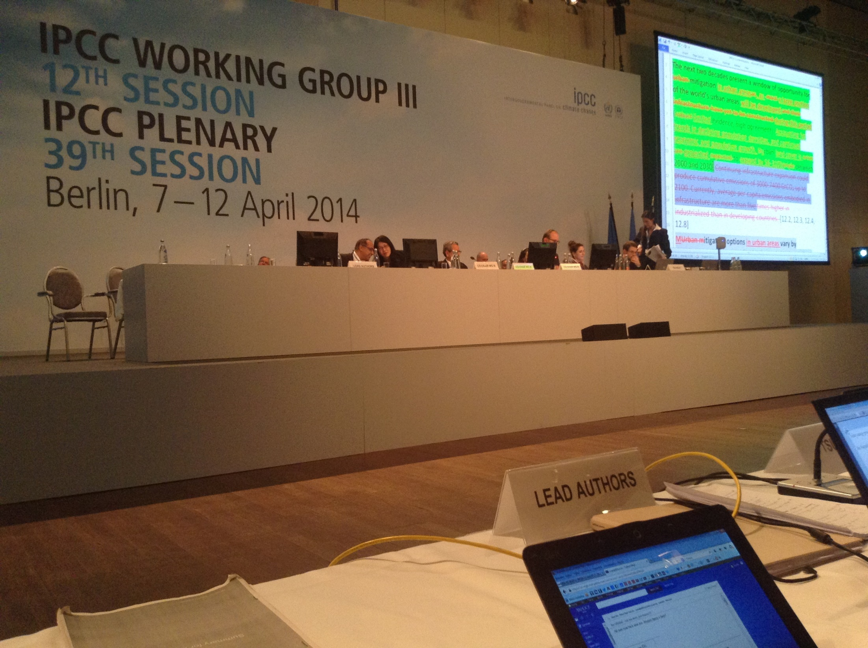
IPCC 5th Assessment Report Approval Plenary (2014)

Slide 43
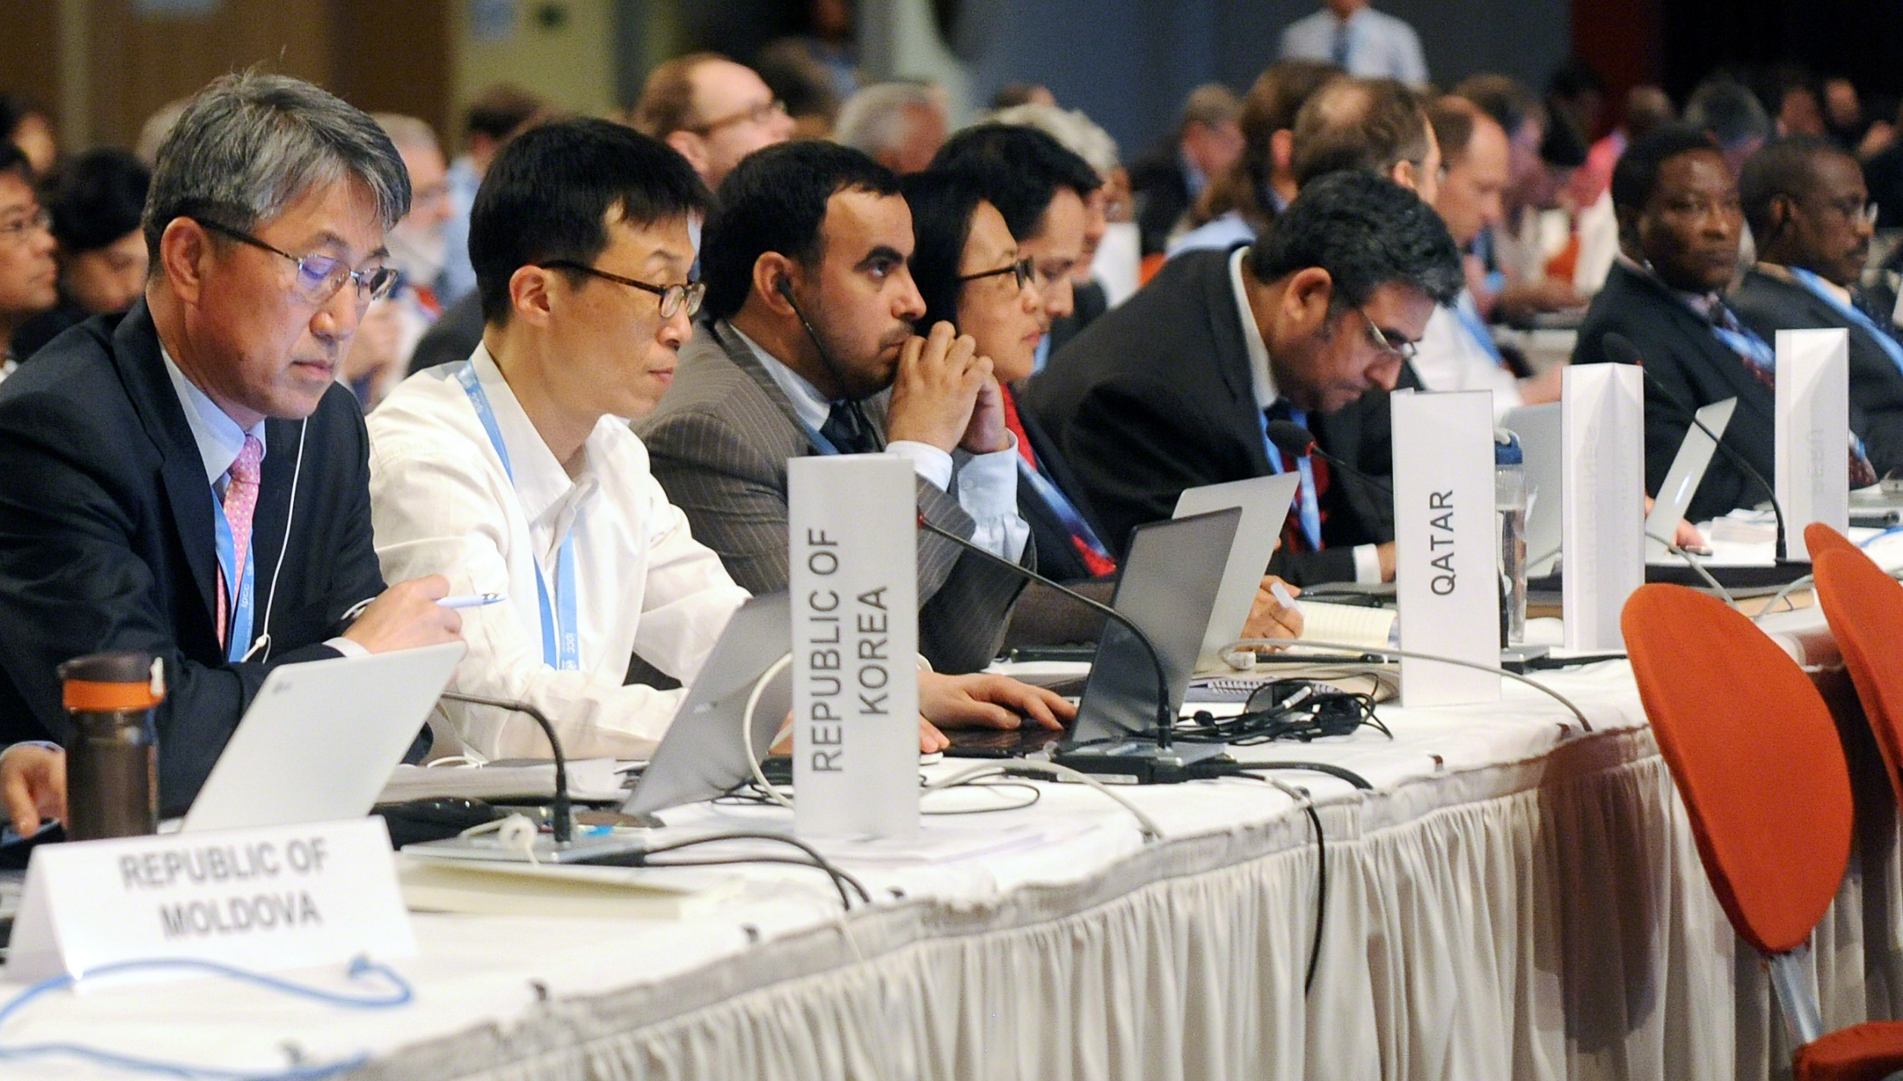
IPCC 5th Assessment Report Approval Plenary (2014)

Slide 44
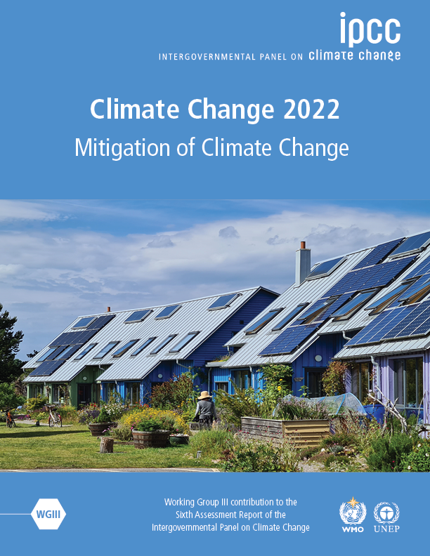
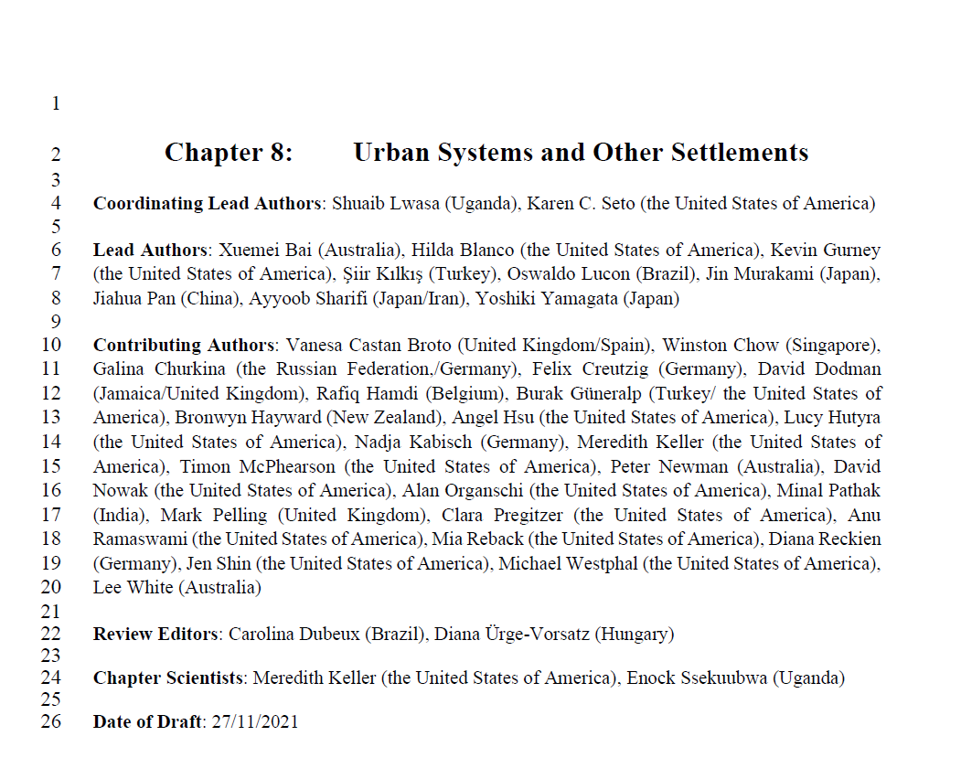

Slide 45
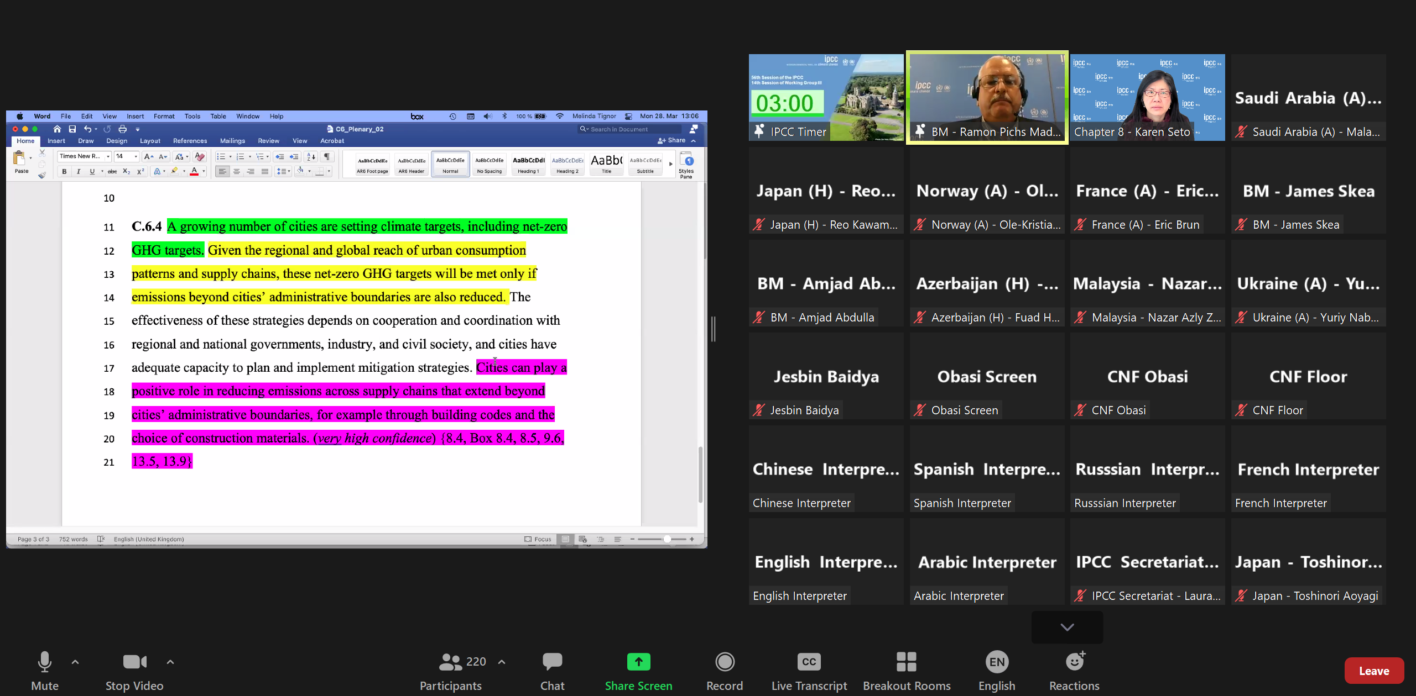
IPCC 6th Assessment Report Approval Plenary (2022)

Slide 46
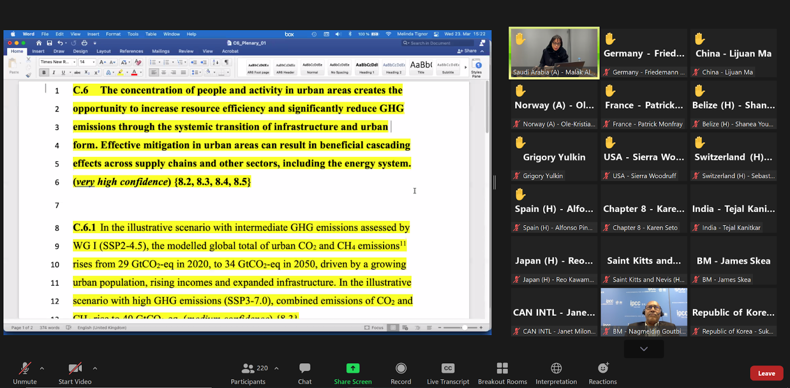
IPCC 6th Assessment Report Approval Plenary (2022)

Slide 47
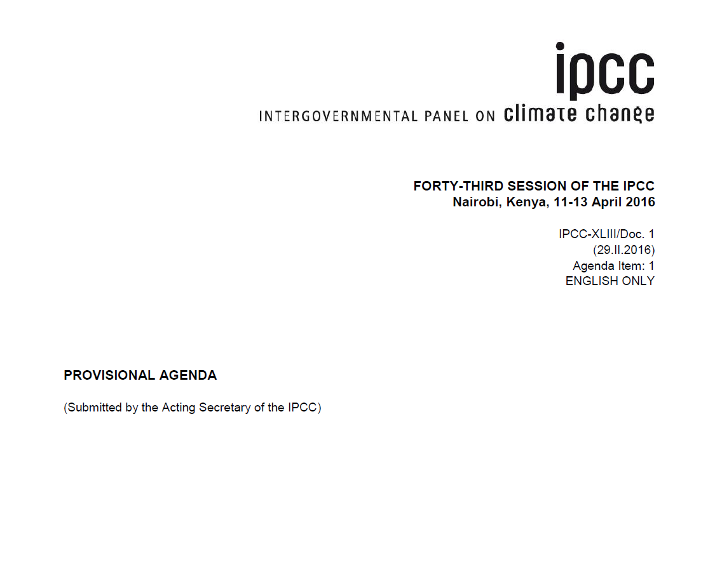

Slide 48

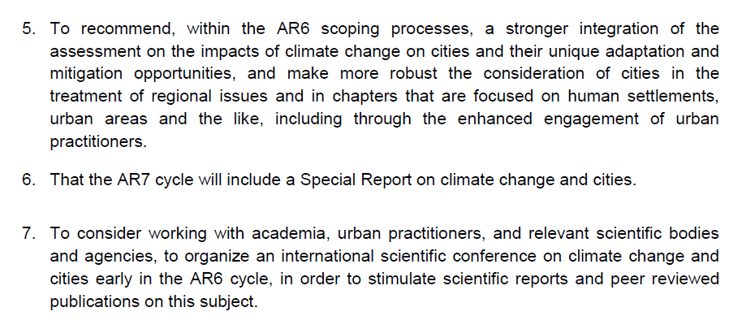

Slide 49
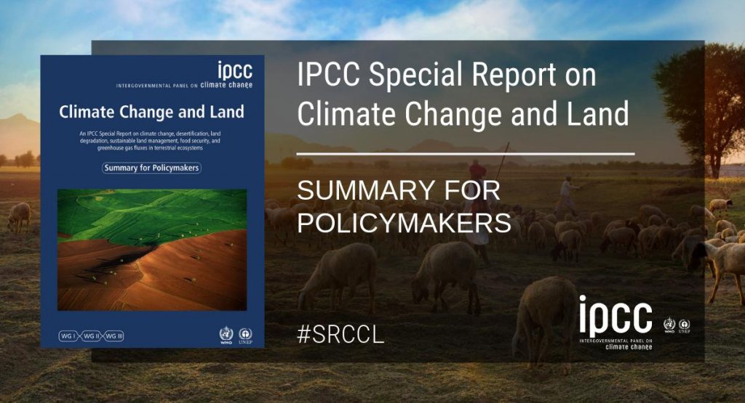

Slide 50
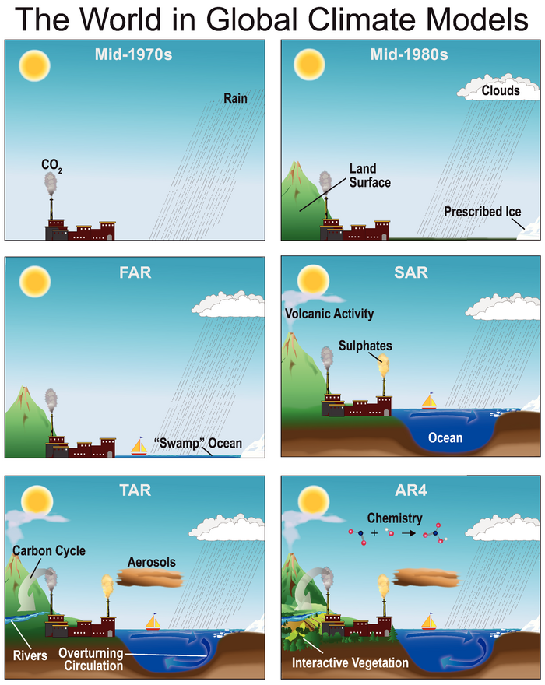
Urban systems
are missing
Source: IPCC AR4, Fig 1.2

Slide 51
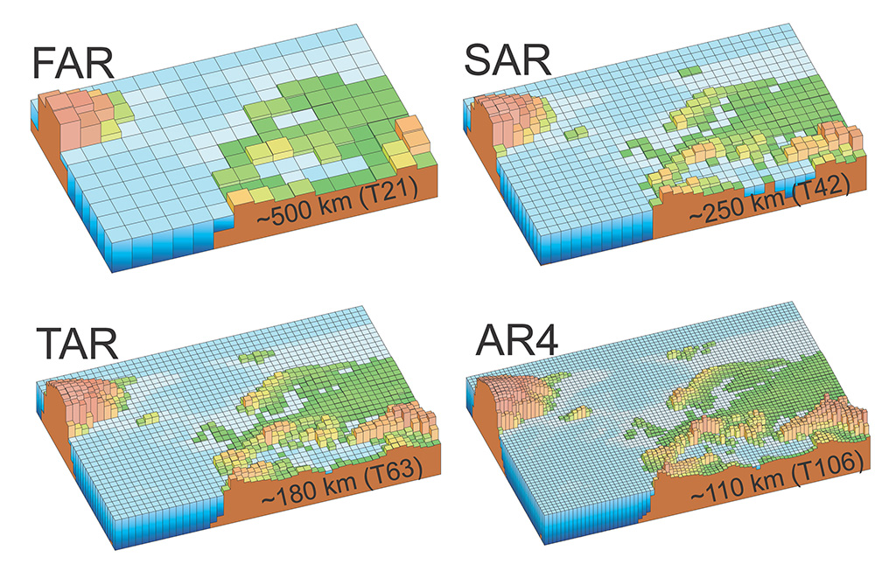
Urban systems
are missing
Source: IPCC AR4, Fig 1.2

Slide 52
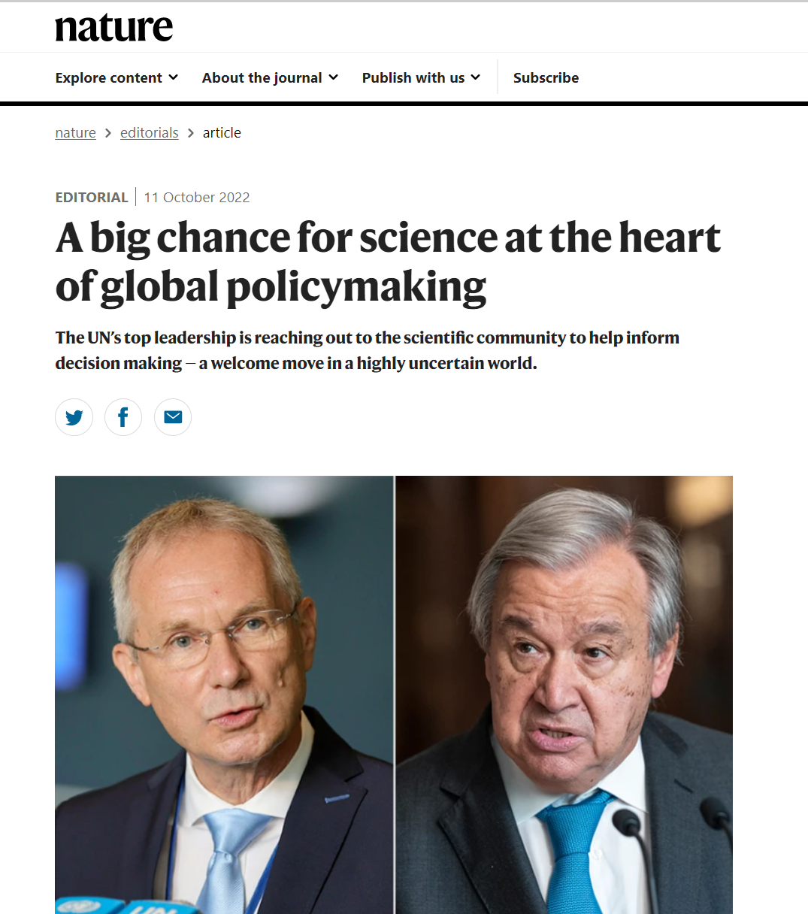

Körösi said he wants scientists to help the General Assembly with
“knowledge from microscopes to microphones”
Csaba Körösi António Guterres
President General Secretary
UN General Assembly UN
Notes:
Csaba Körösi

Slide 53
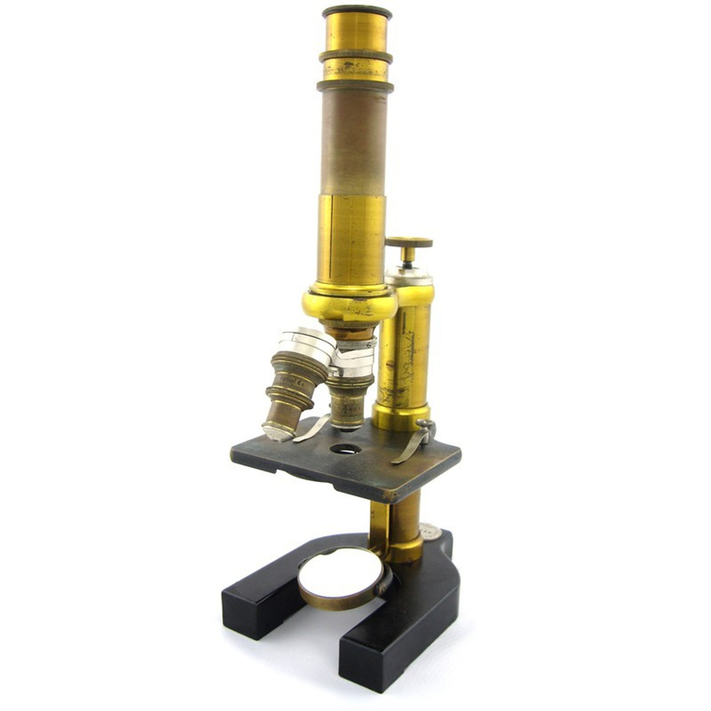
Notes:
History is replete with technological inventions that changes out societies view the world and subsequently understand it. The microscope fundamentally transformed our ability to see more than with the naked eye. We are in a similar transformative time in human history.
The widespread availability of remote sensing data from satellites orbiting Earth

Slide 54
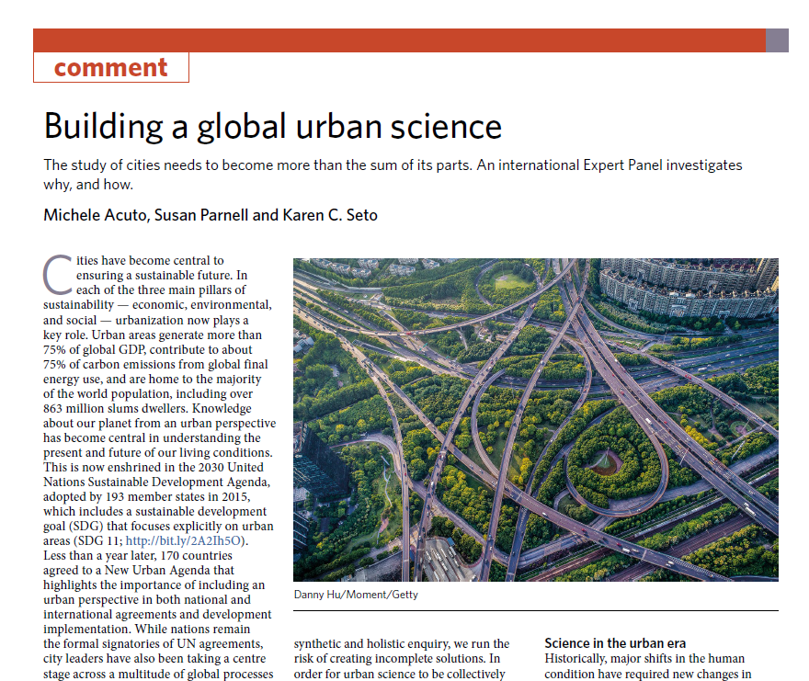

Acuto et al., 2018. Nat. Sus.

Slide 55
Thank you for your attention
Karen C. Seto
LCLUC 25th Anniversary Science Team Meeting
October 18-20, 2022
October 18-20th, 2022

