Slide 1
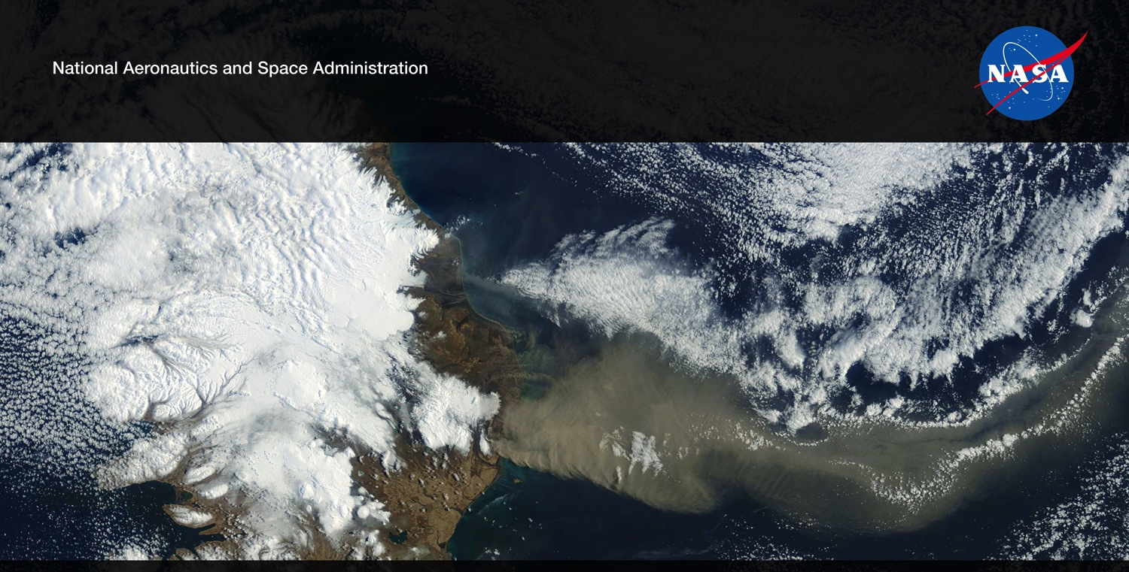
Future US Land Imaging Jeffrey Masek, NASA GSFC
Harmonized Landsat/Sentinel-2 (HLS) Update
Jeff Masek, Junchang Ju, Eric Vermote, NASA GSFC
Martin Claverie, Jean-Claude Roger, Sergii Skakun, University of Maryland
Jennifer Dungan, NASA ARC
LCLUC - April 14 2017
NASA Agency Update – CEOS LSI-VC-2
July 20-22, 2016
Dave Jarrett, NASA HQ
Jeff Masek, NASA GSFC

Slide 2
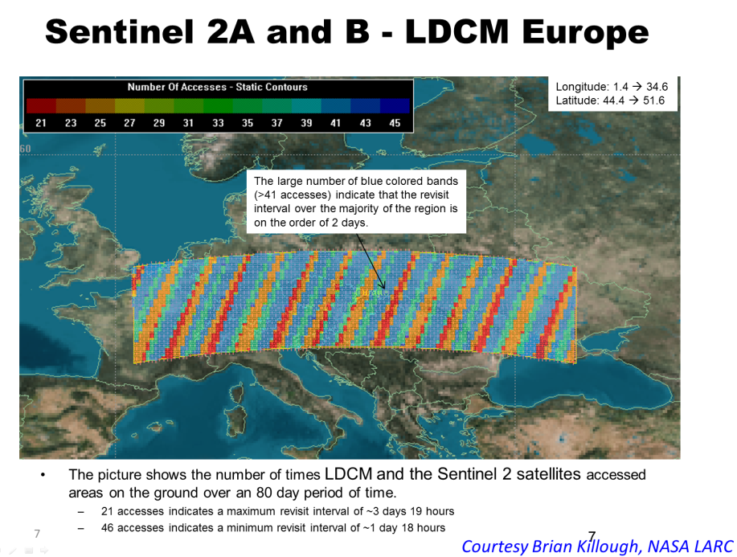
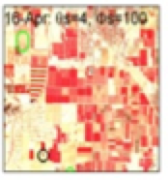
Harmonized Landsat Sentinel-2 (HLS) Project
Merging Sentinel-2 and Landsat data streams can provide 2-3 day global coverage
Goal is “seamless” near-daily 30m surface reflectance record including atmospheric corrections, spectral and BRDF adjustments, regridding
Project initiated as collaboration among GSFC, UMD, NASA Ames

Slide 3
HLS Test Sites
69 Test sites (45 from MuSLI team)
783 MGRS tiles
>7.5 million sq. km2
Landsat-8 data set: 147k products From Mar-2013 to Dec-2016
Sentinel-2 data set: 47k products From Jun-2015 to Dec-2016
Alaska / NW Canada: 16
NE Asia: 11
Europe: 15
(w/o Germ.)
Germany: 62
S Asia: 122
Africa: 6 (w/o SA and TZ)
North America: 95
Tanzania: 121
South America: 28
South-Africa: 166
SE Australia: 141
Online Request Form
https://hls.gsfc.nasa.gov/ test-sites/propose-a-new-site/

Slide 5
HLS Algorithms overview and status
Landsat-8 (L1T)
Geographic registration
Sentinel-2 (L1C)
Atmospheric Correction
Atmospheric Correction
S10 (MSI SR 10m)
Geometric Resampling
Offset
coefficients
Geometric Resampling
L30
(OLI SR 30m)
BRDF Adjustment
BRDF Adjustment
Temporal Compositing
Band Pass Adjustment
S30
(MSI NBAR 30m)
M30
(5-day composite NBAR)
Algorithm | Current (V1.2) | Other Options
Geographic registration | AROP (Gao et al. 2009, JARS) | -
Atmospheric Correction | OLI and MSI: Landsat-8 6S algorithm | CNES MACCS
Cloud/Shadow Mask | OLI: Landsat-8 6S algorithm output MSI: BU MSI Fmask | CNES MACCS
BRDF Adjustment | Fixed BRDF (Roy et al. 2016, RSE) | Downscaling MODIS BRDF + Fixed BRDF as Backup
Band Pass Adjustment | Fixed, per-band linear regression | Regression-tree (based on spectral shape)
Temporal Compositing | TBD | -

Slide 6
S2 / L8 Registration Issues
Mis-registration between Landsat and Sentinel-2
Up to 35m mismatch due to some areas of relatively poor Landsat ground control (Storey et al, 2016, RSE)
Magnitude of problem varies around the globe
USGS will improve Landsat ground control in ~2018-19
For now, users can use automated cross-correlation algorithms to co-register and/or resample L8 to S2.
Mis-registration among early Sentinel-2
S2a data (processed before June 2016) showed relative misregistration between adjacent orbits
Error in yaw payload processing
Corrected with Sentinel-2 v2.04 processing
HLS uses a single Sentinel-2 image as reference for each time series & AROP to co-register (see next slide)

Slide 7
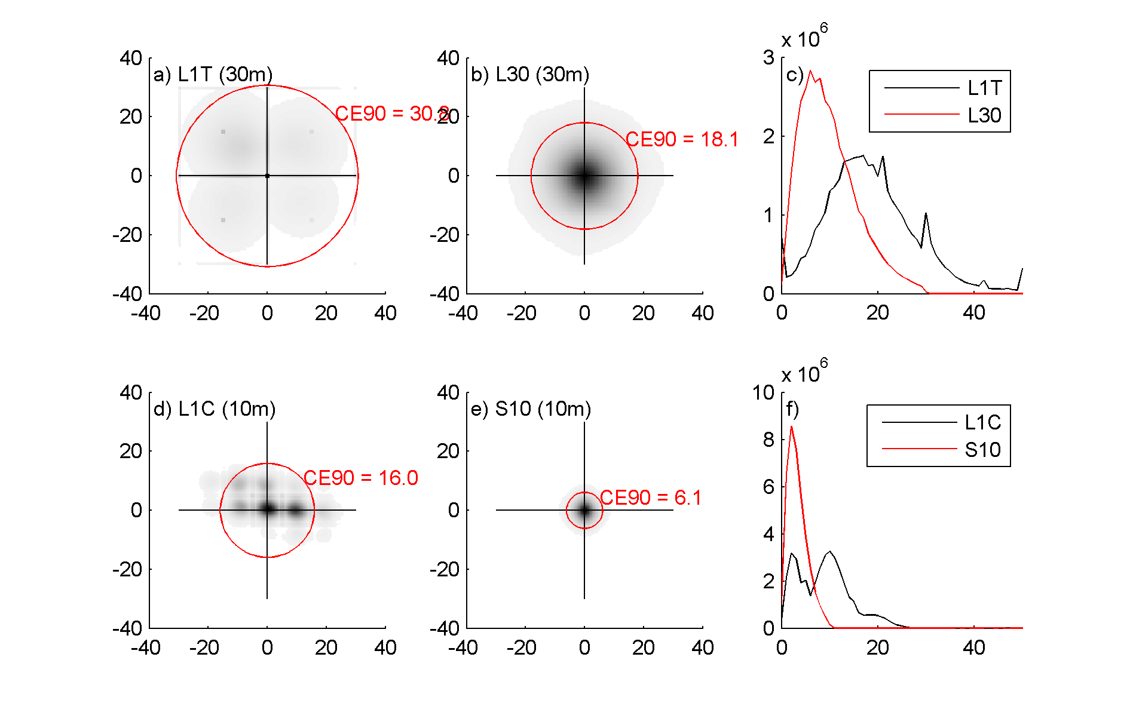
HLS Circular Error (CE) relative to S2a reference granule

Slide 8
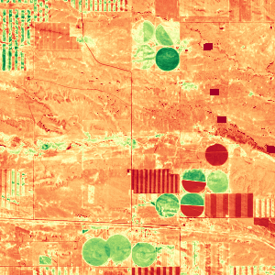
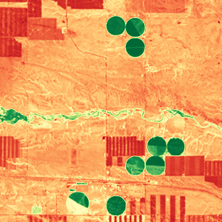
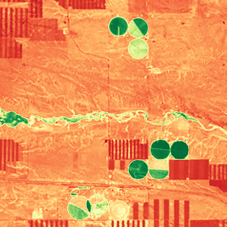
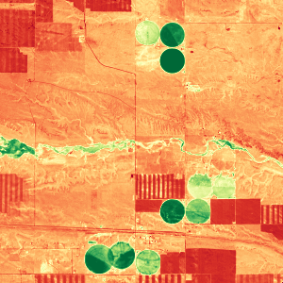
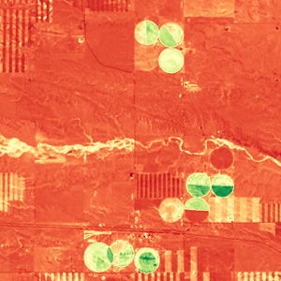
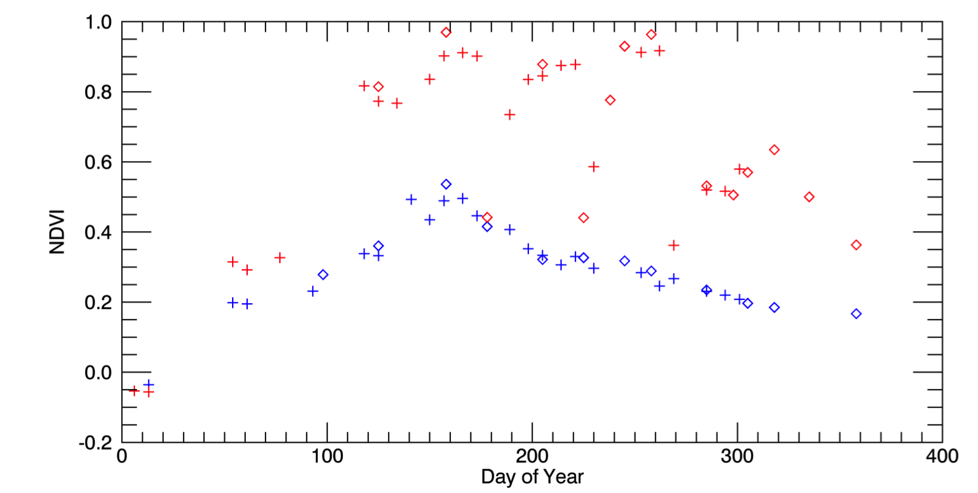
Harmonized Landsat / Sentinel-2 Products
Laramie County, WY
May 4, 2016 (S2)
Aug 8 (L8)
Aug 17 (L8)
Sep 1 (S2)
Oct 20 (L8)
3km
0.1 NDVI 0.9
Seasonal phenology (greening) for natural grassland (blue line) and irrigated alfalfa fields (red line) near Cheyenne Wyoming observed from Harmonized Landsat/Sentinel-2 data products. The high temporal density of observations allows individual mowing events to be detected within alfalfa fields. HLS Products available from https://hls.gsfc.nasa.gov
Sentinel-2 Landsat-8
+
Alfalfa
NDVI
mowing
Grassland
Day of Year

Slide 9
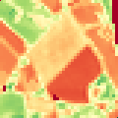
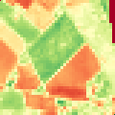
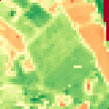
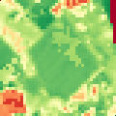
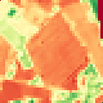
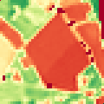
Harmonized Landsat / Sentinel-2 Products
SW France
Coordinates: 43.68°N, 1.25°E
Location: South-West France
1.2km
Time series of a 3x3 pixel window around the cross
Daily interpolated NDVI
HLS from Sentinel-2A MSI
ρ Red band
HLS from Landsat-8 OLI
ρ NIR band
0 NDVI 1
NDVI

Slide 10
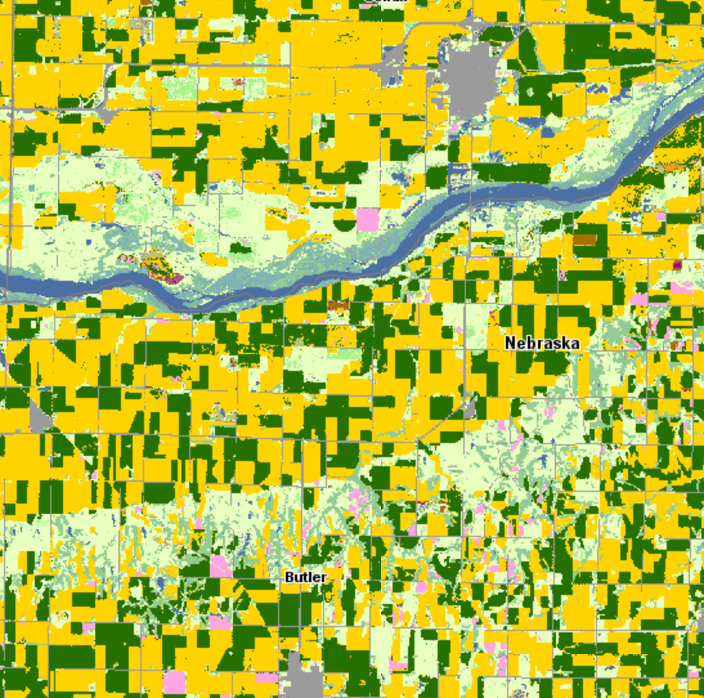
55
Schuyler,
Nebraska
USDA 2016 Cropscape
5km

Slide 11
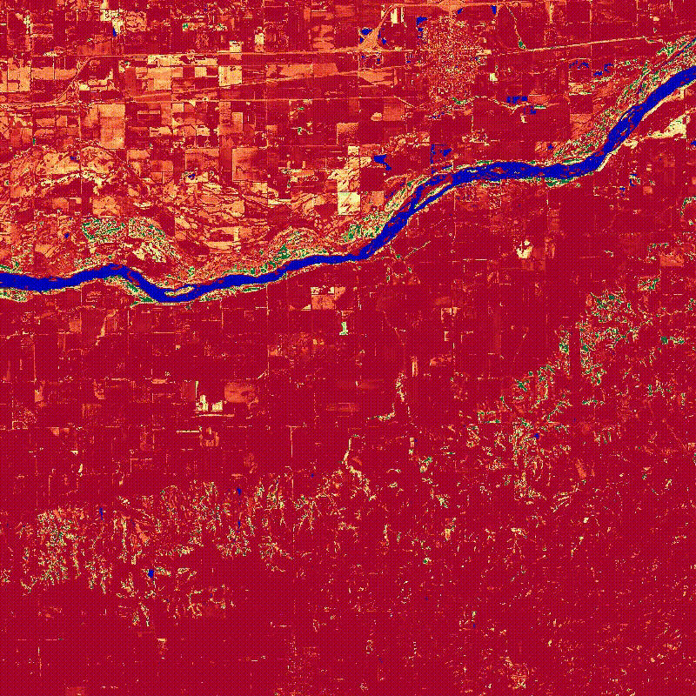
Schuyler,
Nebraska
HLS NDVI
Filtered, interpolated to daily time step
1.0
0.0

Slide 12
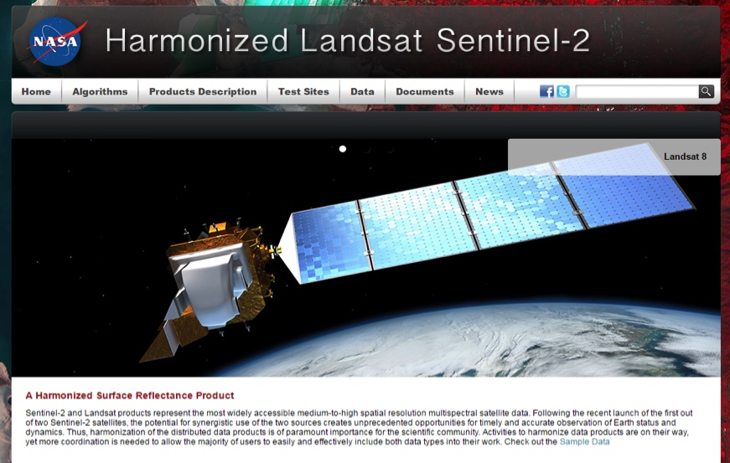
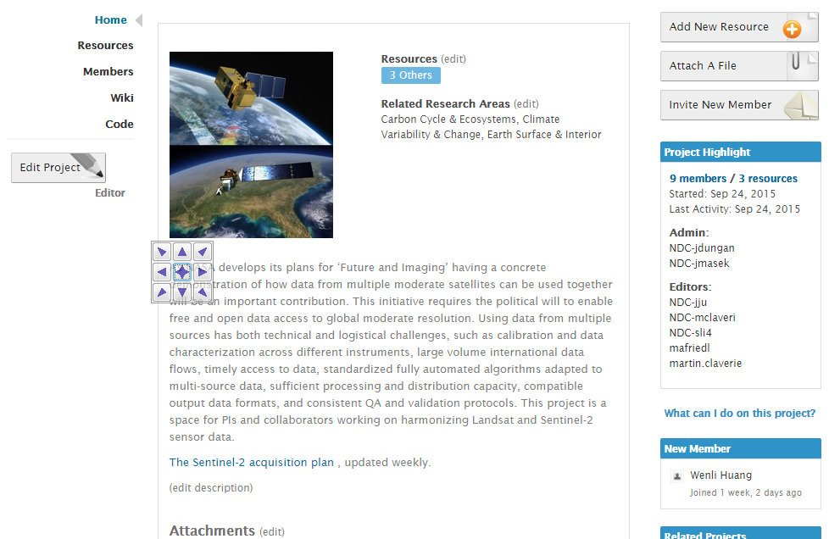
Websites and Public Interface
HLS website
NEX project page
https://hls.gsfc.nasa.gov
Public access
Sample data available (via FTP)
Algorithm & Product descriptions
https://nex.nasa.gov/nex/projects/1371
Registered user access
All HLS data available
Documents (slides, user guides)

Slide 13
HLS QA\QC Processes
Reflectance comparison with daily MODIS CMG
dataset & granule level metric
evaluation not validation
up to 5-day window w/ MODIS
eliminate HLS granules with high number of discrepant 0.05° CMG reflectance values
Per-tile time series smoothness
Per-pixel QA attributes
Cloud, shadow, water, adjacent cloud (L30 only)
Inherited L1 QA metadata

Slide 14
HLS QC: MODIS CMG Comparison
L30
S30
MODIS CMG Reflectance
Discarded S30 Tiles (<3%) due to S2 Cloud Omission

Slide 15
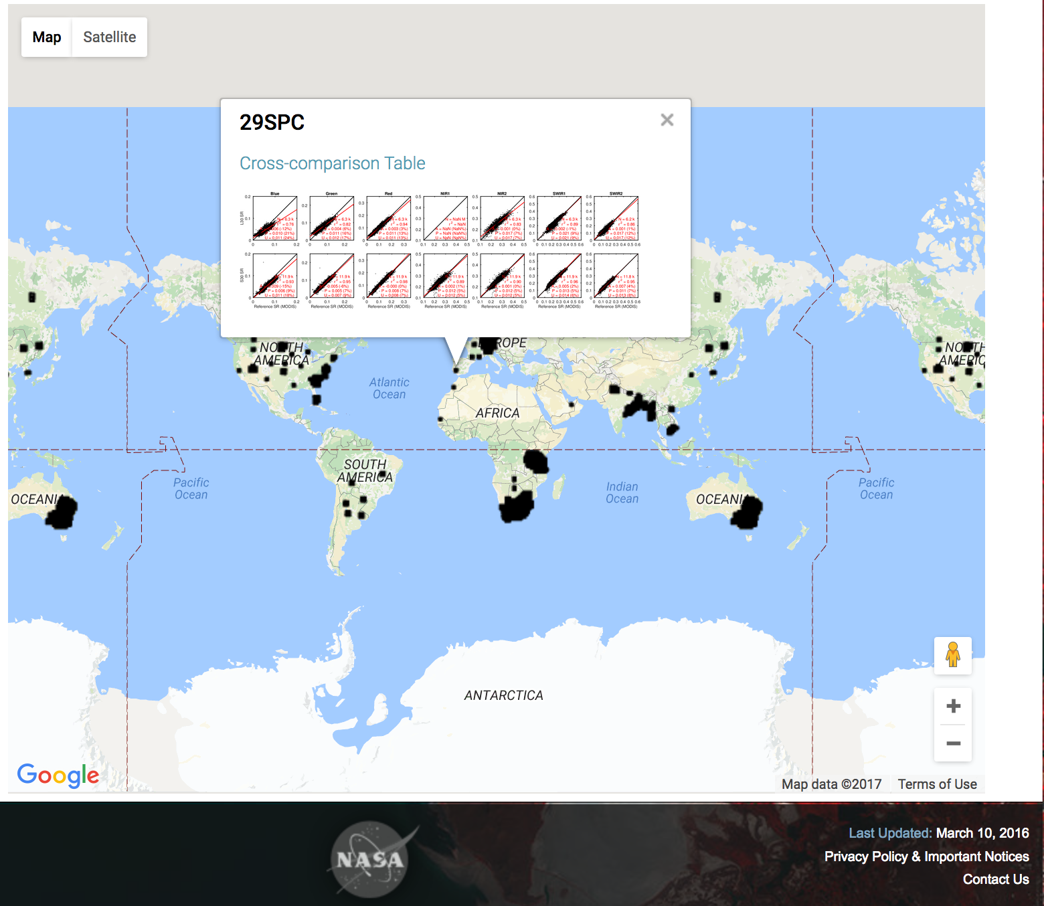
HLS QC: MODIS CMG Comparison

Slide 16
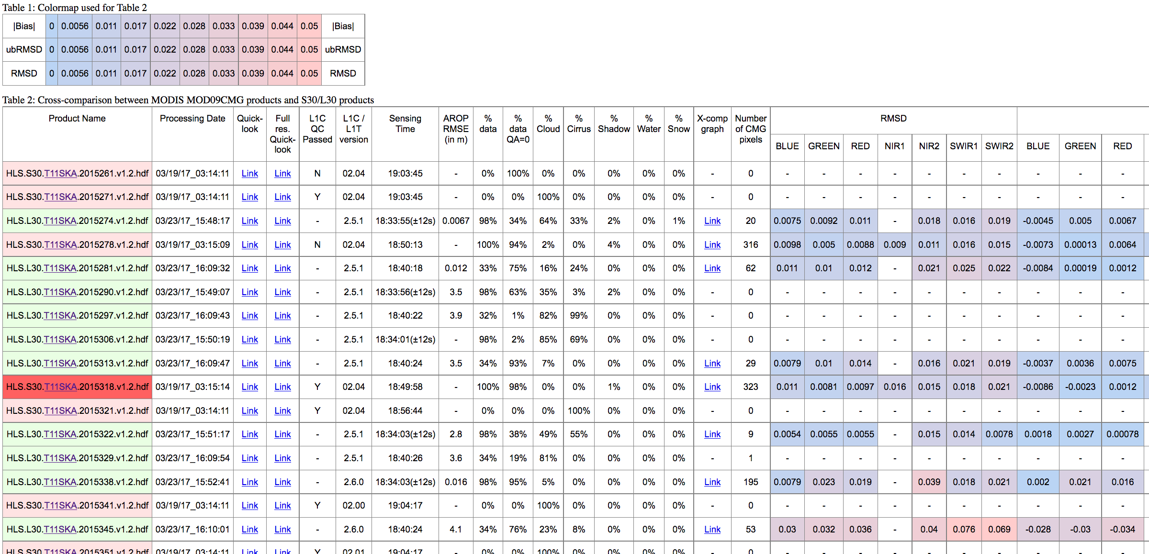
HLS QC: MODIS CMG Comparison

Slide 17
HLS QC: Temporal Smoothness
Approach based on variance among cloud-free VI triplets (Vermote et al., 2009)
Per-pixel metric calculated from median of all triplets (N>6) in time series
VI (y)
Noise
day

Slide 18
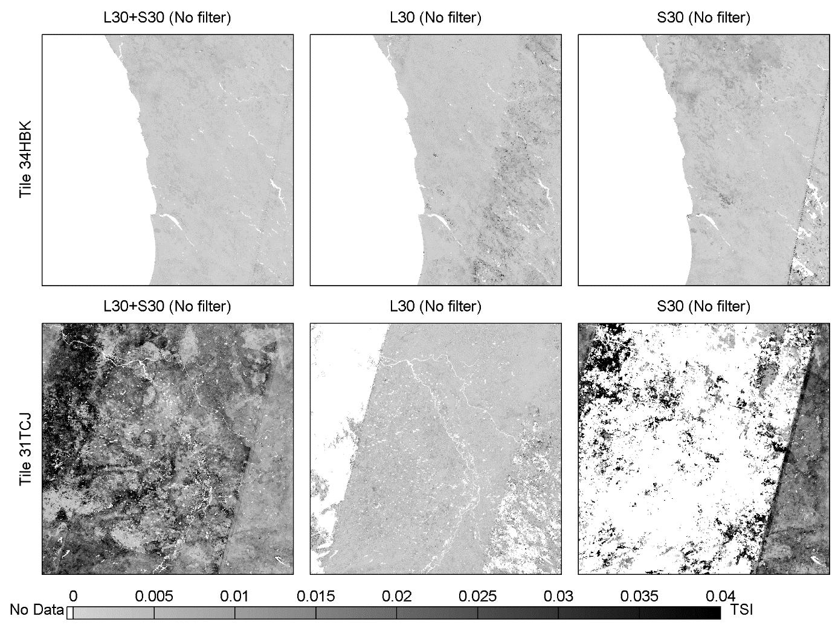
HLS QC: Temporal Smoothness
Tile
34HBK
(S.Af)
Tile
31TCJ
(France)
Smooth <-
-> Noisy
Adding S2 data increases time series noise due to cloud commission

Slide 19
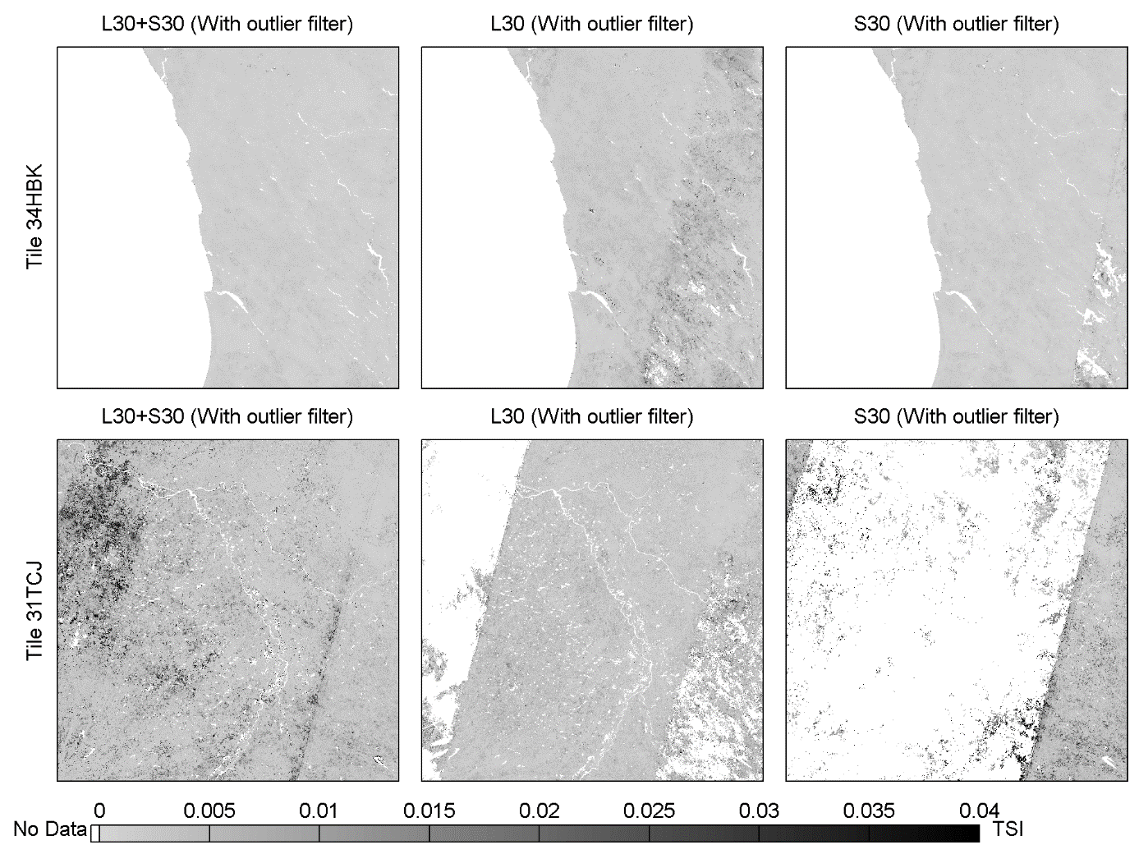
HLS QC: Temporal Smoothness
Tile
34HBK
After Filtering
Tile
31TCJ
Smooth <-
-> Noisy
Per-pixel filtering for temporal “outliers” reduces variance

Slide 20
HLS Releases
V1.2 Released February, 2017
Per-pixel view angle correction
All bands used for aerosol retrieval
Fix of pixel indexing problem in v1.1 arising from atmospheric correction, resulting in mis-alignment of 10, 20, and 60m bands
Registration of all imagery to single reference S2 L1C image
Correction of bug in Fmask
Known Issues
Cloud mask for Sentinel-2 needs improvement
L1C cloud mask poor, difficult to use (vector)
Fmask better but errors of omission are common
Boston U. working on improvements
Atmospheric Correction lags behind LaSRC for L8
Blockiness & pin-hole drop outs
Artifacts in snow-covered scenes
Bug in BRDF implemention (~1% relative error)

Slide 21
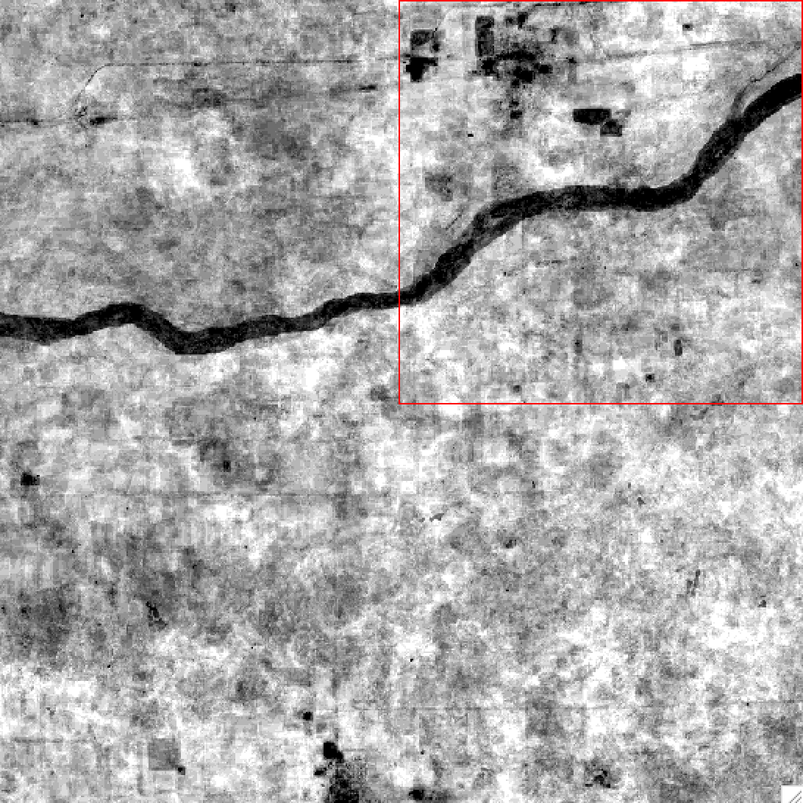
Known Issues
Error in atmospheric correction over snow?
Number of non-cloud, non-shadow observations => water is called shadow

Slide 22
Future Directions
Version 1.3 – release ASAP to fix minor BRDF bug, add user-requested test sites
Q3-Q4 2017: North America wall-to-wall
Fully automated processing w/ ~5-day latency
<24 hours Landsat (USGS/NEX), <2 days for S2 (Google)
2-10 days for ancillary (ozone, water vapor)
Leverage AWS for processing, archive, distribution
2018: extension to MuSLI Round 2 sites

Slide 23
Backup

Slide 24
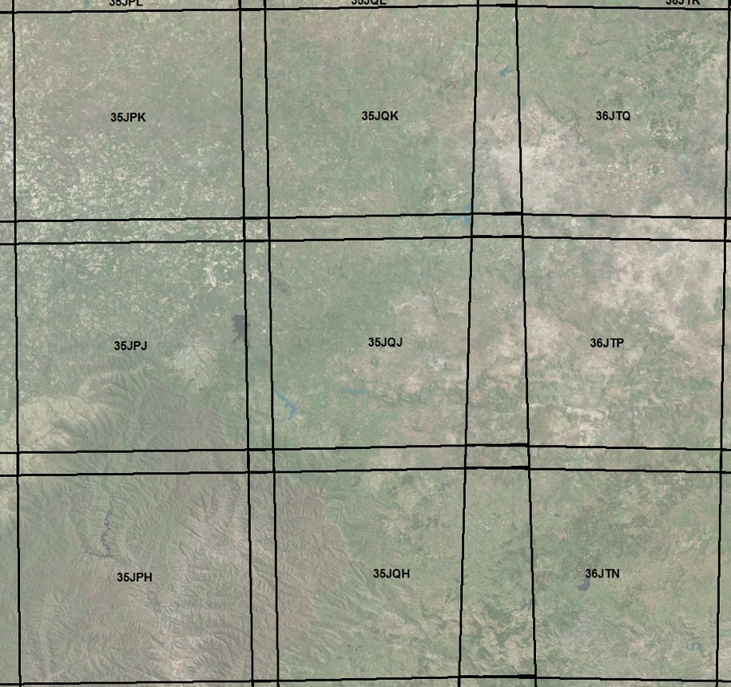
HLS Products Specification
All 4 products are aligned on the S2 Tiling system (Military Grid Reference System), following UTM zones + 3 letters defining a grid
Tiles are 110km square with 10km overlap for same UTM zone adjacent tiles
S10
Spatial: 10m, 20m, 60m
Spectral Bands: All MSI
Temporal: All Sentinel-2 L1C granules
NBAR: No
L30
Spatial: 30m
Spectral Bands: All OLI
Temporal: All Landsat-8 L1T granules
NBAR: Yes
S2 Tiles system
109,080m
S30
Spatial: 30m
Spectral Bands: OLI-like + MSI Red Edge
Temporal: All Sentinel-2 L1C granules
NBAR: Yes
M30
Spatial: 30m
Spectral Bands: OLI-like + MSI Red Edge + TIRS TOA
Temporal: 5-day “best pixel” based on min AOT
NBAR: Yes
Overlap area
UTM zone 35
UTM zone 36

Slide 25
HLS QC: MODIS CMG Comparison

