Slide 1

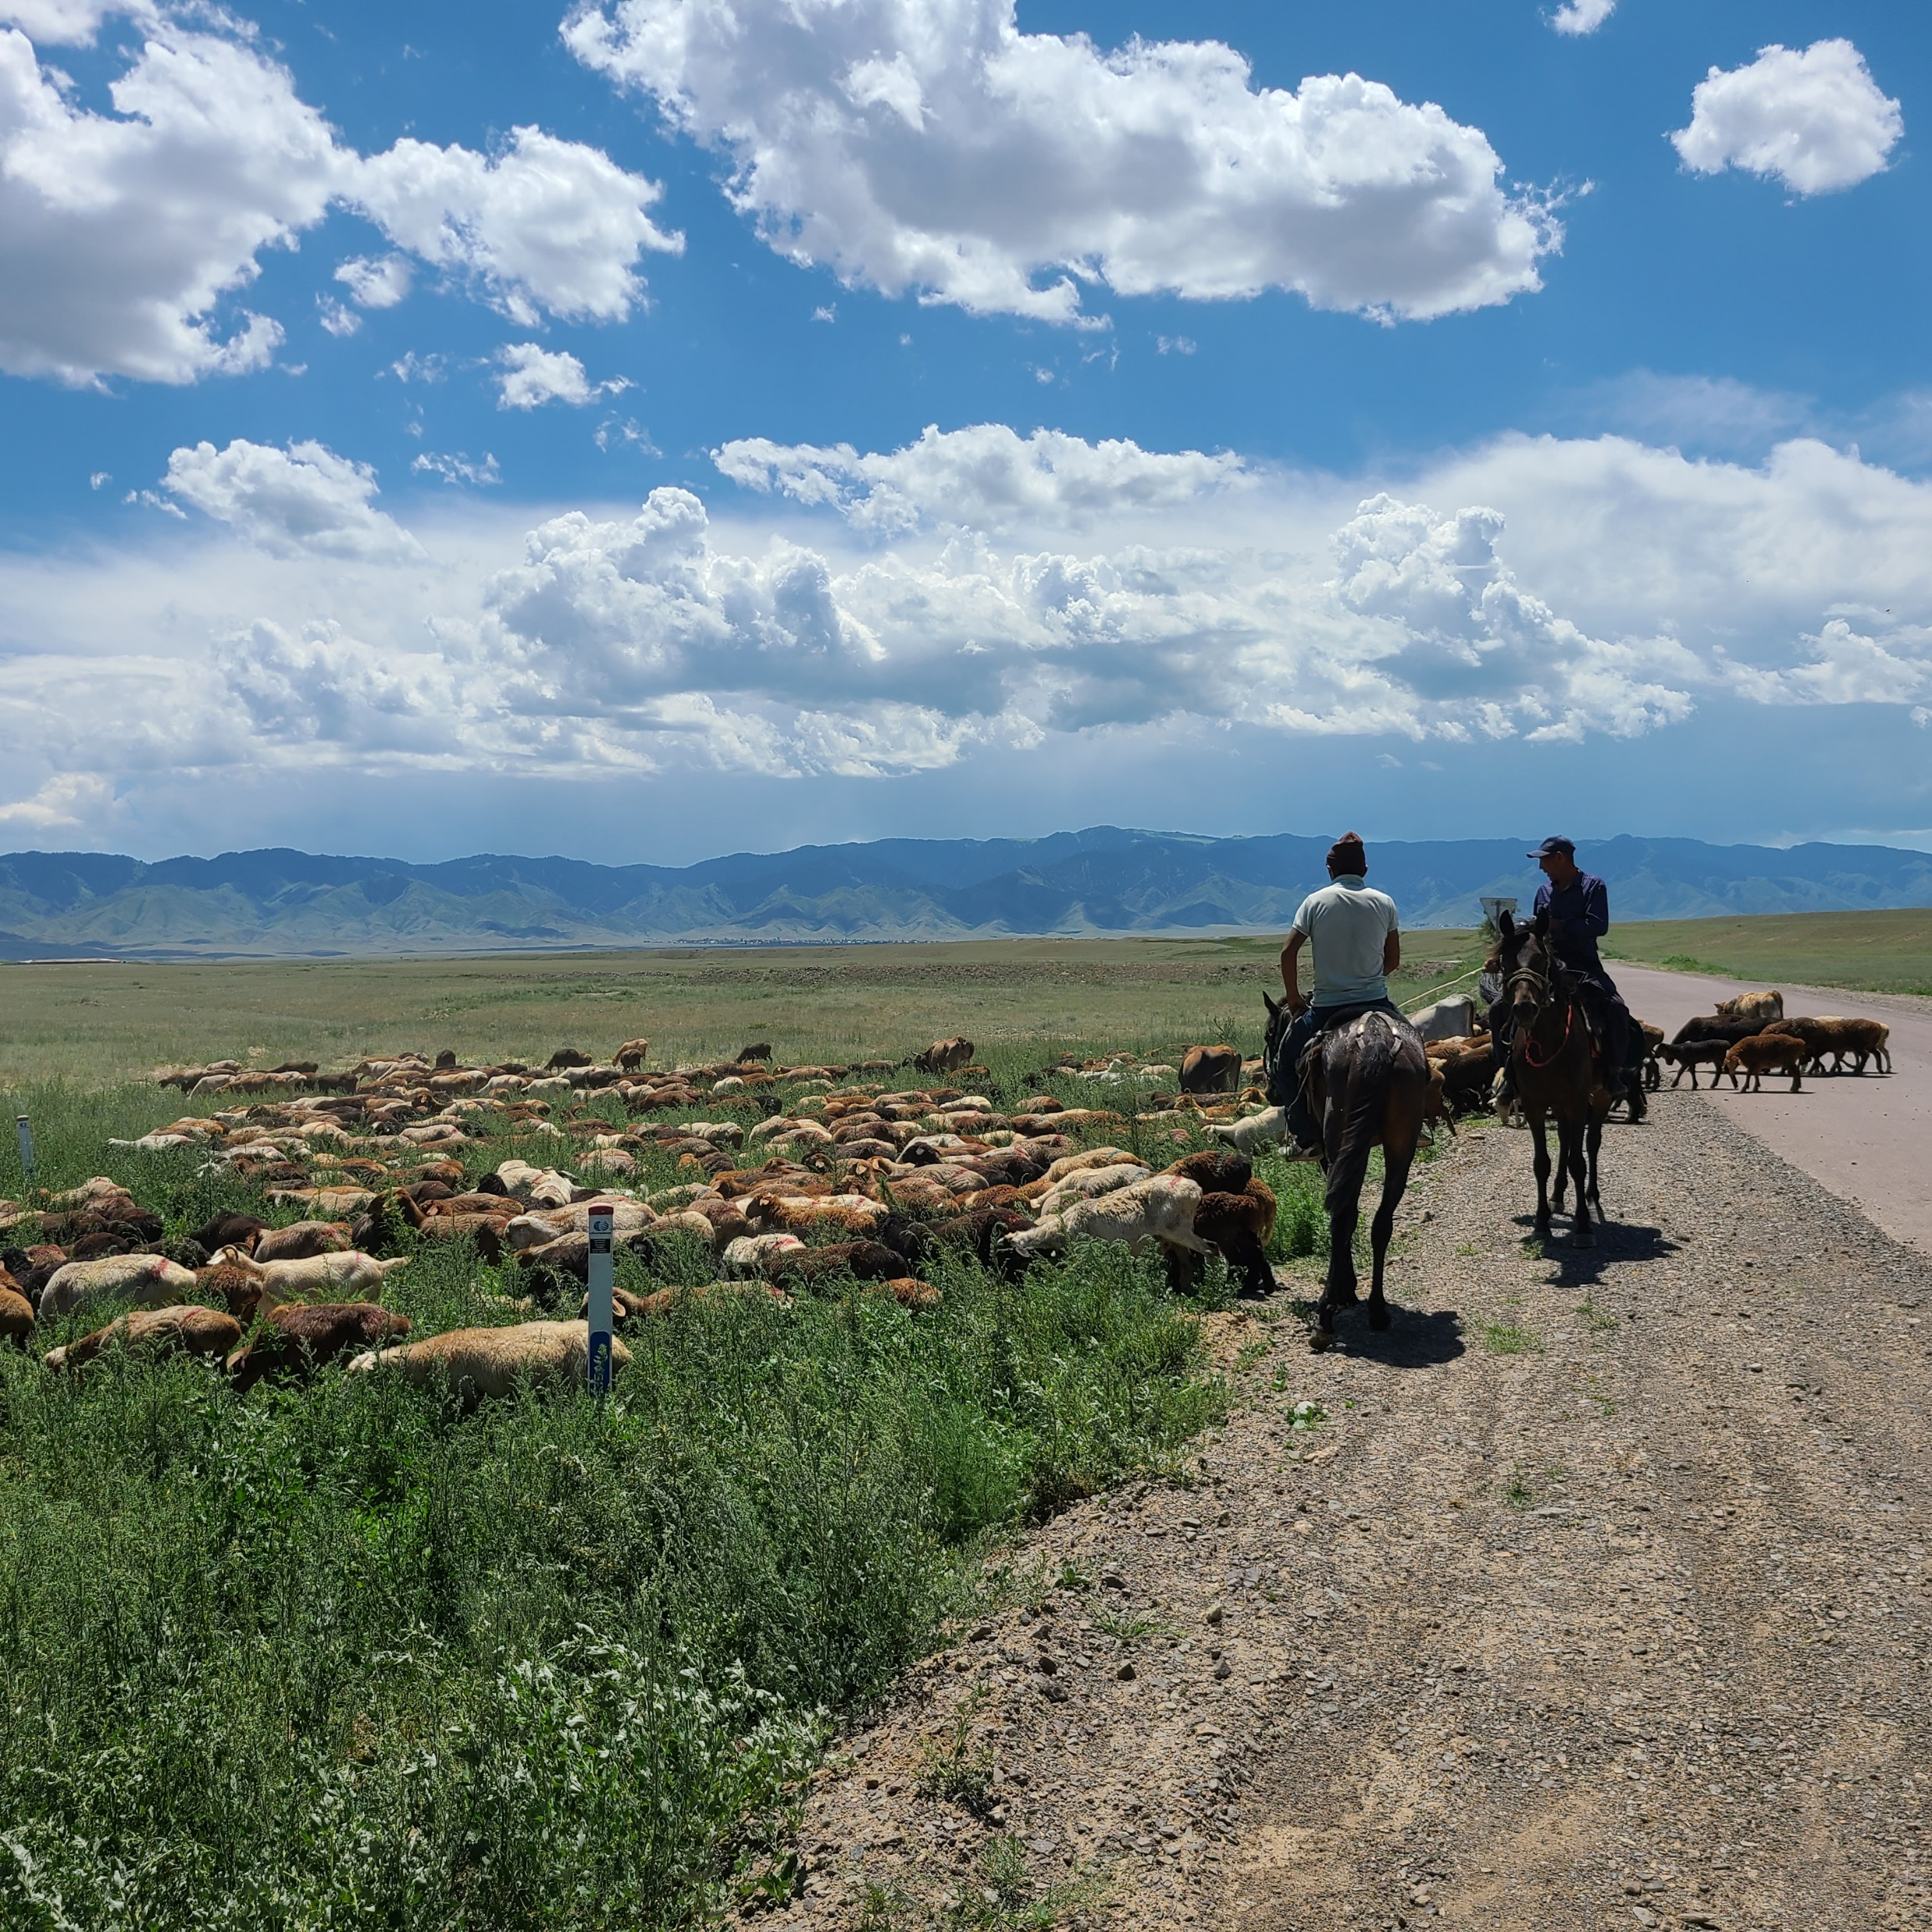

The Status and Future of Remote Sensing of Rangelands Land Use
Ranjeet John
University of South Dakota
10/19/2022

Slide 2
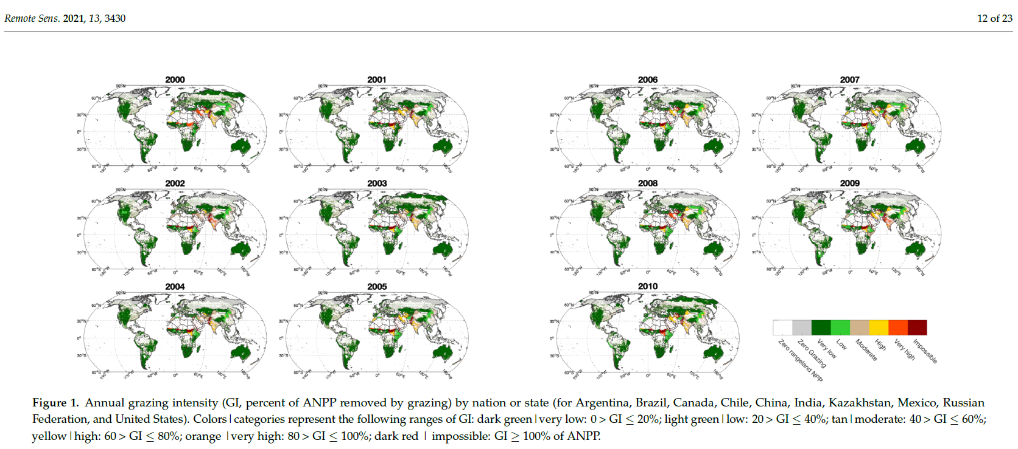
Rangelands are under significant pressure to accommodate rising grazing demand
Significant % of the developing world lives in arid/semiarid rangelands where herding is the major land use
Wolf, Chen, M. et al 2021

Slide 3
Knowledge and data gaps
Changes in land cover/use, level of degradation
State-Change of rangelands, ecosystem structure/function - % canopy cover & AGB
Changes in socio-economic conditions-access to jobs, education, health-Human development index (HDI)
Trends in livestock density & proportional change in herd composition (e.g., increase in goat pop. vs sheep population to mitigate climate risk)
Agricultural production in rangelands
Changes in the moisture and temperature regimes

Slide 4
Socioeconomic drivers
“boom-bust cycles”
IM
MG
a)
b)
Temporal trends of total livestock, goat, sheep, cattle, horse and their proportions in Inner Mongolia (a & c) and Mongolia (b & d)
Figure shows the dramatic proportional increase in goat population in Mongolia as well as increase in total livestock in both Mongolia and Inner Mongolia between 1990 -2010
No of livestock (in million)
c)
d)
% livestock
John et al. 2016, Landscape Ecology

Slide 5
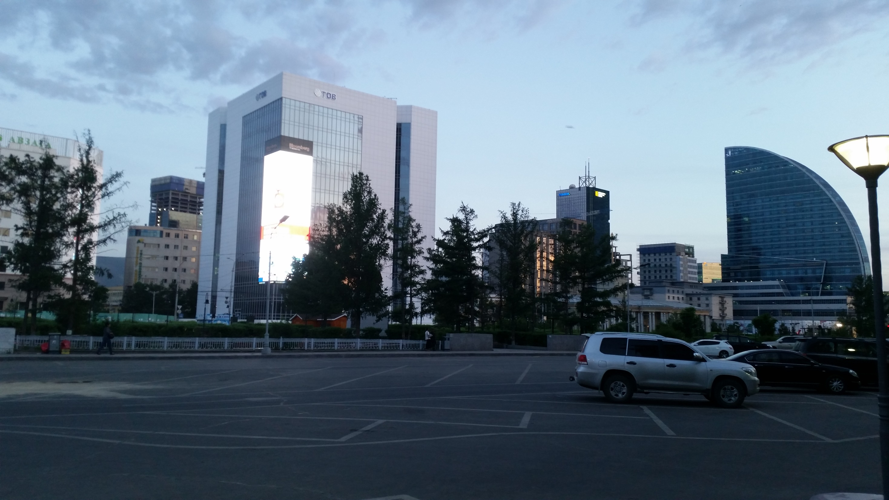
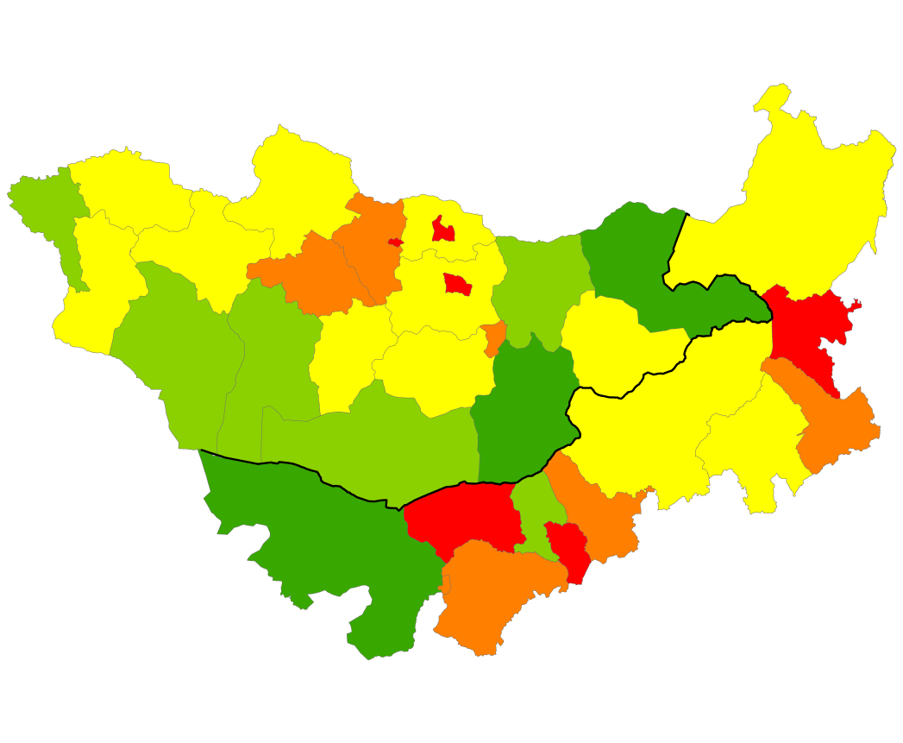
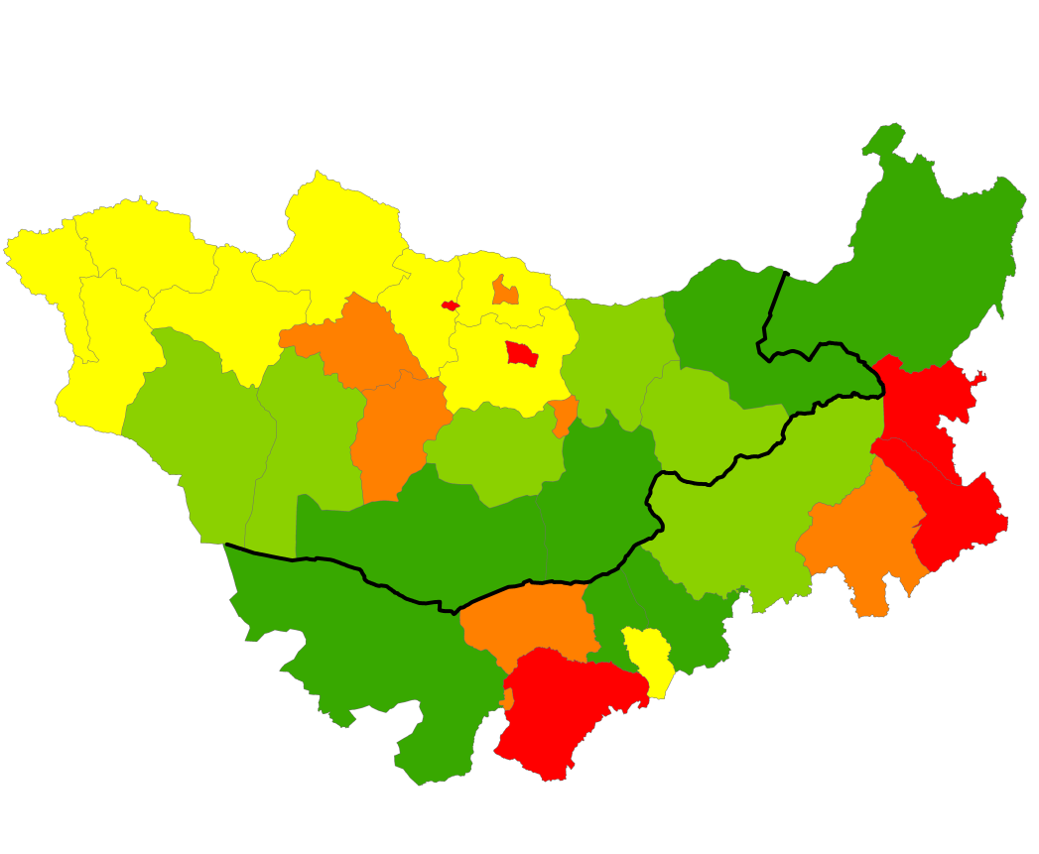
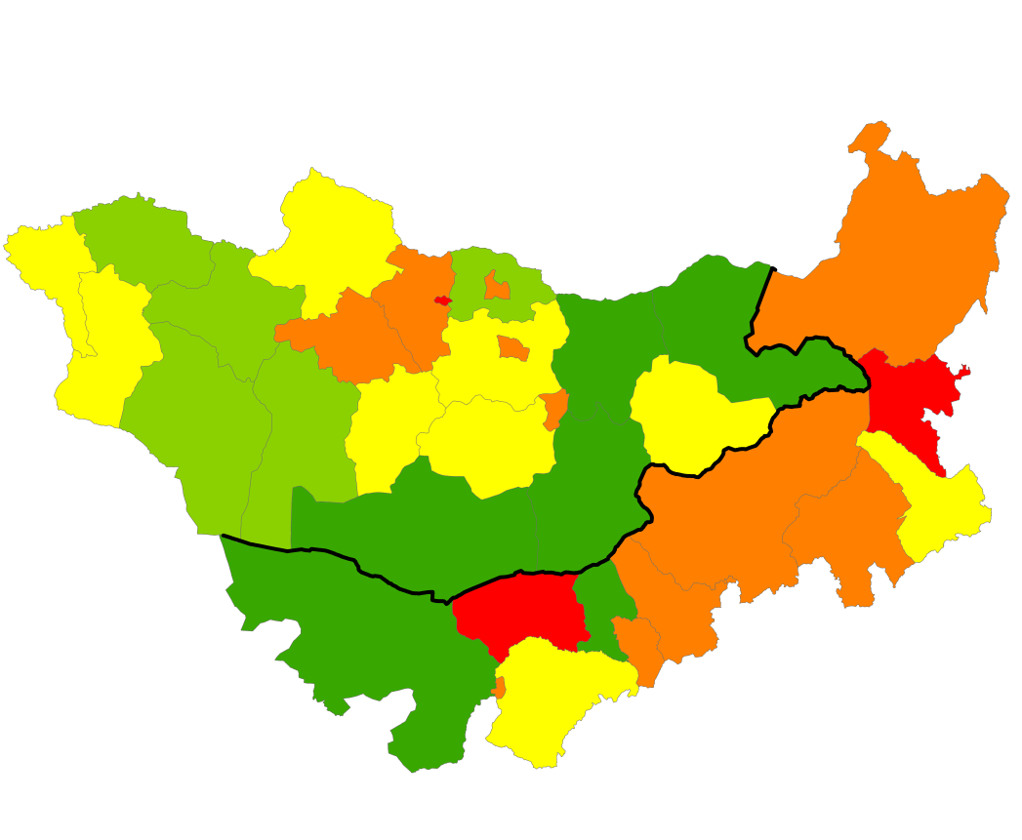
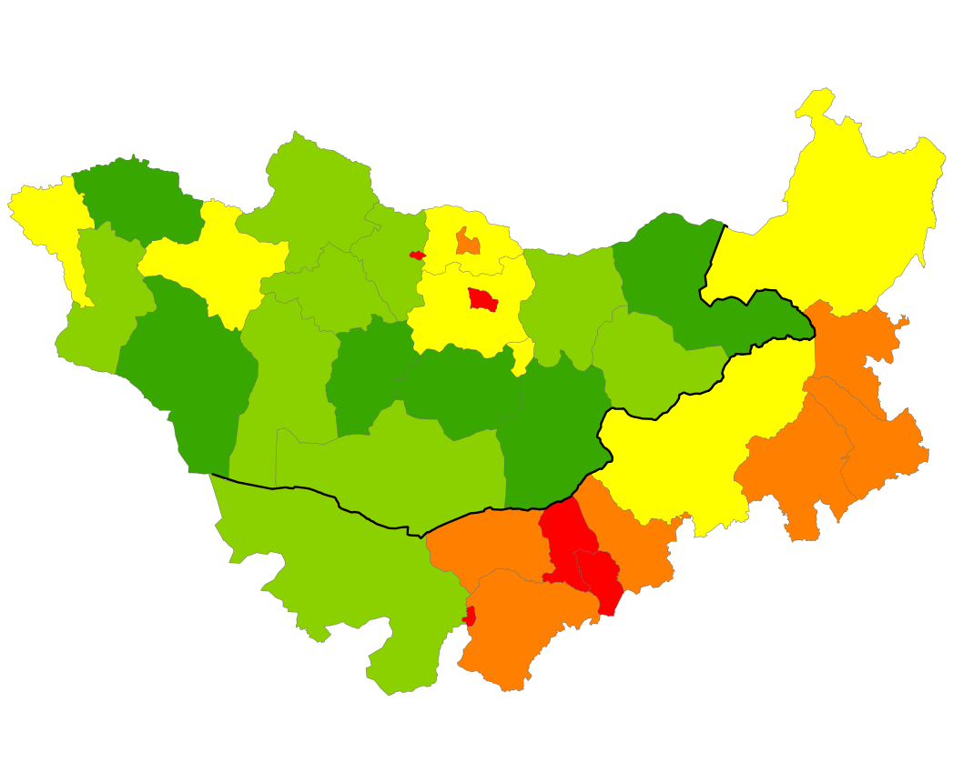
Figure 4: Mann–Kendall spatial and temporal slope trends of a) total livestock density b) goat livestock density, c) sheep livestock density and d) total population density.
a)
b)
c)
d)
John et al. 2016
“Pull” factor urban migration

Slide 6
Rangeland health and land use
Rangeland health and Biotic integrity as measured by
Structure
  Total foliar cover and herbaceous percent canopy cover
  Canopy height
Function
  Above ground biomass/ANPP
  Plant species diversity/community richness
  C3 vs C4

Slide 7
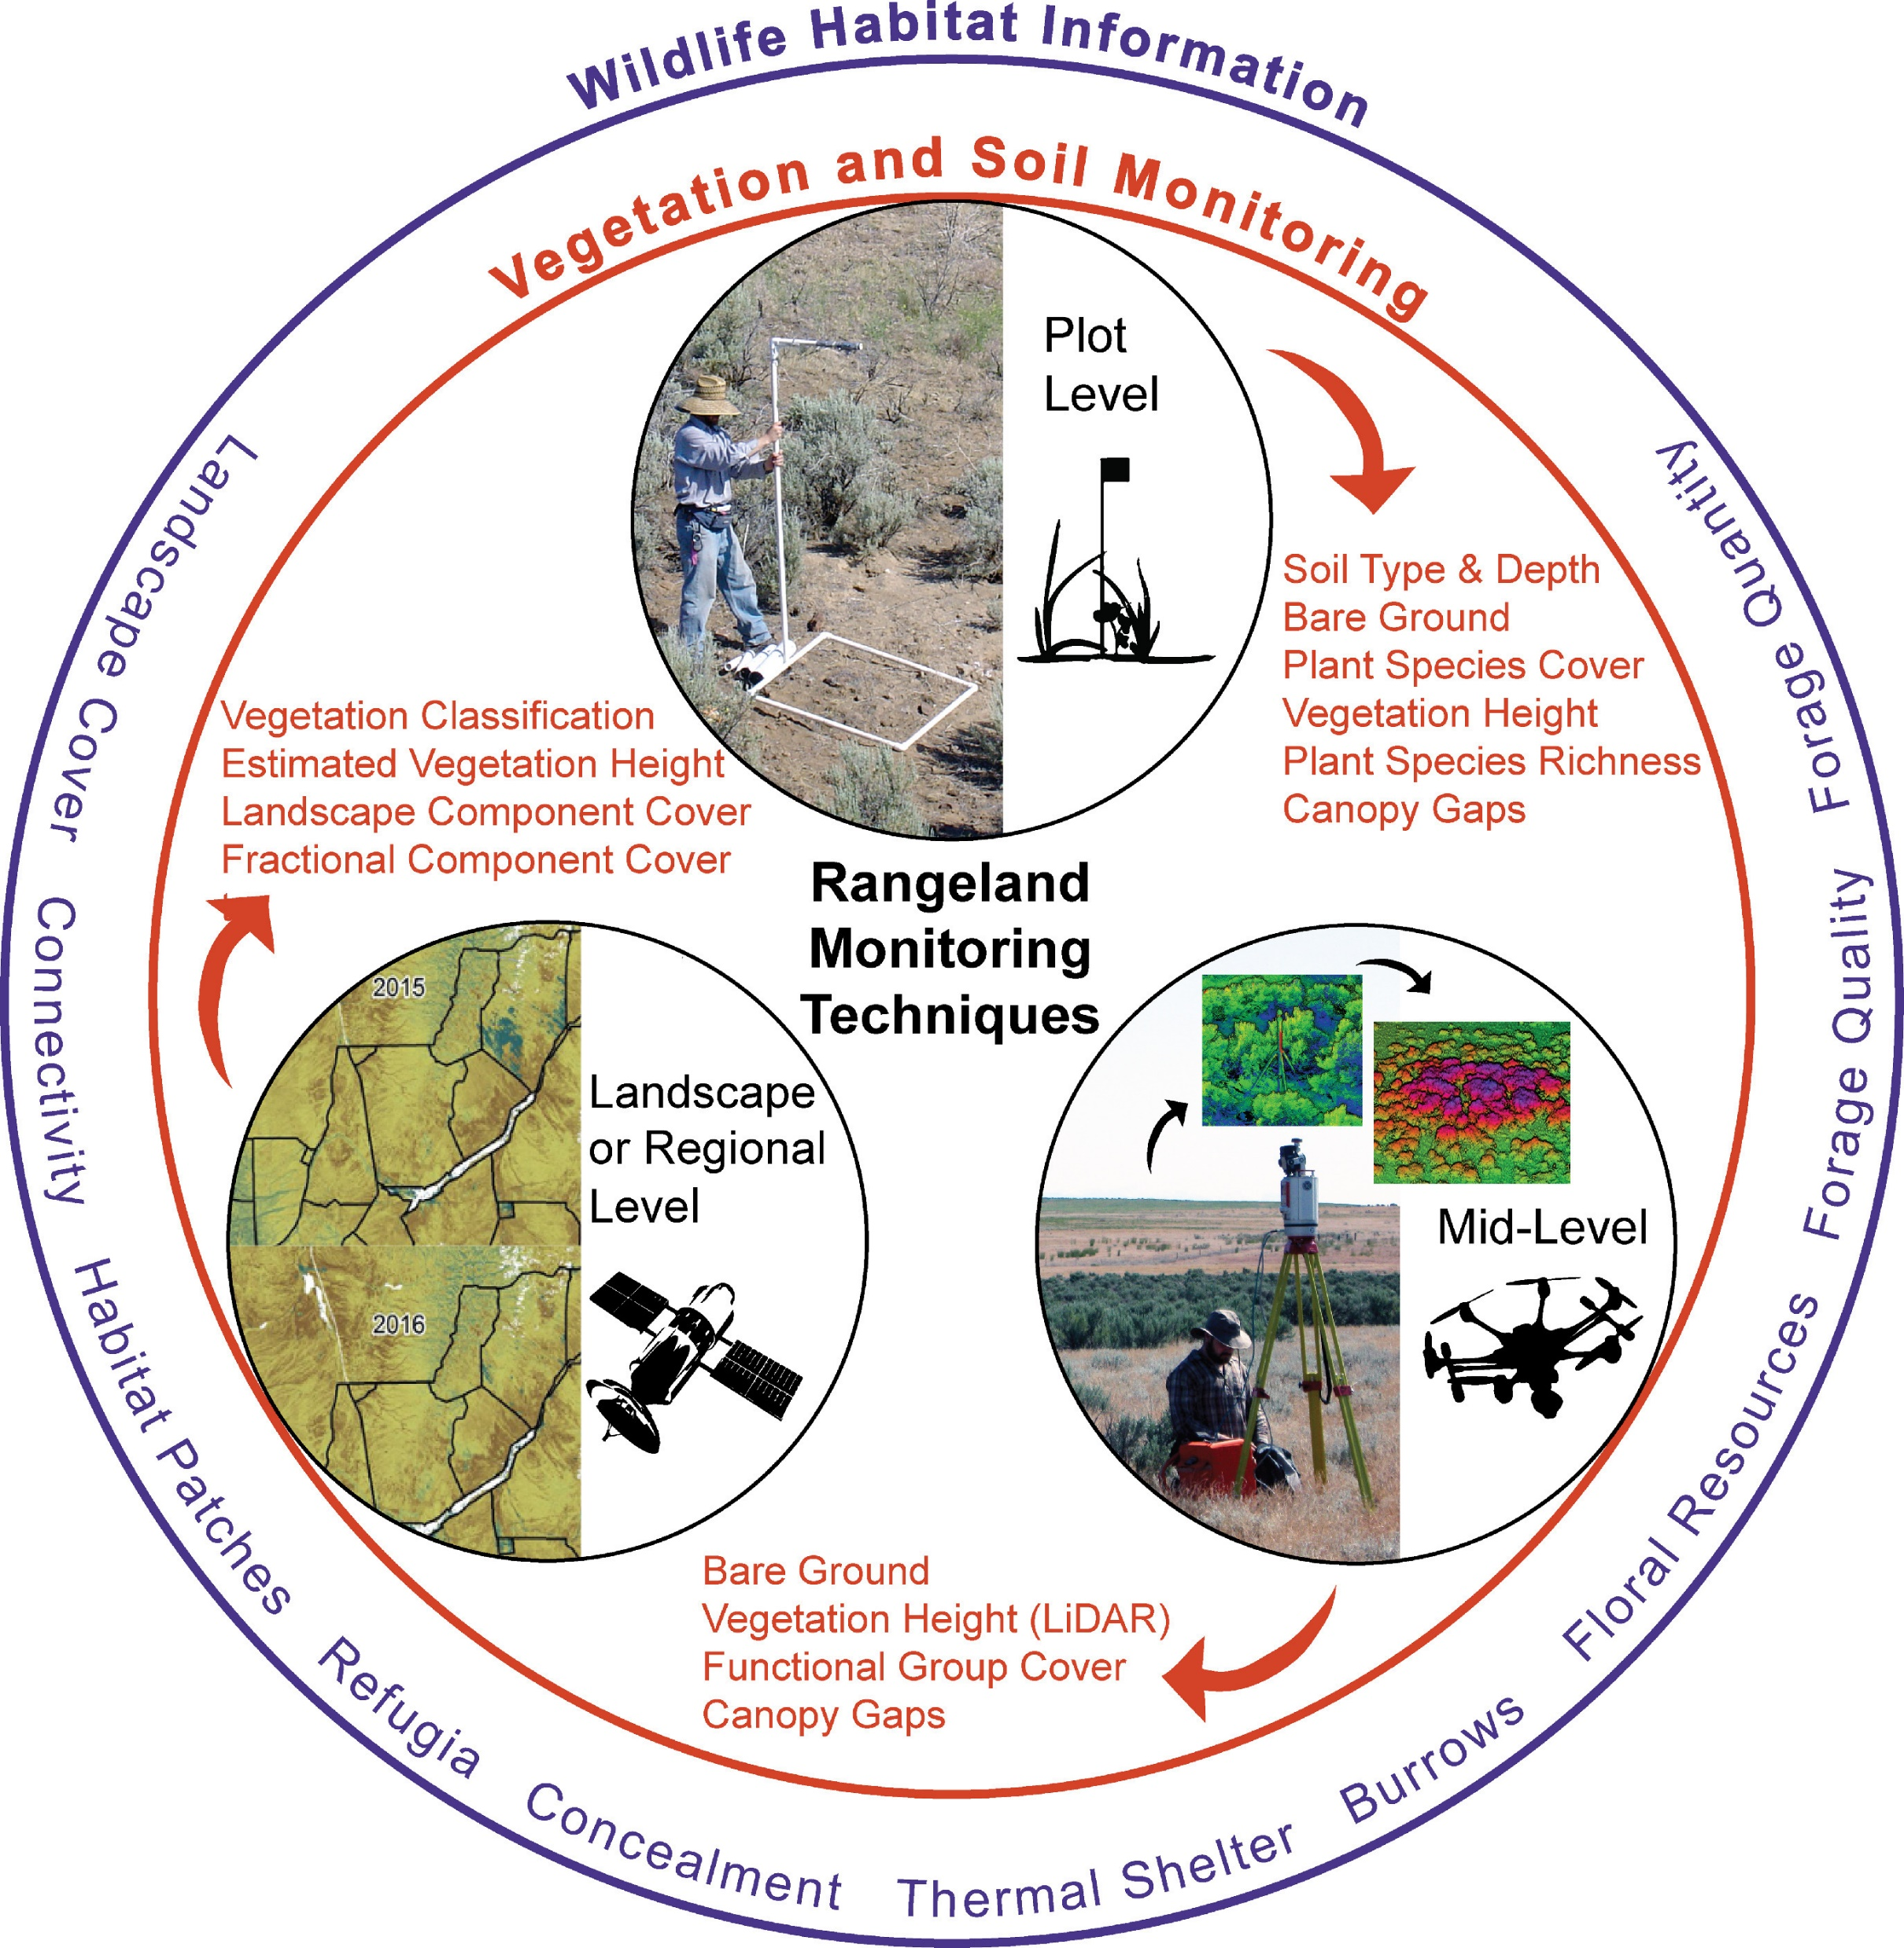
Rangeland land use monitoring issues
VIs shown to correlate with AGB with different levels of accuracy
plant biomass correlates well with reflectance and optical vegetation indices
However, model accuracy depends on spatial resolution, and by number of sampling points to estimate AGB per unit area
mismatch occurs between ground measurements and satellite reflectance and or VI data.
increasing n samples of ground truth and resolving the multiscale mismatch needed to improve accuracy of grassland AGB estimation

Slide 8
Rangeland monitoring and inventory

Slide 9
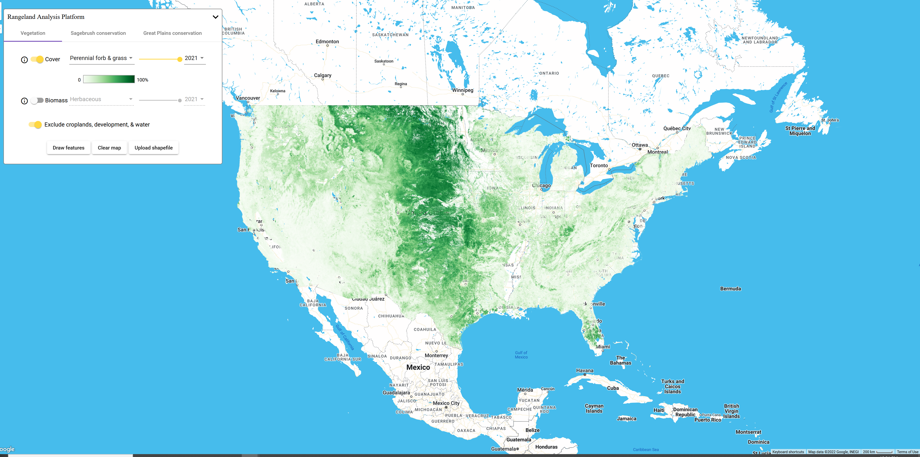
Rangeland monitoring-Rangeland Analysis Platform
Rangeland Analysis platform v3.0
Landsat collection 2.0 (12; 64-day averages)
Convolutional Neural Network
74,966 plots from BLM's Assessment, Inventory, and Monitoring (AIM) data, and Landscape Monitoring Framework (LMF)
Google Earth Engine & AI Platform

Slide 10
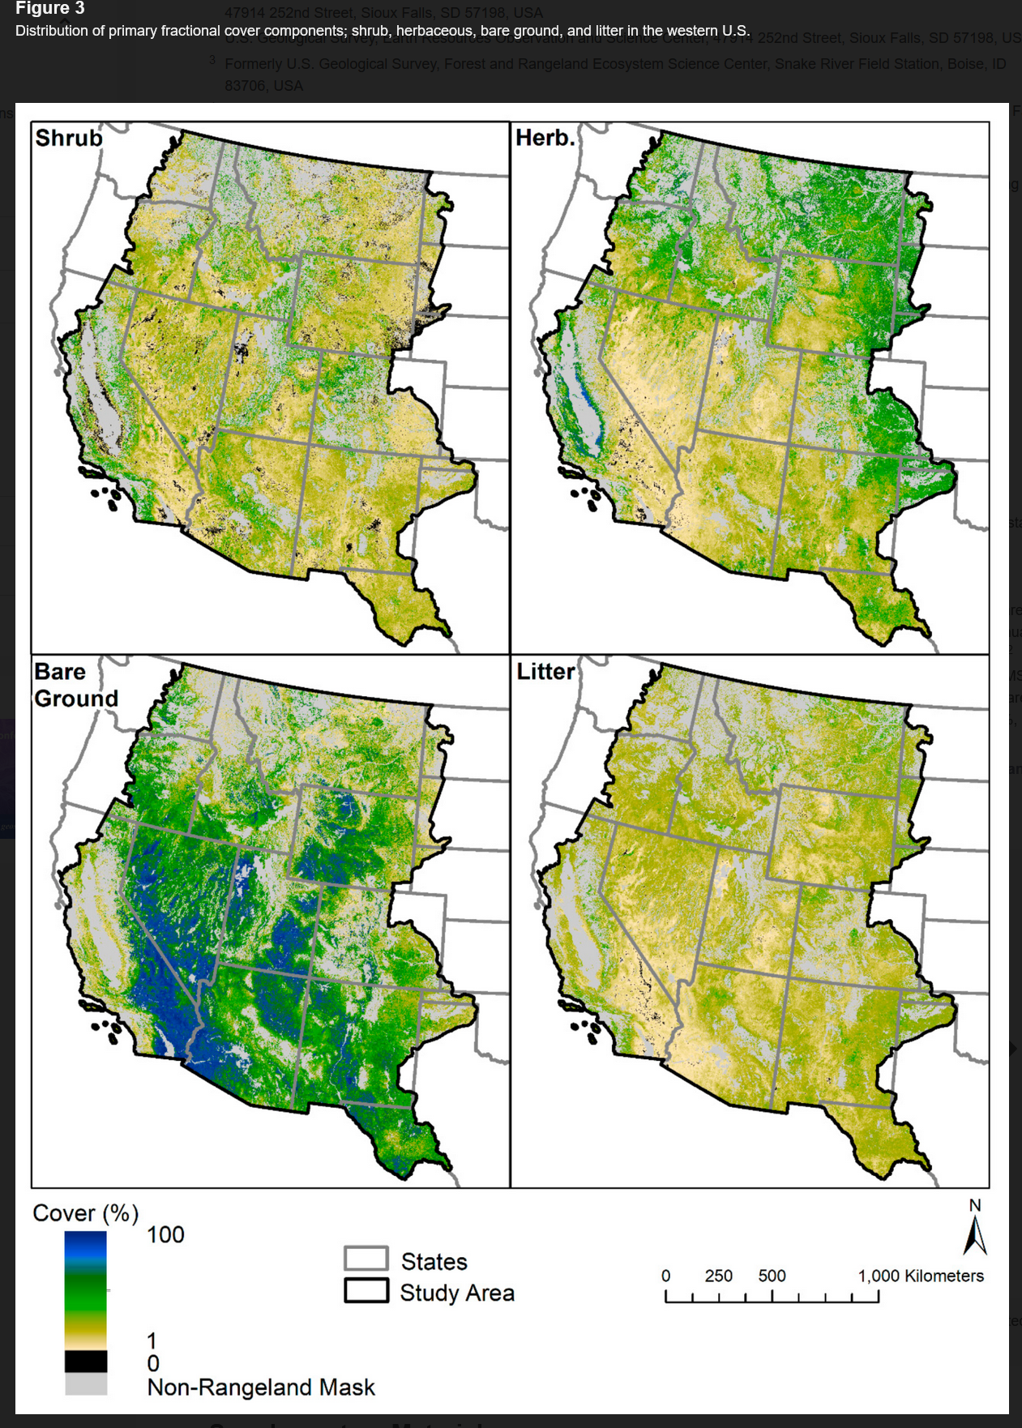
Rangeland Monitoring using Rangeland Condition, Monitoring, Assessment, and Projection
RCMAP quantifies % cover of components across the western U.S. rangelands using Landsat (1985-2020)
timeseries consists of 8 fractional components: annual herbaceous, bare ground, herbaceous, litter, non-sagebrush shrub, perennial herbaceous, sagebrush and shrub
four primary components (bare ground, shrub, litter, and herbaceous) sum to 100% in each pixel when added to tree canopy cover
secondary components-- annual herbaceous and perennial herbaceous are subsets of the primary component herbaceous, while non-sagebrush shrub and sagebrush are subsets of shrub
Secondary components cannot have cover greater than their respective primary component
Rigge et al. 2017

Slide 11
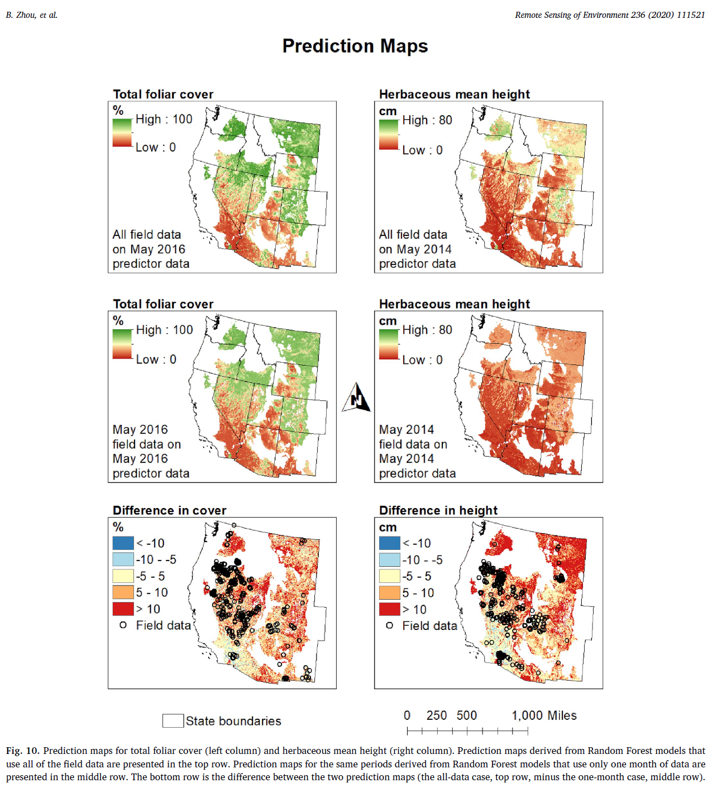
Rangeland Monitoring
using google earth engine
B. Zhou et al. 2020

Slide 12
Rangeland RS sampling synthesis and “bottom-up” scaling

Slide 13
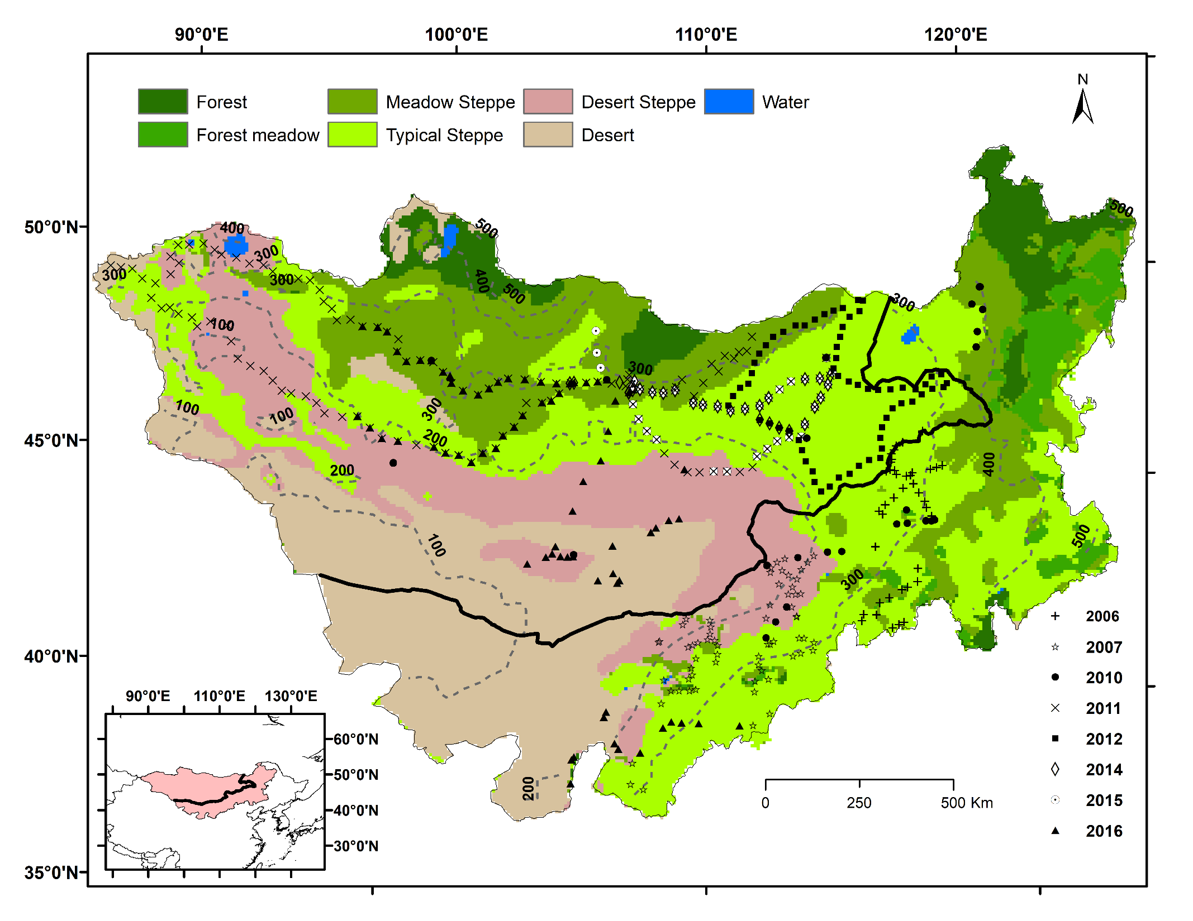
Figure 1: Multi-year in situ measurements and isohyets (dashed lines) derived from CRU TS323 mean annual precipitation (1981-2014) overlaid on vegetation types on the Mongolian Plateau. Thick line denotes the border between the Republic of Mongolia and the province of Inner Mongolia, China.

Slide 14
Rangeland change detection, “Hotspots” and trends

Slide 15
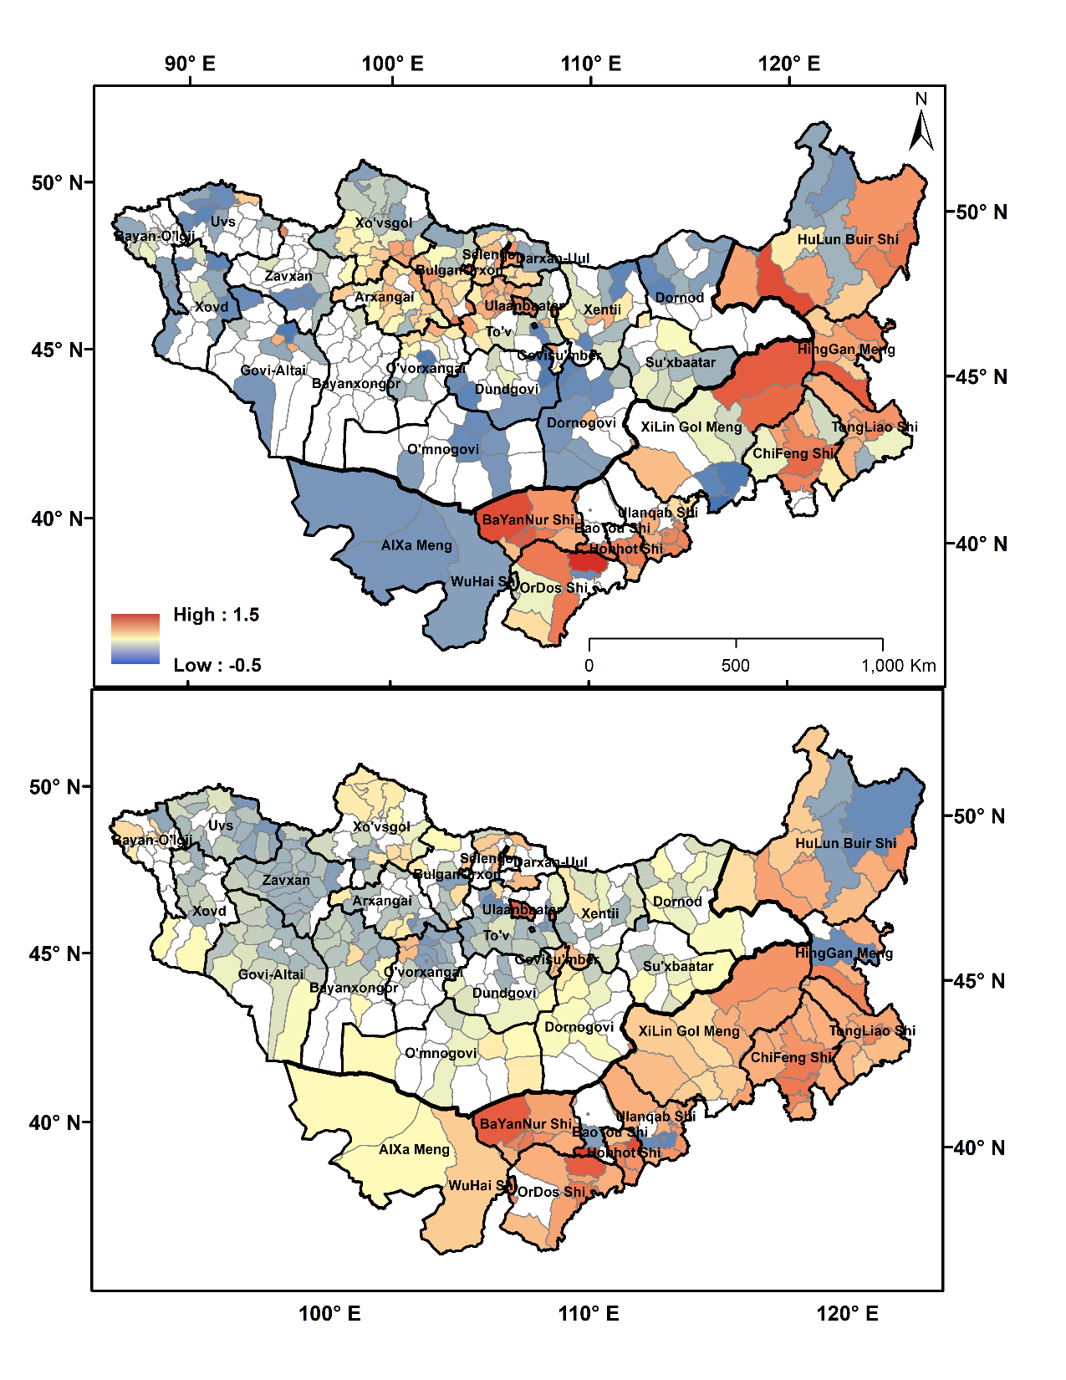
a)
Spatial heterogeneity in Theil‐Sen
trends of
a) LSKD ‐‐ total livestock density
b) POPD ‐‐ total population density
• Red shows positive trends
• Blue shows negative trends
• White shows soums or xiàn
(counties) without significant
trends
b)
Livestock and Population density in counties closer to cities/provincial centers increase at the cost of counties on periphery
John et al. 2018
Notes:
Theil–Sen estimator is a method for robustly fitting a line to sample points in the plane (simple linear regression) by choosing the median of the slopes of all lines through pairs of point

Slide 16
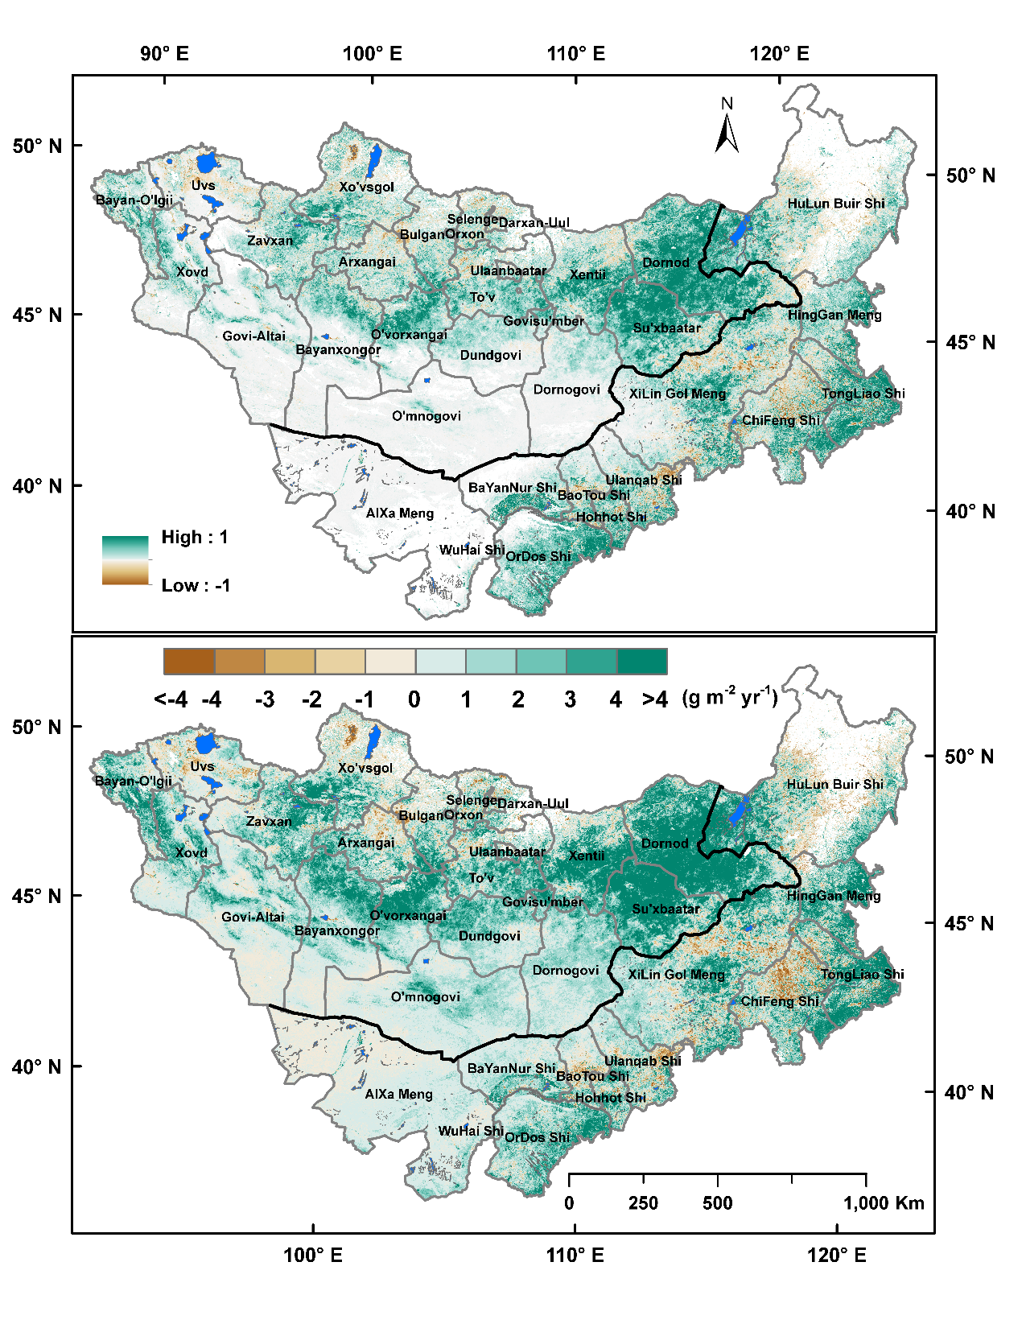
Spatial changes in Theil-sen slope trends (2000-2016) of
canopy cover (CC)
aboveground biomass (AGB) derived from MODIS MCD43A4 NBAR surface reflectance and ancillary variables
• Green shows positive trends
• Brown shows negative trends
• White shows provinces or prefectures without significant trends
a)
b)
AGB & canopy cover show decreasing trend close to cities/provincial centers while there is an increase away from cities
John et al. 2018

Slide 17
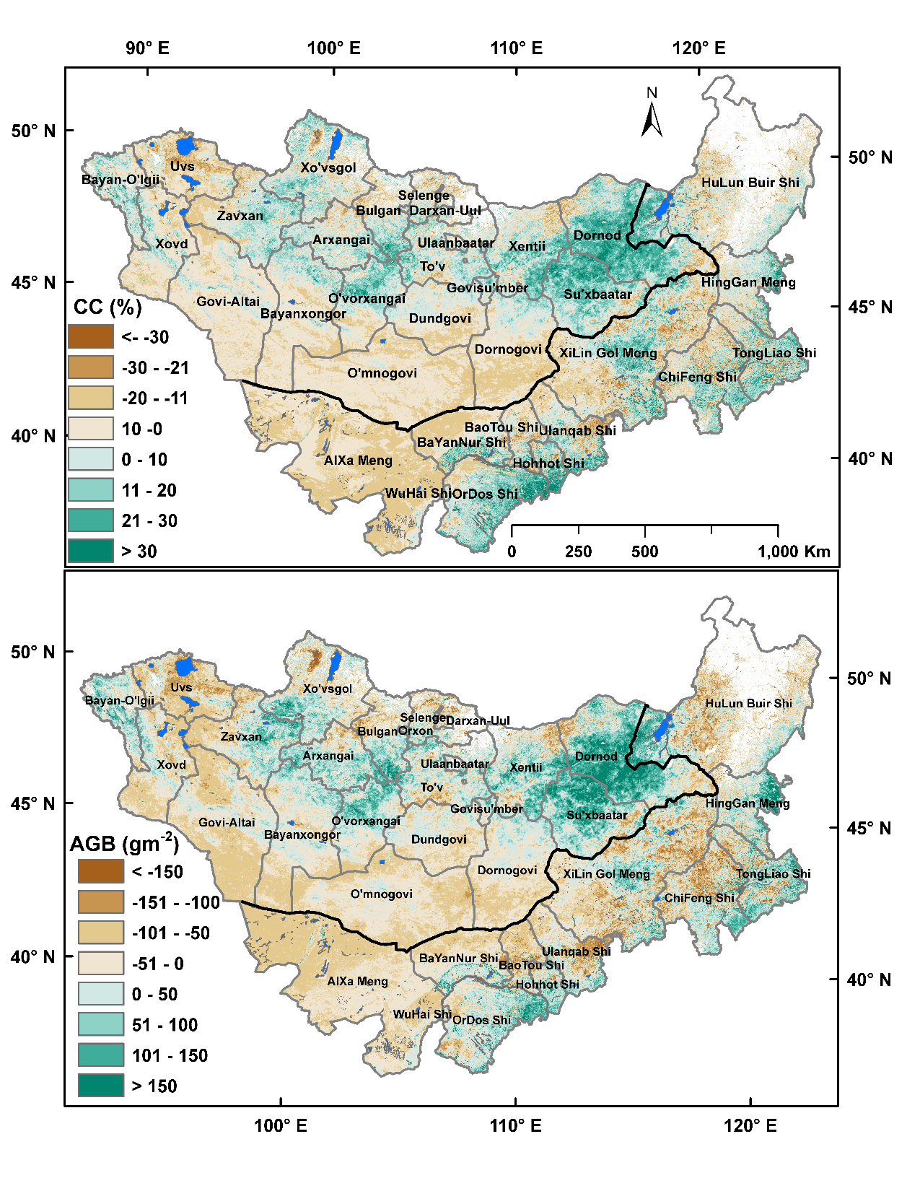
a)
Difference images for:
canopy cover (%)
aboveground biomass (g m⁻²) created by subtracting July 2016 from July 2001.
AGB & canopy cover close to cities/provincial centers decrease while there is an increase in provinces away from cities (Ulaanbaatar in particular)
b)
John et al 2018

Slide 18
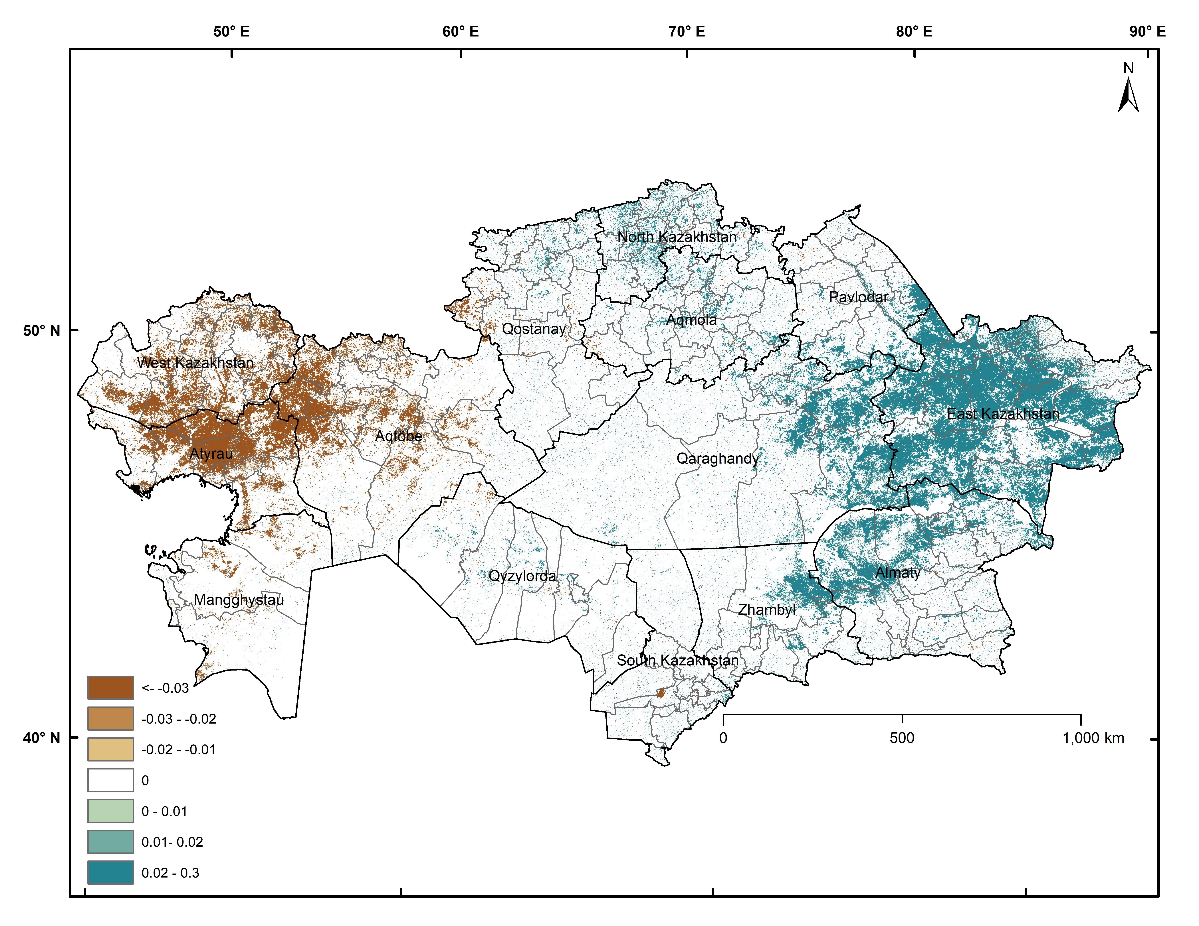
MOD13A3v6-NDVI 1km, slope trend (2000-2020) with p< 0.05 mask
Area under significant decrease (brown) 9.76%
Area under significant increase
(green) 7.18%
slope/yr

Slide 19
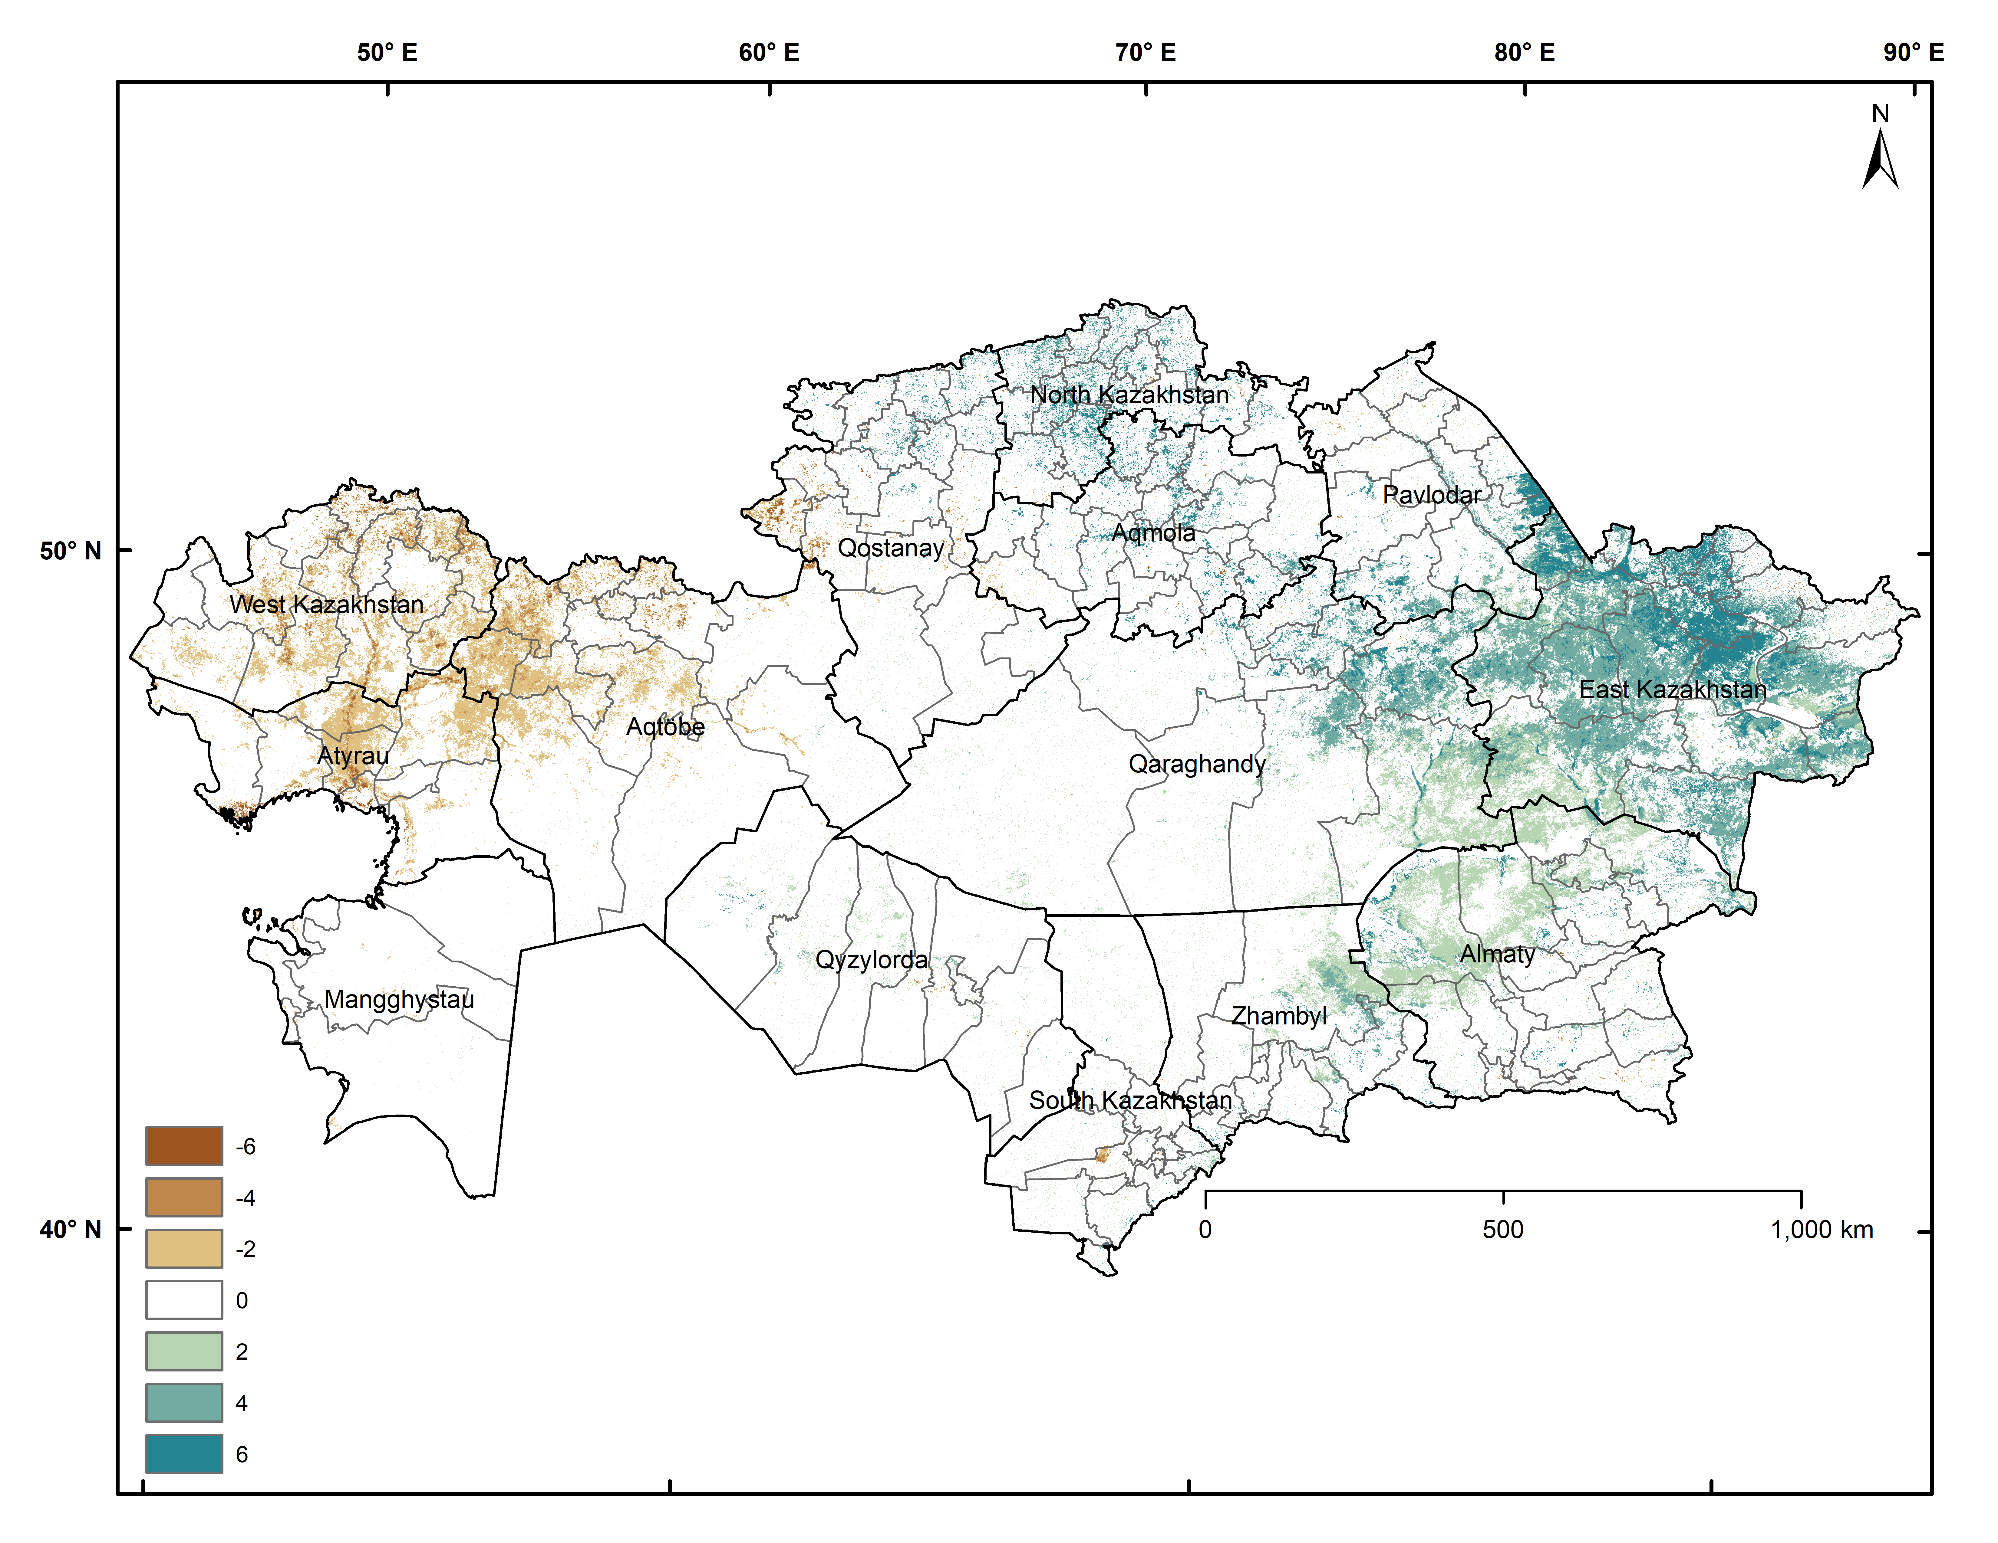
MOD17A3HGF-NPP 500m, slope trend (2000-2020) with p< 0.05 mask
Area under significant decrease (brown) 6.76%
Area under significant increase (green)
13.05%
g C/m²/yr

Slide 20
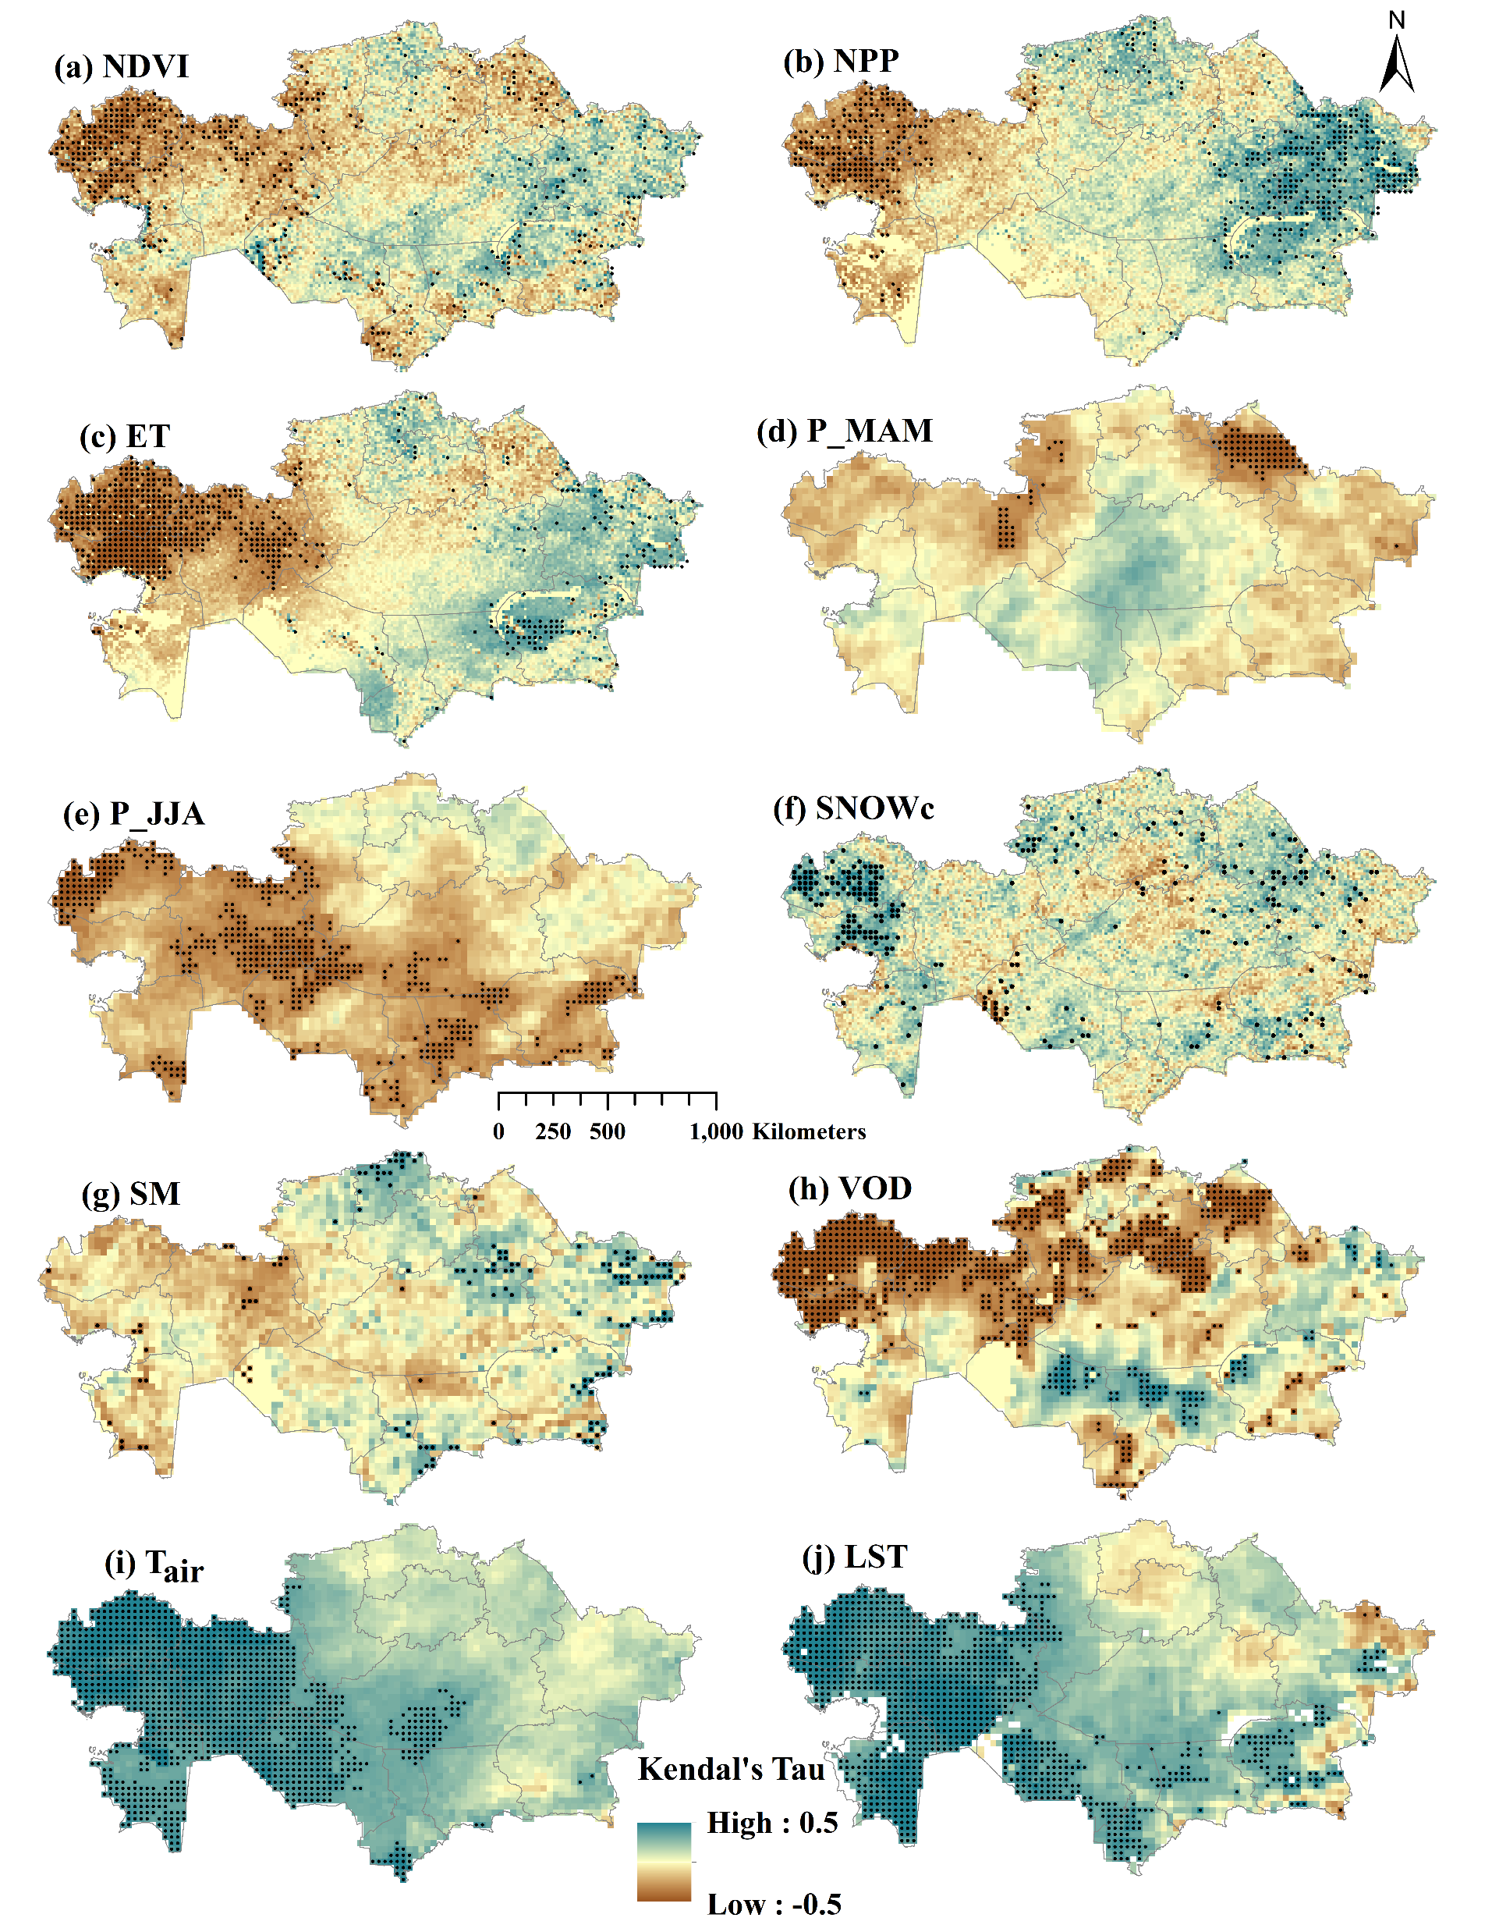
Figure Mann–Kendall trends of ESF and driver variables, for Kazakhstan during 2000–2016. Dots indicate pixels with significant p-value (p < 0.05).

Slide 21
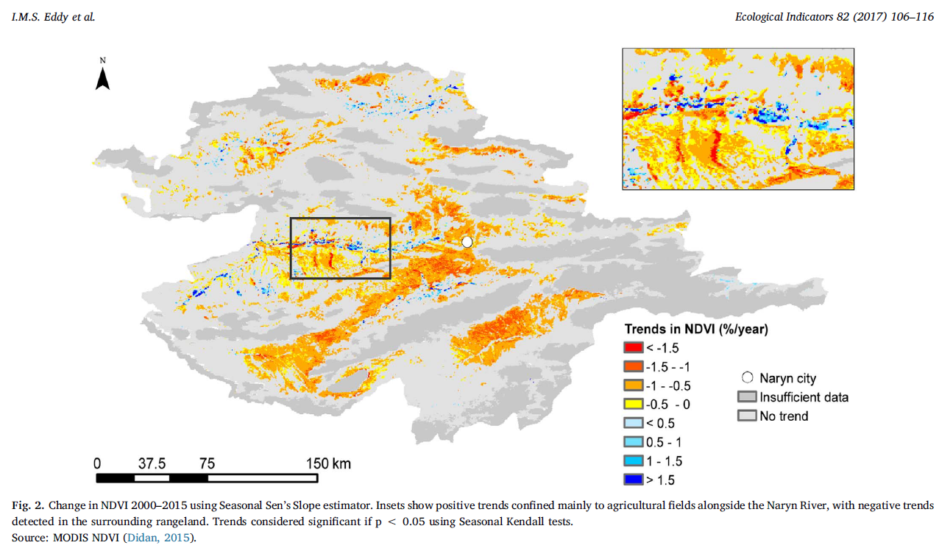
Rangelands and High temporal moderate resolution data
Changes in NDVI trends using theil sen slope In Naryn, Kyrghzstan
Eddy et al. 2017

Slide 22
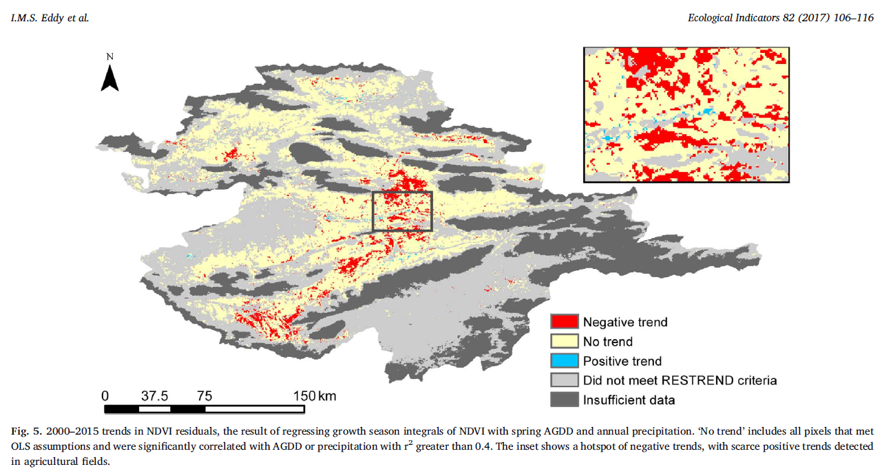
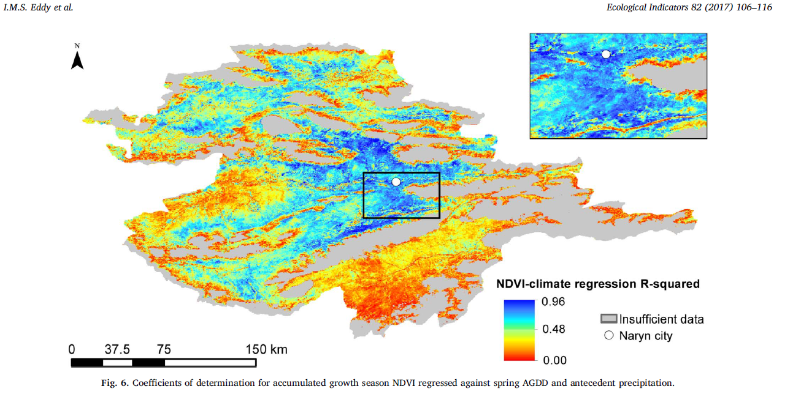
Residual trends of growing season NDVI with spring AGDD and annual precip. in Naryn, Kyrghzstan

Slide 23
Rangeland RS and high resolution/revisit spatiotemporal data

Slide 24
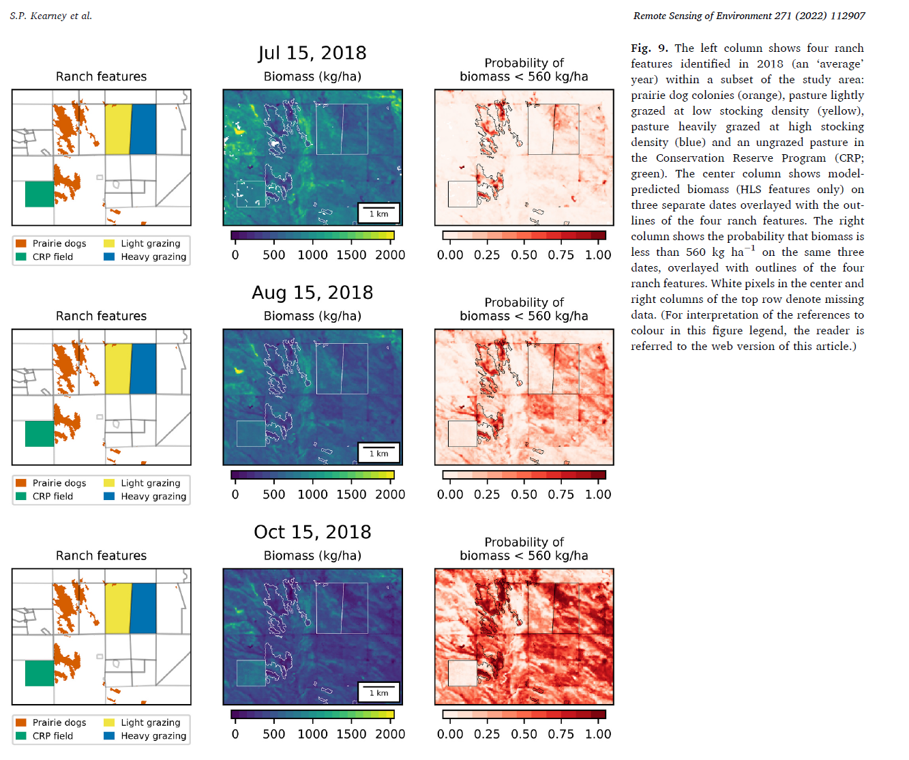
Harmonized landsat sentinel (HLS data) for within season adaptive management
Kearney et al. 2022

Slide 25
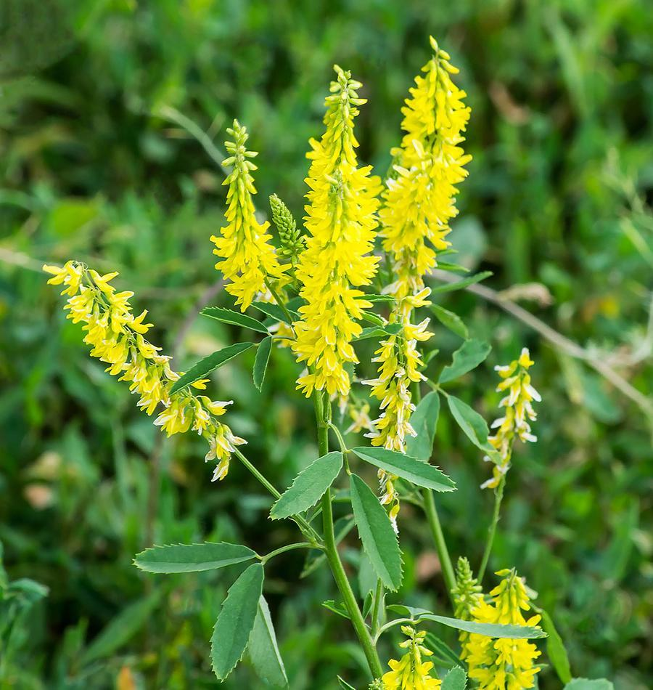
OBJECTIVES
To develop a generalized prediction model to predict the relative abundance of Yellow sweet clover (YSC) in suitable habitats across rangelands of western SD for the recent sweet clover year 2019.

Slide 26
HYPOTHESIS
H1: Predictors of YSC blooms in the western SD can be determined by a combination of wetter than average climate and low-lying areas.
H2: YSC’s distribution can be determined by a combination of heavy clay to loamy soils with alkaline to slightly acidic soil and above average soil moisture, and
H3: YSC’s distribution can be biased based on proximity to roads and stream networks which facilitate dispersion
Figure 1. YSC percent canopy cover and mean annual precipitation for western SD for 2016-2021 (Bar graph with whiskers represents mean percent canopy cover with standard deviation and dashed line represents the mean annual precipitation).

Slide 27
Figure 2. Field data points collected (n = 2787) across the years (2016-2021) overlaid on the Level III ecoregions of the Upper Missouri River Basin and land cover map of western SD overlaid with county boundaries.
Saraf et al. 2022

Slide 28
Figure 4. Schematic workflow for predicting habitat suitability of YSC and its percent canopy cover distribution across western SD.
Feature selection
-RFE
Model accuracy assessment
- Accuracy
- Kappa coefficient
- AUC
- TSS
Presence-absence data
Data for YSC probability of occurrence classification
80% - training
20% - validation
YSC habitat suitability models
- RF
- MARS
- GAM
- GBM
- Maxent Phillips
- Ensemble
Data acquisition
Best model selected
YSC percent cover & habitat suitability map of YSC
Independent Variables
Feature selection
-RFE
Percent cover data
Google Earth Engine
Best model selected
Data for YSC percent canopy cover regression
80% - training
20% - validation
YSC percent cover regression models
- RF
- XGBoost
- Cubist
- GAM
Model accuracy assessment
- R²
- RMSE
- MAE
- MAPE
Saraf et al. 2022

Slide 29
Figure 5. Climate and topographic variables used in this study for predicting YSC presence and percent cover using various machine learning models.(a) Spring precipitation (P_MAM), (b) Variability of spring precipitation (P_MAM_{sd} ), (c) Summer precipitation (P_JJA) , (d) Spring temperature (T_MAM), (e) Summer temperature (T_JJA) (f) Variability of summer temperature (T_JJA_{sd}) (g) Elevation (m), (h) Slope (% rise), (i) Terrain Wetness Index (TWI), (j) Normalized Difference Snow Index (NDSI) , (k) Variability of Normalized Difference Snow Index (NDSI_{sd}), (l) Variability of snow depth (Sdepth_{sd}).
Saraf et al. 2022

Slide 30
Figure 6. Bio-physical variables used in this study for predicting YSC presence and percent cover using various machine learning models. (a) Normalized Difference Yellow Index (NDYI), (b) Land Surface Water Index (LSWI), (c) Normalized Difference Water Index (NDWI), (d) Sentinel-2A near infrared (S2A-NIR), (e) Sentinel-2A short wave infrared1 (S2A-SWIR1), (f) Tasseled cap wetness (TCW), (g) Variability of tasseled cap wetness (TCW_{sd}), (h) Distance to roads, (i) Percent clay (%), (j) Percent silt (%), (k) Soil pH.(Soil_pH).
Saraf et al. 2022

Slide 31
Figure 8. Pearson correlation matrix for 22 out of 57 variables with less than 0.7 threshold selected for recursive feature elimination (RFE) using percent cover data.
Saraf et al. 2022

Slide 32
YSC probability of occurrence
Figure 14. Habitat suitability map for YSC developed using an ensemble model across rangelands of western South Dakota.

Slide 33
YSC presence
Figure 15. YSC habitat suitability map developed using ensemble model across rangelands of western SD. YSC Presence is defined by the higher probability of occurrence values than the threshold value.

Slide 34
Results for % canopy cover model
Table 8. Hyperparameter and cross-validation technique details for habitat suitability and percent cover prediction models.
Model | CV method | Parameters
GAM | 10-fold CV
Cubist | 10-fold CV with 5 repeats | committees = 100 and neighbors = 3
Random Forest | 10-fold CV with 5 repeats | mtry = 4.12 and ntree = 2500
XGBoost | 10-fold CV with 5 repeats | Nrounds = 100, max_depth = 4, eta = 0.3, gamma = 20, colsample_bytree = 0.5, min_child_weight = 25, and subsample = 0.5
Figure 16. Variable importance from the random forest model for predicting the YSC percent canopy cover.
Table 9. Statistical comparison of machine learning models for predicting percent canopy cover of YSC.
*Footnote: NDYI -Normalized Difference Yellowness Index, LSWI - Land Surface Water Index, T_JJA_{sd} - variation in summer temperature (standard deviation), NDSIsd - variation in Normalized Difference Snow Index (standard deviation), TCW - Tasseled Cap Wetness, TCW_{sd} - variation in Tasseled Cap Wetness (standard deviation), P_MAM - mean spring precipitation, T_JJA - mean summer temperature, LCLU - Land cover land use, NDWI - Normalized Difference Water Index, P_MAM_{sd} - Variation in spring precipitation (standard deviation), Sdepth_{sd} - Variation in soil depth (standard deviation)
Model | R² | R | RMSE | MAE | MAPE | Variable Importance
GAM | 0.31 | 0.56 | 8.90 | 6.03 | 2.85 | NDYI, LSWI, TCW_{sd}, P_MAM, T_JJA_{sd}, T_JJA, Sdepth_{sd}, NDSI_{sd}, Elevation, and TCW
Cubist | 0.56 | 0.74 | 7.10 | 4.23 | 1.87 | LSWI, Elevation, T_JJA, NDYI, T_JJA_{sd}, P_MAM, SWIR1, NDSI_{sd}, TCW, Silt, P_MAM_{sd} and Sdepth_{sd}
Random forest | 0.61 | 0.78 | 6.67 | 4.33 | 2.16 | NDYI, LSWI, T_JJA_{sd}, S2A-SWIR1, NDSI_{sd}, TCW, TCW_{sd}, P_MAM, S2A-NIR, T_JJA, Elevation, and Slope
XGBoost | 0.48 | 0.69 | 7.74 | 5.38 | 2.83 | NDYI, LSWI, S2A-NIR, TCW, NDSI_{sd}, TCW_{sd}, NDWI, Sdepth_{sd}, P_MAM, T_JJA, and T_JJA_{sd}

Slide 35
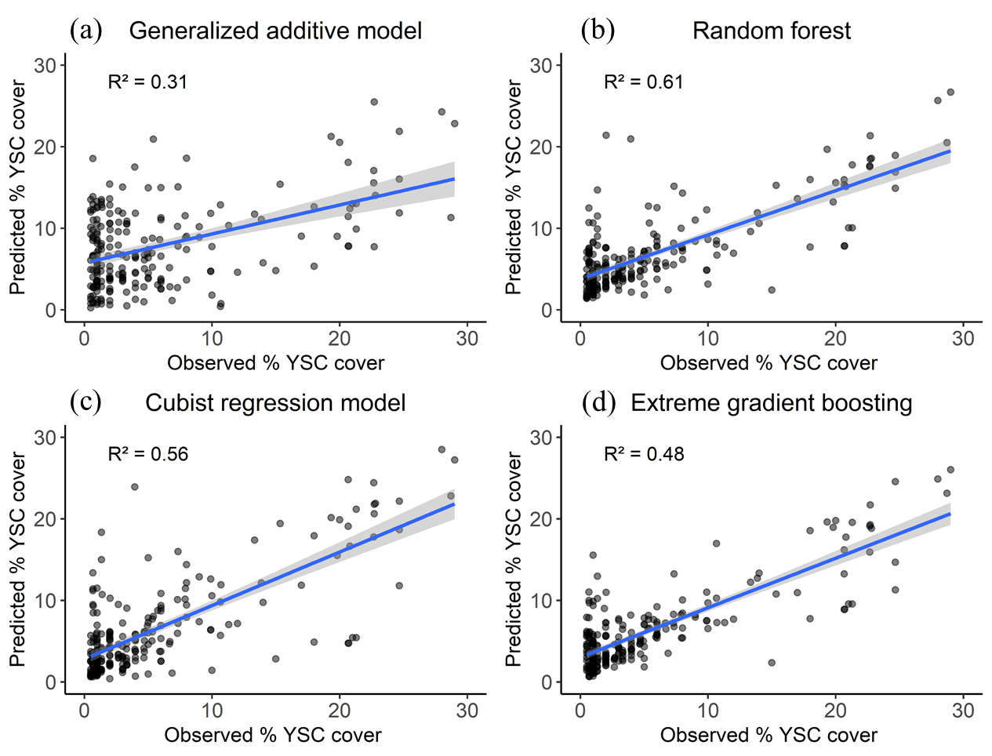
Results for % canopy cover model
Figure 17. Coefficient of determination between observed and predicted yellow sweet clover percent canopy cover for (a) Generalized additive model (GAM), (b) Random Forest model (RF), (c) Cubist regression model (Cubist) (d) Extreme Gradient Boosting model (XGBoost). The shaded region around the regression line indicates 95% confidence interval.

Slide 36
% canopy cover model
Figure 18. YSC percent canopy cover map developed using random forest (best) model across rangelands of western SD.

Slide 37
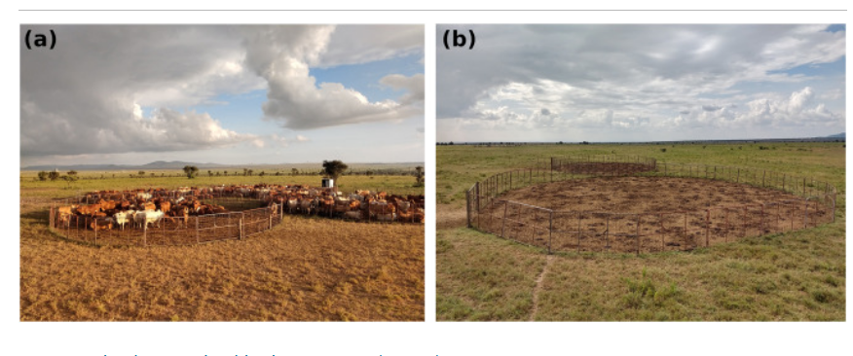
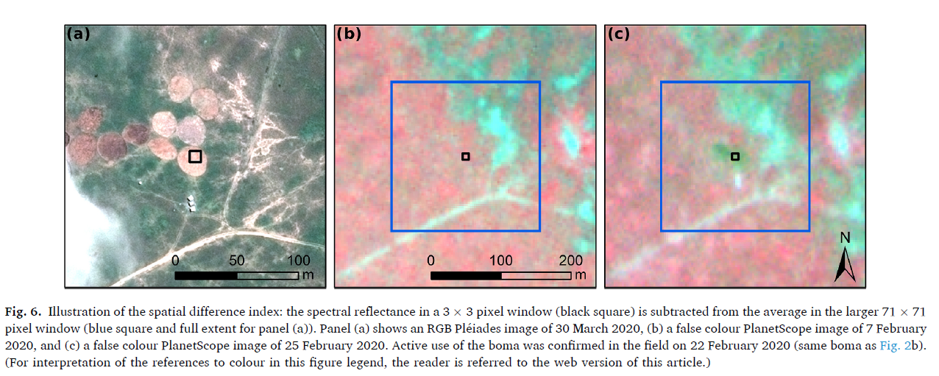
Rangelands and Hyperspatial(PlanetScope)data
map and monitor the appearance of bomas or corrals across African rangelands with the use of satellite image time series.
Vrieling et al. 2022

Slide 38
Rangeland RS and sUAS data

Slide 39
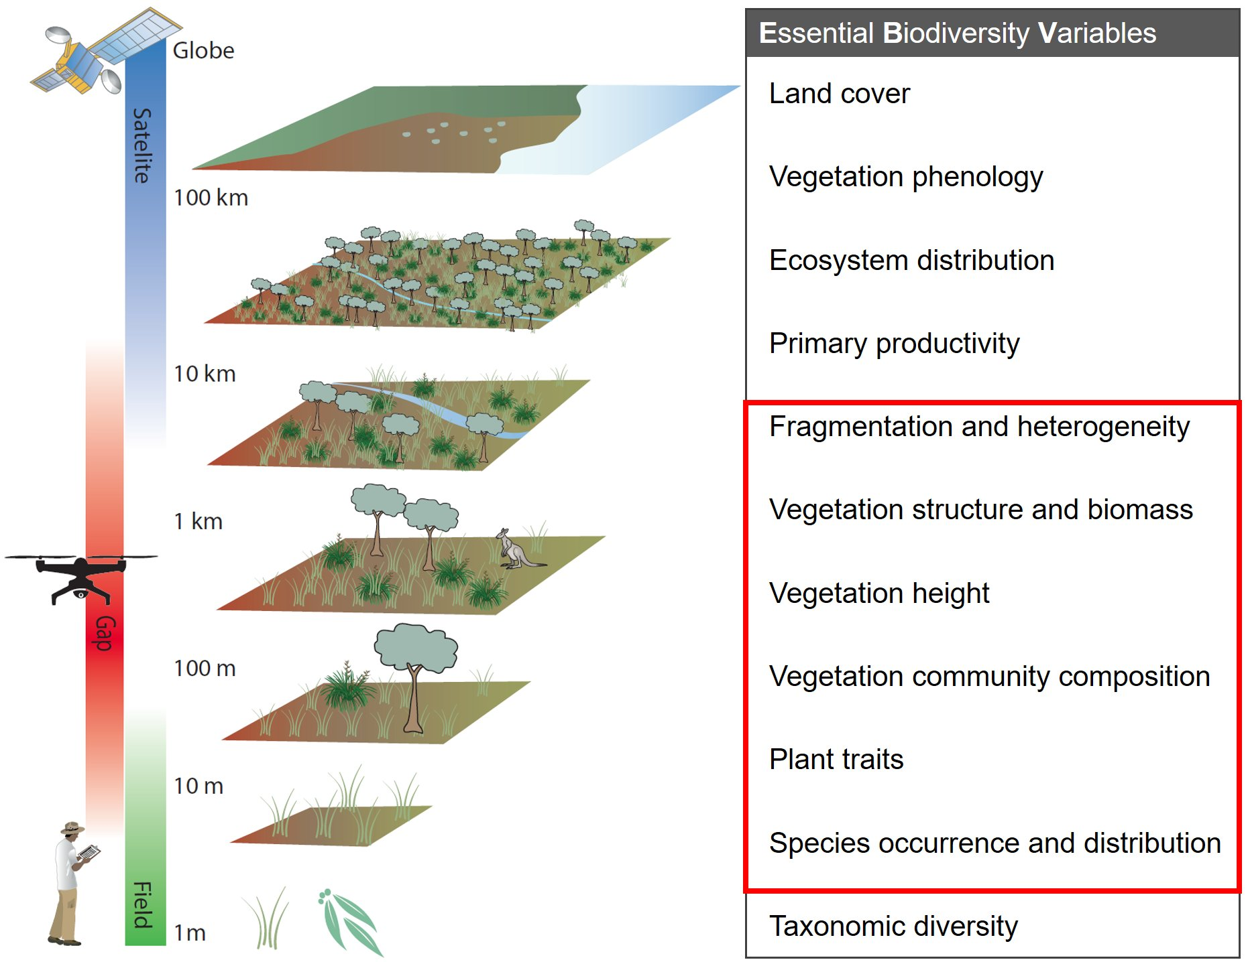
Missing data and knowledge gap and solution

Slide 40
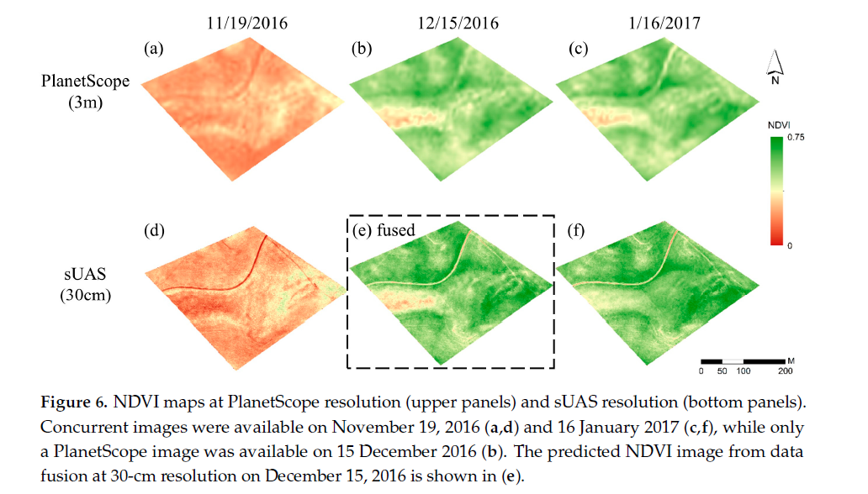
Hyperspatial and sUAS fusion
Spatial and Temporal Adaptive Reflectance Fusion Model (STARFM) used to fuse sUAS data and Planetscope
Liu et al. 2022

Slide 41
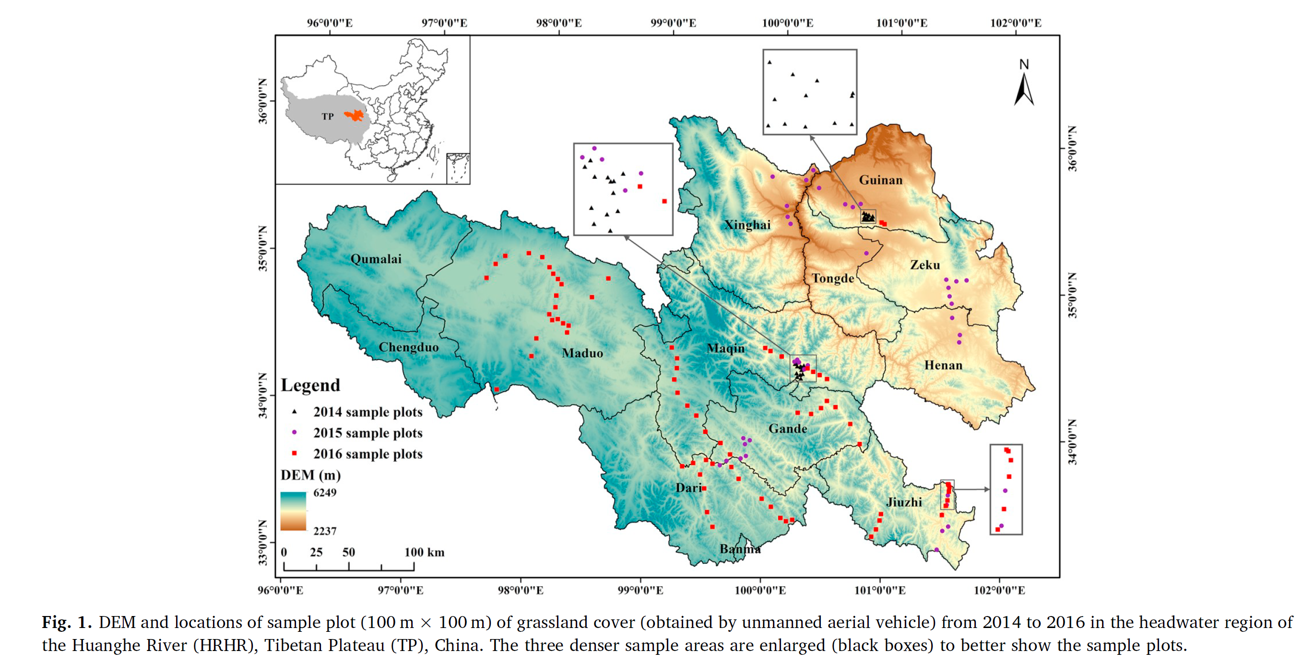
Ge et al. 2018

Slide 42
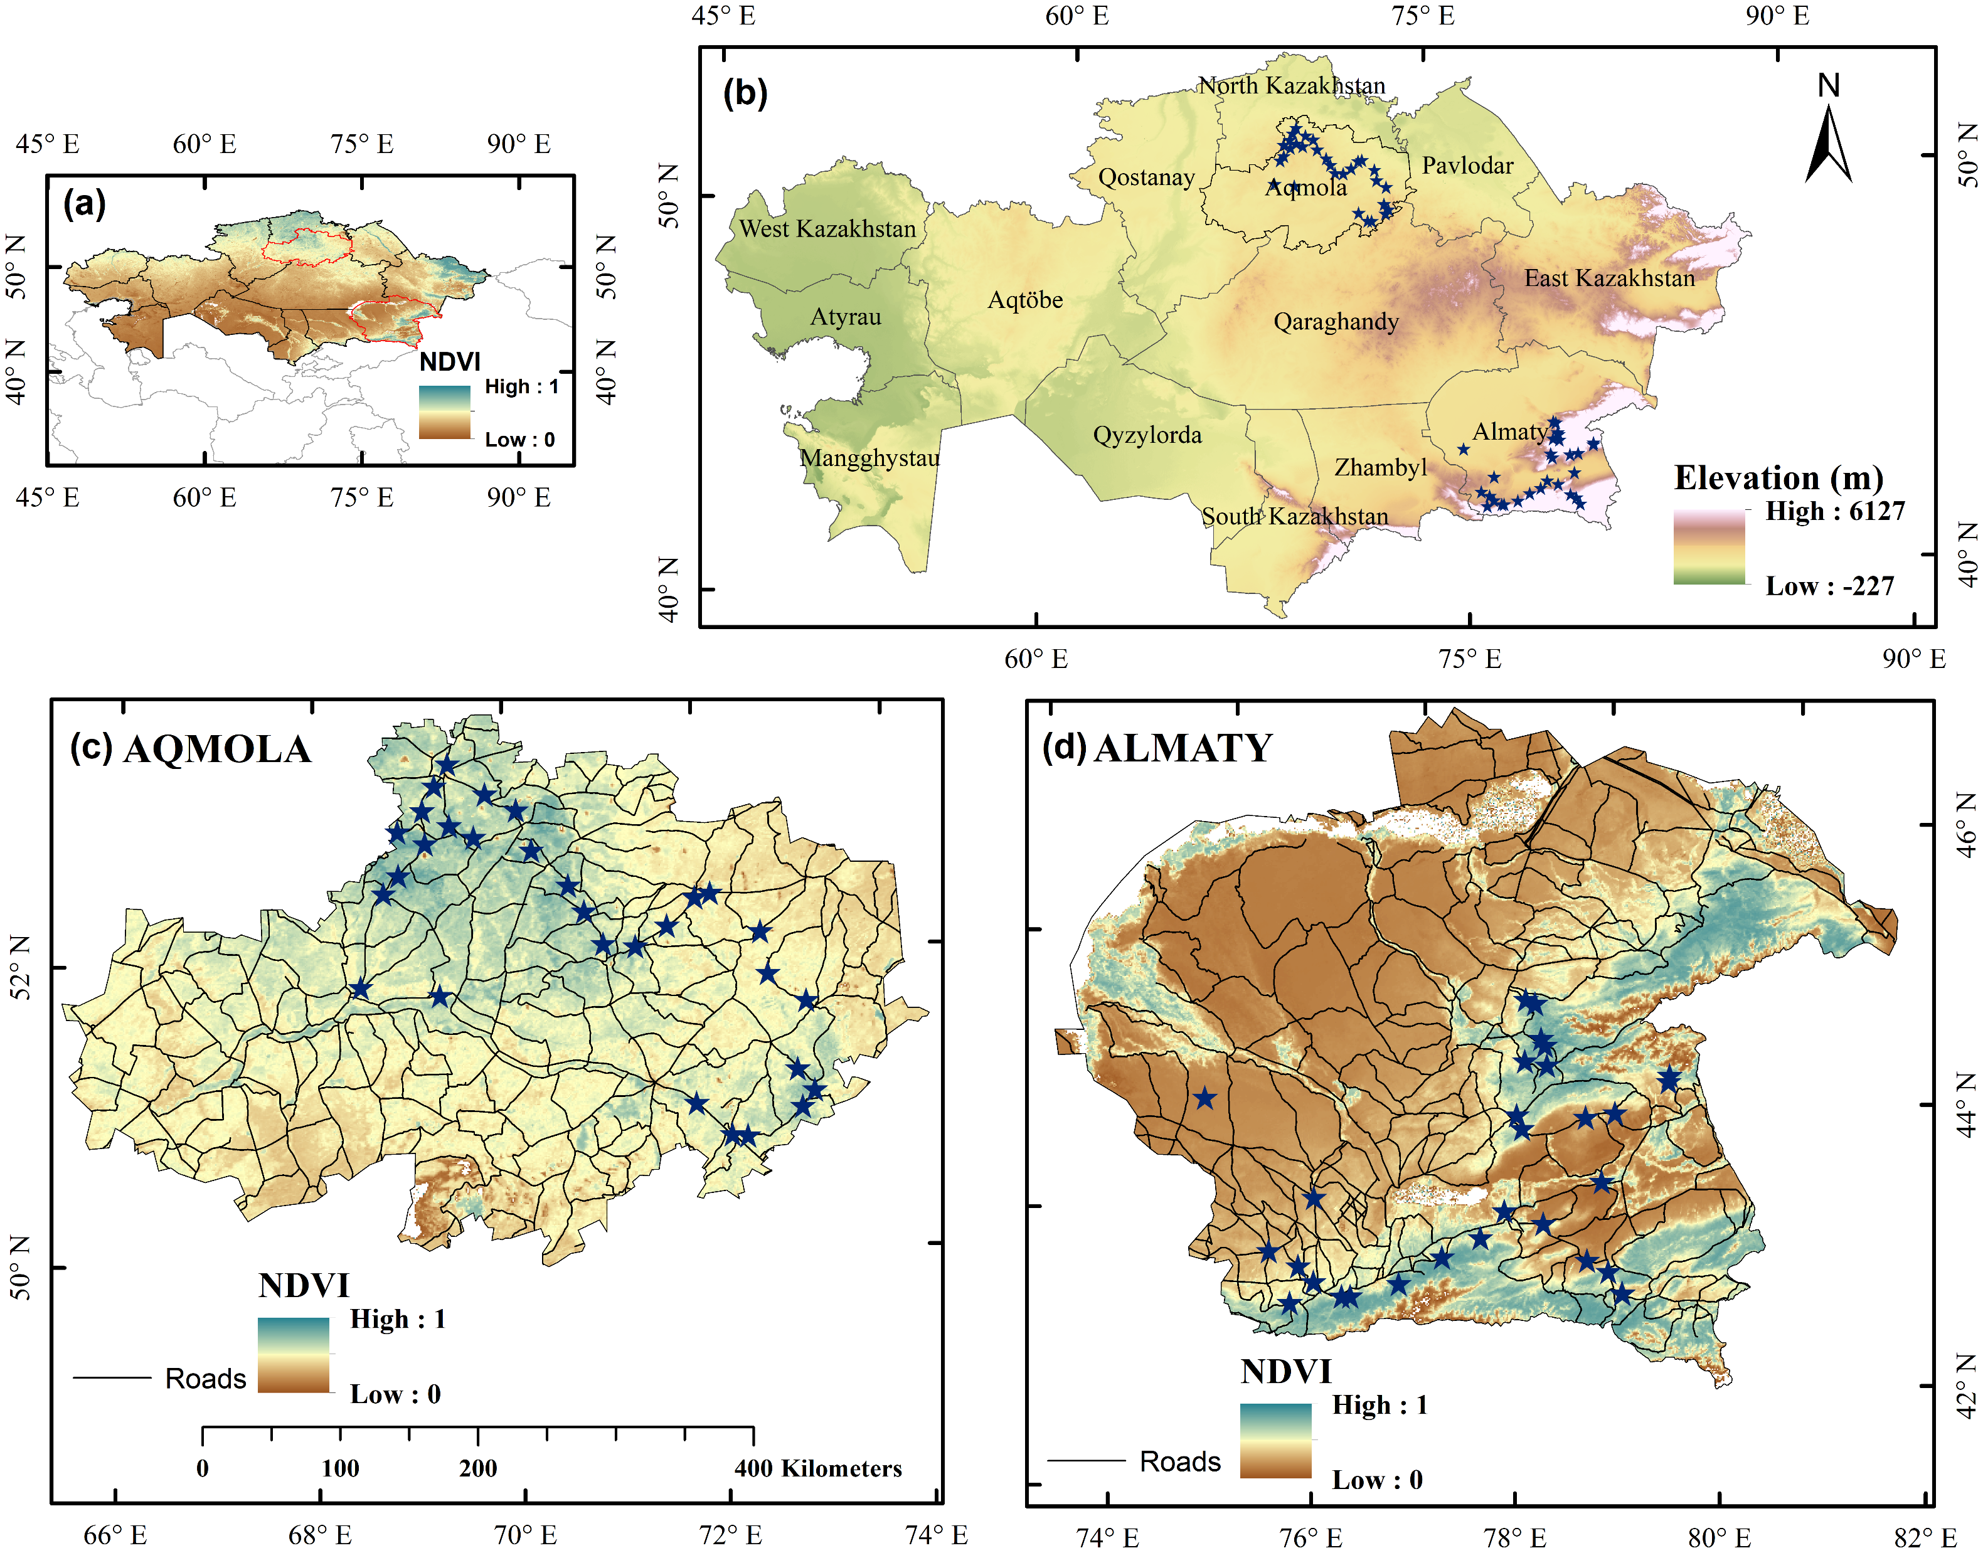
Figure Caption: Map showing (a) MODIS NDVI (MOD13A2) overlaid with provincial boundaries of Kazakhstan, (b) Elevation obtained from SRTM (SRTMGL1_v003) overlaid with provincial boundaries and sampling sites from the summer field trip (2022), (c) NDVI map of Aqmola province overlaid with major district roads and field sampling sites and (d) NDVI map of Almaty province overlaid with major district roads and field sampling sites.

Slide 43
Rangeland land use and socioecological system analysis

Slide 44
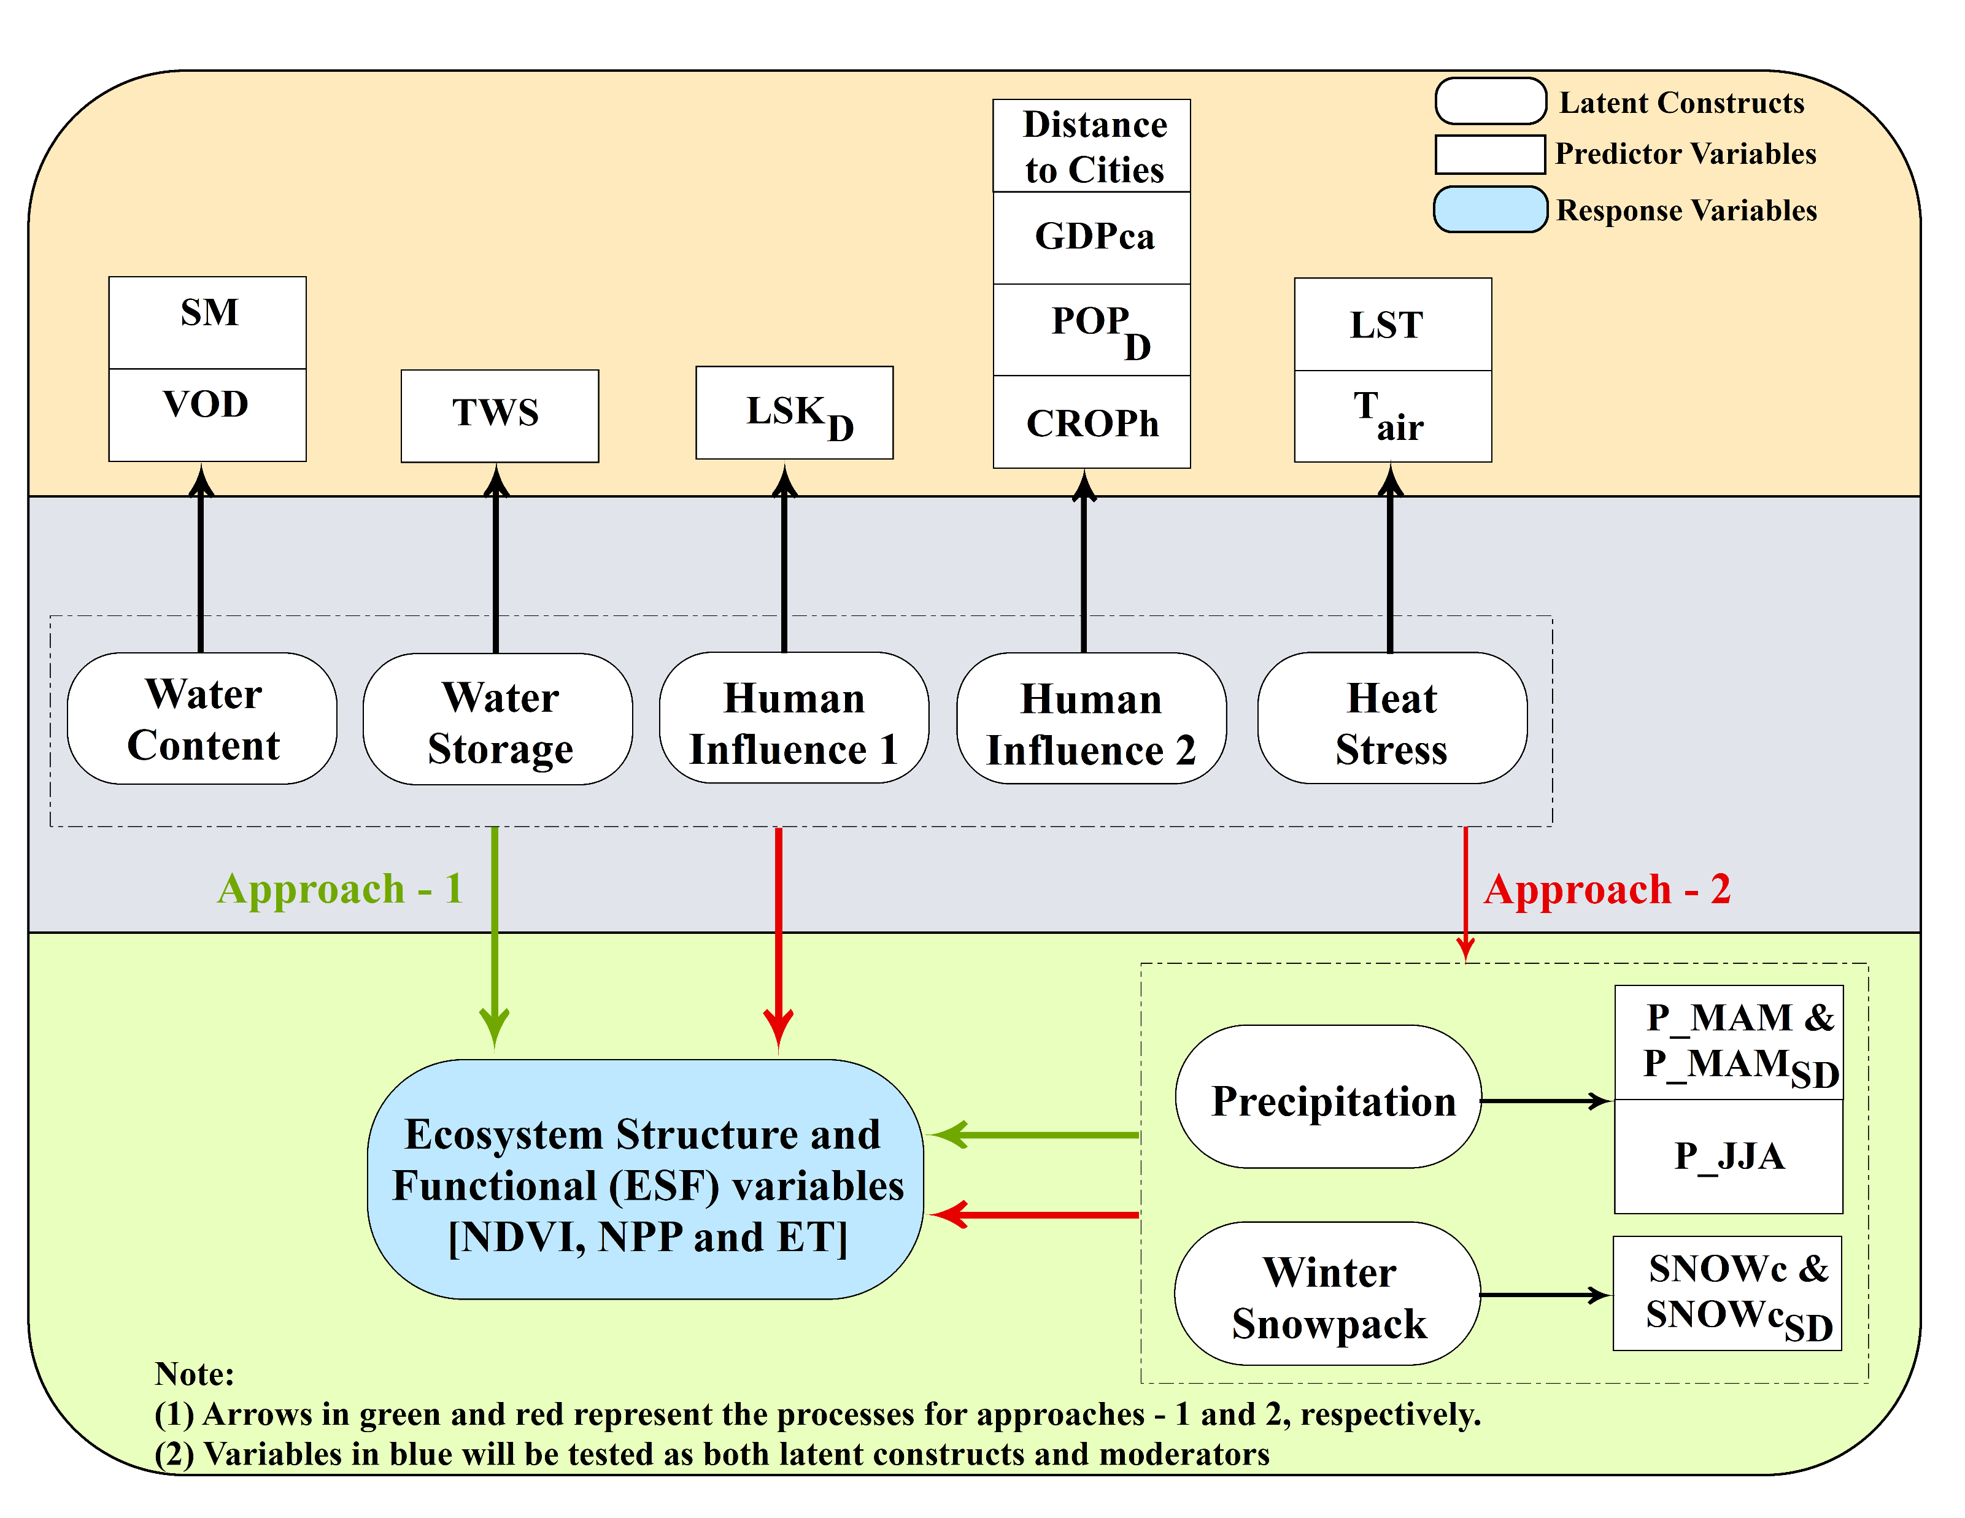
Figure 2. Structural equation model (SEM) framework investigating the possible pathways to find the interactions between predictors or drivers (climate, moisture and socioeconomic variables grouped under different latent constructs) and response variables (NDVI/NPP/ET) in this study.
Kolluru et al. 2022

Slide 45
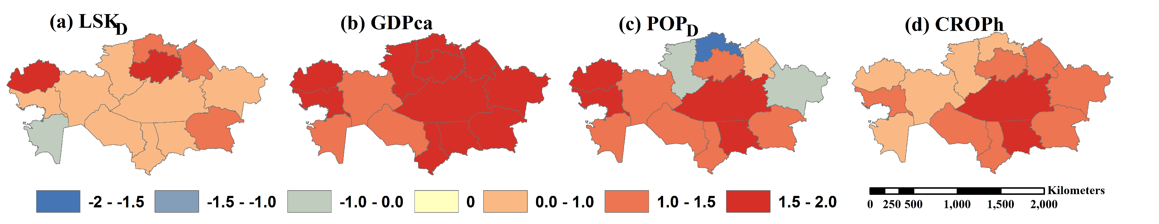
Figure 3. Standardized anomalies of socioeconomic variables of 14 provinces in Kazakhstan: (a) livestock density (LSKD), (b) GDP per capita (GDPca), (c) population density (POPD) and (d) crops per hectare (CROPh).
Kolluru et al. 2022

Slide 46
Fig. 3. Spatial distribution of socioeconomic variables from 2000 to 2016 ((a) livestock density (LSKD), (b) GDP per capita (GDPca), (c) population density (POPD) and (d) crop production in tons per hectare (PCROP)).
Kolluru et al. 2022

Slide 47
Fig. 4. Spatial distribution of seasonal composites (2000–2016) of (a) summer (JJA) normalized difference vegetation index (NDVI), (b) winter (DJF) percent cover snowpack (SNOWc), (c) winter snow depth (SNOWde), (d) spring precipitation (P_MAM), (e) summer soil moisture (SM) (f) summer terrestrial water storage (TWS), (g) summer air temperature (Tair), (h) summer land surface temperature (LST), (i) spring drought (D_MAM), (j) winter freeze-thaw (FT), (k) slope and (l) elevation variables.
Kolluru et al. 2022

Slide 48
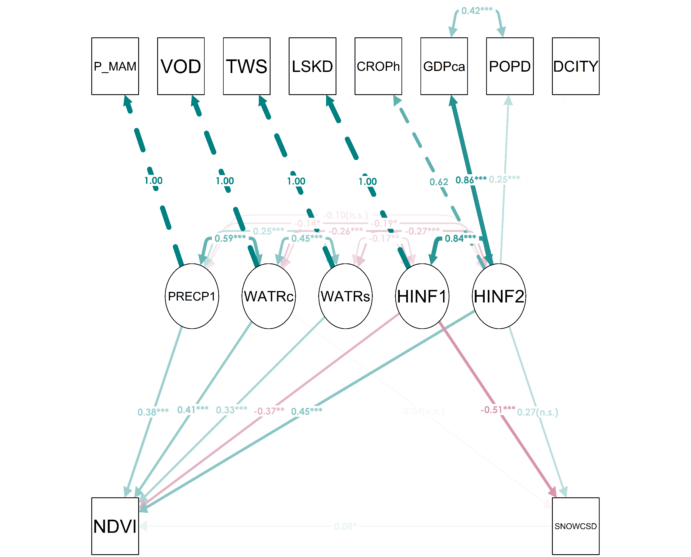
Figure 5. Structural equation modeling examining percent snow cover variability (SNOWcSD) as the moderator between mean normalized difference vegetation index (NDVI) and precipitation (PRECP), water content (WATRc), water storage (WATRs), human influence—1 (HINF1) and human influence—2 (HINF1) as constructs (i.e. latent variables). Model fit—chi-square (χ2; degrees of freedom = 19) = 58.31, comparative fit index = 0.96; Tucker–Lewis index = 0.90; standardized root mean square residual = 0.07. All parameter estimates are standardized (full forms in appendix). Statistical significance: p < 0.05*; p < 0.01**; p < 0.001***, n.s.—non-significant. The square elements in the first row represent the drivers, and the circles in the second row represent the latent constructs. In the last row, NDVI represents the response variable and the SNOWcSD is the SEM moderator.
Kolluru et al. 2022

Slide 49
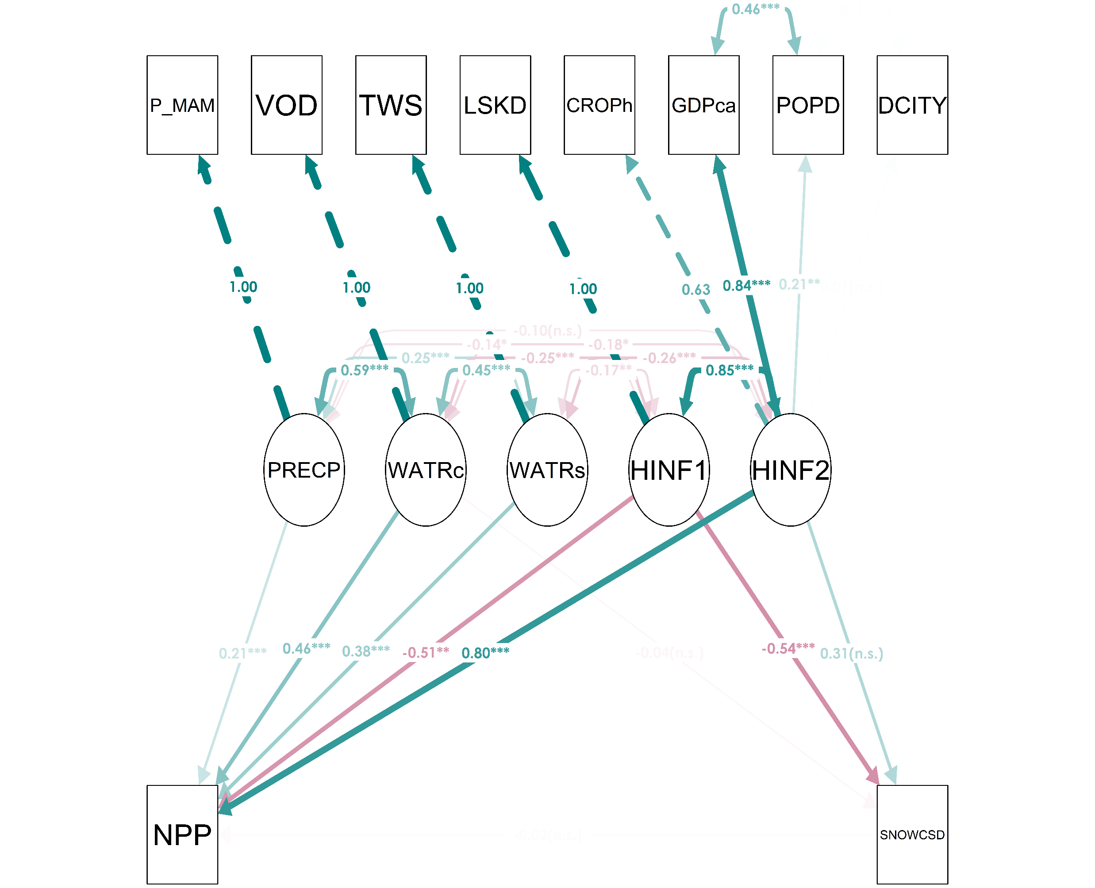
Figure 6. Structural equation modeling examining percent snow cover variability (SNOWcSD) as a moderator between the mean net primary productivity (NPP) and precipitation (PRECP), water content (WATRc), water storage (WATRs), human influence—1 (HINF1) and human influence—2 (HINF2) as constructs (i.e. latent variables). Model fit—chi-square (χ2; degrees of freedom = 19) = 61.31, comparative fit index = 0.95; Tucker–Lewis index = 0.89; standardized root mean square residual = 0.07. All parameter estimates are standardized (full forms in appendix). Statistical significance: p < 0.05*; p < 0.01**; p < 0.001***, n.s.—non-significant.
Kolluru et al. 2022

Slide 50
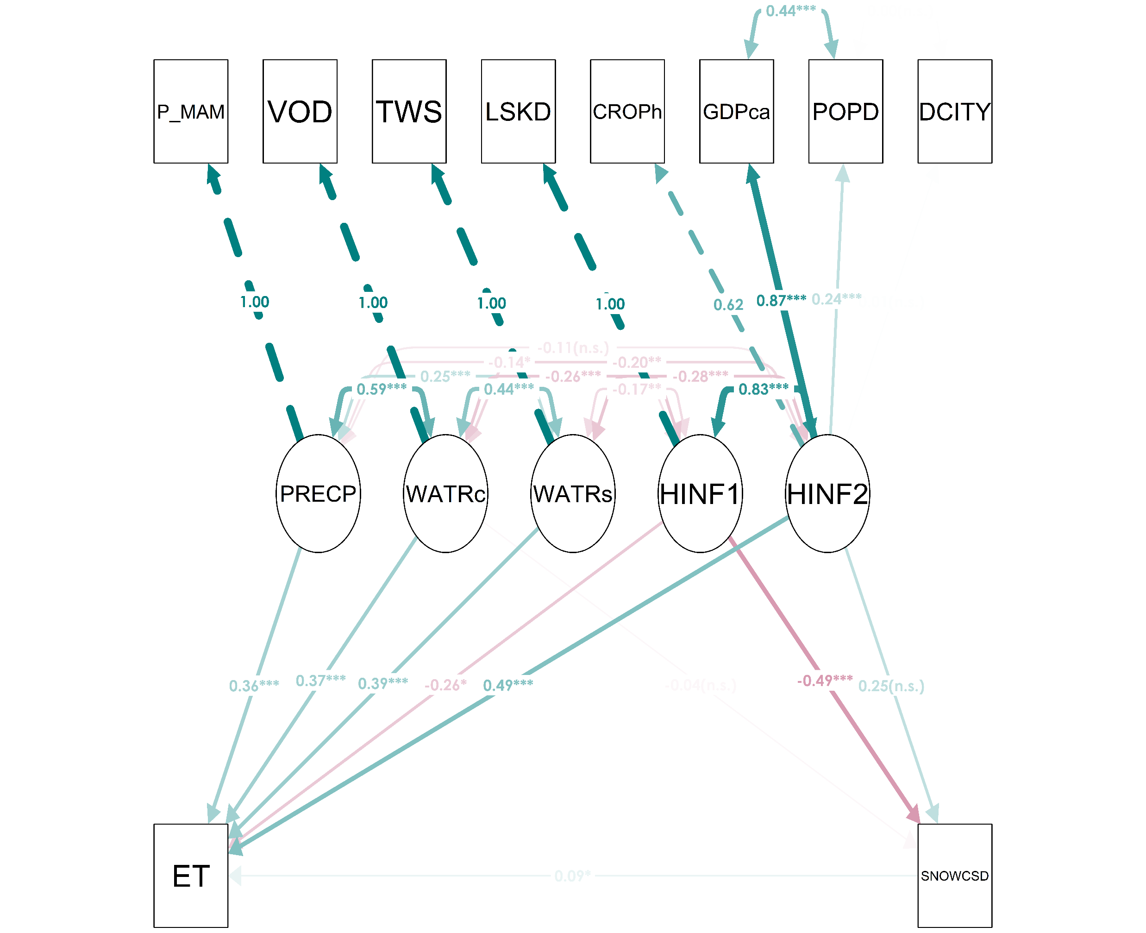
Figure 7. Structural equation modeling examining percent snow cover variability (SNOWcSD) as a moderator between the evapotranspiration (ET) and precipitation (PRECP), water content (WATRc), water storage (WATRs), human influence—1 (HINF1) and human influence—2 (HINF2) as constructs (i.e. latent variables). Model fit—chi-square (χ2; degrees of freedom = 19) = 55.26, comparative fit index = 0.96; Tucker–Lewis index = 0.90; standardized root mean square residual = 0.07. All parameter estimates are standardized (full forms in appendix). Statistical significance: p < 0.05*; p < 0.01**; p < 0.001***, n.s.—non-significant.
Kolluru et al. 2022

Slide 51
Kolluru et al. 2022
Fig. 6. Power of determinant (q) values of potential driving factors affecting the distribution of NDVI variability in Kazakhstan. Bars with patterns indicate the influence of socioeconomic drivers on NDVI. All q-values are statistically significant (p < 0.01) except for TWS and q - value represents the degree to which the predictor variable explains the response variable.

Slide 52
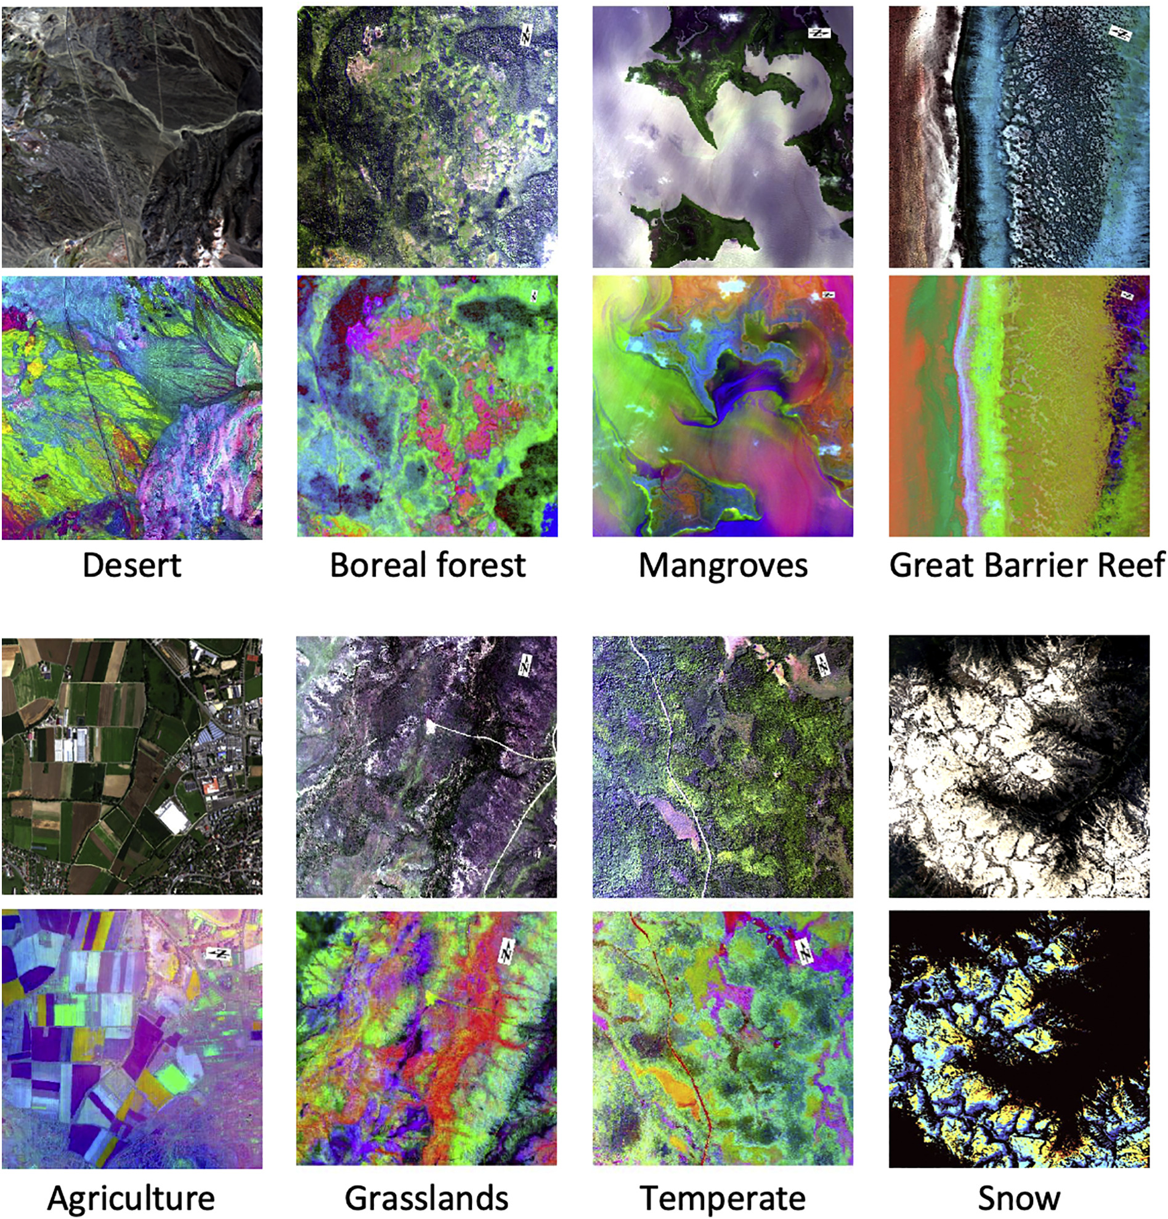
The Future of Rangeland RS
New sensors and upcoming missions including hyperspectral
  DESIS
  PRISM
  AVIRIS-NG
  Surface Biology and Geology (SBG)

Slide 53

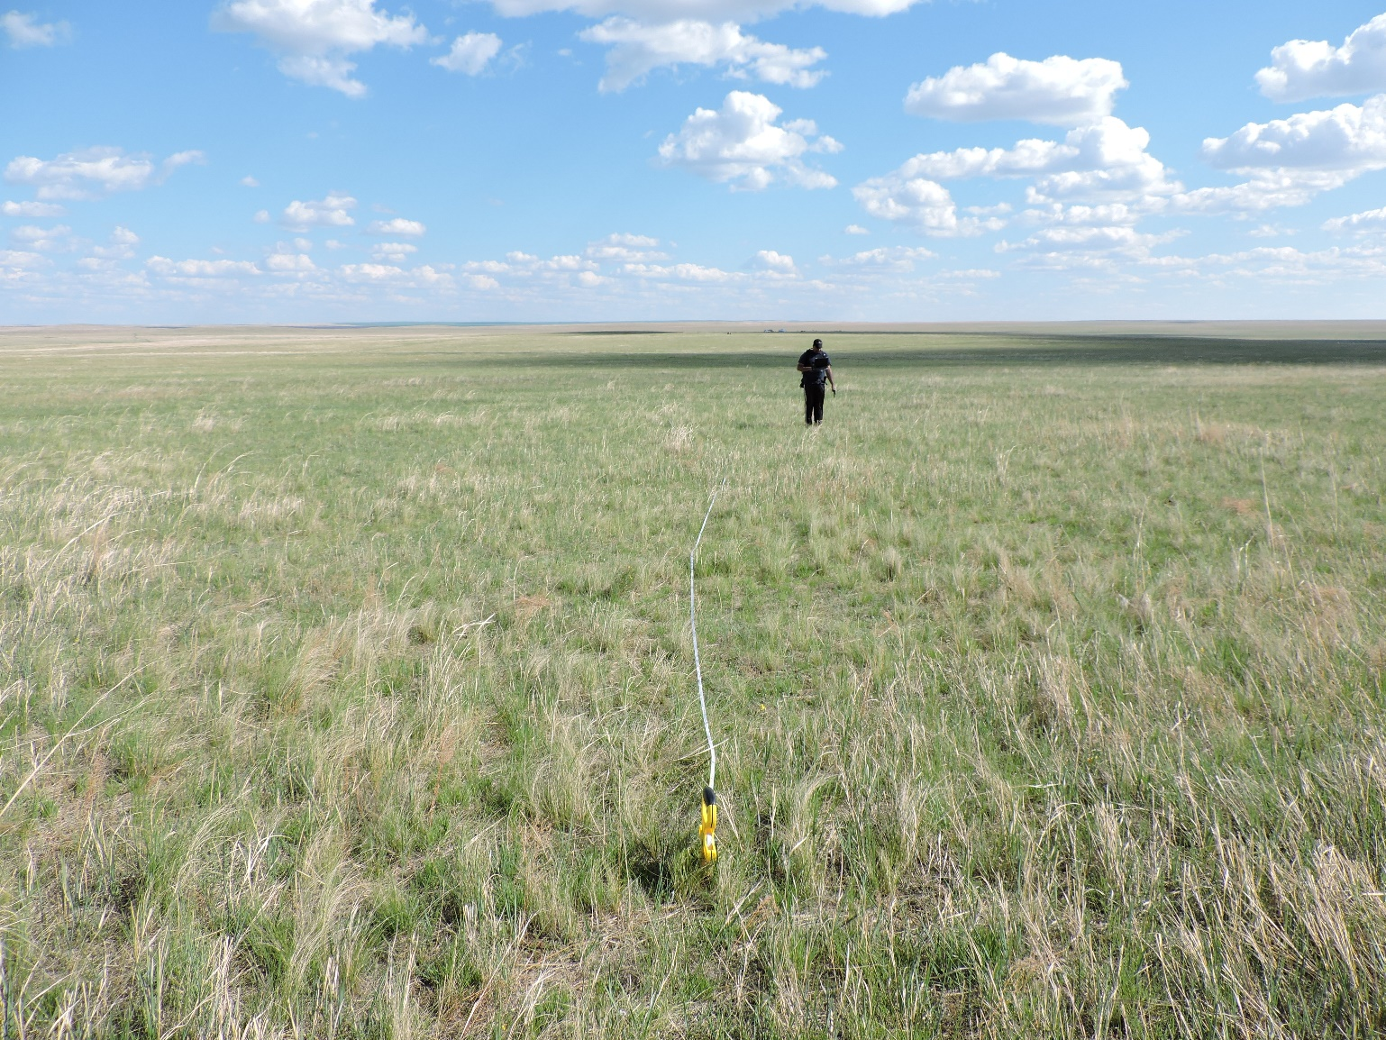
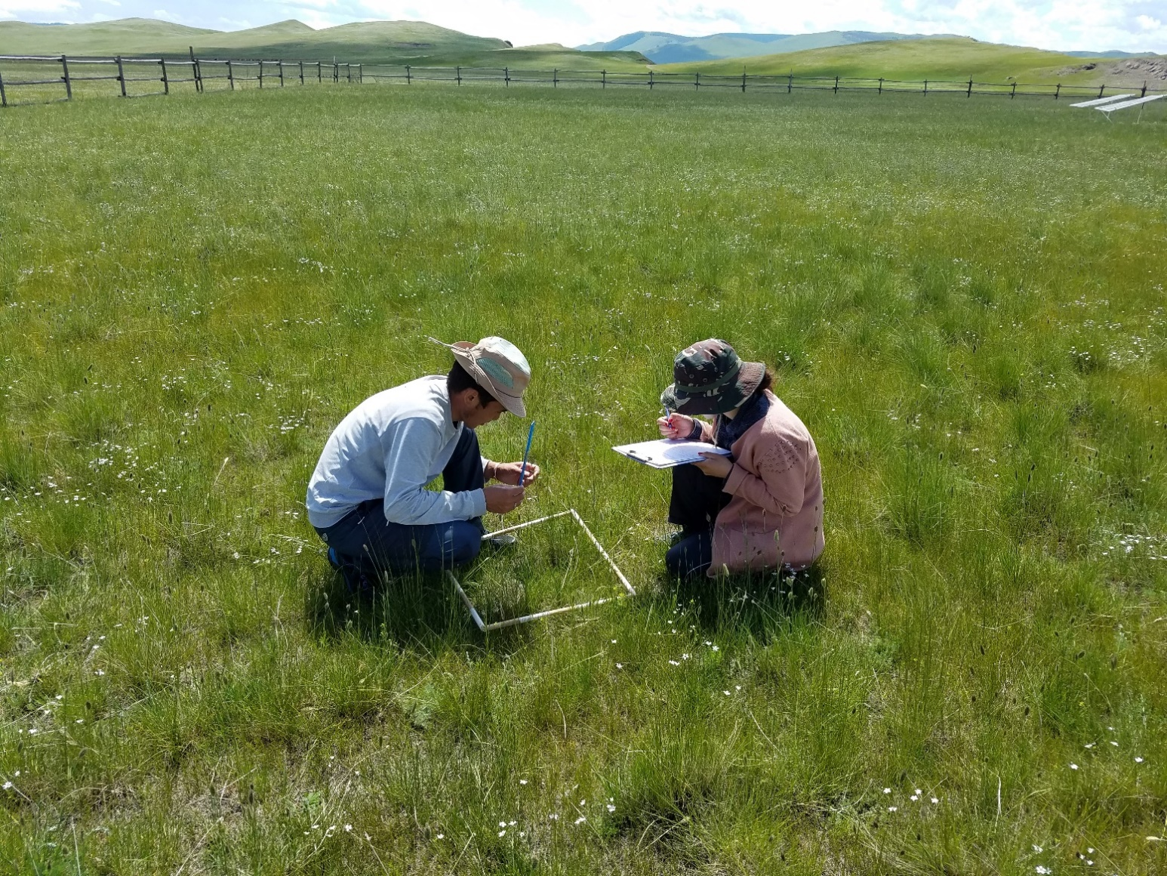

Acknowledgements
University of South Dakota Ph.D. students-Venkatesh Kolluru, Reza Goljani, Sakshi Saraf, Khushboo Jain
Michigan State University- Jiquan Chen, Geoffrey Henebry
fellow Investigators/Collaborators/Colleagues in University of South Dakota, Michigan State University, Kazakhstan/ Mongolia and LCLUCers

