Slide 1

Was Drought Really the Trigger Behind the Syrian Civil War in 2011?
Prof. Arnon Karnieli
The Remote Sensing Laboratory
Jacob Blaustein Institutes for Desert Research
Ben-Gurion University of the Negev

Slide 2
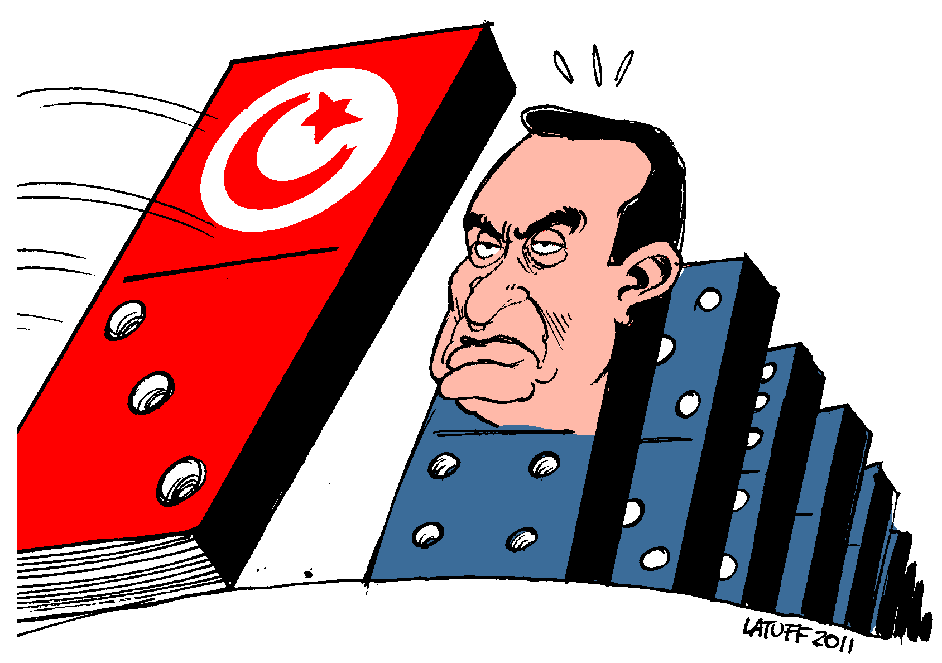
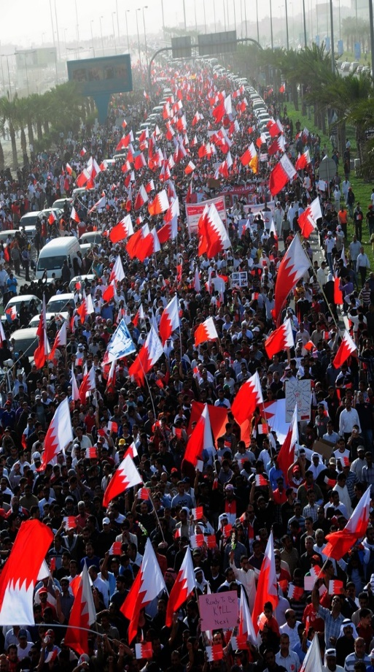
Arab Spring
The Arab Spring refers to a revolutionary wave of both violent and non-violent demonstrations, protests, and civil wars that began on 17 Dec. 2010 in Tunisia and spread, like a domino effect, to many other counties in North Africa and the Middle East.
Notes:
Some historical background. The Arab Spring refers to a revolutionary wave of both violent and non-violent demonstrations, protests, and civil wars that began on 17 Dec. 2010 in Tunisia and spread, like a domino effect, to many other counties in North Africa and the Middle East.

Slide 3
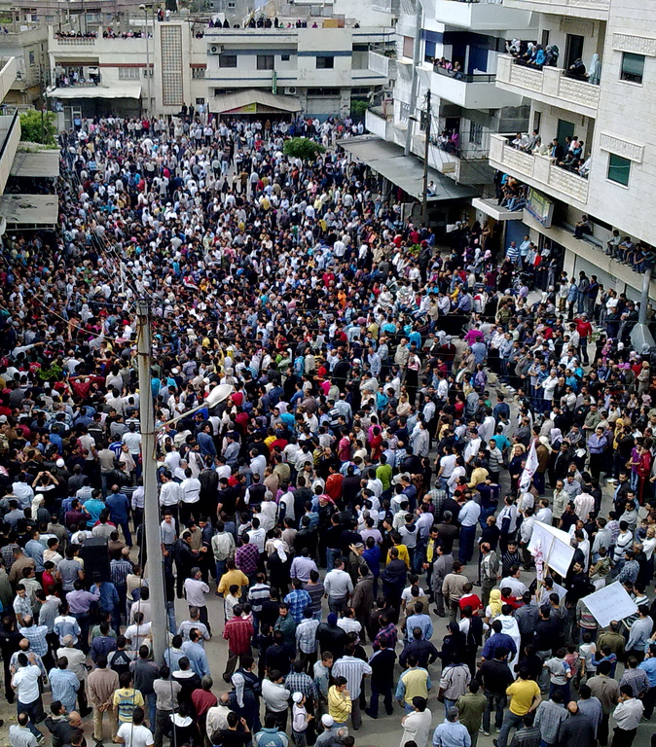
Arab Spring
There is no agreement about the reasons for the Arab Spring. This was explained by a variety of reasons, such as:
Poverty;
Hunger;
Unemployment;
Immorality of the government;
Dictatorship; and
Infection of human rights.
The Syrian uprising started on 15 Mar. 2011.
Notes:
The current study is focused on the Syrian uprising that was started on 15 March 2011.

Slide 4
Droughts and Climate Change
2015
Notes:
All the mentioned reasons for the civilian uprising were existed in Syria, but on top of the human reasons, many analysts also raised the effect of climate change, consecutive droughts, and environmental conditions that happened in the region at the beginning of the 21st century.

Slide 5
Droughts and Climate Change
Kelley, C.P. et al., 2015, PNAS, 112(11):3241-3246.
Notes:
Keley show negative trend of precipitation, positive trend of surface temperature, negarive trend of the Palmer Drought Severity Index, and above all very rapid increase of the population.

Slide 6

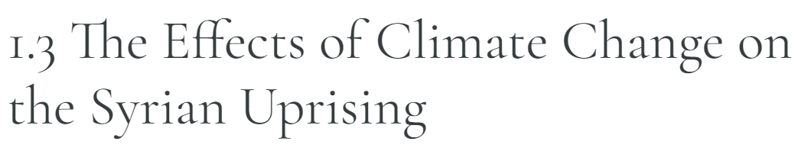

Droughts and Climate Change
2016
2017
Environmental ScienceBites
Notes:
Many other articles in scientific journals and popular newspapers claimed the same.

Slide 7
Study Area
Notes:
The current study is focused on the vicinity of Syria and Turkey border, where the two countries share the same geographical, climatic, or agricultural conditions.
Two large rivers, the Euphrates and Tigris, started in the Anatolia mountains in Turkey and crossing the border line to Syria.

Slide 8

Syria – Turkey Bilateral Accords
1987 – The Protocol on Economic Cooperation is an interim agreement on water quantity, which states that an annual 500 m³/s is to be released at the Syrian - Turkish border.
2009 – The Turkish-Syrian Strategic Cooperation Council Agreement addresses joint activities in the field of water, such as the improvement of water quality, the
construction of water pumping stations, joint dams, as well as the development of joint water policies.
Notes:
Since 60% of its water resources originate in Turkey, Syria has always been aware of this problematic and dangerous situation, and therefore signed a series of agreements with Turkey to ensure access to waters from the watershed.

Slide 9
Mean Annual Discharge at Jarablus
Notes:
Data from the beginning of the 20th century reveal a significant negative trend of discharge of the Euphrates river across the border.
To some degree, this is trend is due to climate variability and more frequent drought periods.

Slide 10
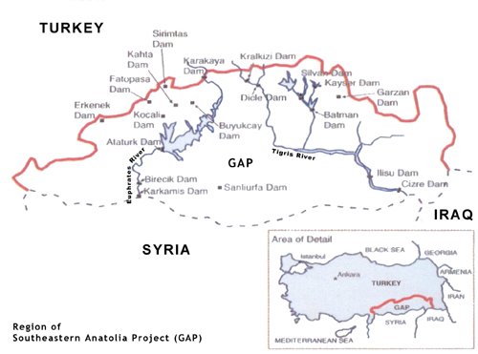
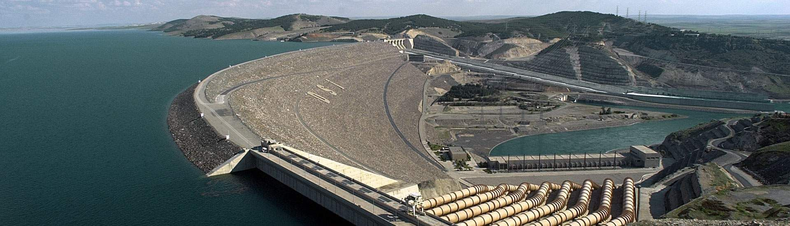
Southeastern Anatolia Project (GAP)
Started in early 1970s;
22 large dams with
maximum storage capacity of more than 144 billion m³;
Two parallel tunnels with carrying capacity of 328 m³/sec;
17,000 km² of irrigated land.
Almost the storage of the 10 largest water reservoirs in the USA
.
Turkey didn’t ask for money from the World Band.
Notes:
But this is not the whole story. A more significant contribution to the reduced flow is the ambitious Turkish Southeastern Anatolia Project (GAP).
It is important to note that Turkey built this huge project by its own resources, has never asked for international support, such as the World Band.

Slide 11
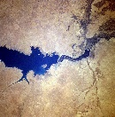
Dams along the Euphrates River
Lake Ataturk
Lake Ataturk – 39.3 million ac-ft
Lake Mead, NV – 28.3 million ac-ft
Lake Assad
Notes:
Lake Ataturk in Turkey and Lake Assad in Syria are the main water reservoirs in these respective countries.
Lake Ataturk is larger than Lake Mead in Neveda – the largest water reservoir in the USA.

Slide 12
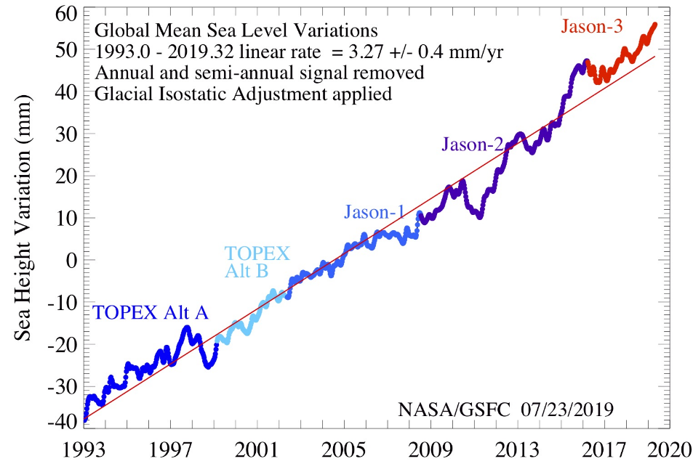
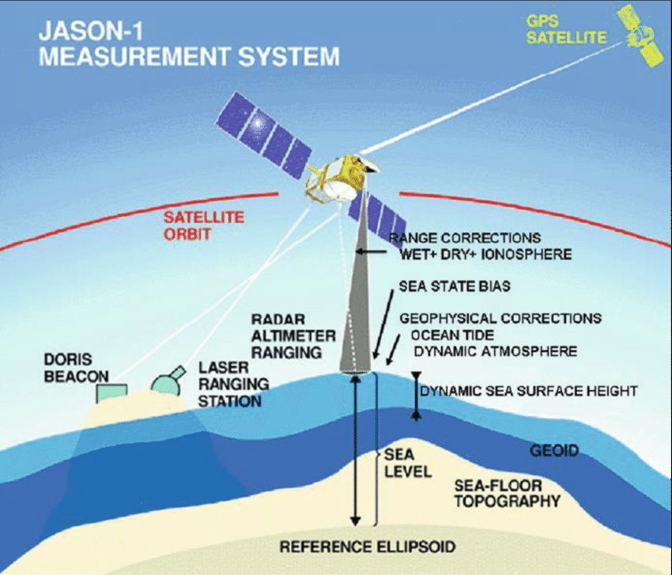
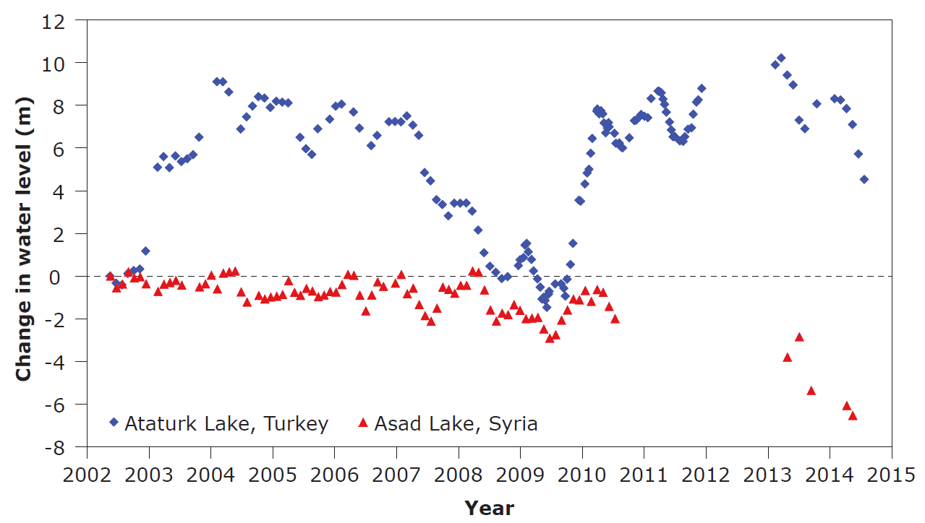
Lakes’ Water Level Anomaly
Notes:
Time series of the water levels in lakes Ataturk and Asad were derived from satellites altimetry.
The comparison shows a dramatic increase in Lake Ataturk volume during 2010 with a corresponding drop in the volume of Lake Assad.

Slide 13
Mean Annual Discharge
Syrian News Agency (SANA) Report, 17 Jun. 2015
Notes:
The Syrian News Agency, called SANA, reported in June 2015, that the discharge across the border was significantly low.
Microorganism and culture heritage materials

Slide 14
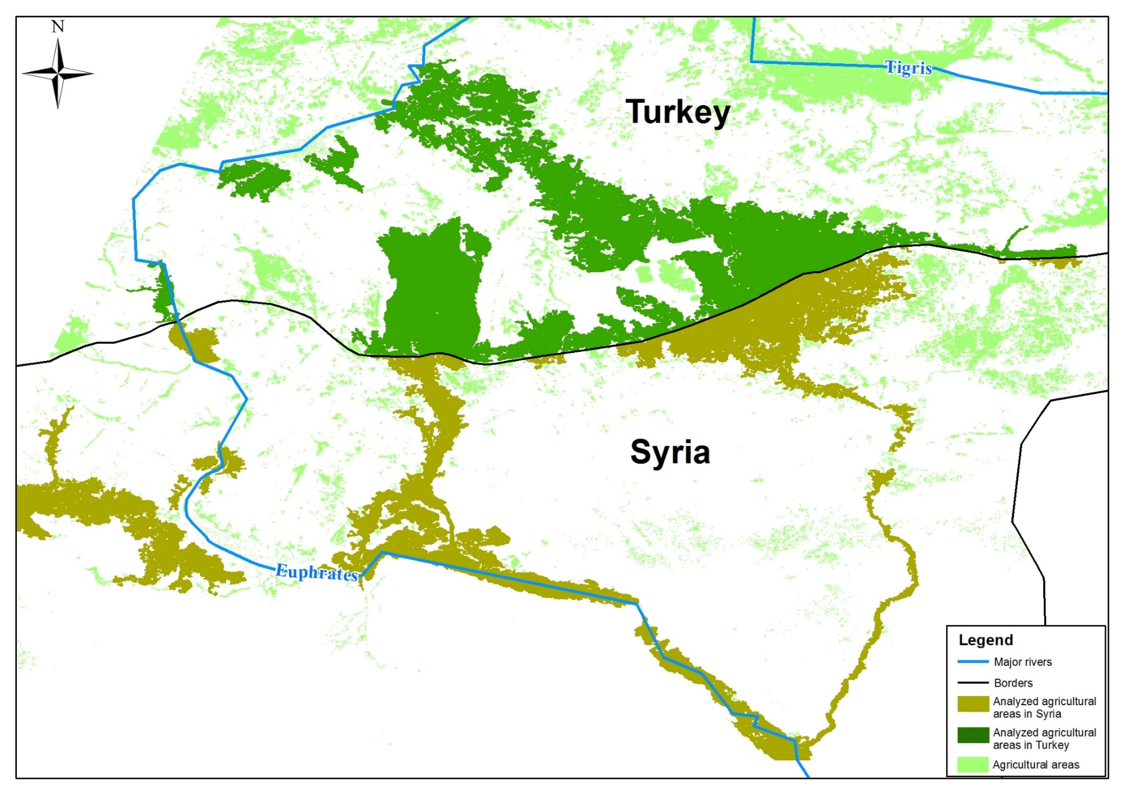
Agriculture Area in Turkey and Syria
Notes:
In the current study we compared the agriculture areas in Turkey and Syria along the Euphrates river in the vicinity of the border.

Slide 15
AVHRR-MODIS NDVI Time Series
Notes:
The annual mean NDVI values for September increased, in parallel, in Turkey and Syria until 2009, reflecting steady agricultural growth in both countries. Then in 2010 the trends change: a sharp increase of NDVI values in Turkey, indicating expanded agricultural activities, in contrast to noticeable decreases in Syria.

Slide 16
Mean Annual Precipitation
Notes:
The climate is semiarid characterized by mean annual rainfall between 200-350 mm yr⁻¹. There are two main seasons – winter with rains falling between November and April, and dry summer.

Slide 17

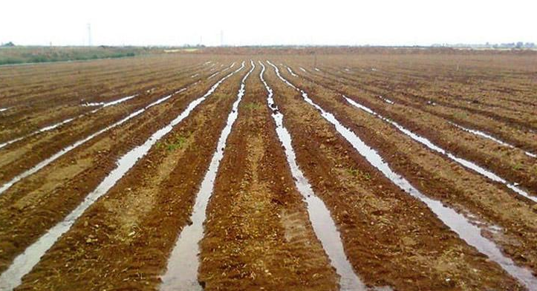
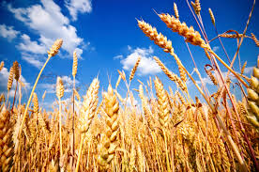
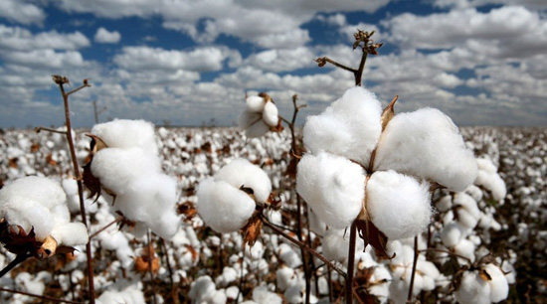
Winter vs. Summer Crops
Winter
Summer
Rainfed agriculture
Irrigation (mostly flooded)
Wheat and barley
Cotton, sugar-beet, and vegetables
Notes:
Given the Mediterranean climate, the winter is the rainy season. The main rainfed crops are wheat and barley.
During the summer, cotton, an important cash crop, is totally dependent on irrigation water.

Slide 18
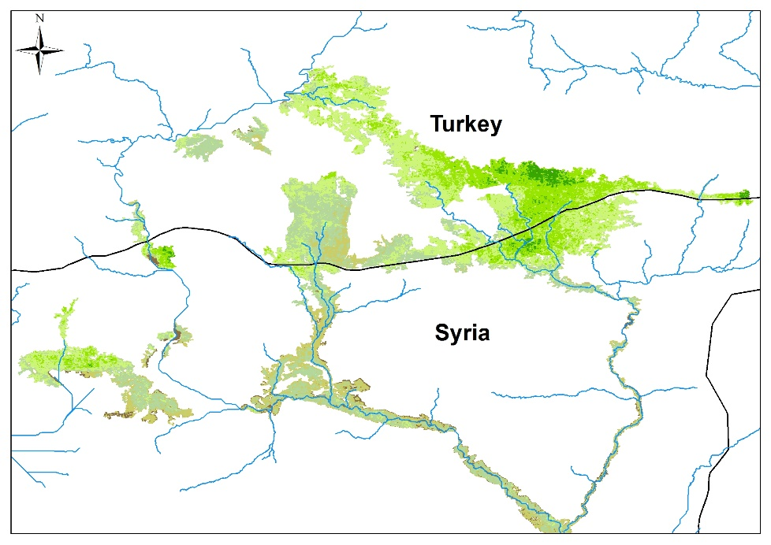
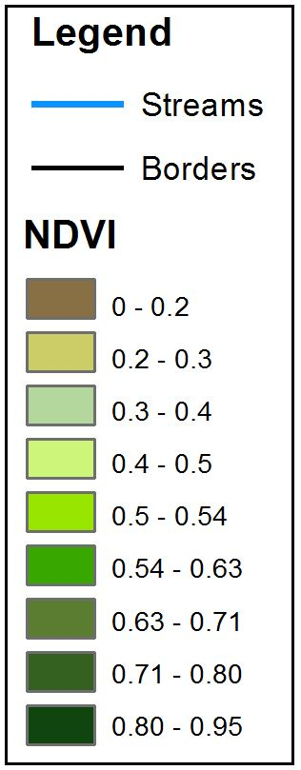
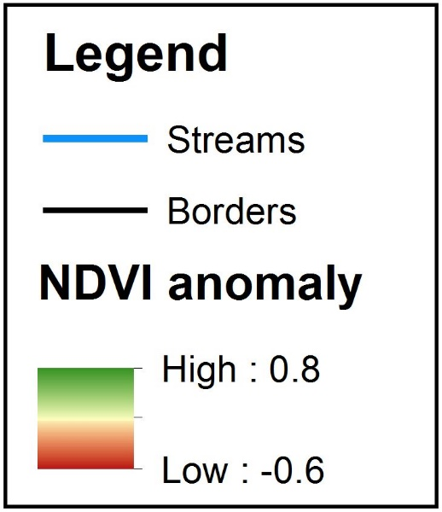
March NDVI
Long-term mean 1982-2015
Notes:
No notable difference between the two countries was observed in March 2011 and 2015.
This suggests that rainfed agriculture was unaffected by the drop in the availability of Euphrates water.

Slide 19
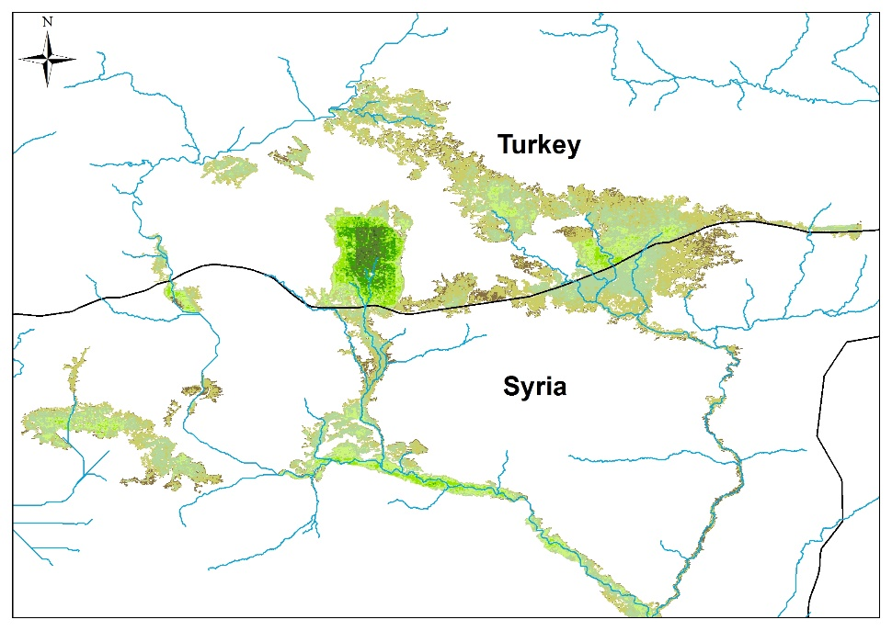
September NDVI
Long-term mean 1982-2015
Notes:
In September 2011, however, when farmers are most dependent on irrigation, vegetation signals observed in Turkey are significantly higher than in Syria.
The clear contrast becomes even more pronounced in September 2015.

Slide 20
Wheat vs. Cotton Production
Source: http://www.indexmundi.com/
Notes:
USDA sources report that wheat yields (representative of Syrian rainfed crops) were of average value in 2011, and only fluctuated modestly during the following years.
However, cotton, which represents locally irrigated crops that rely on the Euphrates flow, exhibits drastic production drops since 2011, vanishing almost entirely in 2016.

Slide 21
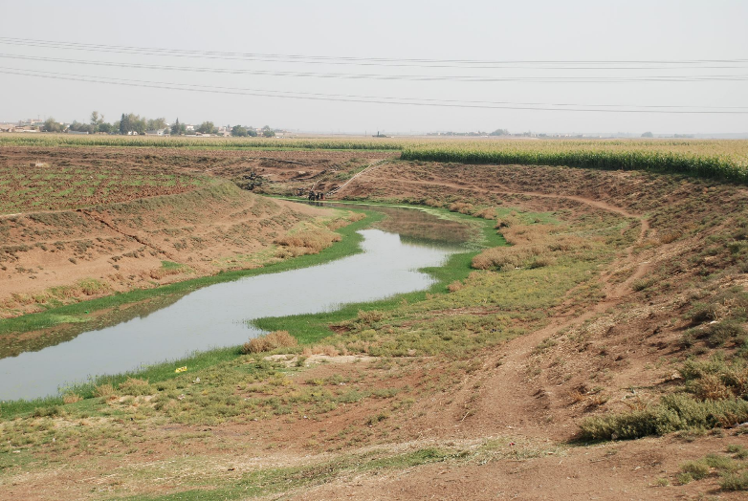
Groundwater – Before Pumping
Notes:
Another related issue is the ground water. In the past the water table was high, feeding several big springs in Syria.

Slide 22
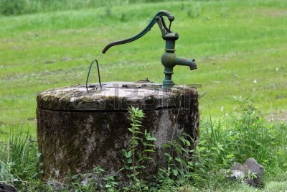
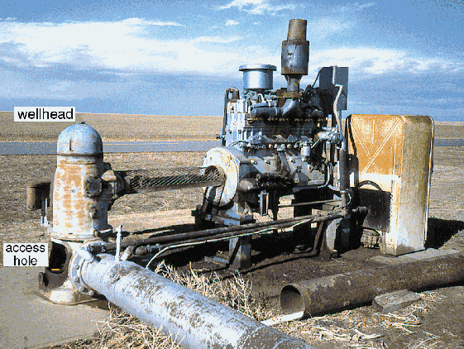
Water wells in Syria
In old years, hand-operated pumps lifted water from 10-15 m belowground.
In recent decades, the diesel-powered pumps were used to pump water from depths of tens to hundreds of meters.
In 2001, the World Bank reported some 1550 wells in Syria, mostly pirate.

Slide 23
Groundwater – After Pumping
“If overuse continues, it may not be possible to recover the aquifer’s resources within a reasonable timeframe.”
M. Öztan and M. Axelrod, Water International, 2011
Notes:
Overuse of groundwater in Turkey and Syria caused dramatic decline in the water table in many areas of Syria.
This increases the dependency of farmers on surface water supply during the dry season.

Slide 24
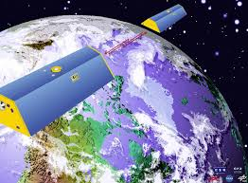
GRACE Mission
The NASA’s Gravity Recovery and Climate Experiment (GRACE) maps the Earth's gravity.
Notes:
Gravity Recovery and Climate Experiment (GRACE) satellite enable measurements of the ground water level.

Slide 25
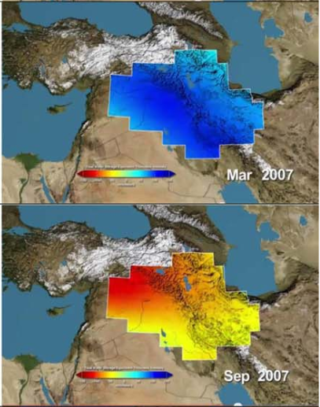
Groundwater Storage Trend
Groundwater Storage
Mar. 2007
Groundwater storage anomaly
Sep. 2007
Dry
Wet
Dry
Wet
(Source: https://www.nasa.gov/mission_pages/Grace/news/grace20130212.html
Notes:
The GRACE time series of the regional groundwater storage in Syria reveals constant conditions, with winter-summer fluctuations until 2007. Later the water level was dropped.
In the images, blue color represents below normal wet conditions during the winter, while red color represents dry conditions during the summer.

Slide 26

Take-home Message
The prevailing narrative, which blames climate change and droughts for the Syria’s political instability, is inconsistent with actual environmental conditions. Different types of satellite products reveal that the reduced Euphrates flow caused the 2011 Syrian agricultural collapse.
Notes:
The prevailing narrative, which blames climate change and droughts for the Syrian political instability, is inconsistent with actual environmental conditions. Different types of satellite products reveal that the reduced Euphrates flow caused the 2011 Syrian agricultural collapse.

