Slide 1


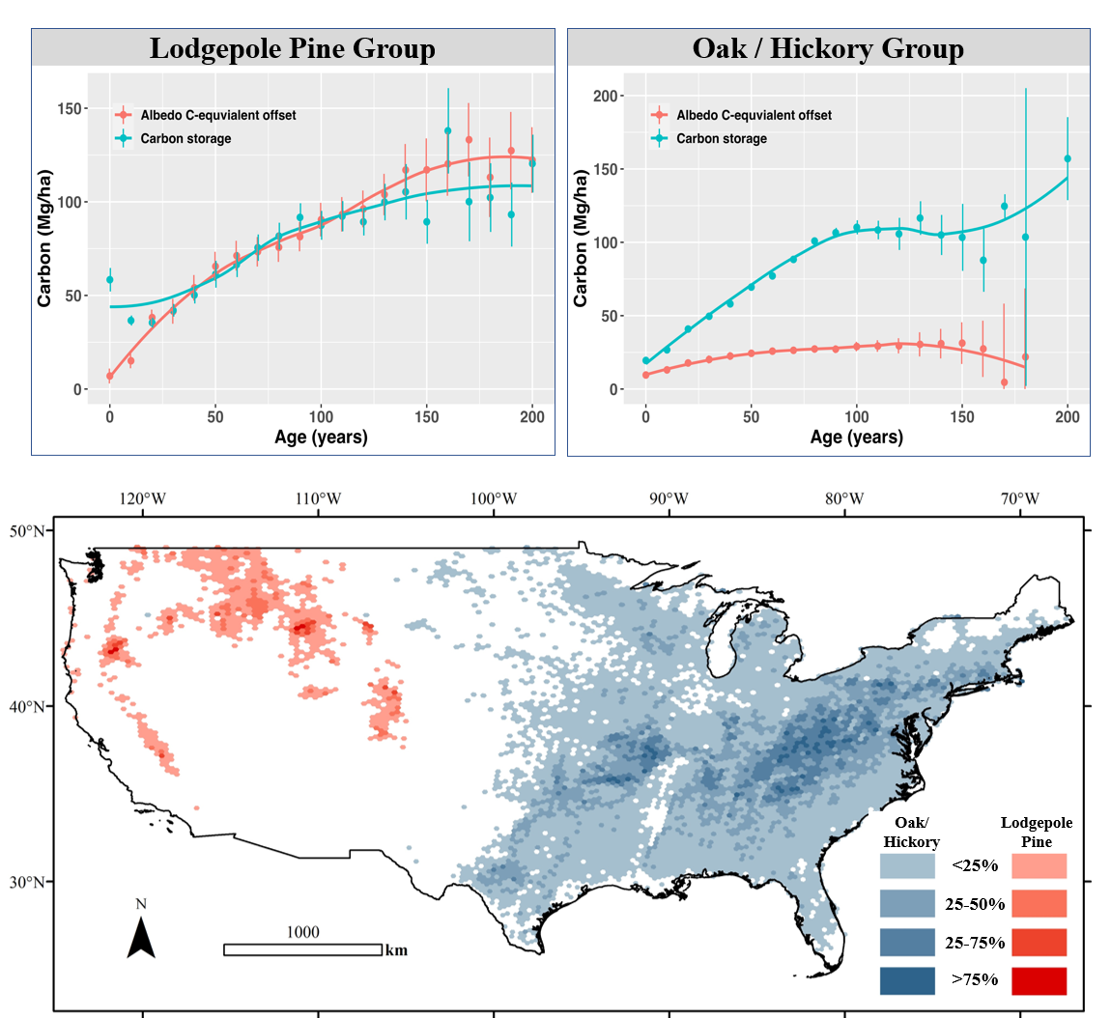
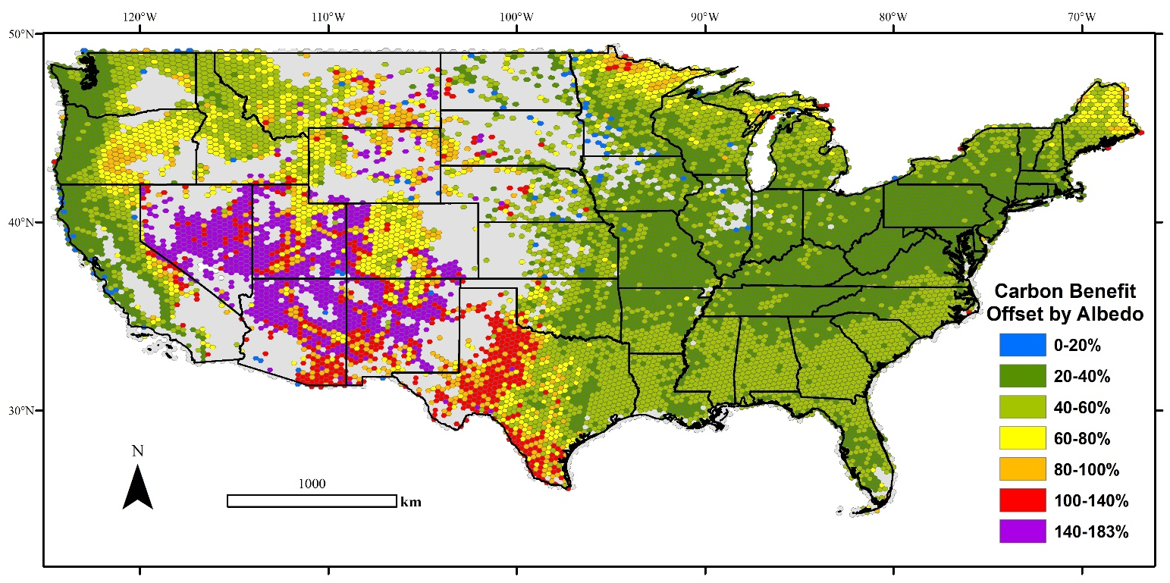
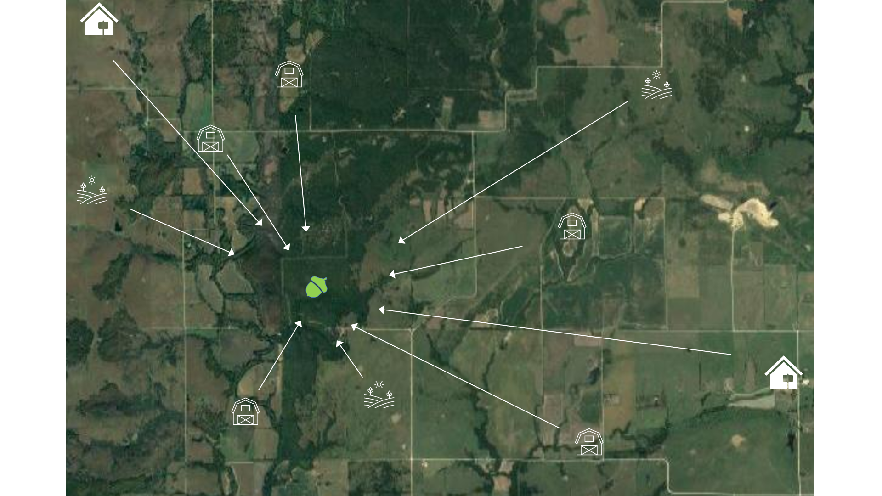
Sean Healey
Challenges for Forests in LCLUC Science
Challenge: Understand the climate effects of albedo in forests vs. alternative land uses
Lodgepole Pine
Oak/Hickory
New data: Landsat albedo from UMASS Boston + designed sample of 355,000 field plots measured by the Forest Service
Albedo in some forest types largely offsets effects of carbon storage

Slide 2
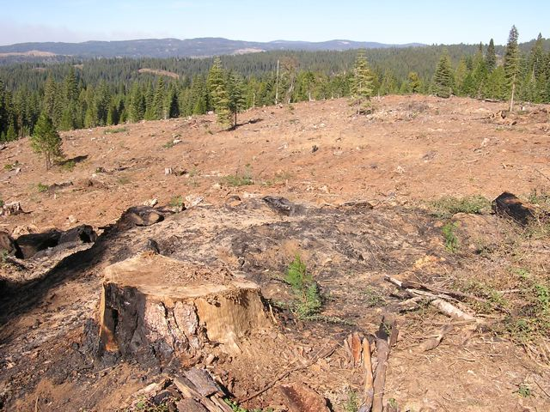
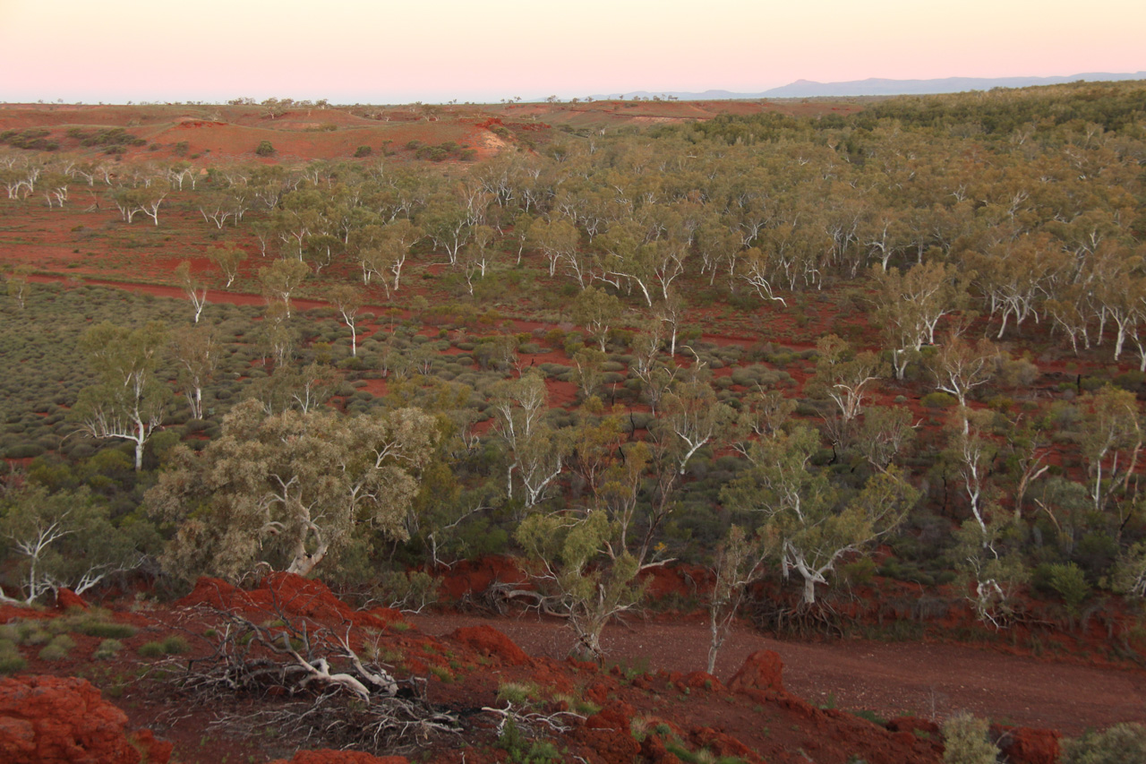
Alexandra (Sasha) Tyukavina
Challenges for Forests in LCLUC Science
Definitions of forest:
  Binary forest definition/boundary, challenges to define/detect, multiple definitions co-exist, forest vs. tree cover;
  Trees outside the forest and minimum mapping unit;
  Presence of trees detected with RS (land cover-based forest definition) vs. land use-based national forest definitions;
  Lack of integration between RS products and national forest reporting;
Reference data for RS model calibration and validation:
National forest inventory (NFI) data largely unavailable or absent;
RS data needs to be systematically acquired globally and available for researchers:
  Airborne lidar data - to calibrate and validate woody vegetation structure models (tree canopy cover, height and biomass);
  Optical high resolution imagery – to validate forest extent and change maps, and provide thematic value-added information (drivers of forest loss, forest type, etc.);
  Lack of targeted funding for validation efforts.
Photo from www.cserc.org
Forest?
A coolabah (Eucalyptus victrix) forest in the Pilbara region of Western Australia.
Photo and caption by TERN Ausplots via Mongabay

Slide 3
Christoph Nolte
Challenges and opportunities in forest change remote sensing
with acknowledgments to Paulo Arévalo, Eric Bullock, Ana Reboredo Segovia all errors my own
What the future brings:
It will become easier to detect change in the forest attributes that people care about, and to attribute it to different proximate causes of change.
Carbon stocks, storage potential, forest height: GEDI (Lidar, available now), NISAR (L & S-band radar, future mission), BIOMASS (P-band radar)
Forest habitat types: fine granularity may be possible with new high-res sensors (Sentinel-2, Planet)
New compute environments offer analytical flexibility while using cloud storage and computing (e.g. Microsoft Planetary Computer)
Open-access training datasets (Radiant Earth, MLHub)
Data source integration and harmonization, e.g. Harmonized Landsat-Sentinel (HLS)
Open-source tools and government policies on open access data availability – much easier to share datasets
What we learned about Landsat-based forests change detection in cloudy and mountainous landscapes:
No single change detection algorithm (CCDC, LandTrendr, CODED, Hansen) was sufficient for detailed classes needed in our analysis.
Ensemble model appears to improve spatial and temporal accuracy in detecting forest loss and gain considerably.
Start date of forest regrowth remains difficult to define / detect.
Seasonality features help with the detection of change in the extent of a critically endangered ecosystem (dry forest).
What’s next for us:
Test a wider suite of topographic correction methods or include topographic or illumination conditions in the classification.
Filling in data gaps with radar (Sentinel-1, PALSAR 1 and 2).
Complete accuracy assessment (maps) and area estimation (changes in classes through time).
Expand to full Andes; include forest height, biomass, biodiversity.

Slide 4
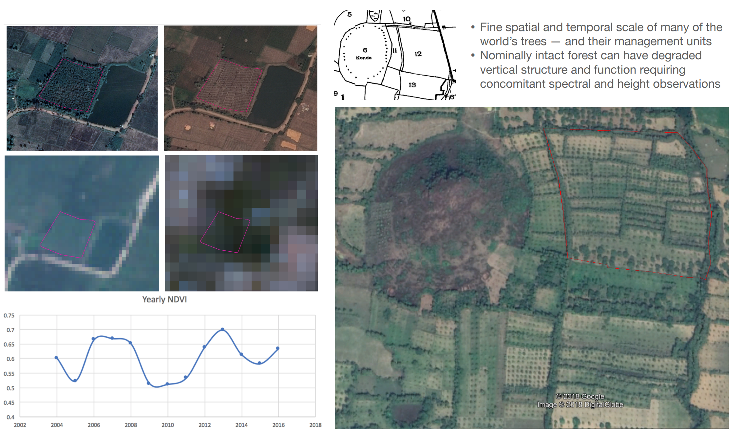
Randolph Wynne
Challenges and opportunities in forest change remote sensing

