Slide 1
GOFC-GOLD land cover team activities Martin Herold (with contributions by many) Land Cover Implementation Team www.gofcgold.org

Slide 2
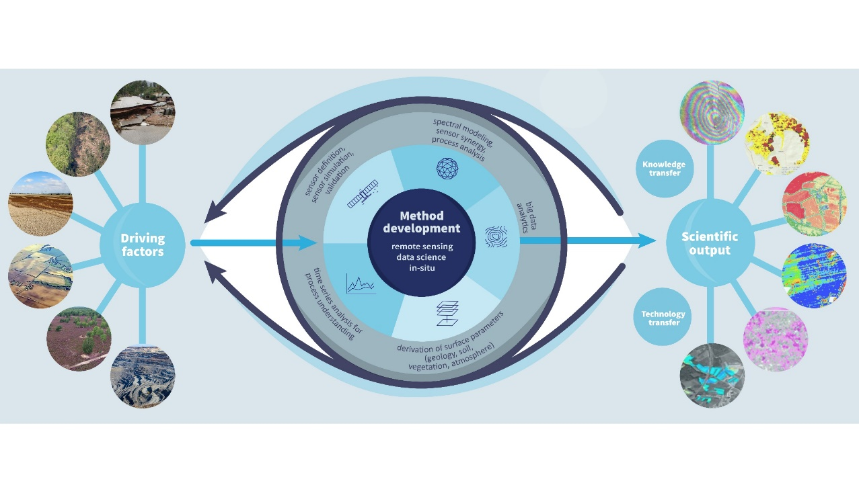
GFZ Section: Remote Sensing and Geoinformation
Our goal: Establish Earth Observations as key Method for Earth Science and Geo- and Nature-based Solutions
~90 scientists, 6 Profs
Research groups:
Hyperspectral remote sensing (ENMAP)
EO mission development/processing
Integration of in-situ and remote sensing data
Remote sensing for geohazards
Earth-Atmosphere Interactions
Big Data Analytics
Technology transfer for remote sensing
Global monitoring (NEW)
Starting projects:
ESA ForestCarbon (2022-23)
ESA CCI-Biomass (2022-24)
EC ForestNavigator (2022-25)
EC OpenEarthMonitor (2022-2026)
ESA GFOI (2023-2025)
EC FORWARDS (2023-2027)
https://www.gfz-potsdam.de/en/section/remote-sensing-and-geoinformatics

Slide 3
GOFC-GOLD land cover: support for UN Conventions, Global Assessment, Users & Monitoring Programs
Develop and promote community consensus guidance/standards (i.e. harmonization, validation, REDD+, SDGs)
Coordinate Land Cover input to the WMO GCOS (ECV’s)
Lead the R&D component of Global Forest Observations Initiative (GFOI)
Outreach and support capacity development (i.e. GOFC-GOLD regional networks, World Bank training materials)
Facilitation of national and regional user access to the various international EO programs
Support to space agencies and global land monitoring programs (user needs, standards, validation)
Promote transparency and free & open source data

Slide 4
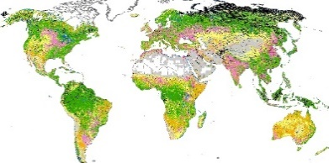
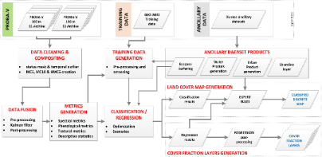
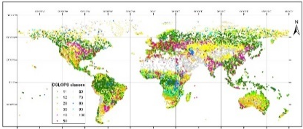
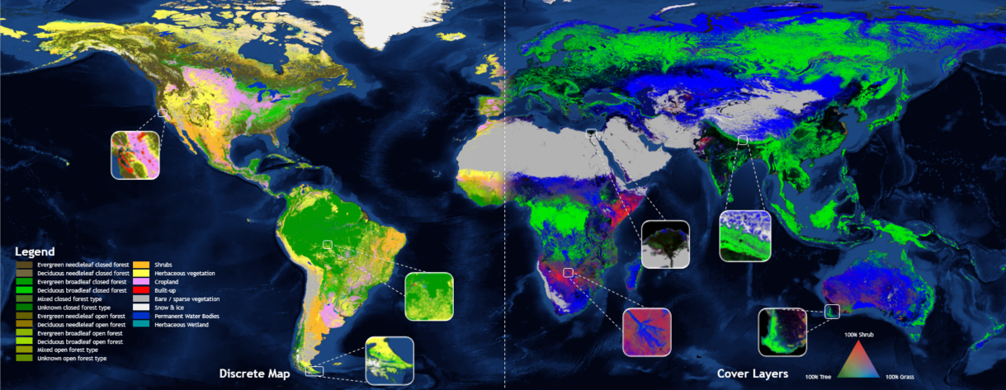
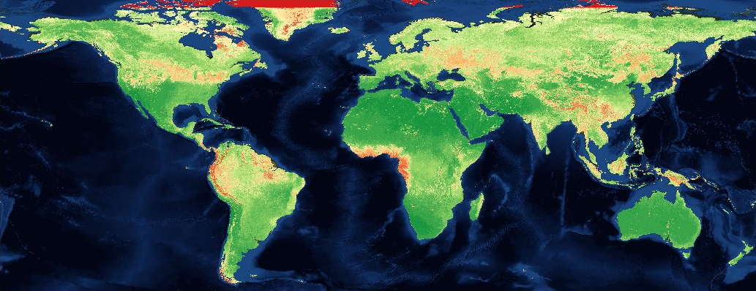
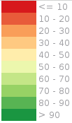
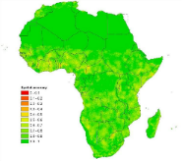
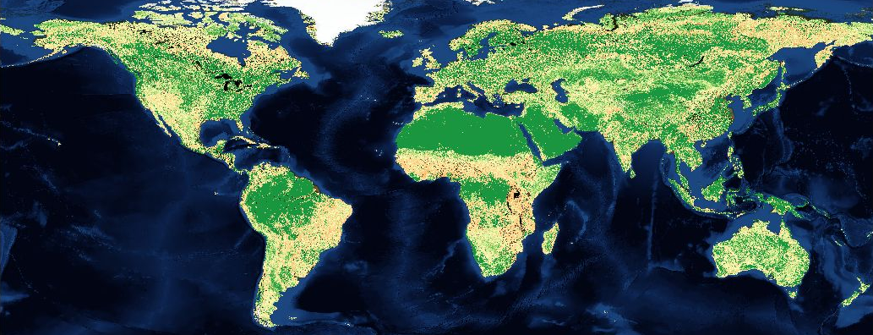
Copernicus Global Land Cover Service
Training data collection system
Land cover data system
Independent validation system
Annual and global 100m (2015-2019)
Land cover product: Buchhorn et al., 2020,RS
Land cover fractions: Masiliūnas et al., (2021). RSE
Multi-date validation: Tsendbazar et al., (2021). RSE
https://land.copernicus.eu/global/products/lc
A systematic service providing dynamic, yearly, user-oriented global land cover maps from 2015
Input data QI
Spatial Accuracy Map*
Algorithm QI (7)
Discrete Map (21 classes)
10 Continuous Cover Fractions (0-100%)
Quality Indicators
Permanent water is derived from GSW (Pekel et al.)
Built-up is derived from WSF (Marconcini et al.)
(*) demonstration over Africa, global maps under release test
https://blog.vito.be/remotesensing/annual-global-land-cover-maps

Slide 5
Training for national REDD+ monitoring
Guidance: GOFC-GOLD Sourcebook and GFOI MGD
14 modules: lectures, country examples, exercises
3 languages (English, French, Spanish)
30+ authors, regular updates incl. scientific synthesis
Regional workshops (Asia, Africa, Latin America)
Recorded lectures and E-learning tools and webinars, training the trainers
http://www.gofcgold.wur.nl/redd/training-materials/ https://www.forestcarbonpartnership.org/redd-training-material-forest-monitoring

Slide 6
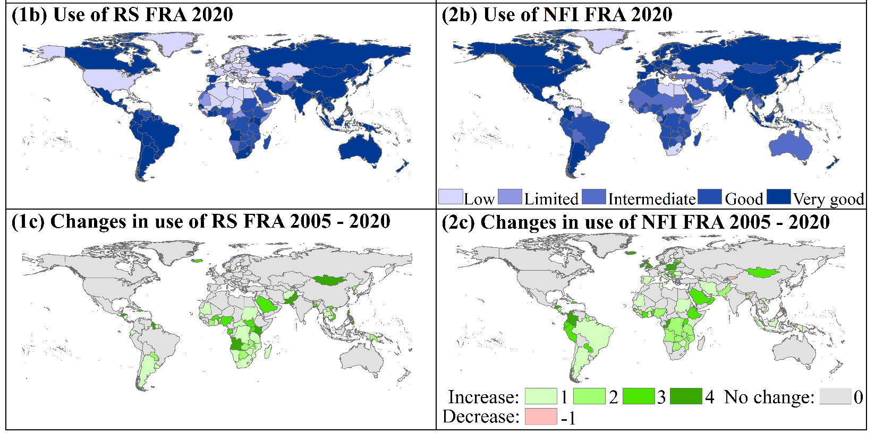
National Forest Monitoring/Data Assessment based on FAO’s FRA 2020
Continuous improvement in the use of RS for area & change estimation based on free and open satellite data
National forest inventory (NFI) data improvements widespread in tropics, mostly one-time NFI’s
Importance of both international support and countries own investments
Key issues for future:
Sustain progress
Fill remaining gaps
Respond to evolving needs
Space-based biomass estimation and NFI’s
Nesha et al., 2021. An assessment of data sources, data quality and changes in national forest monitoring capacities in the Global Forest Resources Assessment 2005–2020, ERL

Slide 7
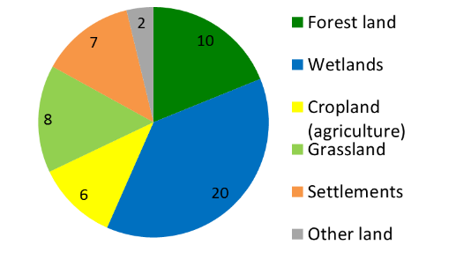
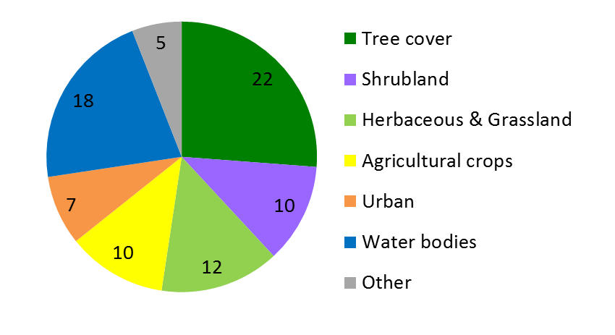
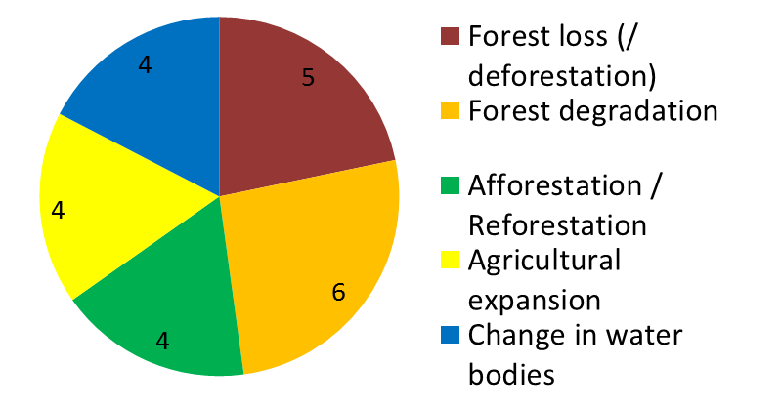
SDG indicator data requirements for land sub-categories LU / LC monitoring provides important data to monitor 8 goals, 29 targets, and 33 indicators
Land Use data
Land Cover data
Land Cover Change data
Earth observations contribution to the SDGs with a focus on land cover datasets:
http://ggim.un.org/documents/Paper_Land_cover_datasets_for_SDGs.pdf
# The numbers in the pie charts refer to the number of indicators for which the spatial data requirements apply
GOFC-GOLD SDG land cover assessment: http://www.gofcgold.wur.nl/documents/newsletter/Sustainable_Development_Goals-infobrief.pdf
Notes:
# The numbers in the pie charts refer to the number of indicators for which this type of data is needed.

Slide 8
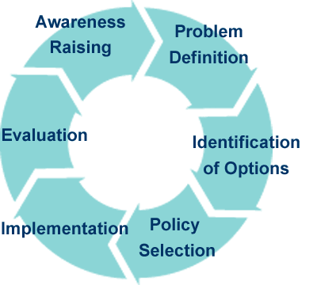
Differentiated user needs along the policy cycle
Awareness/problem definitions:
Global assessments: IPCC, UN-SDG, IPBES etc.
European Green Deal
Policy options/activities:
Paris climate agreement national policies (NDCs)
Identify/define hotspots for action
Implementation:
Local data supporting land management
Regular progress tracking, transparency
Evaluation/performance:
National: GHG inventories
Sustainable development goals & indicators
UNFCCC global stocktake (2023+)

Slide 9
Looking ahead
Policy drivers: Paris Climate Agreement – UNFCCC Global Stocktake, Nature-based solution/restoration agenda, SDGs, refined GCOS implementation plan, country climate policies (adaptation and mitigation), sustainable sourcing (i.e. EU regulation on deforestation-free commodities), …
Key issues of GOFC-GOLD:
Remain engaged (GCOS, GFOI, CEOS GST/AFOLU, SDGs, …) … after Corona …
High-resolution land cover and change (≤30 m):
Increasing diversity vs. independent validation and user uptake
Agriculture, Forestry and Other Land Uses (AFOLU):
Integrating land change and biomass/carbon EO data streams
National estimation versus global assessments (Global stocktake)
Increasing detail (i.e. tree-based monitoring, reference measurements)
Enhancing transparency and speed -> actionable information

Slide 10
R&D component as part of the GFOI
Advocacy role for novel data and approaches: potential and limitations (i.e. CALM)
Assessing country needs to define R&D priorities and stimulate research and funding
Data access
Country needs / capacities
R&D experts addressing priorities in their ongoing work
Space Data
Funding
Research
Capacity building
R&D
Development of training materials and joint capacity building activities
Methods & Guidance
Research synthesis (expert workshops) on key issues (countries, donors) and regular updates of guidance documents (GFOI MGD)

Slide 11
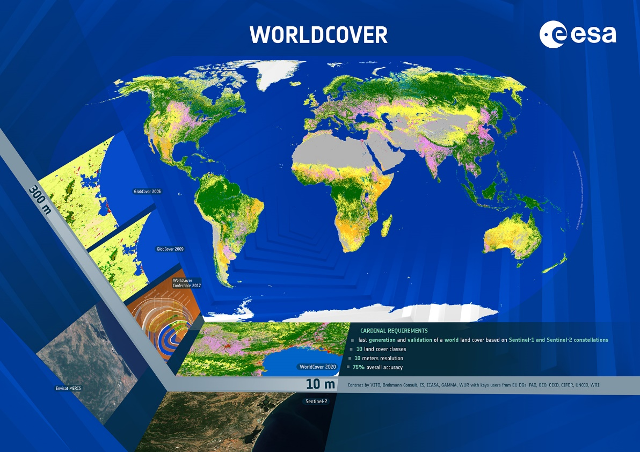
ESA WorldCover 2020/2021
2020 Global Land Cover map at 10x10 m resolution based on Sentinel 1/Sentinel 2
10 classes & ~75% overall accuracy
Released Oct. 2020, 2021 upcoming in Oct’22
Data viewer and access: https://viewer.esa-worldcover.org/worldcover/
Expansion to next phase Copernicus global land cover service

Slide 12
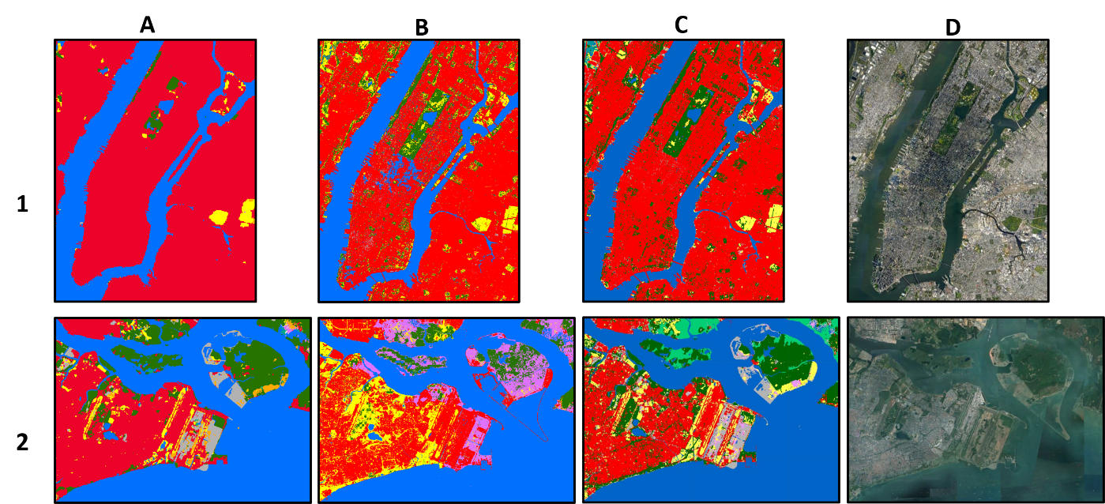
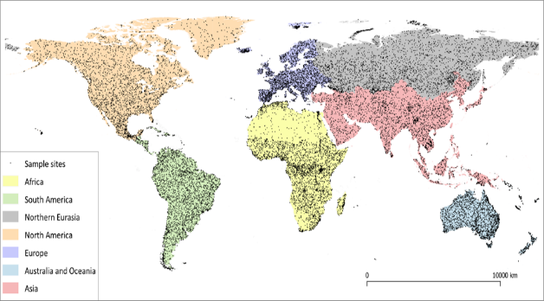
Global land cover comparison/validation
Esri 2020 landcover
FROM-GLC10
WorldCover
Google Earth
New York
CEOS WGCV land cover team activity:
Revise land cover validation protocol - leadership: Sasha Tyukavina (UMD) and Sophie Bontemps (UCL)
Update and amend: high-resolution land cover and change
https://lpvs.gsfc.nasa.gov/LandCover/LC_home.html
https://docs.google.com/document/d/1QnyhCGHIf0cgjH6y9D_9Lq7qMdaHZHCDM7gIPu2ua7c/edit?usp=sharing
Notes:
To give an indication on the map quality, we checked the accuracy level at macro region as well.

Slide 13
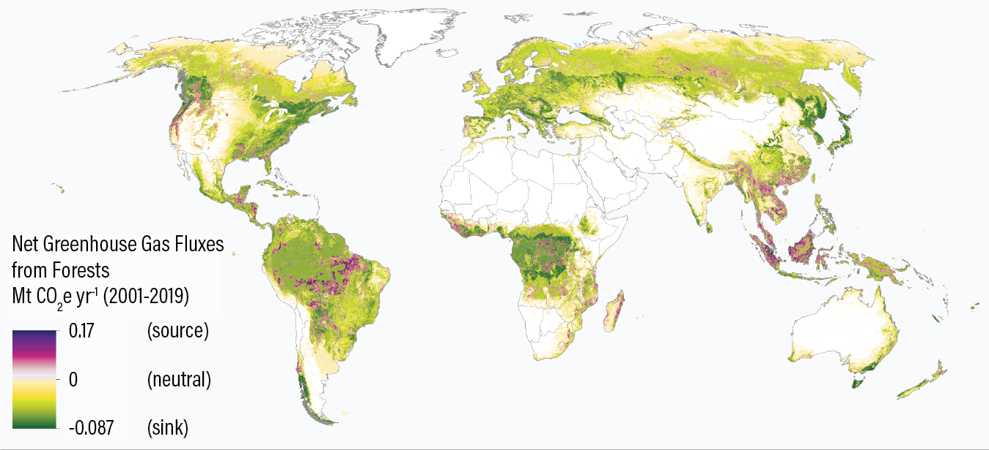
Towards Earth Observation data-driven, spatial GHG inventories
Updated global forest flux budget for 2020
Annual gross emissions | 8.3 | Gt CO2e/yr
Annual gross removals | -15.6 | Gt CO2e/yr
Annual net flux | -7.3 | Gt CO2e/yr
Paper: Harris et al., 2021, Nature Climate Change
Data on GFW: https://gfw.global/315sv5h

Slide 14
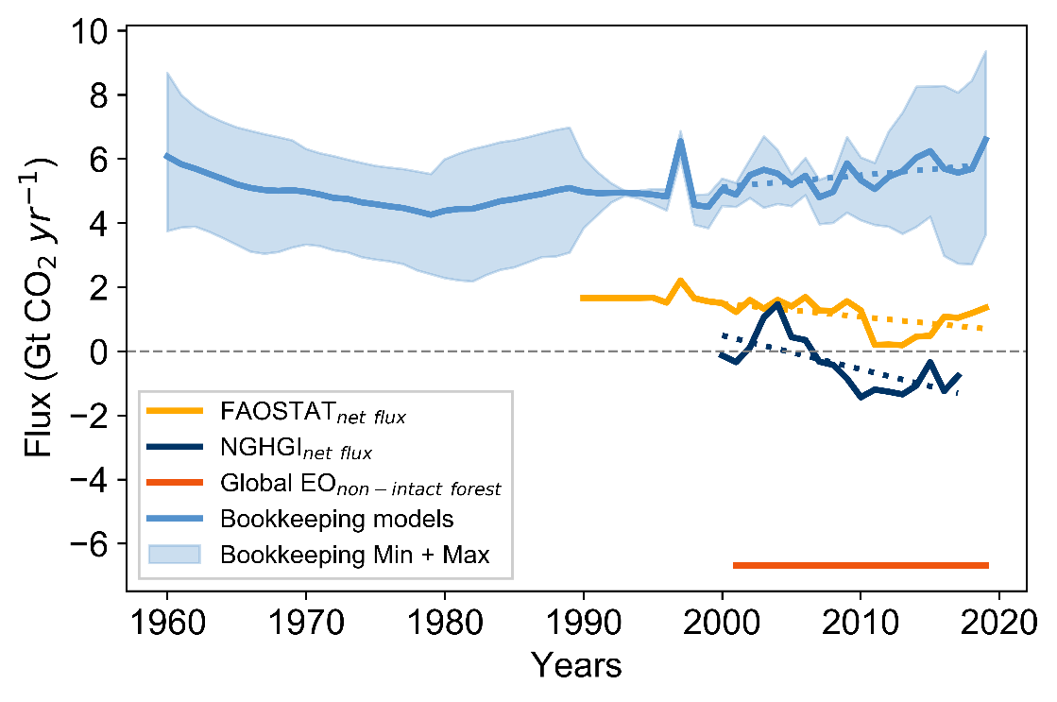
Towards Earth Observation data-driven, spatial GHG inventories
Global net CO2 flux due to LULUCF or forest only related fluxes IPCC AR6 - Nabuurs et al. (2022)

Slide 15
Towards Earth Observation data-driven, spatial forest carbon stock changes
Nature Communications 2021, 12, 2501

Slide 16
Towards Earth Observation data-driven, spatial forest carbon stock changes
SCIENCE, 2022, DOI: 10.1126/science.abm9267

Slide 17
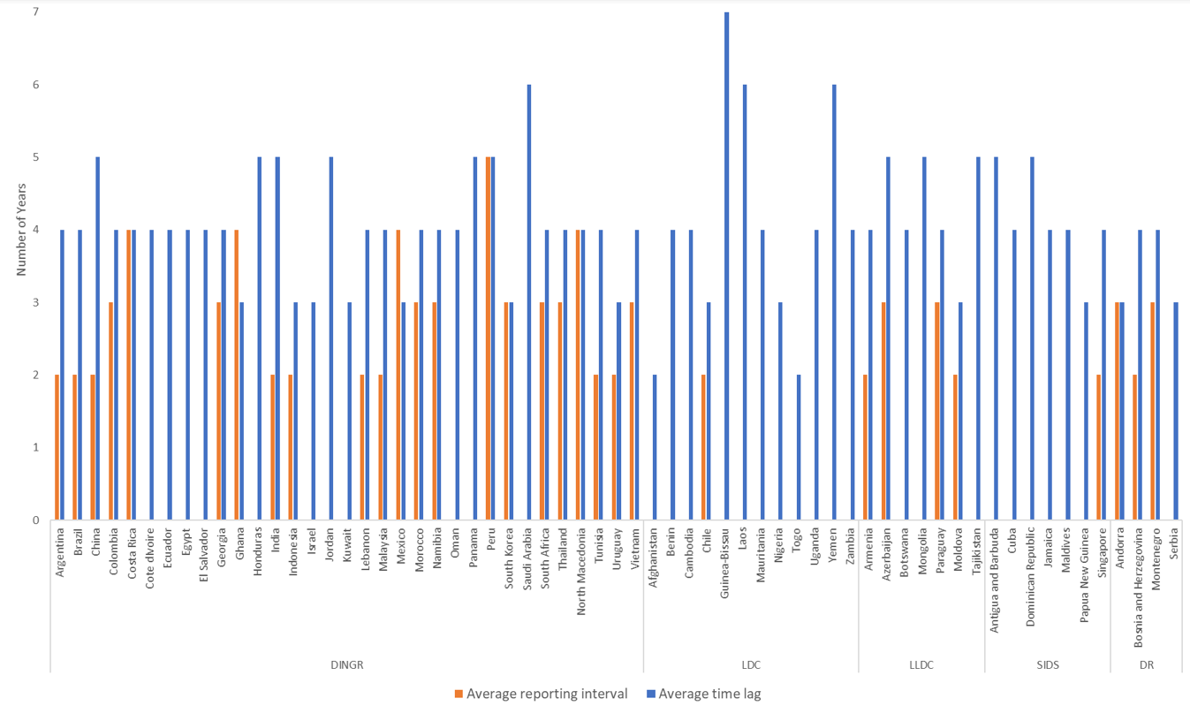
Need for increasing frequency and speed of reporting
Average reporting interval of BURs (for countries with more than one report submitted) and the average time lag between assessment and reporting periods of Non-Annex I countries (n=64). Least Developed Countries (LDC), Landlocked Developing Countries (LLDC), Developing Regions (DINGR), Small Island Developing States (SIDS), and Developed Regions (DR).

Slide 18
Selective logging pattern in Central African Republic
Sentinel-1-based weekly forest disturbance alerts at 10 m resolution for humid tropics in 46 countries (RADD alerts)
Paper: Reiche et al., 2021. ERL, https://iopscience.iop.org/article/10.1088/1748-9326/abd0a8
RADD alert app: https://gena.users.earthengine.app/view/raddalert
(also available on WRI’s Global Forest Watch)
Sentinel-1-based weekly alerts, period Jan. 2019 – Dec. 2020
http://radd-alert.wur.nl

Slide 19
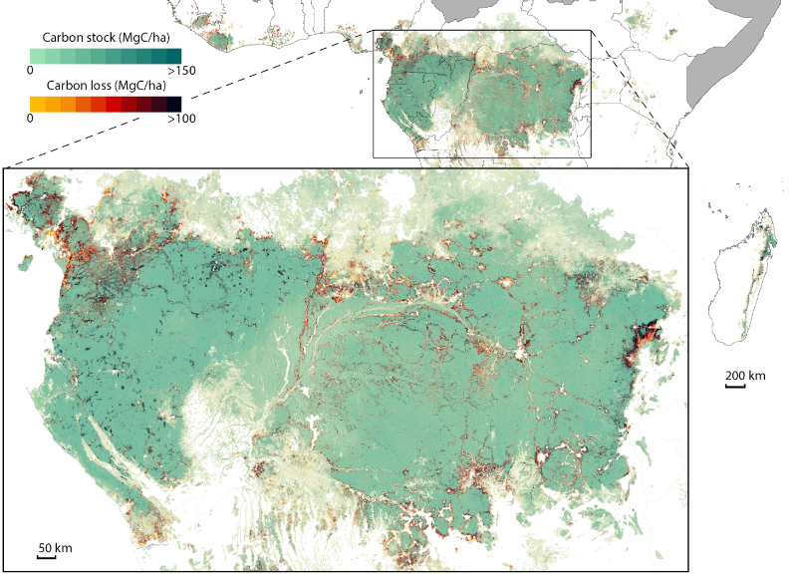
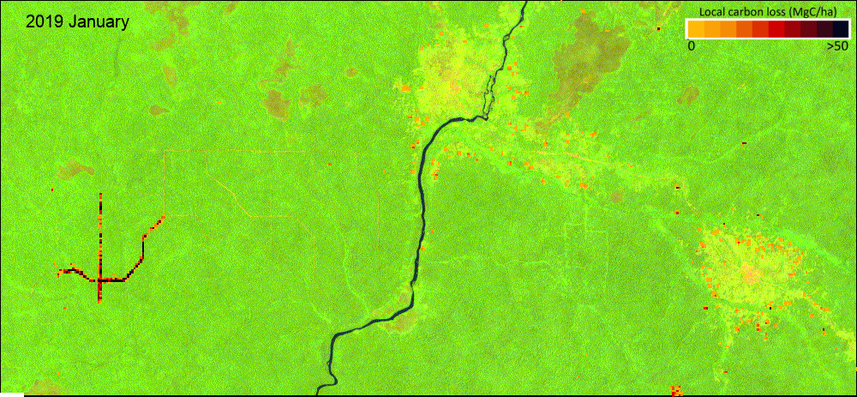
Higher frequency/near-real time monitoring for enforcement and adaptation – Central Africa
Csillik et al. 2022. Nature Coms.EE
https://gena.users.earthengine.app/view/raddalert

Slide 20
What’s next
Policy drivers: many, strong needs
Key issues of GOFC-GOLD in the coming years:
Remain engaged (GCOS, GFOI, CEOS GST/AFOLU …)
High-resolution land cover and change at 1-30 m: validation protocols, comparison, user uptake
Agriculture, Forestry and Other Land Uses (AFOLU): Integrating land change and biomass/carbon data streams, national vs. global, increasing detail …
Enhancing transparency and speed -> actionable information
Important NASA commitment for GOFC-GOLD land cover co-leadership
ESA has committed to support the leadership role for the R&D component in GFOI

Slide 21
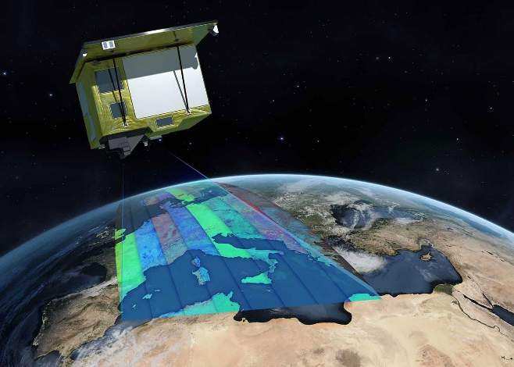
EnMAP – The Environmental Mapping and Analysis Program
German spaceborne imaging spectrometer (Hyperspectral)
GFZ – Science PI:
Science program, tools, calibration/validation, demos
Helmholtz POF Topic 5 – Landscapes of the Future:
New level of land surface characterization: vegetation, soils, water, environmental pollution (plastics) etc.
Core funding from BMWi / DLR-RfM
5 year mission, 6 months commissioning
30x30 m resolution, 250 spectral bands
Nominal phase: Data open to everyone
Data delivery will start ~ Oct. 2022
More info: DLR / GFZ
EnMAP Launch 1. April 2022
Phoenix TV

