Slide 1
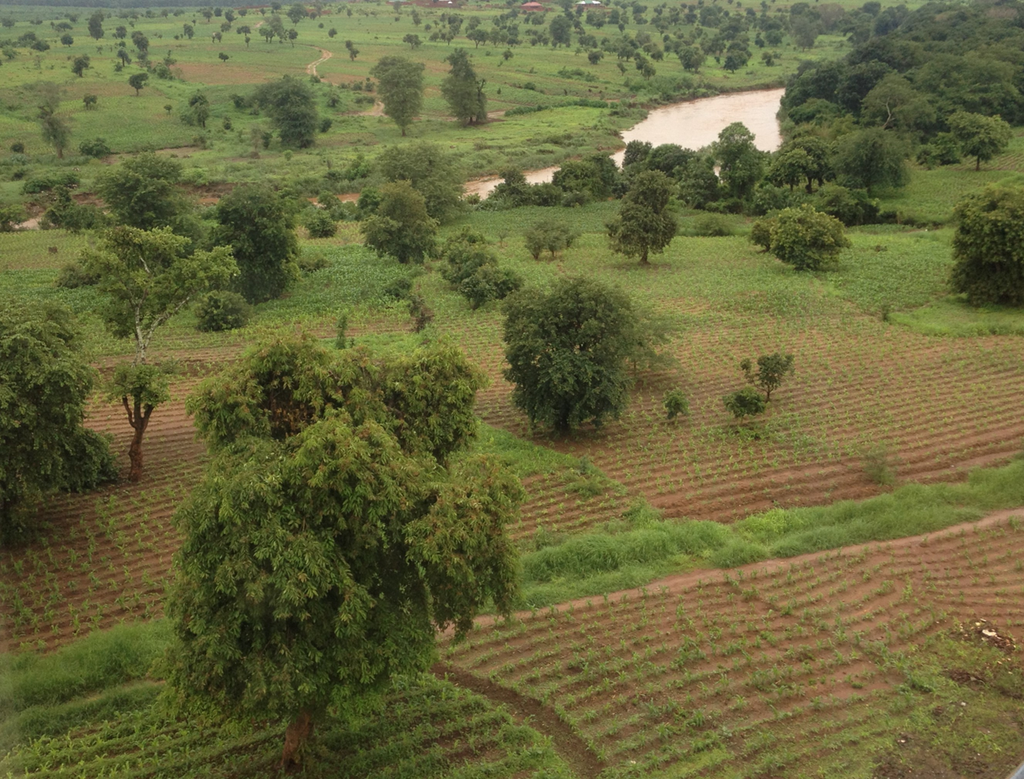
Remote Sensing and Policy Aspects of AFoLU
David L. Skole
Michigan State University
19 October 2022

Slide 2
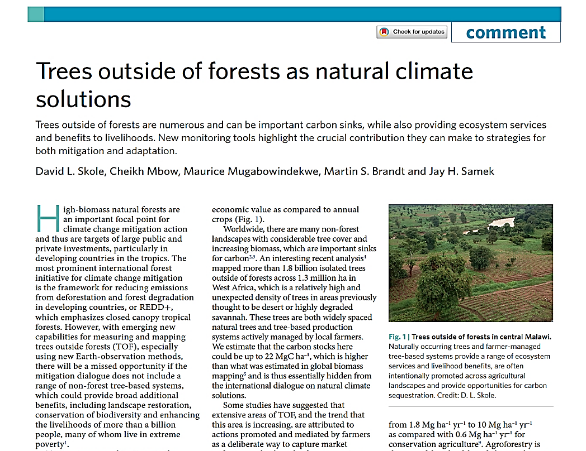

Slide 3
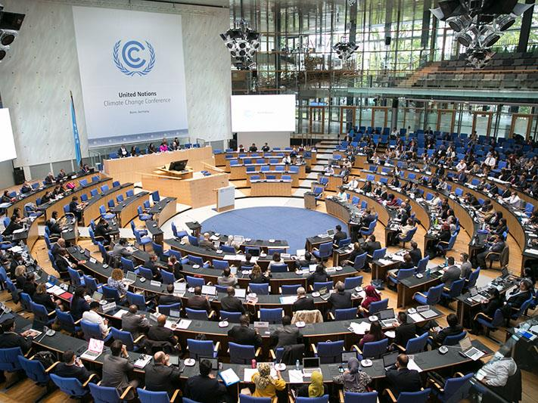
Forests, Trees and Climate Change Mitigation Policy

Slide 4
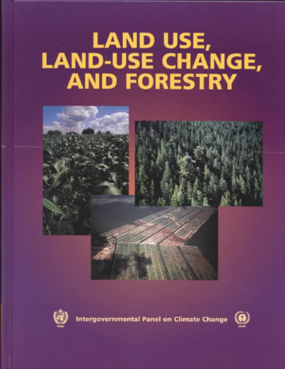
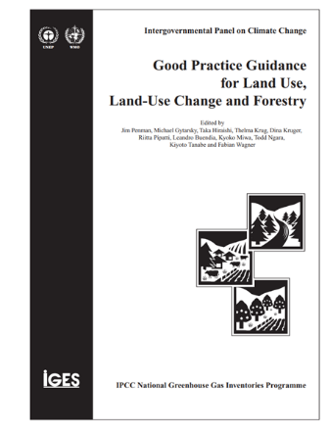
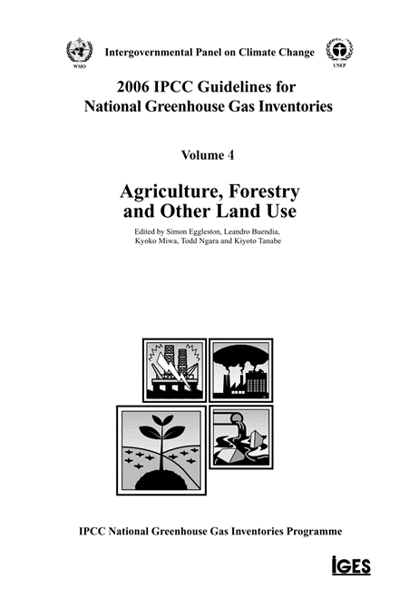
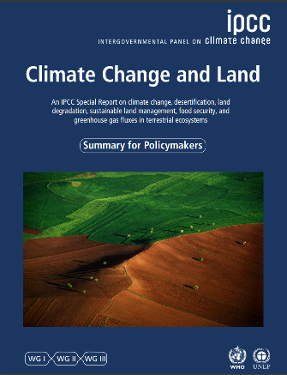
Forests Are Important in Post-Paris Climate Mitigation Policy
The “Land Use Sector” follows a lineage and long technical history from the initial IPCC Special Report on Land Use, Land-Use Change and Forestry in 2000.
A broader concept of Agriculture, Forestry and Other Land Uses follows emerges by 2006
Following COP21 (2015), a broader interpretation of Land based Carbon
2000 2003 2006 2019

Slide 5
Forests and REDD+
The importance of forests emerges after Paris and the REDD+ is the primary framework for forests
With Paris Agreements other mechanisms also emerge, which open the door for inclusion of a range of land-based elements within national Policies and Measures (PAMs) and national actions and contributions: NDCs.
Natural Climate Solutions (NCS) and Nature-Base Solutions (NbS)
Distinctions, REDD+ vs NDCs; forest actions vs land-based actions. “Related but different”
With Paris an additional emphasis on Adaptation as well as Mitigation
The Forest and REDD emphasis: high biomass forests, reducing D and D which is an “avoided emissions” mitigation strategy
Payments for Performance emerges as a defacto principle in carbon and climate finance – measurement and reporting necessary, not just in the Conventions, e.g. FIP.
National REDD Scope: becomes defined by what’s measurable, but even degradation is a challenge, e.g. Zambia

Slide 6
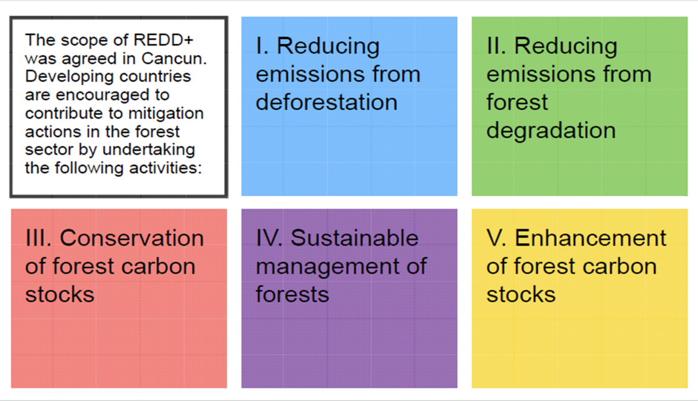
Main Pillars of REDD: The Scope
REDD+ Framework: follows many agreements and discussions from several sessions prior to COP21

Slide 7
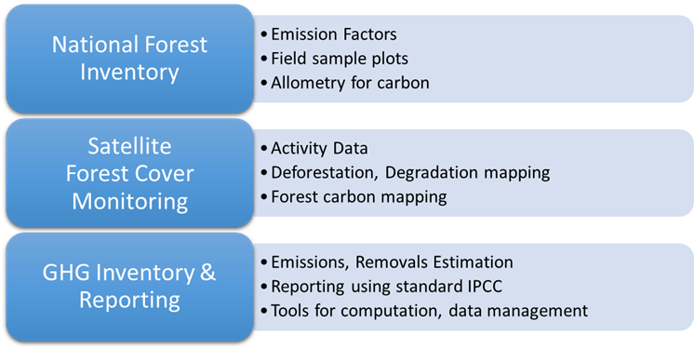
National Forest Monitoring Systems

Slide 8
REDD+ from a Landscape Perspective
Degradation
Deforestation
Regeneration
Mbow, C., Smith, P., Skole, D.L., Duguma,L., Bustamante, B. 2014. Achieving mitigation and adaptation to climate change through sustainable agroforestry practices in Africa. Current Opinion in Environmental Sustainability 6 (2014): 8-14.
Mbow, C., E. Toensmeier, M. Brandt, D. Skole, et al. 2020. Agroforestry as a solution for multiple climate change challenges in Africa. In, Deryng, D. (ed.), Climate Change and Agriculture, Burleigh Dodds Science Publishing, Cambridge, UK, 404 pp.

Slide 9
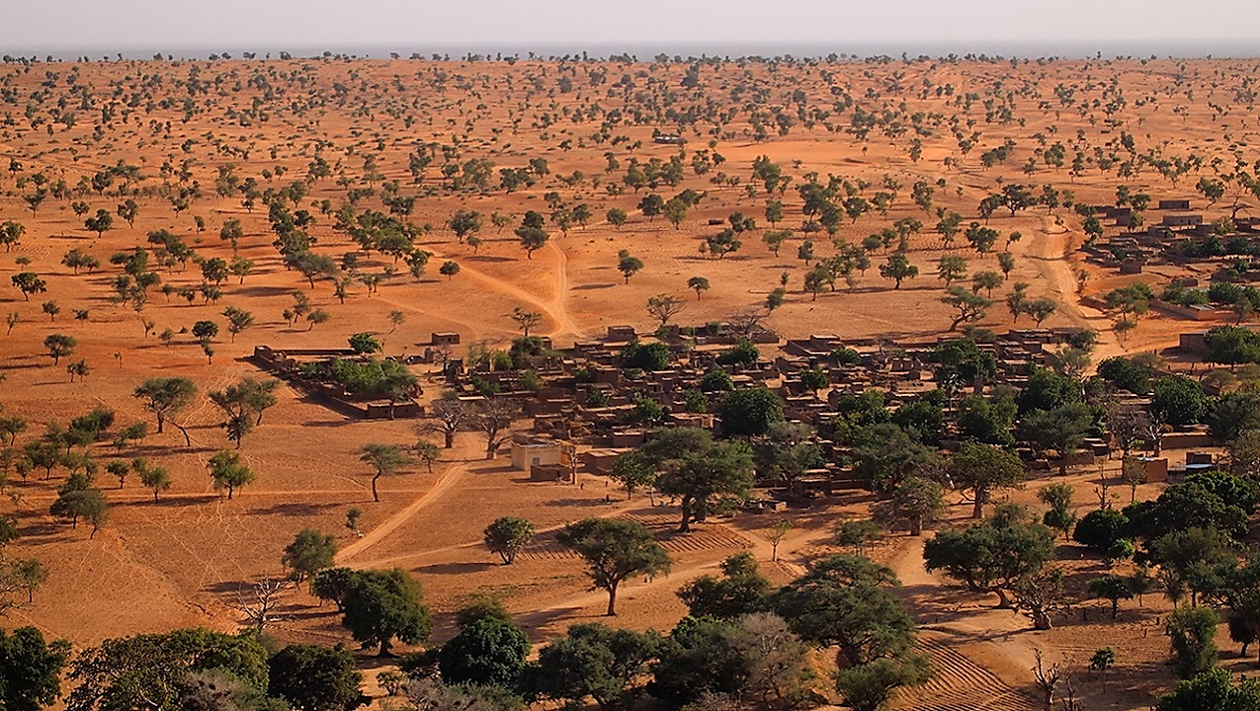
Landscape Carbon and Trees Outside of Forests

Slide 10
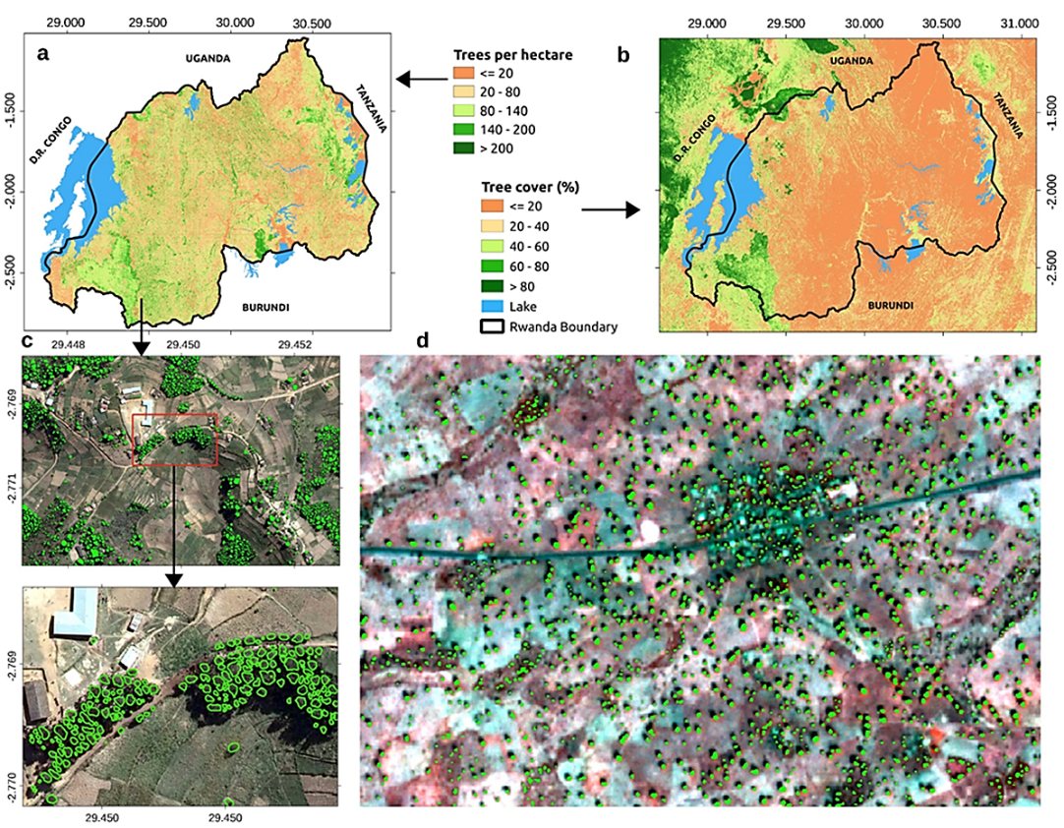
National-scale Individual Tree Carbon Mapping
Source: Skole, D.L., Mbow, C., Mugabowindekwe, M., Brandt, M.S., Samek, J.H. 2021.The importance of trees outside of forests as natural climate solutions. Nature Climate Change, 11(12): 1013–1016.

Slide 11
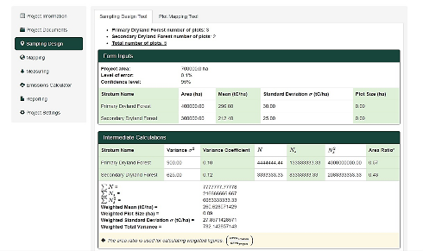
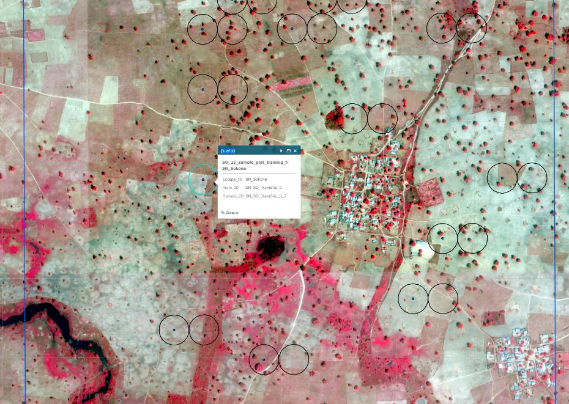
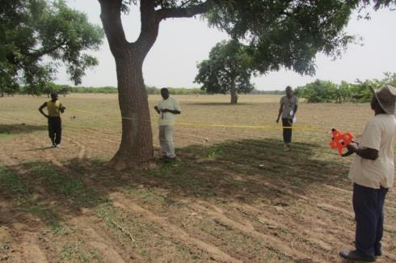
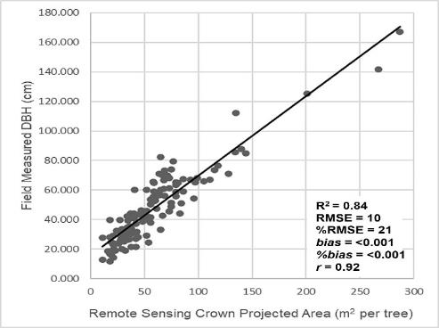
Field Sample Frame

Slide 12
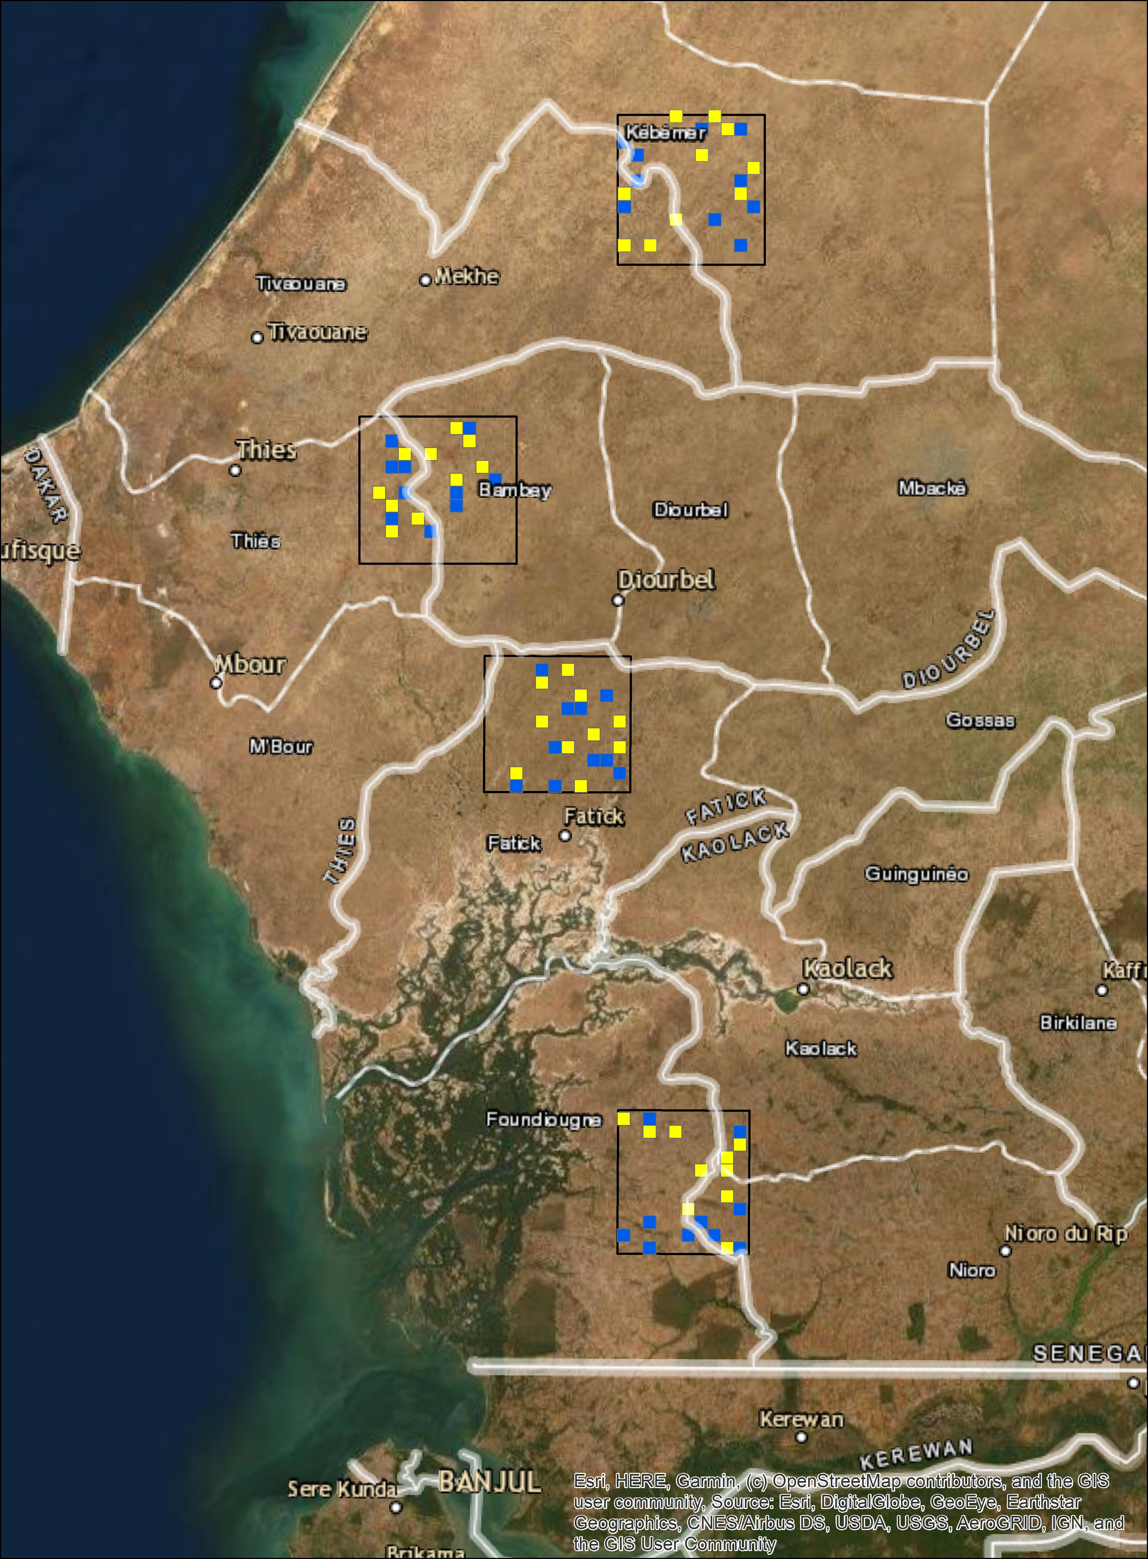

Slide 13
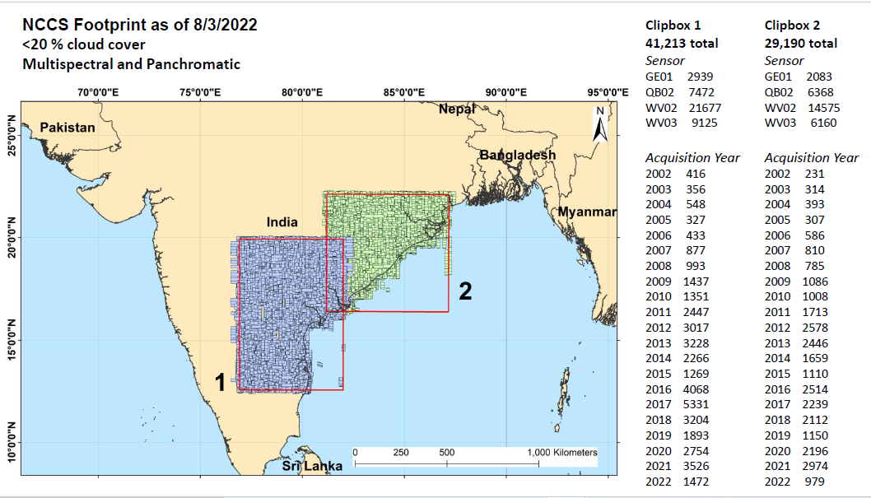

Slide 14
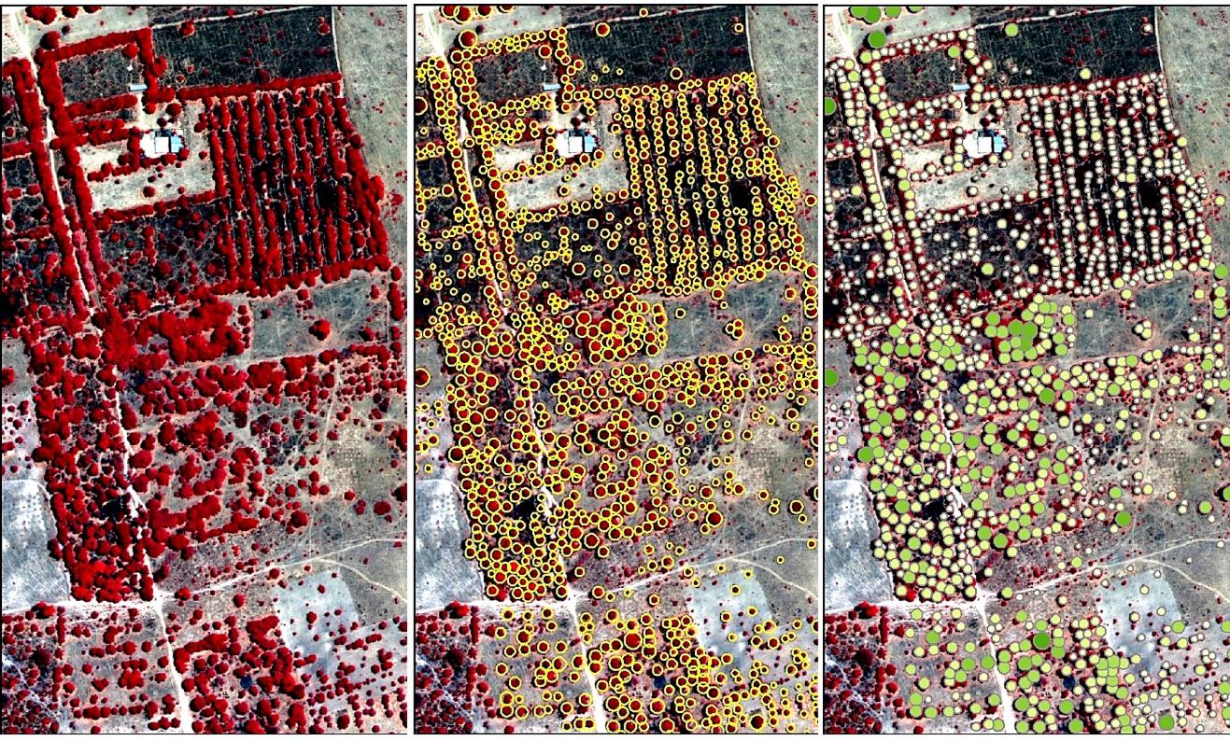
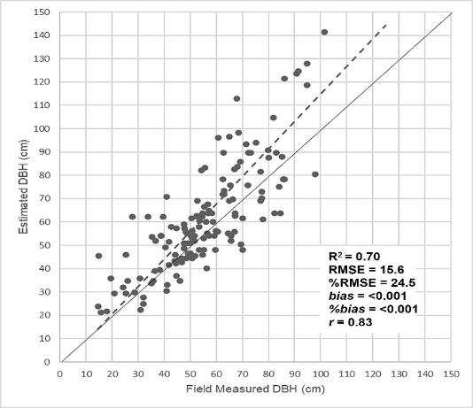
Allometric Scaling Model Training and Testing
A
B
A. Field analysis, B. model validation, estimated DBH from VHR-CPA
Source: Skole, D.L., Samek, J.H., Dieng, M., Mbow, C. 2021. The Contribution of trees outside of forests to landscape carbon and climate change mitigation in West Africa, Forests, 12(12): 1652

Slide 15
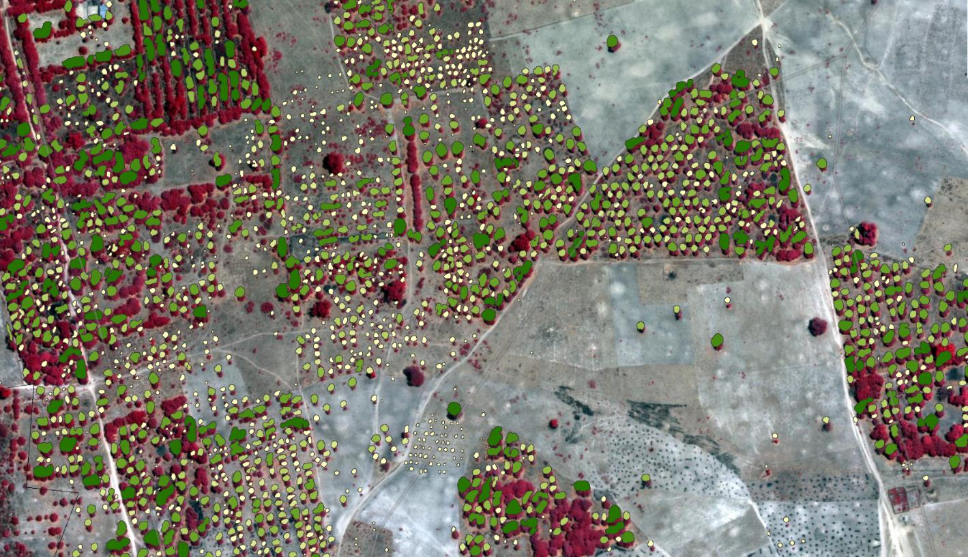
Landscape Tree Carbon Mapping

Slide 16
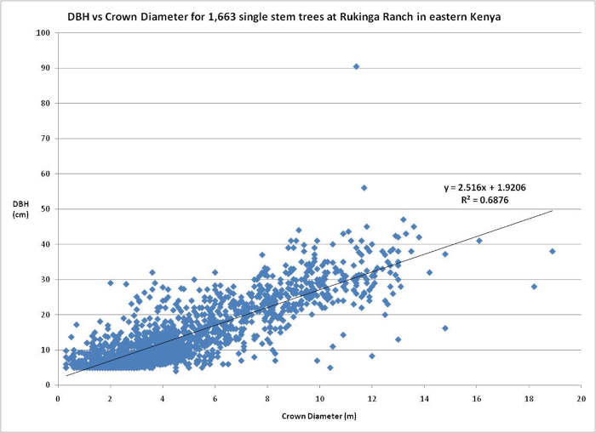
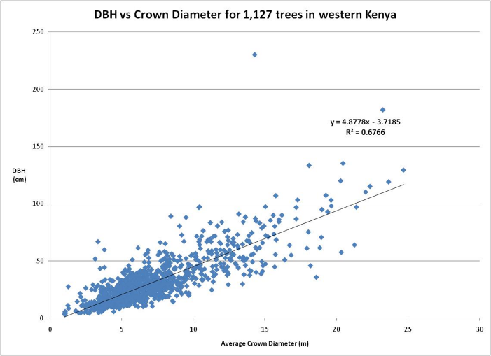
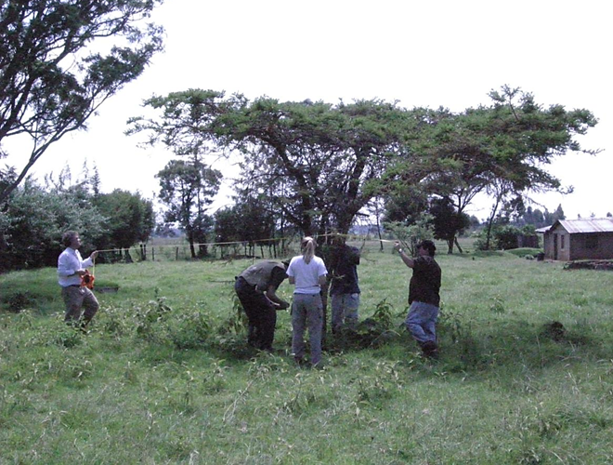
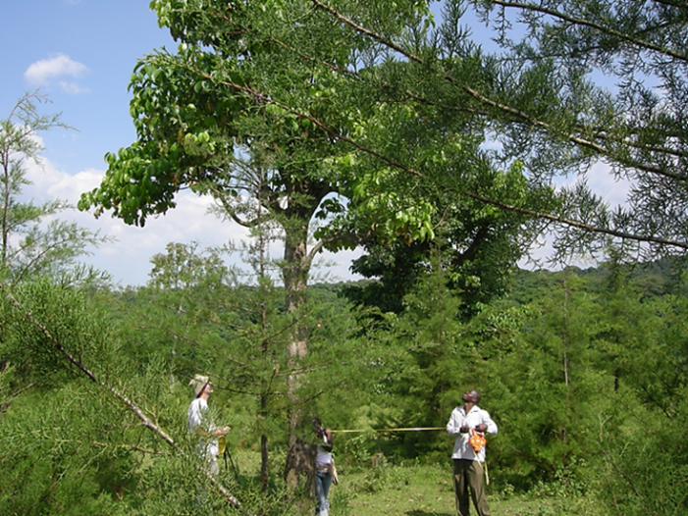

Slide 17
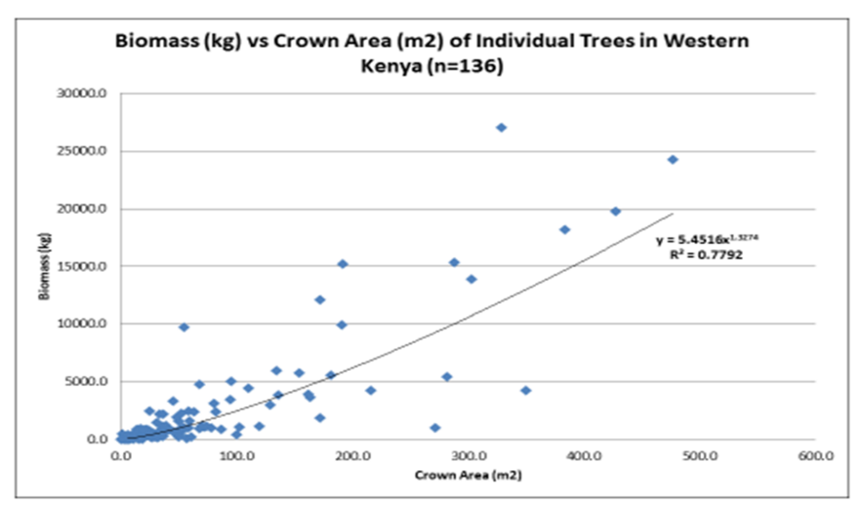
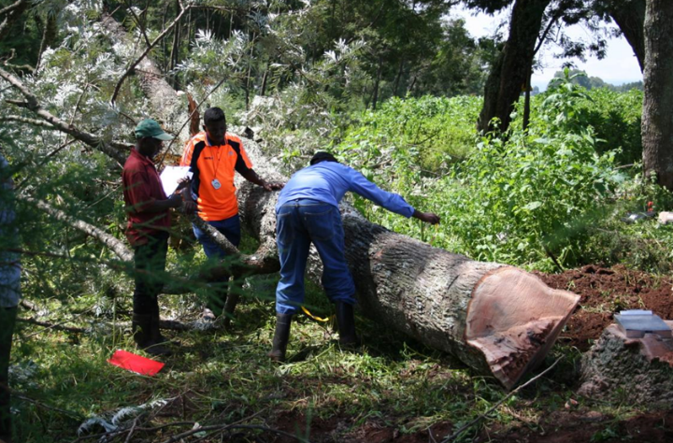
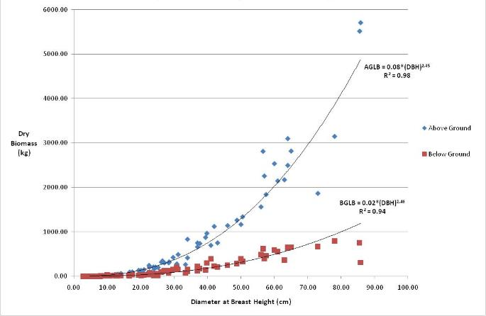

Slide 18
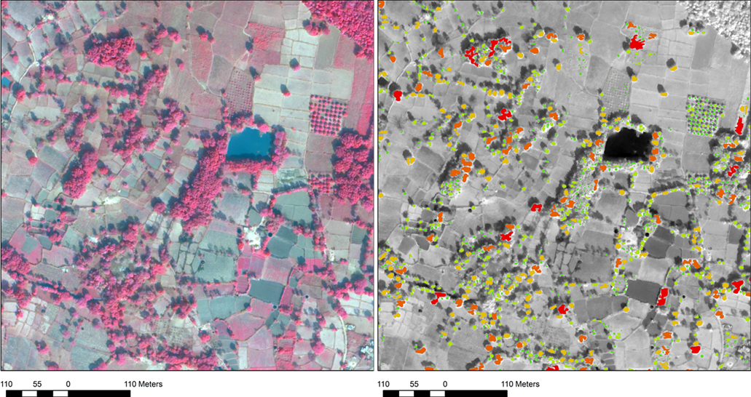
TOF Carbon India

Slide 19
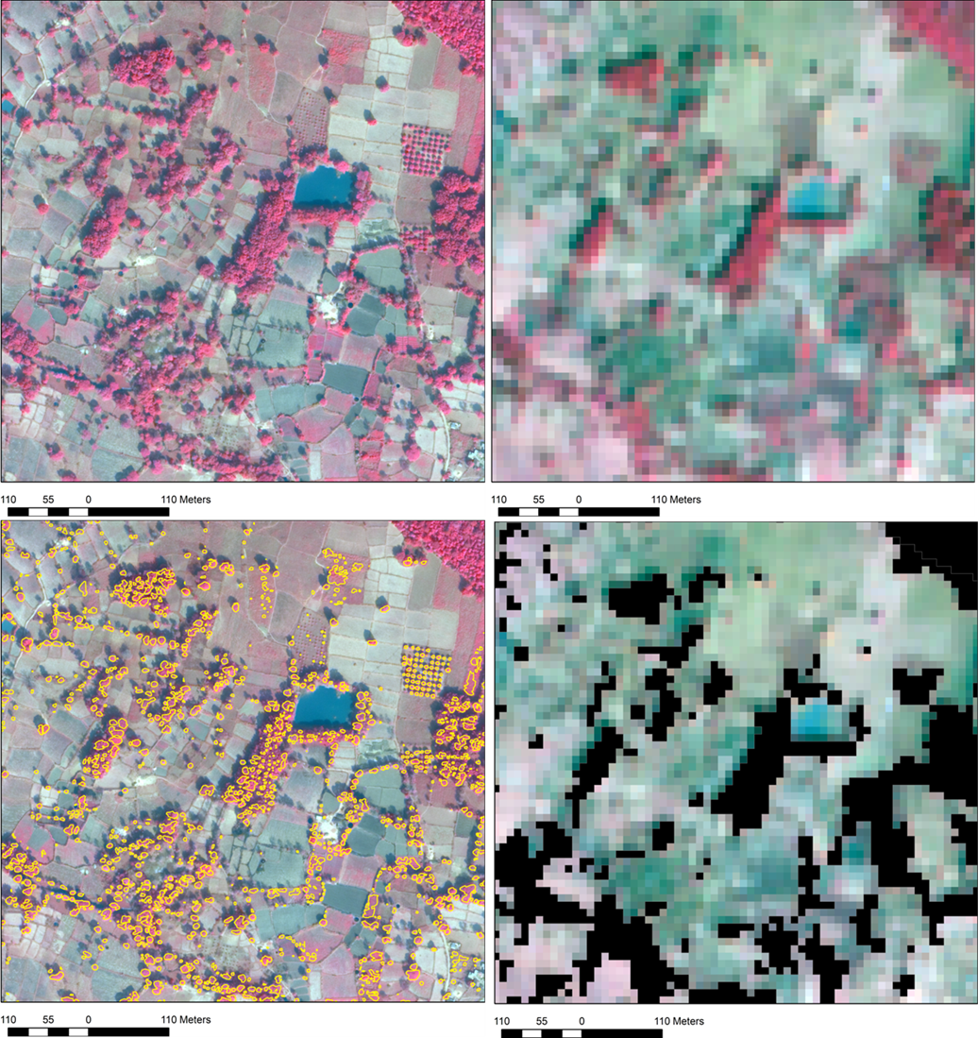

Slide 20
This Study: 1 ha Gridded Landscape Carbon, VHR-CPA Model
Baccini et al. 25 km² Gridded
Zarin et al. re-processed Baccini at 30 m

Slide 21
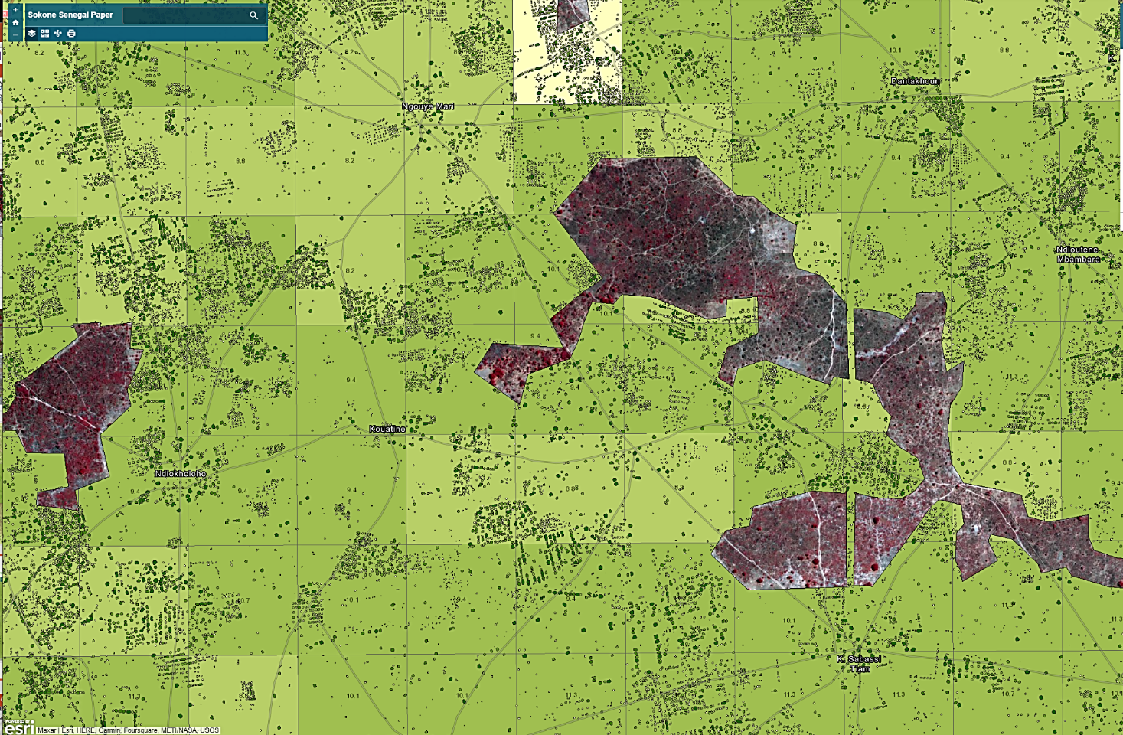

Slide 22
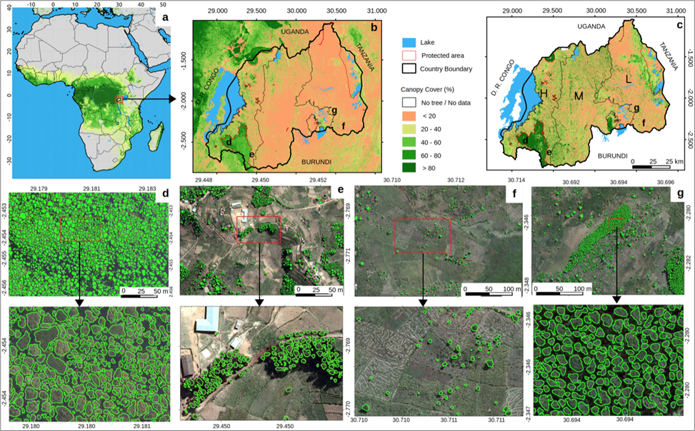
National Scale Application: Rwanda Carbon Stocks
Nation-wide mapping of tree level carbon stocks in Rwanda, in review. Nature Climate Change.
M. Mugabowindekwe, M Brandt, J Chave, F Reiner, D Skole, A Kariryaa1, C Igel, P Hiernaux, P Ciais, O Mertz, X Tong, S Li1, G Rwanyiziri, T Dushimiyimana1, A Ndoli, V Uwizeyimana, J Lillesø, F Gieseke, C Tucker, S Saatchi, R Fensholt

Slide 23
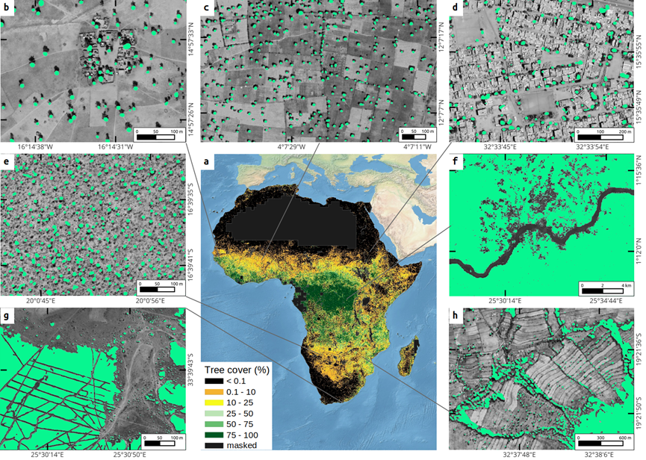
Pan-African Tree Cover, Trees Outside of Forests
A consistent assessment of trees inside and outside forests improves estimates of total tree cover in Africa. In review Nature Communications.
F Reiner, M Brandt, X Tong, D Skole, A Kariryaa, P Ciais, A Davies, P Hiernaux, J Chave, M Mugabowindekwe, C Igel, S Oehmcke, F Gieseke, S Li, S Liu, S Saatchi, P Boucher, J Singh, S Taugourdeau, M Dendoncker, X Song, O Mertz, C Tucker, R Fensholt

Slide 24
AFOLU as More Inclusive Framework
Degradation
Deforestation
Regeneration

Slide 25
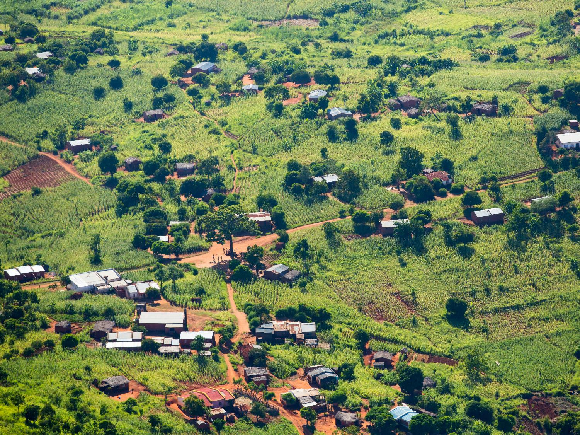
Importance of AFoLU Landscapes
AFOLU landscapes are opportunities for sequestration, not simply reduced and avoided future emissions. They are opportunities for both mitigation and adaptation actions.
A stronger focus on AFOLU with TOF would facilitate meeting net-zero goals by adding landscapes that cover extensive areas in Africa, Asia and Latin America.
These landscapes have the potential for important atmospheric-carbon removal while directly contributing to enhancing adaptation and livelihoods and more stable income generation under climate-stress conditions.
A TOF strategy would ensure participation is not restricted to the countries with high-carbon forests. Many countries already include actions involving TOF removals in their reporting on Nationally Determined Contributions (NDC).
Mitigation targets for land use, forestry and agriculture are included in 73% of all NDCs submitted so far, which surpasses all other priority areas, including those in the energy sector.
Agroforestry is specifically identified in more than 50% of all domestic NDC mitigation activities.
AFoLU farmers are intentionally promoting these tree-based systems, this represents an existing lever for rapidly scaling up carbon sequestration interventions because these systems would already be linked to traditional knowledge and practices.

Slide 26
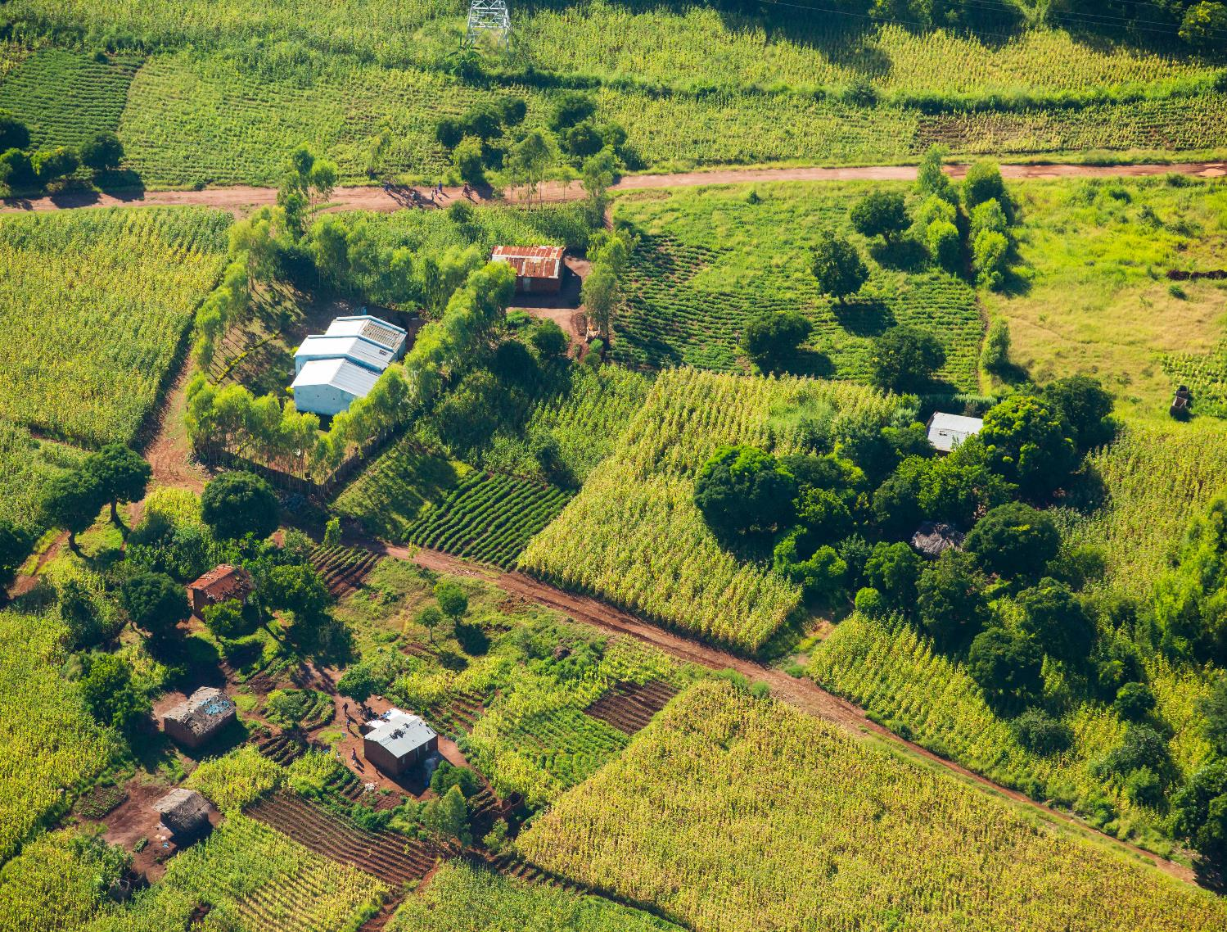
Moving the Agenda to AFOLU
The Bonn Challenge recognizes the value of forest landscape restoration (FLR) to climate change mitigation and adaptation. It recognizes that a forest-only approach will miss opportunities for climate-smart land-based mitigation options in non-forest landscapes, where tree-based systems can increase carbon removals while also supporting nature-based adaptation and development.
Most of the national commitments in the Bonn Challenge, and its African contributions from AFR100 program focus on tree-based activities outside of forests and thus should be elevated in priority for financing.
To do this, these activities should drive an overt effort to explicitly ensure TOF are counted, inventoried, and measured in climate change programs.
New public-private partnerships are raising large capital investments for high biomass forests, including the Green Gigaton Challenge, Lowering Emissions by Accelerating Forest finance Coalition (LEAF), or the new Architecture for REDD+ Transactions (ART), greater inclusion of TOF would increase the relevancy and effectiveness of these investments because they create incentives for tree-based carbon removals in places and ways that matter to people and livelihoods, and thus better secure permanence and scale from these investments.
New measurements using Earth observations are quickly being deployed, with capabilities to measure at the scale of individual trees applied across expansive areas. These monitoring tools have opened a window of opportunity to expand the existing dialog on forests to include trees outside of forests, and in turn create an improved and more inclusive environment enabling large-scale investments in natural climate solutions.

Slide 27
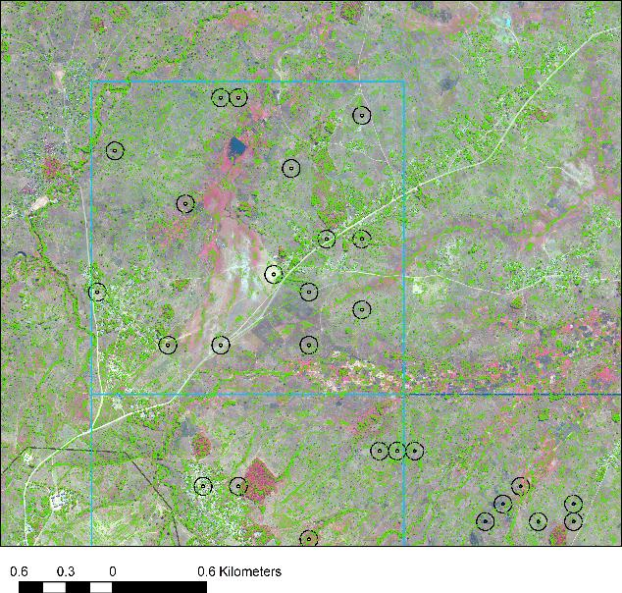
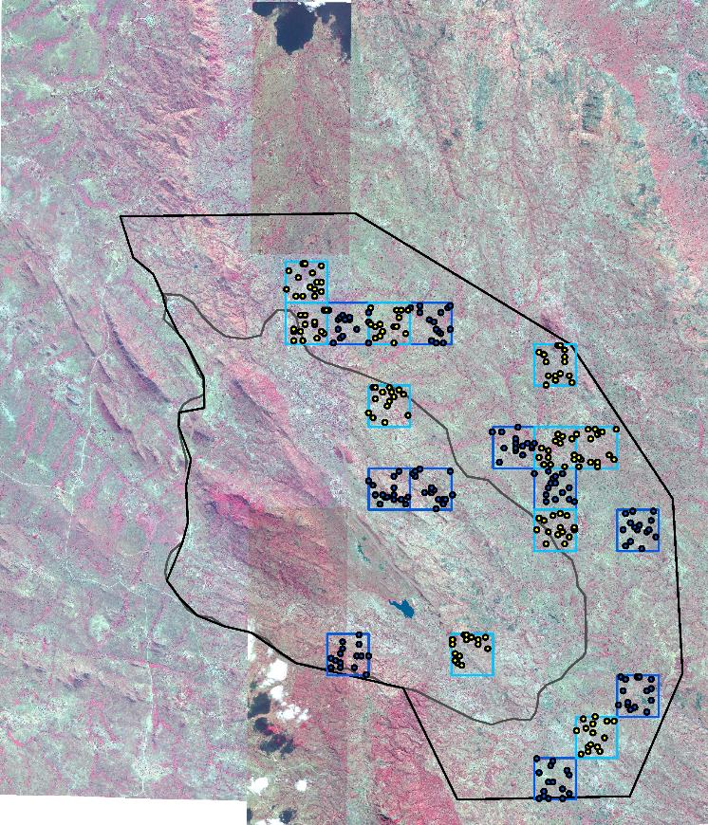
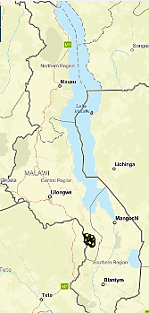
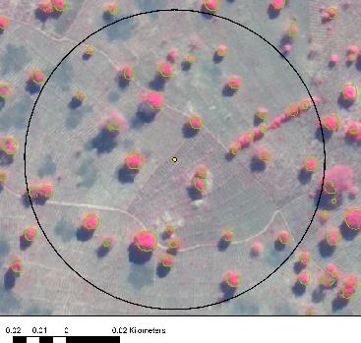
AFR100: ALLIANCE FOR RESTORATION OF FOREST LANDSCAPES AND ECOSYSTEMS IN AFRICA (AREECA)

Slide 28
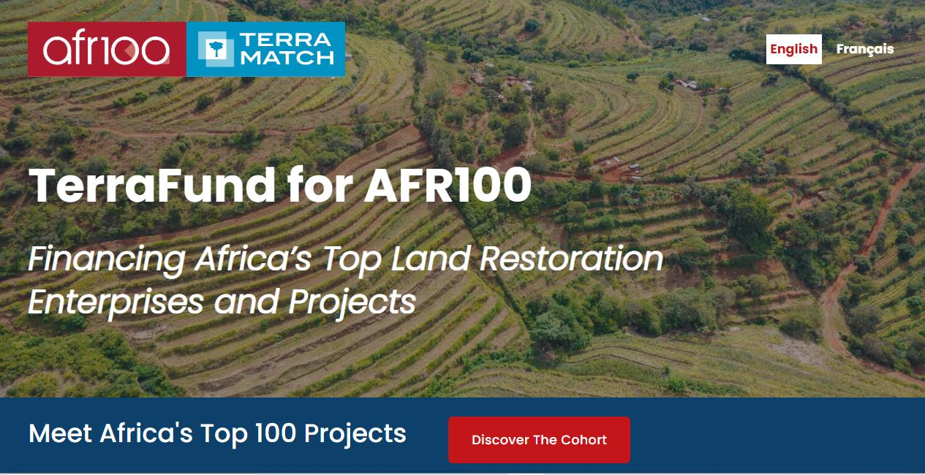
Forest Landscape Restoration, Mitigation and Adaptation in AFOLU

