Slide 1
THE PROGRAM ROOTS: LUCC TO LCLUC
Reflections from B. L. Turner II

Slide 2
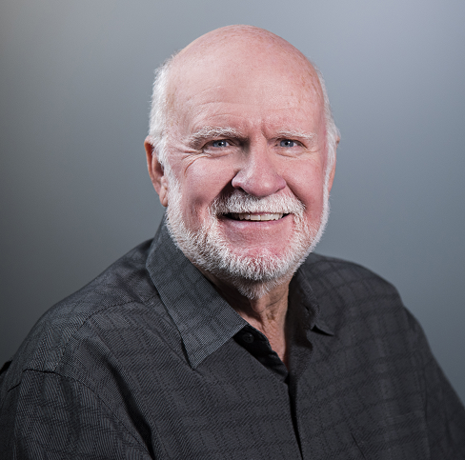
This is me.

Slide 3
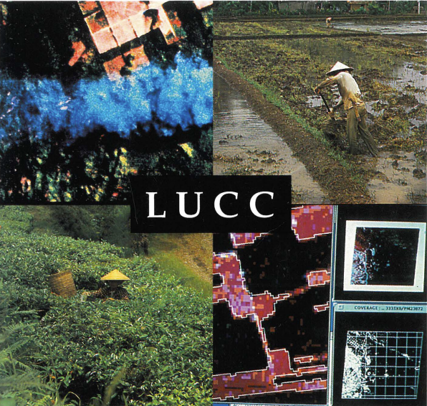
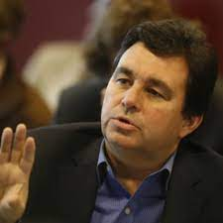
International Human Dimensions Programme
Need for basic science of land dynamics
Dave Skole

Slide 4
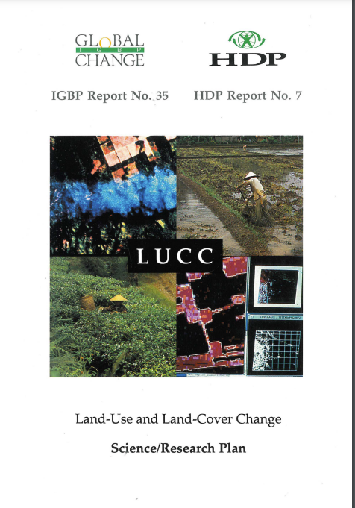
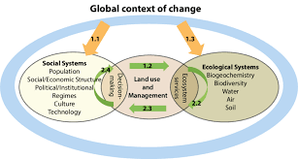
Social-Ecological/Environmental System
Science-based lens with aim to include all social science that might inform science.

Slide 5
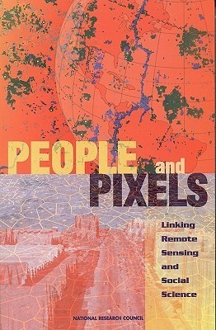
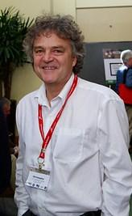
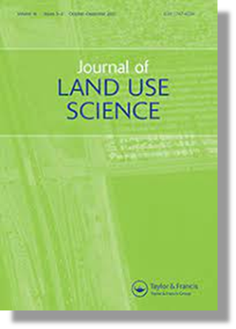
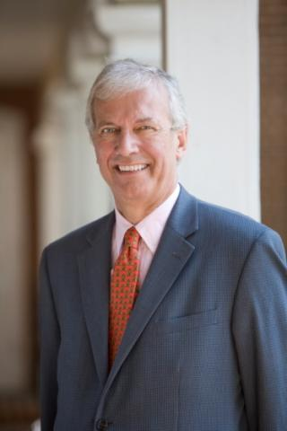
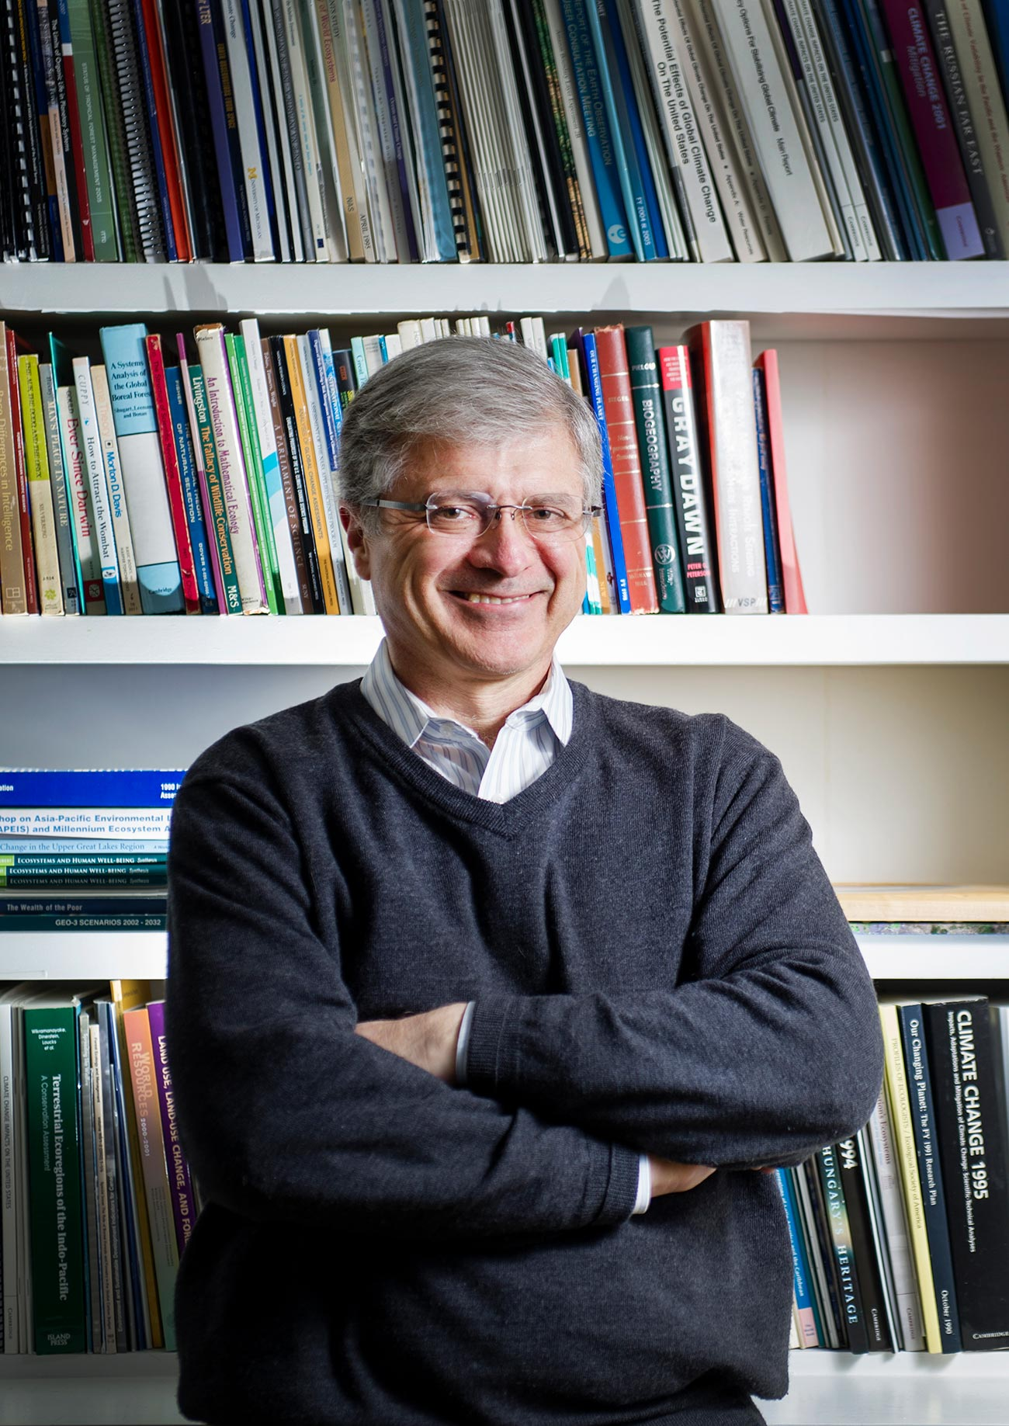
Chris Justice
John Townshend
Anthony Janetos

Slide 6
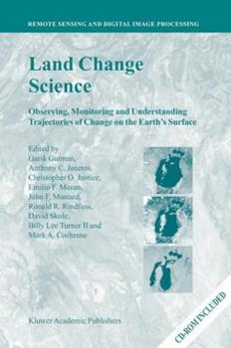
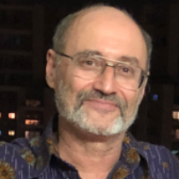
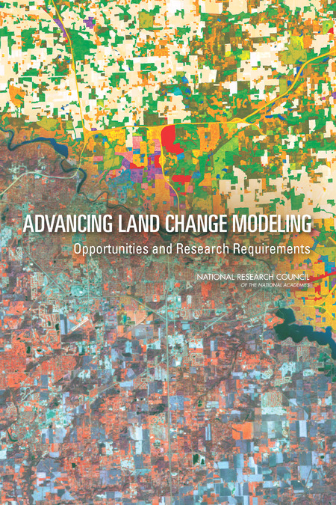
Garik
Gutman

Slide 7
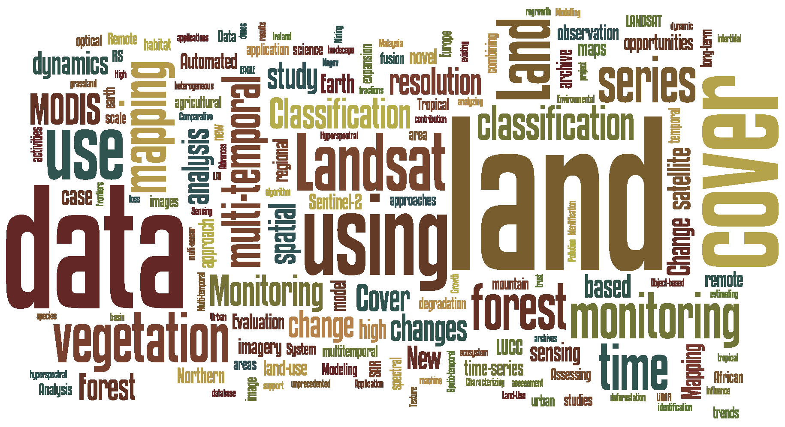
LCLUC Maintains
A Strong Biophysical Interest
While Maintaining
Social Science Interests
Issues Addressed in Recently Sponsored LCLUC Research
Outmigration
Societal conflict
Women’s health
Wildfire strategies
Property values
Narco trafficking

Slide 8
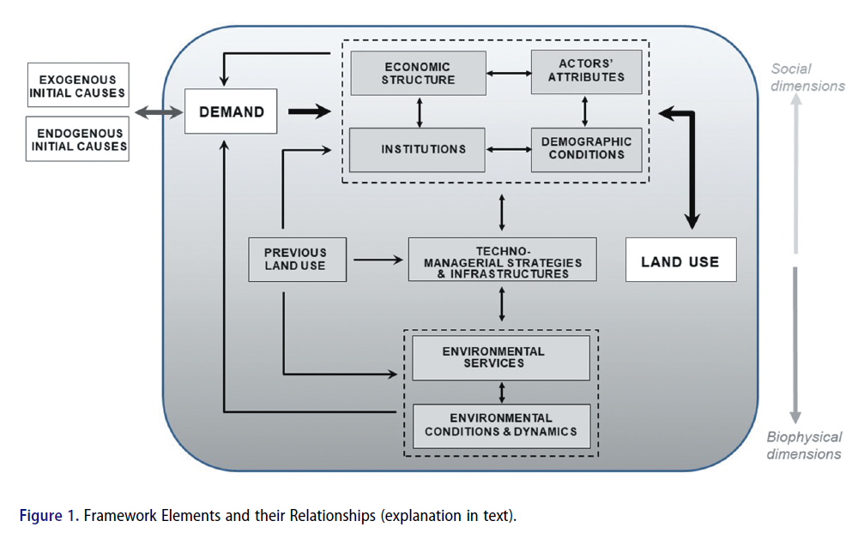
Turner et al. J Land Use Science 2021
Where do we stand on integrated understanding of land change?
That is: social-environmental systems interactions.

Slide 9
Thanks for your attention.
Congratulations LCLUC

