Slide 1
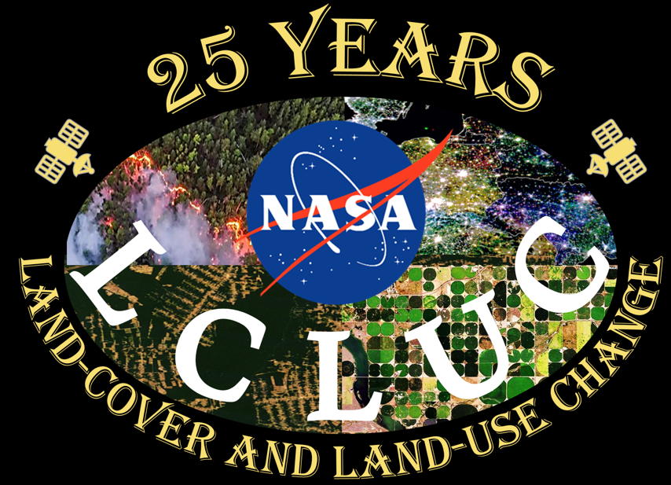
Volker Radeloff
Challenges in Fire Monitoring and LCLUC Science
CHALLENGES AND OPPORTUNITIES
Fire risk and the Wildland-Urban Interface
‘Messy middle’; highest threat to people and homes; ignitions; houses are fuels
Goldilocks: too little, too much, just the right amount of fire
Baseline fire regimes often unknown; fuel management; ecosystem restoration
Grass- and wetland fires
Fleeting and rare; major losses of houses and carbon
Changes versus trends in fire frequency and severity
Need for long burned area time series and statistical tests for significance in trends

Slide 2
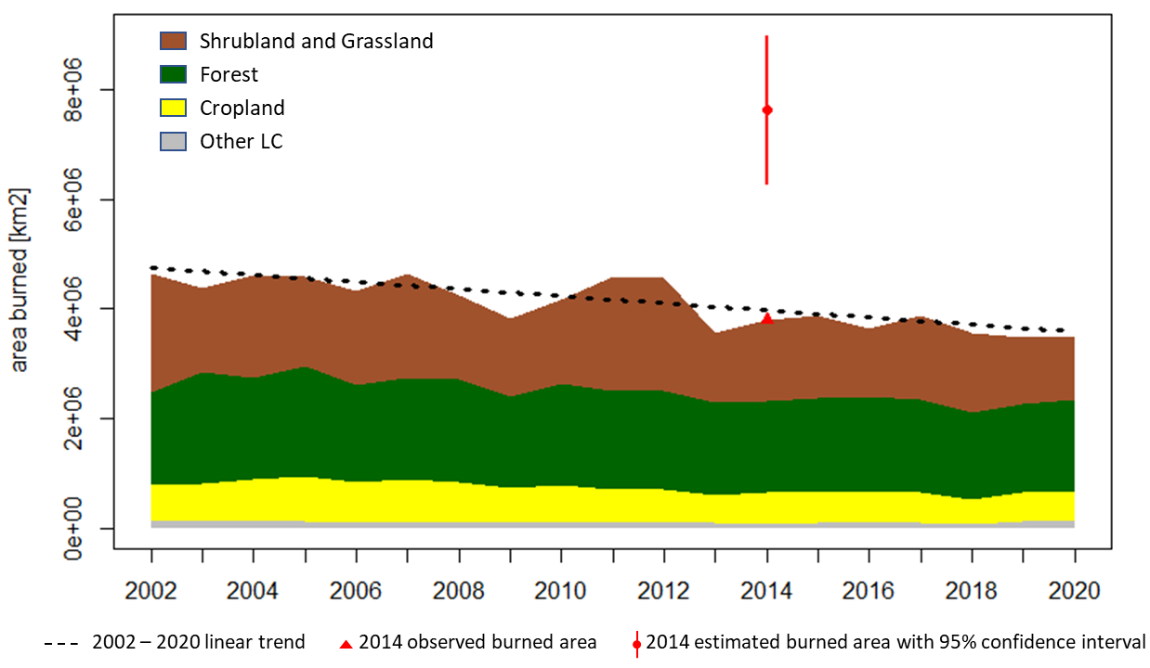
Luigi Boschetti
Challenges in Fire Monitoring and Land-Use Science
Overarching issue: meeting the needs of multiple communities (science and applications)
Understanding the role of fire in the global Earth System
Provide societal benefit by meeting the needs of fire management
Fire datasets:
MODIS + VIIRS harmonized record will produce a 30-year time series (climate normal), AVHRR needed for 1980+
Transition to global moderate resolution 10-30m mapping to capture (small fires, support for fire users)
Moving beyond binary maps (fire characterization)
High temporal resolution active fire mapping
Science questions:
Trends in global fire activity
Land cover change and climate drivers of fire
Vegetation recovery trajectories and climate change
Short and medium term fire models (and related inputs)
An underlying problem: fire ”science” needs a more rigorous framework
unambiguous definition of fundamental concepts (“Fire Regime”, “Fire Risk”, ”Fire Severity”)
Physically based definitions (e.g., minimum mapping unit for area burned, emitted power threshold for active fires)
MODIS MCD64 – Annual Area Burned

Slide 3
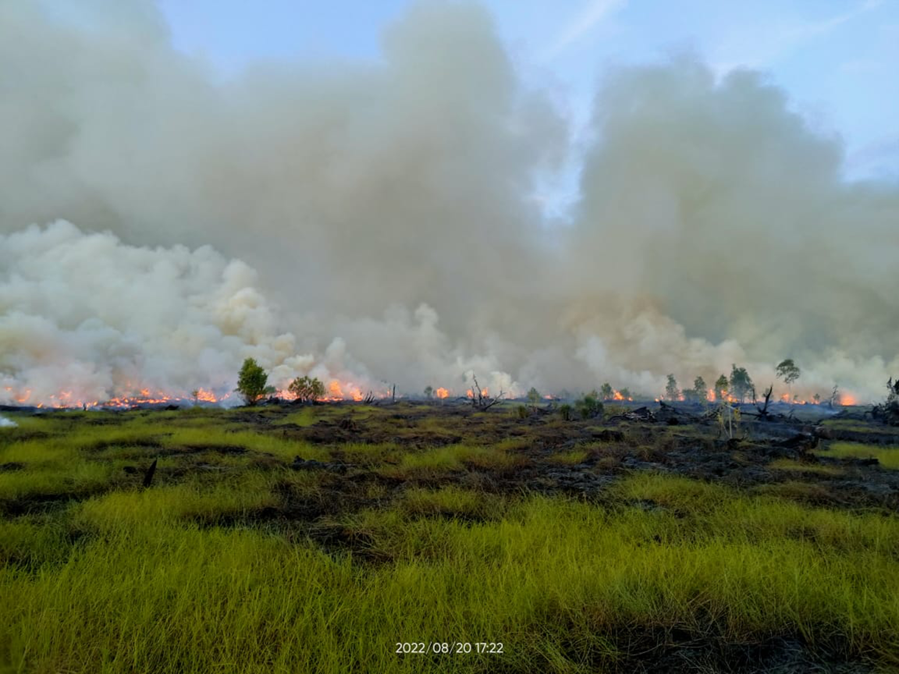
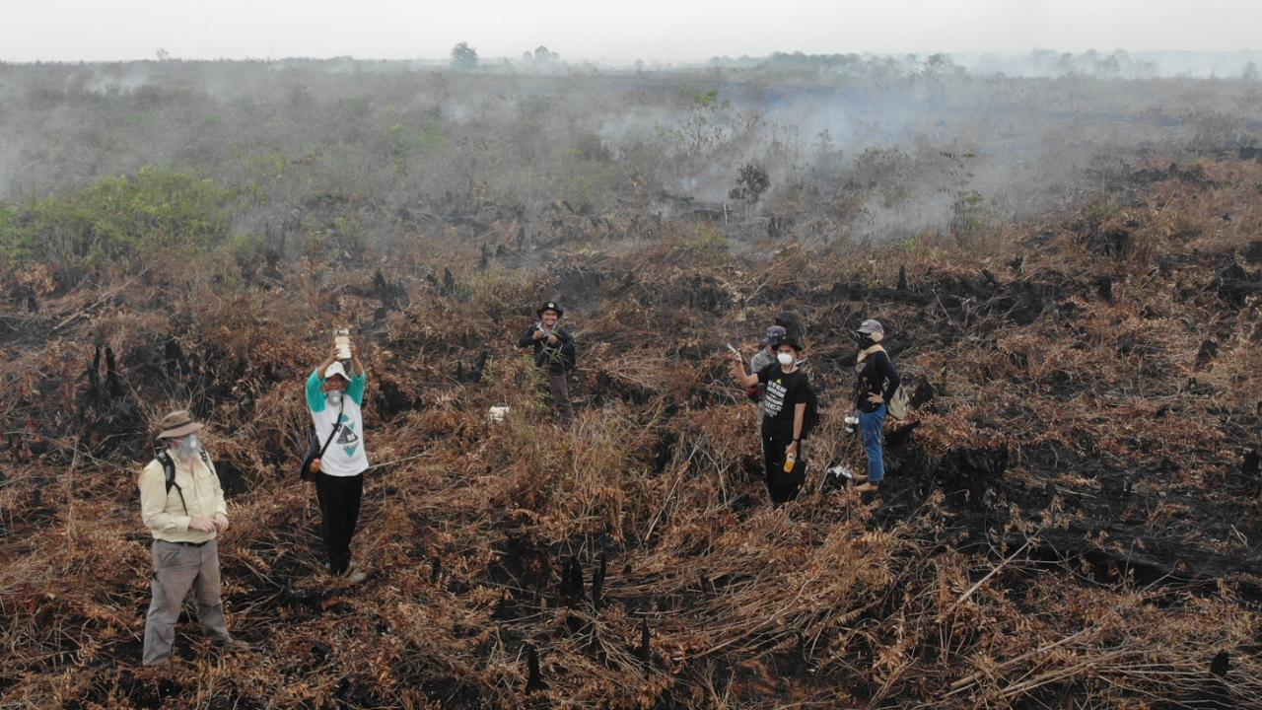
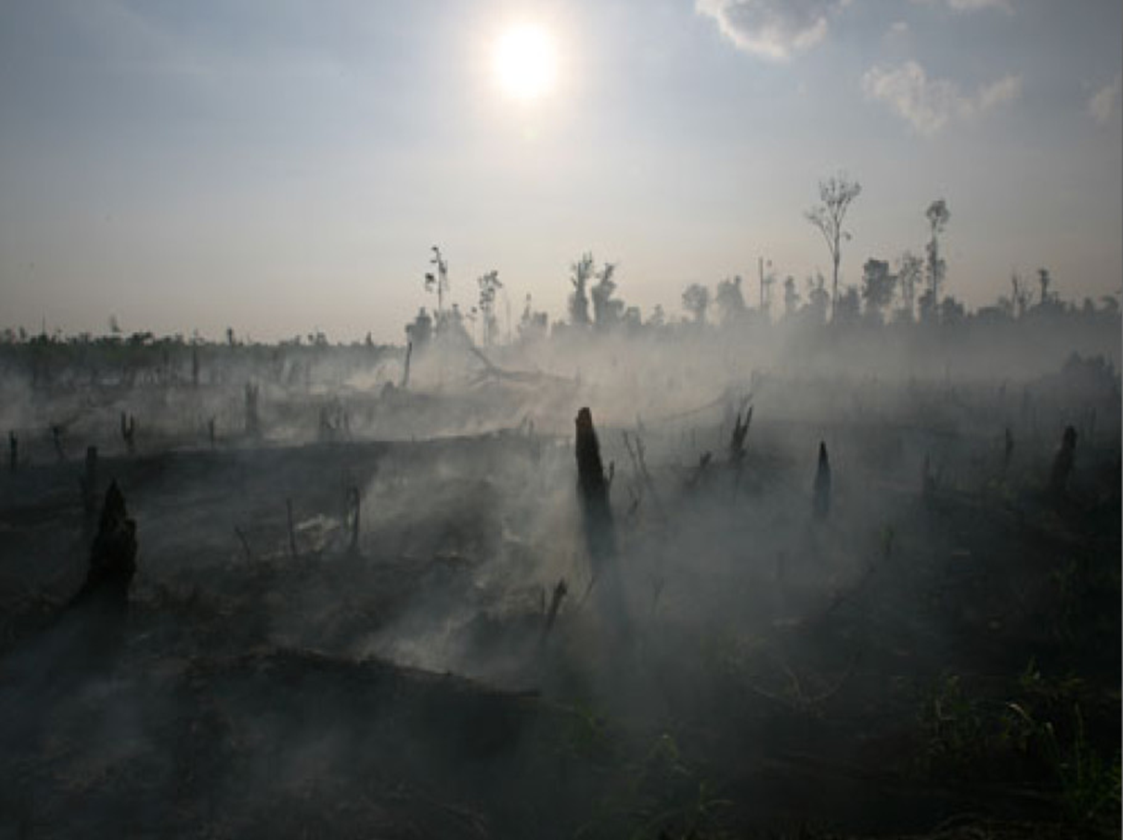
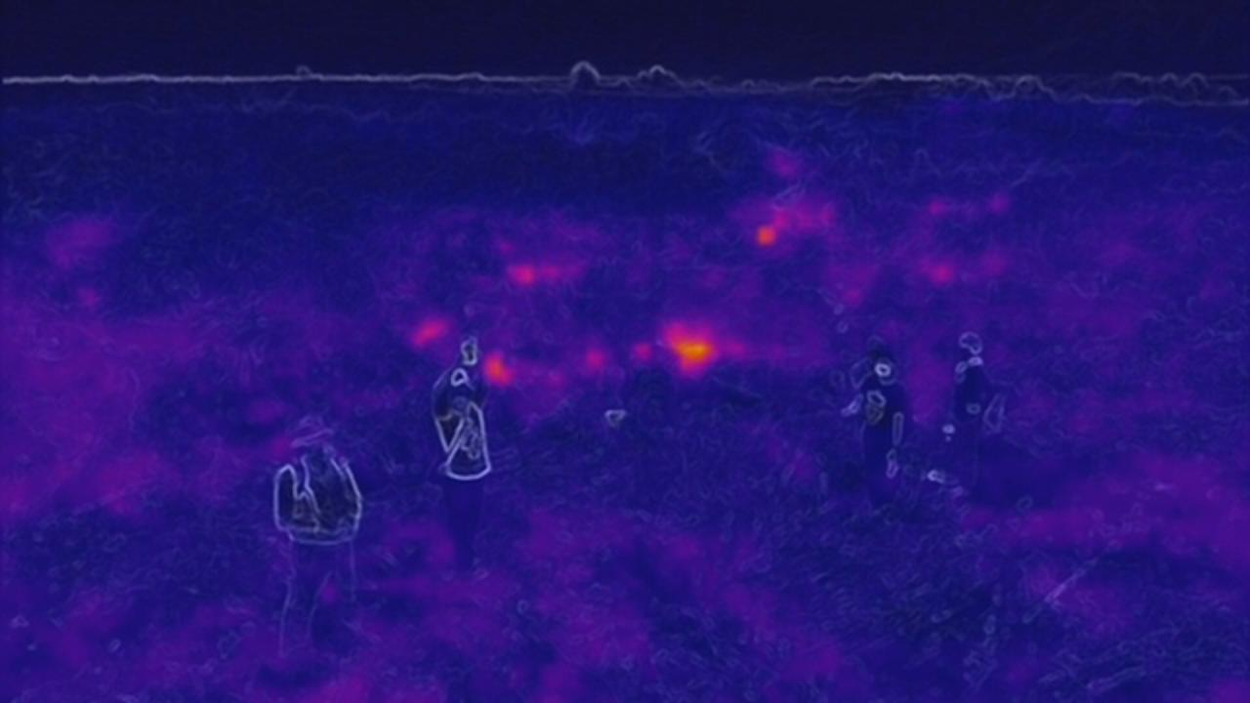
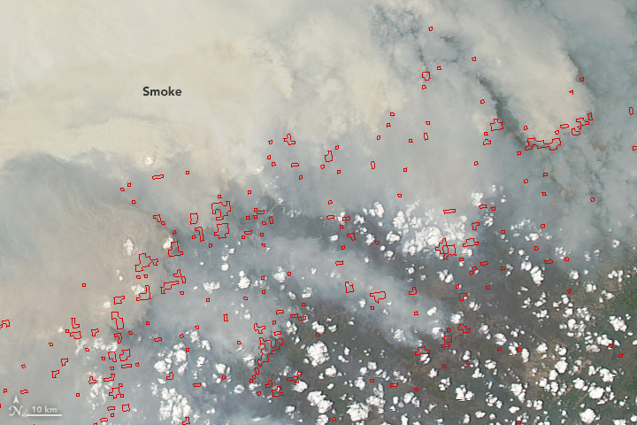
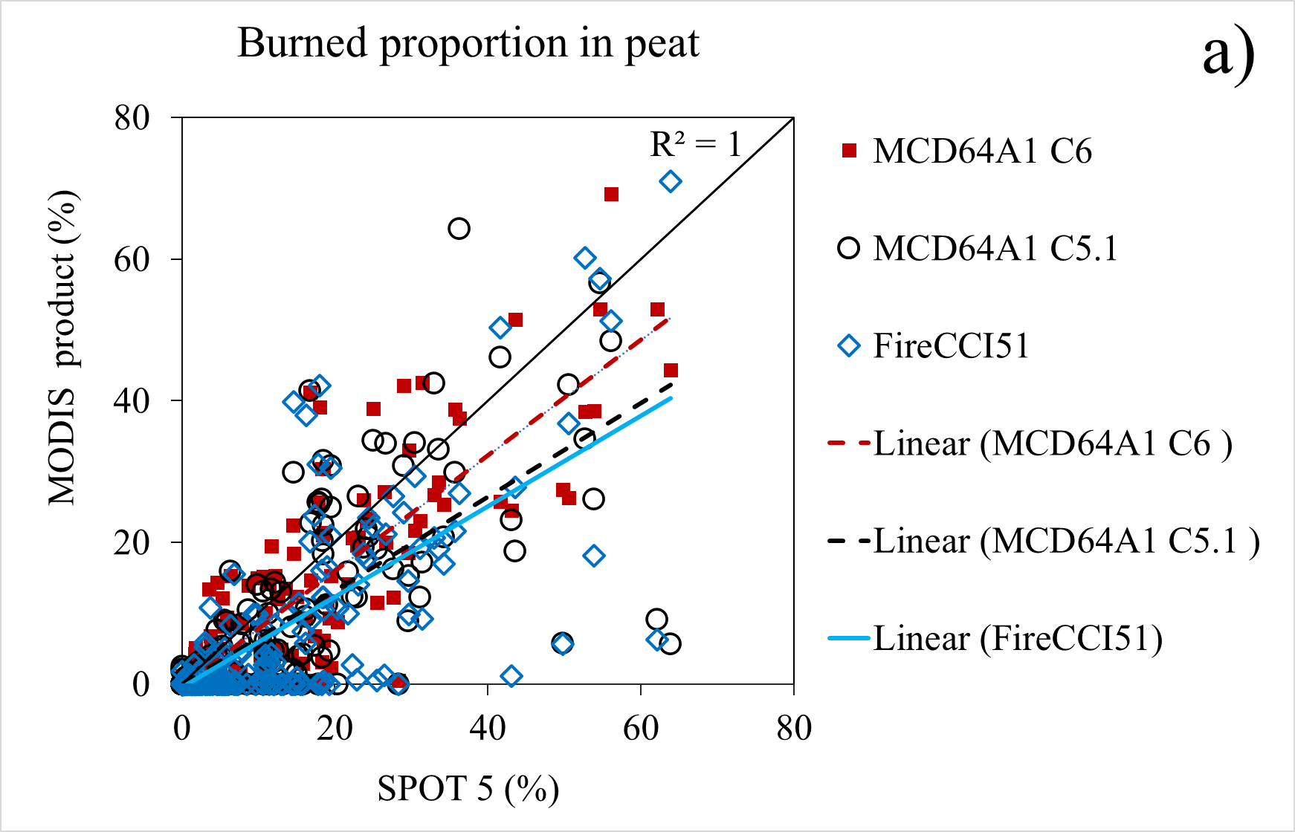
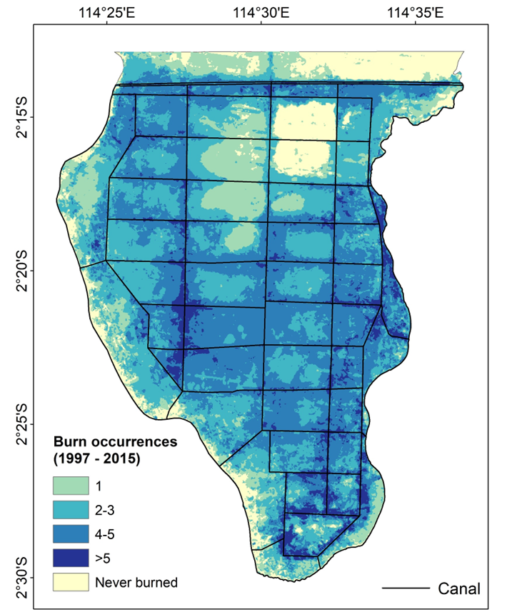
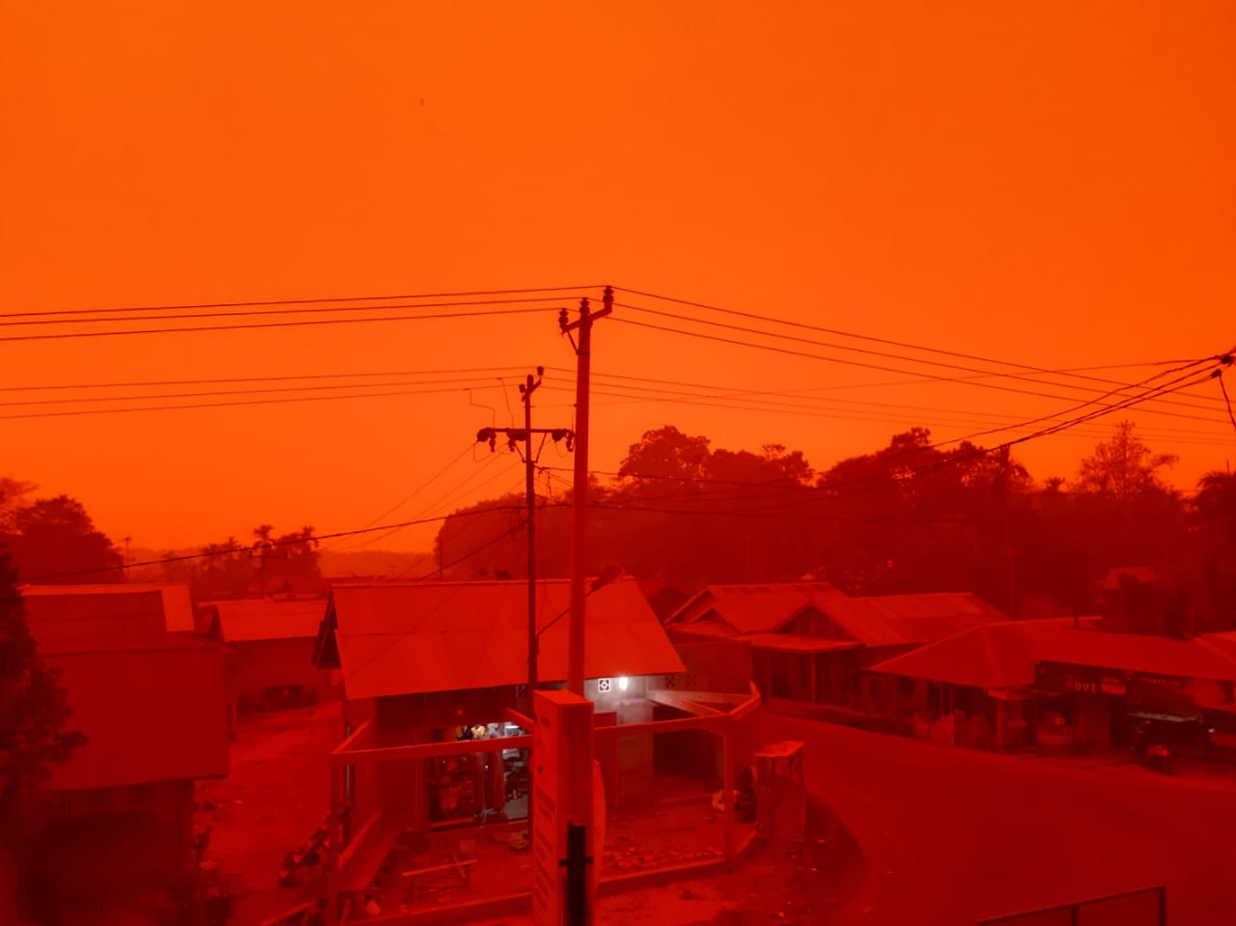
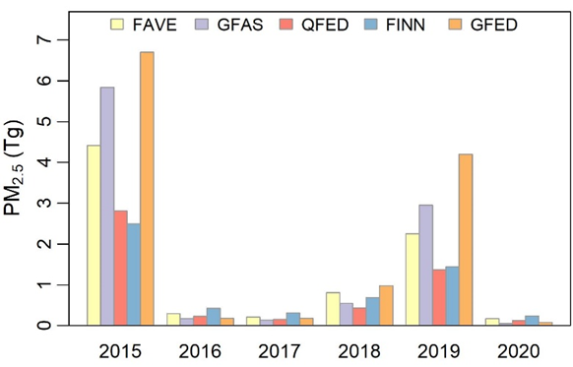
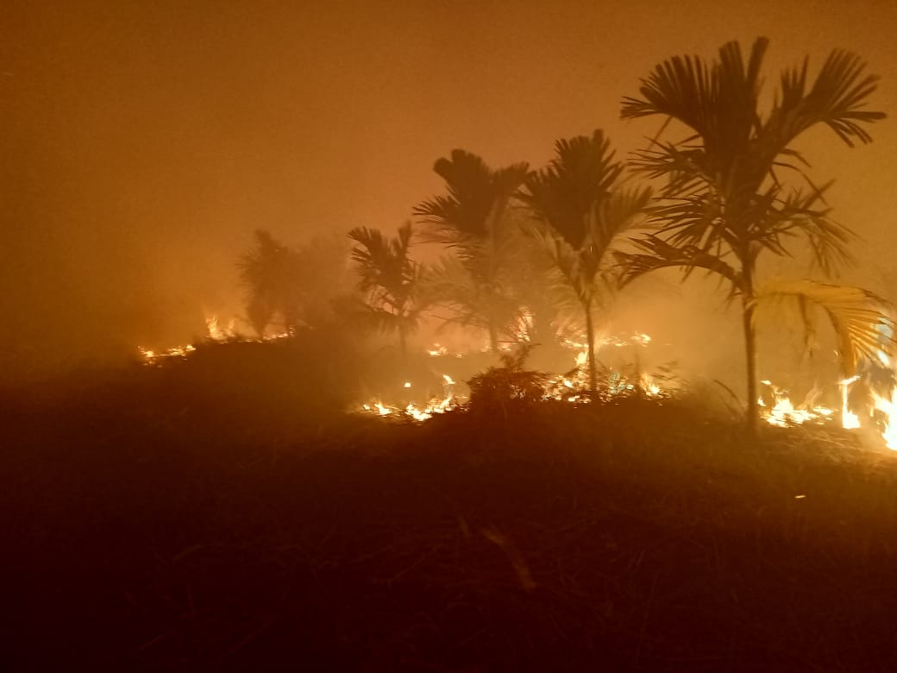
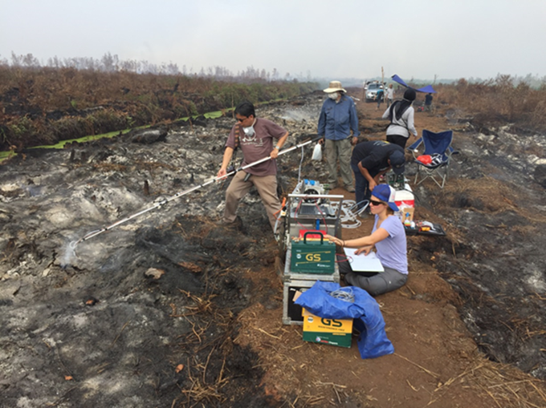
Mark A. Cochrane (UMCES)
Challenges for monitoring fire in tropical peatlands
Detection
Fire radiative power (FRP)
Clouds
Smoke
VIIRS does better
Mapping
Burned area products not optimized for peatlands
Possible with Landsat/Sentinel 2, SPOT
Sentinel 1 works great …. Unless it is wet
Still underestimate due to size and time since burning
Emissions
What burned?
Bottom-up estimates need area and …… depth
Where there is smoke…. Top-down estimates hold promise
Fused AHI-VIIRS emissions

