Slide 1
Final Remarks

Slide 2
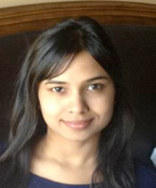
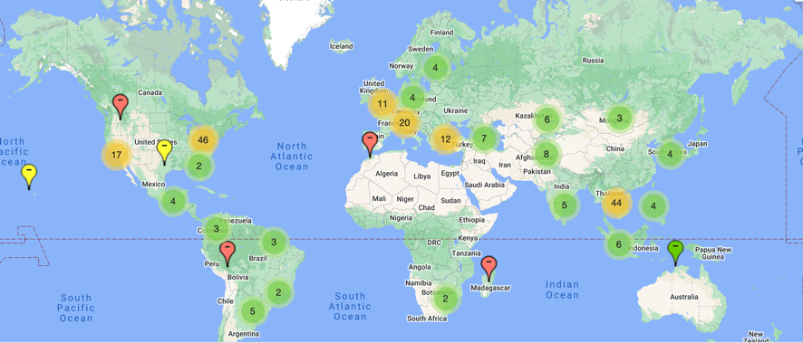
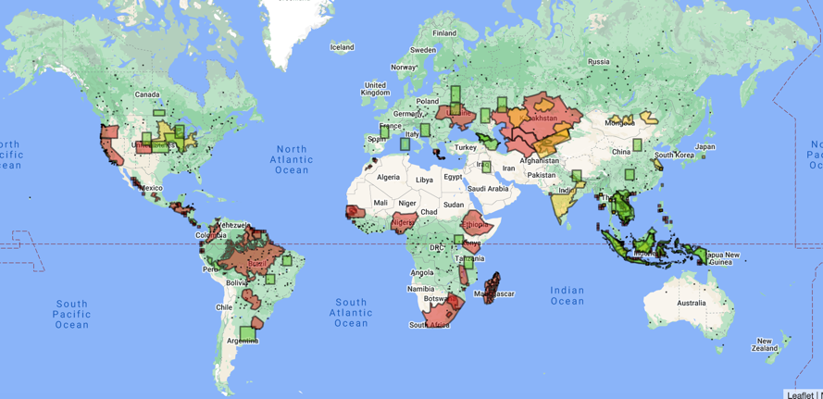
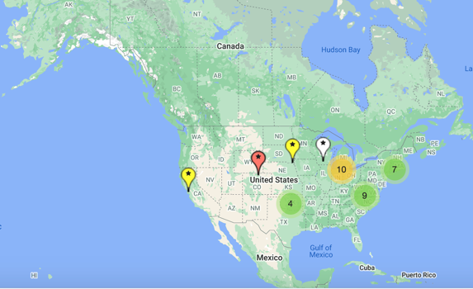
LCLUC Mapper Options
Principal Investigators
Regional Collaborators
Indrani Kommareddy
LCLUC Program
Project Research Areas
Graduate Students

Slide 3
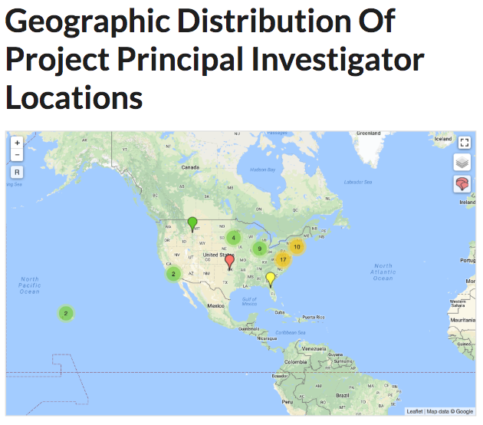
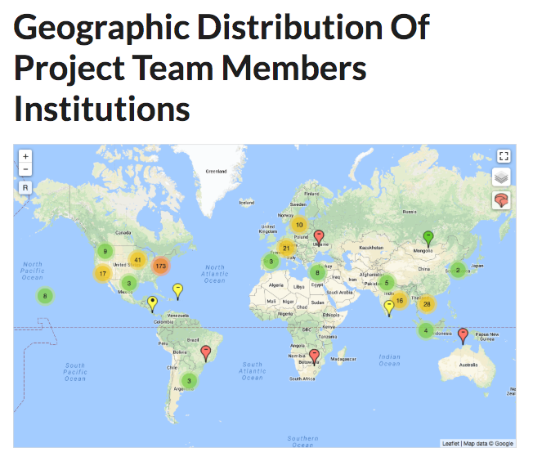
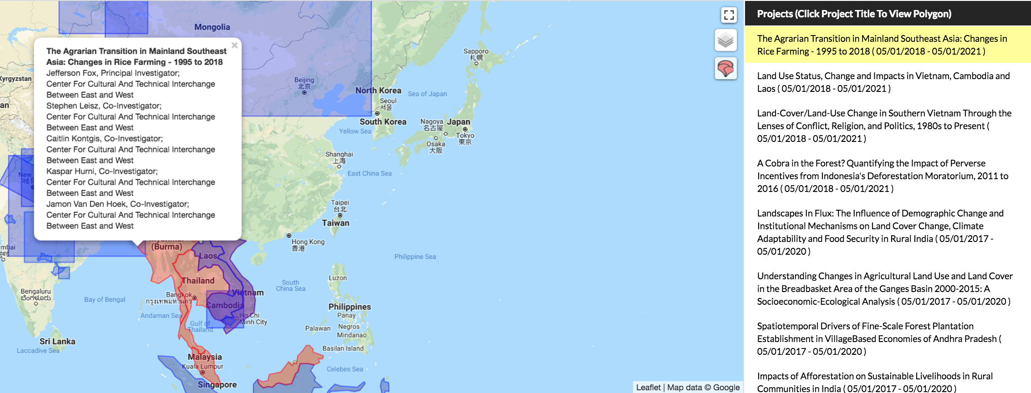
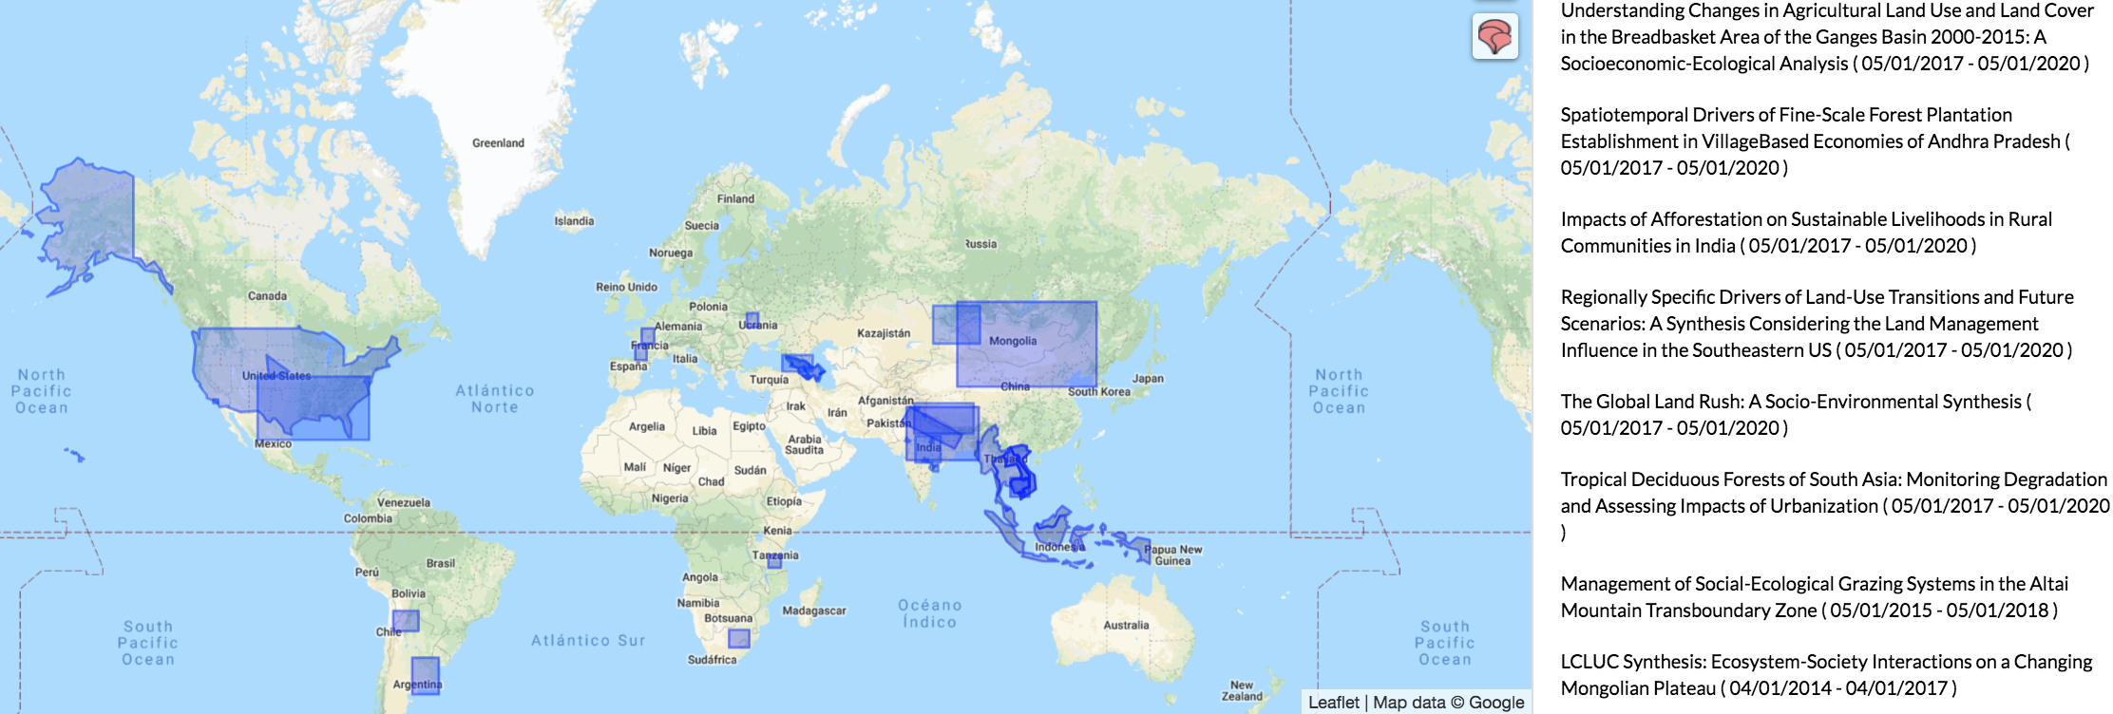
The LCLUC Mapper
Geographic Areas of Research Projects
Kudos to Indu!

Slide 4
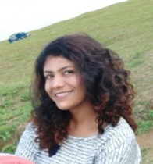
Hotspots of Land Use
Indrani Kommareddy
LCLUC Program
Meghavi Prashnani
LCLUC Program

Slide 5
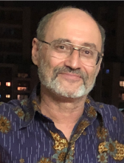
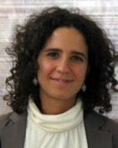
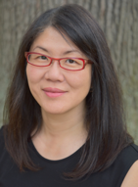
LCLUCers in Media: Sep 2020-Sep 2022
Albedo, Its Importance, and How It Can Affect Climate : Eyes on Earth – EROS Center Podcast on Remote Sensing, Earth observation, land change and science
Crystal Schaaf, Jan 2021
BBC Future Planet reports on research conducted by LCLUC PI Alexandra Tyukavina in the Congo Basin Rainforest.
Sasha Tyukavina, June 2021
How the world’s northernmost forests are also under threat from climate change - Inquirer.Net Earth & Environment
Marc Friedl, May 2021
Solving Ecological Mysteries using Satellite data - New York Times
Volker Radeloff, Jan 2021
Commercial Satellites Shed Light on Small-Scale Agriculture - NASA Earth Data
Chris Neigh,Dec 2020
India's groundwater crisis threatens food security - A study covered by CNN and AAAS
Meha Jain, Feb 2021
BBC News reported on agricultural research in Africa by Catherine Nakalembe, Dec 2020
Also. Uganda's highest civilian award, the Golden Jubilee Medal Feb 2022
Interview on NETVIET TV, Vietnam
Garik Gutman Feb 2020
Radiant Earth Foundation featured Catherine N. and Karen Seto in an article "Celebrating Women in the ML4EO Community.”
Mar 8, 2021 (Int. Women Day)
“Amazon degradation has become more destructive than deforestation.” highlighted in Science Bulletin, Eureka alerts, AAAS, MSUToday, Folha de Sao Paulo, The Conversation, Earth.com
Dave Skole, Sep 2020
Reference in the Washington Post on irrigated lawns
Garik Gutman Aug 2022
BBC world news interviewed Dr. Inbal Becker Reshef on how satellite information can be used to improve food security and agricultural decisions. Feb 2022
Talking Climate Change with Smithsonian Conservation Commons’ Earth Optimism Initiative
Jeff Masek Oct 2020
https://lcluc.umd.edu/content/archive-announcements. Only last 5 years out of 25 – needs backtracking

Slide 6
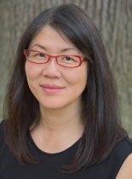
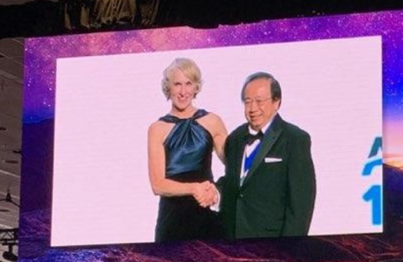
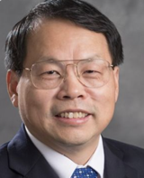
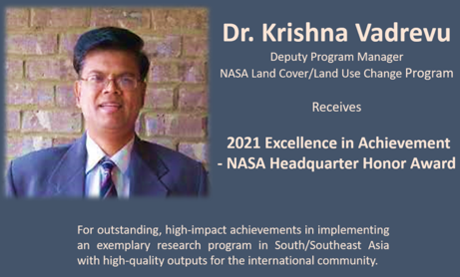
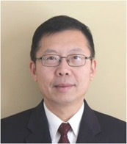
LCLUC Awardees: 2018-2022
Throw a tomato at me (and keep me informed) if I missed someone
Karen Seto (Yale U.)
2019 AAG Awardee for Outstanding Contributions to Remote Sensing
Catherine Nakalembe (UMD)
2020 Africa Food Prize Laureate
2019 GEO Individual Excellence Award
Jiquan Chen (Michigan State U.)
OutstandingFaculty Award (2020)
Fulbright Global Scholar Award (2021-2022)
Tatyana Loboda (UMD)
2020 UMD Research Excellence Award
Son Nghiem (JPL) elected AGU Fellow 2019
World Sustainability Award (2021)
Gunnerus Award in Sustainability Science (2021)
2018 SERVIR Excellence Award
Jianguo "Jack" Liu, Michigan State U.
2019
...and the 2021 Distinguished University Professor award - the highest honor that UMD bestows on faculty members for their contributions to their fields of research.
Feng Gao (USDA)
2018 Arthur S. Flemming Award

Slide 7
25 Years of Early Career Scientists Support
Students through Student Fellowships → FINESST calls
New Investigator Program (NIP) calls
LCLUC special calls to bring in young talents to the Program
LCLUC-11 (10 selections)
LCLUC-19 (9 selections)
LCLUC-21 (8 selections)
NASA-Michigan State U. project to support students’ participation in IALE conferences
Science Team meeting in May 2023 - Focus on ECS

Slide 8
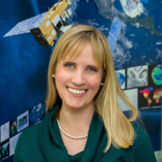
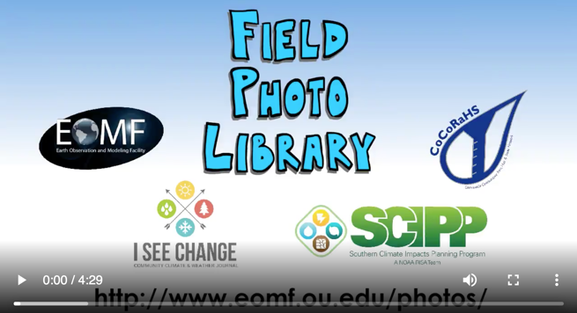
Involving Very Young in LCLUC
Global Geo-Referenced Field Photo Library
@U. Oklahoma
Holli Kohl,
NASA GSFC
LCLUC-GLOBE partnership
Getting school students interested in LCLUC science
To help inclusion/diversity issues
To uncover the LCLUC world for kids
Volunteering
I gave 5 lectures to GLOBE Estonia students and teachers: Introduction to Land Remote Sensing
A talk to school kids in Paphos, Cyprus
Dr. Xiaming Xiao,
U. Oklahoma
Crowdsourcing and citizen science (including kids) to help LCLUC science:
Taking pictures, learning to comply with protocols, enjoying impact of their work

Slide 9
Carbon Cycle & Ecosystems Focus Area Joint Workshop May 8-12, College Park, MD
 | Monday | Tuesday | Wednesday | Thursday | Friday
8:30 |  |  | Plenary Opening | NASA Leadership Roundtable | DAACs Training
9:00
9:30
10:00 |  |  | Break | Break
10:30 |  |  | Talks Theme 1: Human influence on global ecosystems | Talks Theme 4: Research to Applications
11:00
11:30
12:00 |  |  | Lunch | Lunch
12:30
1:00
1:30 |  |  | Talks Theme 2: Climate Change Impacts | Talk Theme 5: Future research direction
2:00
2:30
3:00 |  |  | Break | Poster Session
3:30 |  |  | Talks Theme 3: Disturbance, Resilience, Mitigation, and Adaptation
4:00
4:30
5:00 |  | Poster Session | Poster Session
5:30
6:00
6:30
LCLUC
ST Meeting
Early Career
Researchers
LCLUC-2019
Oral presentations
LCLUC-21 poster
Ad presentations (2min)
LCLUC NIP and FINESST Students will be welcome too

Slide 10
LCLUC-23 solicitation
MuSLI, Socio-Economic component NOT mandatory
Focus on the synergistic use of infrared (SWIR-TIR) in MuSLI approaches (optical+microwave, moderate res+VHR)
Will be announced in Feb 2023
Check out other programs’ calls!

Slide 11
LCLUC and GOFC-GOLD Regional Meetings
GOFCGOLD.org website
LCLUC.hq.NASA.gov website

Slide 12
Towards a Potential LCLUC Initiative in Latin America
Build on the past and ongoing LCLUC projects in Latin America
Enhance current GOFC-GOLD RedLATIF (mostly fire) network for LCLUC activities
Focus on the areas beyond Amazon (to complement the NASA-Brazil LBA program of 1997-2017)
Need a critical mass of interested key LCLUC scientists (SARI example) – any volunteers?

Slide 13
Personal Remarks
Everything new is well-forgotten old
New stuff is well forgotten stuff
Or well-developed stuff?
E.g. ANN (Dan Brown 40 years ago)
CNN
Deep learning
ML – regressions
First time in –person after a long hiatus
Many names, and now faces
Limited space – many more would have been invited

Slide 14
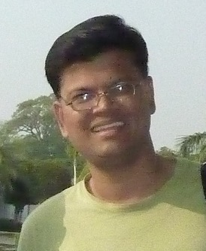
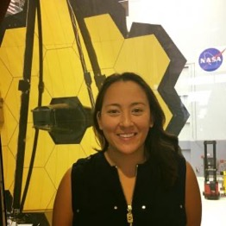
Thanks go to
Organizers: C. J. and Co.
Sponsor: KBR
Doug Jaton, Calli Jenkerson, Mary Armstrong
Mary
Rohan
Meghavi
Alison
Keelin
Deputy LCLUC Program Manager
Krishna Vadrevu, NASA MSFC
Notes:
Sponsors: KBRwyle Government Services – NOT THIS TIME

Slide 15
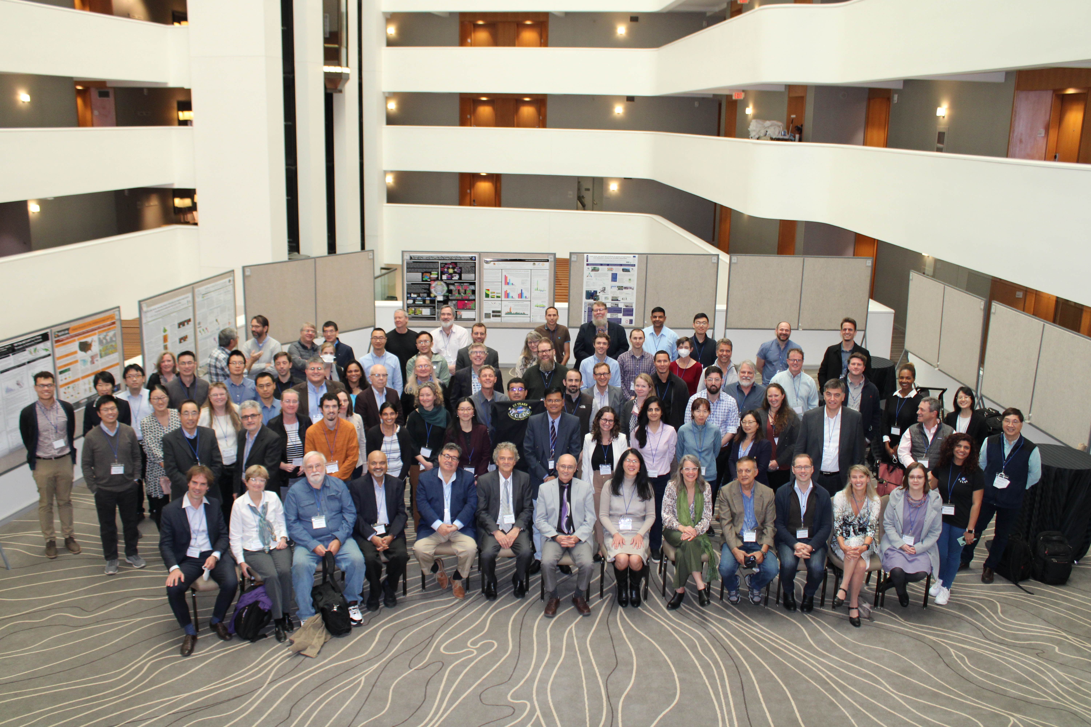
Happy Anniversary, LCLUC!
St. Petersburg, Russia
June 2001

