Slide 1



The Current Status and Future of Fire Monitoring
David Roy
Centre for Global Change and Earth Observations (CGCEO),
and Department of Geography, Environment, & Spatial Sciences
Michigan State University
With help from: Louis Giglio (UMD), Haiyan Huang (MSU), Martin Wooster (Kings London),
Luigi Boschetti (UofI), Joshua Johnston (NRCAN), Myung Sik Cho (MSU), Yuean Qiu (MSU)
2021 -22 NASA LCLUC Science Team Meeting & Silver Jubilee Celebration
LCLUC Spring Science Team Meeting, 2018
3-5 April, Gaithersburg Marriott Washingtonian Center (Rio), Maryland \

Slide 2
The Current Status and Future of Fire Monitoring
Fire preamble
Current
  Satellite active fire detection
  Satellite burned area mapping
Future
  Landsat Sentinel-2: burned area products from regional -> global
  High spatial resolution commercial data: new opportunities
  Validation: needs & new opportunities
  Looking back: need for a long term pre-MODIS burned area record
  Looking forward: active fire AM gap, active fire constellation, system of systems
  Fire LCLUC research

Slide 3
The Current Status and Future of Fire Monitoring
Fire preamble
Current
  Satellite active fire detection
  Satellite burned area mapping
Future
  Landsat Sentinel-2: burned area products from regional -> global
  High spatial resolution commercial data: new opportunities
  Validation: needs & new opportunities
  Looking back: need for a long term pre-MODIS burned area record
  Looking forward: active fire AM gap, active fire constellation, system of systems
  Fire LCLUC research

Slide 4
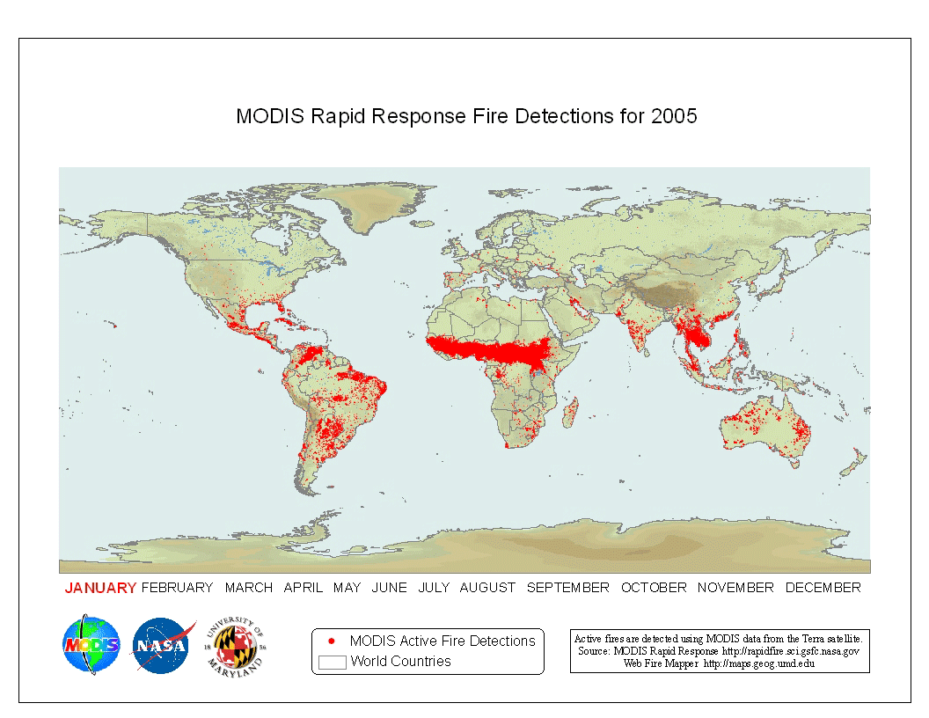
Fire is a Global Phenomenon
Except in sparsely populated regions fires are predominantly lit by people
Globally, fires burn annually on average ~3.4% of the terrestrial surface (Giglio et al. 2018)

Slide 5
Fire has Important Positive Ecological Effects
may mobilizes nutrients into the soil
may maintain or increase
  ecosystem productivity
  biodiversity
some plants are fire-adapted (pyrophytes)
  require fire for their seeds to germinate
  some species become locally extinct without fire
maintain savanna ecosystems
prevent bush encroachment
prevent invasive species
Modern ecosystem management has moved from total fire suppression to recognizing fire as an important and natural process in ecosystem management

Slide 6
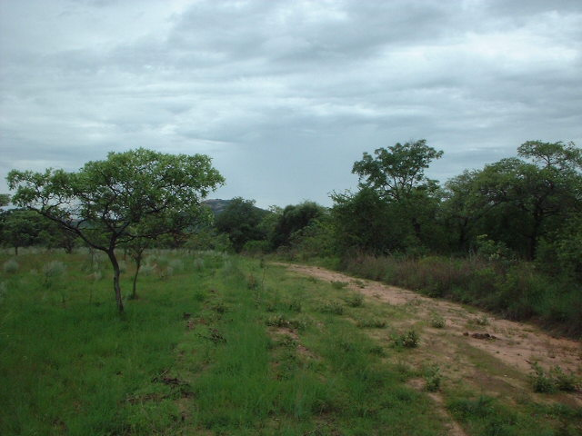
On left: area burnt every year for last 50 years
Kruger National Park (South Africa savanna)
(William Bond, UCT)

Slide 7
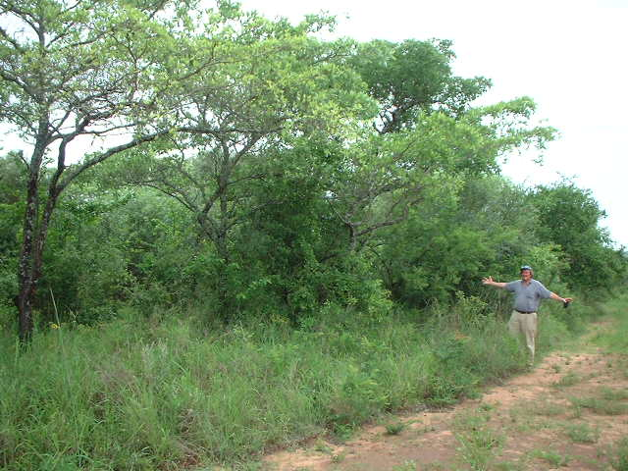
Plot next door, protected from burning for 50 years,
(same soils & climate)
Kruger National Park (South Africa savanna)
(William Bond, UCT)

Slide 8
Some negative consequences of fire:
Loss of flora and fauna after
  too severe fires
  too frequent fires
Increased soil erosion risk, esp. on steep slopes, increased sediment flows
Risk to human life and property
  uncontrolled wildfire
  increased fire at the wildland urban interface

Slide 9
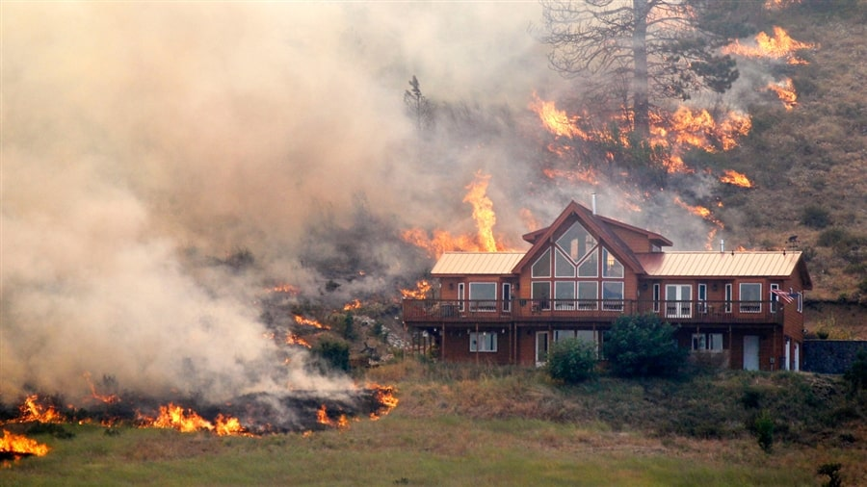
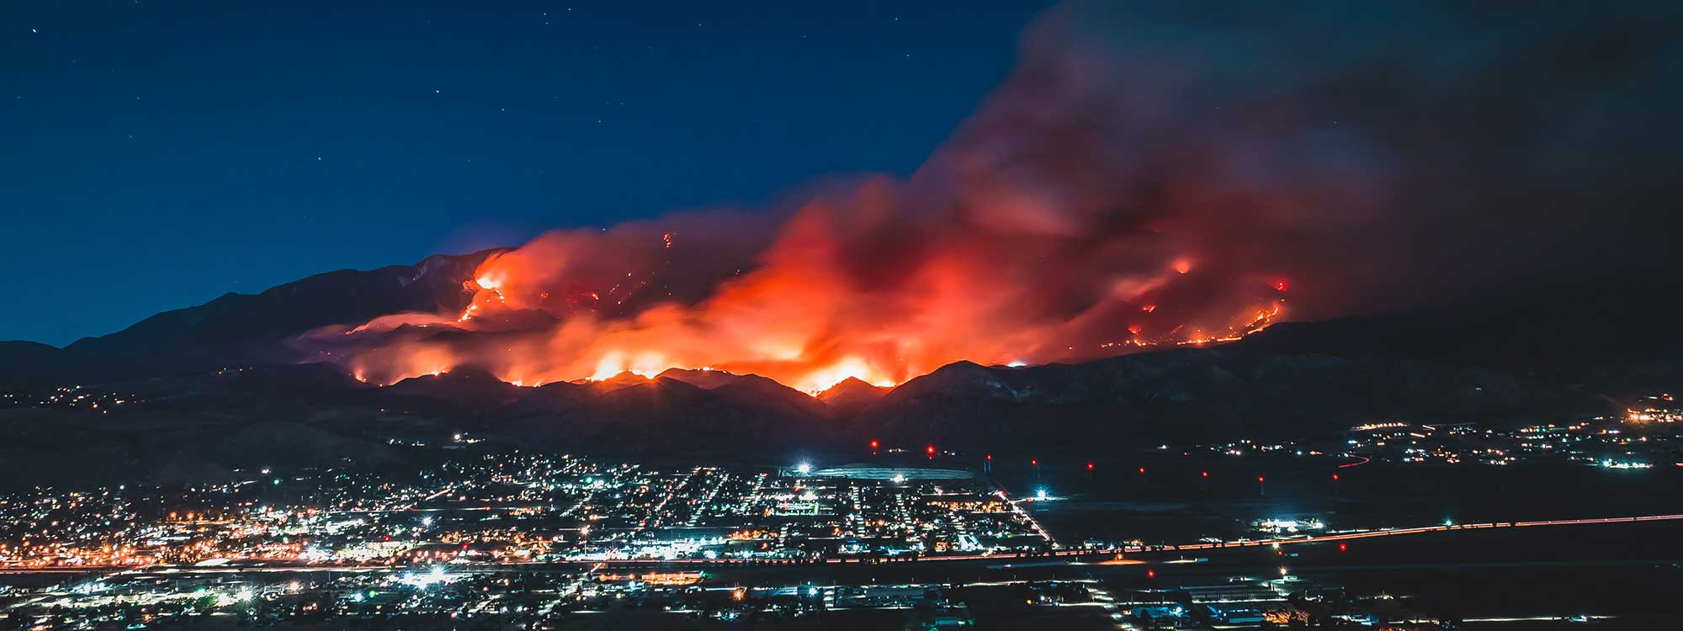
Fire at the Wildland Urban Interface (WUI)
Fire at the WUI becomes a problem as more people move to the edges of wild places
Increasing need to manage fires at this interface
Notes:
One definition:
The wildland/urban interface is defined as the line, area, or zone where structures and other human development meet or intermingle with undeveloped wildland or vegetative fuels (SAF, July 1990)
Another definition:
The Southwest Forest Alliance considers WUI "areas where urban fuels directly meet forest fuels. This is primarily within 20-60 meters (66-200 feet) of houses, where fire most directly threatens the house, and where a defensible zone can be developed.”
A growing body of research suggests that “the only effective home protection treatment is treatment in, on, and around the house...homeowners must be responsible for protecting that property” (Nowicki 2001, p. 1:3). U.S. Forest Service research scientist, Jack Cohen stated that “home ignitions are not likely unless flames and firebrand ignitions occur within 40 meters [131 feet] of the structure […] the WUI fire loss problem primarily depends on the home and its immediate site” (qtd. Nowicki 2001, 2:4). The Firewise (http://firewise.org/) website contains valuable information to homeowners seeking to protect their properties.

Slide 10
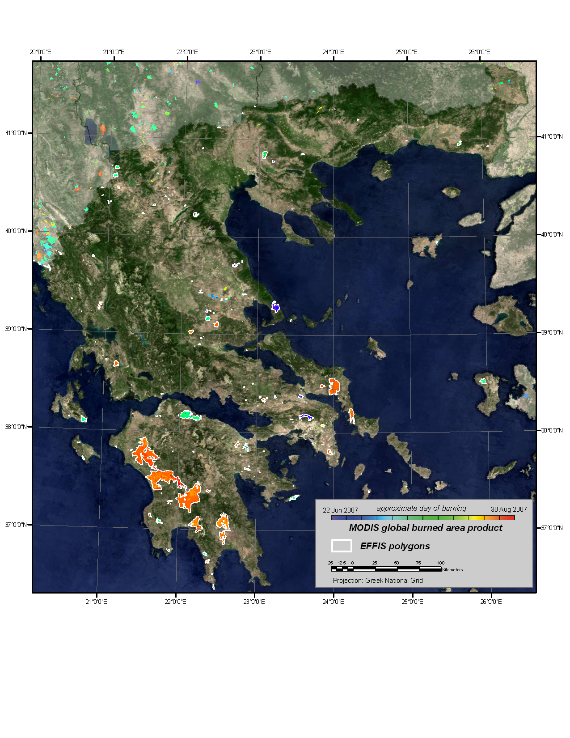
~2% of Greece Burned Summer 2007
60 human lives lost, destruction of >100 villages
Boschetti et al. 2008

Slide 11
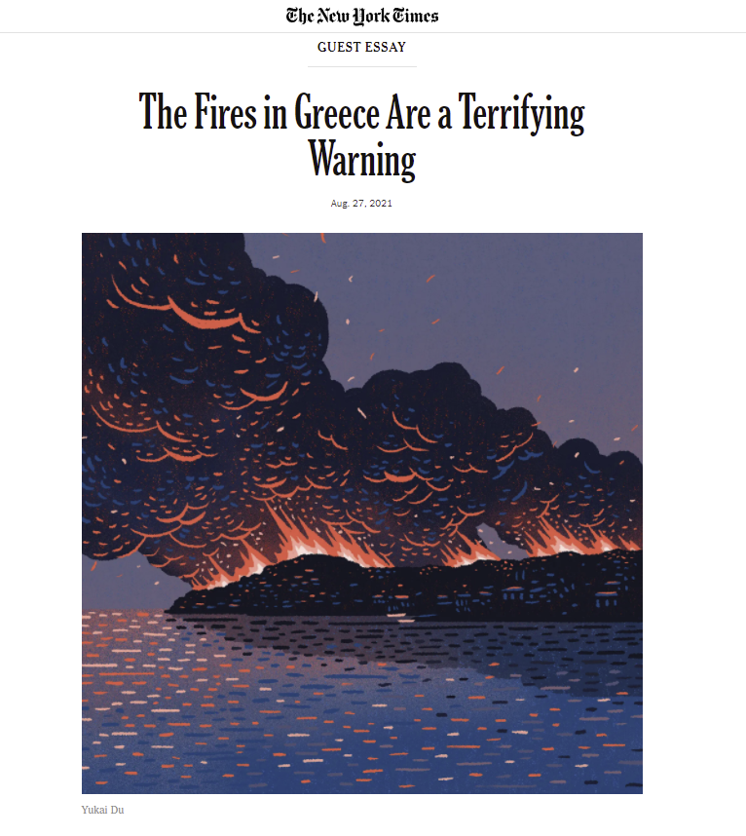
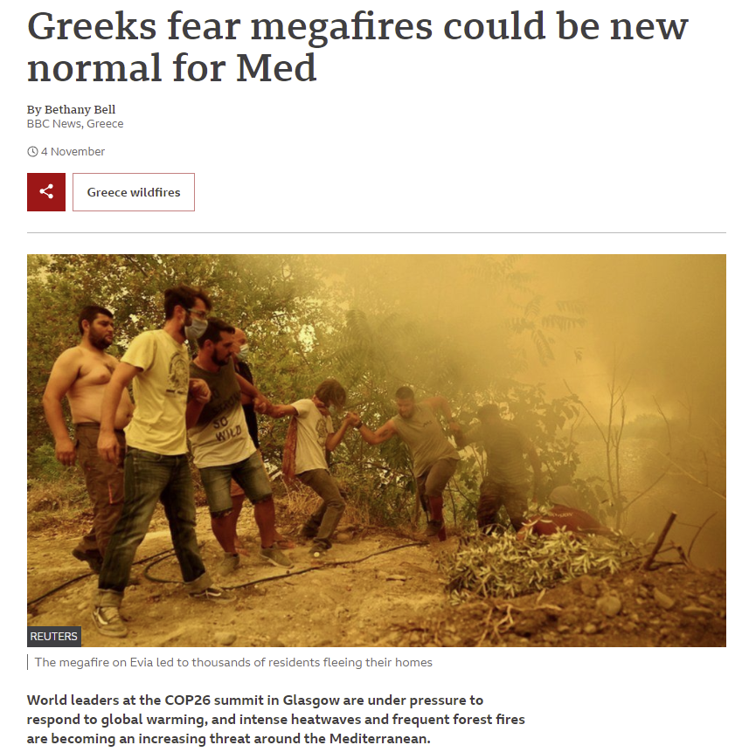

Slide 12
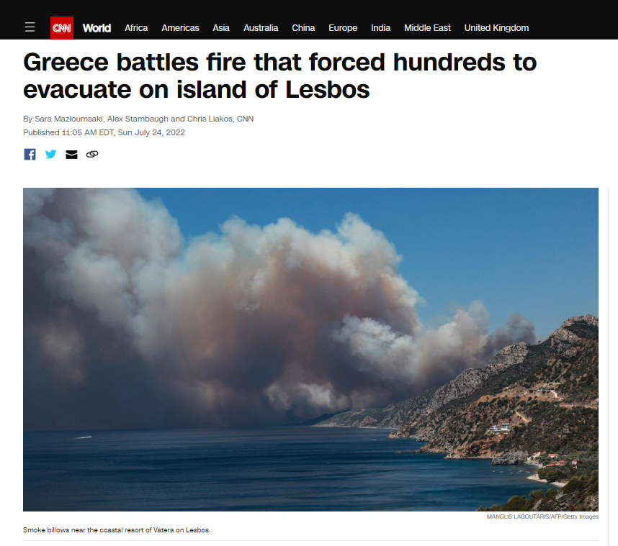
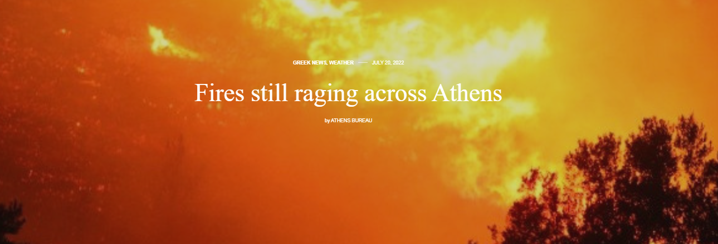

Slide 13
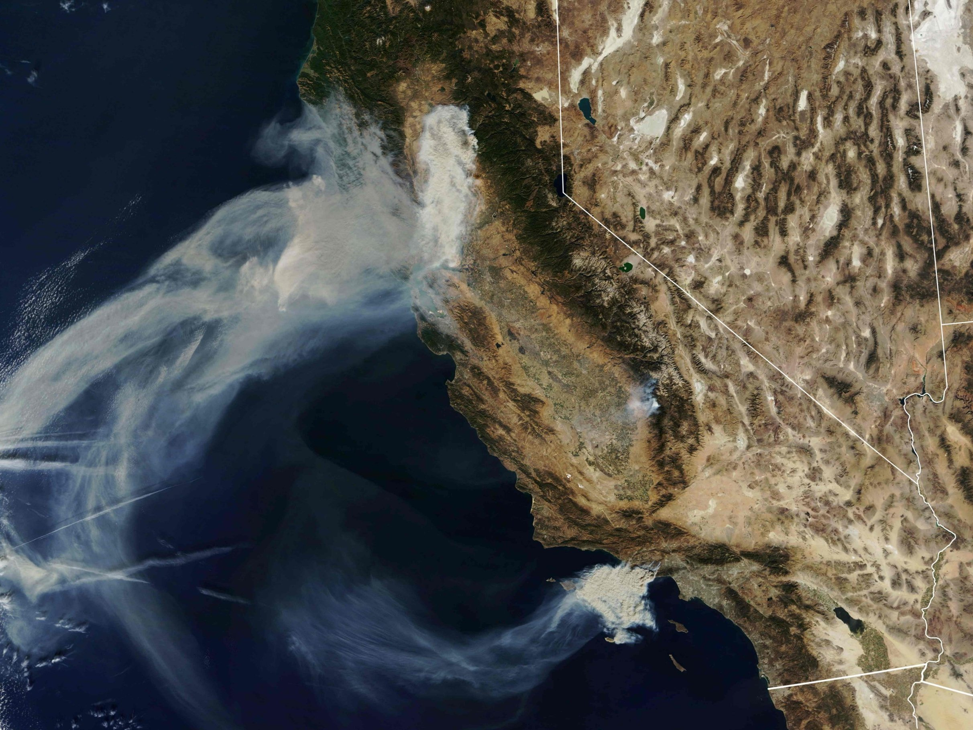
Deadliest fires in CA history, November 2018
Camp Fire
MODIS True color
California November 9 2018
Woolsey Fire
(near Malibu)

Slide 14
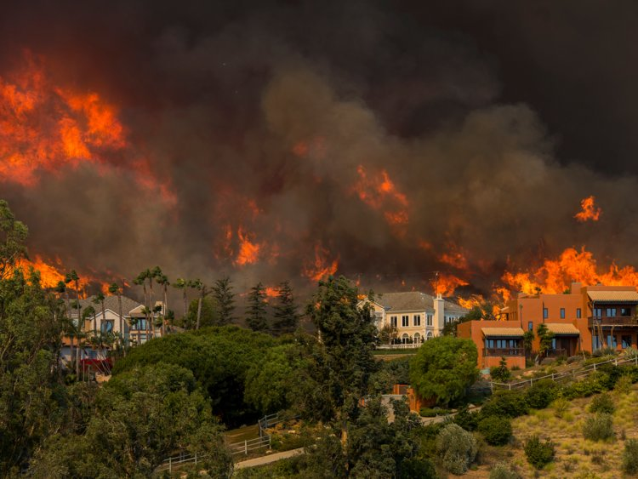
Woolsey Fire
(near Malibu, Los Angeles)

Slide 15
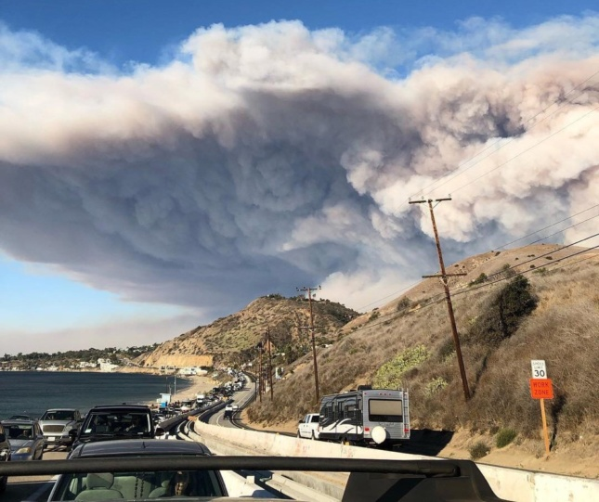
View of the smoke plume from the fast-moving Woolsey Fire outside LA where wealthy enclaves, including Malibu, burned over a weekend.

Slide 16
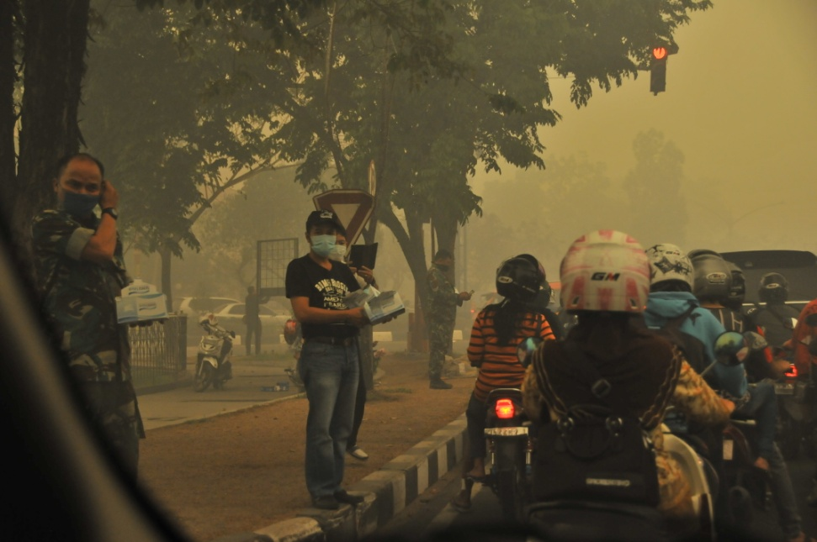
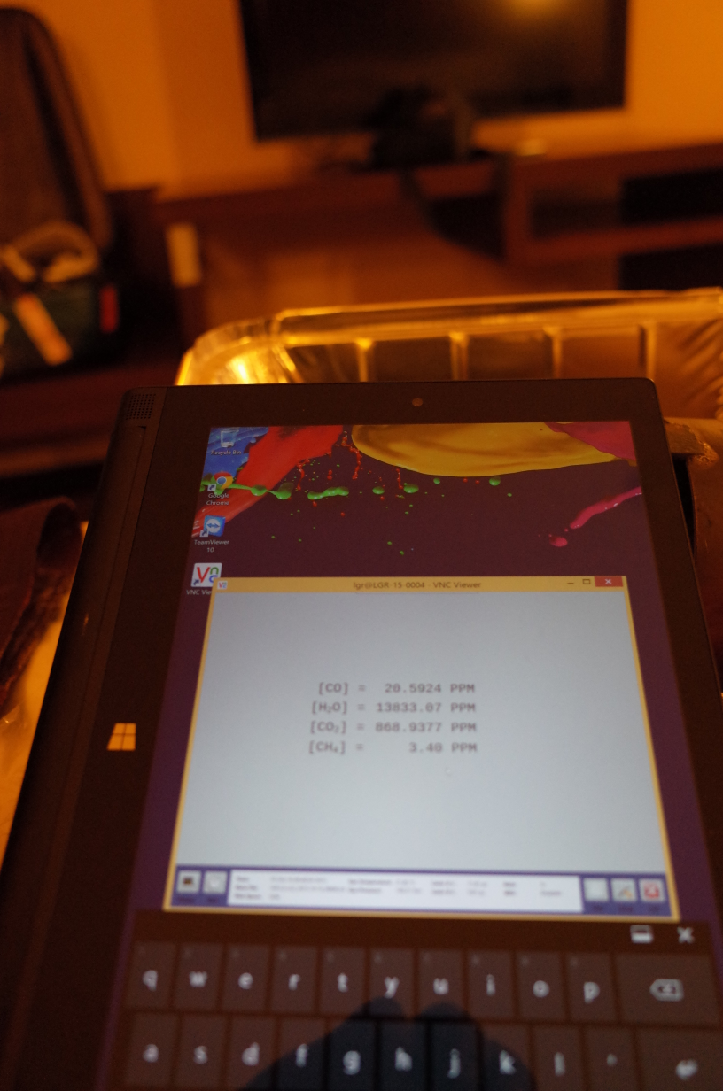
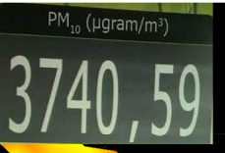
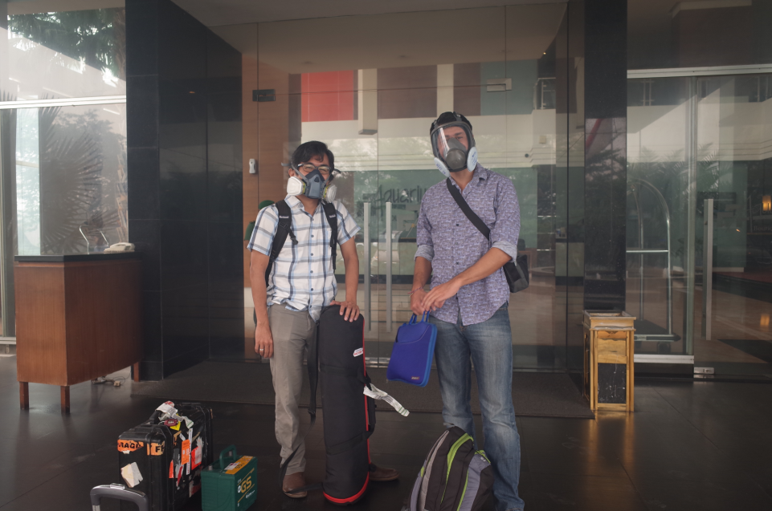
Palankaraya, Borneo
Oct 2015
Other negative consequences of fire: Pollution & Reduced Air Quality
CO = 20.5 ppm
Smoke so bad researchers wear gas masks in hotels
(Wooster)

Slide 17



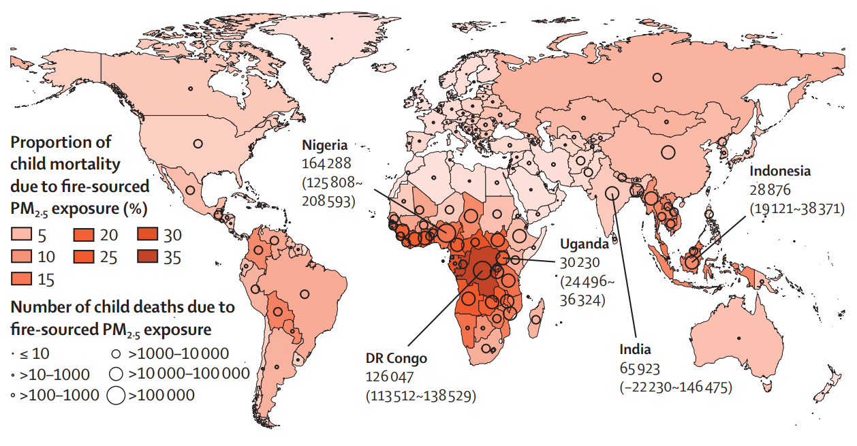
Global Child Mortality from Landscape Fire Smoke
Exposure–resp curve non-linear → only high PM_{2.5} really contributes to increasing child mortality
In 2000-14, largest number of child deaths from fire-sourced PM_{2.5} :
  Nigeria – 164k deaths.yr⁻¹ ; DRC – 126k
  India – 66k deaths.yr⁻¹; Uganda – 30k
  Indonesia – 29k deaths.yr⁻¹
Almost 1 in 10 child deaths (<5 yrs) worldwide attributable to exposure to landscape fire smoke.
Total 0.75 to 1.0 ×10⁶ deaths.yr⁻¹.
→ 99% in LMICs, so changing agri-burning practices can save hundreds of thousands of lives per yr.

Slide 18
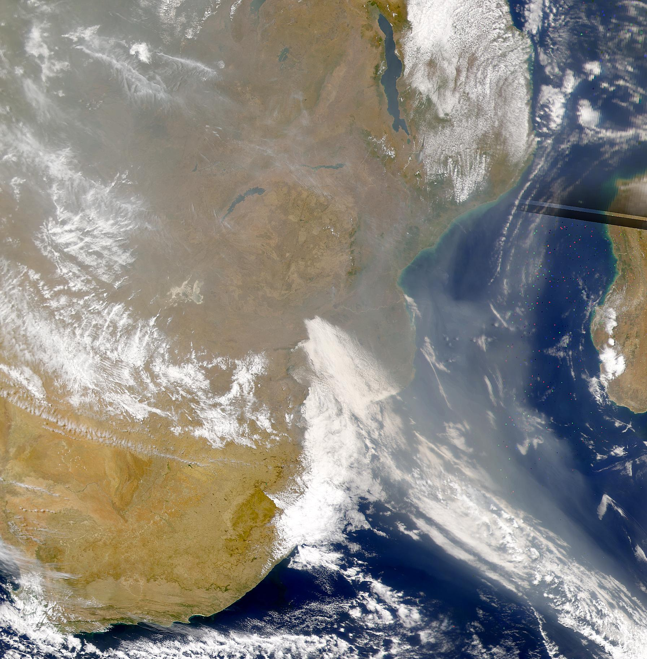
Climate & Fire
Fires regulate the carbon cycle by releasing terrestrial carbon from stored pools to other locations and to the atmosphere releasing the equivalent of 22% of fossil fuel emissions
(van der Werf et al. 2010)
“The River of Smoke”
Southern Africa

Slide 19
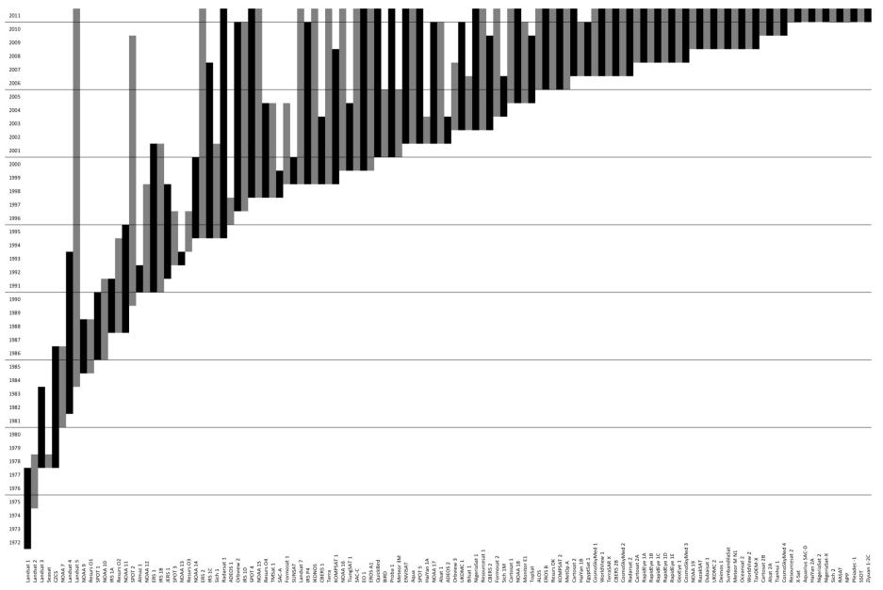
Many Environmental Remote Sensing Systems launched since 1972
But only a minority designed for fire monitoring
Landsat-1
Belward and Skøien, 2014

Slide 20
Satellite data can provide information on:
- Active fire location, energy, and timing
- Burned areas and (imprecise) timing
- Smoke
- Trace gases
- Fuel type, load and moisture
- Fire risk estimation

Slide 21
The Current Status and Future of Fire Monitoring
Fire preamble
Current
  Satellite active fire detection
  Satellite burned area mapping
Future
  Landsat Sentinel-2: burned area products from regional -> global
  High spatial resolution commercial data: new opportunities
  Validation: needs & new opportunities
  Looking back: need for a long term pre-MODIS burned area record
  Looking forward: active fire AM gap, active fire constellation, system of systems
  Fire LCLUC research

Slide 22
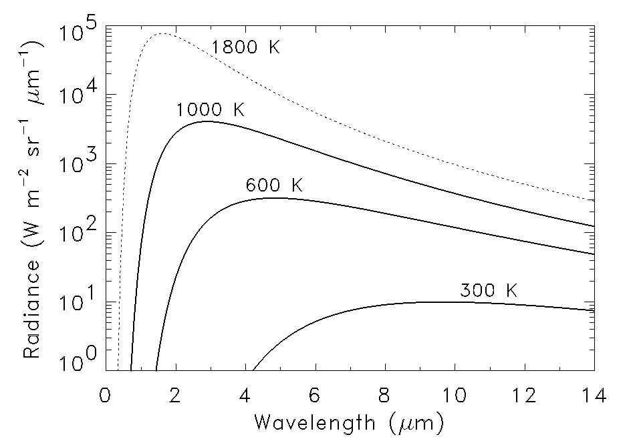
Active fire detection: use differential increase of black body radiance with temperature at ~4 μm and ~11 μm
Visible λ
typical flaming fire
typical smoldering fire
~3 orders of
magnitude
~1 order of
magnitude
typical land surface

Slide 23
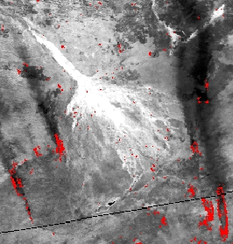
Heritage fire satellite sensors - AVHRR, early GOES, DMSP - not designed for fire monitoring – but important contribution
AVHRR
1km NDVI
active fire detections
Greyscale
(single band image)
Okavango Delta,
Botswana,
Sept 6th 1989

Slide 24
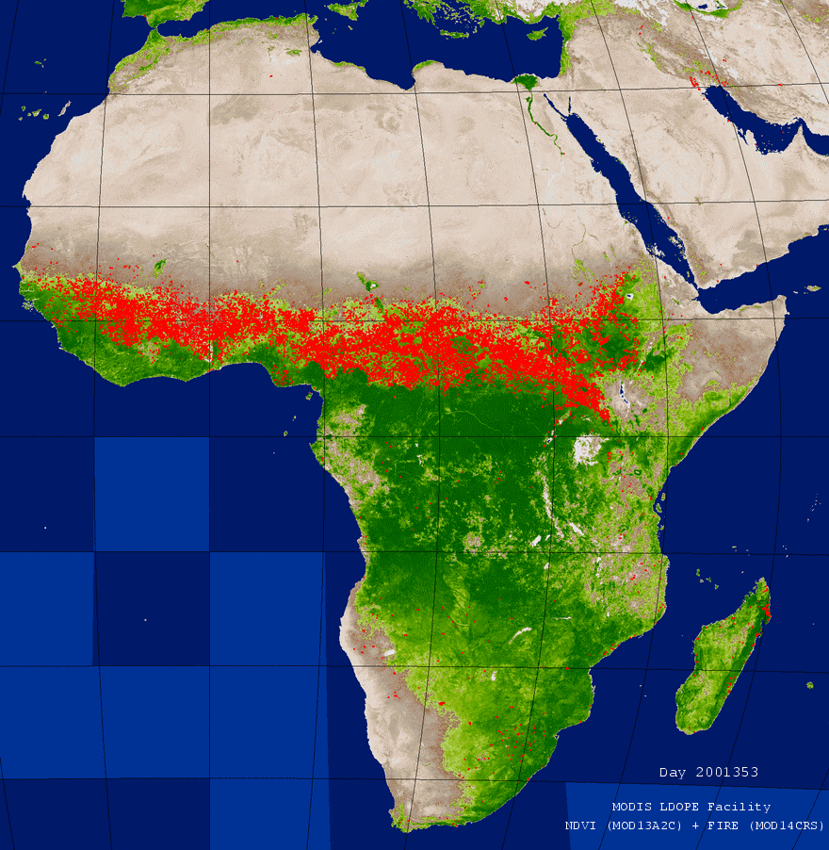
MODIS ! Global, daily, monitoring of active fires from the Terra and Aqua satellites since 2000
ACTIVE
FIRES
2001 animation
1km MODIS active fire detections (red)
superimposed on MODIS 16 day NDVI

Slide 25
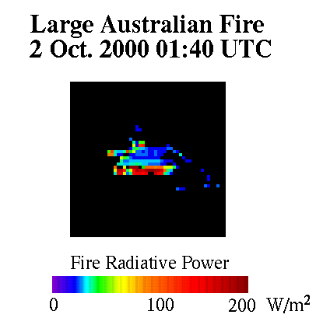
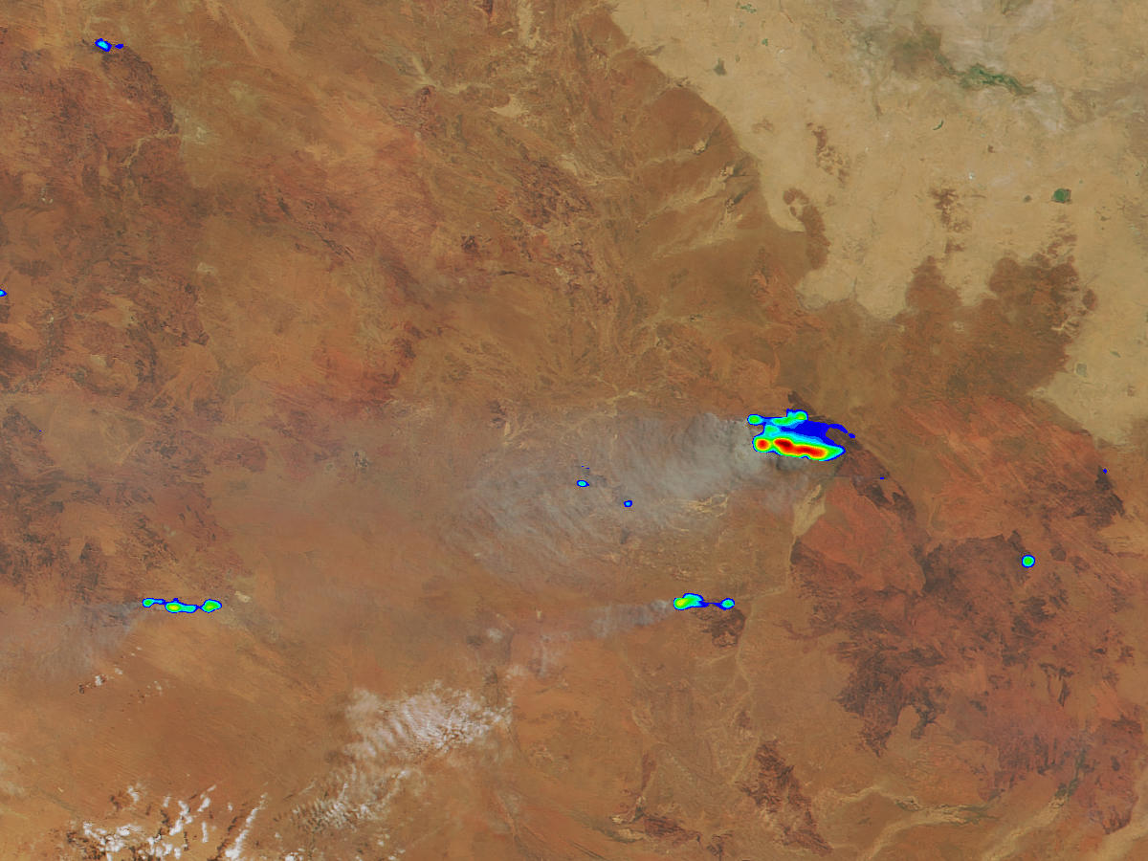
Fire Radiative Power (W) retrieved at MODIS 1km Active Fire Detections
Kaufman et al. (1996) FRP directly proportional to rate of biomass consumption !
W
FRP is the heat energy liberated by combustion per unit time
C₆H₁₀O₅ + O₂ + heat -> C0₂ + H₂0 + heat

Slide 26
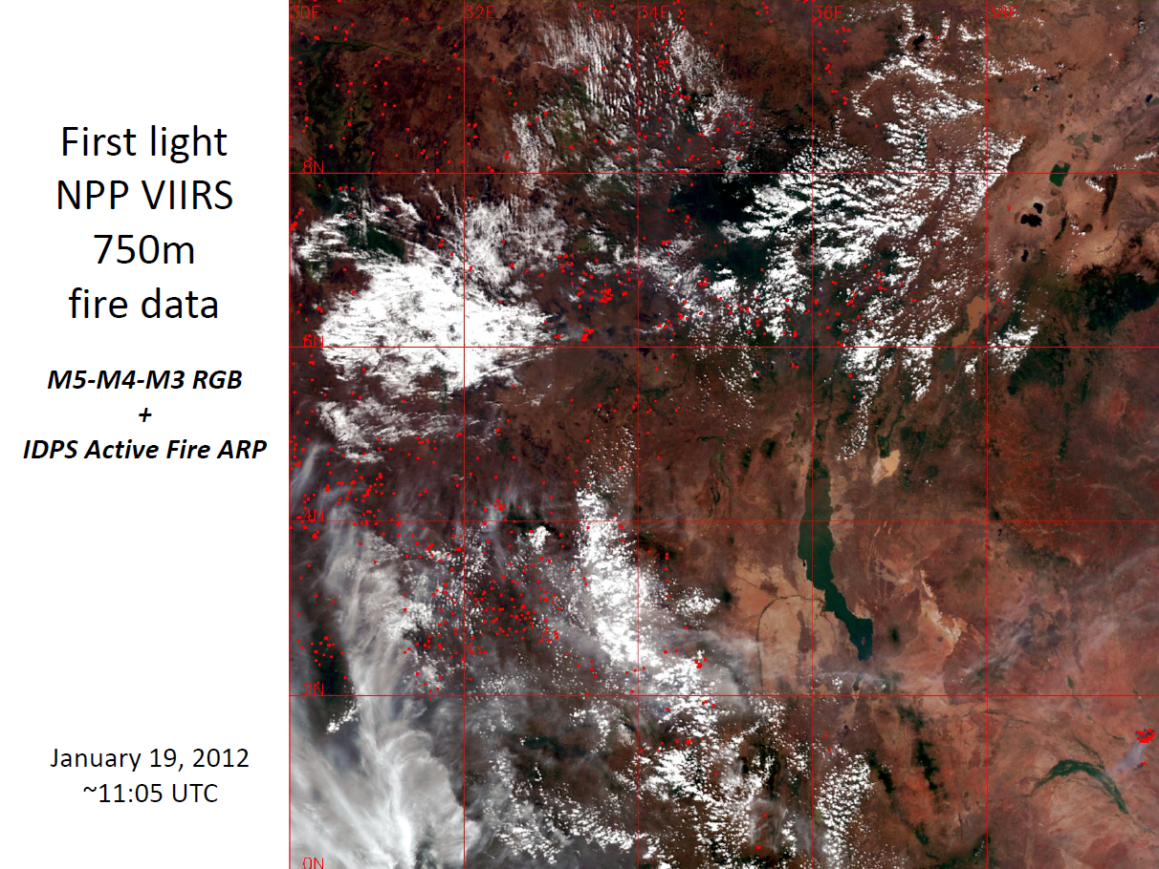
VIIRS launched 2011 in afternoon orbit
to extend and improve
upon AVHRR and MODIS
375m active fire detections + FRP
750 m active fire detections + FRP
(kept for continuity with MODIS)
VIIRS first light January 19th 2012

Slide 27
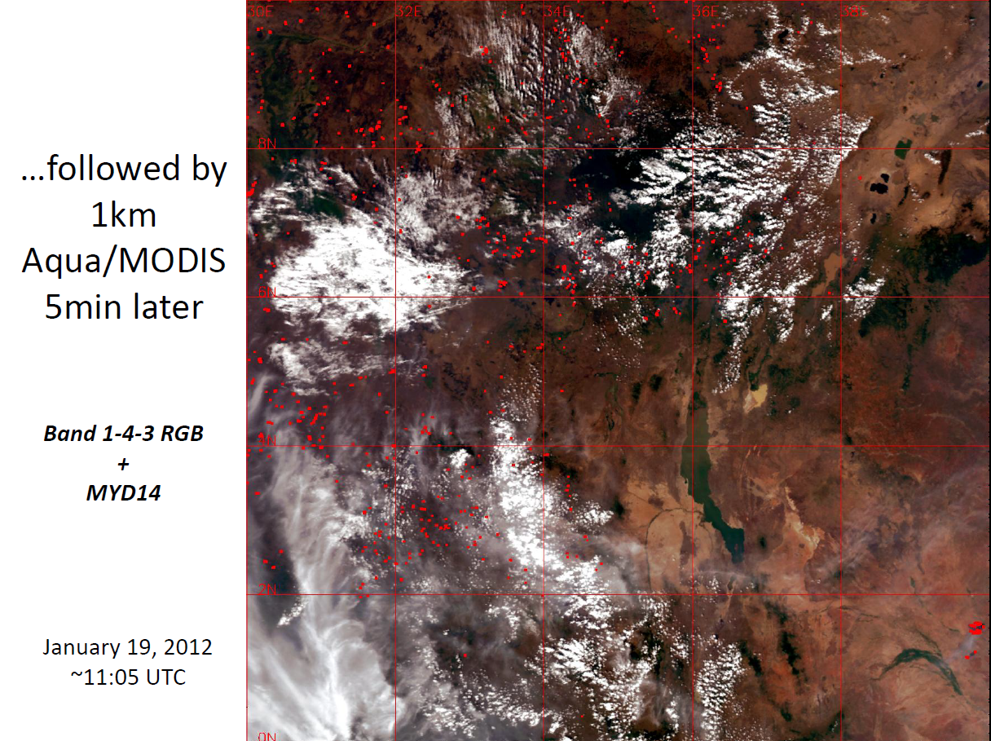
MODIS on AQUA
~5 minutes later than VIIRS afternoon overpass
1km active fire detections

Slide 28
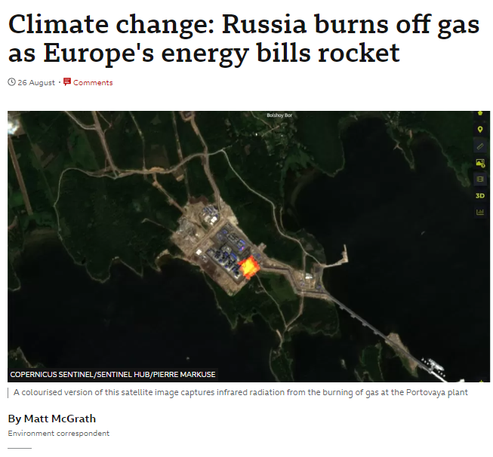
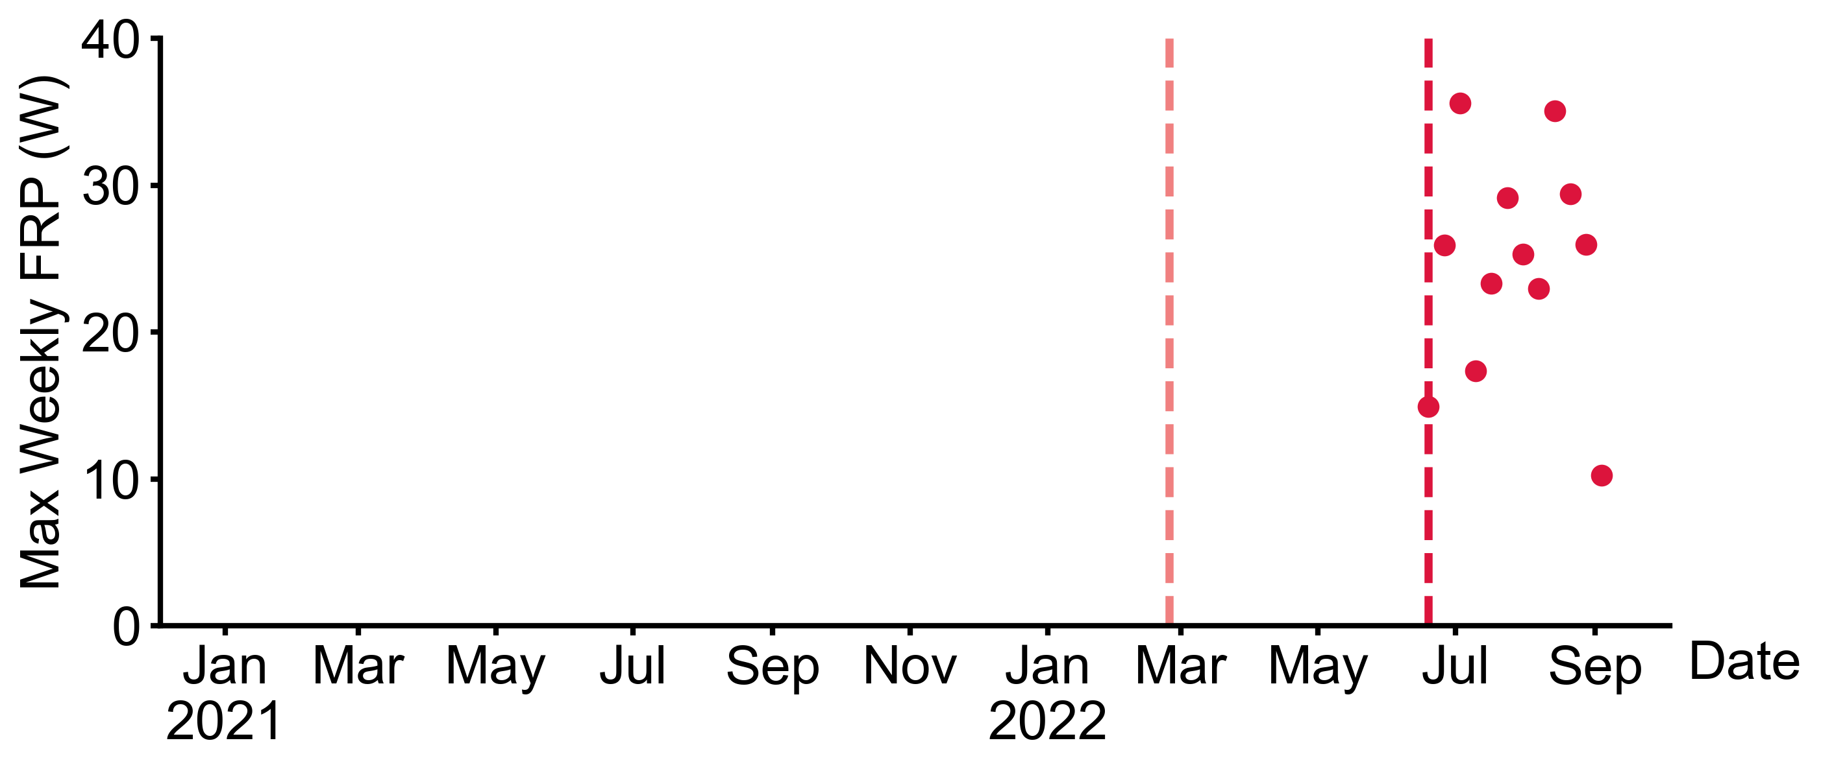

Gas flaring evident in VIIRS 375m FRP temporal record
June 17
flaring
starts
Feb 24
war
starts
Portovaya: a new liquefied natural gas (LNG) plant close to a compressor station at the start of the Nord Stream 1 pipeline.
(Yuean Qiu, MSU)

Slide 29
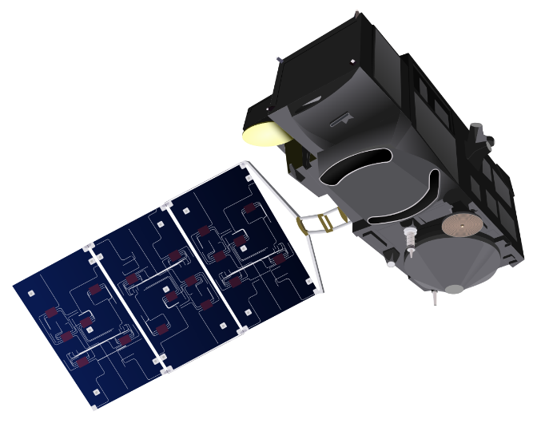
ESA Sentinel-3
Sea and Land Surface Temperature Radiometer (SLSTR)
SLSTR Channel | Band center (µm) | Bandwidth (µm) | Albedo range (%) | Reference albedo (%) | SNR at reference
S1 | 0.555 | 0.020 | 0 – 100 | 0.5 – 30 | 25 – 570
S2 | 0.659 | 0.020 | 0 – 100 | 0.5 – 30 | 25 – 570
S3 | 0.865 | 0.020 | 0 – 100 | 0.5 – 30 | 21 – 630
S4 | 1.375 | 0.015 | 0 – 100 | 0.5 – 5 | 25 – 162
S5 | 1.610 | 0.060 | 0 – 100 | 0.5 – 50 | 37 – 900
S6 | 2.250 | 0.050 | 0 – 100 | 0.5 – 4 | 27 – 142
 |  |  | BT range (K) | Reference BT (K) | NEdT at reference (mK)
S7 | 3.74 | 0.38 | 200 – 311 | 270 | 56
S8 | 10.85 | 0.9 | 200 – 321 | 270 | 29
S9 | 12 | 1.0 | 200 – 318 | 270 | 21
F1 | 3.74 | 0.38 | 285 – 450 | 285 – 450 | 680 – 16
F2 | 10.85 | 0.9 | 230 – 400 | 230 – 400 | 79 – 35
Two operational satellites
Global Daily Data
@ ~ Terra overpass times
S3A (2016+) S3B (2018+)

Slide 30
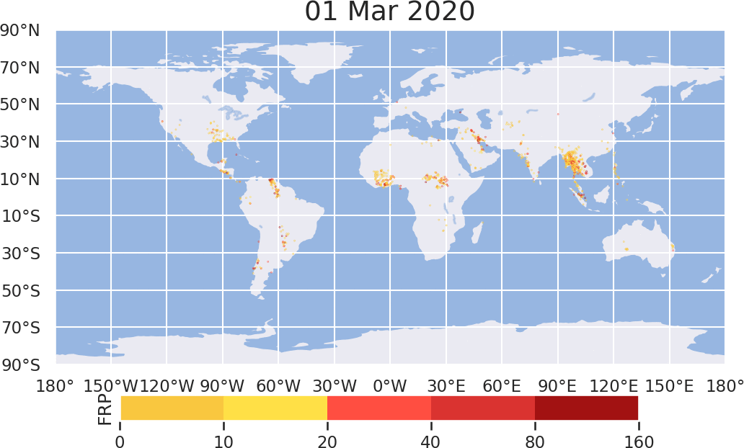
Operational Sentinel-3A and -3B
Active Fire Detection & FRP Products
Like MODIS,
global night and day products
Day time saturation issue BT > 311 K
(Wooster)

Slide 31
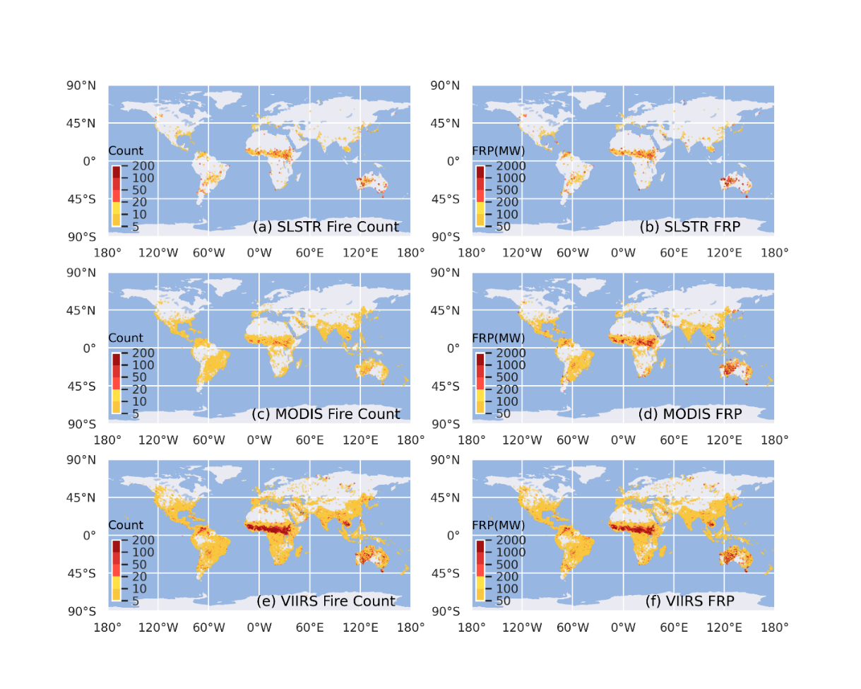
Active Fire Counts FRP Totals
S3B SLSTR
Daytime Sentinel-3 SLSTR detects fewer active fires than MODIS, & far fewer than VIIRS
Terra MODIS
NPP VIIRS

Slide 32
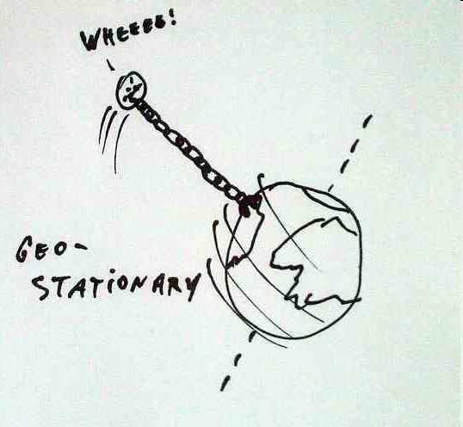
Geostationary systems for active fire monitoring
High temporal resolution with Low spatial resolution
GOES-W
(USA)
HIMAWARI-8
(Japan)

Slide 33
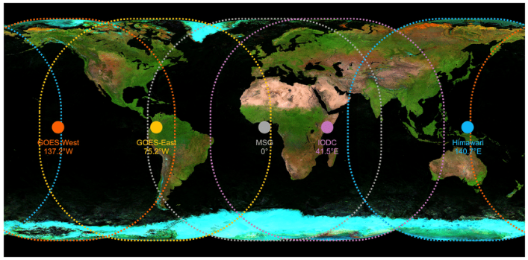
Global Geostationary 5 Satellite Network
5 geostationary satellites have their data processed in EU with the same
active fire detection & FRP retrieval algorithm originally designed for MSG
(Wooster)

Slide 34
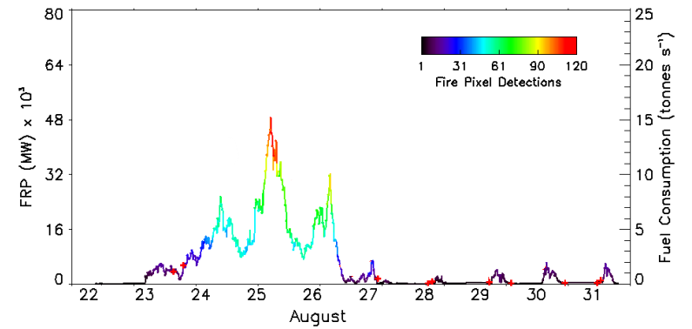
Geostationary high temporal resolution (now every 10 - 15 minutes)
MSG-derived FRP time-series of Greek fire
(Wooster)

Slide 35
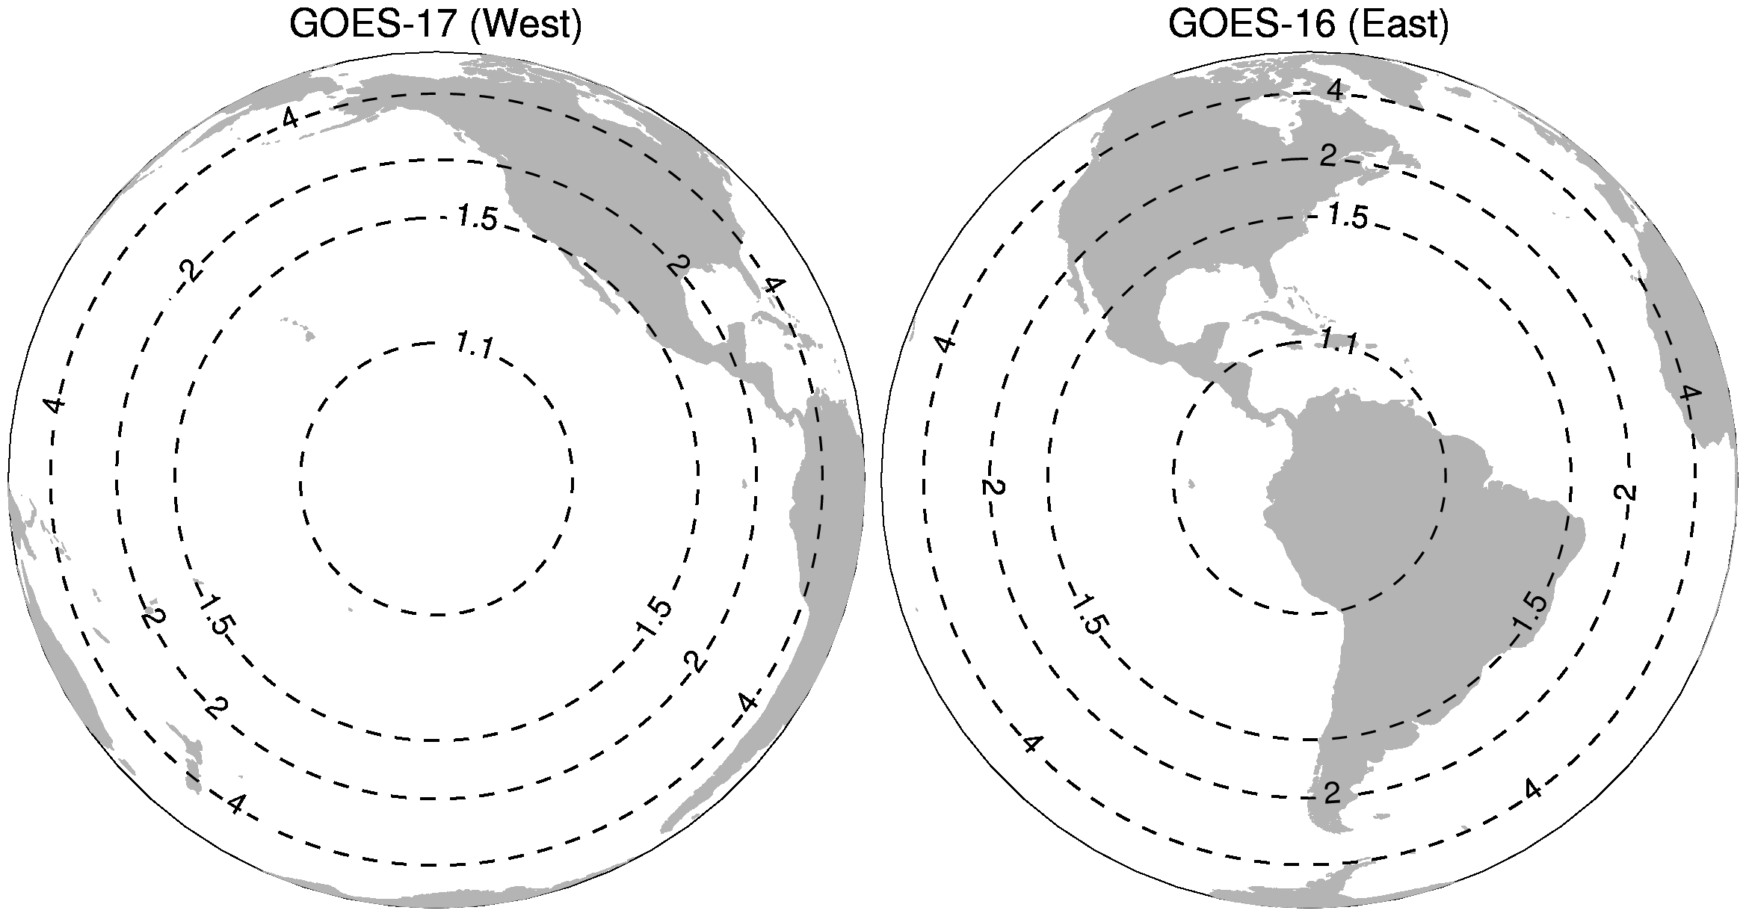
Geostationary low spatial resolution and decreases away from the sub-satellite point significantly due to the scanning geometry and Earth surface curvature
Contour plots of NOAA GOES-17 and GOES-16 Advanced Baseline Imager (ABI) pixel area expansion factor as a function of distance from the respective sub-satellite point.
Reduced spatial resolution means geostationary systems
miss small and low FRP fires
(Louis Giglio)

Slide 36
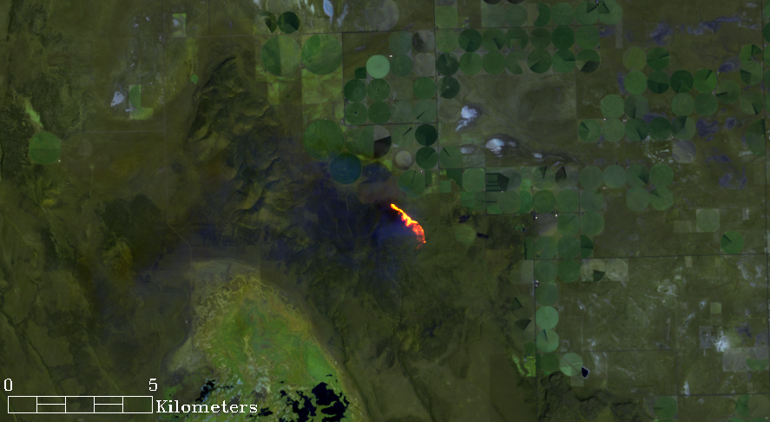
Medium resolution sensors Landsat/Sentinel-2 can detect active fires but not reliably due to insufficient/no MIR-thermal bands
and non-daily repeat coverage
Landsat 8 bands 7/5/2
30m data
23 April 2013
Oregon
(Wilfred Schroeder)

Slide 37
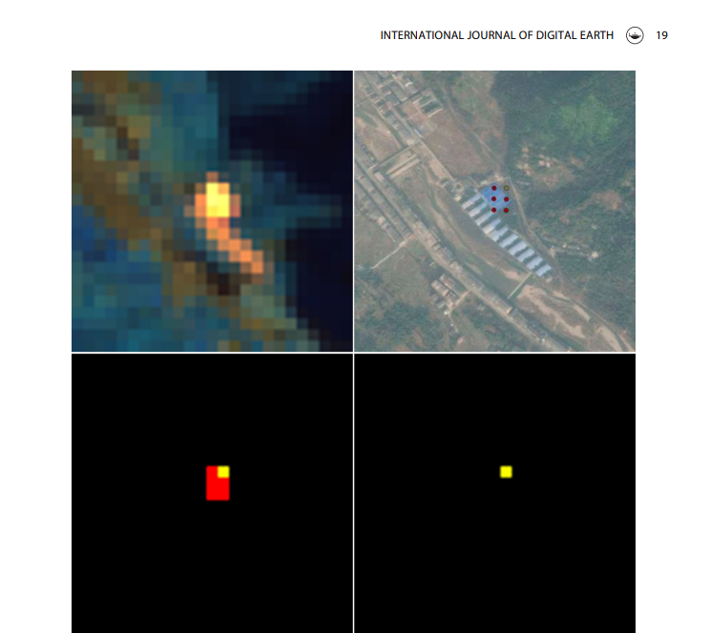
Landsat
Google Earth
Landsat
active fire detection
commission error
example
due to
buildings with highly reflective building rooftops
In correct Landsat active fire detections
(Kumar and Roy)

Slide 38
The Current Status and Future of Fire Monitoring
Fire preamble
Current
  Satellite active fire detection
  Satellite burned area mapping
Future
  Landsat Sentinel-2: burned area products from regional -> global
  High spatial resolution commercial data: new opportunities
  Validation: needs & new opportunities
  Looking back: need for a long term pre-MODIS burned area record
  Looking forward: active fire AM gap, active fire constellation, system of systems
  Fire LCLUC research

Slide 39
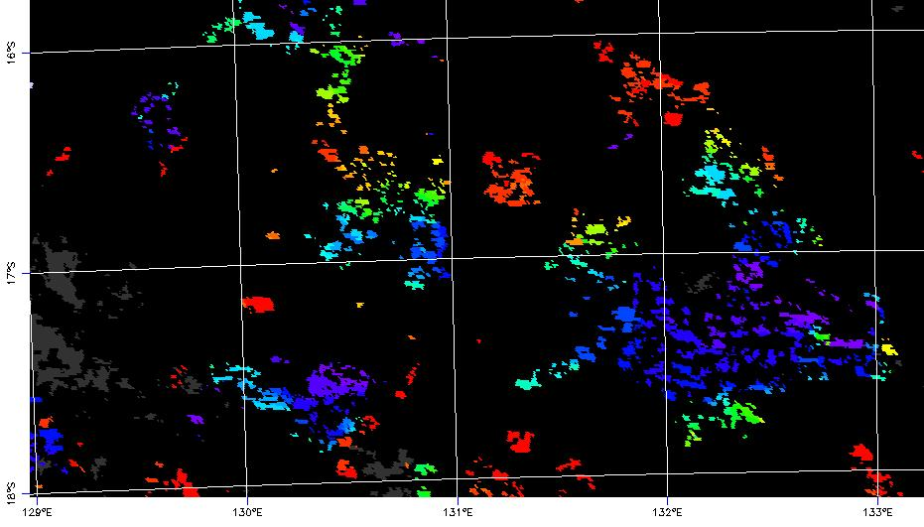
in most regions cumulative active fire detections
do not provide reliable burned area estimates
(first order because of clouds & overpass when fire not burning)
OZ
MODIS
Active fires
Colors show day of detection in one month

Slide 40
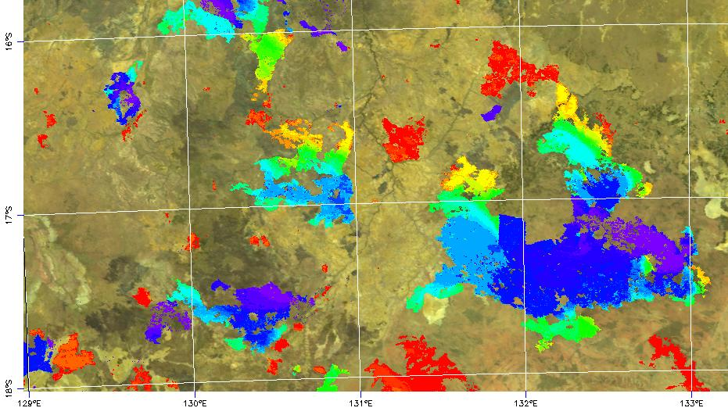
in most regions cumulative active fire detections
do not provide reliable burned area estimates
(first order because of clouds & overpass when fire not burning)
OZ
MODIS
burned areas
Colors show day of detection in one month

Slide 41
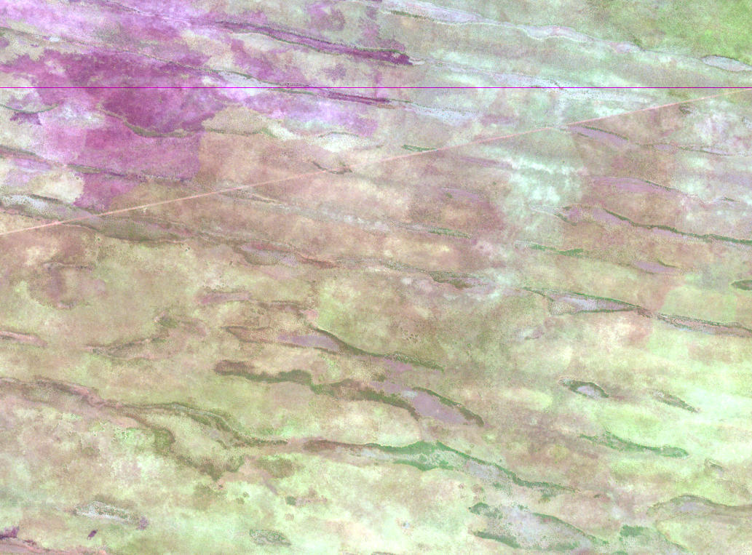
Temporal persistence of char/ash/vegetation removal/structure change enables burned area mapping
August 19th 2001
Botswana
Landsat 30m
(1.65μm, 0.82μm, 0.66μm)
31km x 22km

Slide 42
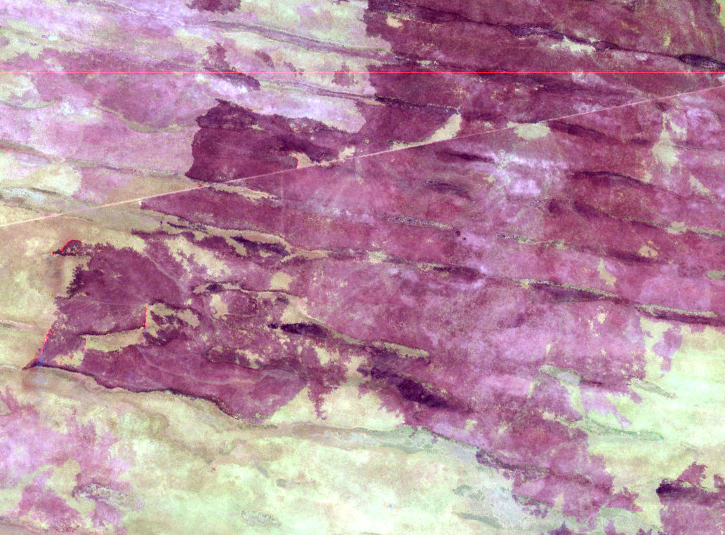
Temporal persistence of char/ash/vegetation removal/structure change enables burned area mapping
Sept 4th 2001
Botswana
Landsat 30m
(1.65μm, 0.82μm, 0.66μm)
31km x 22km

Slide 43
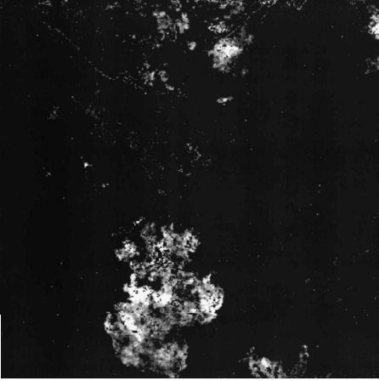
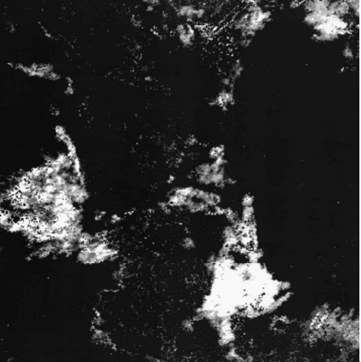
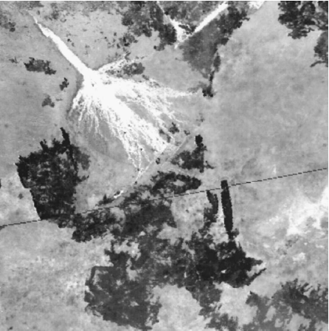
Early AVHRR burned area mapping
(thresholding VI3 with active fires)
NOAA-11 AVHRR 1.1 km LAC, Botswana
Active fire detections
24 day period of mapped burned areas
Following 24 day period of mapped burned areas
Roy, Giglio, Kendal, Justice, 1999, IJRS
VI3 = (0.9 - 3.7 μm)/(0.9 + 3.7 μm)

Slide 44
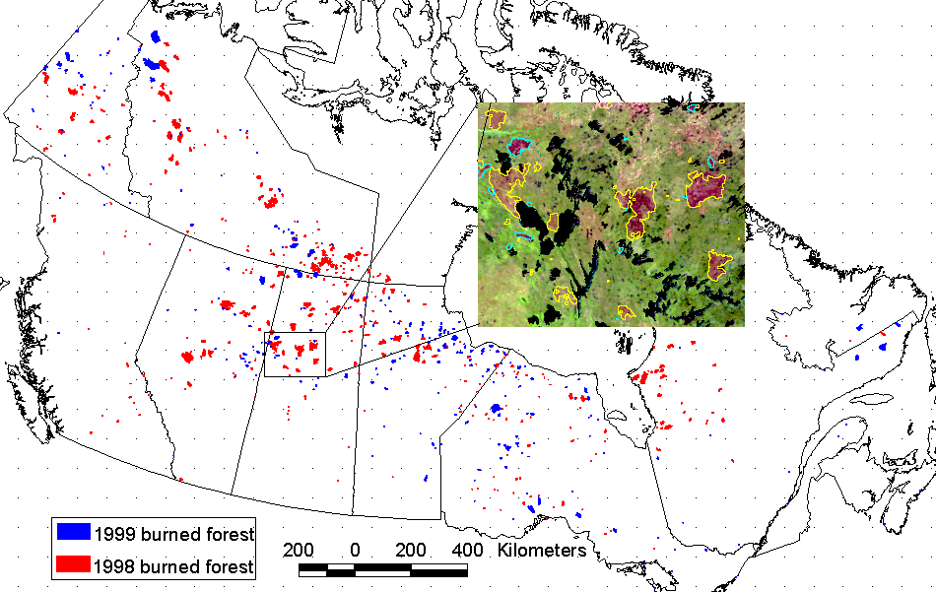
Canada-Wide Burned Area Mapping
(HANDS technique – thresholding NDVI with active fires – works particularly in boreal systems)
within 15% of
Canadian Interagency Forest Fire Centre non-satellite burned area estimates
Fraser et al., 2000

Slide 45
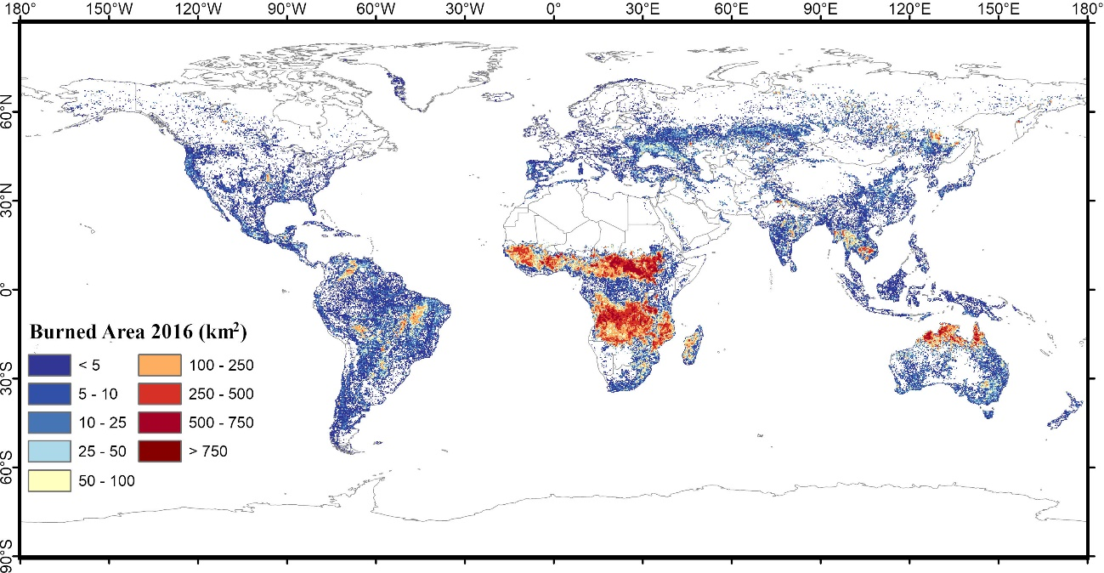
Recent ESA AVHRR 0.05° BA product (FireCCILT11) 1982+
Oton et al., 2021, IJAG
(E. Chuvieco)

Slide 46
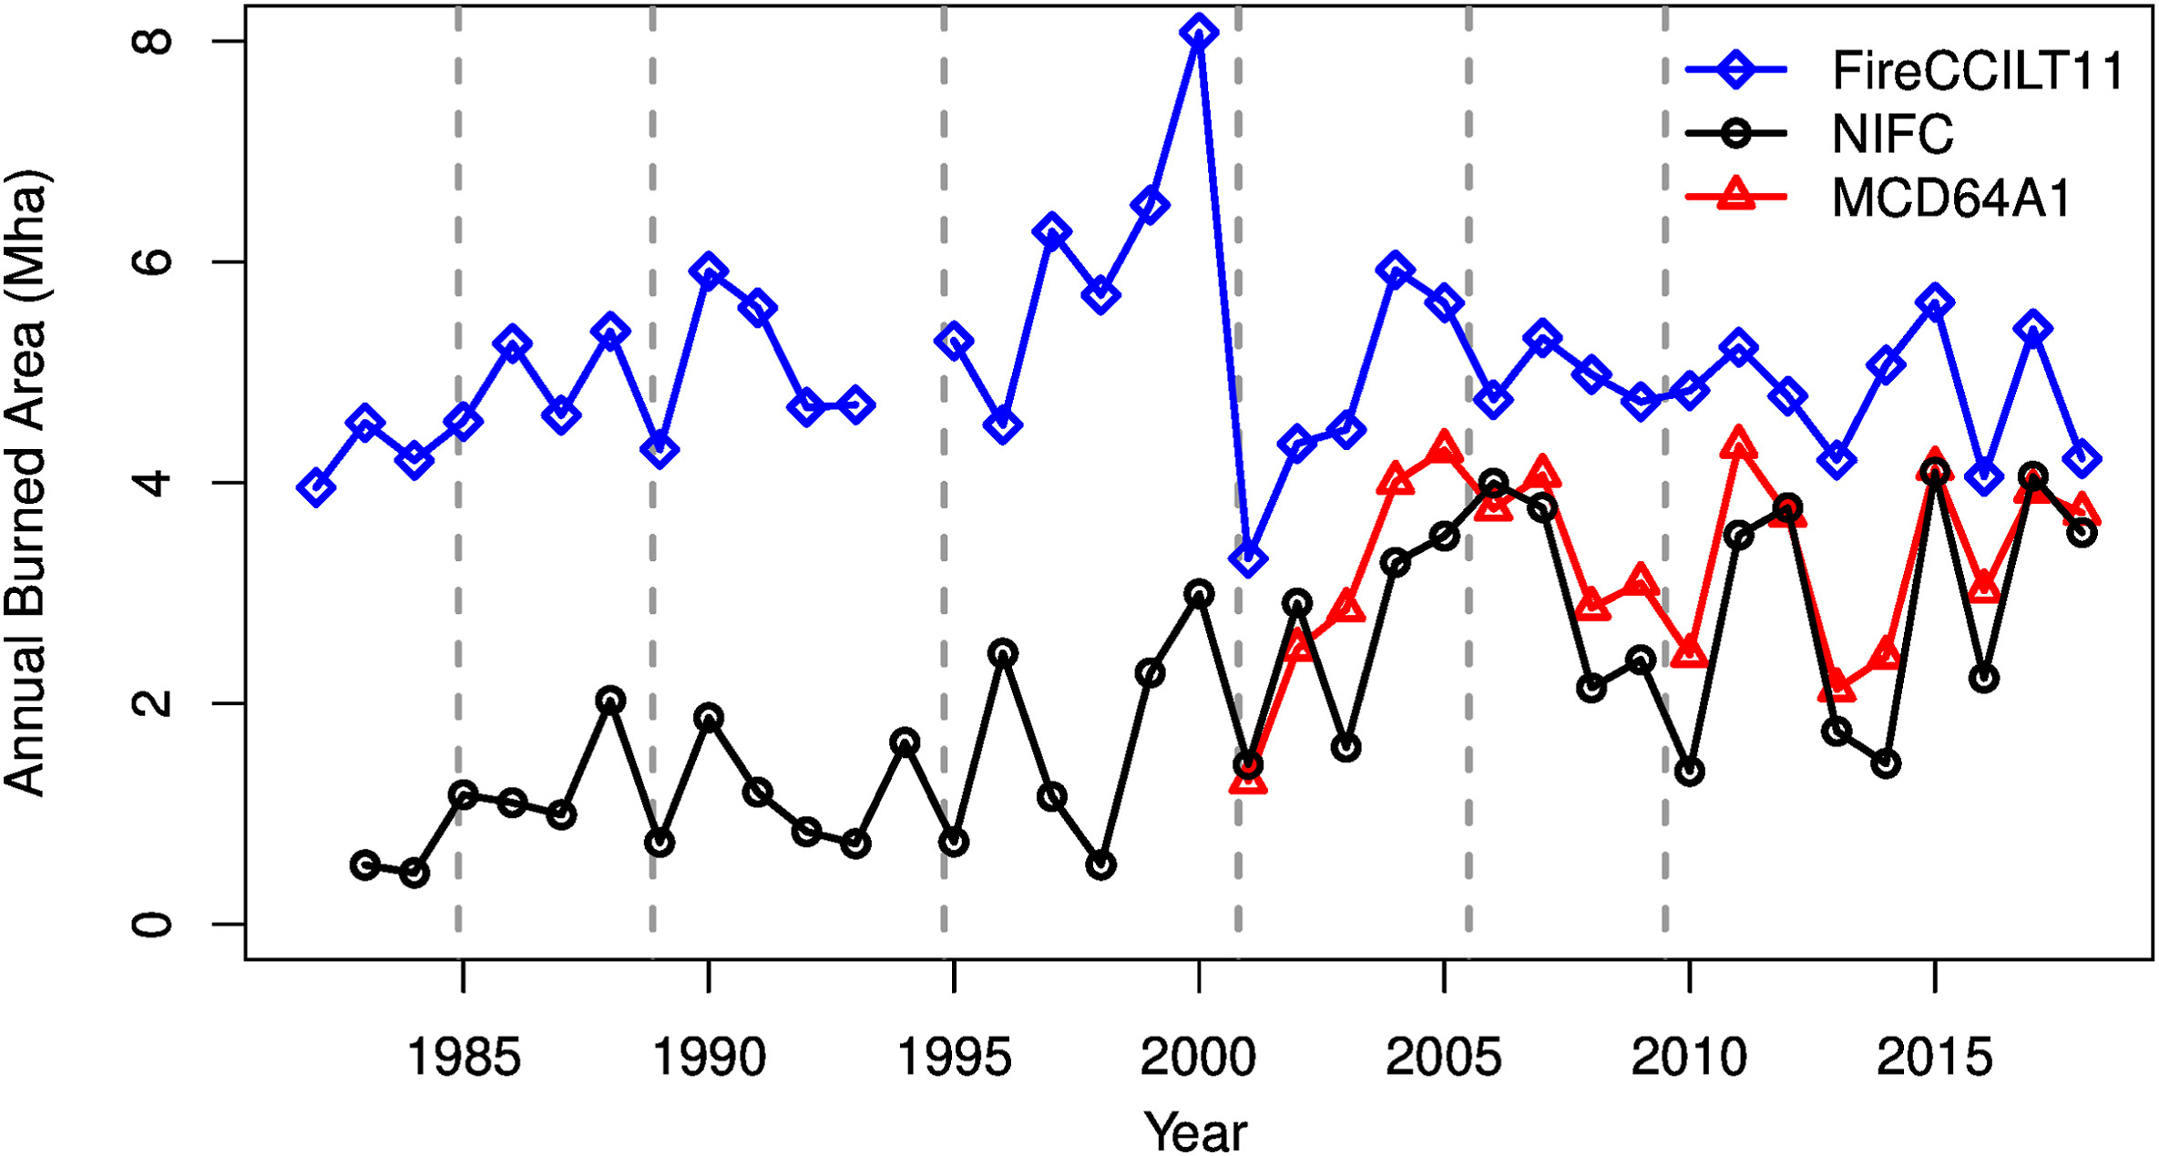
Annual total BA for the conterminous United States, Alaska, Hawaii reported by FireCCILT11 (AVHRR), MCD64A1 (MODIS) and as compiled by U.S. National Interagency Fire Center (NIFC)
significant orbit-drift artifacts in the FireCCILT11 product
FireCCILT11 drastically overestimates U.S burned area before 2001
Gilgio & Roy, Science of RS, 2022

Slide 47
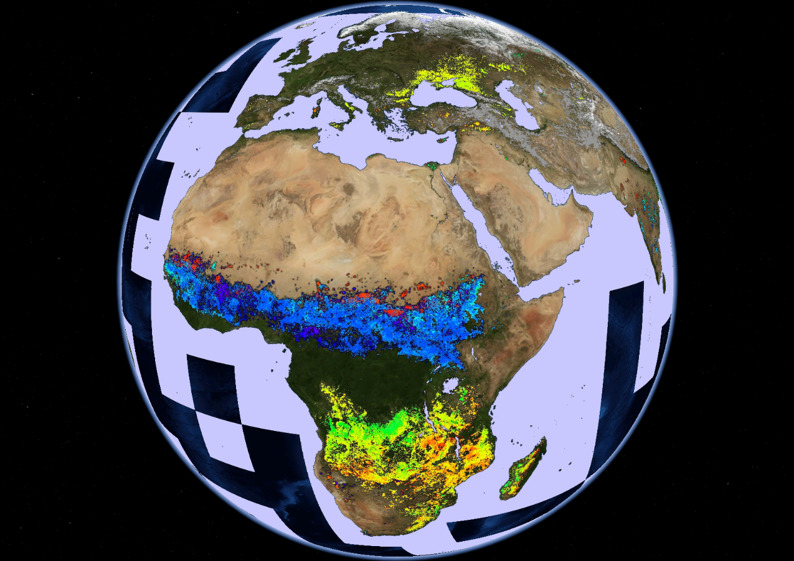
MODIS global monthly burned area from
Terra and Aqua satellites since
2000
Giglio et al. 2018, RSE

Slide 48
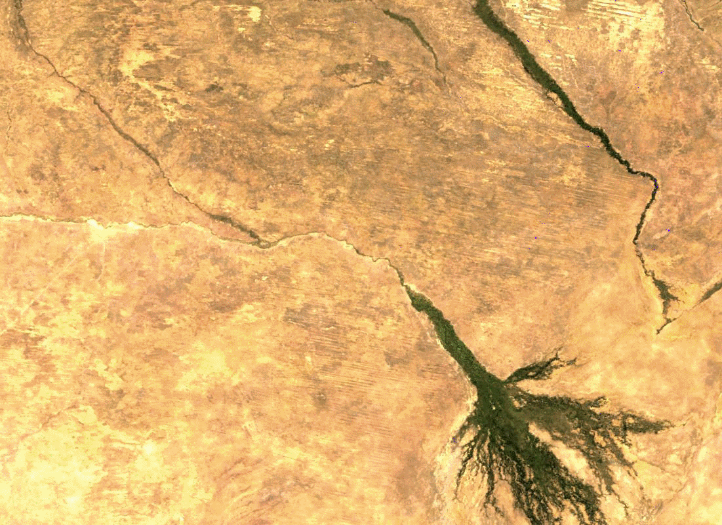
Movie:
5 Months of 500m MODIS mapped burning, Okavango Delta, Botswana

Slide 49

VIIRS burned area product
retained 500-m MODIS grid for compatibility
limited C1 release due to artifacts in C1 cloud mask (fixed for C2)
C2 release scheduled for 2023
VIIRS 500m
Global
2017 cumulative burned area
(Gulf of Carpentaria, Northern Australia)
(Giglio)

Slide 50


Recent ESA (MODIS 250m + MODIS active fire detections)
250m BA product (FireCCI51)
Lizundia-Loiola et al., 2020, RSE
(E. Chuvieco)

Slide 51
Another recent ESA (OLCI 300m + MODIS active fire detections)
300m BA product (C3SBA10 BA)
Lizundia-Loiola et al., 2021, Remote Sensing
(E. Chuvieco)

Slide 52
The Current Status and Future of Fire Monitoring
Fire preamble
Current
  Satellite active fire detection
  Satellite burned area mapping
Future
  Landsat Sentinel-2: burned area products from regional -> global
  High spatial resolution commercial data: new opportunities
  Validation: needs & new opportunities
  Looking back: need for a long term pre-MODIS burned area record
  Looking forward: active fire AM gap, active fire constellation, system of systems
  Fire LCLUC research

Slide 53

Accounting for small fires increased total global burned area by ~35%, from 345 Mha/yr to 464 Mha/yr
“A formal quantification of uncertainties was not possible …”

Slide 54

ESA Regional BA products: Africa (2019) Sentinel 2A & 2B
4.8 Mkm² just for Africa.
Lower omission errors than using one Sentinel-2 satellite: 8.5% versus 26.5%
Similar commission error: 15% versus 19%
Significantly lower errors than global products
(Chuvieco et al., 2022, STOTEN, in review)
(E. Chuvieco)

Slide 55


Slide 56


Sentinel-2 & Landsat-8 30 m
2861 109 x 109 km HLS tiles
August 2019
Roy, Huang, et al. 2019, Landsat-8 and Sentinel-2 burned area mapping - a combined sensor multi-temporal change detection approach, RSE, 231, 111254.

Slide 57
Day of burning
MODIS
500m MCD64
July
Days since the first day of the month
0-2
3-5
6-8
9-11
12-14
15-17
18-20
21-23
24-27
28-31
Angola,
Lunda Sul
Province
159 x 159 km

Slide 58
Day of burning
30m Sentinel-2
Landsat-8
July
0-2
3-5
6-8
9-11
12-14
15-17
18-20
21-23
24-27
28-31
Angola,
Lunda Sul
Province
159 x 159 km

Slide 59
Day of burning
MODIS
500m MCD64 C6
Sept.
0-2
3-5
6-8
9-11
12-14
15-17
18-20
21-23
24-27
28-31
Angola,
Lunda Sul
Province
159 x 159 km

Slide 60
Day of burning
30m Sentinel-2
Landsat-8
Sept.
0-2
3-5
6-8
9-11
12-14
15-17
18-20
21-23
24-27
28-31
Angola,
Lunda Sul
Province
159 x 159 km

Slide 61

Research challenge: Generate validated
global daily10 - 30 m burned area product

Slide 62
The Current Status and Future of Fire Monitoring
Fire preamble
Current
  Satellite active fire detection
  Satellite burned area mapping
Future
  Landsat Sentinel-2: burned area products from regional -> global
  High spatial resolution commercial data: new opportunities
  Validation: needs & new opportunities
  Looking back: need for a long term pre-MODIS burned area record
  Looking forward: active fire AM gap, active fire constellation, system of systems
  Fire LCLUC research

Slide 63


Slide 64


PlanetScope constellation
average revisit interval
analysis
~200 sensors
461- 594 km altitude
~3m
blue / green / red / NIR λ
Roy, Huang, Houborg, Martins, RSE, 2021
Global
median
revisit
30.3 hours !

Slide 65


Slide 66
Sensor: BlackSky
Spatial Resolution: 1 m
Date: 2022/01/05
Time: 16:03:37 UTC
Solar Elevation: 44°
Location: SAL Airport, San Luis Talpa, La Paz, El Salvador
Dimension:
3000 x 3000

Slide 67
Sensor: Planetscope
Spatial Resolution: 3 m
Date: 2022/01/05
Time: 17:01:25 UTC
Solar Elevation: 51°
Location: SAL Airport, San Luis Talpa, La Paz, El Salvador
Dimension:
1000 x 1000

Slide 68

Sensor: Landsat 9
Spatial Resolution: 30 m
Date: 2022/01/12
Time: 16:18:34 UTC
Solar Elevation: 46°
Location: SAL Airport, San Luis Talpa, La Paz, El Salvador
Dimension:
100 x 100

Slide 69

PlanetScope 3m 2019 July 5th

Slide 70

PlanetScope 2019 July 6th

Slide 71

Deep learning burned area classification

Slide 72


Slide 73
The Current Status and Future of Fire Monitoring
Fire preamble
Current
  Satellite active fire detection
  Satellite burned area mapping
Future
  Landsat Sentinel-2: burned area products from regional -> global
  High spatial resolution commercial data: new opportunities
  Validation: needs & new opportunities
  Looking back: need for a long term pre-MODIS burned area record
  Looking forward: active fire AM gap, active fire constellation, system of systems
  Fire LCLUC research

Slide 74
Reminder: Why validate satellite fire products ?
Good science and resource management require understanding of product accuracy/uncertainty
Explicit statements of accuracy/uncertainty fosters an informed user community and improved use of data
Use of products for policy analysis implies products may be independently evaluated and possibly challenged
As more, and similar, global products are produced, particularly given capacity of cloud computing, product inter-use will require characterization of each product’s accuracy/uncertainty

Slide 75
Active Fire and FRP validation remains challenging
Active Fire
well established comparison with QA’d contemporaneous active fire detections from ASTER, Landsat, Sentinel-2
definition of “contemporaneous” observations TBD (ballooned from ± minutes to ± ~8 hours)
small and agricultural active fire validation uncertain
FRP
very challenging due to limited availability of reference data (airborne data and field campaigns) and need for “contemporaneous” obs. within ± minutes
(Roberts & Giglio, CEOS LPV Plenary: 28-29 September 2022)

Slide 76

Moderate resolution (MODIS/VIIRS) burned area validation protocol established and implemented under CEOS Stage 3 protocol comparison with maps interpreted from Landsat-8
two-date 30 m image pairs selected with a space & time stratification
MODIS Burned Area validation
Omission Error (0-1) = 0.72
Commission Error (0-1) = 0.40
Locations of 558 Landsat-8 two date image pairs16 days apart interpreted into burned, unburned, and unmapped classes
Boschetti et al. RSE, 2019

Slide 77
Challenge:
need a process to validate Landsat/Sentinel-2 burned area products

Slide 78

Commercial data use for burned area product validation is promising
PlanetScope 3m
image pairs
(Nov. 2018 to Oct. 2019)
370 pairs selected with the same
acquisition dates as HLS BA product
cloud/shadow pixels < 30%
Deep learning classify, QA, use as a source of reference for validation of HLS burned area product
Paper in Preparation

Slide 79

HLS 30 m surface reflectance
Detailed example at one of the 370 pairs
September 4
September 10
HLS 30 m
burned area
September 10
PlanetSclope 3 m surface reflectance
September 4
September 10
PlanetScope 3m
DL classified
burned area
6.9 x 5.3 km Moxico province, Angola

Slide 80
HLS 30 m surface reflectance
Detailed example at one of the 370 pairs
September 4
September 10
HLS 30 m
burned area
September 10
PlanetSclope 3 m surface reflectance
September 4
September 10
PlanetScope 3m
Deep Learning classified
burned area
6.9 x 5.3 km Moxico province, Angola

Slide 81
HLS 30m Africa burned area product (Nov. 2018 to Oct. 2019) validation with the 370 PlanetScope results
PlanetScope | HLS
 | Burned [km²] | Unburned [km²] | Row total [km²]
Burned [km²] | 473 | 127 | 600
Unburned [km²] | 184 | 17,800 | 17,984
Column total [km²] | 657 | 17,927 | 18,584
Commission error (0-1) = 0.28 Omission error (0-1) = 0.21
Paper in Preparation

Slide 82


Cropland harvesting can be spectrally & temporally similar to burning
Need to find a solution for unambiguous validation (and BA product algorithms)

Slide 83

Ensure QA undertaken before Validation
(over large areas quality issues may remain undetected by validation activities that necessarily rely on a sample of independent reference data)
Google Earth Engine Landsat-8 burned area prototype looks good at this scale

Slide 84

Need to ensure QA undertaken before Validation
(over large areas quality issues may remain undetected by validation activities that necessarily rely on a sample of independent reference data)
Google Earth Engine Landsat-8 burned area prototype looks good at this scale
30m burned areas in S.W Minnesota ?
How to ensure QA is undertaken ?

Slide 85
The Current Status and Future of Fire Monitoring
Fire preamble
Current
  Satellite active fire detection
  Satellite burned area mapping
Future
  Landsat Sentinel-2: burned area products from regional -> global
  High spatial resolution commercial data: new opportunities
  Validation: needs & new opportunities
  Looking back: need for a long term pre-MODIS burned area record
  Looking forward: active fire AM gap, active fire constellation, system of systems
  Fire LCLUC research

Slide 86

Looking back: we need a global harmonized long term fire record baseline i.e. AVHRR 1982 to 2000’s
AVHRR use is confounded by factors
sub-optimal 3 ​× ​5 ​km effective Global Area Coverage (GAC) image resampling
problematic and/or inconsistent calibration of the red and near-infrared bands
variable and/or ill-behaved saturation of the 3.8 ​μm band
low geolocation accuracy
significant sensor orbit drift of hours between successive AVHRR sensors

Slide 87
The Current Status and Future of Fire Monitoring
Fire preamble
Current
  Satellite active fire detection
  Satellite burned area mapping
Future
  Landsat Sentinel-2: burned area products from regional -> global
  High spatial resolution commercial data: new opportunities
  Validation: needs & new opportunities
  Looking back: need for a long term pre-MODIS burned area record
  Looking forward: active fire AM gap, active fire constellation, system of systems
  Fire LCLUC research

Slide 88

Looking forward: soon we will have a gap in U.S. morning active fire and FRP observation capability due to upcoming Terra/Aqua MODIS end of Life
Gap fill with Sentinel-3 ?

Slide 89

Looking forward: we need a dedicated active fire & FRP wildfire constellation – thermal sensor cost driver
Canadian budget 2022 provides ~$170 million over 11 years to the Canadian Space Agency, Natural Resources Canada and Environment and Climate Change Canada for planned WildFireSat, a new wildfire monitoring satellite system.
Joshua Johnston
Hope (me) for WildFireSat constellation augmentation
to broaden rapid revisit from high northern latitudes to also get rapid revisit in southern latitudes and with morning overpasses

Slide 90

August 2013
Yosemite Rim Fire
Looking forward:
users (e.g. international GOFC Fire network members) would appreciate a sensor agnostic harmonized satellite fire monitoring system of systems
Nevada
- GOES Imager Instrument - AVHRR on NOAA 18-19
- MODIS Terra and Aqua
Rim Fire
California
(Xiaoyang Zhang)

Slide 91
The Current Status and Future of Fire Monitoring
Fire preamble
Current
  Satellite active fire detection
  Satellite burned area mapping
Future
  Landsat Sentinel-2: burned area products from regional -> global
  High spatial resolution commercial data: new opportunities
  Validation: needs & new opportunities
  Looking back: need for a long term pre-MODIS burned area record
  Looking forward: active fire AM gap, active fire constellation, system of systems
  Fire LCLUC research

Slide 92
The frequency, seasonality, intensity, severity, fuel consumption and spread patterns of fires that prevail, are referred to as the fire regime (Bond and Keeley, 2005, Gill 1975).
Climate and LCLUC affect fire regimes
directly, through changes in the ways fire is used
indirectly, by modifying the environmental conditions and the amount of fuel available for fire
Fire regime change research ongoing but not coordinated
Where / When / Understanding / Modelling / Prediction

Slide 93

Statistical modelling approach
satellite fire products
gridded human and physical explanatory variables
random forest

Slide 94


1999
2020
Process based approach
Revaluated with satellite observations

Slide 95

NASA Earth System Science Today & Tomorrow:
Linking Measurements-Missions-Models To Improve Scientific Impact
Global fire regime change research
(where/when/why/model/predict)
Pressing need to coordinate and perhaps fund research in a more coherent and so impactful manner.

